Slide 1
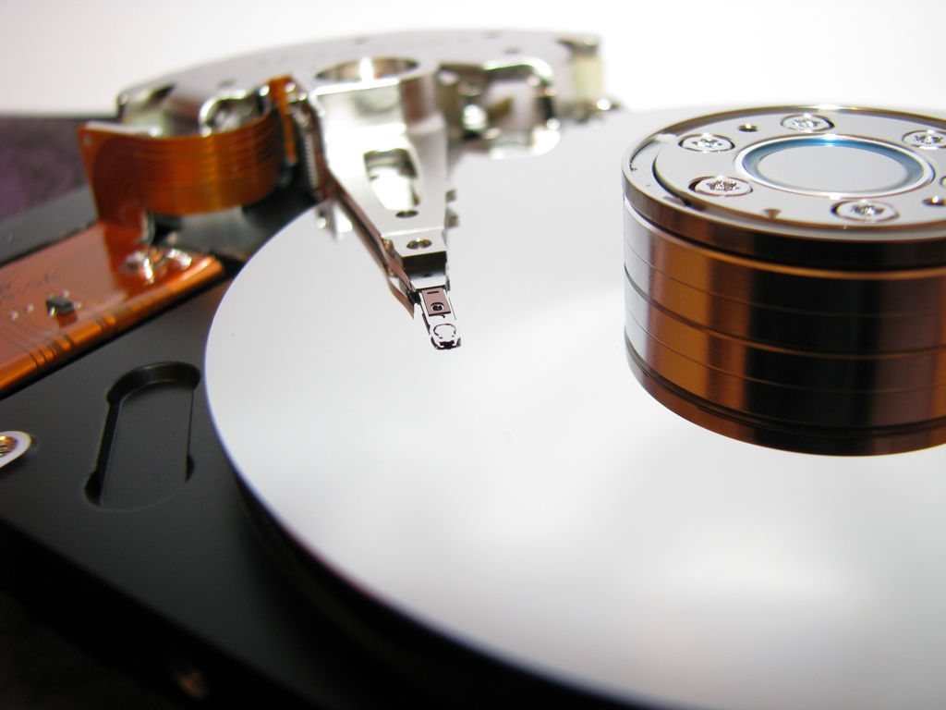

Energy Efficient Data Storage Systems
Xiao Qin
Department of Computer Science
and Software Engineering
Auburn University
http://www.eng.auburn.edu/~xqin
xqin@auburn.edu

Slide 2



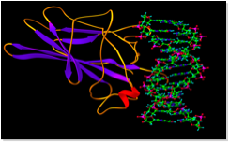
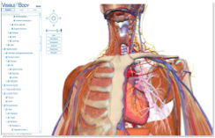
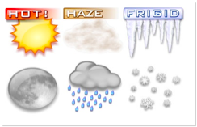
Data-Intensive Applications
Stream Multimedia
Bioinformatic
3D Graphic
Weather Forecast

Slide 3





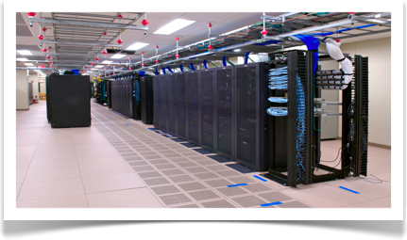

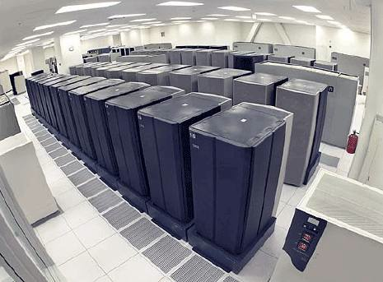
Cluster Computing in
Data Centers
Data Centers

Slide 4

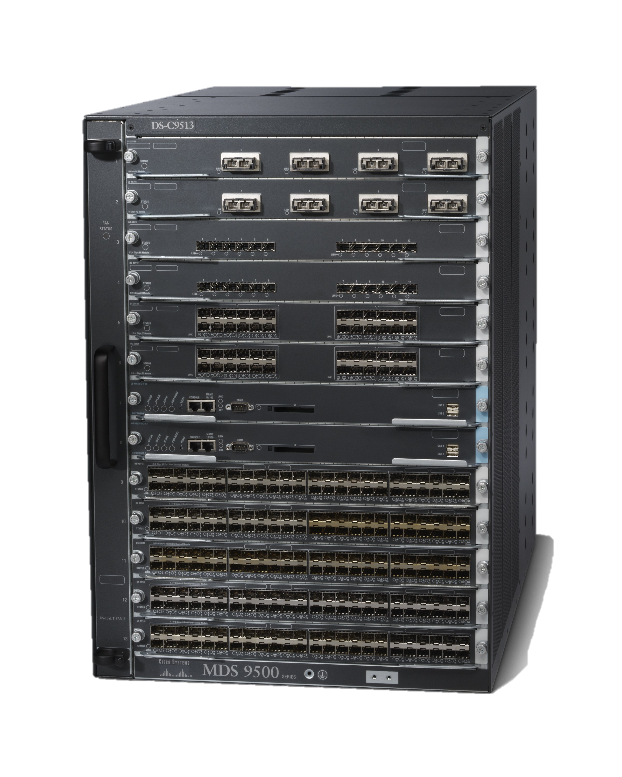

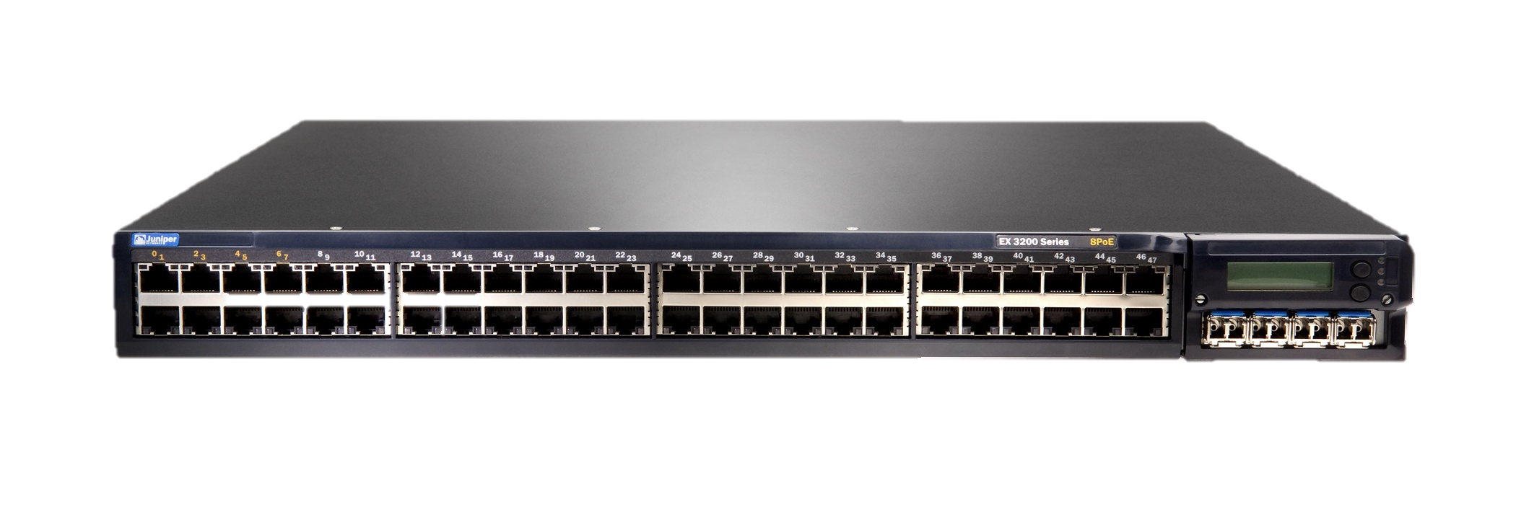
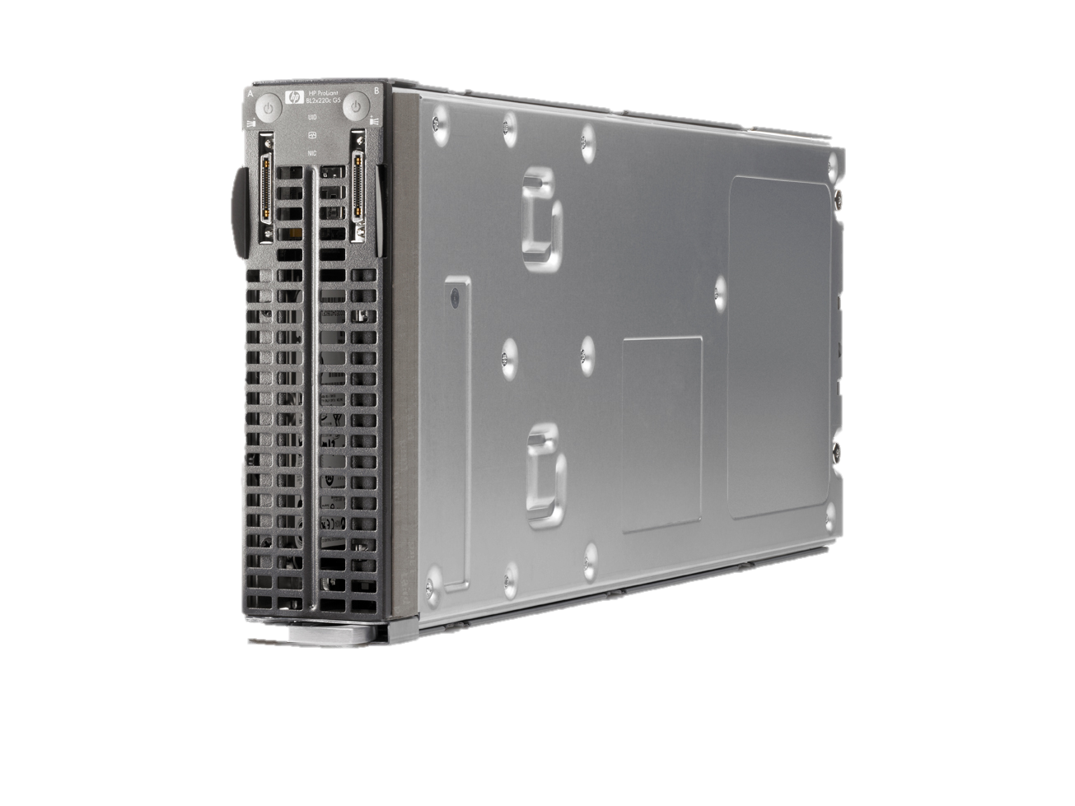
Computing and Storage Nodes in a Cluster
Storage Node
(or Storage Area Network)
Head Node
Internet
Client
Network switch
Computing Nodes

Slide 5

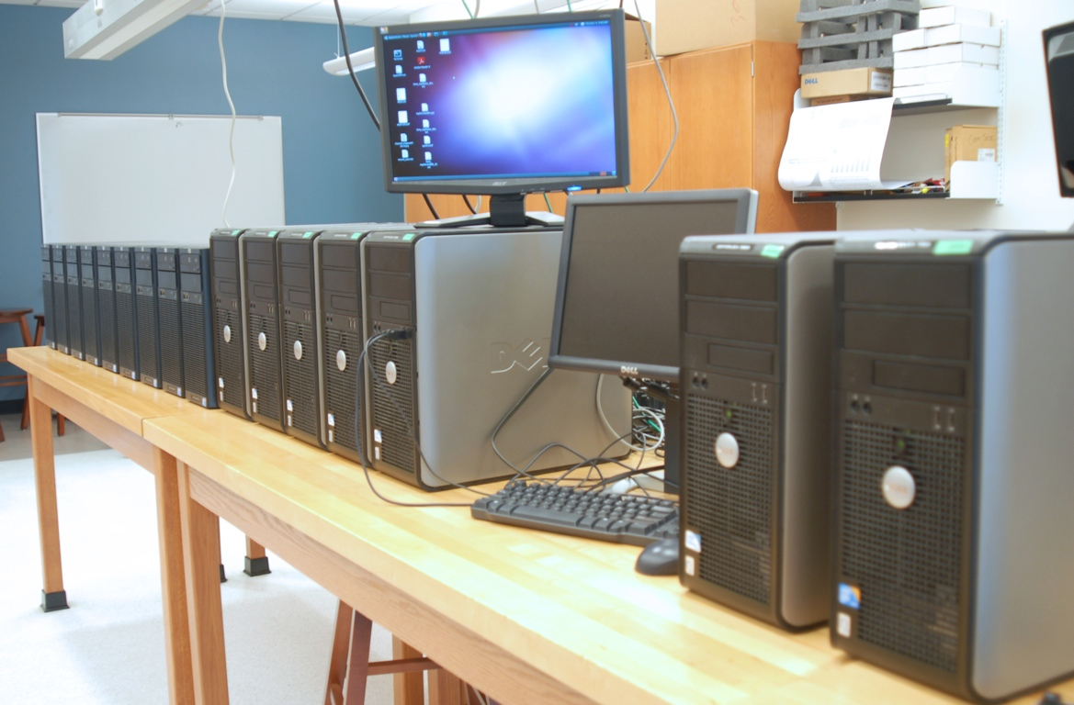

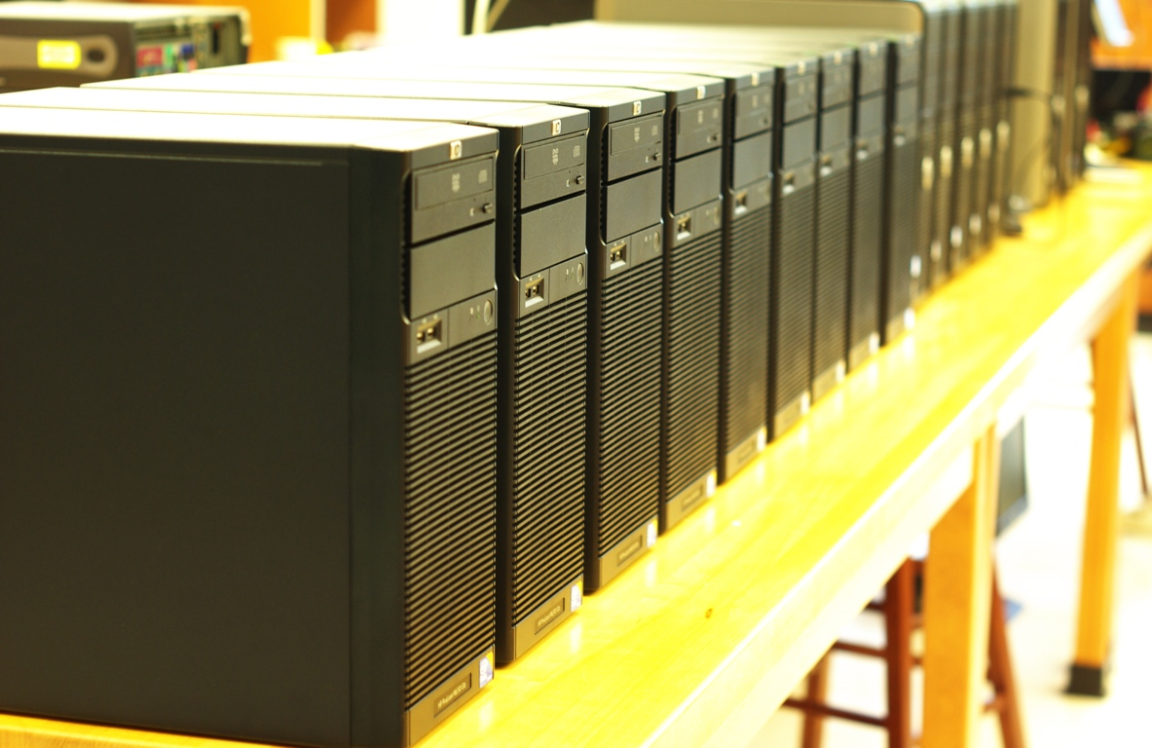

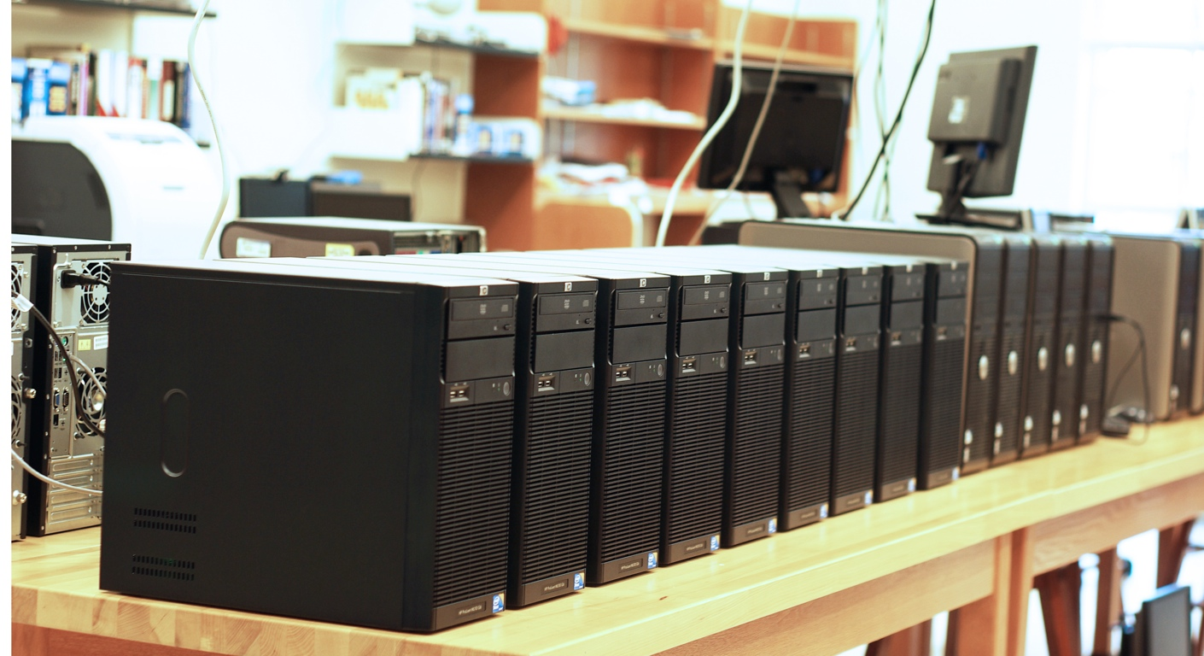
Clusters in Our Lab at Auburn
Notes:
Dell * 8
Intel XEON X3430
2GB DDR3(PC-10600)
Ubuntu 9.04 32-bit
Gigabit LAN
HP * 12
Intel Core 2 Q9400
2GB DDR3(PC-10600)
Ubuntu 9.04 32-bit
Gigabit LAN

Slide 6

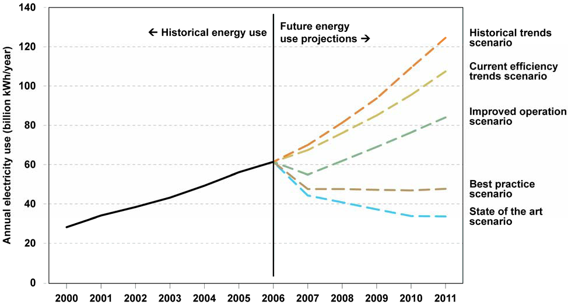

Energy Consumption was Growing
EPA Report to Congress on Server and Data Center Energy Efficiency, 2007

Slide 7
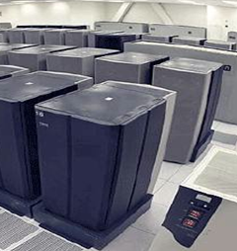
2020 Projections
Data Center:
increases by 200%
Clients:
  number – increases by 800%
  Power – increases by 300%
Network:
Increases by 300%

Slide 8

Energy Efficiency of Data Centers
Data Centers consume 110 Billion kWh per Year
Storage
37%
Server
40%
Network 23%
Average cost: ¢9.46 per kWh
Dell’s Texas Data Center
Storage system may
cost 2.8 Billion Dollars!

Slide 9
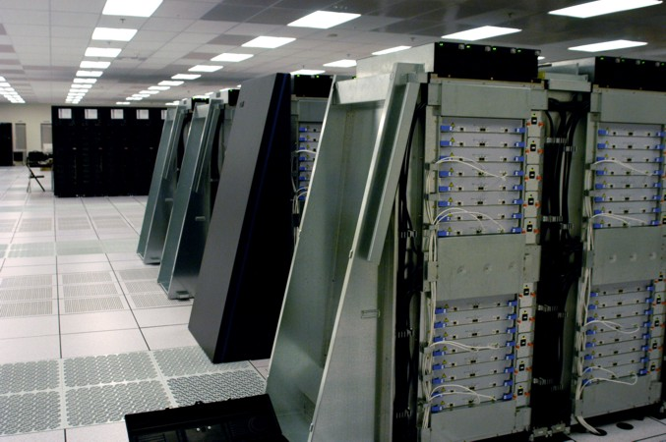
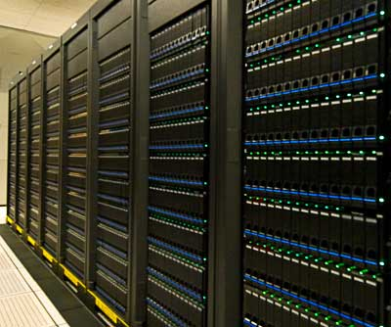
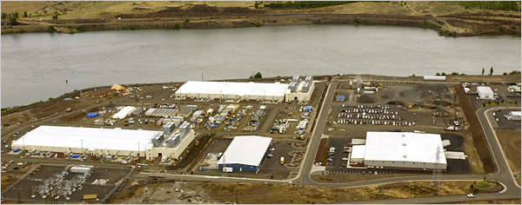
Build Energy-Efficient Data Centers
Notes:
This slide shows a typical high-performance computing platform, which was built by Google in the Oregon state. There is no doubt that they have significantly changed our lives and we all benefit from the great services provided by these super computing platforms . However, these giant machines consume a huge amount of energy.

Slide 10
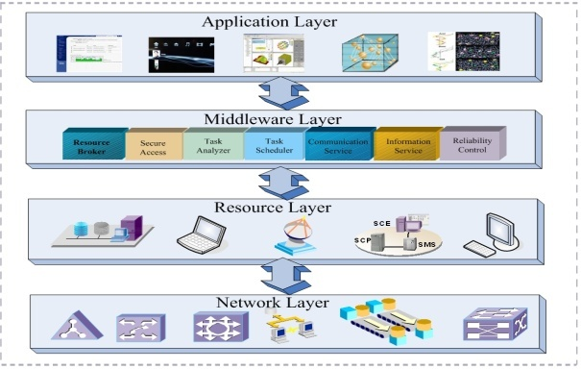
Energy Conservation Techniques
Notes:
Architecture – Multiple Layers
In our architecture, we have four layers: application layer, middleware layer, resource layer, network layer. In each layer, we can incorporate energy-aware techniques. For example, in the application layer, we can reduce the unnecessary access to hardware when writing the code. In the middleware layer, we can schedule parallel tasks in more energy-efficient ways. In the resource and network layers, we can do energy-aware resource management.

Slide 11
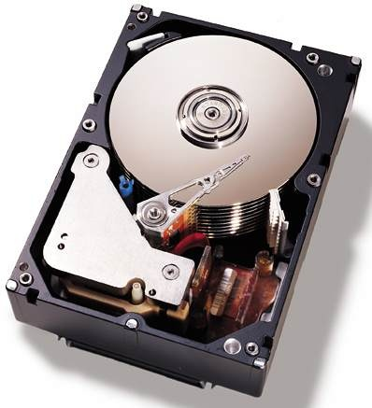

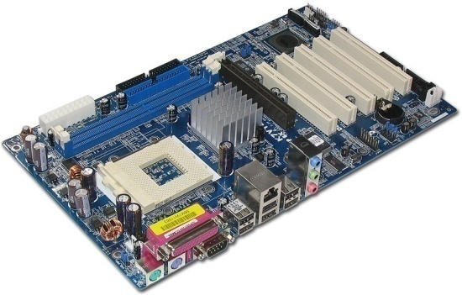
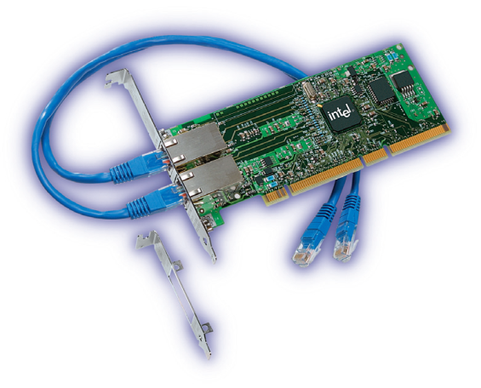
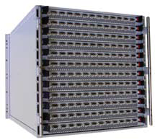
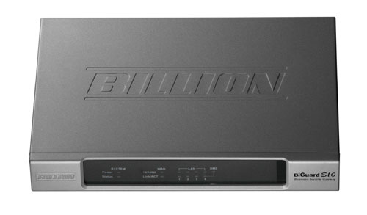
Energy Efficient Devices
Notes:
This slide shows some typical hardware in the resource and network layers like CPU, main board, storage disk, network adapter, switch and router.

Slide 12
Multiple Design Goals
High-Performance Computing Platforms
Performance
Energy Efficiency
Reliability
Security
Notes:
One thing I would like to emphasize here is that any energy-oriented research should not scarify other important characters like performance, reliability or security. Although there must be some tradeoff once we introduce energy-aware techniques, we do not want to see significant degradation in other characters. In other words, we would like to make our research compatible with existing techniques. For my research, I mainly focus on the tradeoff between performance and energy.

Slide 13
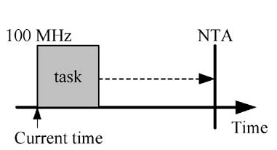
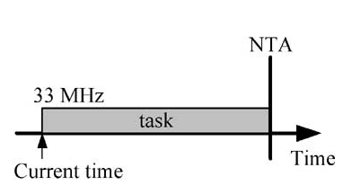
DVS – Dynamic Voltage Scaling
Trade performance for energy efficiency

Slide 14
Energy-Aware Scheduling for Clusters
Z.-L. Zong, X.-J. Ruan, A. Manzanares, and X. Qin, “EAD and PEBD: Two Energy-Aware Duplication Scheduling Algorithms for Parallel Tasks on Homogeneous Clusters,” IEEE Transactions on Computers, vol. 60, no. 3, pp. 360- 374, March 2011.
Notes:
Before we talk about the algorithms, let’s see the cluster systems first. In a cluster, we have the master node and slave nodes. The master node is responsible to schedule tasks and allocate them to slave nodes for parallel execution. All slave nodes are connected by high speed interconnections and they communicate with each other through message passing.

Slide 15
Parallel Applications
Notes:
The parallel tasks running on clusters are represented using Directed Acyclic Graph , or DAG for short. Usually, a dag has one entry task and one or multiple exit tasks. Dag shows the task number and the execution time of each task. It also shows the dependence and communication time among tasks. Explain a little bit…

Slide 16
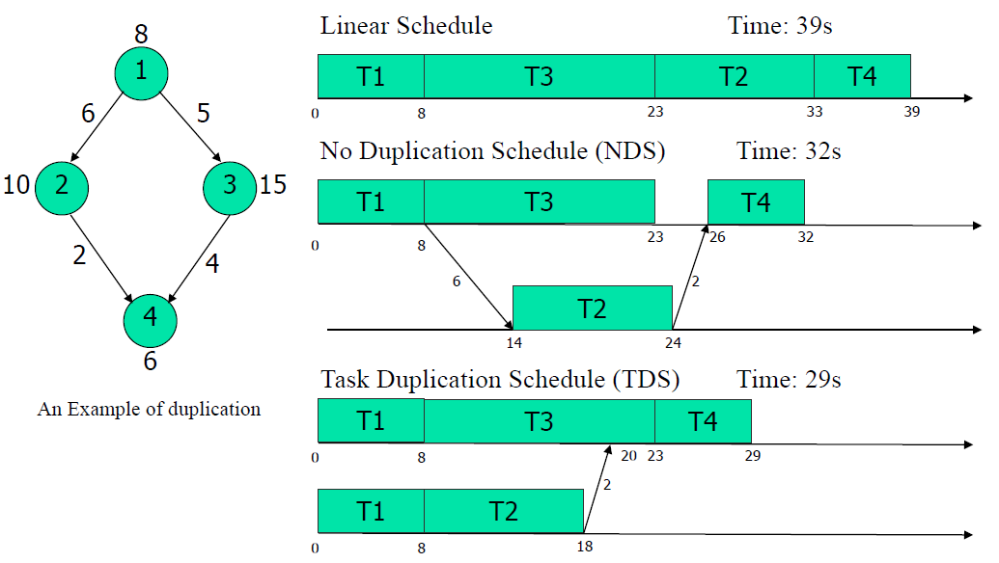
Energy-Aware Scheduling: Motivational Example
Notes:
Weakness 1: Do not consider energy conservation in memory
Weakness 2: Energy can’t be conserved even then network interconnects are idle
In order to improve performance, we use duplication strategy. This slide shows why duplication can improve performance. Here we have 4 tasks represented by the DAG in the left side. If we use linear scheduling, all four tasks will be allocated in 1 CPU and the execution time will be 39s. However, we noticed that we can schedule task 2 to the 2nd CPU so that we do not need to wait the completion of task 3. In that way, the total time will shortened to 32s. We also noticed that 6s are wasted in the 2nd CPU because task 2 has to wait the message from task 1. If duplicate task 1 in the 2nd CPU, we can further shorted the schedule length to 29s. Obviously, the duplication could improve performance.

Slide 17
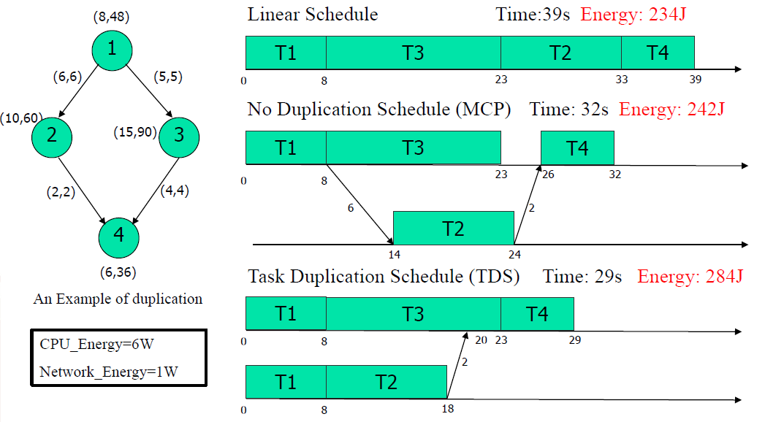
Motivational Example (cont.)
Notes:
However, if we calculate the energy, we will find that duplication may consume more power. For example, if we set the energy consumption for CPU and network 6w and 1w, the total energy consumption of duplication will be 42J more than NDS and 50J more than linear schedule. That is mainly because task 1 are executed twice. Here I would like to mention that I will use NDS(MCP) to represent no duplication schedule and use TDS to represent task duplication schedule. You will see a lot of them in the simulation results.

Slide 18
The EAD and PEBD Algorithms
Generate the DAG of given task sets
Calculate energy increase
and time decrease
Calculate energy increase
Find all the critical paths in DAG
Ratio= energy increase/ time decrease
more_energy<=Threshold?
Generate scheduling queue based on the level (ascending)
No
Ratio<=Threshold?
No
select the task (has not been scheduled yet) with the lowest level as starting task
Yes
Duplicate this task and select the next task in the same critical path
Yes
meet entry task
Duplicate this task and select the next task in the same critical path
For each task which is in the
same critical path with starting task, check
if it is already scheduled
No
No
Yes
allocate it to the same processor with the tasks in the same critical path
Save time if duplicate
this task?
Yes
PEBD
EAD
Notes:
This diagram summarize the steps we just talked about. I will just skip it.

Slide 19
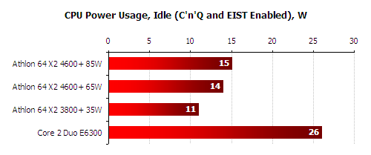
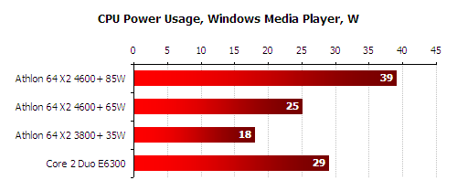
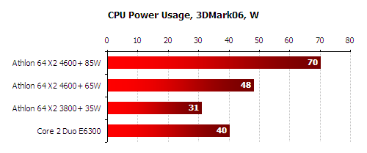
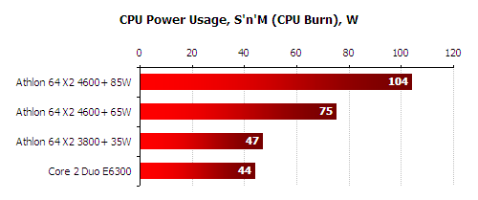
Energy Dissipation in Processors
http://www.xbitlabs.com
Notes:
Now we are going to discuss the simulation results. We implement our own simulator using C language under Linux system. The CPU power consumption parameters come from the xbitlabs. We simulate 4 different CPUs, 3 of them are AMD and one is Intel.

Slide 20
Parallel Scientific Applications
Fast Fourier Transform
Gaussian Elimination
Notes:
This slide shows the structure of two small task set. The left one is Fast Fourier Transform and the right one is Gaussian Elimination.

Slide 21

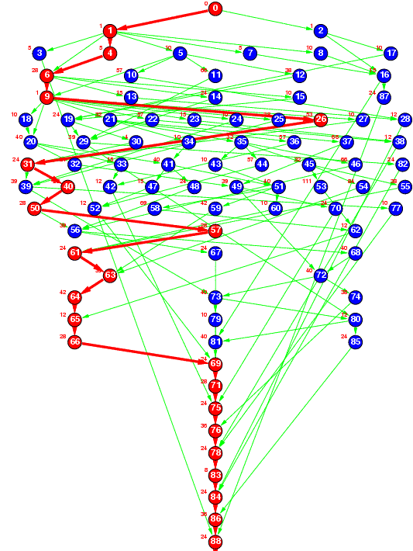
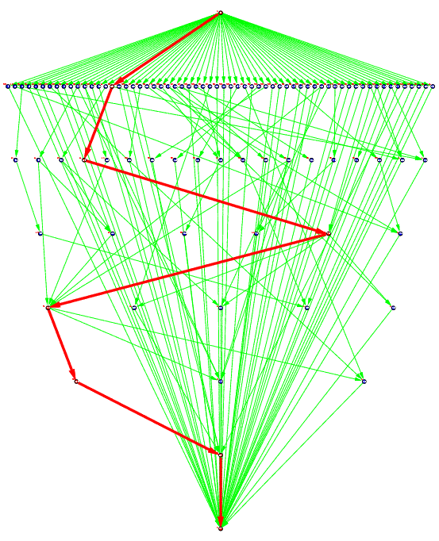
Large-Scale Parallel Applications
Robot Control
Sparse Matrix Solver
http://www.kasahara.elec.waseda.ac.jp/schedule/
Notes:
The slide shows the DAG structure of two real-world applications. The left one is Robot Control and the right one is Sparse Matrix Solver.

Slide 22
Impact of CPU Power Dissipation
19.4%
3.7%
CPU Type | Power (busy) | Power (idle) | Gap
 | 104w | 15w | 89w
 | 75w | 14w | 61w
 | 47w | 11w | 36w
 | 44w | 26w | 18w
Observation: CPUs with large gap between CPU_busy and CPU_idle can obtain greater energy savings
Energy consumption for different processors (Gaussian, CCR=0.4)
Energy consumption for different processors (FFT, CCR=0.4)
Notes:
This slide shows the impact of CPU types. Recall that I simulate 4 different CPUs, which are represented in 4 different colors. We found that the CPU with blue color can save more energy compares with other 3 CPUs. For example, we can save 19.4% energy using blue CPU while we only can save 3.7% for the purple CPU. The indication behind is that these 4 CPUs have different gaps between CPU_busy and CPU_idle. This table summarize the difference. The gap for the blue CPU is 89w but the gap for the purple CPU is only 18w. So our observation is…

Slide 23
Performance
Impact to Schedule Length:
Schedule length of Gaussian Elimination
Schedule length of Sparse Matrix Solver
Application | EAD Performance Degradation (: TDS) | PEBD Performance Degradation (: TDS)
Gaussian Elimination | 5.7% | 2.2%
Sparse Matrix Solver | 2.92% | 2.02%
Observation: it is worth trading a marginal degradation in schedule length for a significant energy savings for cluster systems.
Notes:
This group of simulation results show the impact to performance. The left one is for Gaussian and the right one is for Sparse. This table summarize that the overall performance degradation of EAD and PEBD is 5.7% and 2.2% compared with TDS for Gaussian. For Sparse, the number is 2.92% and 2.02%. Our observation is …

Slide 24
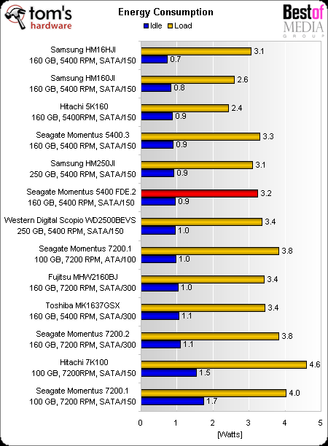
Energy Consumption of Disks

Slide 25
Power States of Disks
Active State: high energy consumption
Active
Standby
State transition penalty
Standby State: low energy consumption

Slide 26
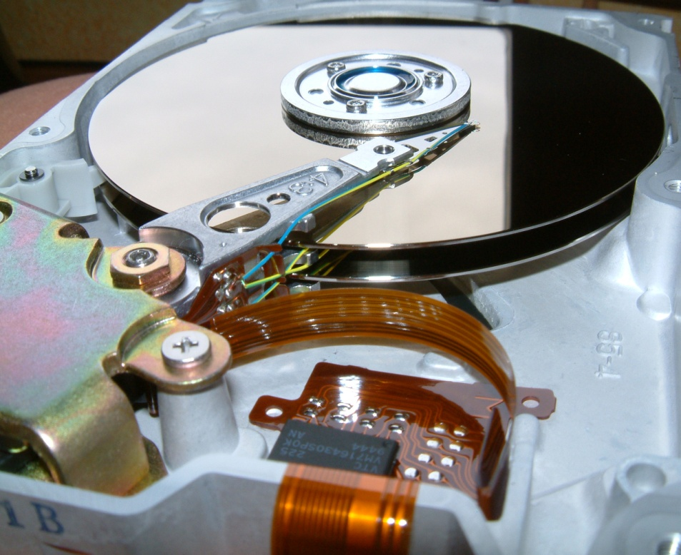
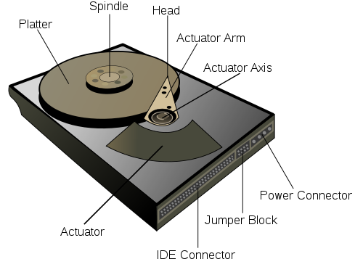
A Hard Disk Drive
  A10000RPM Hard Drive may take 10.9 seconds to wake up!
Notes:
So random read is good?

Slide 27
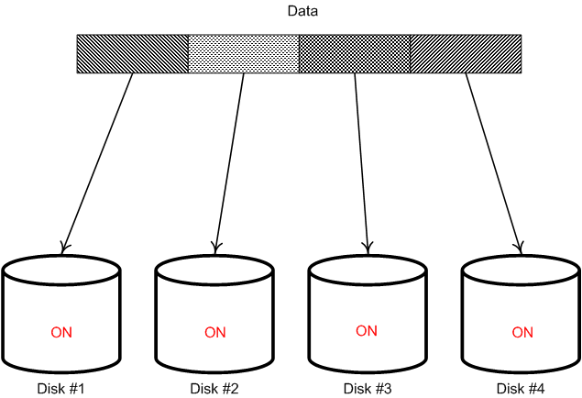
Parallel Disks
Performance
Energy Efficiency
Notes:
So random read is good

Slide 28
Put It All Together:
Buffer Disk Architecture
Energy-Related Reliability Model
Prefetching
Data Partitioning
Security Model
Disk Requests
RAM Buffer
Buffer Disk Controller
Load Balancing
Power Management
m buffer disks
n data disks

Slide 29
IBM Ultrastar 36Z15
Transfer Rate | 55 MB/s | Spin Down Time: T_{D} | 1.5 s
Active Power: P_{A} | 13.5 W | Spin Up Time: T_{U} | 10.9 s
Idle Power: P_{I} | 10.2 W | Spin Down Energy: E_{D} | 13 J
Standby Power: P_{A} | 2.5 W | Spin Up Energy: E_{U} | 135 J
Break-Even Time: T_{BE} |  | 15.2 S

Slide 30


Prefetching
Buffer Disk
Disk 1
Disk 2
Disk 3
Notes:
16%

Slide 31
Energy Saving Principles
Energy Saving Principle One
  Increase the length and number of idle periods larger than the disk break-even time T_{BE}
Energy Saving Principle Two
  Reduce the number of power-state transitions
A. Manzanares, X. Qin, X.-J. Ruan, and S. Yin, “PRE-BUD: Prefetching for Energy-Efficient Parallel I/O Systems with Buffer Disks,” ACM Transactions on Storage, vol. 7, no. 1, Article 3 June 2011.

Slide 32
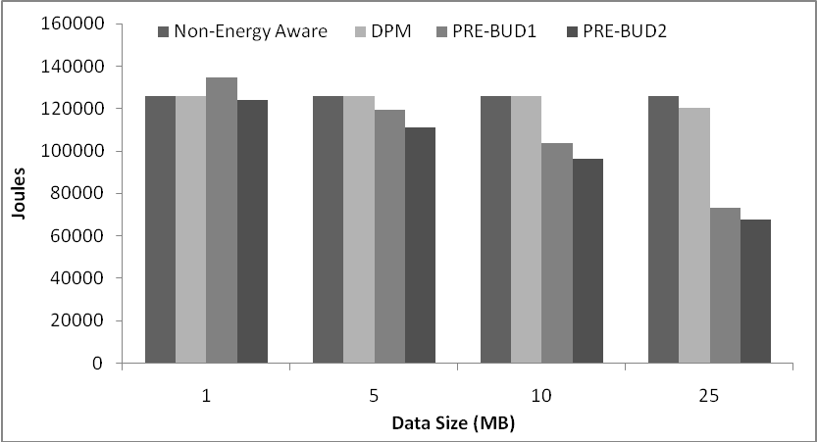
Energy Savings Hit Rate 85%
Notes:
12 disk

Slide 33
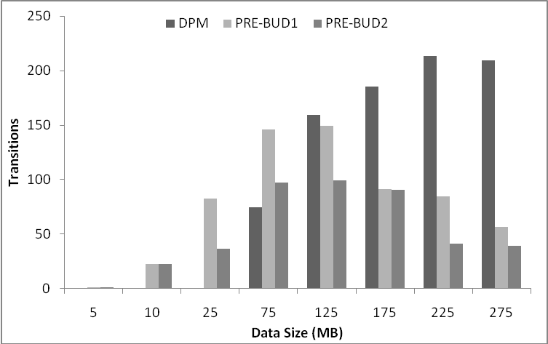
State Transitions

Slide 34







Heat-Based Dynamic Data Caching
buffer disk
buffer disk
buffer disk
Requests Queue
Notes:
In the traditional disk arrays, requests are served directly by data disks. To maximize the performance, the traditional disk arrays tend to keep the disks in active state, even they do not produce any useful work. This will waste a lot of energy. Actually, some disks has very low utilization rate in real world traces, probably less than 20% or even 10%, we can save a lot of energy if we turn them into sleep state. Please note that the golden disks are active disks and gray disks are sleeping disks. However, the utilization of some disks might be extremely high because they stored very hot or popular blocks. It is almost impossible to make them sleep. Our idea is to add one more layer, called the buffer disk layer, on the top of the data disk layer. The requests will be served by buffer disks first rather than by data disks directly. We can cache all those hot blocks to the buffer disks and sleep as many data disks as possible.

Slide 35
Heat-Based Dynamic Data Caching
Requests Queue
buffer disk
buffer disk
buffer disk
Notes:
Cont..

Slide 36
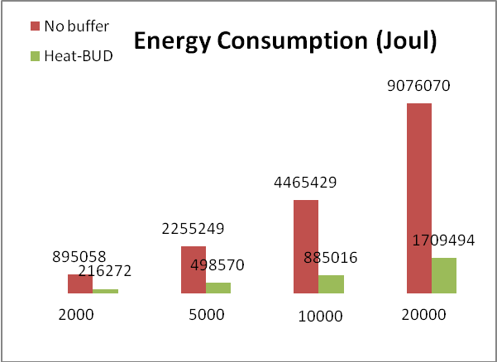
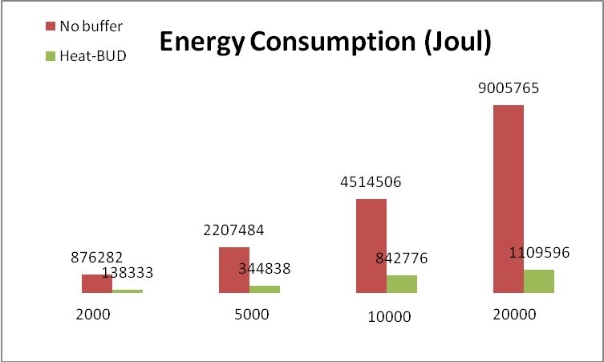
Energy Consumption Results
Large Reads: average 84.4% improvement (64MB)
Small Reads: average 78.77% improvement (64KB)
Energy consumption for large reads
Energy consumption for small reads
Notes:
motivation.
Results: x-axis, y-axix, red bars, green bars
Observation
indication

Slide 37
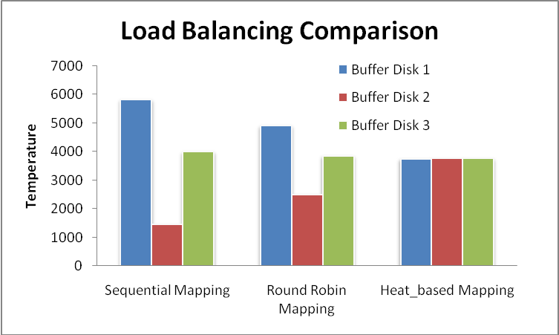
Load Balancing Comparison
Load balancing comparison for three mapping strategies

Slide 38
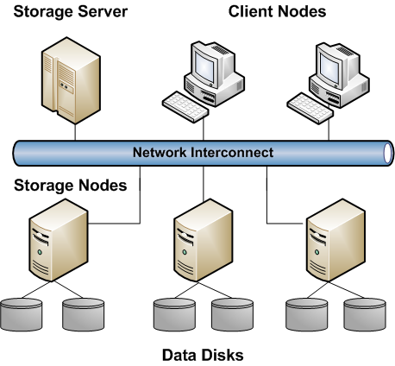
Energy Efficient Virtual File System

Slide 39
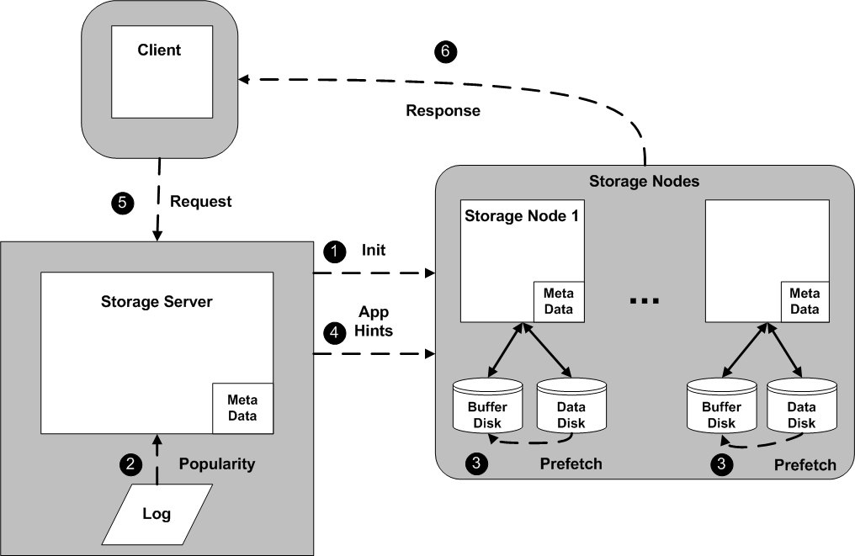
EEVFS Process Flow

Slide 40
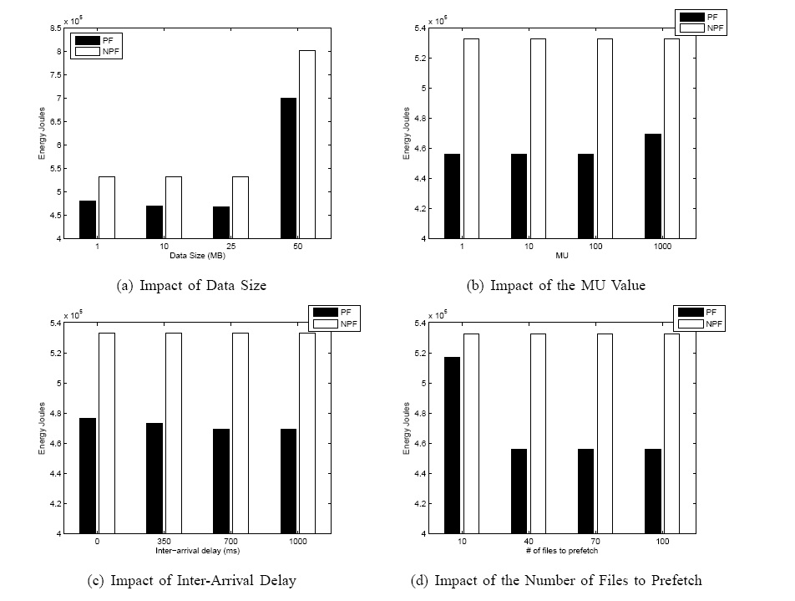
Energy Savings

Slide 41
Improving Performance of EEVFS
Parallel Striping Groups
File 1
Group 1
File 3
File 2
Group 2
File 4
Buffer Disk
Disk 1
Disk 2
Buffer Disk
Disk 5
Disk 6
Storage Node 1
Storage Node 3
Buffer Disk
Disk 3
Disk 4
Buffer Disk
Disk 7
Disk 8
Storage Node 2
Storage Node 4

Slide 42
Striping Within a Group
Buffer Disk
Disk 1
Disk 2
1
2
3
5
7
9
4
6
8
10
Storage Node 1
Buffer Disk
Disk 3
Disk 4
1
2
3
5
7
9
4
6
8
10
Storage Node 2
Group 1
File 2
File 1
2
2
1
1

Slide 43
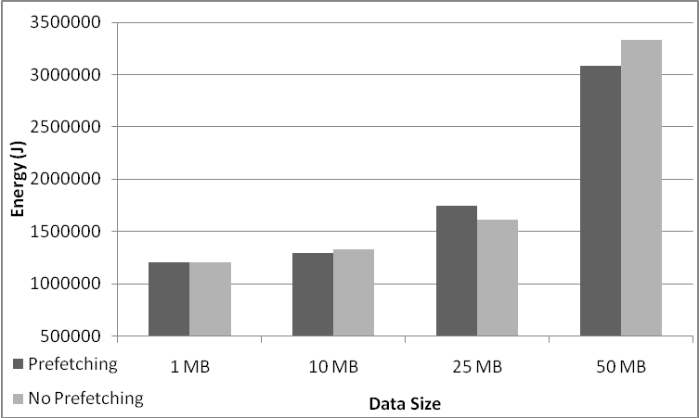
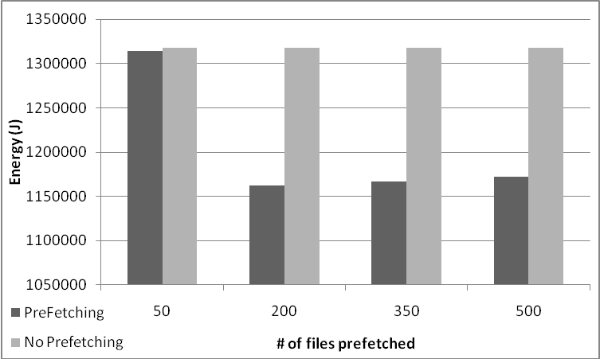
Measured Results

Slide 44
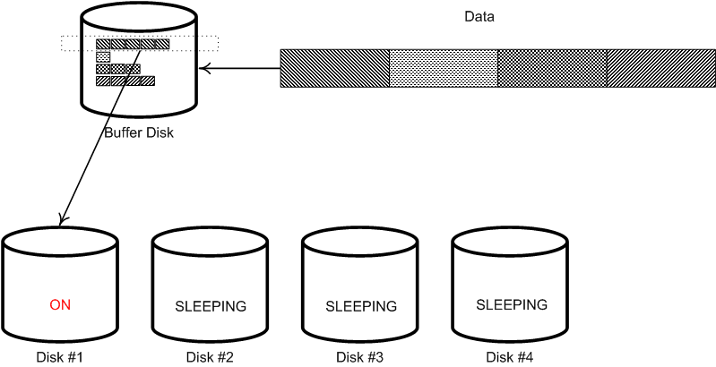
A Parallel Disk System with a Write Buffer Disk
Notes:
So random read is good

Slide 45
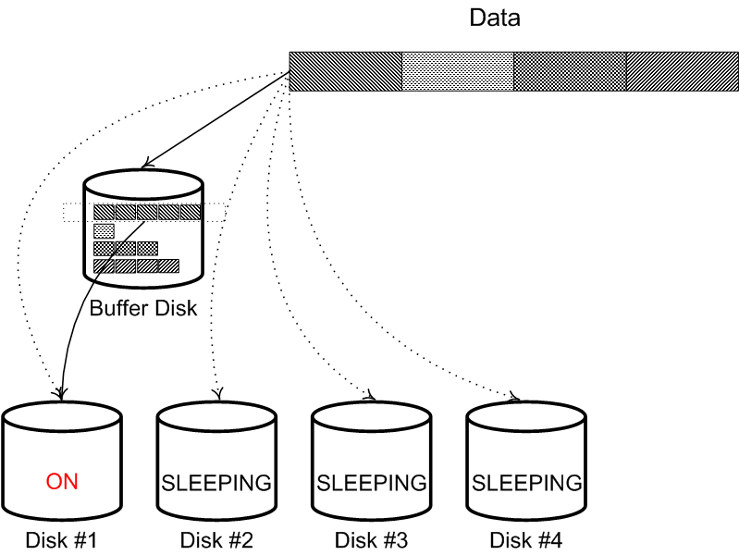
Under High Workload Conditions
  Data Disks can serve requests without buffer disks when workload is high

Slide 46

Wakeup Data Disks
Requests Queue
Buffer Disk

Slide 47
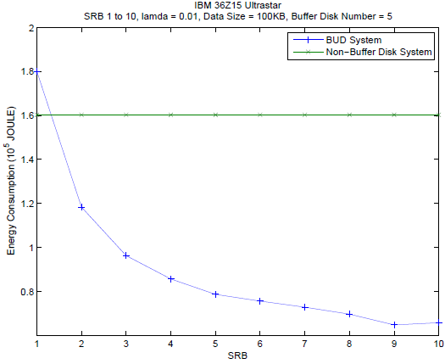

Energy Savings
Low Workload, UltraStar
Notes:
SRB is small, transfer data from buffer disk to data disk for too many times. Small SRB, more spin up and spin down times.

Slide 48




Energy Conservation Techniques
Software-Directed Power Management
Dynamic Power Management
Redundancy Technique
Multi- speed Setting
How Reliable Are They?
48

Slide 49

Tradeoff between Energy Efficiency and Reliability
Example: Disk Spin Up and Down

Slide 50

MINT
(MATHEMATICAL RELIABILITY MODELS FOR ENERGY-EFFICIENT PARALLEL DISK SYSTEMS)
Energy Conservation Techniques
Single Disk Reliability Model
System-Level Reliability Model
S. Yin et al. “Reliability Analysis for an Energy-Aware RAID System,” Proc. the 30th IEEE International Performance Computing and Communications Conference (IPCCC), Nov. 2011.

Slide 51
MINT(Single Disk)
Disk Age
Temperature
Frequency
Utilization
Single Disk Reliability Model
Reliability of Single Disk

Slide 52

MINT
(MATHEMATICAL RELIABILITY MODELS FOR ENERGY-EFFICIENT PARALLEL DISK SYSTEMS)
Access Pattern
Energy Conservation Techniques
Single Disk Reliability Model
System Level Reliability Model
Reliability of A Parallel Disk System

Slide 53

Preliminary Result
Comparison Between PDC and MAID
AFR Comparison of PDC and MAID
Access Rate(*10⁴) Impacts on AFR (T=35°C)
Notes:
Utilization Sensitivity: PDC is higher than MAID;
AFR: when the access rate is low, PDC is lower than MAID
the reason is on the following slide

Slide 54
Summary
Energy-Aware Scheduling
BUD - Buffer Disk Architecture
Energy-Efficient File Systems
Reliability Models for Energy-Efficient Storage Systems

Slide 55

Download the presentation slides http://www.slideshare.net/xqin74
Google: slideshare Xiao Qin

Slide 56

Questions

