Slide 1
How to Write Research Papers
Part 1 – General Principles
Xiao Qin
Department of Computer Science and Software Engineering
Auburn University
http://www.eng.auburn.edu/~xqin
xqin@auburn.edu
Some slides are adapted from notes by Simon Peyton Jones (Microsoft Research, Cambridge)
Notes:
Version 3: June 15, 2015
My story: 1996

Slide 2


My First Paper

Slide 3
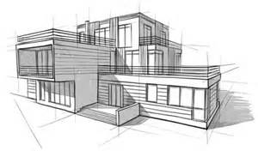
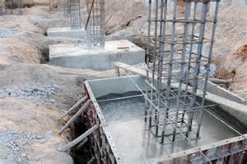


How to write a good research paper?
Research Idea
Implementation
A good research project starts with a good idea
  Implement your idea and conduct experiments
Presentation
Improve your writing
  A good organization is the first step towards presenting your idea
  Improving your written English is a key

Slide 4
Writing Papers is a Skill
Many papers are badly written
Good writing is a skill you can learn
It’s a skill that is worth learning:
  You will get more brownie points (more papers accepted etc)
  Your ideas will have more impacts
  You will have better ideas
Increasing importance
Notes:
Research projects – research skills
Presentation - writing skills (Organization, Logic, English) + presentation skills

Slide 5
Writing Papers: Model 1
Idea
Do research
Write paper
When I was a doctoral student 7 years ago, this is my model of writing papers.

Slide 6
Writing Papers: Model 2
Idea
Do research
Write paper
Idea
Write paper
Do research
Forces to be clear, focused
Crystallises what we don’t understand
Opens the way to dialogue with others: reality check, critique, and collaboration

Slide 7
Do not be Intimidated
Fallacy You need to have a fantastic idea before you can write a paper. (Everyone else seems to.)
Write a paper,
and give a talk, about
any idea,
no matter how weedy and insignificant it may seem to you

Slide 8
Do not be intimidated
Write a paper, and give a talk, about any idea, no matter how insignificant it may seem to you
Writing a paper is how you develop an idea in the first place
It usually turns out to be more interesting and challenging that it seemed at first

Slide 9
The Purpose of Your Papers
Xiao Qin
Department of Computer Science and Software Engineering
Auburn University
http://www.eng.auburn.edu/~xqin
xqin@auburn.edu

Slide 10
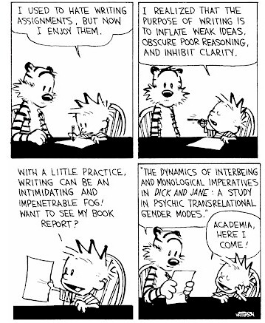
Why bother?
Good papers and talks are a fundamental part of research excellence
Fallacy
we write papers and give talks mainly to impress others, gain recognition, and get promoted

Slide 11
Papers Communicate Ideas
Your goal: to infect the mind of your reader with your idea, like a virus
Papers are far more durable than programs (think Mozart)
The greatest ideas are (literally) worthless if you keep them to yourself

Slide 12
The Idea
Idea
A re-usable insight,
useful to the reader
Figure out what your idea is
Make certain that the reader is in no doubt what the idea is. Be 100% explicit:
  “The main idea of this paper is....”
  “In this section we present the main contributions of the paper.”
Many papers contain good ideas, but do not distil what they are.

Slide 13
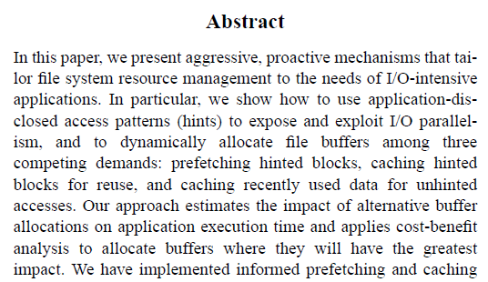
The Idea – An example

Slide 14
One Ping
Your paper should have just one “ping”: one clear, sharp idea
Read your paper again: can you hear the “ping”?
You may not know exactly what the ping is when you start writing; but you must know when you finish
If you have lots of ideas, write lots of papers
Thanks to Joe Touch for “one ping”

Slide 15
The purpose of your paper is not...
To describe the WizWoz system
Your reader does not have a WizWoz
Readers are primarily interested in re-usable brain-stuff, not executable artefacts
Notes:
Tao’s example: Write an algorithm for his simulator NOT the algorithm of his idea.

Slide 16
Your Narrative Flow
I wish I knew how to solve that!
Here is a problem
It’s an interesting problem
It’s an unsolved problem
Here is my idea
My idea works (details, data)
Here’s how my idea compares to other people’s approaches
I see how that works. Ingenious!

Slide 17
Structure (Conference Paper)
Title (1000 readers)
Abstract (4 sentences, 100 readers)
Introduction (1 page, 100 readers)
The problem (1 page, 10 readers)
My idea (2 pages, 10 readers)
The details (5 pages, 3 readers)
Related work (1-2 pages, 10 readers)
Conclusions and further work (0.5 pages)

Slide 18
The Abstract
I usually write the abstract last
Used by program committee members to decide which papers to read
Four sentences [Kent Beck]
  State the problem
  Say why it’s an interesting problem
  Say what your solution achieves
  Say what follows from your solution
Notes:
Sometimes, add one sentence at the beginning to describe background.

Slide 19
Example
Many papers are badly written and hard to understand
This is a pity, because their good ideas may go unappreciated
Following simple guidelines can dramatically improve the quality of your papers
Your work will be used more, and the feedback you get from others will in turn improve your research

Slide 20
Structure
Abstract (4 sentences)
Introduction (1 page)
The problem (1 page)
My idea (2 pages)
The details (5 pages)
Related work (1-2 pages)
Conclusions and further work (0.5 pages)

Slide 21
The introduction (1 page)
Describe the problem
State your contributions
...and that is all
ONE PAGE!
Notes:
The problem may include the background of your research.

Slide 22
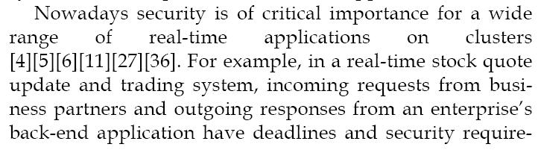
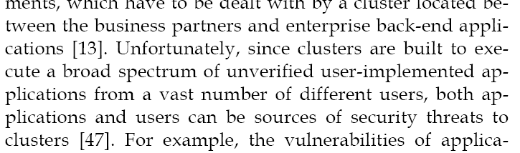
Describe the Problem
Use an example to introduce the problem

Slide 23
State Your Contributions
Write the list of contributions first
The list of contributions drives the entire paper: the paper substantiates the claims you have made
Reader thinks “gosh, if they can really deliver this, that’s be exciting; I’d better read on”
Notes:
Contribution Drivers: Once you state your contributions, the paper must explain how the contributions were delivered in your project.

Slide 24
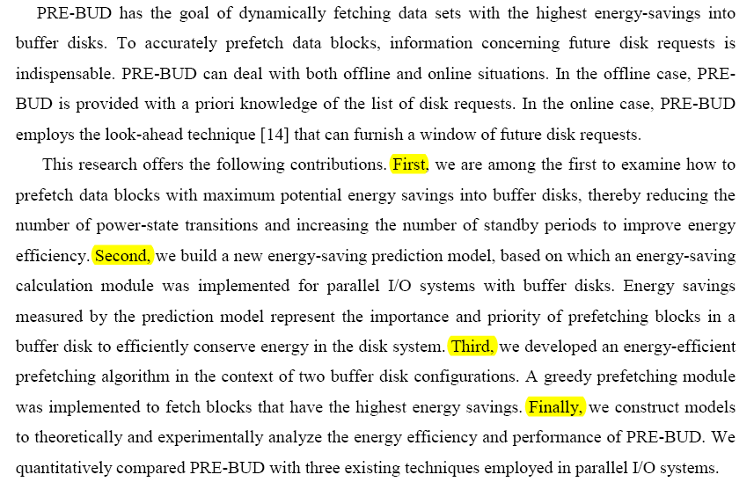
State Your Contributions
Bulleted list of contributions
Do not leave the reader to guess what your contributions are!

Slide 25
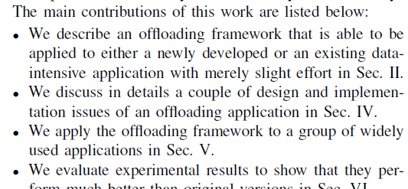
Bulleted List and Forward References

Slide 26
Structure
Abstract (4 sentences)
Introduction (1 page)
Related work
The problem (1 page)
My idea (2 pages)
The details (5 pages)
Related work (1-2 pages)
Conclusions and further work (0.5 pages)

Slide 27
Contributions should be refutable
NO! | YES!
We describe the PRE-BUD system. It is really cool. | …to examine how to prefetch data blocks with maximum potential energy savings into buffer disks, thereby reducing the number of power-state transitions and increasing the number of standby periods to improve energy efficiency.
We study an energy consumption model. | We build a new energy-saving prediction model, based on which an energy-saving calculation module … (see Section 4.2)
We developed a prefetching algorithm. | We developed an energy-efficient prefetching algorithm in the context of two buffer disk configurations. A greedy prefetching module … (see Section 4.1)

Slide 28
No “rest of this paper is...”
Not:
Instead, use forward references from the narrative in the introduction.
The introduction (including the contributions) should survey the whole paper, and therefore forward reference every important part.
“The rest of this paper is structured as follows. Section 2 introduces the problem. Section 3 ... Finally, Section 8 concludes”.

Slide 29
No related work yet!
Related work
Your reader
Your idea
Energy efficient prefetching was explored by Papathanasiou and Scott [20]. Their techniques relied on changing prefetching and caching strategies within the Linux kernel. PB-LRU is another energy efficient cache management strategy [32]. This strategy focused on providing more opportunities for underlying disk power strategies to save energy. Flash drives have also been proposed for use as buffers for disk systems [4].

Slide 30
No related work yet
I feel stupid
Problem 1: the reader knows nothing about the problem yet; so your (carefully trimmed) description of various technical tradeoffs is absolutely incomprehensible
Problem 2: describing alternative approaches gets between the reader and your idea
I feel tired

Slide 31
For readers who know your field very well...
Abstract (4 sentences)
Introduction (1 page)
Related work (1-2 pages)
The problem (1 page)
My idea (2 pages)
The details (5 pages)
Related work
Conclusions and further work (0.5 pages)

Slide 32
Related work first!
Related Work
Is your idea novel?
What are your contribution?
Your reader
Your idea
Energy efficient prefetching was explored by Papathanasiou and Scott [20]. Their techniques relied on changing prefetching and caching strategies within the Linux kernel. PB-LRU is another energy efficient cache management strategy [32]. This strategy focused on providing more opportunities for underlying disk power strategies to save energy. Flash drives have also been proposed for use as buffers for disk systems [4].

Slide 33
Where should you put the related work?
Abstract (4 sentences)
Introduction (1 page)
Put related work here?
The problem (1 page)
My idea (2 pages)
The details (5 pages)
Put related work here?
Conclusions and further work

Slide 34
Where should you put the related work?
A Suggested Principle
Abstract (4 sentences)
Introduction (1 page)
Put related work here?
The problem (1 page)
My idea (2 pages)
The details (5 pages)
Put related work here?
Conclusions and further work
You want to convince reviewers in the first place.
You feel this is a novel idea

Slide 35
Structure
Abstract (4 sentences)
Introduction (1 page)
The problem (1 page)
My idea (2 pages)
The details (5 pages)
Related work (1-2 pages)
Conclusions and further work (0.5 pages)

Slide 36
Presenting the idea
3. The idea
Consider a bifircuated semi-lattice D, over a hyper-modulated signature S. Suppose p_{i} is an element of D. Then we know for every such p_{i} there is an epi-modulus j, such that p_{j} < p_{i}.
Sounds impressive...but
Sends readers to sleep
In a paper you MUST provide the details,
but FIRST convey the idea

Slide 37
Presenting the idea
Explain it as if you were speaking to someone using a whiteboard
Conveying the intuition is primary, not secondary
Once your reader has the intuition, she can follow the details (but not vice versa)
Even if she skips the details, she still takes away something valuable

Slide 38
Putting the reader first
Do not recapitulate your personal journey of discovery. This route may be soaked with your blood, but that is not interesting to the reader.
Instead, choose the most direct route to the idea.

Slide 39
The payload of your paper
Introduce the problem, and your idea, using
EXAMPLES
and only then present the general case

Slide 40
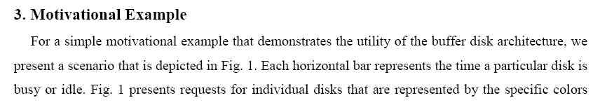
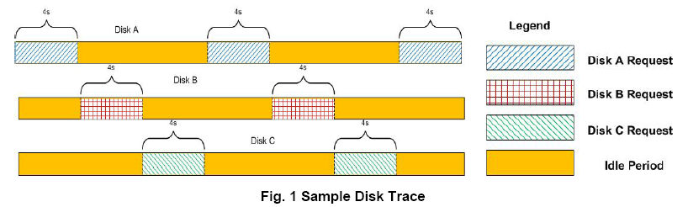
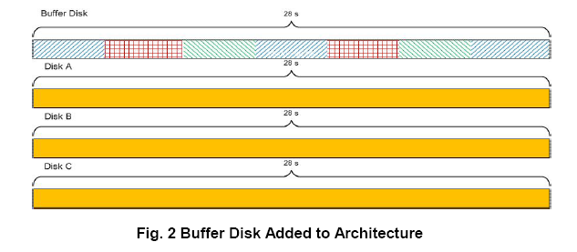
Using examples
Example right away

Slide 41
The details: evidence
Your introduction makes claims
The body of the paper provides evidence to support each claim
Check each claim in the introduction, identify the evidence, and forward-reference it from the claim
Evidence can be: analysis and comparison, theorems, measurements, case studies

Slide 42
Structure
Abstract (4 sentences)
Introduction (1 page)
The problem (1 page)
My idea (2 pages)
The details (5 pages)
Related work (1-2 pages)
Conclusions and further work (0.5 pages)

Slide 43
Related work
Fallacy To make my work look good, I have to make other people’s work look bad

Slide 44
The truth: credit is not like money
Giving credit to others does not diminish the credit you get from your paper
Warmly acknowledge people who have helped you
Be generous to the competition. “In his inspiring paper [Foo98] Foogle shows.... We develop his foundation in the following ways...”
Acknowledge weaknesses in your approach

Slide 45
Credit is not like money
Failing to give credit to others can kill your paper
If you imply claim that an idea is yours, and the referee knows it is not, then either
  You don’t know that it’s an old idea (bad)
  You do know, but are pretending it’s yours (very bad)
If reviewers pointed out that your idea is not novel, what can you do?
Notes:
If reviewers pointed out that your idea is not new, you have to either give up or show more evidence.

Slide 46
Structure
Abstract (4 sentences)
Introduction (1 page)
The problem (1 page)
My idea (2 pages)
The details (5 pages)
Related work (1-2 pages)
Conclusions and further work (0.5 pages)

Slide 47
Conclusions and further work
Be brief.

Slide 48
Future Work
Fallacy (1) Do not let others compete against me using my future work ideas.
(2) Point out future directions that seems to be a dead-end.
(3) A future work I believe I can complete sooner than the others.

Slide 49
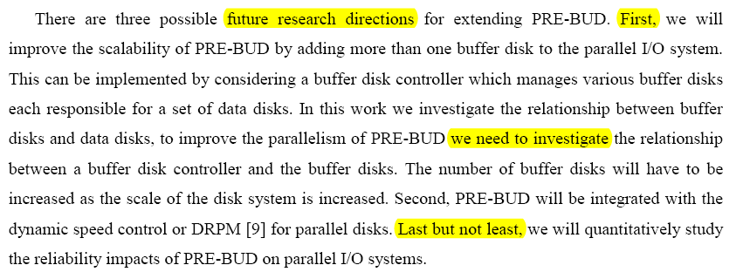
Future Work (cont.)
Refer to the weakness of my work
Encourage other researchers to continue working on your project
Issues that you plan to address

Slide 50
Software Tools
Latex
  MikTex
  TexMaker
Figures: Matlab
Diagram: Matlab, visio, google docs

Slide 51
Summary
If you remember nothing else:
Identify your key idea
Make your contributions explicit
Use examples
Download the slides from
A good starting point:
“Advice on Research and Writing”
http://www.slideshare.net/xqin74/how-to-write-papers-part-1-principles
http://www-2.cs.cmu.edu/afs/cs.cmu.edu/user/
mleone/web/how-to.html

Slide 52

Google: Xiao Qin
http://www.eng.auburn.edu/~xqin

Slide 53
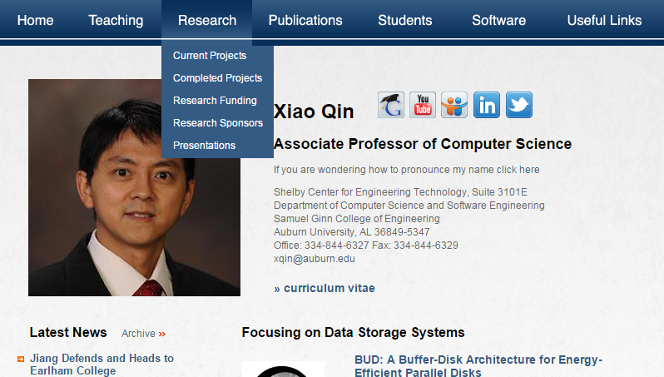
My webpage
http://www.eng.auburn.edu/~xqin

Slide 54
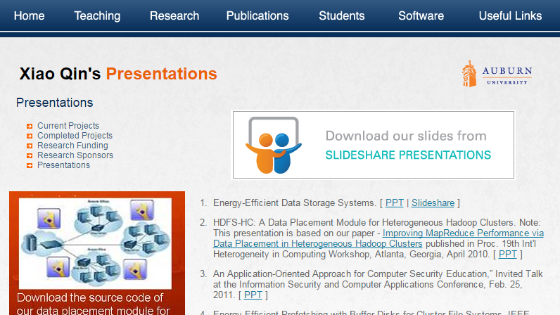
Download Slides at slideshare
http://www.slideshare.net/xqin74

Slide 55
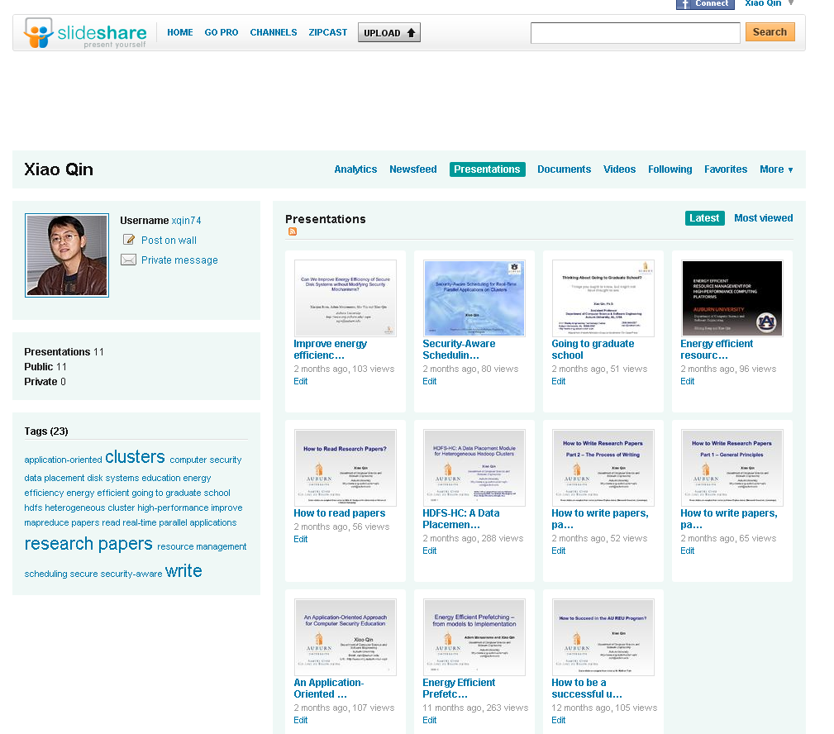

Slide 56

Questions

