Slide 1
Novel Approaches for
Microelectronics
Security and Test
Ziqi Zhou
Thesis Advisor: Prof. Ujjwal Guin
Committee Members:
          Prof. Vishwani D. Agrawal
          Prof. Adit D. Singh
          Prof. Peng Li
External Reader:
Prof. Shubhra (Santu) Karmaker
Department of Electrical and Computer Engineering
Notes:
Hello ,everyone. Welcome to my presentation. I am Ziqi Zhou. Today I am going to present my thesis: Methods for Microelectronics Security and Test in Emerging Technologies

Slide 2

The Need for Hardware Security
Supply Chain Resiliency:
  “White House 100-Day Reviews under Executive Order 14017" on "Building Resilient Supply Chains, Revitalizing American Manufacturing, and Fostering Broad-Based Growth.”
  “More secure and resilient supply chains are essential for our national security, our economic security, and our technological leadership.”
Notes:
The need for hardware security is an urgent and well-accepted concept by GOV, academia, and industry. I will present 3 examples to show this is a real issue and I will provide solutions.
The supply chain resiliency of ICs becomes a common concern and attract more attention in recent years. Because of the globalization of semiconductor industries, most fabrication and assembly companies are outside the US. This can not guarantee of security of the Supply Chain. Recently, Biden Administration Announces Supply Chain Disruptions Task Force to Strengthen Critical Supply Chains. Try to limit the design, manufacturing, and testing of ICs inside the country.

Slide 3
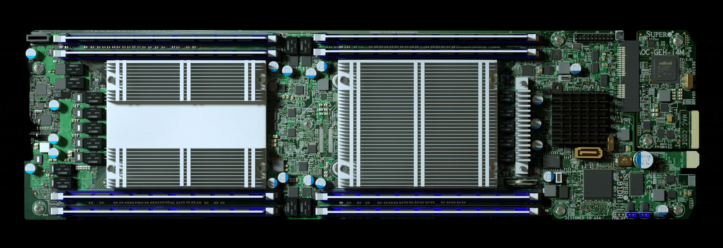
The Need for Hardware Security
Hardware Trojan:
  Bloomberg report: a tiny microchip is nested on the mother boards to steal the critical information
Notes:
HT is one of issues of Hardware Security. HT can modify the function of design or steal key information. Recently, There are more and more reports about hardware Trojan attacks. A recent report from Bloomberg Businessweek shows that a tiny chip, which is not larger than a grain of rice to infiltrate(fill) 30 U.S. companies, including Apple and Amazon. This tiny microchip is nested on the mother boards to steal the critical information once the motherboard is powered up.

Slide 4

The Need for Hardware Security
IP Piracy:
  Theft of American Intellectual Property – IP Commission Report
  “The US Intellectual Property Commission estimated trade secret theft costs 1–3% of GDP, meaning that the cost to the $18 trillion U.S. economy was between $180 billion and $540 billion.”
Notes:
Another threat is IP Piracy. The US Intellectual Property Commission estimated trade secret theft costs 1–3% of GDP, meaning that the cost is around hundreds of billion.
In our research, we are trying to solve all the motioned problems, we proposed some solutions to address those problems but not completely. The remaining part can be used as future works.

Slide 5
Outline
Motivation
Contributions
Proposed Solutions
  IP piracy and IC overproduction
  Hardware Trojan
  Test generation for Emerging Technologies
Conclusion
Future Works
Notes:
Now please let me introduce the outline of my presentation. I will star this presentation with motivation, contributions,. Then I will conduct three different research Solutions on the requirements of security: They are novel structure to prevent IP piracy and IC overproduction, Attack and the defense method for Hardware Trojan, and the test generation method for emerging technologies. In the end, I will conclude the presentation, and talk about the future works

Slide 6
Motivation
Piracy, Counterfeiting and Tampering of microelectronics are some of the emerging and evolving threats
  Amount of total counterfeiting globally reached 1.2 Trillion USD in 2017 and was projected to exceed 1.82 Trillion USD in the year 2020
SoC design and fabrication are becoming increasingly vulnerable to malicious activities and alterations with globalization:
  Untrusted foundry may pirate the design of client, overproduce the product or insert a hardware Trojan during the manufacturing process.
  IP vendor and system integrator may also place a Trojan in the design.
Notes:
Let us talk about the motivation. The first reason is that the income of SoC design companies has decreased. Piracy, Counterfeiting and Tampering of microelectronics are some of the emerging and evolving threats.
Second, SoC design and fabrication are becoming vulnerable to malicious activities with globalization: Untrusted foundry may pirate the design of client, overproduce the chip or insert a hardware Trojan during the manufacturing process. IP vendor and system integrator may also place a Trojan in the design.

Slide 7

Motivation (Continued)
Untrusted System Integrator
Untrusted IP Owner
Ship to the market
IP
GDSII
Untrusted Foundry
Fab
IP
Assembly
Untrusted SoC Designer
DFT
Untrusted Assembly
IP
Notes:
Because of globalization of semiconductor industry, (SoC) designer no longer maintain a fabrication unit of their own, trust becomes one of the major issues. This picture shows the entire process of SoC production. The designer of the SoC may be from the United States, the fabrication Foundry may be located in Taiwan, and the packaging plant may be located in China. Any of these steps may be untrusted

Slide 8
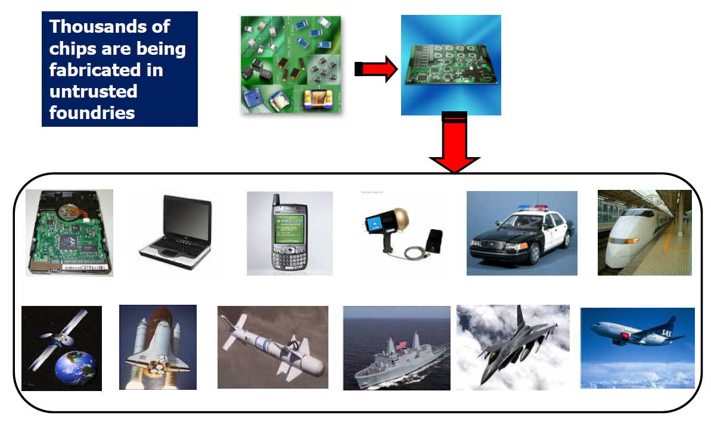
Motivation (Continued)
Notes:
This picture shows how HT may affect our lives.
Adversary can send and receive secret information Adversary can disable the chip, blow up the chip, send wrong processing data, impact circuit information etc. ➢

Slide 9
Contributions
Hardware Security
IP Piracy & IC Overproduction
Hardware Trojan (HT)
Emerging Technologies
Defense
Attack
Defense
Attack
Test generation
Design for security [3][8]
Topology-Guided Attack [2][6]
Modeling and Test Generation for HT [7]
Tampering Attack [1]
Defect Characterization and Testing of Skyrmion Circuit [4]
Tampering Attack [1]
Survey of HT Detection Methods [5]
A. Jain, Z. Zhou and U. Guin, "TAAL: Tampering Attack on Any Key-based Logic Locked Circuits", in ACM Transactions on Design Automation of Electronic Systems (TODAES), 2021
Y. Zhang, A. Jain, P. Cui, Z. Zhou, and U. Guin, "A Novel Topology-Guided Attack and Its Countermeasure Towards Secure Logic Locking", Journal of Cryptographic Engineering, 2020
U. Guin, Z. Zhou, and A. Singh, “Robust Design-for-Security (DFS) Architecture for Enabling Trust in IC Manufacturing and Test”, IEEE Transactions on Very Large Scale Integration Systems (TVLSI), 2018
Z. Zhou, U. Guin, P. Li and V. Agrawal, “Defect Characterization and Testing of Skyrmion-Based Logic Circuits,” in VLSI Test Symposium (VTS), 2021 (Best Paper Nomination).
A. Jain, Z. Zhou, and U. Guin, “Survey of Recent Developments for Hardware Trojan Detection,” in IEEE International Symposium on Circuits & Systems (ISCAS), 2021
Y. Zhang, P. Cui, Z. Zhou, and U. Guin, “TGA: An Oracle-less and Topology-Guided Attack on Logic Locking”, in Attacks and Solutions in Hardware Security (ASHES), 2019
Z. Zhou, U. Guin, and V. D. Agrawal, “Modeling and Test Generation for Combinational Hardware Trojans”, in IEEE VLSI Test Symposium (VTS), 2018
U. Guin, Z. Zhou, and A. D. Singh, “A Novel Design-for-Security (DFS) Architecture to Prevent Unauthorized IC Overproduction”, IEEE VLSI Test Symposium (VTS), 2017
Notes:
This organization chart shows the contributions of our research: We have one defense mechanism and two attack method in IP Piracy & IC Overproduction. We also have corresponding defense and attack methods for hardware Trojan. We also proposed a defect characterization and Testing method on emerging technology.

Slide 10
Outline
Contributions
Motivation
Proposed Solutions
  IP piracy and IC overproduction
  Hardware Trojan
  Test generation for Emerging Technologies
Conclusion
Future Works
Notes:
Now let’s start the with the IP piracy and IC overproduction first

Slide 11
Threat Model
Adversary，e.g., an untrusted foundry, tries to find secret key to unlock the design.
Adversary reverse engineers the design to reconstruct the gate-level netlist.
  Adversary has the layout/mask information from the GDSII or OASIS file.
  Identify the key gates/wires by tracing routes from tamper-proof memory.
  Then, having scan access can lead to the key.
Notes:
The Threat Model indicates that the untrusted foundry is considered as attacker. The untrusted foundry, tries to find secret key to unlock the design +(Read)

Slide 12
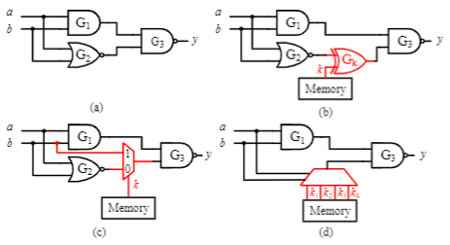
Background - Logic Locking
Logic locking is a popular technique to protect against untrusted manufacturing.
Different logic locking techniques have been proposed over the years:
  XOR-based
  MUX-based
  LUT-based
XOR-based logic locking is popular due to its simplicity.
(a) An original netlist (b) XOR/XNOR-based logic locking (c) MUX-based logic locking (d) LUT-based logic locking.
Notes:
Let’s introduce some background of the research before we deep into the proposed method: firstly - Logic locking. Logic locking is developed to hide the functionality of an IP by inserting additional logic gates into the netlist.
A locked circuit means original functionality can only be reversed, when a correct key is programmed into the chip. Logic locking becomes a popular technique to address untrusted manufacturing. We can see there are three different logic locking techniques have been proposed over the years: XOR-based , MUX-based, and LUT-based.
Key stored at Non-volatile memory. And the key is unknow to the foundry.
XOR-based logic locking is popular due to its simplicity.

Slide 13
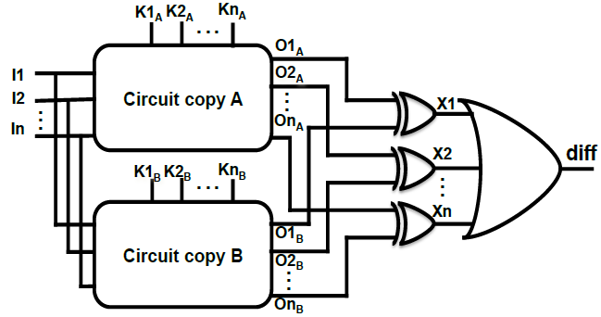
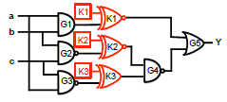
Boolean Satisfiability (SAT)-Based Attack to Find Logic Locking Keys
SAT attack is an oracle-guided attack.
SAT attack requires two steps.
  Compute distinguishing input patterns (DIPs) using simulation.
  Apply DIPs to oracle device and locked netlist to determine the value of the key.
The correct key is value is 110.
Circuit to determine DIPs [1]
Use DIPs to eliminate the Incorrect key
1. Yasin, Muhammad, et al. "SARLock: SAT attack resistant logic locking." 2016 IEEE International Symposium on Hardware Oriented Security and Trust (HOST). IEEE, 2016.
Notes:
People proposed Logic Locking to protect their design. But Logic Locking does not completely ensure the safety of the circuit. The Boolean Satisfiability (SAT) - based attacks can break the Logic Locking in a short period of time. The SAT is an oracle-guided attack. An oracle means an unlocked functional chip. The Boolean SAT solvers can iteratively update and solve the conjunctive normal form (CNF) formula of the target circuit. In each iteration, a distinguishing input pattern (DIP) is found, and the corresponding correct output is derived by querying the functional chip. Then the correct output is utilized to exclude wrong keys.
In the left figure, show how to Compute DIP. The SAT solver finds a DIP Xd for which diff=1,
the right figure shows how to eliminate the Incorrect key . Use DIPs 011 can eliminate wrong key100. I00 can eliminate the all the wrong key.

Slide 14
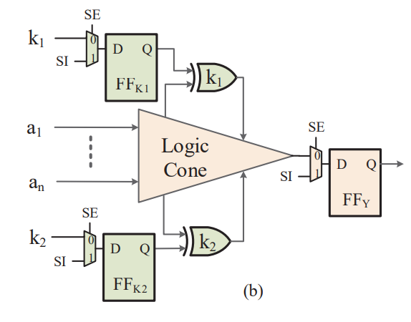
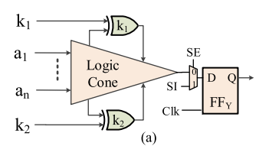
Prior Work - SAT Resiliency
Prior obfuscation approaches and their vulnerabilities. (a) Techniques proposed in [1], [2]. (b) Technique proposed in [3].
Roy, Jarrod A., Farinaz Koushanfar, and L. Igor. "Markov. EPIC: Ending piracy of integrated circuits." Proceedings of the conference on Design, automation and test in Europe. 2008.
Rajendran, Jeyavijayan, et al. "Security analysis of logic obfuscation." Proceedings of the 49th Annual Design Automation Conference. 2012.
Guin, Ujjwal, et al. "FORTIS: a comprehensive solution for establishing forward trust for protecting IPs and ICs." ACM Transactions on Design Automation of Electronic Systems (TODAES) 21.4 (2016): 1-20.
Notes:
Those are prior logic locking approaches and their vulnerabilities. Fig. (a) is obfuscated by two XOR key bits, k1 and k2. A logic cone is a combinational logic unit that represents a Boolean function, and generally bordered by FFs and input/output ports. Assume that this cone produces different outputs for k1 = 0 and k1 = 1 for some input pattern [a1 a2 ... an]. Then, by observing the correct response from an activated working chip, the correct key (k1 = 0 or 1) can be determined.
Fig. (b) is an advanced version of (a) , it blocks the scan chain to get the key value. It placing multiple FFs capturing signals controlled by different key bits at the same level of the parallel scan chains .
This structure can prevent ordinary SAT attack. However, a vulnerability remains with this design, the key may be exposed to the adversary through multicycle tests with SAT attack.
Now read:
So even if the designer attempts to obscure the capture of key FFk1 and FFk2 at the end of the first cycle, an attacker can capture two or more clock cycles (FFY ) to perform a SAT-based analysis.
Fig. (b) is an advanced version of (a) , it blocks the scan chain to get the key value. It placing multiple FFs capturing signals controlled by different key bits at the same level of the parallel scan chains used in current test compression methodologies, thereby exploiting the output compression architecture to address SAT-based attacks.
Let's say, K1 and K2 are captured at FFk1 and FFk2 in first function clock cycle, in the next clock cycle the key information is captured at FFY which can be located in a different scan chain. (point) Thus, an adversary can perform a multicycle attack using a SAT-based approach.

Slide 15
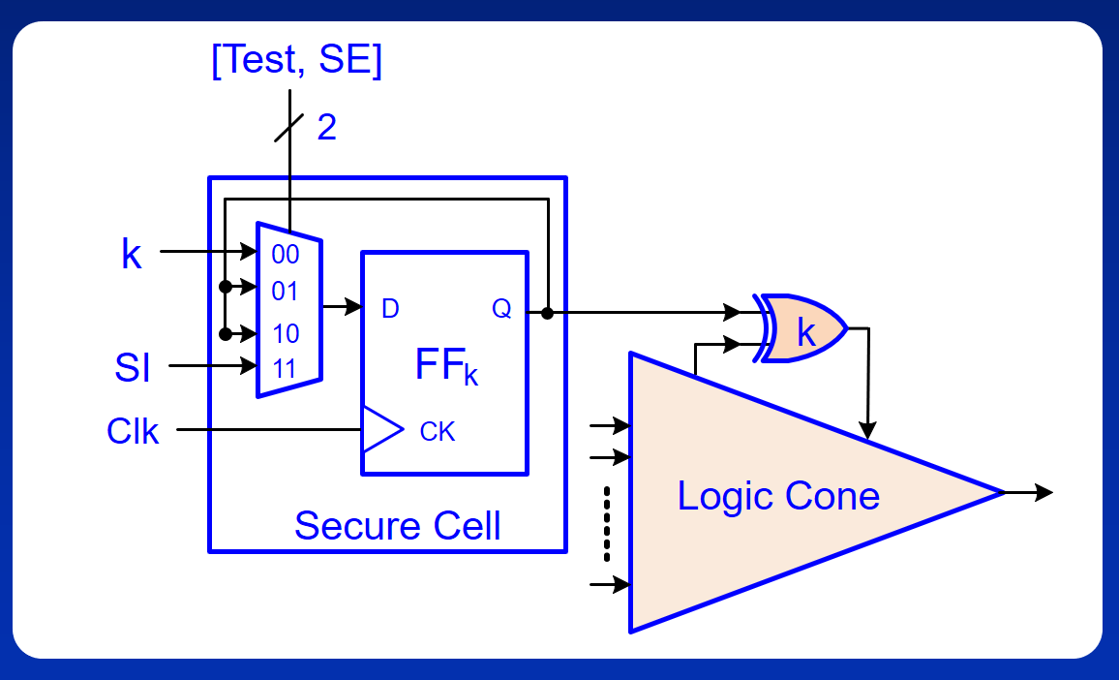
Proposed Design-for-Security (DFS) Architecture
Notes:
Because the existing methods cannot completely prevent SAT attacks. We have proposed a new structure. This figure shows our proposed secure cell (SC) architecture used for design-for-security. We modify the scan cell in such a way, that it can hold its previous state. The output of FFk is fed back to the its input through a multiplexer (MUX). As the MUX has four inputs, we need one additional Test pin for the MUX control. Depending on the value of Test and SE pins, a particular input is selected. The key bit , and scan in are connected to the first and forth input of the MUX respectively. The output of FFk is connected to the second and third inputs, which provides the capability to hold its previous state. We replace the key FF in the previous circuit with the new secure cell structure.
//NO actual observation of the response of a logic cone: no sat

Slide 16

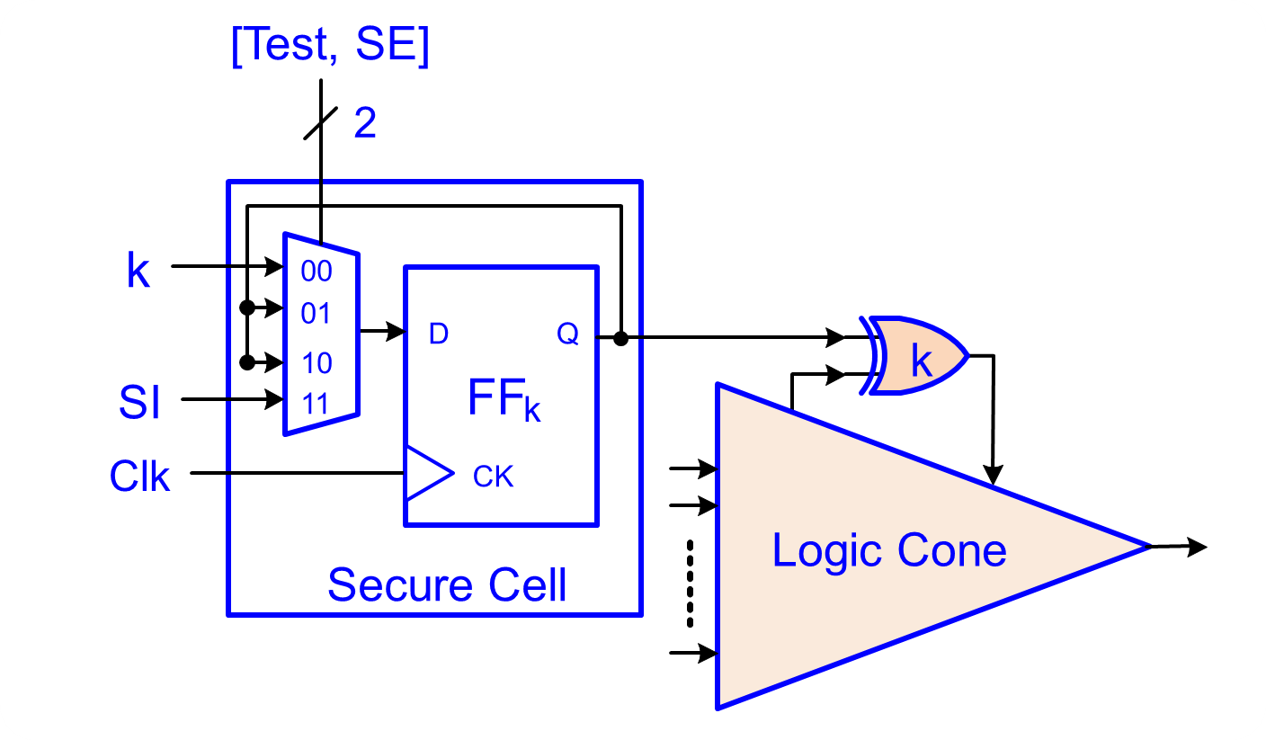
Modes of Operation
Notes:
The secure cell operates in three different modes based on Test and SE, which is shown in Table . In mode M0, FFk captures the key, which represents the normal functionality of the unlocked chip. The chip will be operated in this mode while it is in the field. In mode M1, the secure cell continues to hold its previous state. This mode provides test and debug capability without letting the key to be exposed, as FFk continues to hold its previous state. Thus, no key information is captured in M1. Finally, secure cell becomes the scan cell at mode M2 and FFk becomes a part of a scan chain.
//Note that the rest of the circuit becomes functional mode when SE = 0 and scan mode when SE = 1.

Slide 17
Enabling Manufacturing Tests
Manufacturing Tests
  No key required
Post-Si Debug and Validation
  Key is shifted through the scan chain
  Performed at the trusted site
In-system Tests
  Disable scan
  dump
Shift
-
In
Capture
Shift
-
Out
SE
Test
Clk
Timing diagram for manufacturing tests
Notes:
During Manufacturing Tests, the SCs switch between mode M2 and M1. As the key gate (k) is directly reachable from the SI, we do not need to provide the key information during test pattern generation. The Post-Si Debug and Validation is performed at the trusted site and the Key is shifted through the scan chain. In the In-system Tests, the scan dump needs to be disabled.

Slide 18
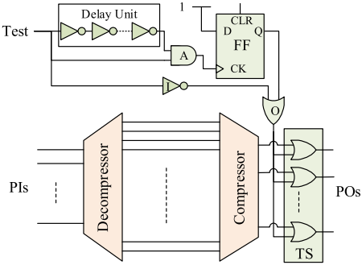
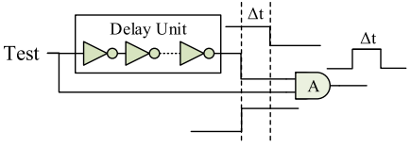
Scan Data Access Restriction
No positive transition at the Test pin
Pulse generator module for detecting a positive transition at Test pin.
Proposed architecture to restrict scan data access.
Notes:
To disable scan dump , We must ensure that switching from M0 to M2 is not allowed.
This figure shows our proposed architecture to restrict scan data access. We have added a series of OR gates at the output of the compressor, which is highlighted in green. The output of the test suppressor (TS) becomes always 1 when the output of the OR gate is 1. The output of the OR gate becomes 1 when one or both inputs become 1. This ensures that an adversary cannot access scan data while Test = 0, which is one of the requirements for protecting the key.
Now, we need to make sure that there is no positive transition on the Test pin. We can see the figure on the right side. When test pin switch from 0 to1. The AND gate will generate a pulse signal. This pulse signal will make the output of FF a logic high, which keeps OR gate stay 1.

Slide 19
Test Metric Comparison
Benchmark | Test Coverage |  |  |  | Area Overhead
 | ORG | KEY | DFS | Change(100%)
s35932 | 100% | 100% | 100% | 0.00% | 6.14%
s38584 | 100% | 100% | 100% | 0.00% | 7.84%
s38417 | 100% | 100% | 100% | 0.00% | 6.75%
b17 | 99.92% | 99.91% | 99.80% | -0.11% | 4.23%
b18 | 99.54% | 99.60% | 99.58% | -0.02% | 1.51%
b19 | 99.65% | 99.65% | 99.64% | -0.01% | 0.80%
Benchmark | Pattern Count
 | ORG | KEY | DFS | Change(100%)
S35932 | 56 | 55 | 65 | 18.18%
S38584 | 536 | 549 | 565 | 2.91%
s38417 | 1133 | 1124 | 1115 | -0.80%
b17 | 2542 | 2516 | 2559 | 1.71%
b18 | 5086 | 5112 | 5116 | 0.08%
b19 | 9395 | 9387 | 9398 | 0.12%
Notes:
This table shows the test metrics comparison between our proposed DFS method and other method. We compare the test coverage and pattern counts among the original netlist with no locks (denoted as ORG), only XOR gate-inserted netlist (KEY) and our proposed DFS-inserted netlist (DFS).
We do not expect any significant change in the test coverage, pattern count and area overhead for large circuit. For example, circuit B19

Slide 20
Contributions: DFS Architecture
Secure cell disables scan dump after functional mode which provides a complete protection against all different attacks.
Secure cell enables manufacturing tests before the activation of chips, which is absolutely necessary to prevent unauthorized overproduction of chips.
The DFS architecture provides complete support for post-Si validation and debug.
Notes:
read
attacks that require an oracle to compare the simulation responses.
The Post-Si Debug and Validation is performed at the trusted site and the Key is shifted through the scan chain.
Compliance(satisfy) to its specifications.

Slide 21
Outline
Contributions
Motivation
Proposed Solutions
  IP piracy and IC overproduction
  Hardware Trojan
  Test generation for Emerging Technologies
Conclusion
Future Works
Notes:
In the previous section, I introduced the method of DFS Architecture which can prevent SAT –based attack, in this section, I am going to introduce the How the hardware Trojan infect the security of SoCs.

Slide 22
Non-Traditional Attacks on Logic Locking
Majority of the research of logic locking is linked with resiliency against the SAT based attacks.
Does SAT resiliency achieve the complete security for logic locking? No!
An untrusted foundry can tamper the netlist with hardware Trojan to leak the secret key.
The adversary can design a hardware Trojan to evade all the manufacturing test as they are performed at the foundry.
Notes:
Read +

Slide 23
Tampering Attacks on Logic Locking
What is Hardware Trojan:
  Malicious altercation.
  Modifies device functionality.
The properties of a hardware Trojan:
  Property 1: Modifies the logical function of a chip.
  Property 2: Must not be activated by manufacturing tests.
  Property 3: Distinctly differs from a design error.
Notes:
In order to apply Tampering Attacks, we have to introduce the concept of Hardware Trojans. Hardware Trojans is a malicious altercation of the original circuit. It modifies device functionality. It has 3 properties: Modifies the logical function of a chip & Must not be activated by manufacturing tests and Distinctly differs from a design error. A design error is not planned, but HT is intentional.

Slide 24
Hardware Trojans
A hardware Trojan has two parts:
  Trigger
  Payload
Trigger
A model for a combinational hardware Trojan
Notes:
This is a example of a combinational hardware Trojan: It contains two parts: Trigger and payload. The trigger activates the hardware Trojan when a certain condition is satisfied. The payload change the functionality of the circuit. We can see that the circuitry inside solid line is the original netlist, and the circuitry in dotted line is the HT. The trigger can directly come from primary inputs (PI) or from internal nets. When the Trojan is activated, the output will change from s to s’.

Slide 25
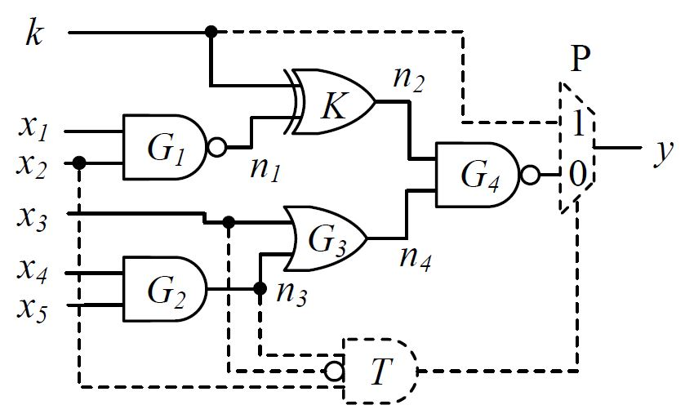
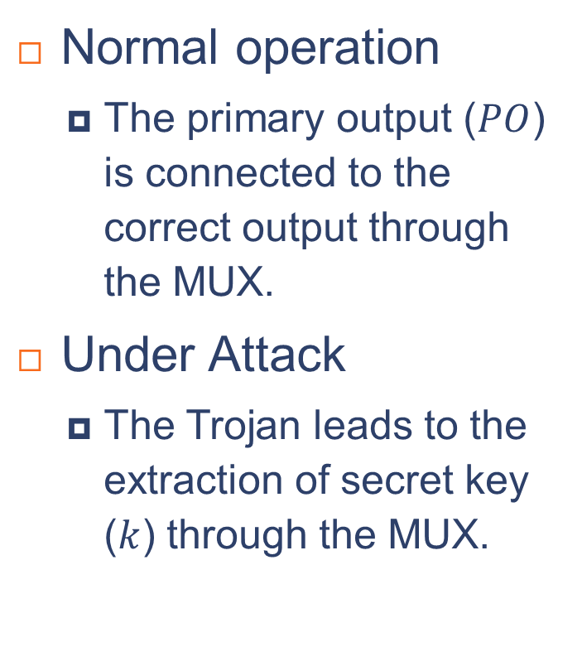
Attack Approach 1
Normal operation
  The primary output ($PO$) is connected to the correct output through the MUX.
Under Attack
  The Trojan leads to the extraction of secret key ($k$) through the MUX.
1
1
0
0
1
1
1
0
1
0
1
1
Tampering attack with a Type-3 Trojan
Input pattern [11011] leaks the secret key k to the output.
Notes:
So we know what is HT, But how a hardware Trojan can leak the Key value to attacker? This is one of the Approaches for HT tampering attack.
In the Normal operation, the primary output ($PO$) is connected to the correct output through the MUX.
In order to activate the attack , the nodes need to be set as n3 =1, X3=0 and x2=1. The mux will switch from input 0 to 1. Input pattern [11011] leaks the secret key k to the output.

Slide 26
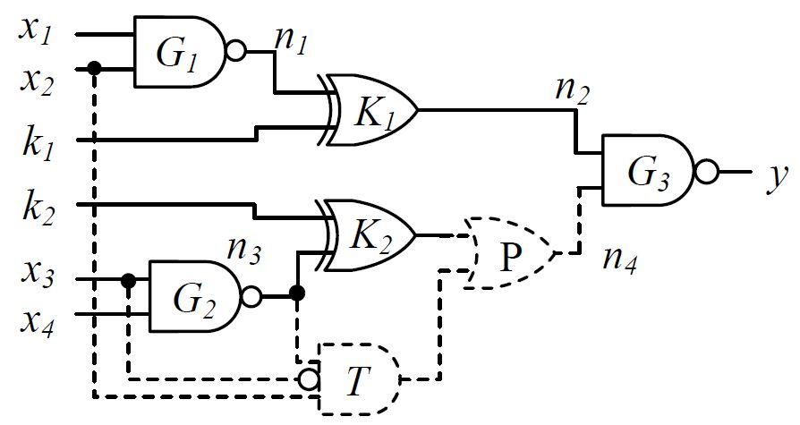
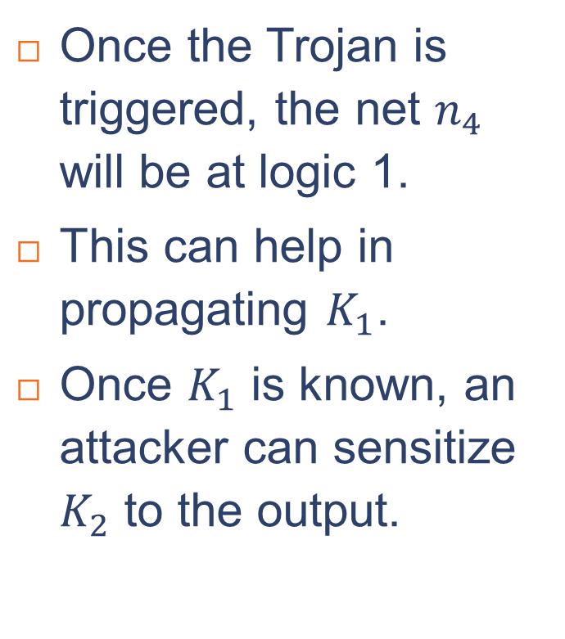


Attack Approach 2
Once the Trojan is triggered, the net $n_{4}$ will be at logic 1.
This can help in propagating $K_{1}$.
Once $K_{1}$ is known, an attacker can sensitize $K_{2}$ to the output.
1
1
0
$$k_{1}$$
$$\overline{k_{1}}$$
1
0
X
1
Tampering attack with a Type-3 combinational Trojan with payload as OR gate .
Input pattern [110X] leaks k₁ to the output.
Notes:
This is the second approach. Instead of sending the key directly to the PO in approach 1, an adversary can propagate it through internal logic. (READ)

Slide 27
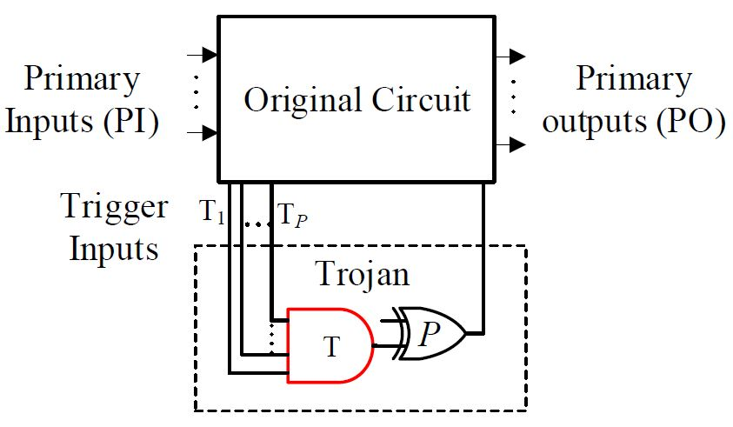
Design of Hardware Trojans
A Type-p Trojan consists of p trigger inputs
Rare nodes should be selected as Trigger inputs.
It should not be triggered during manufacturing test (stuck-at fault) patterns.
Notes:
So, we know how to use HT to implement Tampering attack, Next step is designing a HT for Tampering attack. First, we defied a Trojan named Type-p Trojan. A Type-p Trojan consists of p trigger inputs. When all p inputs meet the conditions, HT is activated.
In order to make HT not easy to be found, trigger inputs should choose rare nodes. And make sure that HT will not be activated during manufacturing test

Slide 28
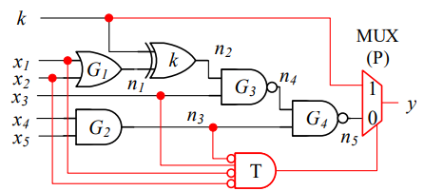
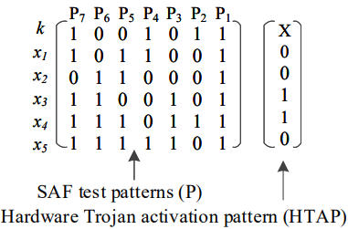
A Hardware Trojan to Steal the Key
Design for a combinational hardware Trojan that evades manufacturing tests.
Notes:
This figure show the design for a combinational hardware Trojan that evades manufacturing tests. It is a type-4 Trojan with a MUX as payload. Pattern P1 to P7 are the manufacturing Stuck-at fault (SAF) test patterns. The hardware Trojan activation pattern (HTAP) is [0 0 1 1 0] while the key value will propagate through output Y.

Slide 29
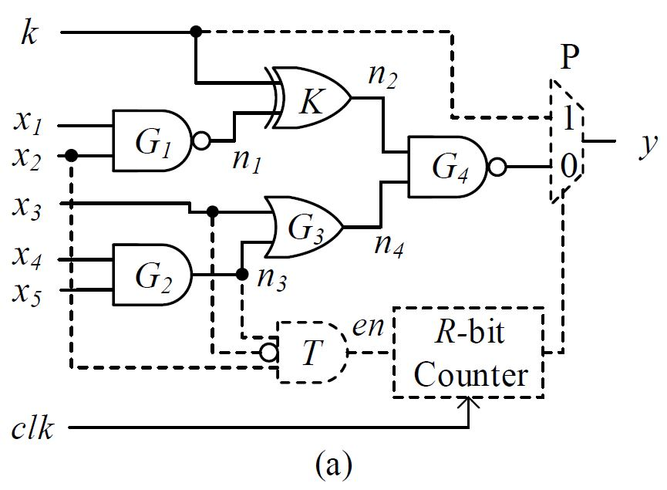
A Sequential Trojan to Steal the Key
Provides difficulty of detection.
An additional state element in the trigger
Tampering attack with a Type-3 sequential Trojan with R-bit counter.
Notes:
This figure show the structure of Sequential Trojan. Instead of the output of Trigger directly goes to payload, it has a add state element in trigger part.
Compared with Combinational Trojan, Sequential Trojan is less likely to be activated because of the counter, so it is less likely to be detected.

Slide 30
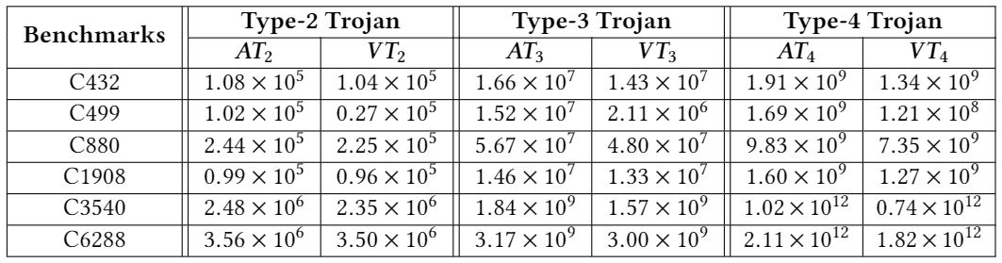
Result and Analysis
This table shows a large number of valid Trojan choices available to the adversary.
Number of valid Trojans increases exponentially for the increase in the trigger inputs and circuit size.
Number of Hardware Trojans for launching tampering attacks
Notes:
In previous slides, we showed that how to use HT tampering attack to obtain key value. In this part, we will show that an adversary can implement the Trojan in a very large number of ways, and it is practically infeasible to detect all of them with absolute certainty. This table shows the large number of valid Trojan choices available to the adversary. AT is the upper bound of all possible Type-p Trojans and VT is the number of valid Trojan. We can see with the order and circuit size increases; the number of valid Trojan increases exponentially. In a large circuit the number of valid Trojan can up to 10 to the power of 12.

Slide 31
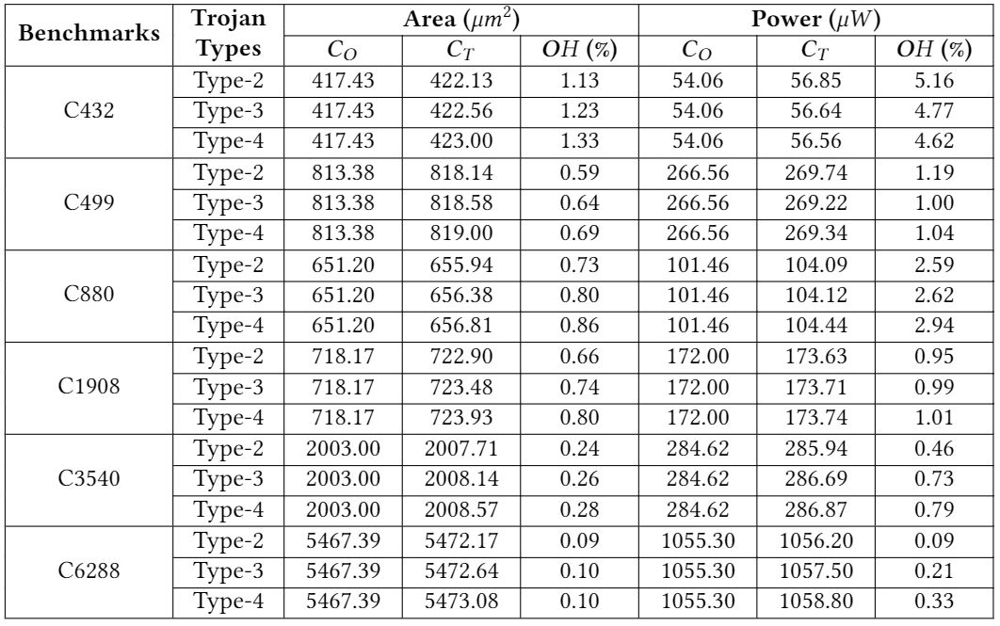
Area and Power Overhead of the Trojan Inserted Circuit
Notes:
This table show the area and power over head after the Trojan tampering attack applied.
We can see that for a large circuit, the area overhead is only 0.1% and the power over head is less than 0.4%.

Slide 32
Contributions: Tampering Attacks on Logic Locking
Logic locking is vulnerable against tampering attacks, which can leak the secret key through the activation of a hardware Trojan.
The number of valid Trojans that remains undetected during manufacturing tests is very large, which makes it difficult to detect the attack.
In order to counter this new tampering attack, we need to propose a method that can effectively detect a hardware Trojan.
Notes:
Based on the above analysis, Read

Slide 33
Hardware Trojan Detection: Modeling and Test Generation
A generalized model of hardware Trojan:
Definition 1: A Type-n Trojan is a combinational hardware Trojan of order n and has n trigger inputs.
Definition 2: The location of a Trojan is a site (signal or line) in the circuit where the payload is delivered.
Number (𝐾) of fault sites in a circuit is defined as:
$$K=\#PI+\#Gates+\#Fanout branches$$
Notes:
In order to prevent the hardware Trojan Tampering attack, an effective method to detect HT is in demand. So, we proposed a Modeling and Test Generation for Combinational HT. Here let us talk about some definitions first. Read +K(We named fault site in circuit as K those nodes can be either trigger or payload of a Trojan
)
//Type one means it has only have one trigger.

Slide 34
Modeling of a Combinational Hardware Trojan
To detect hardware Trojan we need to model it first.
Example: Type-4 Trojan (n7|x1, x2, x3, x5)
Conditional SAF patterns (CSP) (n7 sa0 | x1, x2, x3, x5) and (n7 sa1 | x1, x2, x3, x5)
Notes:
To detect hardware Trojan, we need to model it first.
In this example: we have a Type-4 Trojan which means it has 4 trigger inputs and 1 payload XOR gate. The Trojan will keep stealth/quite unless the trigger inputs is activated. The payload is located at fault site to ensure that the faulty result will affect PO. Pattern P1 to P9 are the manufacturing Stuck-at fault (SAF) test patterns. The Trojan activation pattern (TAP) is = [1010x0x] Once the Trojan is activated the output will switch from correct value 0 to faulty result 1.
After we model the Trojan, we need to generate test pattern to detect our modeled Trojan.
When we model a Trojan, the payload is always delivered to the fault site. Because if it did not deliver to the fault side, the response will not go to the output.
In order to detect the Trojan, we do the reverse process: We detect a stuck at fault of particular line, while use constrain get from other lines.(Which is the trigger ) This Type-4 Trojan is detected by conditional SAF (n7 sa0 or sa1 with x1, x2, x3, x5 equal 1010. After have this pattern, we iterate all the rest passible location of the 4 triggers with all the value. Then we can detect all the Type-4 Trojan which has a payload at node n7. Then we iterate the test generation process on rest of fault site., then we can detect all the Type-4 Trojan in the net list.

Slide 35
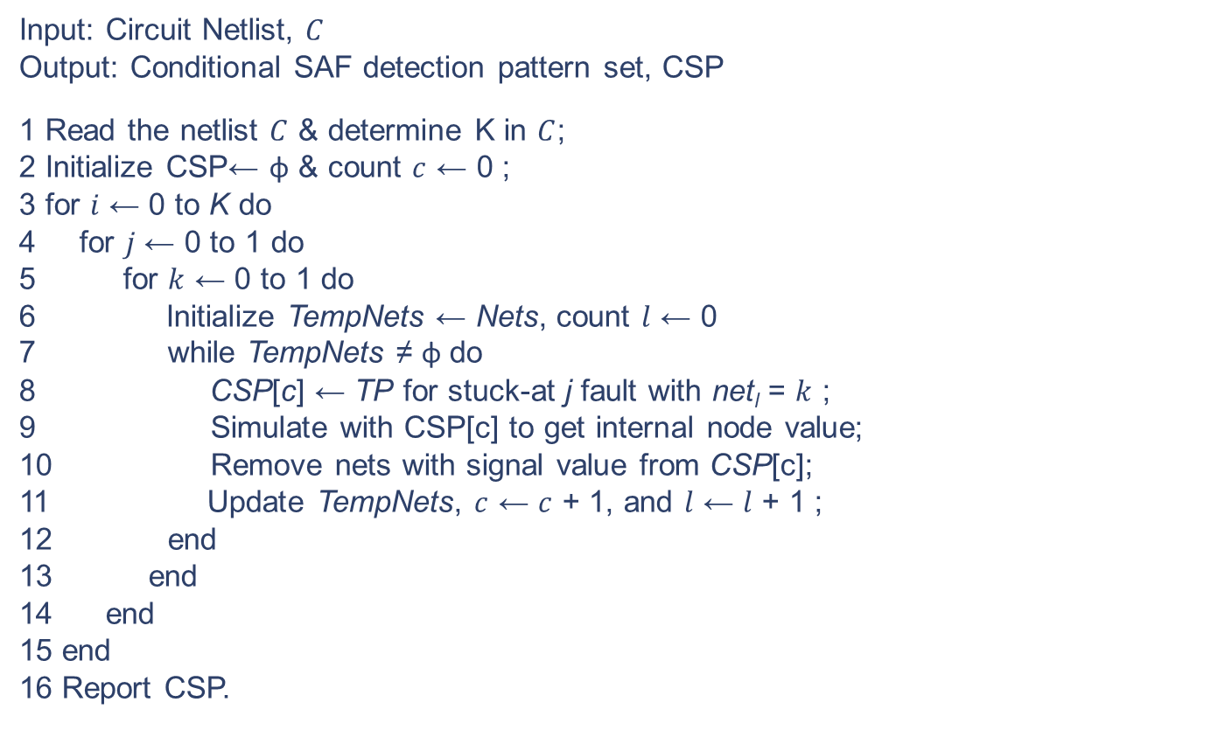
Test Generation for Detecting Combinational Trojans
Test Generation for Type-n Trojans
Input: Circuit Netlist, $C$
Output: Conditional SAF detection pattern set, CSP
1 Read the netlist $C$ & determine K in $C$;
2 Initialize CSP← φ & count $c$ ← 0 ;
3 for $i$ ← 0 to K do
4 for $j$ ← 0 to 1 do
5 for $k$ ← 0 to 1 do
6 Initialize TempNets ← Nets, count $l$ ← 0
7 while TempNets ≠ φ do
8 CSP[c] ← TP for stuck-at j fault with net_{l} = $k$ ;
9 Simulate with CSP[c] to get internal node value;
10 Remove nets with signal value from CSP[c];
11 Update TempNets, $c$ ← $c$ + 1, and $l$ ← $l$ + 1 ;
12 end
13 end
14 end
15 end
16 Report CSP.
Notes:
This algorithm shows Test Generation for Type-n Trojans.
I will not go into details here
If you are interested, we can go to my paper or we can discuss it after the presentation.

Slide 36
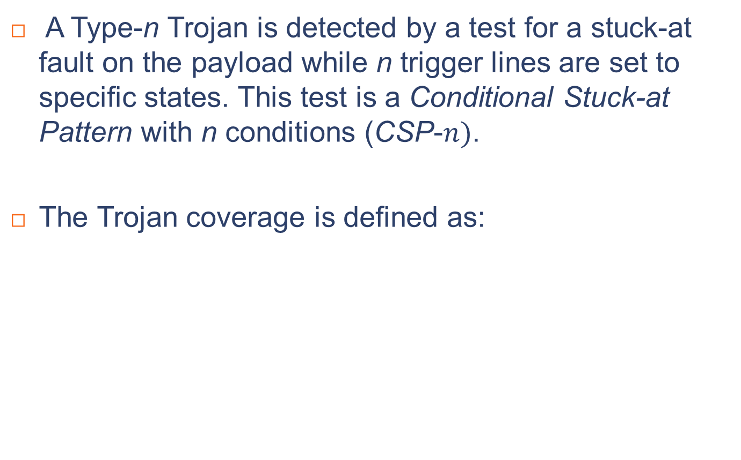
Test Generation for Detecting Combinational Trojans – Cont.
A Type-n Trojan is detected by a test for a stuck-at fault on the payload while n trigger lines are set to specific states. This test is a Conditional Stuck-at Pattern with n conditions (CSP-$n)$.
The Trojan coverage is defined as:
Trojan Coverage = $\frac{\# of detected vaild Trojans}{\# of all valid Trojans}×100\%$
Notes:
A Type-n Trojan is detected by a test for a stuck-at fault on the payload while n trigger lines are set to specific states. This test is a Conditional Stuck-at Pattern with n conditions (CSP-$n)$.
The Trojan Coverage can be defined as :

Slide 37
Test Generation Solution
Sampling the CSP:
  When the number of CSP’s is enormous, applying all patterns becomes impractical.
  For a large circuit, sample CSP’s from the exhaustive set.
Sampling the Trojans:
  The number of valid Trojans is large.
  Verifying all Trojans is infeasible.
Notes:
In the next part, we will show the Experimental Results. But before going to the Results, let us talk about some techniques we used in the experimentation.
Experimental Results is based on Sampling the valid Trojans and Sampling from the CSP set
When the number of CSP’s is enormous, applying all patterns becomes impractical. We can sample CSP’s from the exhaustive set for a large circuit.
Also the number of valid Trojans is large and verifying all Trojans is infeasible. We also need to sampling it as well.

Slide 38
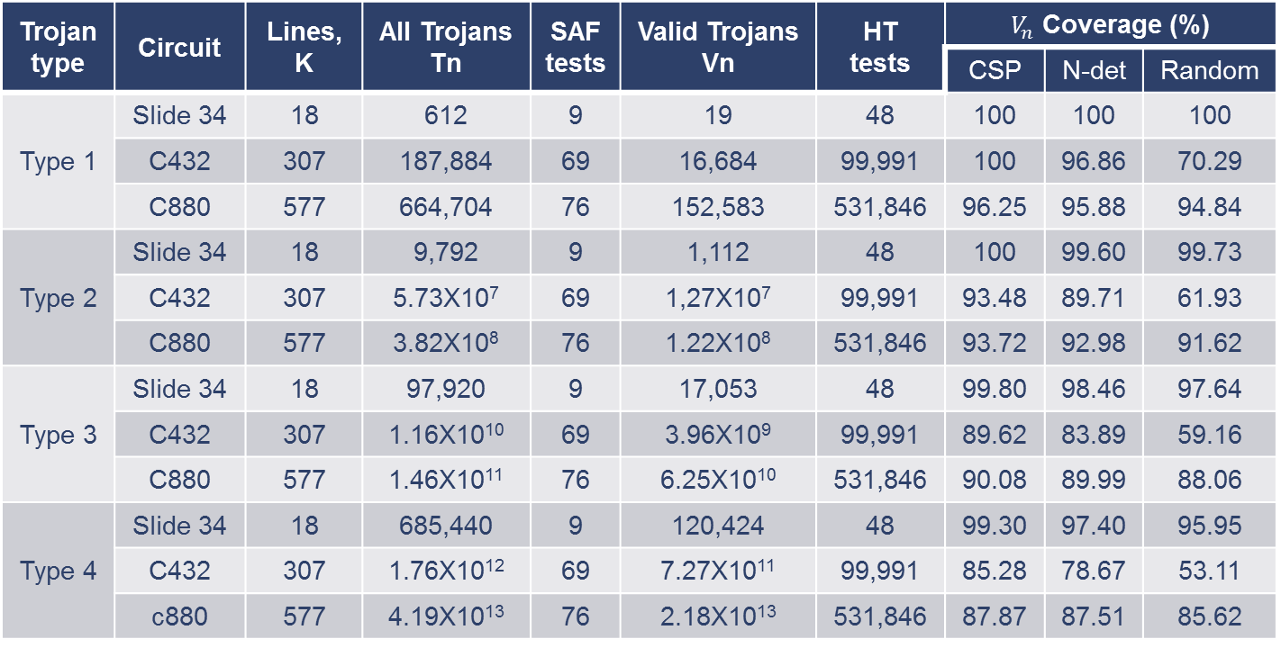
Experimental Results
Hardware Trojan Test Coverage (%) of Valid Trojan ($V_{n}$).
Trojan type | Circuit | Lines, K | All Trojans Tn | SAF tests | Valid Trojans Vn | HT tests | $V_{n}$ Coverage (%)
 |  |  |  |  |  |  | CSP | N-det | Random
Type 1 | Slide 34 | 18 | 612 | 9 | 19 | 48 | 100 | 100 | 100
 | C432 | 307 | 187,884 | 69 | 16,684 | 99,991 | 100 | 96.86 | 70.29
 | C880 | 577 | 664,704 | 76 | 152,583 | 531,846 | 96.25 | 95.88 | 94.84
Type 2 | Slide 34 | 18 | 9,792 | 9 | 1,112 | 48 | 100 | 99.60 | 99.73
 | C432 | 307 | 5.73X10⁷ | 69 | 1,27X10⁷ | 99,991 | 93.48 | 89.71 | 61.93
 | C880 | 577 | 3.82X10⁸ | 76 | 1.22X10⁸ | 531,846 | 93.72 | 92.98 | 91.62
Type 3 | Slide 34 | 18 | 97,920 | 9 | 17,053 | 48 | 99.80 | 98.46 | 97.64
 | C432 | 307 | 1.16X10¹⁰ | 69 | 3.96X10⁹ | 99,991 | 89.62 | 83.89 | 59.16
 | C880 | 577 | 1.46X10¹¹ | 76 | 6.25X10¹⁰ | 531,846 | 90.08 | 89.99 | 88.06
Type 4 | Slide 34 | 18 | 685,440 | 9 | 120,424 | 48 | 99.30 | 97.40 | 95.95
 | C432 | 307 | 1.76X10¹² | 69 | 7.27X10¹¹ | 99,991 | 85.28 | 78.67 | 53.11
 | c880 | 577 | 4.19X10¹³ | 76 | 2.18X10¹³ | 531,846 | 87.87 | 87.51 | 85.62
Notes:
This table shows how our CSP method compares with other methods:
解释：The N-det means N detect，Random means apply random patterns for the test.
Last three Column shows Trojan coverage by CSP, N-detect patterns, and random patterns, respectively, Please note that, the CSP test coverages are always higher.
First Column indicate the type of Trojan. Column 2 shows the circuit name. Column 3 is the number of lines, Column 4 shows upper bound on the number of Type-n Trojans. Column 5 shows the # SAF tests pattern. Column 6 is # of valid Trojan. Column 7 is the number of HT test pattern. (We can see for a small circuit C880 the HT test pattern is enormous, We randomly sampled 5,000 patterns from 531,846 HT tests to estimate the coverage of Trojans of Types 1)
Last three Column shows Trojan coverage by CSP, N-detect patterns, and random patterns, respectively, Notably, the CSP coverages are consistently higher.
//N-detect: targeting faults more than one time to increase the probability of catching non-modeled defects.

Slide 39
Contributions: Modeling and Test Generation
The Type-n Trojan is a generalized model that facilitates test generation and coverage analysis.
Based on our observation, CSP coverage is higher than random and N-detect patterns.
Both Trojan sampling and vector sampling are beneficial for coverage estimation.
Notes:
Read
//Based on the above analysis, we can say that: The Type-n Trojan is a generalized model that facilitates/help test generation and coverage analysis.

Slide 40
Outline
Contributions
Motivation
Proposed Solutions
  IP piracy and IC overproduction
  Hardware Trojan
  Test generation for Emerging Technologies
Conclusion
Future Works
Notes:
So far we have finished our discussion on Microelectronics Security, and then we will discuss Emerging Technology.

Slide 41
What is Skyrmion?
Skyrmion is a stable magnetic field that acts like a particle, we refer to as pseudoparticle.
Skyrmion is created by transverse current injection in a ferromagnetic thin film through magnetic tunnel junction (MTJ).
The state of a logic signal is represented by the presence (logic-1) or absence (logic-0) of a single skyrmion.
Notes:
What is Skyrmion.? Skyrmion is a stable magnetic field that acts as a pseudo particle. Skyrmion is created by transverse current injection in a ferromagnetic thin film through the magnetic tunnel junction (MTJ). The presence of a skyrmion indicates a logic high in the skyrmion -based circuit and an absence of skyrmion means logic low in the circuit.

Slide 42
Why Skyrmion Circuit ?
With rapid scaling, CMOS devices are approaching the quantum-mechanical limits.
Leads to ultrafast and ultra low power digital gates.
Magnetic skyrmion is promising for building next-generation spintronic logic devices and magnetic memories due to their stability, small size, and extremely low operational currents.
Notes:
Then why do we use Why Skyrmion Circuit? With rapid scaling, CMOS devices are approaching the limit. Fortunately, spintronic devices offer a feasible choice for post-Moore devices,.
Magnetic skyrmion is an emerging digital technology with ultra-high integration density and ultra-low energy. Magnetic skyrmion is promising for building next-generation magnetic memories and spintronic devices due to their stability, small size and the extremely low currents needed.
//current density 𝐽 = 5 × 10^10 A⁄m2

Slide 43
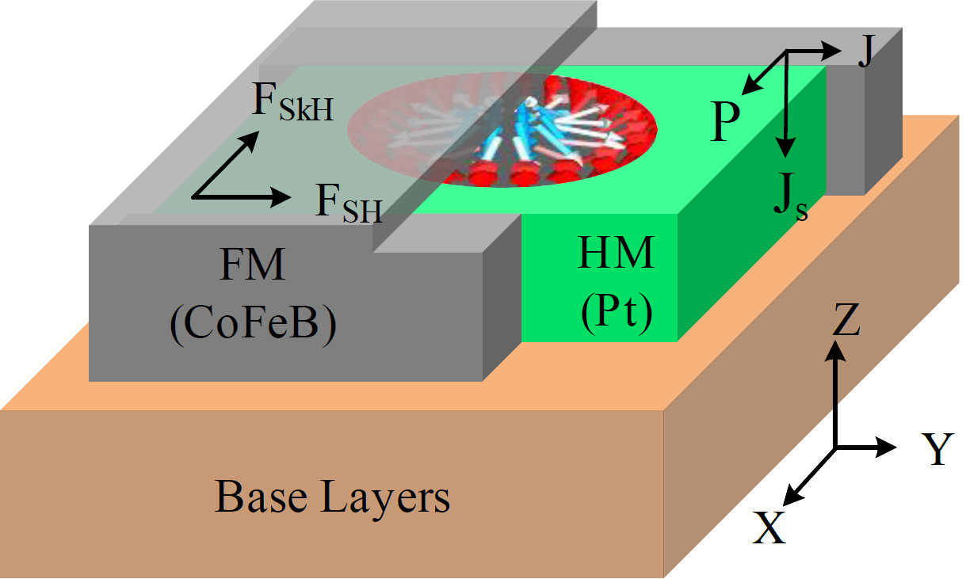
Skyrmion Motion in Nanotrack
Skyrmion nanotrack structure consists of three parts: a ferromagnetic (FM) layer, a heavy metal (HM) layer and the base.
The skyrmion lies in the ferromagnetic layer at the interface with the heavy metal.
Skyrmion is driven by a continuous electric current in +y direction, which is also the direction of the skyrmion motion.
Nanotrack structure for skyrmion movement
Notes:
Skyrmion nanotrack structure consists of three parts. This fig shows the 3D cross sectional view of a nanotrack consisting of a FM layer (gray) , a HM layer (green). and base layers(Brown). The skyrmion lies in the ferromagnetic layer at the interface with the heavy metal. Skyrmion is driven by a continuous electric current on +y detection, which is also the direction of the skyrmion motion.
//Fe0.5Co0.5Si
F sh stands for the driving force generated by the spin-orbit torque and . F SkH represents the forece driven by skyrmion Hall effect. The side wall wrapping structure eliminates transverse motion of the skyrmion caused by the skyrmion Hall effect, allowing only linear motion.

Slide 44
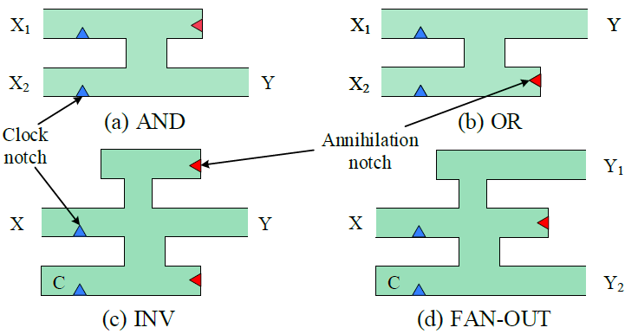

Skyrmion Logic Gates
A traditional skyrmion gate combines phenomena such as spin Hall effect, skyrmion Hall effect, skyrmion-skyrmion repulsion and skyrmion curb repulsion.
The green part is the nanotrack of skyrmion, small blue triangle is clock notch and red triangle is annihilation notch.
Structure of skyrmion gates. (a) AND gate (b) OR gate (c) Inverter, and (d) Fanout.
Note: The skyrmion behaves as a single pseudoparticle, so a logic circuit additionally needs a special fanout element to generate multiple skyrmions for fanout branches.
Notes:
We have adopted Skyrmion Logic Gates originally developed at the University of Texas at Dallas by Dr. Friedman //by modifying them as non-reversible logic gates.
The green part is the nanotrack of skyrmion, The blue triangle on the inputs side is the clock notch to synchronize the computing system. A red triangle is added at the end of a nanotrack so that any additional skyrmions are destroyed to preserve the proper logic operation which is primarily dependent on skyrmion-skyrmion interactions.
Please note that the skyrmion behaves as a pseudo particle, so the skyrmion circuit needs an additional fanout element to generate multiple skyrmions for fanout branches.

Slide 45
Problem Statement
Map Skyrmion gate defects onto logic gate faults supported in test CAD tools.
Some previous defect and fault mapping efforts:
  Verification testing, McCluskey, IEEETC 1984.
  Inductive fault analysis, Maly et al., D&T 1985.
  Gate-exhaustive testing, Cho et al., ITC 2005.
Our objective: Classify Skyrmion defects in three classes:
  Defects equivalent to faults supported in existing test CAD.
  Defects that cannot be supported in existing test CAD.
  Defects that do not cause logic malfunction – “no faults”.
  Faults supported in existing test CAD: stuck-at, transition, path delay, bridging, IDDQ . . .
Notes:
We want to Map Skyrmion gate defects onto logic gate faults supported in test CAD. In that case, We can use CAD tools to generate test patterns for SKYEMION circuit.
Here are Some previous defect and fault mapping efforts:
+ The above test methods are all good methods, but they are not suitable for skyrmion. Like The Inductive fault analysis is for the entire circuit here, but here we are only focus on singe gate
+Our objective: Classify Skyrmion defects in three classes:

Slide 46
Fault Equivalence Method
Analyze single gates, Skyrmion gate and equivalent logic gate.
Establish defect to fault equivalence using functional fault equivalence: Two faults of a circuit are equivalent when the corresponding faulty circuits produce identical outputs for all inputs.
Exhaustively simulate each Skyrmion gate using technology simulator.
Exhaustively simulate all logic gates for all supported faults using logic simulator.
Compare simulation results.

Slide 47

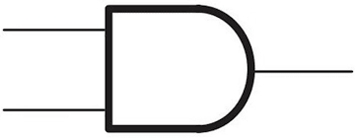


Defect Characterization – AND gate example.
Technology-Specific Defects in AND gate:
X₁ | X₂ | Y
0 | 0 | 0
0 | 1 | 0
1 | 0 | 0
1 | 1 | 0
X₁ | X₂ | Y
0 | 0 | 0
0 | 1 | 0
1 | 0 | 0
1 | 1 | 0
X₁
X
Y
X₂
X₁ stuck at 0
Break at X₁
  Defect equivalent to X1 stuck at 0
X₁ | X₂ | Y
0 | 0 | 0
0 | 1 | 0
1 | 0 | 0
1 | 1 | 1
X₁ | X₂ | Y
0 | 0 | 0
0 | 1 | 0
1 | 0 | 0
1 | 1 | 1
X₁
Y
X₂
Fault free gate
Break at dummy channel
  Defect that do not cause “no faults”.
X₁ | X₂ | Y
0 | 0 | 0
0 | 1 | *
1 | 0 | *
1 | 1 | *
Absent of annihilation notch
  Defect can not be mapped on CAD tools
Notes:
This picture shows how Classify Skyrmion defects in three classes: We use AND gate as a example.
The upper skyrmion AND gate has a Break at X_{1,} base on the exhaustive test result, the Break at X₁ equivalent to X1 stuck at 0
The middle skyrmion AND gate has a Break at dummy channel. Based on the exhaustive test result, this defect that cause “no faults”.
The Lower skyrmion AND gate has an absent of annihilation notch . Based on the exhaustive test result, this Defect can not be mapped in the CAD tools

Slide 48
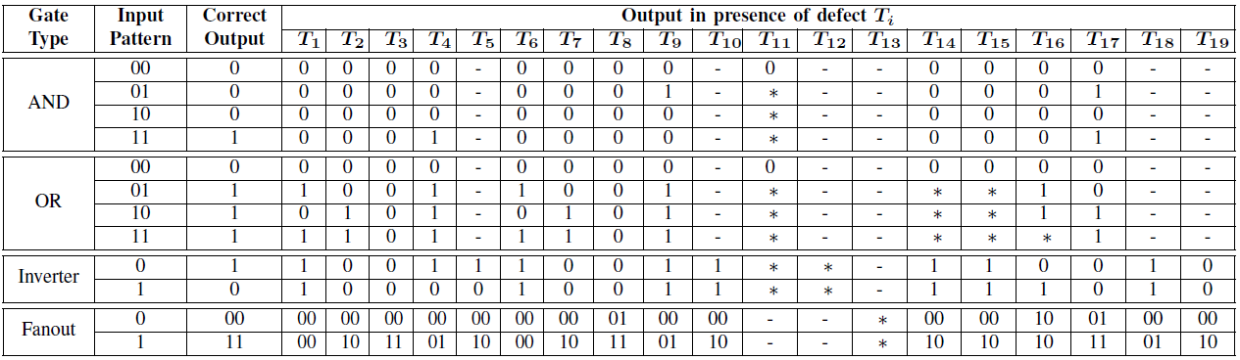
Fault Modeling
Exhaustive simulation of skyrmion gates
The asterisk (*) marks the defects that will produce faulty response with a pair of input patterns rather than a single one. Also, (-) denotes the absence of any faulty response from the gate.
Notes:
According to the previous Defect Characterization of AND gate, We applied an exhaustive test for all defects in all the gates. T1 to T19 are different defects that we can think of . This table summarizes the results for all defects under exhaustive input conditions.
//The asterisk (*) marks the defects that will produce faulty response with a pair of input patterns instead of a single one. Also, (-) denotes the absence of any faulty response from the gate.

Slide 49
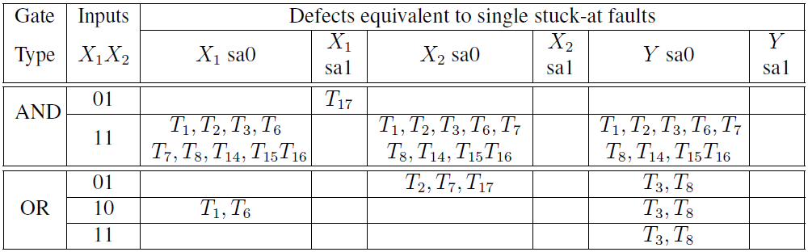
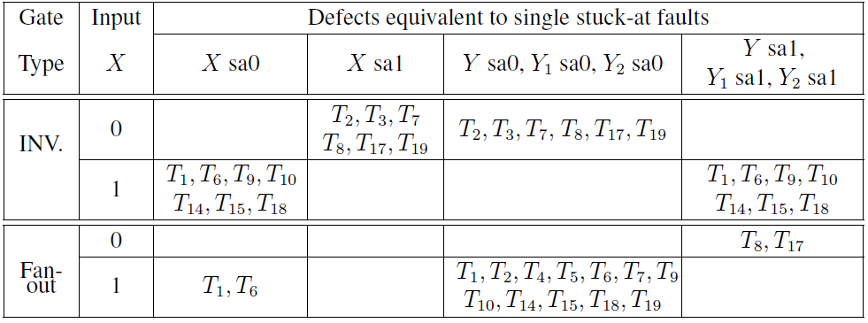
Fault Modeling
Skyrmion gate defect mapping onto single stuck-at faults in AND (Y = X1X2) and OR (Y = X1 + X2) logic gates
Skyrmion gate defect mapping onto single stuck-at faults in inverter (Y = X) and fanout ((Y1; Y2) = X)
Notes:
After analyzing previous table, we find out those defects are equivalent to faults supported in existing test CAD.
For example, in AND gate T1 can be equivalent to Y/X1/X2 stuck at 0. T17 can be equivalent to X1 stuck at 1.
Please note that, there is not stuck at 1 at X2 and Y for AND gate. So the number of equivalent Stuck at faults is less than conventional logic circuit.

Slide 50
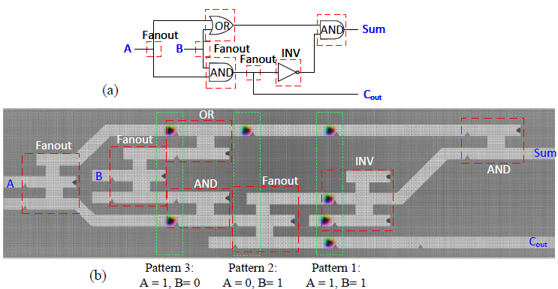
Results and Discussion
Skyrmion circuit design of a half adder.
Note: The design of our skyrmion circuit is a pipeline system.
Notes:
This figure shows how we use skyrmion gates to design the circuit. The gate level netlist can be directly converted into skyrmion circuit
//This Figures shows the design of a half adder skyrmion circuit using AND, OR and fanout gates. Figure (a), is the schematic of half adder by only using two inputs AND/OR gate and Inverter. According to Figure 5 (a), we have designed the corresponding skyrmion-based circuit shown as Figure 5 (b). Please note that : The design of our skyrmion circuit is a pipeline system. The correct result will generated after five cycles, and an output will be generated in each subsequent cycle.

Slide 51
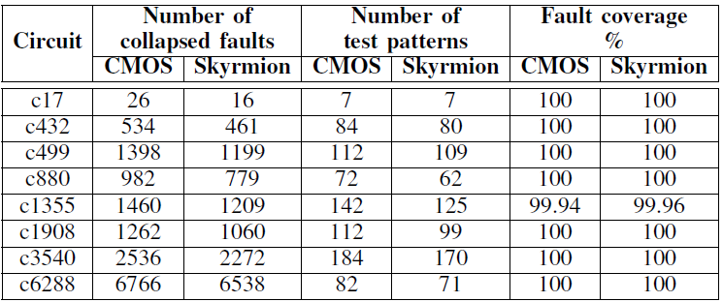
Results and Discussion (Continued)
Testing stuck-at faults in logic circuit and skyrmion circuits.
Notes:
Once we have the conversion method for SKYRMION circuit, we can carry out the corresponding experiment. This table shows the experimental results, such as collapsed faults count, test pattern count and fault coverage. The skyrmion logic circuits is compare with traditional Logic circuits. +less +
//The first column of this table indicates the benchmark circuit name. The second and third columns show the pattern count for both conventional Logic and skyrmion logic circuits. The fourth and fifth columns show the fault coverage results for the same circuit pair. It can be concluded that our pattern generation method for skyrmion logic circuits has reduced the number of test patterns, and increased fault coverage compared to the traditional Logic circuits due to smaller number of stuck-at-1 faults in the netlist.

Slide 52
Contributions: Emerging Technologies
We considered defect scenarios for skyrmion based digital circuits and describe these defects under three separate categories: Technology-independent faults, Technology-specific faults, and no faults.
We believe we are the first to characterize such defects using magnetic simulation.
We devised a test pattern generation procedure for skyrmion-based circuits.
We used traditional ATPG approaches in the existing CAD tools to generate test patterns.
Notes:
Based on the above analysis, we can say that:

Slide 53
Conclusions
DFS architecture prevents the leaking of obfuscation key to an adversary at any time with fully scan-based tests at the foundry.
We proposed a tampering-based attacker can defeat the security measures provided from any existing logic locking methods to obtain the secret key even if the circuit can effectively block the SAT-based attack.
We proposed a method of modeling and test generation for combinational hardware Trojans to against the above-mentioned tampering attack.
Based on a fault modeling technique, a defect characterization and testing method of the skyrmion-based circuit is proposed.
Notes:
To conclude my research:

Slide 54
Future Works
Explore detection methods to detect sequential hardware Trojan.
Characterize the defects that cannot be supported in existing test CAD tools (Technology-specific faults).
Apply the logic locking structure on Skyrmion circuit.
Notes:
There is some scope to improve my work for future researchers. First

Slide 55
Publications
Journal Papers
A. Jain, Z. Zhou and U. Guin, "TAAL: Tampering Attack on Any Key-based Logic Locked Circuits", in ACM Transactions on Design Automation of Electronic Systems (TODAES), 2021
Y. Zhang, A. Jain, P. Cui, Z. Zhou, and U. Guin, "A Novel Topology-Guided Attack and Its Countermeasure Towards Secure Logic Locking", Journal of Cryptographic Engineering, 2020
U. Guin, Z. Zhou, and A. Singh, “Robust Design-for-Security (DFS) Architecture for Enabling Trust in IC Manufacturing and Test”, IEEE Transactions on Very Large Scale Integration Systems (TVLSI), 2018
Conference Papers
Z. Zhou, U. Guin, P. Li and V. Agrawal, “Defect Characterization and Testing of Skyrmion-Based Logic Circuits,” in VLSI Test Symposium (VTS), 2021 (Best Paper Nomination).
A. Jain, Z. Zhou, and U. Guin, “Survey of Recent Developments for Hardware Trojan Detection,” in IEEE International Symposium on Circuits & Systems (ISCAS), 2021
Y. Zhang, P. Cui, Z. Zhou, and U. Guin, “TGA: An Oracle-less and Topology-Guided Attack on Logic Locking”, in Attacks and Solutions in Hardware Security (ASHES), 2019
Z. Zhou, U. Guin, and V. D. Agrawal, “Modeling and Test Generation for Combinational Hardware Trojans”, in IEEE VLSI Test Symposium (VTS), 2018
U. Guin, Z. Zhou, and A. D. Singh, “A Novel Design-for-Security (DFS) Architecture to Prevent Unauthorized IC Overproduction”, IEEE VLSI Test Symposium (VTS), 2017

Slide 56





Acknowledgements
Dr. Ujjwal Guin
Dr. Vishwani D. Agrawal
Dr. Adit D. Singh
Dr. Peng Li
Dr. Shubhra K. Karmaker
Notes:
I am working on a new area: which is Skyrmion-based logic circuits

Slide 57

Thank you!
Any Questions?

