Slide 1
Dual-Threshold Voltage Design of Sub-threshold Circuits
Doctoral Final Examination
Jia Yao
Dept. of ECE, Auburn University
Dissertation Committee:
Dr. Vishwani D. Agrawal ( Chair )
Dr. Victor P. Nelson, Dr. Bogdan M. Wilamowski
University Reader: Dr. Xiao Qin
May 19, 2014

Slide 2
Outline
Motivation
Background
Contributions of This Work
Future Work
Summary

Slide 3
Motivation
Demand for energy constrained design has
increased tremendously, like portable
electronics, medical electronics and sensors
Minimum energy operation typically
occurs in sub-threshold region [1]
Increasing problems of leakage currents as
technology scales down
Dual-Vth technique is an effective approach to
suppress leakage but has not been explored in
sub-threshold region
[1] A. Wang, B. H. Calhoun and A. P. Chandrakasan, Sub-threshold design for ultra low-power systems, Springer, 2006

Slide 4
Objective
Demonstrate the effectiveness of dual-Vth
method on energy per cycle (EPC) reduction
Minimum EPC design of sub-threshold
circuits by dual-Vth method

Slide 5
Outline
Motivation
Background
Contributions of This Work
Future Work
Conclusion

Slide 6
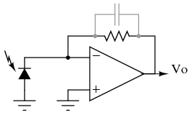
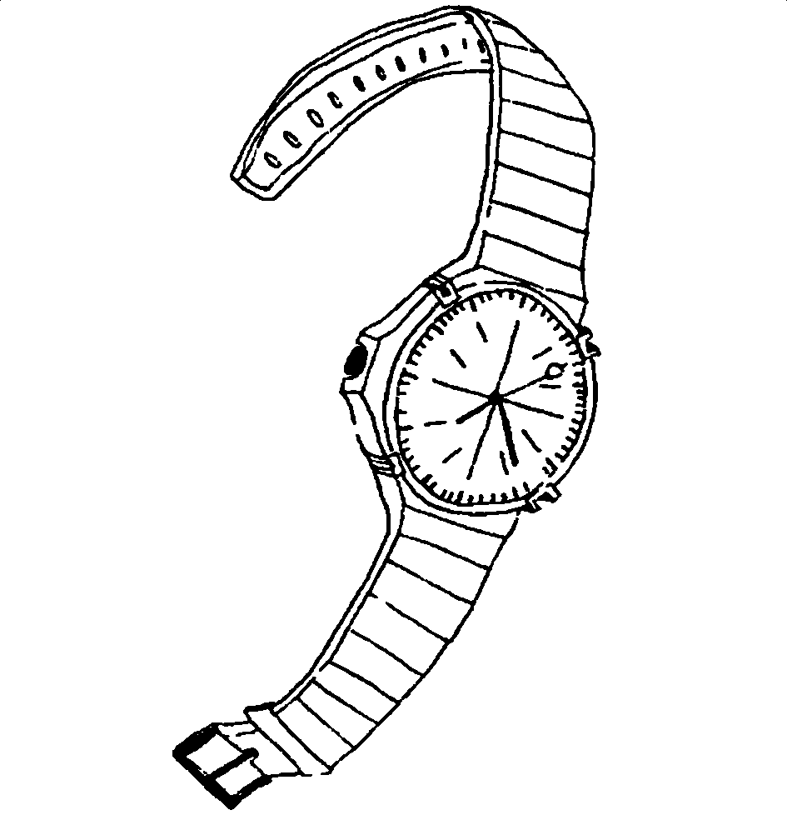
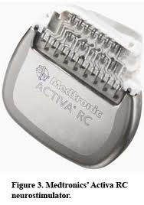
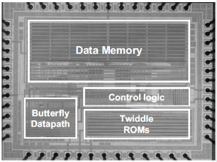
Sub-threshold Circuit Applications
Analog circuits like amplifier, oscillator
in 1970 and 80 s
[3-7]
Energy constrained circuits, portable devices, Gyroscope
Wrist watch in 1970s
Digital CMOS circuits:
DLMS filter, sensor processor, FFT processor, μ controller
since 2000s [10-13]
Micro sensors, pacemakers
since 1990s [8-9]

Slide 7
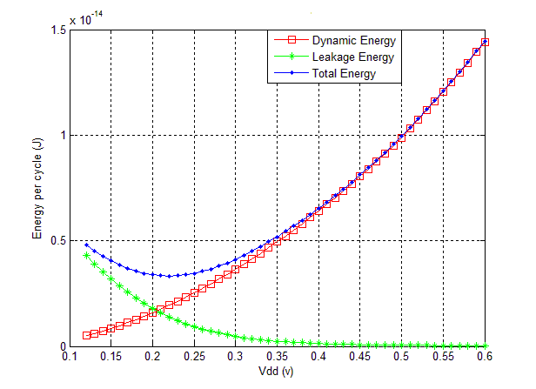
Sub-threshold Circuits: Vdd < Vth
Low power and energy consumption compared to above-threshold circuits
Minimum EPC typically occurs in sub-threshold range
HSPICE simulation of an 8-bit Ripple Carry Adder
Minimum energy is
achieved when dynamic
energy is equal to leakage energy

Slide 8
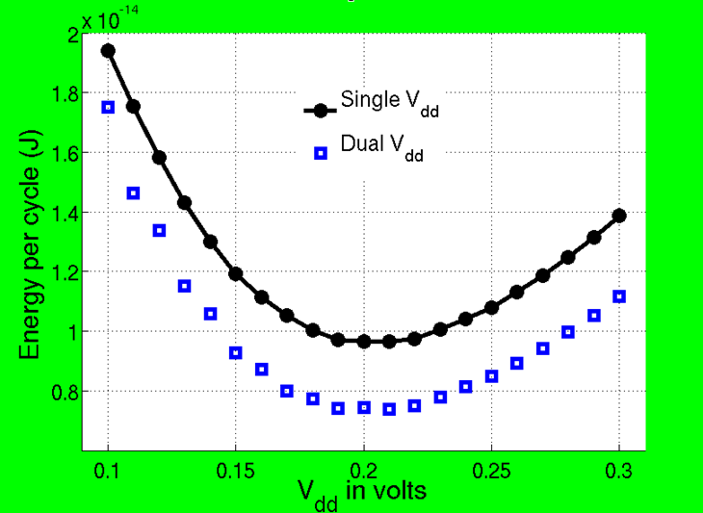
Kim: 16-bit Ripple Carry Adder (RCA)
Energy Saving
23.6%
K. Kim, Ultra Low Power CMOS Design, PhD Dissertation, Auburn University, May 2100.
Need dual voltage supply, level converters, . . .
Can we get more saving with dual threshold voltages?

Slide 9
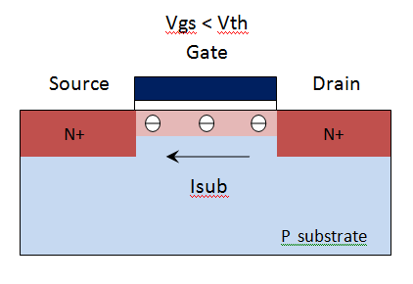
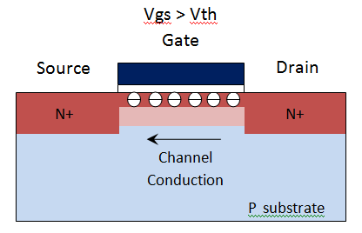
MOSFET Sub-threshold Operation Vgs < Vth
Sub-threshold operation or Weak inversion operation
Transistor is NOT completely OFF
Small amount of electrons flow from Drain to Source

Slide 10
MOSFET Sub-threshold Operation Vgs < Vth
Sub-threshold current I_{sub} is dominant [1]
where
when Vds > 3Vt , Isub can be further simplified to
Note: μ is effective mobility, Cox is oxide capacitance, W is transistor width, L is transistor length, Vgs is gate-source voltage, Vds is drain-source voltage, Vt is thermal voltage
( 25mV at 300K ), Vth is threshold voltage, n is sub-threshold slope, η is DIBL effect coefficient

Slide 11
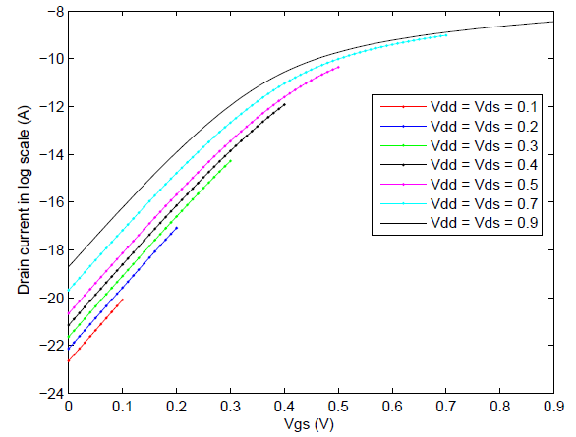
MOSFET Sub-threshold Operation Vgs < Vth
HSPICE simulation results of drain current ID vs. gate-source voltage VGS for PTM 32nm bulk CMOS technology NMOS transistor with Wn=5L , Vth = 0.329V at Vdd = 0.9 V

Slide 12
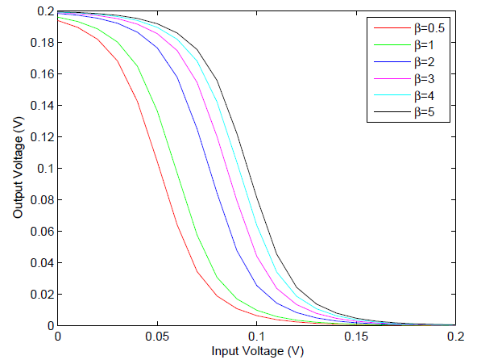
Sub-threshold Inverter
Circuits function correctly in sub-threshold region
but come with large delay ( 500x larger )
Supply Voltage Vdd (V) | Inverter Delay (ns)
Vdd = 0.2 | 7.01
Vdd = 0.3 | 0.51
Vdd = 0.4 | 0.101
Vdd = 0.5 | 0.019
Vdd = 0.7 | 0.015
Vdd = 0.9 | 0.014
HSPICE simulation results of Inverter delay under varying supply voltages in PTM 32nm bulk CMOS technology with Wn = 5L and Wp = 12L, fan-out is one inverter
HSPICE simulation results of Voltage Transfer Curve of an inverter in PTM 32nm bulk CMOS technology at Vdd=0.2V with varying transistor sizing ratio β = Wp / Wn

Slide 13
Outline
Motivation
Background
Contributions of This Work
Single-Vth design
Dual-Vth minimum EPC design
Future Work
Conclusion

Slide 14
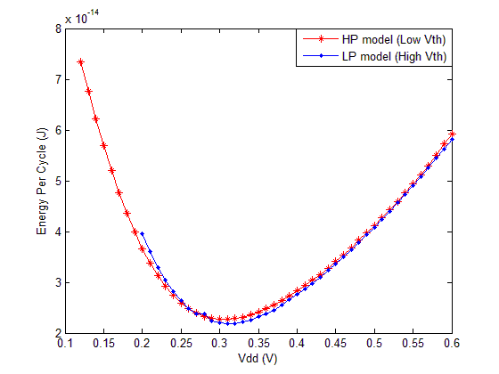
Single-Vth Design of Sub-threshold Circuits
EPC is independent of Vth
Increasing Vth can not reduce EPC
EPC for single low Vth and single high Vth designs remain same
High Vth design reduces leakage power but increases delay
Two effects cancel out
 | NMOS | PMOS
HS model | 0.328 V | -0.291 V
LP model | 0.549 V | -0.486 V
Threshold voltage of PTM 32nm models calculated in HSPICE at Vdd = 0.9 V
HSPICE simulations for EPC for 32-bit RCA single-Vth designs in PTM 32nm bulk CMOS technology with Wn=5L Wp=12L.Each design runs at its maximum operating frequency

Slide 15
Single-Vth Design of Sub-threshold Circuits
On current Ion
with Vgs = Vdd
Off current Ioff
with Vgs = 0
Gate delay D
C is gate capacitance of a characteristic inverter

Slide 16
Single-Vth Design of Sub-threshold Circuits
Circuit delay Tc
Vth factor is
canceled out
C is gate capacitance of a characteristic inverter, Ceff is average switched capacitance per clock cycle in the circuit, l is the length of critical path in terms of a characteristic inverter

Slide 17
General Dual-Vth Design Procedure
Low Vth gate is fast but more leaky;
used on critical paths to maintain high speed
High Vth gate is slow but less leaky;
used on non-critical paths to reduce leakage
Normally, start with assigning low Vth to all gates
and switch as many gates as possible to high Vth to reduce leakage [2]
[2] D. Flynn, R. Aitken, A. Gibbons and K. Shi, Low Power Methodology Manual: For System-on-Chip Design. New York: Springer, 2007

Slide 18
Dual-Vth Minimum EPC Design
Dual Vth design reduces EPC by
inserting high Vth gates to reduce leakage power while keeping the operating frequency unchanged
This is the maximum operating frequency obtained for the single low Vth design
For given circuit netlist, the proposed framework uses the gate slack based algorithm to generate optimum dual-Vth design with minimum EPC, optimum Vdd, optimum high Vth level and estimate the EPC

Slide 19
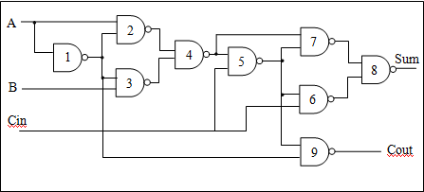
Example
Assuming each gate has one unit time (t₀) of gate delay, gate 9 is regarded as non-critical path gate. However, if gate 9 is a high Vth gate with 4 t₀ delay, a new critical path would be created. The critical path delay would be changed from 6 t₀ to 8 t₀

Slide 20
Gate Slack Based Dual-Vth Algorithm *
Name | Definition
Tpi (i) | the longest time for an event to arrive from PI to gate i
Tpo (i) | the longest time for an event to reach a PO from gate i
D (i) | Gate delay of gate i
Dp (i) | The path delay of the longest path through gate i Dp (i) = Tpi (i) + Tpo (i) + D (i)
Tc | Critical path delay of the whole circuit Tc = Max { Dp (i) }
S (i) | Gate slack S (i) = Tc – Dp (i)
Dh (i) , Dl (i) | Gate delay of gate i with low Vth or high Vth
Delta (i) | Gate delay difference for gate i Delta (i) = Dh (i) – Dl (i)
Su | Upper boundary for slack Su = (k-1) / k * Tc and k = Tc’ / Tc
Sl | Lower boundary for slack Sl = Min { Delta (i) }
* Note: Algorithm is modified for dual-Vth design based on previous work in [14-17]

Slide 21
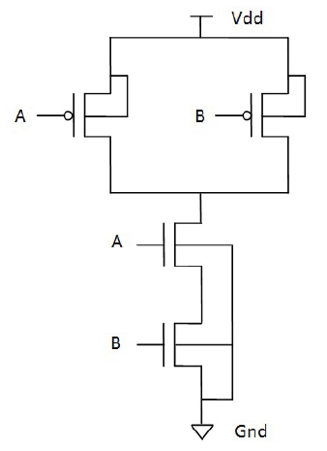
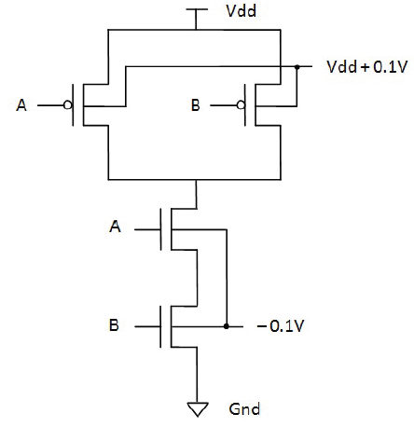
Gate Slack Based Dual-Vth Algorithm
Step 1: Library Characterization
Construct high Vth gate by applying different
reverse body bias voltages on PTM HS model
Body bias | Threshold voltage
 | NMOS | PMOS
zero bias | 0.328 V | -0.291 V
bias = 0.1V | 0.348 V | -0.309 V
bias = 0.2 V | 0.367 V | -0.327 V
bias = 0.3 V | 0.385 V | -0.344 V
bias = 0.4 V | 0.402 V | -0.360 V
bias = 0.5 V | 0.419 V | -0.375 V
bias = 0.6 V | 0.435 V | -0.389 V
bias = 0.7 V | 0.450 V | -0.403 V
bias = 0.8 V | 0.465 V | -0.417 V
Low Vth Gate
zero bias
High Vth Gate
reverse bias = 0.1 V
Threshold voltage of PTM 32nm bulk CMOS technology HS models with varying reverse bias voltages calculated by HSPICE at Vdd = 0.9 V

Slide 22
Gate Slack Based Dual-Vth Algorithm
Step 1: Library Characterization
Calculate gate delay, power consumption, nodal capacitance of basic logic gates under varying Vdd, Vth, fan-out conditions
Step 2: Initialization
Assign each gate to low Vth initially
Step 3: First Round of Selection
Run Static Timing Analysis (STA),
If S (i) > Su, gate i can directly switch to high Vth
If S (i) < Sl, gate i can never switch to high Vth
If S (i) > Delta (i), gate i can possibly switch

Slide 23
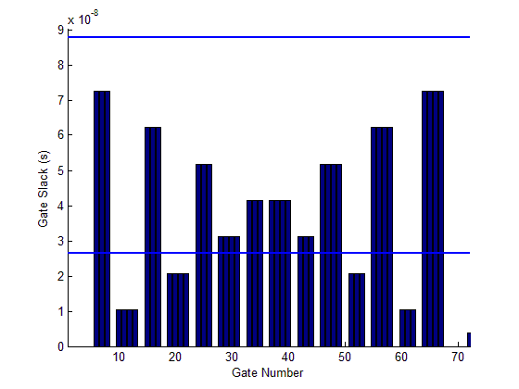
Su
35
Sl
37
Gate slack analysis for 8-bit Ripple Carry Adder

Slide 24
Gate Slack Based Dual-Vth Algorithm
Step 4: Verification
For any gate j selected in step 3, switch it to high Vth, and re-run STA to calculate circuit delay Tc,
If newly calculated Tc_new ! > original Tc, gate j can switch to high Vth
Step 5: Results
Generate dual Vth design, estimate EPC and
find out optimum Vdd and high Vth level with lowest
EPC
EPC estimation
Ceff (i) = α (i) * C (i) = the product of gate output activity and nodal capacitance
C (i) and Pleak (i) are obtained from HSPICE simulations of basic logic gates under varying conditions, α (i) is obtained from Modelsim simulations with real gate delays

Slide 25
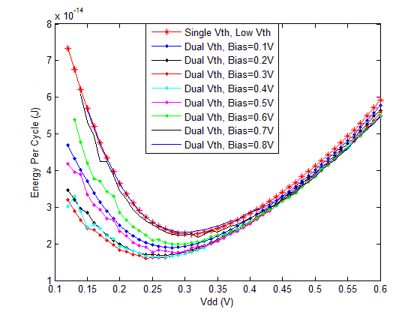
Implementation Results 32-bit RCA
Single-Vth design
Min EPC = 2.268E-014 J
Optimum Vdd = 0.31V
Frequency = 3.99 MHz
Dual-Vth design
Min EPC = 1.610E-014J
Optimum Vdd = 0.24V
Optimum Bias = 0.3V
Frequency = 0.82 MHz
Min EPC reduction: 29%
HSPICE simulations of EPC for 32-bit RCA single and dual-Vth designs
in PTM 32nm bulk CMOS technology with Wp=12L and Wn=5L

Slide 26
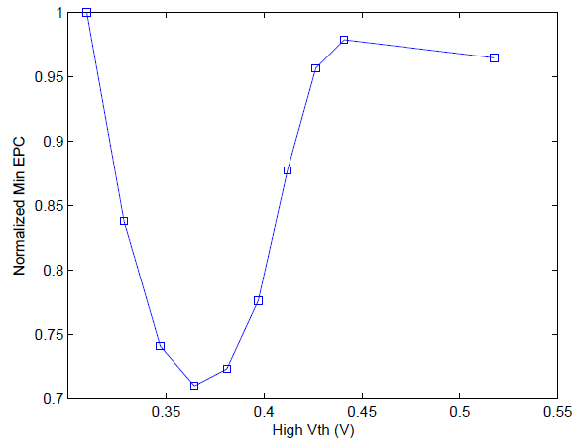
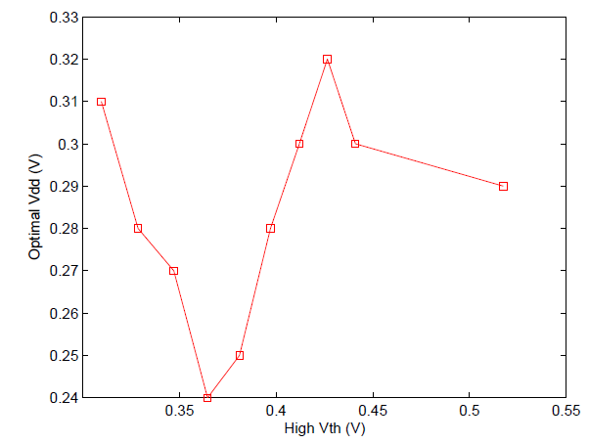
Implementation Results 32-bit RCA
Single low
Vth design
Single low
Vth design
Single high
Vth design
Single high
Vth design
Bias = 0.3V
Bias = 0.3V
High Vth Vs. Normalized minimum EPC points
from single-Vth and dual-Vth designs
High Vth Vs. Optimal Vdd points
from single-Vth and dual-Vth designs

Slide 27
Implementation Results Summary
Minimum EPC reduction is between 10.8% and 29% from
4-by-4 multiplier and 32-bit RCA respectively
Circuit Name | Single-Vth Emin | Single-Vth Vddopt | Dual-Vth Emin | Dual-Vth Vddopt | Emin Drop
4-by-4 Multiplier | 7.59 E-15 J | 0.26 V | 6.77 E-15 J | 0.21 V | 10.8%
C432 | 7.21 E-15 J | 0.28 V | 6.32 E-15 J | 0.26 V | 12.4%
C499 | 2.13 E-14 J | 0.27 V | 1.85 E-14 J | 0.26 V | 13.2%
C880 | 1.43 E-14 J | 0.25 V | 1.06 E-14 J | 0.22 V | 25.9%
C1355 | 1.98 E-14 J | 0.26 V | 1.73 E-14 J | 0.24 V | 12.28%
C1980 | 3.14 E-14 J | 0.27 V | 2.68 E-14 J | 0.25 V | 14.52%
C2670 | 5.09 E-14 J | 0.22V | 3.71 E-14 J | 0.19V | 27.1%
32 RCA | 2.26 E-014 J | 0.31V | 1.610 E-014 J | 0.24 V | 29%

Slide 28
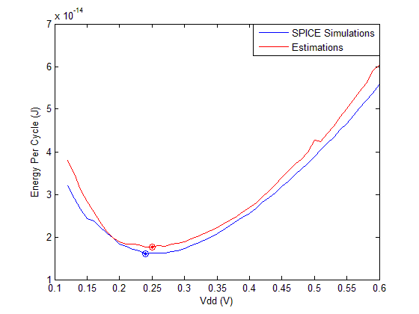
Implementation Results Estimation Accuracy
HSPICE Simulation
Min EPC = 1.61E-014J
Optimum Vdd = 0.24V
Estimation
Min EPC = 1.77E-014J
Optimum Vdd = 0.25V
The average error
between estimation and
simulation is 6.99%
HSPICE simulations Vs. estimation for EPC for 32-bit RCA dual-Vth design at bias = 0.3V in PTM 32nm bulk CMOS technology

Slide 29
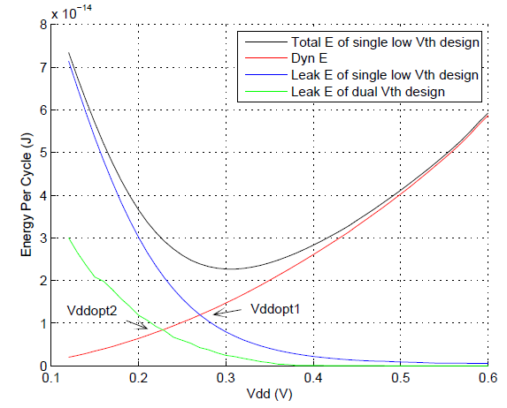
Result Analysis
Minimum EPC occurs
when dynamic energy is equal to leakage energy
Minimum EPC reduction comes from Vdd reduction
Reduction of leakage
energy comes from
leakage power reduction
and unchanged circuit
period
Dynamic energy and leakage energy analysis for 32-bit RCA single-Vth and dual-Vth design

Slide 30
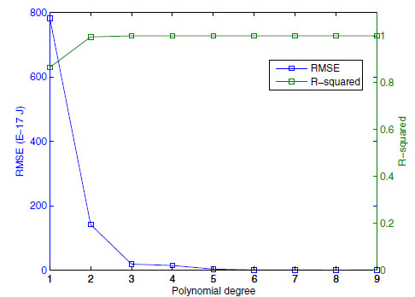
Results Analysis
Theoretical analysis to verify the observed 29%
minimum EPC reduction on 32-bit RCA
Step 1: Leakage energy characterized as 3rd degree polynomials
based on HSPICE simulation results on leakage power of 32-bit RCA with single low Vth or high Vth (with bias=0.3V) as well as circuit delay with single low Vth
where p1 = -2.9 E-12, p2 = 3.46 E-12,
p3 = -1.4 E-12 and p4 = 1.95 E-13
where h1 = -3.4 E-13, h2 = 4.19 E-13,
h3 = -1.75 E-13 and h4 = 2.54 E-14
RMSE and regression coefficient R-squared analysis of polynomial fit for leakage energy

Slide 31
Results Analysis
Step 2: Dynamic energy characterized as 2nd degree polynomial
based on HSPICE simulation results on total energy and leakage energy of 32-bit RCA with single low Vth
Where a = 1.65 E-13 and b = -2.1 E-16
Step 3: Single-Vth design
Optimal Vdd = 0.305 V
where p1 = -2.9 E-12, p2 = 3.46 E-12, p3 = -1.4 E-12, p4 = 1.95 E-13
a = 1.65 E-13 and b = -2.1 E-16

Slide 32
Results Analysis
Step 4: Dual-Vth design
X = fraction of high Vth gates in the circuit and
1- X = fraction of low Vth gates
Where K1 = x * h1 + (1-x) * p1
K2 = x * h2 + (1-x) * p2 + a
K3 = x * h3 + (1-x) * p3
K4 = x * h4 + (1-x) * p4 +b
X = 198/288 in optimal dual-Vth design
Optimal Vdd = 0.254 V
where p1 = -2.9 E-12, p2 = 3.46 E-12, p3 = -1.4 E-12, p4 = 1.95 E-13, a = 1.65 E-13, b = -2.1 E-16, h1 = -3.4 E-13, h2 = 4.19 E-13, h3 = -1.75 E-13 and h4 = 2.54 E-14

Slide 33
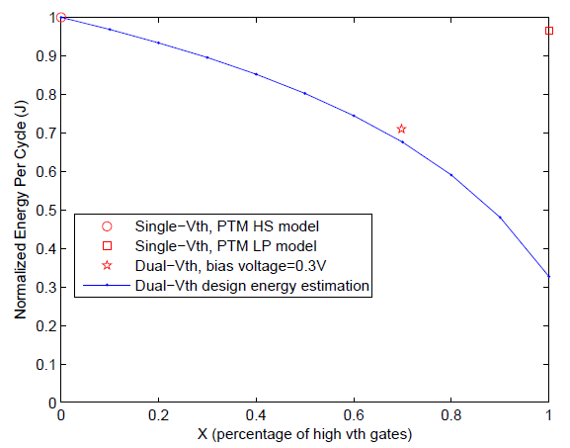
Results Analysis
Step 5: Calculate minimum EPC saving between single-low Vth and dual-Vth design
Theoretical results show
minimum EPC saving is
33.4 %
Blue curve only express
a lower bound of energy
saving
In practical, circuit delay
increases as Vth in
single-Vth design increseas
Single
High Vth
Single
Low Vth
Dual Vth
HSPICE simulation results vs. theoretical analysis of energy ratio of 32-bit RCA dual-Vth design with bias = 0.3V and single-Vth design

Slide 34
Outline
Motivation
Backgroud
Contributions of This Work
Future Work
Conclusion

Slide 35
Future Work
Robust Dual-Vth Design
Why do we need robust design?
Process variation causes variance in circuit performance
and lower yield
Process variation issue gets worse in sub-threshold
circuits due to exponential relation between I_{sub} and Vth

Slide 36
Future Work
Combine Dual-Vth with Different
Low Power Design Methods
Dual-Vth only reduces leakage energy
Dual-Vth and Dual-Vdd : Reduce both dynamic and leakage energy
Dual-Vth and Transistor Sizing: Reduce both dynamic and leakage

Slide 37
Outline
Motivation
Backgroud
Contributions of This Work
Future Work
Conclusion

Slide 38
Conclusion
EPC of single-Vth design is independent of Vth
Dual-Vth approach is effective to suppress leakage and
reduce minimum EPC
For given circuit, the proposed framework uses the gate slack based algorithm to generate optimum dual-Vth design with minimum EPC, optimum Vdd, optimum high Vth level and estimate the EPC
For 32-bit RCA, minimum EPC is reduced by 29% by dual-Vth approach; for 4-by-4 multiplier, minimum EPC is reduced by 10.8%; for ISCAS85 benchmark circuits, energy saving is between this range

Slide 39
References
[1] A. Wang, B. H. Calhoun and A. P. Chandrakasan, Sub-threshold design for ultra low-power systems, Springer, 2006
[2] D. Flynn, R. Aitken, A. Gibbons and K. Shi, Low Power Methodology Manual: For System-on-Chip Design, New York: Springer, 2007
[3] M. Degrauwe, J. Rijmenants, E. Vittoz, and H. D. Man, “Adaptive biasing CMOS ampliers,” IEEE Journal of Solid State Circuits, vol. 17, no. 13, pp. 522-528, June 1982.
[4] E. Vittoz, “Micropower switched-capacitor oscillator," IEEE Journal of Solid State Circuits, vol. 14, no. 3, pp. 622-624, June 1979.
[5] E. Vittoz, \Quartz oscillators for watches," Proceeding 10th International Congress of Chronometry, pp. 131-140, 1979.
[6] Y. P. Tsividis and R. W. Ulmer, “A CMOS voltage reference," IEEE Journal of Solid State Circuits, vol. 13, no. 6, pp. 774-778, December 1978.
[7] E. Vittoz and F. Krummenacher, “Micropower SC filters in Si-gate CMOS technology," Proceeding ECCTD'80, pp. 61-72, 1980.
[8] A. P. Pentland, M. Petrazzouli, A. Gerega, A. P. Pentland, and T. Starner, “Digital doctor: An experiment in wearable telemedicine," Proceeding of Intl. Symp. on Wearable Computers, pp. 173-174, October 1997.

Slide 40
References
[9] L. A. Geddes, “Historical highlights in cardiac pacing," IEEE Engineering in Medicine and Biology Magazine, pp. 12-18, June 1990.
[10] C. H. Kim, H. Soeleman, and K. Roy, “Ultra-low-power DLMS adaptive filter for hearing aid applications," IEEE Tran. Very Large Scale Integration (VLSI) Systems, vol. 11, no. 6, pp.1058-1067, December 2003
[11] A. Wang and A. Chandrakasan, “A 180mV FFT Processor Using Sub-threshold Circuit Techniques,” in IEEE International Solid-State Circuits Conference Digest of Technical Papers, 2004, pp. 292–529.
[12] B. Zhai et al., “A 2.60pJ/Inst Sub-threshold Sensor Processor for Optimal Energy Efficiency,” Proc. of Symposium on VLSI circuits, 2006, pp.154-155
[13] J. Kwong et al, “A 65nm Sub-Vt Microcontroller with Integrated SRAM and Switched-Capacitor DC-DC Converter,” Proc. ISSCC, 2008.
[14] K. Kim, Ultra Low Power CMOS Design, PhD thesis, Auburn University, ECE Dept., Auburn, AL, May 2011.
[15] K. Kim and V. D. Agrawal, “Dual voltage design for minimum energy using gate slack,” Proc. of IEEE Intl. Conf. on Industrial Technology, March 2011, pp. 419-424.
[16] M. Allani, Polynomial-time algorithms for designing dual-voltage energy efficient circuits, Master's thesis, Auburn University, ECE Dep., Auburn, AL, December 2011.

Slide 41
References
[17] M. Allani and V. D. Agrawal, “Energy-Efficient Dual-Voltage Design using Topological Constraints,” Journal of Low Power Electronics, vol. 9, no. 3, pp. 275-287, October 2011
[18] J. Yao and V. D. Agrawal, “Dual-Threshold Design of Sub-Threshold Circuits,” in Proc. IEEE SOI-3D-Subthreshold Microelectronics Technology Conference, Oct. 2013, pp. 77–78.
[19] J. Yao and V. D. Agrawal, “Dual-Threshold Voltage Design of Ultra-Low Voltage Circuits,” submitted to IEEE Custom Integrated Circuits Conference 2014

Slide 42
Thank You

