Slide 1
A Low-Power Analog Bus for
On-Chip Digital Communication
Master’s Thesis Defense
Farah Naz Taher
Thesis Advisor: Dr. Vishwani D. Agrawal
Committee Members:
Dr. Victor P. Nelson, Dr. Adit D. Singh
June 21, 2013

Slide 2
Outline
Motivation
Background
Problem Statement
Concept
Result
Future Work
Reference
2
Farah Naz Taher

Slide 3
Motivation
Power
Area
Performance
Testability
3
Farah Naz Taher

Slide 4
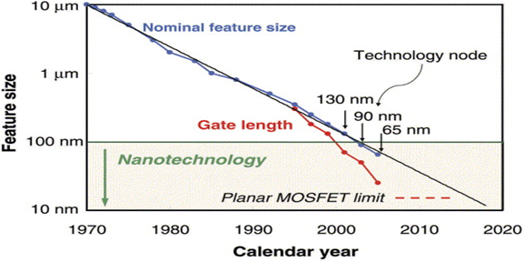
Motivation
Moore’s Law: Empirical observation that component density and performance of integrated circuits doubles every year
G. E. Moore, 1965
S. E. Thompson et. al., Materials Today 2006.
4
Farah Naz Taher

Slide 5
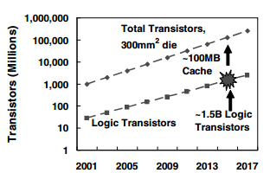
Motivation
Pollack's Rule: Each technology generation doubles the number of transistor on a chip which enables that performance increase is roughly proportional to square root of increase in complexity.
S. Borkar, DAC 2007
5
Farah Naz Taher

Slide 6
Motivation
More Transistors
More Blocks
More Cores
More on-chip Communication
More Power
6
Farah Naz Taher

Slide 7
Outline
Motivation
Background
Problem Statement
Concept
Result
Future Work
Reference
7
Farah Naz Taher

Slide 8
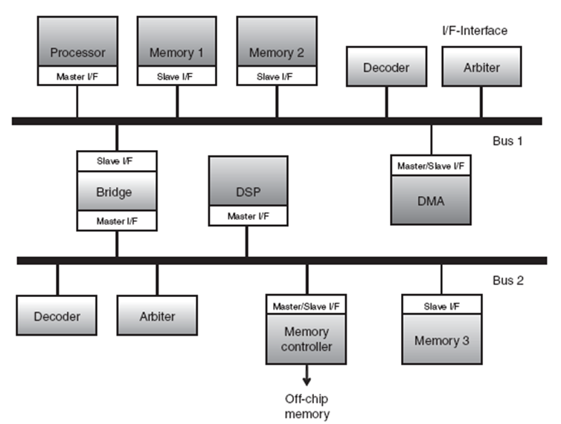
Bus Structure
A bus is a collection of signals (wires) that connects one or more IP components for the purpose of data communication.
8
Farah Naz Taher

Slide 9
Issues With Parallel Bus
Power Dissipation
Routing Complexity
Area
Signal Integrity and Crosstalk
Performance
9
Farah Naz Taher

Slide 10
Dynamic Power
For low swing signaling:
Average dynamic power for a single wire:
Weste and Harris, 2010
10
Farah Naz Taher

Slide 11
Dynamic Power
If there are n-lines in the bus with similar activity, then the total power consumed by such a bus will be n-times that of a single bit line
Weste and Harris, 2010
11
Farah Naz Taher

Slide 12
Dynamic Power
Analysis shows that interconnect power can be over 50% of the dynamic power; over 90% of the interconnect power is consumed by only 10% of the interconnections
Weste and Harris, 2010
12
Farah Naz Taher

Slide 13
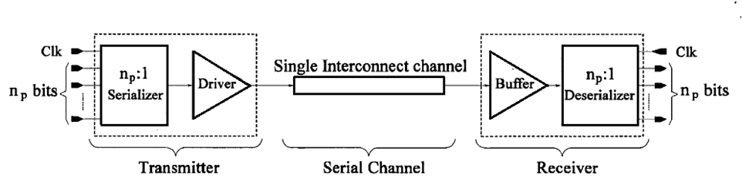
The SerDes Option
SerDes is a widely used technique for replacing multiple-lines on-chip bus with a single on-chip line to achieve high speed serial communication.
In serial bus architecture, n parallel data bits are serialized at the transmitter side. The data transfer takes place at a speed which is n times higher than the data rate of the parallel data.
At the receiver side, the data has to be de-serialized to reproduce the n-bit parallel word.
A. Kedia et. al., ISCAS 2007 N. Hatta et. al. ISPJ 2006
13
Farah Naz Taher

Slide 14
Disadvantages of SerDes
Increase in the number of transitions
n times faster frequency
More Power Consumption
Encoding scheme needs to be employed to reduce power consumption. Some proposed methods are:
    Silent: Low energy transmission
    LOUD: Bit ordering
14
Farah Naz Taher

Slide 15
Outline
Motivation
Background
Problem Statement
Concept
Result
Future Work
Reference
15
Farah Naz Taher

Slide 16
Problem Statement
The objective of this work is to develop a low power analog bus for on-chip communication to replace existing parallel digital bus.
16
Farah Naz Taher

Slide 17
Outline
Motivation
Background
Problem Statement
Concept
Result
Future Work
Reference
17
Farah Naz Taher

Slide 18
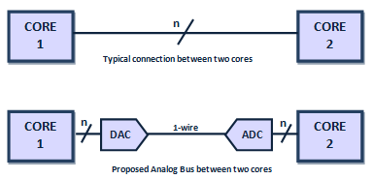
Analog Bus
Replace n wires of an n-bit digital bus carrying data between cores with just one (or few) wire(s) carrying analog signal(s) encoded into 2^{n} levels of voltage
Analog bus uses digital-to-analog converter (DAC) drivers and analog-to-digital converter (ADC) receivers.
18
Farah Naz Taher

Slide 19

Parallel Bus vs. Analog Bus
19
Farah Naz Taher

Slide 20
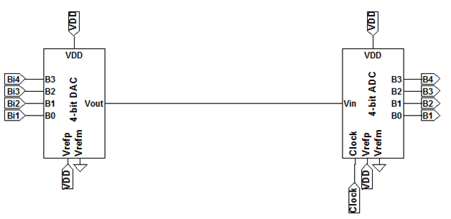
Parallel bus vs. Analog Bus
20
Farah Naz Taher

Slide 21
Analog Bus
Parallel Bus Digital Data (Volt)
1 | 0 | 1 | 0 | 0 | 1 | 0 | 0 | 1 | 1 | 0 | 1 | 1 | 0 | 0 | 0
1 | 0 | 0 | 0 | 0 | 1 | 1 | 0 | 0 | 1 | 1 | 0 | 1 | 1 | 0 | 0
1 | 0 | 1 | 0 | 0 | 1 | 0 | 1 | 0 | 0 | 0 | 1 | 0 | 0 | 1 | 1
1 | 1 | 0 | 0 | 1 | 0 | 0 | 0 | 1 | 1 | 0 | 0 | 1 | 1 | 0 | 0
Converted Analog Bus (Volt)
1.00 | 0.067 | 0.67 | 0.00 | 0.067 | 0.933 | 0.267 | 0.133 | 0.600 | 0.867 | 0.267 | 0.67 | 0.867 | 0.333 | 0.133 | 0.133
21
Farah Naz Taher

Slide 22
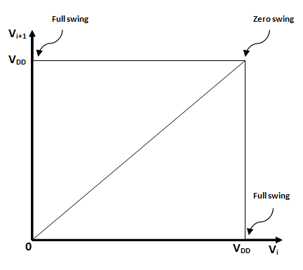
V_{swing}
22
Farah Naz Taher

Slide 23
V_{swing}
Total number of possible variations
Total possible voltage swing
Average Voltage swing
23
Farah Naz Taher

Slide 24
Proposition
The analog bus can be used in cases where:
  i. Power consumed by analog bus architecture < Power consumed by parallel bus
  ii. The signal can be reproduced without any error
The choice of resolution for substituting the number of lines in digital buses with proposed analog bus depends on two criteria.
  i. Power consumed by the ADC and DAC
  ii. Noise margin of signal line
24
Farah Naz Taher

Slide 25
Proposition
The analog bus can be used in cases where:
  i. Power consumed by analog bus architecture < Power consumed by parallel bus
  ii. The signal can be reproduced without any error
The choice of resolution for substituting the number of lines in digital buses with proposed analog bus depends on two criteria:
  i. Power consumed by the ADC and DAC
  ii. Noise margin of signal line
25
Farah Naz Taher

Slide 26
Proposition
Corollary 1:
Analog bus is effective only if the power consumed by the analog bus architecture is less than the power consumption of the digital bus.
Corollary 2:
To reproduce the signal in the digital bus without any error, the noise level should be less than half of the resolution of the ADC.
26
Farah Naz Taher

Slide 27
Proposition
Corollary 1:
Analog bus is effective only if the power consumed by the analog bus architecture is less than the power consumption of the digital bus.
Corollary 2:
To reproduce the signal in the digital bus without any error, the noise level should be less than half of the resolution of the ADC.
27
Farah Naz Taher

Slide 28
Advantages
Less Number of wires
Lower Capacitance
Power Saving
Lower Voltage Swing
28
Farah Naz Taher

Slide 29
Advantages
Potential Savings
Power
Crosstalk
Routing Complexity
Wire Area
Multiple
Drivers/
Buffers
29
Farah Naz Taher

Slide 30
Outline
Motivation
Background
Problem Statement
Concept
Experimental Result
Future Work
Reference
30
Farah Naz Taher

Slide 31
Experimental Setup
ITRS Interconnect Roadmap 2012
LTspice IV (Version 4.18b)
Baker 2008
31
Farah Naz Taher

Slide 32
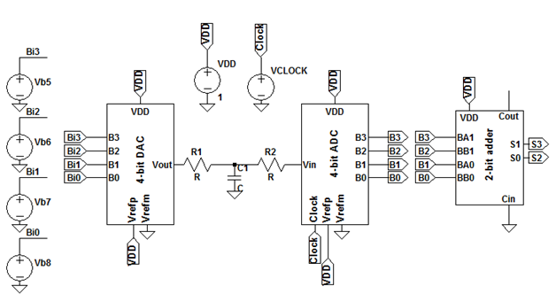
Replacement of 4-Line Parallel Bus
32
Farah Naz Taher

Slide 33
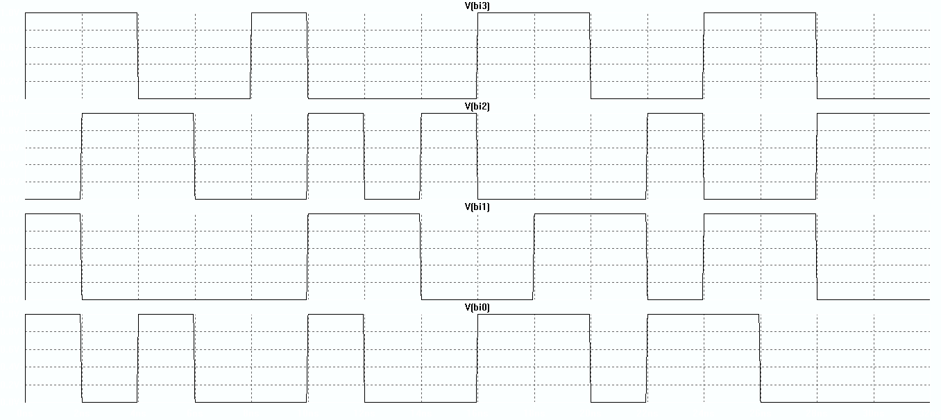
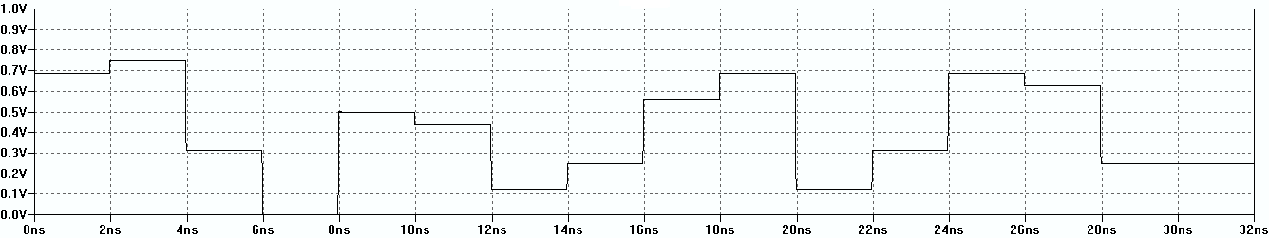
Replacement of 4-Line Parallel Bus
Digital Data: Bus Input
Analog Data: Simulated DAC Output
33
Farah Naz Taher

Slide 34
Replacement of 4-line Parallel Bus
Bus width = 4, Frequency = 1GHz
34
Farah Naz Taher

Slide 35
Replacement of 4-line Parallel Bus
Bus width = 4, Frequency = 1GHz
35
Farah Naz Taher

Slide 36
Replacement of 4-line Parallel Bus
Bus width = 4, Frequency = 500MHz
36
Farah Naz Taher

Slide 37
Replacement of 4-line Parallel Bus
Bus width = 4, Frequency = 500MHz
37
Farah Naz Taher

Slide 38
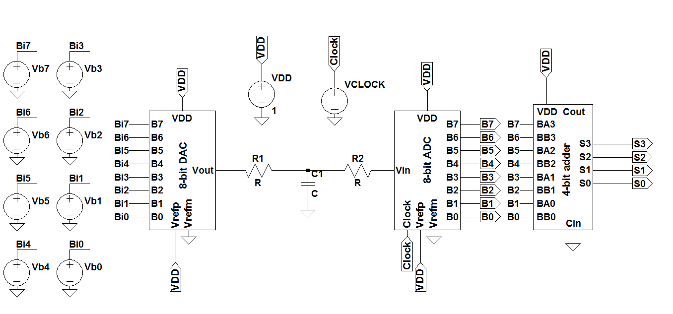
Replacement of 8-Line Parallel Bus
38
Farah Naz Taher

Slide 39
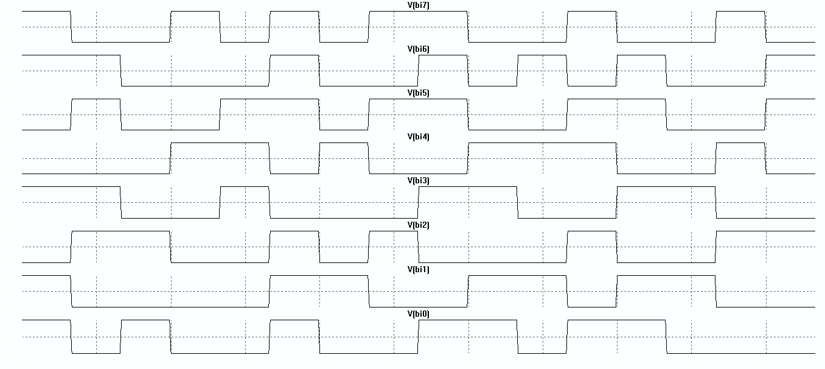
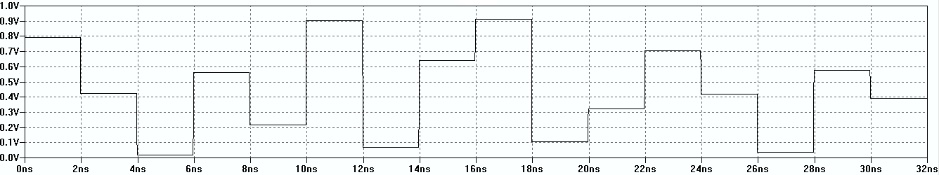
Replacement of 8-Line Parallel Bus
Digital Data
Analog Data
39
Farah Naz Taher

Slide 40
Replacement of 8-Line Parallel Bus
Bus width = 8, Frequency = 500MHz
40
Farah Naz Taher

Slide 41
Replacement of 8-Line Parallel Bus
Bus width = 8, Frequency = 500MHz
41
Farah Naz Taher

Slide 42
Analysis for f = 500MHz
42
Farah Naz Taher

Slide 43
Analysis
Bus Width: 4, Frequency: 500MHz, Length = 1mm
  The average power consumption per mm for the analog bus is around 16.17 µW.
  The average power consumption for a 4-bit bus is 219 µW.
Bus Width: 8, Frequency: 500MHz, Length = 1mm
  The average power consumption per mm for the analog bus is around 18.3 µW.
  The average power consumption for an 8-bit bus is 469.2 µW.
43
Farah Naz Taher

Slide 44
Analysis
The power consumption in the parallel bus has an exponential increase with respect to the bus length whereas the power consumption in the analog bus increases slowly.
SPICE simulation for an ideal case shows that, the ratio of bus power consumed by the proposed analog scheme to a typical parallel digital scheme is given by P_{analog}/P_{digital} = 1/(3n).
44
Farah Naz Taher

Slide 45
Analysis
The power consumption of the ADC/DAC can be a design challenge for analog bus.
ADC/DAC with a power consumption in µW range exists already. Example:
    ADC (ADS7924 from Texas Instruments): 5.5µW
    DAC (LTC1591 from Linear technology): 10µW
In the 4-Bit and 8-Bit cases we have available power margins of 200µW and 450µW, respectively.
The analog bus architecture will save power even after addition of 15.5µW power consuming elements.
45
Farah Naz Taher

Slide 46
Outline
Motivation
Background
Problem Statement
Concept
Experimental Result
Future Work
Reference
46
Farah Naz Taher

Slide 47
Future Work
This thesis examined the feasibility of the scheme, much work remains to be done
Design Suitable Converters
Design Encoding Scheme
Analyze the Scheme in Digital Testing
Fabricate the System on a Chip
47
Farah Naz Taher

Slide 48
Outline
Motivation
Background
Problem Statement
Concept
Experimental Result
Future Work
Reference
48
Farah Naz Taher

Slide 49
Reference
“14-Bit and 16-Bit Parallel Low Glitch Multiplying DACs with 4-Quadrant Resistors,“ White Paper, Linear Technology Corporation, Feb. 1999. http://cds.linear.com/docs/en/datasheet/15917fa.pdf.
“2.2V, 12-Bit, 4-Channel, microPOWER Analog-to-Digital converter With I2C Interface,“ White Paper, Texas Instruments Incorporated, Jan. 2012. http://www.ti.com/lit/ds/symlink/ads7924.pdf.
“LTspice IV (Version 4.18b)," 2013. Linear Technology Corporation, http://www.com/designtools/software/#LTspice.
R. J. Baker, CMOS Mixed-signal Circuit Design. John Wiley & Sons, 2008.
S. Borkar, “Thousand Core Chips: A Technology Perspective," in Proc. 44th Design Automation Conference, 2007, pp. 746-749.
N. Hatta, N. D. Barli, C. Iwama, L. D. Hung, D. Tashiro, S. Sakai, and H. Tanaka, “Bus Serialization for Reducing Power Consumption," ISPJ Trans. Advanced Computing Systems, vol. 47, no. SIG-3, pp. 686-694, Mar. 2006.
A. Kedia and R. Saleh, “Power Reduction of On-Chip Serial Links," in IEEE International Symp. Circuits and Systems, 2007, pp. 865-868.
B. Li, V. D. Agrawal, and B. Zhang, “Mixed-Signal Compression of Digital Test Data.“ Personal Communication, June 2013.
G. E. Moore, “Cramming More Components onto Integrated Circuits," Electronics. Vol. 38, no. 8, Apr. 1965.
Semiconductor Industry Association, “International Technology Roadmap for Semiconductors,“ 2012. http://www.itrs.net/Links/2012ITRS/Home2012.htm.
F. N. Taher and V. D. Agrawal, “A Low-Power Analog Bus Approach for On-Chip Digital Communication," 31st IEEE International Conf. Computer Design, 2013. Submitted
F. N. Taher, S. Sindia, and V. D. Agrawal, “An Analog Bus for Low Power On-Chip Digital Communication," in Work-in-Progress Poster Session, Design Automation Conference, (Austin, Texas), June 2013.
49
Farah Naz Taher

Slide 50

Farah Naz Taher

Slide 51

Farah Naz Taher

