Slide 1
A High-Voltage On-Chip Power Distribution Network
Master’s Thesis Defense
Mustafa M. Shihab
Thesis Advisor
Dr. Vishwani D. Agrawal
Committee Members
Dr. Adit D. Singh, Dr. Victor P. Nelson
June 28, 2013

Slide 2
Outline
Motivation
On-Chip Power Distribution Network
I²R Power Loss
Problem Statement
Proposed Scheme
Results
Challenges, Development and Future Work
References

Slide 3
Outline
Motivation
On-Chip Power Distribution Network
I²R Power Loss
Problem Statement
Proposed Scheme
Results
Challenges, Development and Future Work
References

Slide 4
Motivation
Moore’s Law:
In 1965, Intel co-founder Gordon Moore observed and formulized that - transistor density is doubling every 18 months
Latest (2012): Intel Xeon Phi processor
5,000,000,000 Transistors
Sources:
http://www.computerhistory.org/semiconductor/timeline.html
http://en.wikipedia.org/wiki/Transistor_count

Slide 5
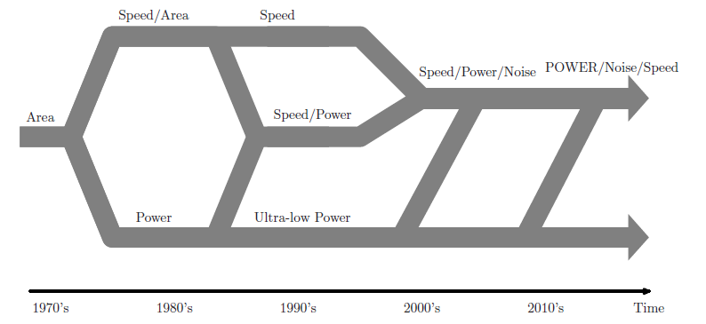
Motivation
Evolution of Design Criteria in CMOS Integrated Circuits:
Source:
M. Popovich et al., IEEE Transactions on Very Large Scale Integration (VLSI) Systems 2008

Slide 6
Motivation
Historically, IC designers considered:
Performance, Area and Cost
And left out:
Power
But now Power Budget is critical in deciding fate of designs

Slide 7
Outline
Motivation
On-Chip Power Distribution Network
I²R Power Loss
Problem Statement
Proposed Scheme
Results
Challenges, Development and Future Work
References

Slide 8
On-Chip Power Distribution Network
Power Supply System – From Board to Chip:
Source:
N. Weste et al., CMOS VLSI design: A Circuits and Systems Perspective 2006

Slide 9
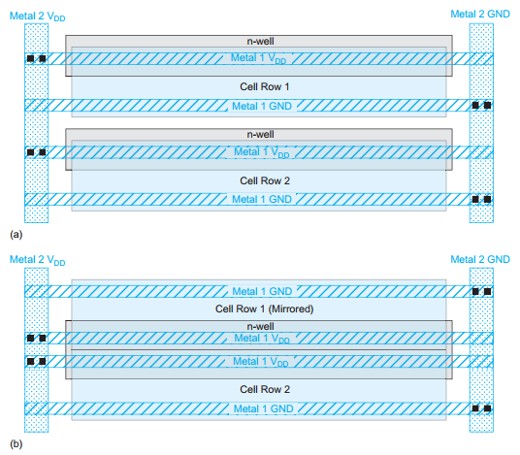
On-Chip Power Distribution Network
Power Distribution for Standard Cell Layout:
Source:
N. Weste et al., CMOS VLSI design: A Circuits and Systems Perspective 2006

Slide 10
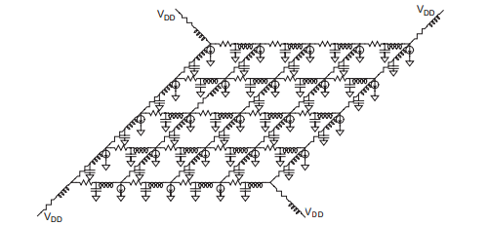
On-Chip Power Distribution Network
Power Distribution ‘Grid’:
Source:
N. Weste et al., CMOS VLSI design: A Circuits and Systems Perspective 2006

Slide 11
On-Chip Power Distribution Network
Issues with Present Day On-Chip Power Grid:
IR Drop
L(di/dt) Noise
Electromigration
Signal Delay Uncertainty
On-chip Clock Jitter
Noise Margin Degradation

Slide 12
Outline
Motivation
Present Day On-Chip Power Distribution Network
I²R Power Loss
Problem Statement
Proposed Scheme
Results
Challenges, Development and Future Work
References

Slide 13
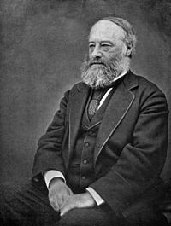
I²R Power Loss
Joule’s First Law or Law of Resistive Heating:
Passage of an electric current through conductor
releases heat, and the amount of heat released is
proportional to the square of the current such that:
P = I²R
James Prescott Joule
Basically, the law states that power lost or dissipated in a current carrying conductor is linearly related to the resistance of the conductor, and quadratically related to the amount of current flowing through it.
Source:
http://en.wikipedia.org/wiki/Joule%27s_first_law

Slide 14
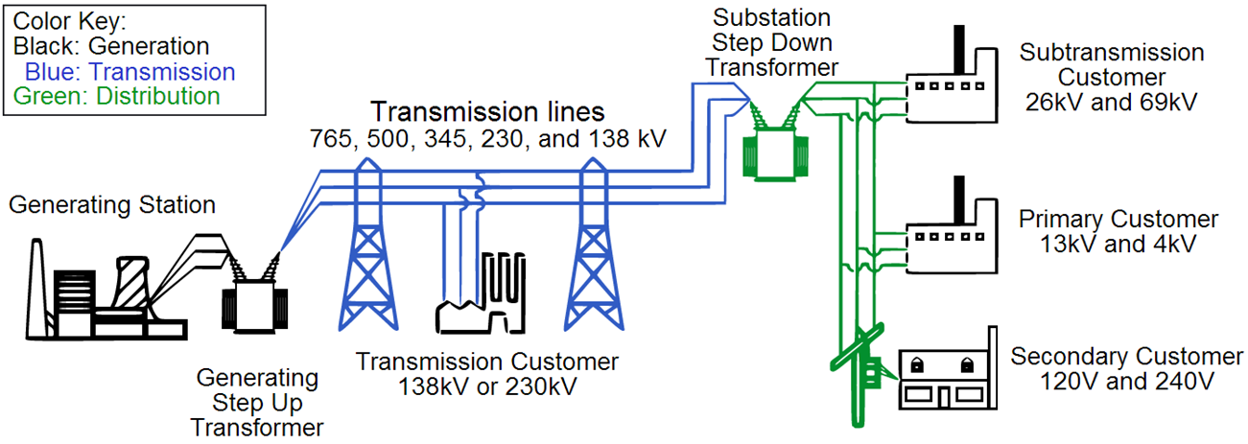
I²R Power Loss
Greatest Application of Joules Law
Long Distance Power Grid
Take Away: For a 100 mile long line carrying 1000 MW of energy
@ 138 kV power loss = 26.25% @ 765 kV power loss = 1.1% to 0.5%
@ 345 kV power loss = 4.2%
Source:
“American Electric Power Transmission Facts “, http://bit.ly/11nUMvf

Slide 15
I²R Power Loss
I²R Loss in On-Chip Power Distribution Network:
Increasing Current Density
Increasing Wire Resistivity
Increasing I²R Loss
Technology
Scaling

Slide 16
Outline
Motivation
Present Day On-Chip Power Distribution Network
I²R Power Loss
Problem Statement
Proposed Scheme
Results
Challenges, Development and Future Work
References

Slide 17
Problem Statement
In this work, we propose a scheme for delivering power to different parts of a large integrated circuit, such as cores on a System on Chip (SoC), at a higher than the regular(V_{DD}) voltage.
This increase in voltage lowers the current on the grid, and thereby reduces the I²R loss in the on-chip power distribution network.

Slide 18
Outline
Motivation
Present Day On-Chip Power Distribution Network
I²R Power Loss
Problem Statement
Proposed Scheme
Results
Challenges, Development and Future Work
References

Slide 19
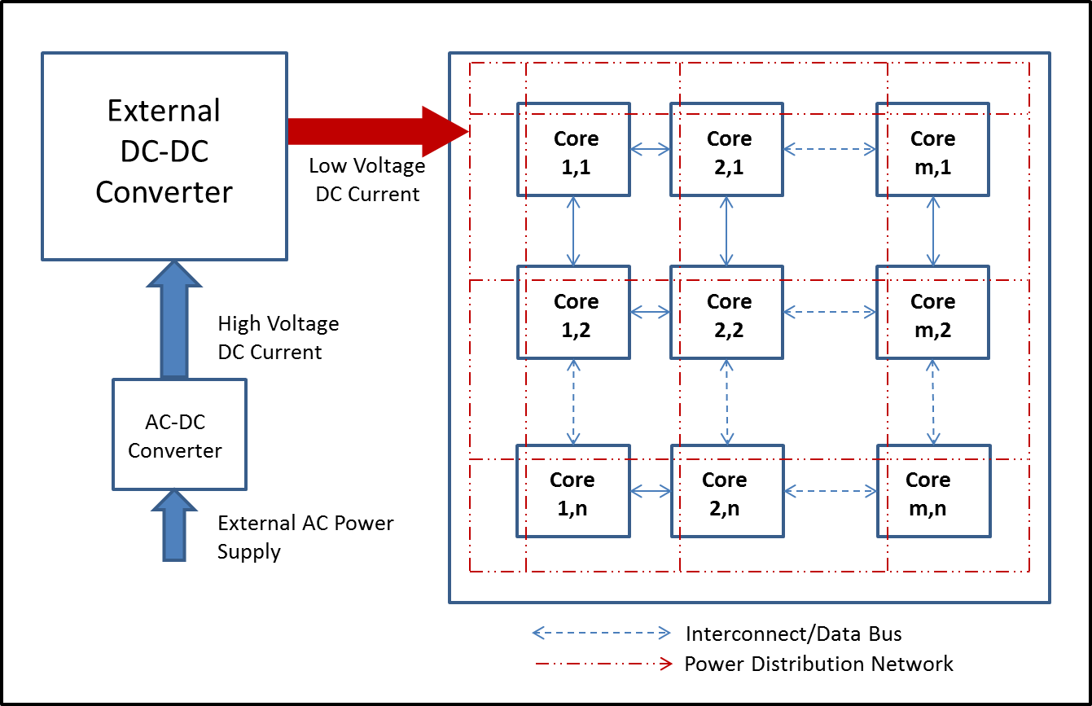
Proposed Scheme
Present Day On-Chip Power Distribution Network:

Slide 20
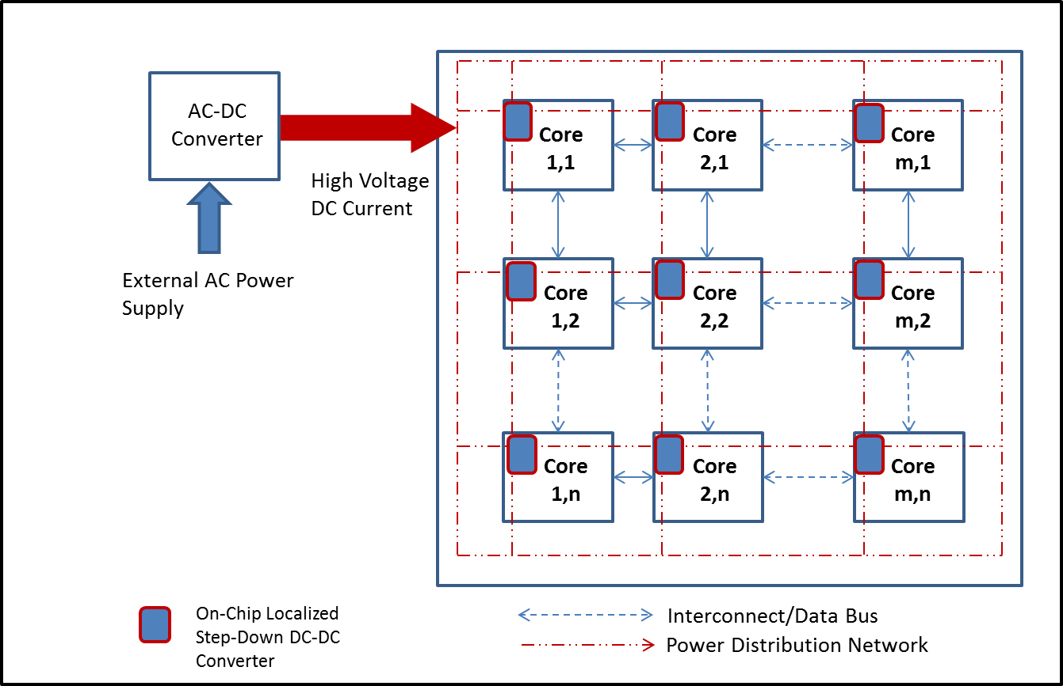
Proposed Scheme
Proposed HIGH-VOLTAGE On-Chip Power Distribution Network:

Slide 21
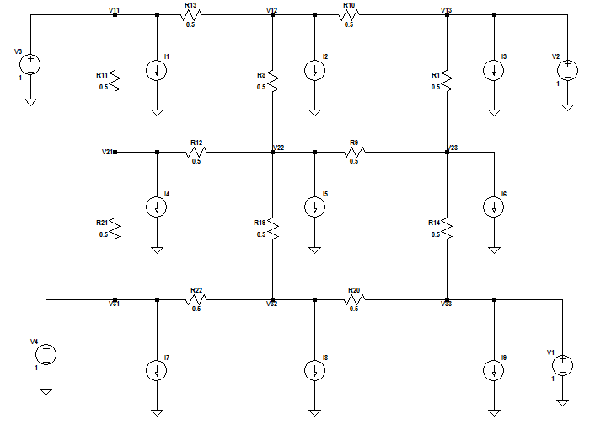
Proposed Scheme
Example: Present Day Low-Voltage(V_{DD}) Power Grid(9 loads)

Slide 22
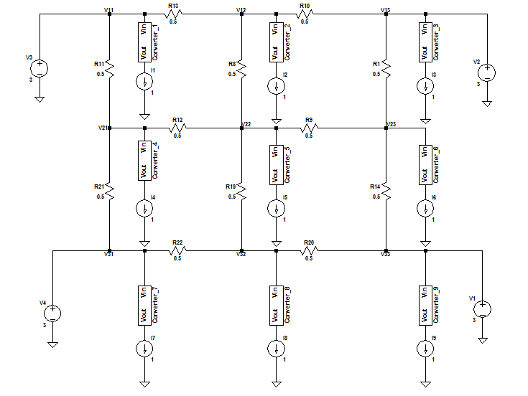
Proposed Scheme
Example: Proposed High-Voltage(3V) Power Grid(9 loads)

Slide 23
Proposed Scheme
Advantages:
Reduced Current through the Grid
Reduced I²R Loss
Reduced IR Drop
Reduced Electromigration
Reduced Signal Delay Uncertainty
Reduced Noise Margin Degradation

Slide 24
Outline
Motivation
Present Day On-Chip Power Distribution Network
I²R Power Loss
Problem Statement
Proposed Scheme
Results
Challenges, Development and Future Work
References

Slide 25
Results
Present Day PDN: Power Consumption and Efficiency
Supply Voltage: 1V
Load: 1W
Grid Resistances: 0.5 Ω (ITRS 2012)
Number of Loads | Load Power (W) | Grid Power (W) | Total Power (W) | Efficiency (%)
1 | 1 | 0.13 | 1.13 | 88.50
4 | 4 | 0.67 | 4.67 | 85.65
9 | 9 | 1.69 | 10.69 | 84.19
16 | 16 | 3.57 | 19.57 | 81.76
25 | 25 | 7.02 | 32.02 | 78.08
64 | 64 | 23.76 | 87.76 | 72.93
100 | 100 | 49.32 | 149.32 | 66.97
256 | 256 | 169.4 | 425.4 | 60.18

Slide 26
Results

Slide 27
Results
High-Voltage PDN: Power Consumption and Efficiency
(Ideal Converter)
Supply Voltage: 3 V
Load: 1W
Grid Resistances: 0.5 Ω (ITRS 2012)
DC-DC Converter: LTC 3411-A (Linear Technology)(100% Efficiency)
Number of Loads | Load Power (W) | Grid Power (W) | Total Power (W) | H-V PDN Efficiency (Ideal Converter) (%)
1 | 1 | 0.01 | 1.01 | 98.58
4 | 4 | 0.07 | 4.07 | 98.17
9 | 9 | 0.19 | 9.19 | 97.96
16 | 16 | 0.40 | 16.40 | 97.58
25 | 25 | 0.78 | 25.78 | 96.97
64 | 64 | 2.64 | 66.64 | 96.04
100 | 100 | 5.48 | 105.48 | 94.80
256 | 256 | 18.82 | 274.82 | 93.15

Slide 28
Results

Slide 29
Results
High-Voltage PDN: Power Consumption and Efficiency
(Non-Ideal Converter)
Supply Voltage: 3 V
Load: 1W
Grid Resistances: 0.5 Ω (ITRS 2012)
DC-DC Converter: LTC 3411-A (Linear Technology)(80% Efficiency)
Number of Loads | Load Power (W) | Grid Power (W) | Total Power (W) | Efficiency (%)
1 | 1 | 0.02 | 1.02 | 98.04
4 | 4 | 0.11 | 4.11 | 97.32
9 | 9 | 0.39 | 9.39 | 95.85
16 | 16 | 1.21 | 17.21 | 92.97
25 | 25 | 2.68 | 27.68 | 90.32
64 | 64 | 9.12 | 73.12 | 87.53
100 | 100 | 18.97 | 118.97 | 84.05
256 | 256 | 63.3 | 319.3 | 80.18

Slide 30
Results

Slide 31
Results
Comparison: Power Consumption
Number of Loads | Load Power (W) | Grid Power (W)
 |  | Present Day PDN | High-Voltage PDN (Ideal Converter) | High-Voltage PDN (Non-Ideal Converter)
1 | 1 | 0.13 | 0.01 | 0.02
4 | 4 | 0.67 | 0.07 | 0.11
9 | 9 | 1.69 | 0.19 | 0.39
16 | 16 | 3.57 | 0.40 | 1.21
25 | 25 | 7.02 | 0.78 | 2.68
64 | 64 | 23.76 | 2.64 | 9.12
100 | 100 | 49.32 | 5.48 | 18.97
256 | 256 | 169.40 | 18.82 | 63.3

Slide 32
Results
Comparison: Efficiency
Number of Loads | Efficiency
 | Regular PDN | High-Voltage PDN (Ideal Converter) | High-Voltage PDN (Non-Ideal Converter)
1 | 88.50 | 98.58 | 98.04
4 | 85.65 | 98.17 | 97.32
9 | 84.19 | 97.96 | 95.85
16 | 81.76 | 97.58 | 92.97
25 | 78.08 | 96.97 | 90.32
64 | 72.93 | 96.04 | 87.53
100 | 66.97 | 94.80 | 84.05
256 | 60.18 | 93.15 | 80.18

Slide 33
Outline
Motivation
Present Day On-Chip Power Distribution Network
I²R Power Loss
Problem Statement
Proposed Scheme
Advantages
Results
Challenges, Development and Future Work
References

Slide 34
Challenges, Developments and Future Work
Challenges
DC-DC Converter Design:
Efficiency
Power
Area
Output Drive Capacity
Fabrication

Slide 35
Challenges, Developments and Future Work
Developments:
Input Voltage: 3.3 V
Output Voltage: 1.3 V – 1.6 V
Output Drive Current: 26 mA
Efficiency: 75% - 87%
Input Voltage: 3.6 V & 5.4 V
Output Voltage: 0.9 V
Output Drive Current: 250 mA
Efficiency: 87.8% & 79.6%
Sources:
B. Maity et al., Journal of Low Power Electronics 2012
V. Kursun et al., Multi-voltage CMOS Circuit Design. Wiley, 2006

Slide 36
Challenges, Developments and Future Work
Future Work:
DC-DC Converters:
Have the capability of driving output loads of reasonable size
Have power efficiency of 90% or higher
Meet the tight area requirements of modern high-density ICs
Be fabricated on-chip as a part of the SoC
Also have ‘regulator’ capability to convert a range of input voltage to the designated output voltage
Higher Efficiency + Higher Output Drive
Smaller
Cores
DC-DC Converters
High-Voltage PDN
SoCs

Slide 37
Outline
Motivation
Present Day On-Chip Power Distribution Network
I²R Power Loss
Problem Statement
Proposed Scheme
Advantages
Results
Challenges, Development and Future Work
References

Slide 38
References
W. N. HE et al., CMOS VLSI design: a circuits and systems perspective. Pearson Education India, 2006.
D. Chinnery and K. Keutzer, Closing the Power Gap Between ASIC and Custom: Tools and Techniques for Low Power Design. Springer, 2007.
M. Keating, D. Flynn, R. Aitken, A. Gibbons, and K. Shi, Low power methodology manual for System-On-Chip Design. Springer Publishing Company, Incorporated, 2007.
V. Kursun and E. Friedman, Multivoltage CMOS Circuit Design. Wiley, 2006.
C. Neau and K. Roy, "Optimal body bias selection for leakage improvement and process compensation over different technology generations," in Proceedings of the 2003 international symposium on Low power electronics and design, ISLPED '03, (New York, NY, USA), ACM, 2003, pp. 116-121.
B. C. Paul, A. Agarwal, and K. Roy, "Low-power design techniques for scaled technologies,“ Integration, the VLSI Journal, vol. 39, no. 2, pp. 64 - 89, 2006.
L. Technology, "Linear Technology: LT3411A DC-DC Converter Demo Circuit @ONLINE,“ Nov. 2011.
M. Pedram and J. M. Rabaey, Power aware design methodologies. Springer, 2002.
M. Popovich, E. G. Friedman, M. Sotman, and A. Kolodny, \On-chip power distribution grids with multiple supply voltages for high-performance integrated circuits," Very Large Scale Integration (VLSI) Systems, IEEE Transactions on, vol. 16, no. 7, pp. 908-921, 2008.
K. Yeo and K. Roy, Low Voltage, Low Power Vlsi Subsystems. Electronic engineering, McGraw-Hill Education (India) Pvt Limited, 2005.
Q. K. Zhu, Power distribution network design for VLSI. Wiley-Interscience, 2004.

Slide 39
Thank You

Slide 40
Questions?

