Slide 1
Thesis Advisor: Dr. Vishwani D. Agrawal
Committee Members: Dr. Adit D. Singh, Dr. Victor P. Nelson
Master’s Thesis Defense
Controlled Transition Density Based Power constrained Scan-BIST with Reduced Test Time
Farhana Rashid

Slide 2
Outline
Motivation
Problem Statement
Background
Contributions
Results
Conclusion & Future work
References

Slide 3
Motivation
Test application time and test power dissipation are two major areas of concern for test engineers
High power dissipation during test mode compared to circuit’s normal mode operation leads to various problems like hot spots, performance degradation , shorten battery life , even from chip malfunction to chip failure
Cost of chip is directly related to test application time for externally tested circuits, but longer test time is undesirable in Self –Tested circuits as well.
Many techniques have been proposed to tackle these two issues separately
For reducing power test clock is slowed down or low transitions in test vectors were aimed for which in turn elongated test time
Test clock can not be made faster because it raises the power consumption during the test procedure
A method that contributes to benefit both the cases ,test time and test power is the motivation behind our work.

Slide 4
Problem Statement
Use transition density of the vectors to produce effective test that will
Be power constrained
Reduce test application time
Achieve sufficient fault coverage

Slide 5
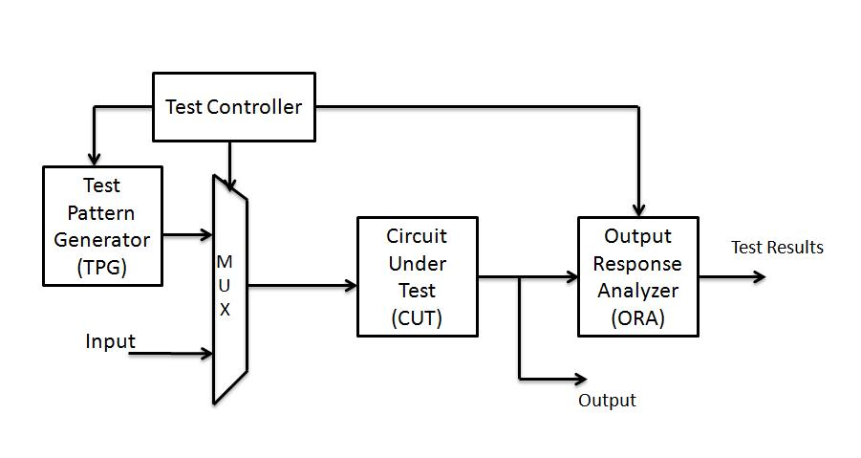
Background
BIST Implementation
Built-In Self Test
  Circuit tests itself
  Test per scan
    BIST applies one test per vector
    Scan in bit by bit a vector, apply one clock then scan out response bit by bit

Slide 6
Background
Scan design
    Chain flip-flops to form shift register during test
    Test vectors scanned in and responses scanned out through mentioned shift register
    Flip-flops function as points of observability and controllability
Scan-BIST
  Scan technique implemented in BIST
Scan out
Scan-in

Slide 7
Background
Transition density T, of a signal is defined as the number of transitions per unit time, i.e.
T=N(t)/t
  transition density of a clock signal is 2 according as there are two transitions, one rising and the other falling in a unit time.
In two bit sequences, even if the number of 1s and 0s are same, the transition density in each case can be different
  0011001100 has a transition density 4/10=0.4
  1010010100 has a transition density 7/10= 0.7
  Even though the number of 1s and 0s are same in both the bit sequences
The number of 1s (0s) in a bit sequence accounts for the weight of the bit sequence.
  Both the sequences have equal weight 4/10=0.4

Slide 8
techniques based on transition density
Low power test generation
  low transition/toggles patterns generators
  Aims to generate high correlation between successive vectors=> test power follows normal mode power
  Control switching activity during test
  Results in longer test sessions to reach sufficient fault coverage
Reduce scan –in time
  Strong correlation between number of transitions in scan cells and test power dissipation[1]
  Low activity in scan chain => scan frequency can be increased without exceeding power budget[2]

Slide 9
Best case transition density selection based on fault coverage
Weighted random patterns
  Generates effective test with shorter length
  For every circuit there exist one weight for random patterns that detects most faults with fewest number of vectors
  Weights are defined as probability of a bit being 1 (or 0)
This is defined as best case weight
  In circuit s1269 0.6 weight (probability of 1s =0.6) is results in best test set generation
Fault profiles of s1269

Slide 10
Best case transition density selection based on fault coverage
Best case transition density
  Analogously effective test set can be generated by generating vectors based on transition density
  There will exist a transition density that will detect more faults with fewer vectors
This is defined as best case transition density
  In circuit s1269 0.5 transition density results in best test set generation
Fault profiles of s1269

Slide 11
Estimation of best transition density from best case weighted random pattern
Fault simulation done with AUSIM for 10000 vectors for weight and transition density of 0.1-0.95 with 0.05 intervals
If best case weight for a circuit is p1
  p1= probability of bit being 1
  P0= probability of bit being 0
  Best case transition density 2*p1*p0
circuit | Target FC | Best case WRP | No of vectors | 2*p1*p0 | Experimental best case TD | No of vectors needed
S298 | 77.1% | 0.6 | 18 | 0.48 | 0.55 | 423
S382 | 95% | 0.3 | 56 | 0.42 | 0.45 | 124
S510 | 95% | 0.4 | 136 | 0.48 | 0.5 | 152
S635 | 95% | 0.9 | 97 | 0.18 | 0.1 | 1883
S820 | 95% | 0.45 | 2872 | 0.495 | 0.45 | 5972
S1196 | 95% | 0.55 | 1706 | 0.495 | 0.45 | 2821
S1269 | 95% | 0.6 | 22 | 0.48 | 0.5 | 24
S1494 | 98.8% | 0.5 | 4974 | 0.5 | 0.45 | 3158
S1512 | 95% | 0.75 | 538 | 0.375 | 0.2 | 338
Best case transition density for ISCAS89 circuits

Slide 12
Comparison between WRP & TD patterns
In some of cases TD patterns are as good as WRP in detecting faults
fault coverage reached by TD is very high
  95%-99%
However 100% fault coverage was not achievable
WRP=weighted random pattern
TD=transition density patterns
Number of vectors needed to reach 95% faults

Slide 13
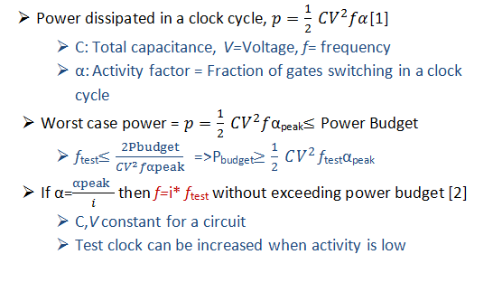
Adapting scan clock with transition density of test vectors
Peak power is the maximum energy consumed in any clock cycle divided by clock period
  Power in any cycle is below peak power =>Peak power never crosses power budget

Slide 14
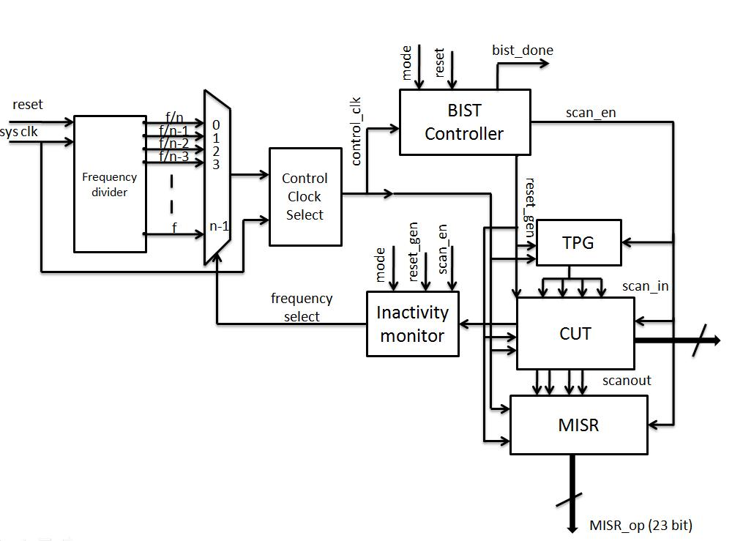
Speedup in scan in time for circuits with multiple chains
Inactivity monitor monitors each scan chain and adds up cumulative non-transitions entered scan chain
Frequency divider block provides frequency
MUX selects required frequency when signaled to step up by inactivity monitor
Adaptive scan clock implementation in scan BIST with multiple chains

Slide 15
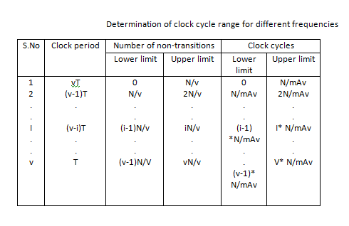
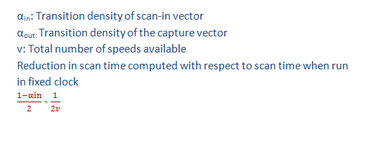
Assuming capture activity α=1
  Number of flip –flops in CUT=N
  Number of scan chains= m
  Flip flops per scan chain=N/m
Scan always starts at lowest frequency
  Step up frequency if cumulative non –transitions in scan chain N/v

Slide 16
Experimental results
The maximum reduction in scan time ca be reached as compared to Fixed clock scan method is 50%
For pseudorandom patterns from the BIST TPG time reduction will be around 25%
Number of vectors chosen based on fault simulation done earlier
Circuit | No. of Flip-flops | No. of gates | Number of vectors applied from TPG | Time savings in percent %
s298 | 23 | 282 | 19 | 29.23
s382 | 30 | 361 | 90 | 32.52
s510 | 32 | 447 | 138 | 29.55
s820 | 42 | 655 | 3455 | 27.55
s1196 | 46 | 885 | 2528 | 27.7
S38417 | 443 | 31834 | 1000 | 27.1
Scan in time reduction in ISCAS89 circuits

Slide 17
The power budget is never crossed.
  For clarity only 100 cycles are plotted
  The green bar is the power budget line => maximum peak power consumed in Fixed scan clock scheme
For simulation
  Time simulated in Modelsim
  Synthesized in Leonardo Spectrum
  SPICE netlist written by Design Architect
  Simulated in NanoSim for peak power report
Per clock peak power consumption with and without adaptive scheme for s1196

Slide 18
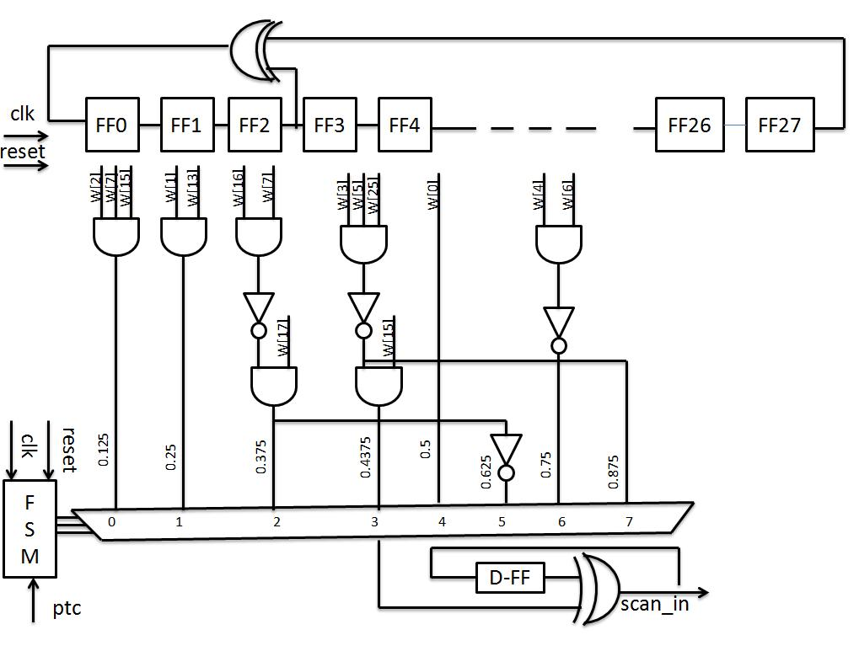
Modified TPG for Controlling Transition density
We propose a modified TPG
  A LFSR => a 28 bit LFSR is used with external feedback
  A combinational part to generate weights (probability of 1s and 0s)
  A FSM to select from the weights
  A Toggle flip –flop to generate transitions according to the weight selected.
  FSM keeps track of numbers of patterns applied through the BIST controller
Simple AND gates and inverters are used for weights.
Output s of non adjacent cells are taken to construct the weights
Modified test patterns to control transition density

Slide 19
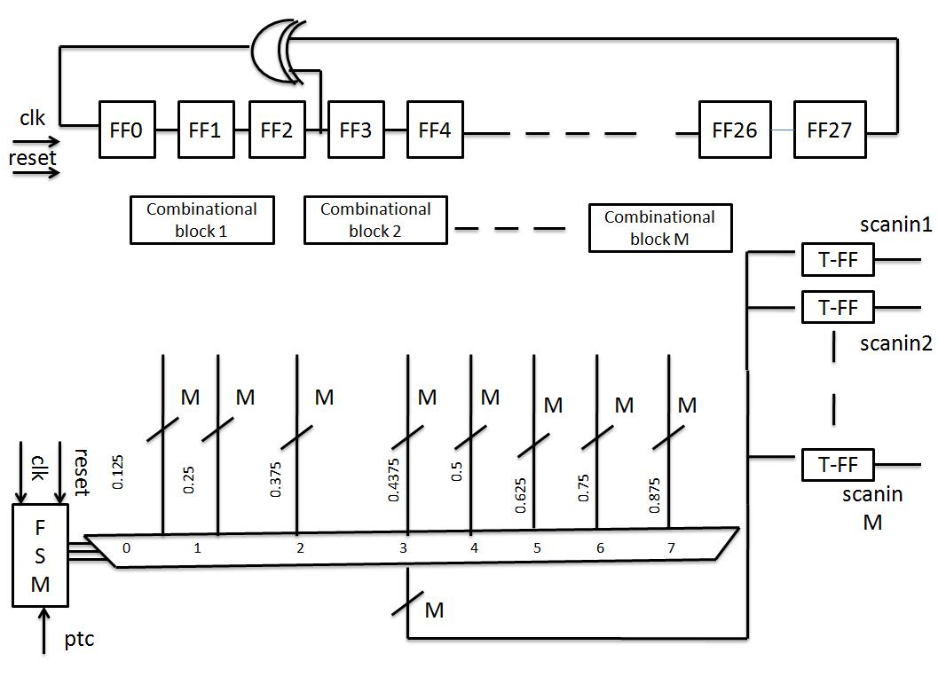
For multiple chains
  The weights are duplicated.
  All the single wires are changed to M bit bus
  M flip-flops are added
A negligible area overhead
Modified test patterns to control transition density-multiple chains

Slide 20
The conventional TPG is replaced by the modified TPG

Slide 21
Fault coverage by modified TPG
10000 vectors for each transition density were generated
Faults simulation were done in AUSIM using HPCC
0.25 TD gives the best test set with shortest length.
The speed up will be effective in this case
Total test time will reduce if 0.25 transition density used in place of 0.5
Adaptive scheme can also speed up
  Best case wrp=0.875
  Best case td= 2*0.875*0.125
  =0.21877
performance of vectors based on transition density and weighted random pattern s1512

Slide 22
For circuit s510
  10000 vectors for each transition density were generated
  Faults simulation were done in AUSIM using HPCC
0.4375 TD gives the best test set with shortest length.
The speed up will not be effective in this case
Total test time will reduce will not reduce
It is to be noted
  Best case wrp=0.4375
  Best case td= 2*0.4375*0.125
  =0.4921
performance of vectors based on transition density and weighted random pattern s510

Slide 23
Fault profiles for transition densities 0.1 -0.5 shows
  70% faults can be detected with any TD with almost same number of vectors
  The higher fault coverage the more efficient is the best case transition density
For circuits with best case 0.4-0.5
  A controlled transition density mixing gives same coverage with same number of vectors

Slide 24
A greedy approach
  Problem solving heuristic
    At each stage find a locally optimal solution
    Finding locally optimal solution at every step may generate globally optimal solution
    For many problems it may fail to produce globally optimum
    Solutution
  Five pillars
    A candidate set, from which a solution is created
    A selection function, which chooses the best candidate to be added to the solution
    A feasibility function, that is used to determine if a candidate can be used to contribute to a solution
    An objective function, which assigns a value to a solution, or a partial solution, and
    A solution function, which will indicate when we have discovered a complete solution

Slide 25
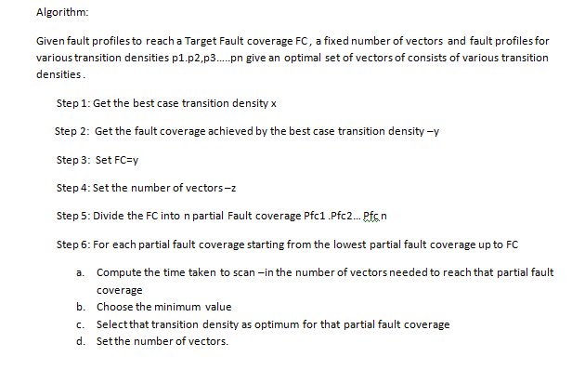
Candidate set
  n Number of partial fault coverage
Selection function
  At each parital coverage,select TD with min(vector* time reduction)
Feasibility function
  Total number of vectors < best case transition density vectors
Objective function
  Overall reduction in scan in time
Solution function
Target fault coverage reached

Slide 26
A matlab program was written to implement the algorithm
Fault profile generated from AUSIM was used as the candidate to select from
 | Best case TD | Mix TD
FC | 99% | 99%
Number of vectors | 492 | 492
Transition density | 0.5 | Pfc1 70%-- TD 0.25 vectors 16 Pfc2 80% -- TD 0.25 vectors 14 Pfc3 85% --TD 0.4 vectors 14 Pfc4 90% --TD 0.5 vectors 32 Pfc5 95%--TD 0.5 vectors 76 Pfc6 99%--TD 0.4 vectors 304

Slide 27
The resultant vector set with mixed transition density is as good as the best case transition density
Test application time can be reduced if lower frequency are given
Fault profiles comparison between best case transition density and mixed transition density

Slide 28
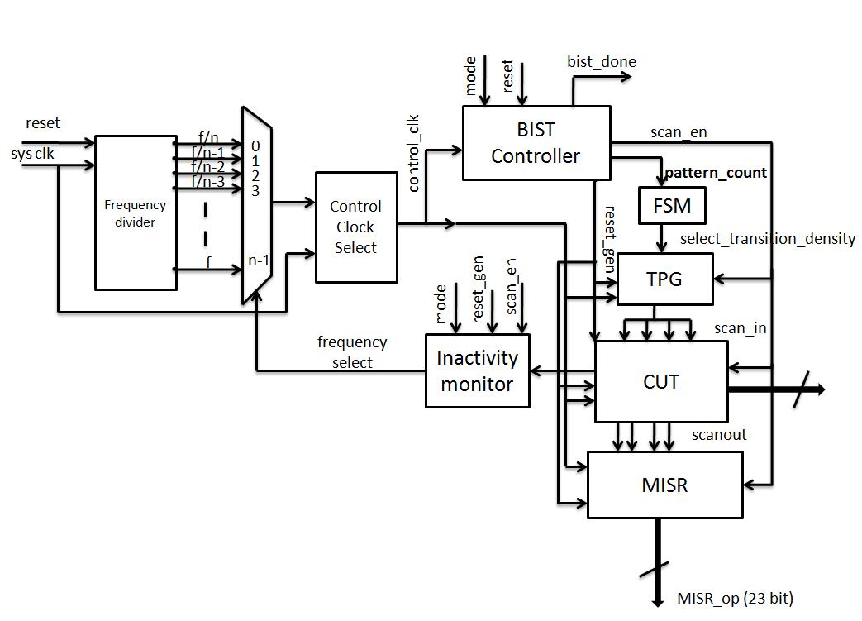
The same hardware can be used
FSM is programmed
Vary transition densities as decided by the algoritm

Slide 29
Greedy algorithm was able to choose the transition densities without sacrificing fault coverage

Slide 30
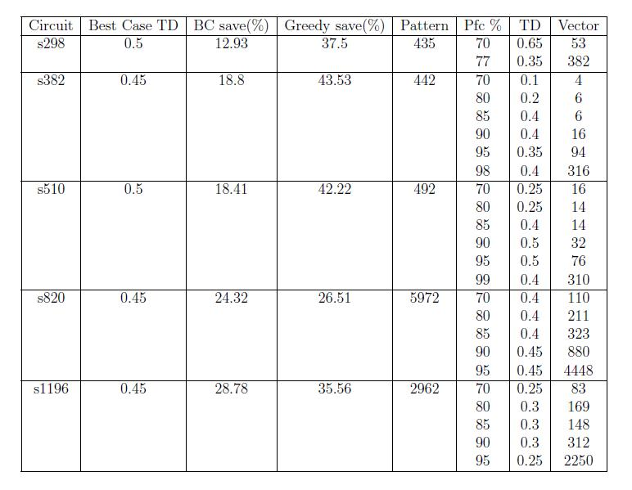

Slide 31
Conclusion
Transition density can be effectively chosen to
  Generate test of shorter length
Combining best case transition density and adaptive scan clock scheme test application time can be reduced
  Best case transition density if lies below 0.4 we can speed up test better.
  For transition densities 0.4 -0.5 greedy method can be used to choose the mixing of transition density effectively
  The experimental results show a further 10-13% decrese in test application time
In the future, more sophisticated methods for obtaining the controlled transition density mixing in the vector set by using linear programming should be examined to balance the test time and test power more efficiently.

Slide 32
Thank you

