Slide 1
Characterizing Processors for Time and Energy Optimization Master’s Thesis Defense Harshit Goyal Thesis Advisor: Dr. Vishwani Agrawal Thesis Committee: Dr. Prathima Agrawal Dr. Victor P Nelson
Department of Electrical and Computer Engineering
Auburn University, AL 36849 USA

Slide 2
Acknowledgment
Prof. Vishwani Agrawal and Prof. Prathima Agrawal for their invaluable guidance throughout my work,
Prof. Victor P Nelson for being my committee member and for his courses that helped me understand various tools,
All staff members of EE department,
My friends and family for their support throughout my research.

Slide 3
Outline
Introduction
Problem Statement
Background
Methodology
Simulation setup
Results
Applications
Conclusion

Slide 4
Introduction
Microprocessors—single-chip computers—are the building blocks of the information world.
In the next two decades, diminishing transistor-speed scaling and practical energy limits create new challenges for continued performance scaling.
Energy efficiency is the new fundamental limiter of processor performance, way beyond numbers of processors.

Slide 5
Motivation
Performance
Power
Area
Performance, Power and Area are three conflicting goals, and industry demands that all three aspects be co-optimized.
To obtain a complete performance modelling requires marrying everything from high-level modelling and synthesis to better characterization and verification.

Slide 6
Problem Statement
Obtain data on voltage, frequency and cycle efficiency of the processor for time and energy optimization.
Determine operating conditions (voltage and frequency) for optimal time energy operations.

Slide 7
Background

Slide 8
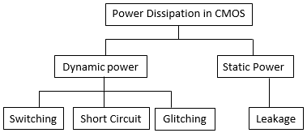
Where Does Power Go in CMOS?
There are three main sources of power dissipation:
Dynamic power dissipation
Short circuit dissipation
Static/Leakage dissipation

Slide 9
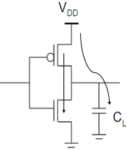
Dynamic Power
Power = Energy/transition • Transition rate
Due to charging and discharging of capacitances. = C_{L}V_{DD} • f_{0→1 (1)} = C_{L}V_{DD}² • f • P_{0→1 (2)} = C_{switched}V_{DD}² • f ₍₃₎
Power dissipation is data dependent – depends on the switching probability
Switched capacitance C_{switched} = P_{0→1}C_{L}= α C_{L} (α is called the switching activity)

Slide 10
Short Circuit Power and Static power
Short Circuit Power
Occurs during signal transitions when both pullup and pulldown paths are partially conducting causing a direct path between Vdd and GND.
Static Power
This power dissipation occurs all the time through leakage even when the device is in standby mode and is given as:
P_{static} = I_{static} V_{dd}
Notes:
Since there is a finite rise/fall time for both pMOS and nMOS, during transition, for example, from off to on, both the transistors will be on for a small period of time in which current will find a path directly from V_{DD} to ground, hence creating a short-circuit current. Short-circuit power dissipation increases with rise and fall time of the transistors.
static power essentially consists of the power used when the transistor is not in the process of switching.

Slide 11
Characterization
What is Characterization?
Characterization over Process, Voltage, Frequency, Power, Temperature
Performance Metric
Energy Efficiency Metric

Slide 12
Existing Energy Efficiency Metrics
PDP(Power Delay Product)/Energy per Cycle
PDP = P_{avg} x t_{p}
Energy Delay Product.
Cycle Efficiency

Slide 13
Existing Performance Metrics
Clock Frequency
MIPS
MFLOPS
Synthetic Benchmarks
Performance per Watt

Slide 14
Two Performances
Time performance = $\frac{1}{Execution Time}$
Energy Performance = $\frac{1}{Energy Dissipated}$

Slide 15
Performances Measures
Time Performance of Processor.
Speed of a processor is measured in cycles per second or clock frequency (f).
Here a clock cycle means 1/f second in time
Execution time of a program using C clock cycles = C/f
Time performance = f/C
Energy Performance of a Processor.
Efficiency of a processor may be measured in cycles per joule or cycle efficiency (η).
Also, a clock cycle means 1/ η joule in energy
Energy dissipated by a program using C clock cycles = C/η
Energy performance = η/C
So the power consumed can be given as, P = f/ η (Product of Energy and Time)

Slide 16
Methodology
Technology Characterization
Simulate a reasonable size adder circuit using selected vectors.
Scale adder data to obtain processor power (cycle efficiency) and frequency at different operating points using scale factors.
Develop power management scenarios using cycle efficiency and frequency.

Slide 17
Simulation Tools Used
Questa Sim
Design, compile and simulate designs
Leonardo Spectrum
ASIC and standard cell synthesis
Design Architect-IC
Schematic Capture
HSPICE
Circuit simulation and verification

Slide 18
Micro-Benchmark Circuit Used
Adder circuit
Fundamental block of functional units
Often in processor’s critical path
Used 16-bit Ripple Carry Adder.
PTM Models
Characterized in two PTM models: bulk CMOS and High-K
Technology node: 45nm, 32nm and 22nm

Slide 19
Results

Slide 20
Vector Selection
1000 random vectors were generated using a MATLAB code
Simulation in H-spice in 90nm Bulk CMOS PTM at 1.4 volts and frequency 1.45 GHz gives cycle avg. power per vector.

Slide 21
Vector Selection (contd.)
Out of 1000 random vectors 50 vector pair were selected such that:
16 consume avg. power
17 consume above avg. power including the peak power vector pair
17 consume below avg. power including the min. power vector pair

Slide 22
Adder Simulation Data
Simulation Data from H-spice for 32nm Bulk CMOS PTM Model
Voltage | Power from simulation |  |  |  | Timing from simulation |  | Energy per cycle
V_{dd} (v) | p_{avg.} (µW) | p_{dyn} (µW) | p_{static} (µW) | P_{peak} (µW) | Critical path Delay (ps) | f_{max} (GHz) | e_{dyn} (fJ) | e_{static} (fJ) | e_{avg.} (fJ)
1.2 | 124.03 | 91.37 | 32.66 | 397.71 | 320.85 | 3.12 | 29.32 | 10.48 | 39.8
1.15 | 100.5 | 78.31 | 22.19 | 335.74 | 338.91 | 2.95 | 26.54 | 7.52 | 34.06
1.1 | 81.93 | 66.72 | 15.21 | 261.9 | 360.46 | 2.77 | 24.05 | 5.48 | 29.53
1.05 | 66.21 | 55.74 | 10.47 | 217.46 | 386.5 | 2.59 | 21.54 | 4.05 | 25.59
1 | 53.77 | 46.51 | 7.26 | 178.2 | 418.72 | 2.39 | 19.47 | 3.04 | 22.51
0.95 | 42.65 | 37.58 | 5.07 | 144.77 | 459.03 | 2.18 | 17.25 | 2.33 | 19.58
0.9 | 33.4 | 29.83 | 3.57 | 115.34 | 509.72 | 1.96 | 15.21 | 1.8202 | 17.03
0.8 | 19.08 | 17.32 | 1.751 | 73.71 | 666.65 | 1.5 | 11.55 | 1.167 | 12.72
0.7 | 9.59 | 8.73 | 0.856 | 35.76 | 986.51 | 1.014 | 8.62 | 0.844 | 9.46
0.6 | 3.97 | 3.57 | 0.406 | 14.71 | 1792.1 | 0.558 | 6.39 | 0.727 | 7.12
0.5 | 1.138 | 0.956 | 0.182 | 4.01 | 4511.7 | 0.222 | 4.31 | 0.819 | 5.13
0.4 | 0.229 | 0.15 | 0.079 | 0.695 | 18928 | 0.053 | 2.84 | 1.488 | 4.33
0.35 | 0.1 | 0.048 | 0.051 | 0.233 | 44168 | 0.023 | 2.13 | 2.27 | 4.4
0.3 | 0.047 | 0.014 | 0.033 | 0.09 | 112760 | 0.009 | 1.601 | 3.75 | 5.35
0.25 | 0.025 | 0.004 | 0.021 | 0.036 | 279310 | 0.004 | 1.056 | 5.85 | 6.91
0.2 | 0.014 | 0.0009 | 0.013 | 0.017 | 716150 | 0.0014 | 0.645 | 9.08 | 9.73
0.15 | 0.0074 | 0.0002 | 0.0072 | 0.0086 | 1851700 | 0.0005 | 0.3494 | 13.27 | 13.62

Slide 23
Power and EPC for Adder
Average, peak, dynamic and static power
PDP/Energy per cycle

Slide 24
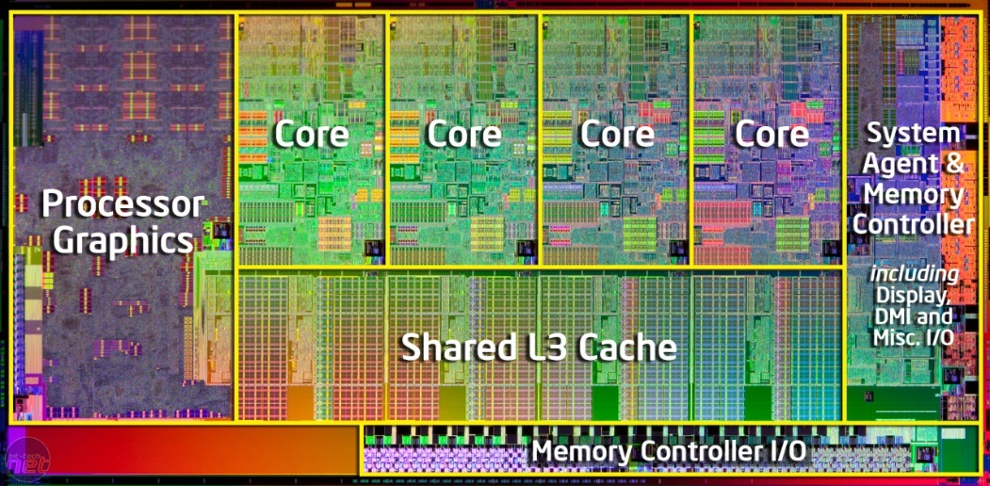
Processor Specifications
Intel i5 Sandy Bridge 2500K | Specifications
Technology Node | 32nm
Voltage Range | 1.2 - 1.5 volts
Nominal Base Frequency, ${\text{ƒ}}_{TDP}$ | 3.3 GHz
Overclock Frequency, ${\text{ƒ}}_{max}$ | 5.01 GHz
Thermal Design Power, TDP | 95 Watts
Peak Power | 132 Watts

Slide 25
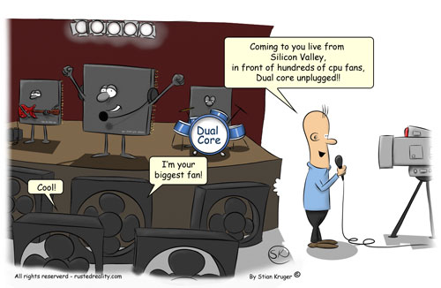
Intel Definitions
TDP- is the average maximum power in watts the processor dissipates when operating at base frequency with all cores active under a manufacturer defined, high complexity workload.
Peak power is the maximum power dissipated by the processor.

Slide 26
Scale Factors

Slide 27
Area Scale Factors
All the scaling factors were found using processor’s specifications given at rated voltage 1.2v assuming that voltage was not raised for overclock frequency.
Total power both circuits are given as:
$p=(edyn×fmax)+pstat$ (1) (Total Power for Adder)
$TDP=(Edyn×fTDP)+Pstat$ (2) (Total Power for Processor)
Since we selected our vectors in specific way, therefore the activity produced in both the circuits is assumed to be same and hence the activity factor in this case is 1. Now, if β is the scale factor representing the relative size of processor to adder circuit and σ is the voltage factor i.e. both the adder as well as processor are simulated at same supply voltage, then eq. 1 modifies eq. 2 as:
$TDP=σβ[\left(edyn×fTDP\right)+pstat]$
Solving for β gives:
$β= \frac{TDP}{σ[\left(edyn×fTDP\right)+pstat] }$ at rate voltage and frequency

Slide 28
Frequency Scale Factors
Processor base frequency ($fnom$) describes the rate at which the processor's transistors open and close. The processor base frequency is the operating point where TDP is defined and is given as:
$fnom =δ×fmax \left(Adder\right)$
Where, δ is a scale factor for $fnom$ and is given by,
δ $=\frac{fnomVdd (Processor)}{fmaxVdd (Adder)}$ (Frequencies at rated voltage =1.2 volts)
In a structure constrained system, the frequency $(fmax$) is limited by the critical path delay of the circuit as follows:
$fmax =γ×fmax \left(Adder\right)$ (3)
Where, $γ$ is a scale factor for $fmax$ and is given by,
$γ$ $=\frac{fmaxVdd (Processor)}{fmaxVdd (Adder)}$ (Frequencies at rated voltage =1.2 volts)

Slide 29
Frequency Scale Factors (contd.)
In a power constrained system ^{[10-12]}, the frequency $(\text{f}\text{TDP}$) is limited by the maximum allowable power of the circuit. In general it can be represented as,
$\text{f}\text{TD}\text{P}= \frac{TDP−βσpstat}{βσ\left(edyn\right)}$ (4)

Slide 30
Scale Factor Summary
Scale Factors | Calculated Values
Voltage factor, σ | 1
f_{nom,} δ | 1.0588
f_{max,} γ | 1.6075
Area factor, β | 7.3414$×{10}^{5}$

Slide 31
Energy per Cycle and Cycle Efficiency for Processor
The energy per cycle for the processor for the nominal frequency and overclock/maximum frequency for a any given Vdd is defined by:
$EPCnom=\frac{TDP}{fnom}$ (5)
$EPCF0 = \frac{Pdyn}{fnom}+\frac{Pstatic}{F0}$ (6) (f_{nom} $≤$F0 $≤$ f_{max})
Here in this case, F₀ = f_{max} = 5.01 GHz, therefore we call EPC_{Fo} as EPC_{fmax}
As we know, cycle efficiency is given by η=1/EPC , eq. 5 and 6 gives:
$η=\frac{1}{EPCnom}$ and, $η0=\frac{1}{EPCF0}$ (f_{nom} $≤$F0 $≤$ f_{max})
Here, EPC_{Fo} = EPC_{fmax} therefore we call$η$₀ as peak cycle efficiency.

Slide 32
Scaled Values for Intel i5 2500K Processor
Voltage | Scaled Power |  |  | Scaled Frequency |  | Energy per cycle |  | Cycle efficiency
V_{dd} (v) | P_{avg.} (W) | P_{dyn} (W) | P_{static} (W) | f_{nom} (GHz) | f_{max} (GHz) | E_{fnom} (nJ) | E_{fmax} (nJ) | η (10⁶cycles/J) | ηo (10⁶cycles/J)
1.2 | 95 | 71.02 | 23.98 | 3.3 | 5.01 | 28.79 | 26.31 | 34.74 | 38.01
1.15 | 77.16 | 60.87 | 16.29 | 3.12 | 4.74 | 24.7 | 22.92 | 40.49 | 43.63
1.1 | 63.03 | 51.86 | 11.17 | 2.94 | 4.46 | 21.46 | 20.16 | 46.6 | 49.6
1.05 | 51.01 | 43.33 | 7.69 | 2.74 | 4.16 | 18.62 | 17.66 | 53.7 | 56.61
1 | 41.48 | 36.15 | 5.33 | 2.53 | 3.84 | 16.4 | 15.68 | 60.96 | 63.76
0.95 | 32.93 | 29.21 | 3.72 | 2.31 | 3.5 | 14.28 | 13.73 | 70.04 | 72.85
0.9 | 25.81 | 23.19 | 2.62 | 2.08 | 3.15 | 12.43 | 11.99 | 80.48 | 83.37
0.8 | 14.75 | 13.47 | 1.286 | 1.588 | 2.41 | 9.29 | 9.01 | 107.66 | 110.96
0.7 | 7.42 | 6.79 | 0.628 | 1.073 | 1.629 | 6.91 | 6.71 | 144.71 | 149.02
0.6 | 3.07 | 2.77 | 0.298 | 0.591 | 0.897 | 5.2 | 5.02 | 192.43 | 199.02
0.5 | 0.877 | 0.743 | 0.133 | 0.235 | 0.356 | 3.74 | 3.54 | 267.7 | 282.35
0.4 | 0.174 | 0.117 | 0.058 | 0.056 | 0.085 | 3.12 | 2.76 | 321.02 | 361.92
0.35 | 0.075 | 0.038 | 0.038 | 0.024 | 0.036 | 3.14 | 2.6 | 318.66 | 384.45
0.3 | 0.035 | 0.011 | 0.024 | 0.0094 | 0.014 | 3.77 | 2.89 | 265.04 | 346.44
0.25 | 0.018 | 0.0029 | 0.015 | 0.0038 | 0.0058 | 4.83 | 3.45 | 206.93 | 290.03
0.2 | 0.01 | 0.0007 | 0.0093 | 0.0015 | 0.0022 | 6.77 | 4.62 | 147.71 | 216.41
0.15 | 0.0054 | 0.0001 | 0.0053 | 0.0006 | 0.0009 | 9.46 | 6.32 | 105.74 | 158.31

Slide 33
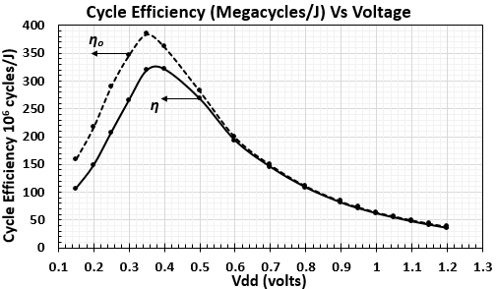
Processor Power and Cycle Efficiency Plots
Because our own greatest access and insight involves Intel designs and data, our graphs and estimates draw heavily on them.

Slide 34
Application

Slide 35
Power and Performance Management
Plot showing proposed “Power Management Method" for three different regions.

Slide 36
Optimum Voltage and Frequency
Power dissipation depends on the time period used
To maintain the same power dissipation, clock period can be reduced i.e. increasing frequency.
To maximize the performance we find the highest frequency, f_{opt} that would exceed neither the power constraint nor the critical path i.e.
$\text{f}\text{opt}=\text{f}\text{max}=\text{f}\text{TDP}$
Using eq. 3 and 4, we measure f_{TDP} and f_{max} for different supply voltages.

Slide 37
Optimum Voltage and Frequency (contd.)
Voltage V_{dd} (Volts) | Clock Frequencies (MHz) |  | Cycle efficiency
 | Structure Constrained (f_{max}) | Power Constrained (f_{TDP}) | Peak η₀ at f_{max} (10⁶ cycles/J) | η_{TDP} at f_{TDP} (10⁶ cycles/J)
1.3 | 5486 | 2243 | 31.09 | 23.57
1.25 | 5257 | 2761 | 34.22 | 29.04
1.2 | 5010 | 3300 | 38.01 | 34.74
1.15 | 4740 | 4040 | 43.63 | 42.52
1.112 | 4531 | 4531 | 47.91 | 47.91
1.1 | 4460 | 4750 | 49.6 | 49.98
1.05 | 4160 | 5520 | 56.61 | 58.11
1 | 3840 | 6270 | 63.76 | 66.02
0.95 | 3500 | 7210 | 72.85 | 75.87
0.9 | 3150 | 8280 | 83.37 | 87.11
$\text{f}\text{TDP}= \frac{TDP−βσpstat}{βσ\left(edyn\right)}$ and $fmax =γ×fmax \left(Adder\right)$

Slide 38
Optimum Voltage and Frequency (contd.)
Plotting and curve fitting these two functions for f and η in Excel gives 4 polynomial equations:
f_{max}= -168.35(V_{dd})³ - 2991.2(V_{dd})² + 13042(V_{dd}) - 6043 (7)
f_{TDP} = -9730.6(V_{dd})³ + 45254(_{Vdd})² – 78922(V_{dd}) + 49719 (8)
η₀ = -66.649(V_{dd})³ + 412.23(V_{dd})² - 792.82(V_{dd}) + 511.39 (9)
η_{TDP} = -100.33(V_{dd})³ + 468.29(V_{dd})² - 820.67(V_{dd}) + 519.25 (10)
The highest power is 3 and is solvable using any Numerical solver such as MATLAB.
Discarding 2 complex roots, the real root gives V_{dd} = 1.112 volts = V_{ddopt}
Substituting V_{dd} = V_{ddopt} in eq. (7) or (8) gives f_{opt} = 4531 MHz
Substituting V_{dd} = V_{ddopt} in eq. (9) or (10) gives η_{opt} = 47.91$×$10⁶cycles/J.

Slide 39
Power and Performance Management (contd.)

Slide 40
Energy Efficient Point (Processor)

Slide 41
Managing the processor operation for Time and Energy
TIME AND ENERGY FOR A PROGRAM THAT EXECUTES IN c= 2 BILLION CLOCK CYCLES
Operating Modes | Voltage (volts) | Clock Frequency f (MHz) | Cycle Efficiency η (10⁶cycles/J) | Power Consumption (Watts) $\frac{f}{η}$ | Execution Time (seconds) $\frac{C}{f}$ | Total Energy (Joules) $\frac{C}{η}$
Nominal Operating Point | 1.2 | 3300 | 34.74 | 95W | 0.61 | 57.57
Overclocked Operating Point 20% Ovrclk |  | At 3300 (80% task) | 34.74 | 95W | 0.485+0.0798 =0.57 | 46.06+10.52 = 56.58
 | 1.2 | At 5010 (20% task) | 38.01 | 132W
Optimum Operating Point | 1.112 | 4531 | 47.91 | 95W | 0.44 (-28%) | 41.75 (-28%)
Dynamic Voltage scale point | 0.92 | 3300 | 79.01 | 41.77W (-56%) | 0.61 (0%) | 25.31 (-56%)
Energy Efficient point | 0.35 | 36.39 | 384.45 | 0.0946 | 54.96 | 5.2

Slide 42
Summary
PTM Models | Intel Processor used | Nominal Operation |  |  |  |  | Performance Optimization |  |  | Energy Optimization
 |  | Rated Specifications |  |  | Optimized
 |  | f_{TDP} (MHz) | V_{dd} (v) | η_{TDP} (10⁶ c/J) | V_{dd} (v) | η_{TDP} (10⁶ c/J) | V_{ddopt} (v) | f_{opt} (MHz) | η_{opt} (10⁶ c/J) | V_{dd} (v) | f_{η0} (MHz) | η₀ (10⁶ c/J)
45nm bulk | Core 2 Duo T9500 | 2600 | 1.25 | 74.29 | 1.07 | 108.58 | 1.2 | 2920 | 82.28 | 0.35 | 33.51 | 829.29
45nm High-K | Core 2 Duo T9500 | 2600 | 1.25 | 74.29 | 0.79 | 350.91 | 1.226 | 3120 | 89.08 | 0.3 | 304.48 | 1795
32nm bulk | Core i5-2500K | 3300 | 1.2 | 34.74 | 0.92 | 79.01 | 1.112 | 4531 | 47.91 | 0.35 | 36.39 | 384.45
32nm High-K | Core i5-2500K | 3300 | 1.2 | 34.74 | 0.67 | 267.57 | 1.155 | 4940 | 51.77 | 0.3 | 414.23 | 953.81
22nm bulk | Core i7- 3820QM | 2700 | 0.8 | 60 | 0.7 | 96.22 | 0.771 | 3494 | 75.46 | 0.38 | 177.25 | 213.99
22nm High-K | Core i7- 3820QM | 2700 | 0.8 | 60 | 0.61 | 137.65 | 0.76 | 3626 | 80.38 | 0.3 | 332.58 | 375.76

Slide 43
Conclusion
Present Work
Simulation based evaluation.
Power management is described through:
Improving rated cycle efficiency
Performance optimization
Energy optimization
Future Work
Process variation can be taken in account
Effect of noise margin in sub-threshold region
Better evaluation of activity factor

Slide 44
References
[1] Harshit Goyal and V. D. Agrawal, “Characterizing Processors for Energy and Performance Management” in Proc. 16th International Workshop on Microprocessor/SoC Test and Verification (MTV), Austin, Texas, Dec. 3-4, 2015
[2] Harshit Goyal and V. D. Agrawal, “Characterizing Processors for Energy and Performance Management” IEEE VLSI Test Symposium, Las vegas, CA, April 2016 (Poster)
[3] D. A. Patterson and J. L. Hennessy, Computer Organization& Design, the Hardware/Software Interface. San Francisco, California: Morgan Kaufman, fourth edition, 2008.
[4] Aditi shinde and V. D. Agrawal, “Managing Performance and Efficiency of a Processor”, in proc. 45th Southeastern Symp. System Theory, 2013.
[5] K. Kim and V. D. Agrawal, “Dual Voltage Design for Minimum Energy using Gate Slack,” in Proc. International Conf. on Industrial Technology, 2011, pp. 419–424.
[6] K. Kim and V. D. Agrawal, “Minimum Energy CMOS Design with Dual Subthreshold Supply and Multiple Logic-Level Gates,” in Proc. International Symp. Quality Electronic Design, 2011, pp. 689–694.
[7]. Bienia, C. et. al. The PARSEC benchmark suite: Characterization and architectural implications. The 17th International Symposium on Parallel Architectures and Compilation Techniques (2008).
[8]. Borkar, Shekhar, and Andrew A. Chien. "The future of microprocessors."Communications of the ACM 54.5 (2011): 67-77.

Slide 45
References
[9] Wang, A; Chandrakasan, AP.; Kosonocky, S.V., "Optimal supply and threshold scaling for subthreshold CMOS circuits," VLSI, 2002. Proceedings. IEEE Computer Society Annual Symposium on , vol., no., pp.5,9, 2002
[10] Venkataramani, P. Reducing ATE Test Time by Voltage and Frequency Scaling. PhD thesis, Auburn University, Auburn, AL, May 2014.
[11] Venkataramani, P., Sindia, S., and Agrawal, V. D. A Test Time Theorem and its Applications. Journal of Electronic Testing: Theory and Applications 30, 2 (2014), 229-236.
[12] Venkataramani, P., and Agrawal, V. D. Reducing Test Time of Power Constrained Test by Optimal Selection of Supply Voltage. In Proc. 26th International Conf. VLSI Design (Jan. 2013), pp. 273-278.
[13] Design Architect User Guide. Mentor Graphics Corp., Wilsonville, OR, 1991-1995.
[14] HSPICE Signal Integrity User Guide. Synopsys, Inc., 700, East Middlefield Road,
Mountain View, CA 94043, 2010.
[15] Leonardo Spectrum User Guide. Mentor Graphics Corp., Wilsonville, OR, 2011.
[16] Questa Sim User Guide. Mentor Graphics Corp., Wilsonville, OR, 2011.
[17] Intel Core i5-2500K Processor (6M Cache, up to 3.70 GHz) Specifications, 2016. http://ark.intel.com/products/52210/Intel-Core-i5-2500K-Processor-6M-Cache-
up-to-3 70-GHz.

Slide 46
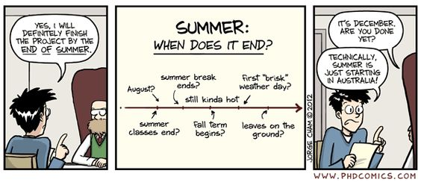
Questions?
Thank You

