Slide 1

Dictionary-Less Defect Diagnosis as Real or Surrogate Single Stuck-At Faults
Master’s Defense
Chidambaram Alagappan
Thesis Advisor: Dr. Vishwani D. Agrawal
Thesis Committee: Dr. Charles E. Stroud and Dr. Victor P. Nelson
Department of Electrical and Computer Engineering
Auburn University, AL 36849 USA

Slide 2
Presentation Outline
Motivation
Introduction and Background
Problem Statement
Diagnosis Algorithm
  Proposed Diagnosis Algorithm
  Analysis of the Algorithm
  Experimental Results
Conclusion

Slide 3
Motivation
Scaling down of device features to an extent that it can be expressed in two digit number of nanometers has made VLSI chip manufacturing, often suffer a relatively low yield.
Fault Diagnosis proves helpful in ramping up the yield.
Most fault diagnosis procedures are fault model dependent.
In this work, we propose a diagnosis procedure using single stuck-at fault analysis, without assuming that the actual defect has to be a stuck-at fault.
Notes:
Every presentation on fault diagnosis starts by quoting Moore’s law, which says that every 18 months, the transistor count on an IC doubles approximately.

Slide 4
Presentation Outline
Motivation
Introduction and Background
Problem Statement
Diagnosis Algorithm
  Proposed Diagnosis Algorithm
  Analysis of the Algorithm
  Experimental Results
Conclusion

Slide 5

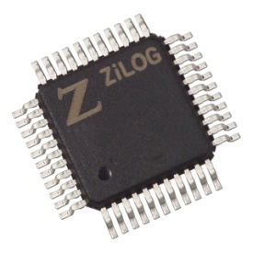
Fault Diagnosis
Test Vectors
Diagnosis
Algorithm
Circuit Netlist
Defective Circuit
Actual Response
Observed Response
Possible
Faults
Compare

Slide 6
Test Vector Set
Exhaustive Test Set – Apply every possible input combination.
Functional Test Set – Exercise every functional node with every possible data set.
Fault Model Derived Test Set – A test pattern for every modeled fault.
Automatic Test Pattern Generation (ATPG) can also identify redundant logic and prove whether one circuit implementation matches another.

Slide 7
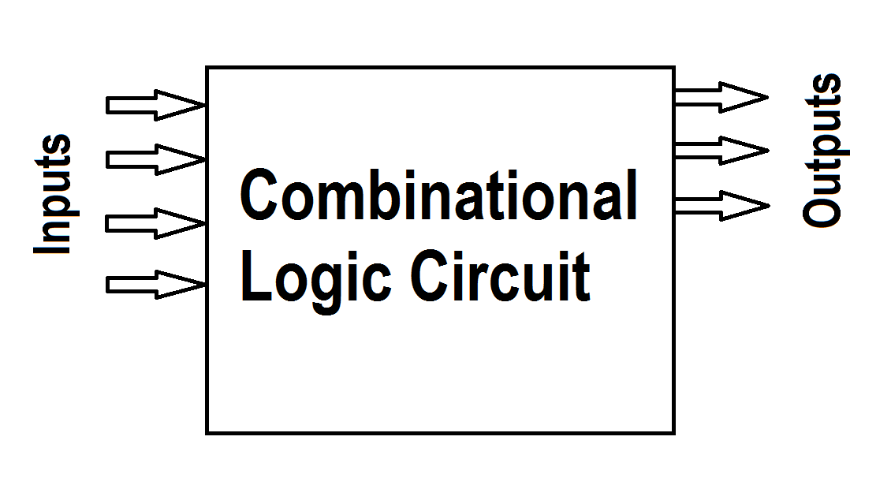
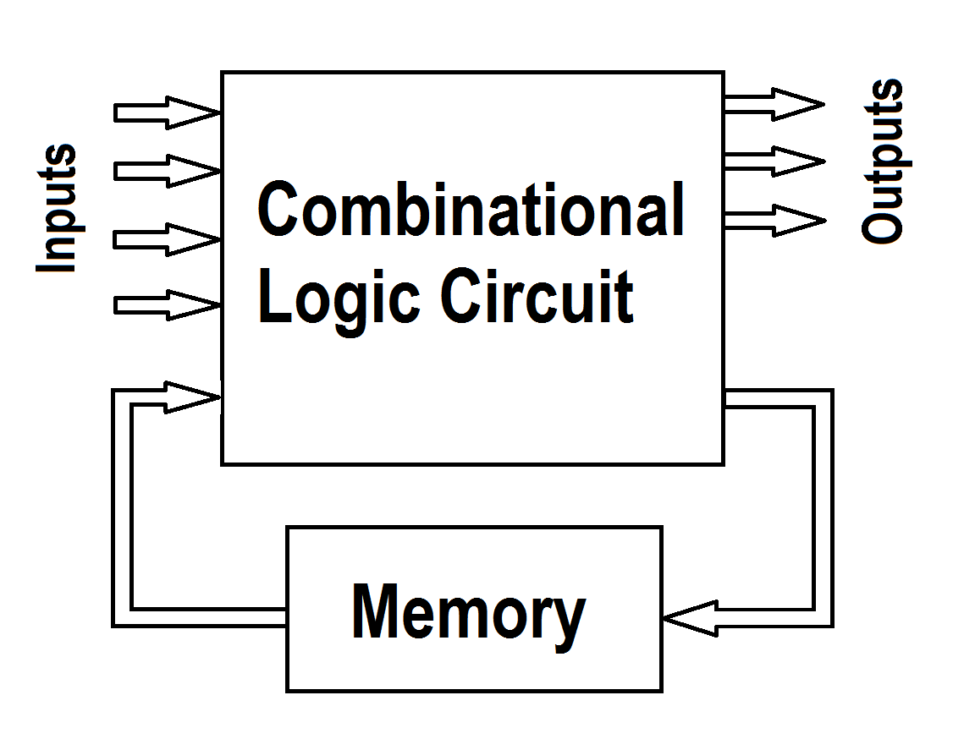
Circuit Under Test
The Circuit Under Test (CUT) can be
  Combinational Circuit: (time-independent logic)
  Sequential Circuit:
Notes:
Combinational – Boolean function which maps the input bit string to output bit string. Purely dependent on current inputs.
Sequential – Memory elements updated when clock signal is triggered. Dependent both on current and past inputs.
Scan Based Design technique.

Slide 8
Fault Simulation
Reverse of ATPG. Inputs – test patterns & fault list.
Fault Dropping Technique.
Fault Coverage (FC) – Quantitative measure of effectiveness of test vector set.
FC = (#Detected Faults)/(Total faults in fault list)
ATPG and Fault Simulator work interactively to achieve high FC.

Slide 9
Fault Models
Abstraction of a defect as an analyzable change in the chip.
Stuck-At Fault – Single and Multiple
  Stuck-at 0 or Stuck-at 1.
Bridging Fault – WAND/WOR and Dominant
  Low resistance short due to under etching.
Transistor Level Stuck Fault – Stuck open and Stuck short
  SAF for Stuck open (memory effect). IDDQ testing for stuck short.
Delay Fault – Gate delay and Path delay
  Gate delay – slow-to-fall and slow-to-rise transitions.
  Path delay - Input to output timing unacceptable.

Slide 10
Fault Diagnosis Strategies
Cause-effect analysis
  Builds simulation response database for modeled faults.
  Not suitable for large designs.
  Too much information increases resources used.
Effect-cause analysis
  Analyzes failing outputs to determine cause
  Backward trace for error propagation paths for possible faults.
  Memory efficient and suitable for large designs.

Slide 11
Presentation Outline
Motivation
Introduction and Background
Problem Statement
Diagnosis Algorithm
  Proposed Diagnosis Algorithm
  Analysis of the Algorithm
  Experimental Results
Conclusion

Slide 12
Problem Statement
Given the failing response of a defective circuit
  Failing patterns
  Erroneous outputs
Given the good circuit netlist
  Verilog Description
  Provide potential fault(s) or surrogates of the potential fault(s) which cause the circuit to fail.

Slide 13
Presentation Outline
Motivation
Introduction and Background
Problem Statement
Diagnosis Algorithm
  Proposed Diagnosis Algorithm
  Analysis of the Algorithm
  Experimental Results
Conclusion

Slide 14
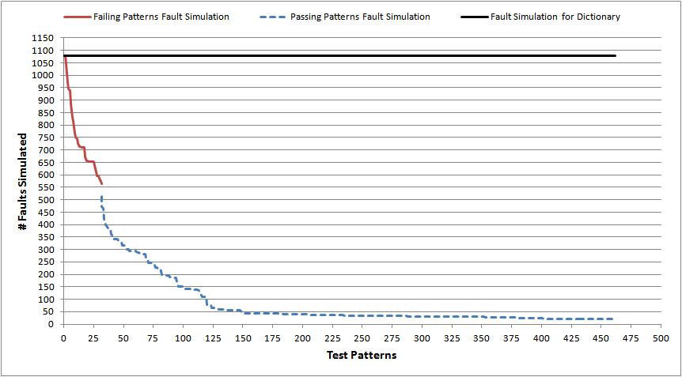
C432: Comparing with Fault Dictionary

Slide 15
Prime Suspect and Surrogate Faults
A prime suspect fault must produce all observed failures. It provides a perfect match with observed failures.
A Surrogate fault has some, but not all, characteristics of the actual defect in the circuit.
A surrogate fault is not believed to be the actual defect.
A surrogate can only partially match symptoms of the actual defect.
Surrogates are representatives of the actual defect and may help identify the location or behavior of the defect.
L. C. Wang, T. W. Williams, and M. R. Mercer, “On Efficiently and Reliably Achieving Low
Defective Part Levels," in Proc. International Test Conf., Oct. 1995, pp. 616-625.

Slide 16
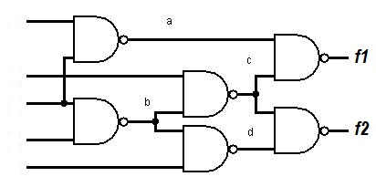
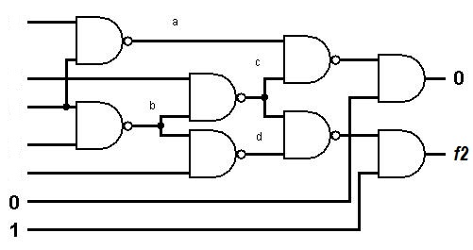
Output Selection
C17 Benchmark Circuit
C17 circuit with output selection

Slide 17
Presentation Outline
Motivation
Introduction and Background
Problem Statement
Diagnosis Algorithm
  Proposed Diagnosis Algorithm
  Analysis of the Algorithm
  Experimental Results
Conclusion

Slide 18
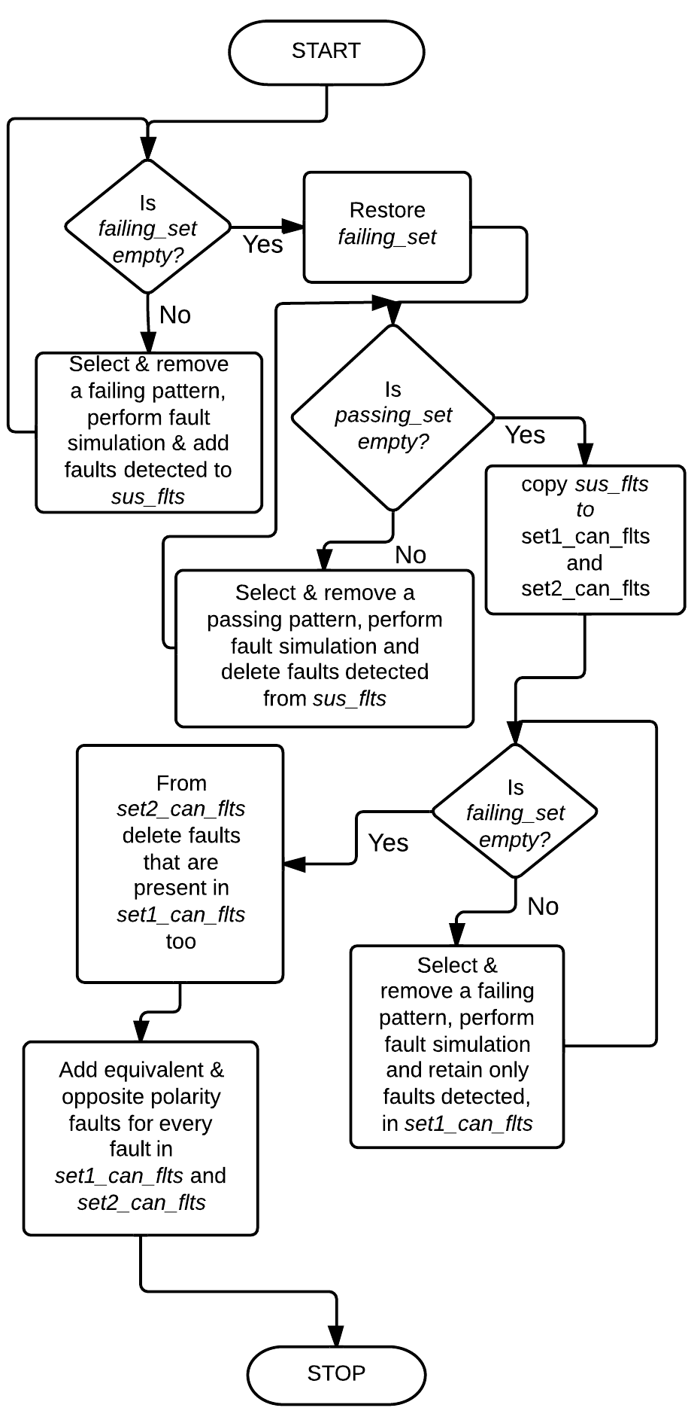
The Diagnosis Algorithm
Phase I
Phase II
Phase III
Phase IV

Slide 19
The Diagnosis Algorithm
The Diagnosis algorithm consists of 4 phases.
Assumption: No circular fault masking present in the circuit.
The following nomenclature is used throughout the diagnosis procedure:
  passing_set – Test patterns producing fault-free response
  failing_set – Test patterns producing faulty response
  sus_flts – Suspected fault list
  set1_can_flts – Set of prime suspect fault candidates
  set2_can_flts – Set of surrogate fault candidates

Slide 20
Phase I
Start with a failing_set containing ATE failing patterns.
Step 1-1: If failing_set is empty, then restore with ATE failing patterns and go to Phase II. Else, remove a pattern from failing_set.
Step 1-2: Perform fault simulation to identify detectable single stuck-at faults by the removed failing pattern.
Step 1-3: Add all faults identified in previous step to the sus_flts list and go to Step1-1.

Slide 21
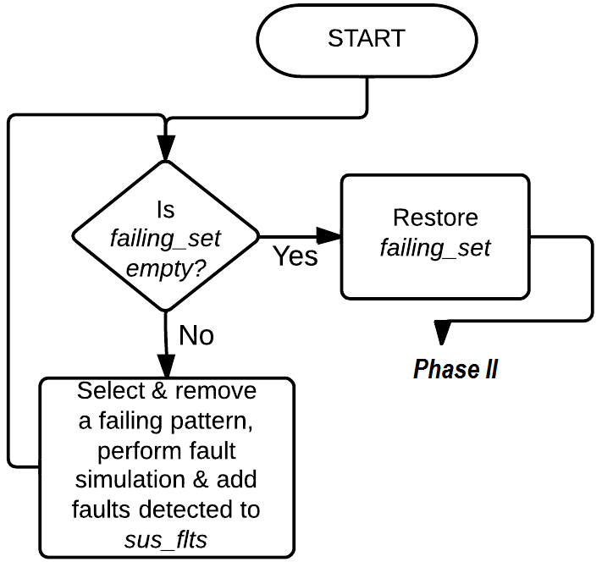
Phase I

Slide 22
Phase II
Start with a passing_set containing ATE passing patterns.
Step 2-1: If passing_set is empty, go to Phase III. Else, remove a pattern from passing_set.
Step 2-2: Perform fault simulation for sus_flts to identify faults detectable by the removed pattern.
Step 2-3: Remove faults identified in Step 2-2 from sus_flts list, and go to Step 2-1.

Slide 23
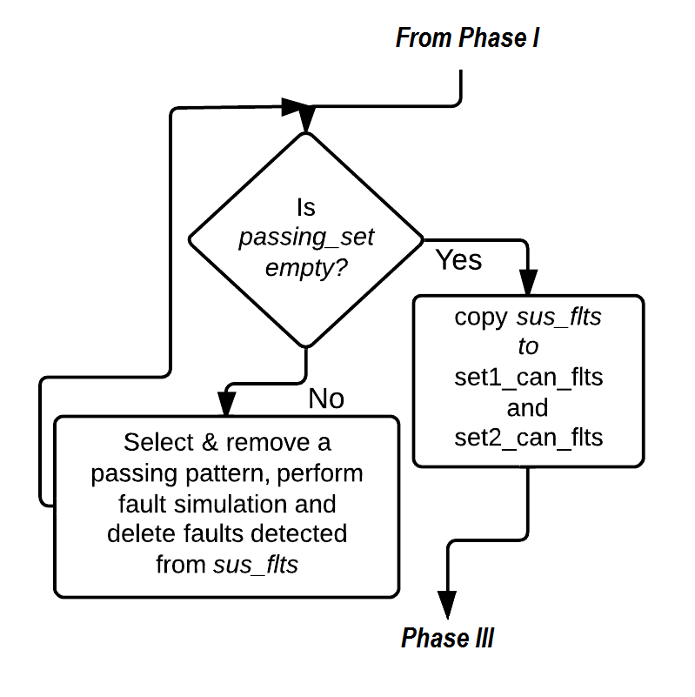
Phase II

Slide 24
Phase III
Skip to fault ranking if sus_flts is empty.
Step 3-1: Copy sus_flts list to set1_can_flts list and set2_can_flts list.
Step 3-2: If failing_set is empty, go to Step 3-5. Else, remove a pattern from failing_set.
Step 3-3: Perform fault simulation on set1_can_flts to identify faults not detected by the removed pattern.
Step 3-4: Update set1_can_flts list by deleting the faults identified in Step 3-3. Go to Step 3-2.
Step 3-5: Remove faults from set2_can_flts list that are common to set1_can_flts list and Go to Phase IV.

Slide 25
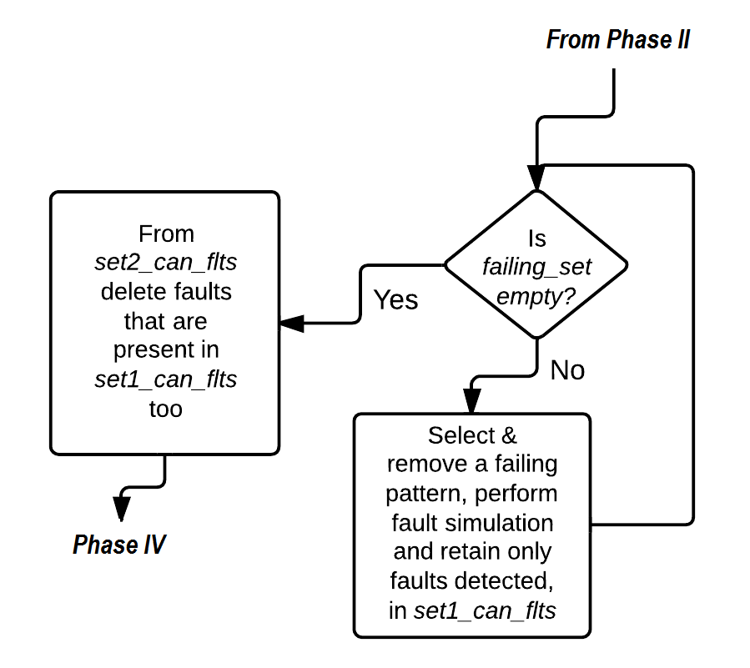
Phase III

Slide 26
Phase IV
Start with set1_can_flts list.
Step 4-1: If there is no unselected fault in set1_can_flts list, repeat Phase 4 for set2_can_flts list and then STOP. Else, select a fault and uncollapse it to obtain its corresponding equivalent set of faults.
Step 4-2: Add the equivalent set of faults to set1_can_flts list.
Step 4-3: Add opposite polarity faults for the selected fault and its equivalent set of faults to set1_can_flts list.

Slide 27
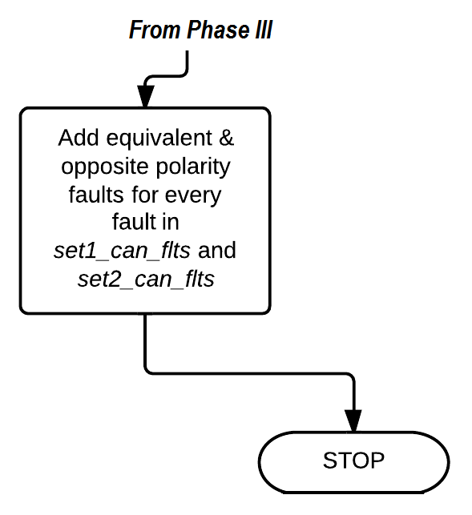
Phase IV

Slide 28
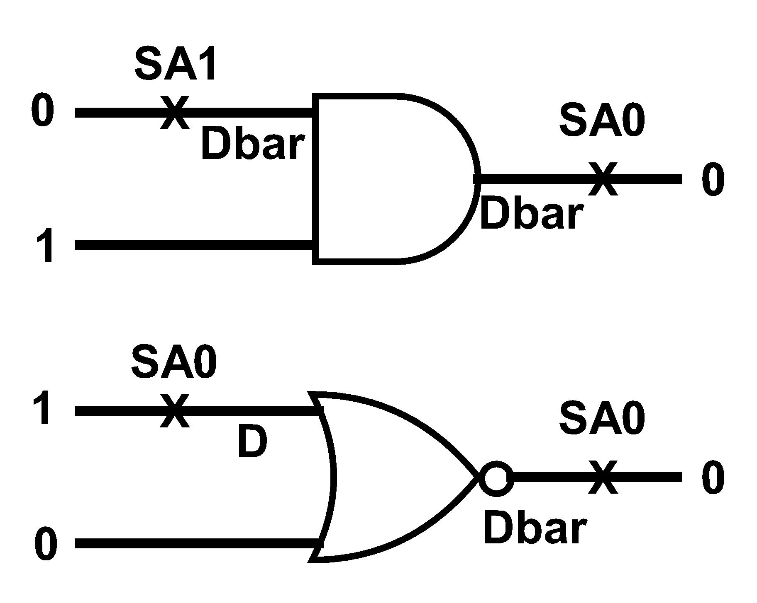
Why add opposite polarity faults?

Slide 29
Fault Ranking
Fault ranking is needed when both fault lists, set1_can_flts and set2_can_flts, are empty.
Rank of a fault F = (#failing patterns detecting F) – (#Passing patterns detecting F)
Highest ranked faults are placed in set1_can_flts and second highest ranked faults are placed in set2_can_flts.
All lower ranked faults are discarded. The numerical ranks can be zero or even negative.

Slide 30
Fault Ranking (contd..)
Faults detected by failing pattern
Both overlapped
Faults detected by passing pattern

Slide 31
A Theorem
If there is only a single stuck-at-fault present in the circuit under diagnosis (CUD), the diagnosis algorithm will always diagnose the fault, irrespective of the detection or diagnostic coverage of the test pattern set.

Slide 32
Presentation Outline
Motivation
Introduction and Background
Problem Statement
Diagnosis Algorithm
  Proposed Diagnosis Algorithm
  Analysis of the Algorithm
  Experimental Results
Conclusion

Slide 33
Analysis of the algorithm
 | t0 | t1 | t2 | t3 | t4
F1 | 1 | 1 | 1 | 0 | 0
F2 | 1 | 0 | 1 | 0 | 0
Case 1: Single Fault F1
Syndrome: 11100
Phase I – F1 and F2 in sus_flts
Phase II – No faults
Phase III – F1 in set1_can_flts and F2 in set2_can_flts
Phase IV – Equivalent and opposite polarity of F1 and F2 are added.
Perfect Diagnosis Achieved.

Slide 34
Analysis of the algorithm (Contd..)
 | t0 | t1 | t2 | t3 | t4
F1 | 1 | 1 | 1 | 0 | 0
F2 | 1 | 0 | 1 | 0 | 0
Case 2: Single Fault F2
Syndrome: 10100
Phase I – F1 and F2 in sus_flts
Phase II – Removes F1 from sus_flts
Phase III – F2 in set1_can_flts
Phase IV – Equivalent and opposite polarity of F2 are added.
Perfect Diagnosis Achieved.

Slide 35
Analysis of the algorithm (Contd..)
 | t0 | t1 | t2 | t3 | t4
F1 | 1 | 1 | 1 | 0 | 0
F2 | 1 | 0 | 1 | 0 | 0
Case 3: Multiple Faults F1 & F2 (No Masking)
Syndrome: 11100
Phase I – F1 and F2 in sus_flts
Phase II – No Faults
Phase III – F1 in set1_can_flts and F2 in set2_can_flts
Phase IV – Equivalent and opposite polarity of F1 and F2 are added.
Perfect Diagnosis Achieved.

Slide 36
Analysis of the algorithm (Contd..)
 | t0 | t1 | t2 | t3 | t4
F1 | 1 | 1 | 1 | 0 | 0
F2 | 1 | 0 | 1 | 0 | 0
Case 4: Multiple Faults F1 Masking F2
Syndrome: 11100
Phase I – F1 and F2 in sus_flts
Phase II – No Faults
Phase III – F1 in set1_can_flts and F2 in set2_can_flts
Phase IV – Equivalent and opposite polarity of F1 and F2 are added.
Perfect Diagnosis Achieved.

Slide 37
Analysis of the algorithm (Contd..)
 | t0 | t1 | t2 | t3 | t4
F1 | 1 | 1 | 1 | 0 | 0
F2 | 1 | 0 | 1 | 0 | 0
Case 5: Multiple Faults F2 Masking F1
Syndrome: 10100
Phase I – F1 and F2 in sus_flts
Phase II – Removes F1 from sus_flts
Phase III – F2 in set1_can_flts
Phase IV – Equivalent and opposite polarity of F2 are added.
Partial Diagnosis Achieved. Needs further testing for perfect diagnosis.

Slide 38
Analysis of the algorithm (Contd..)
 | t0 | t1 | t2 | t3 | t4
F1 | 1 | 1 | 1 | 0 | 0
F2 | 1 | 0 | 1 | 0 | 0
Case 6: Multiple Faults F1 Interfering with F2 (0 to 1)
Syndrome: 11110 (F1 changes t3 of F2)
Phase I – F1 and F2 in sus_flts
Phase II – No faults
Phase III – No faults in set1_can_flts
Phase IV – Equivalent and opposite polarity of F1 and F2 are added.
Perfect Diagnosis Achieved. No prime suspects.

Slide 39
Analysis of the algorithm (Contd..)
 | t0 | t1 | t2 | t3 | t4
F1 | 1 | 1 | 1 | 0 | 0
F2 | 1 | 0 | 1 | 0 | 0
Case 7: Multiple Faults F2 Interfering with F1 (1 to 0)
Syndrome: 11100 (F2 changes t0 of F1)
Phase I – F1 and F2 in sus_flts
Phase II – No faults
Phase III – F1 in set1_can_flts and F2 in set2_can_flts
Phase IV – Equivalent and opposite polarity of F1 and F2 are added.
Perfect Diagnosis Achieved.

Slide 40
Presentation Outline
Motivation
Introduction and Background
Problem Statement
Diagnosis Algorithm
  Proposed Diagnosis Algorithm
  Analysis of the Algorithm
  Experimental Results
Conclusion

Slide 41
Experimental Results
Results for every circuit were obtained by calculating the average values from two separate runs of experiments, each containing 50 random failure cases (except for C17, which has only 22 faults).
Circuit modeling and algorithm – Python
Mentor Graphics Fastscan – ATPG and Fault simulator
Test pattern manipulation – VBA Macros

Slide 42
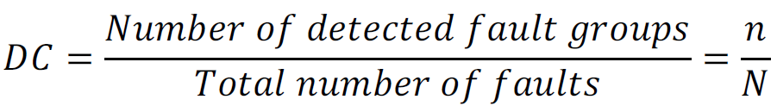
Diagnostic Coverage
Diagnostic coverage based on single stuck-at faults, excluding redundant faults is defined as
Fault Ratio for every set is defined as
  Fault Ratio (FR) = (#Expected faults) / (#Reported faults)
Y. Zhang and V. D. Agrawal, “An Algorithm for Diagnostic Fault Simulation,” in Proc. 11th
Latin-American Test Workshop (LATW), Mar. 2010, pp. 1–5.

Slide 43
Single Fault Diagnosis with 1-Detect Tests
Circuit | #Outputs | #Patterns | DC (%) | Diagnosis (%) | CPU*(s) | Fault Ratio
 |  |  |  |  |  | SET1 | SET2
C17 | 2 | 10 | 95.454 | 100 | 0.067 | 1.100 | 1.780
C432 | 7 | 462 | 94.038 | 100 | 0.189 | 1.025 | 6.675
C499 | 32 | 2080 | 98.000 | 100 | 0.588 | 1.029 | 16.722
C880 | 26 | 1664 | 94.161 | 100 | 0.503 | 1.069 | 2.248
C1908 | 25 | 3625 | 85.187 | 100 | 1.294 | 1.379 | 28.290
C2670 | 140 | 13300 | 85.437 | 100 | 6.455 | 1.320 | 8.207
C3540 | 22 | 3520 | 89.091 | 100 | 1.333 | 1.229 | 5.200
C5315 | 123 | 13899 | 91.192 | 100 | 6.847 | 1.054 | 4.204
C6288 | 32 | 1056 | 85.616 | 100 | 0.764 | 1.138 | 8.255
C7552 | 108 | 17064 | 86.507 | 100 | 10.123 | 1.281 | 10.765
* PC with Intel Core-2 Duo 3.06GHz Processor and 4GB Memory

Slide 44
Single Fault Diagnosis with 2-Detect Tests
Circuit | #Outputs | #Patterns | DC (%) | Diagnosis (%) | CPU*(s) | Fault Ratio
 |  |  |  |  |  | SET1 | SET2
C499 | 32 | 3872 | 98.400 | 100 | 1.025 | 1.029 | 7.970
C1908 | 25 | 6425 | 86.203 | 100 | 2.242 | 1.379 | 14.798
C7552 | 108 | 27756 | 86.750 | 100 | 16.076 | 1.281 | 8.023
* PC with Intel Core-2 Duo 3.06GHz Processor and 4GB Memory

Slide 45
Multiple Fault Diagnosis with 1-Detect Tests
Circuit | #Patterns | DC (%) | Both Faults Diagnosed (%) | One Fault Diagnosed (%) | None Diagnosed (%) | CPU* (s) | Fault Ratio
 |  |  |  |  |  |  | SET1 | SET2
C17 | 10 | 95.454 | 80.950 | 19.040 | 0.000 | 0.067 | 0.500 | 2.091
C432 | 462 | 94.038 | 90.566 | 7.547 | 1.886 | 0.135 | 0.563 | 3.516
C499 | 2080 | 98.000 | 49.056 | 20.754 | 30.188 | 0.613 | 0.371 | 17.589
C880 | 1664 | 94.161 | 86.792 | 9.433 | 3.773 | 0.502 | 0.900 | 3.205
C1908 | 3625 | 85.187 | 90.566 | 0.000 | 9.433 | 0.928 | 0.488 | 12.764
C2670 | 13300 | 85.437 | 88.679 | 3.773 | 7.547 | 4.720 | 0.564 | 7.046
C3540 | 3520 | 89.091 | 86.792 | 3.773 | 9.433 | 1.547 | 0.488 | 5.177
C5315 | 13899 | 91.192 | 98.113 | 1.886 | 0.000 | 7.065 | 0.422 | 3.886
C6288 | 1056 | 85.616 | 83.018 | 0.000 | 16.981 | 0.888 | 0.589 | 5.536
C7552 | 17064 | 86.507 | 96.226 | 1.886 | 1.886 | 7.539 | 0.358 | 7.104
* PC with Intel Core-2 Duo 3.06GHz Processor and 4GB Memory

Slide 46
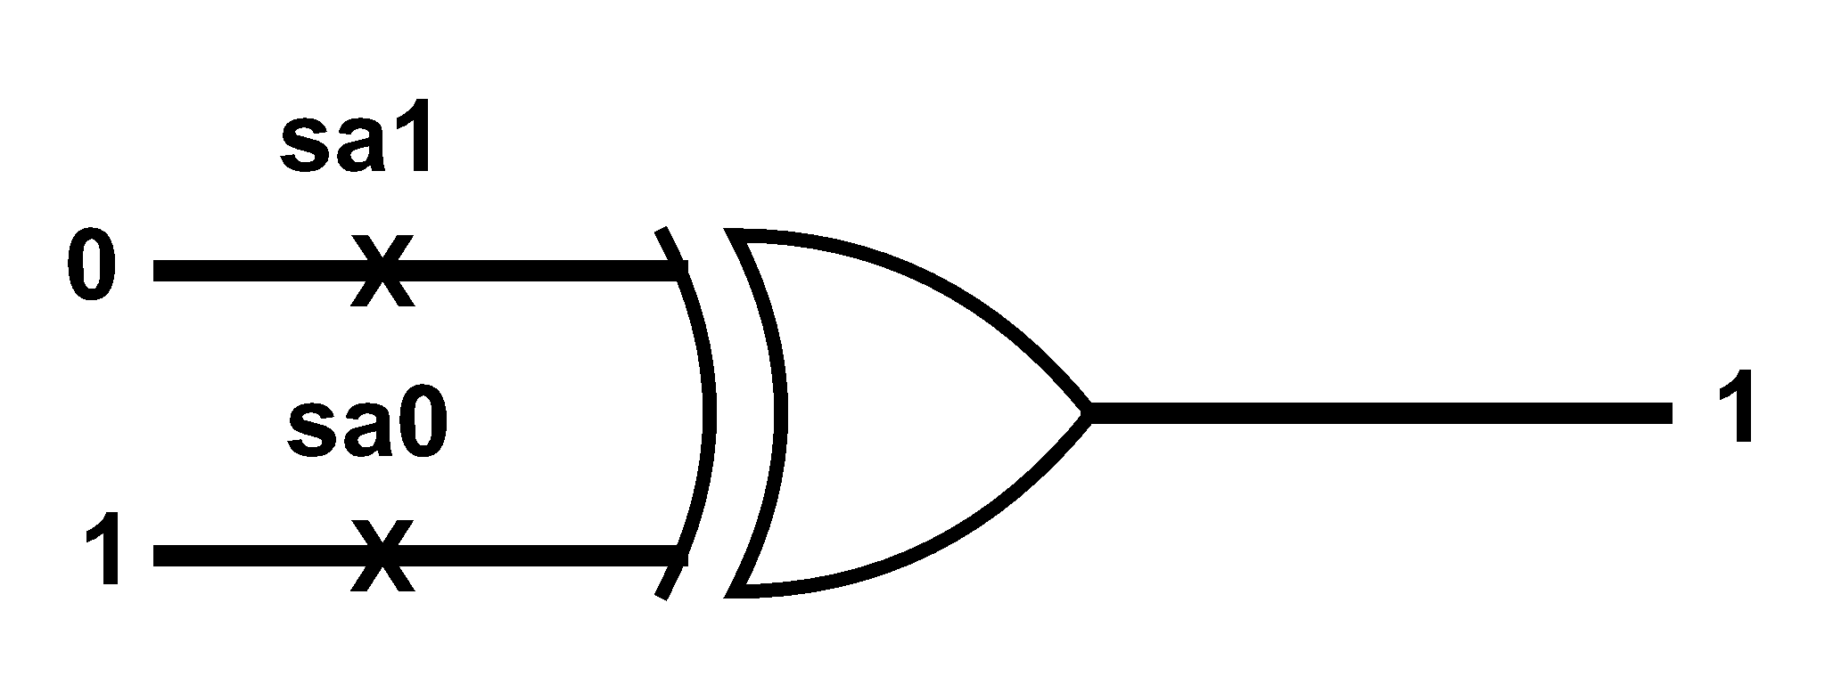
C499 (32-bit single error correcting circuit)
C499 has an XOR tree with 104 two input XOR gates.
XOR gates are not elementary logic gates. Set of faults depends on its construction.
Presence of circular fault masking. Probability of circular fault masking will reduce with increase in number of faults.

Slide 47
Multiple Fault Diagnosis with 2-Detect Tests
Circuit | #Patterns | DC (%) | Both Faults Diagnosed (%) | One Fault Diagnosed (%) | None Diagnosed (%) | CPU* (s) | Fault Ratio
 |  |  |  |  |  |  | SET1 | SET2
C499 | 3872 | 98.000 | 49.056 | 20.754 | 30.188 | 0.696 | 0.371 | 11.555
C1908 | 6425 | 86.203 | 90.566 | 0.000 | 9.433 | 2.314 | 0.488 | 7.232
C7552 | 27756 | 86.750 | 96.226 | 1.886 | 1.886 | 17.291 | 0.358 | 5.905
* PC with Intel Core-2 Duo 3.06GHz Processor and 4GB Memory

Slide 48
Single Fault Diagnosis with Diagnostic Tests
Circuit | #Outputs | #Patterns | DC (%) | Diagnosis (%) | CPU*(s) | Fault Ratio
 |  |  |  |  |  | SET1 | SET2
C17 | 2 | 12 | 100 | 100 | 0.067 | 1.000 | 1.780
Multiple Fault Diagnosis with Diagnostic Tests
Circuit | #Patterns | DC (%) | Both Faults Diagnosed (%) | One Fault Diagnosed (%) | None Diagnosed (%) | CPU* (s) | Fault Ratio
 |  |  |  |  |  |  | SET1 | SET2
C17 | 12 | 100 | 80.952 | 19.047 | 0.000 | 0.067 | 0.489 | 2.102
* PC with Intel Core-2 Duo 3.06GHz Processor and 4GB Memory

Slide 49
Presentation Outline
Motivation
Introduction and Background
Problem Statement
Diagnosis Algorithm
  Proposed Diagnosis Algorithm
  Analysis of the Algorithm
  Experimental Results
Conclusion

Slide 50
Conclusion
Considering fault simulation tools will always be limited to a few fault models, the relationship between non-classical faults and their surrogate classical faults was explored.
The proposed algorithm proves to be memory efficient and utilizes reduced diagnostic effort.
Physical relation of the actual non-classical faults not diagnosed should be examined with respect to the functional relation of the reported faults.
For future work, other non-classical faults (bridging, stuck-open, coupling, delay, etc.) and their surrogates can be examined.

Slide 51
References
M. Abramovici and M. A. Breuer, “Multiple Fault Diagnosis in Combinational Circuits Based on an Effect-Cause Analysis,” IEEE Transactions on Computers, vol. C-29, no. 6, pp. 451–460, June 1980.
M. L. Bushnell and V. D. Agrawal, Essentials of Electronic Testing for Digital, Memory and Mixed-Signal VLSI Circuits. Boston: Springer, 2000.
J. L. A. Hughes, “Multiple Fault Detection Using Single Fault Test Sets,” IEEE Trans.Computer-Aided Design of Integrated Circuits and Systems, vol. 7, no. 1, pp. 100–108, Jan.1988.
Y. Karkouri, E. M. Aboulhamid, E. Cerny, and A. Verreault, “Use of Fault Dropping for Multiple Fault Analysis,” IEEE Transactions on Computers, vol. 43, no. 1, pp. 98–103, Jan.1994.
N. Sridhar and M. S. Hsiao, “On Efficient Error Diagnosis of Digital Circuits,” Proc.International Test Conference, 2001, pp. 678–687.
C. E. Stroud, “A Designer’s Guide to Built-in Self-Test”. Boston: Springer, 2002.
H. Takahashi, K. O. Boateng, K. K. Saluja, and Y. Takamatsu, “On Diagnosing Multiple Stuck-At Faults Using Multiple and Single Fault Simulation in Combinational Circuits,” IEEE Trans. Computer-Aided Design of Integrated Circuits and Systems, vol. 21, no. 3, pp. 362–368, Mar. 2002.

Slide 52
References (contd..)
R. Ubar, S. Kostin, and J. Raik, “Multiple Stuck-at Fault Detection Theorem,” Proc. IEEE 15th International Symp. Design and Diagnostics of Electronic Circuits and Systems, Apr. 2012, pp. 236–241.
L. C. Wang, T. W. Williams, and M. R. Mercer, “On Efficiently and Reliably Achieving Low Defective Part Levels,” Proc. International Test Conf., Oct. 1995, pp. 616–625.
Y. Zhang and V. D. Agrawal, “A Diagnostic Test Generation System,” Proc. International Test Conf., Nov. 2010. Paper 12.3.
V. D. Agrawal, D. H. Baik, Y. C. Kim, and K. K. Saluja, “Exclusive Test and Its Applications to Fault Diagnosis,” Proc. 16th International Conf. VLSI Design, Jan. 2003, pp. 143–148.
L. Zhao and V. D. Agrawal, “Net Diagnosis Using Stuck-At and Transition Fault Models,” Proc. 30th IEEE VLSI Test Symp., Apr. 2012, pp. 221–226.
Y. Zhang and V. D. Agrawal, “An Algorithm for Diagnostic Fault Simulation,” Proc. 11th Latin-American Test Workshop (LATW), Mar. 2010, pp. 1–5.
C. Alagappan and V. D. Agrawal, “Dictionary-Less Defect Diagnosis as Real or Surrogate Single Stuck-At Faults,” Proc. International Test Conf., 2013. Submitted.
C. Alagappan and V. D. Agrawal, “Dictionary-Less Defect Diagnosis as Surrogate Single Stuck-At Faults,” Proc. 22nd North Atlantic Test Workshop, 2013.

Slide 53
Thank You . . .

Slide 54

Questions

