Slide 1
How machine intelligence can solve test problems
(and how it can't)
Spencer Millican
Auburn University

Slide 2
What is machine intelligence?
Circuit
Features
Algorithm / Subroutine /
Process
Answer
State
Statistics
…
Person
ML
Program

Slide 3


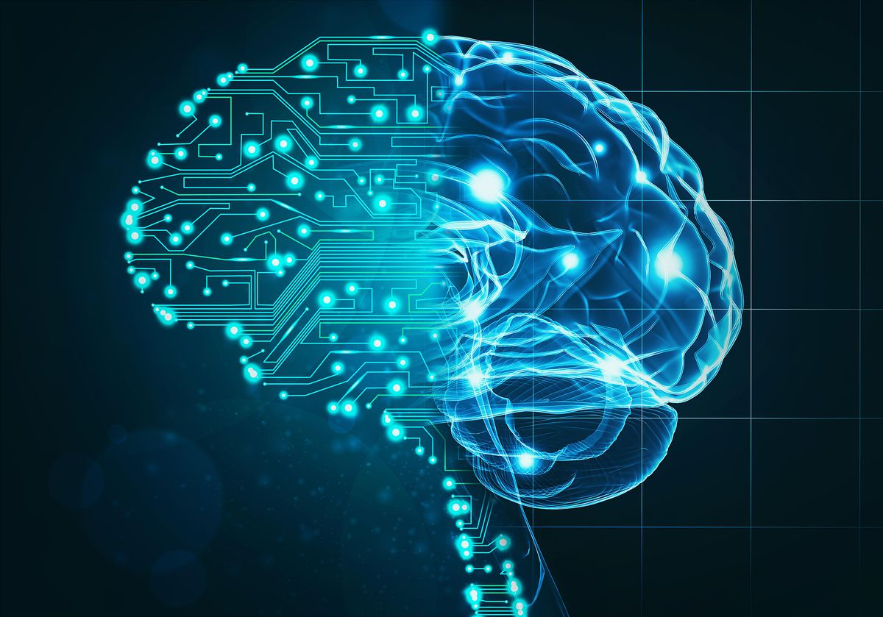


What’s wrong with what we have?
?

Slide 4
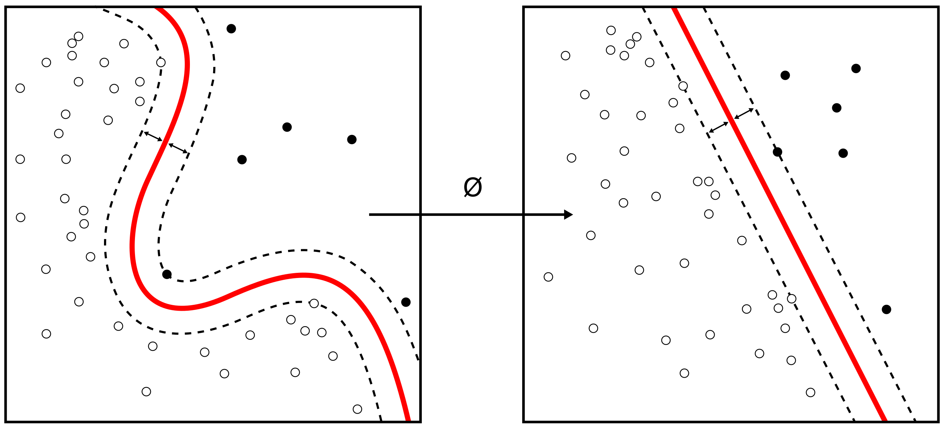
Unsupervised Learning
= “B”
CC BY-SA 4.0
= “A”

Slide 5
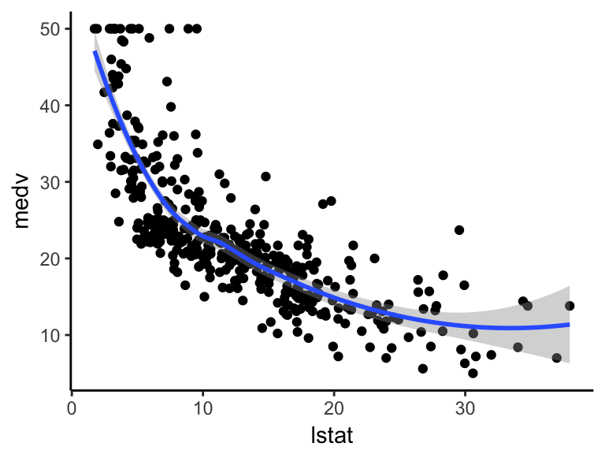

Supervised Learning
Sample Desired
Inputs → Outputs

Slide 6

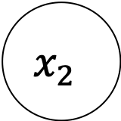

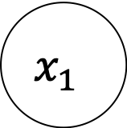

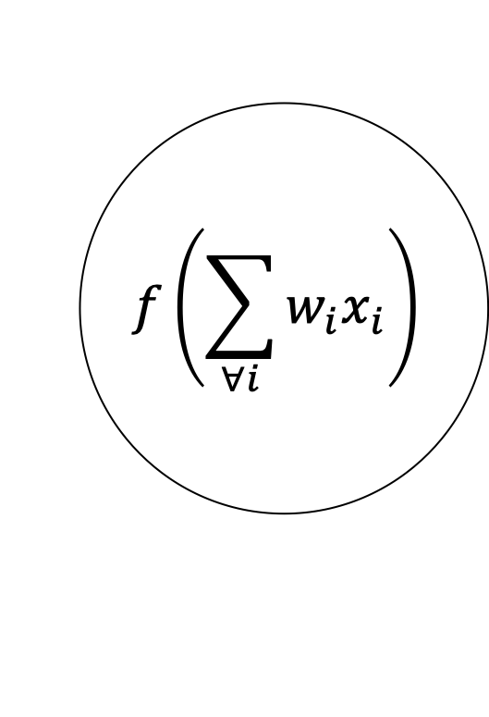
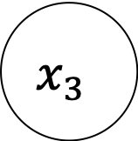
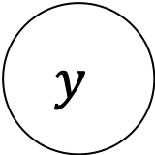
Artificial neural networks
$$x_{1}$$
$$w_{1}$$
$$f\left(\sum_{∀i}{w_{i}x_{i}}\right)$$
$$w_{2}$$
$$x_{2}$$
$$y$$
$$w_{3}$$
$$x_{3}$$

Slide 7
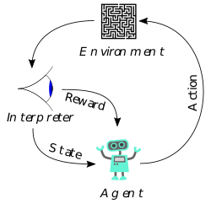
Reinforced Learning
PROBLEM

Slide 8
Why does machine intelligence work?
?
X
X

Slide 9
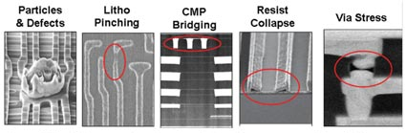
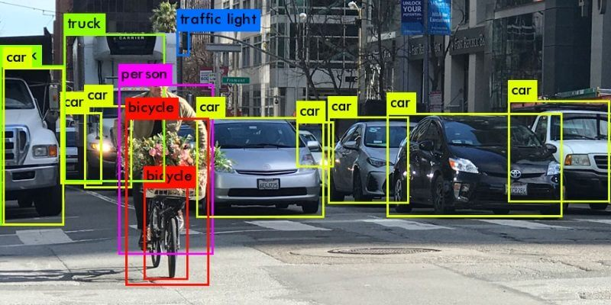
Why test?
?

Slide 10
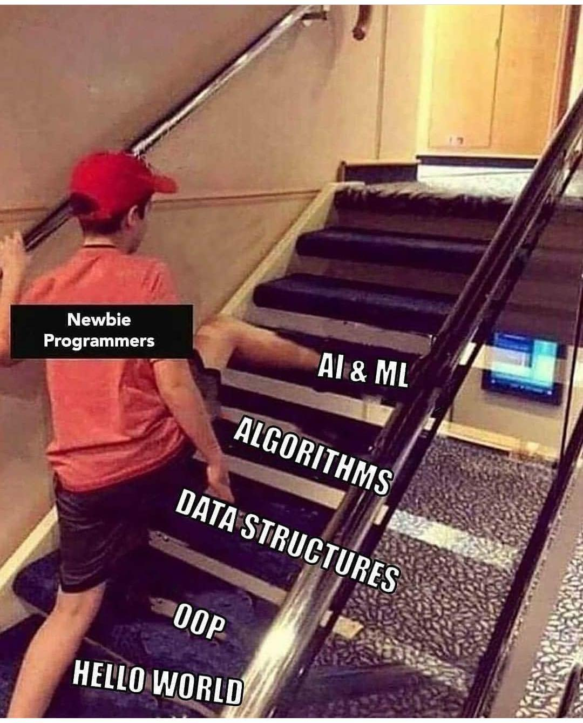
But, it’s not always easy

Slide 11
Collecting (useful) data
?
Answer
?

Slide 12
The challenge of training

Slide 13
Conclusion: can machine intelligence help test?
Machine intelligence can help solve test problems by…
  …mimicking our intuition and incorporating skilled engineers into a fast computer.
  …by forgoing complex computational heuristics with fast-and-fluid computing.
But, machine intelligence cannot help us unless…
  …we collect data which is relevant to the problem we want to solve.
  …we find ways to convert the inputs to our problems into a machine intelligence-friendly format.
  …we put the time and computational effort to train and evaluate our new machine intelligence.
Thankfully, previous studies have shown that we can do this for test problems, as our next talk will show.

Slide 14
Thank you

