Slide 1
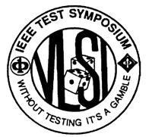
Defect Characterization and Testing of Skyrmion-Based Logic Circuits
IEEE VLSI Test Symposium 2021
Ziqi Zhou, Ujjwal Guin, Peng Li, and Vishwani D. Agrawal
Dept. of Electrical and Computer Engineering
Auburn University, AL, USA
Notes:
Hello ,everyone. I am Ziqi Zhou. I am currently a PHD student at Dept. of Electrical and Computer Engineering, Auburn University. Today I am going to present paper: Defect Characterization and Testing of Skyrmion-Based Logic Circuits. Some of you may not have heard of the skyrmion devices. This is because they belong to an emerging technology.

Slide 2
Outline
Overview
Contributions
Skyrmion-based logic circuit
Skyrmion motion in nanotrack
Skyrmion logic gates
The proposed solution
Defect characterization
Fault modeling
Results and discussion
Conclusion
Future work
Notes:
I will start this presentation with the a brief overview of emerging technologies. Then, I will describe the contribution of this paper. I will explain the background of Skyrmion-based logic circuit,-skyrmion motion in nanotrack, and the structure of Skyrmion logic gates. Then, I will propose a methodology for defect characterization, fault modeling and test pattern generation. I will also discussion simulation results. Finally, I will conclude my talk and in the end we I will talk about the future direction of this research.

Slide 3
Overview
With rapid scaling, CMOS devices are approaching the quantum-mechanical limits.
Magnetic skyrmion is an emerging digital technology with ultra-high integration density and ultra-low energy.
Magnetic skyrmion is promising for building next-generation spintronic logic devices and magnetic memories due to their stability, small size, and extremely low operational currents.
Notes:
With rapid scaling, CMOS devices are approaching the limit of quantum-mechanical boundaries. Among other things, this has resulted in increased process variation and static power dissipation. Fortunately, spintronic devices offer a feasible choice for post-Moore devices, given the recent advances in their design and fabrication process. Magnetic skyrmion is an emerging digital technology with ultra-high integration density and ultra-low energy. Magnetic skyrmion is promising for building next-generation magnetic memories and spintronic logic devices due to their stability, small size and the extremely low currents needed.
Skyrmion, so named after its British inventor, is a localized magnetic field that acts like a particle, and can be moved through a specially constructed metallic channel under the influence of electric current.

Slide 4
Contributions
We characterize the defects in skyrmion-based logic circuits.
We will use the well-accepted stuck-at fault model in a CMOS-based design to model defects of skyrmion-based design.
We propose an approach for generating patterns to test a skyrmion-based circuit by a conventional ATPG tool.
Notes:
Those are the contributions of our paper: (read slide).

Slide 5
Skyrmion Motion in the Nanotrack
Skyrmion is a stable magnetic field that acts like a particle, we refer to as pseudoparticle.
Skyrmion is created by transverse current injection in a ferromagnetic thin film through magnetic tunnel junction (MTJ).
The state of a logic signal is represented by the presence (logic-1) or absence (logic-0) of a single skyrmion.
Notes:
What is Skyrmion.? Skyrmion is a stable magnetic field that acts like a particle, we refer to as pseudoparticle. Skyrmion is created by transverse current injection in a ferromagnetic thin film through the magnetic tunnel junction (MTJ). Once created the skyrmion remains stable until it is intentionally removed by an annhilation procedure. The presence of a skyrmion indicates a logic-high or 1 in skyrmion-based circuit and the absence of skyrmion means logic-low or 0. Patterns on ferromagnetic and metal films form interconnects, called nanotracks, through which drive currents move skyrmions.

Slide 6
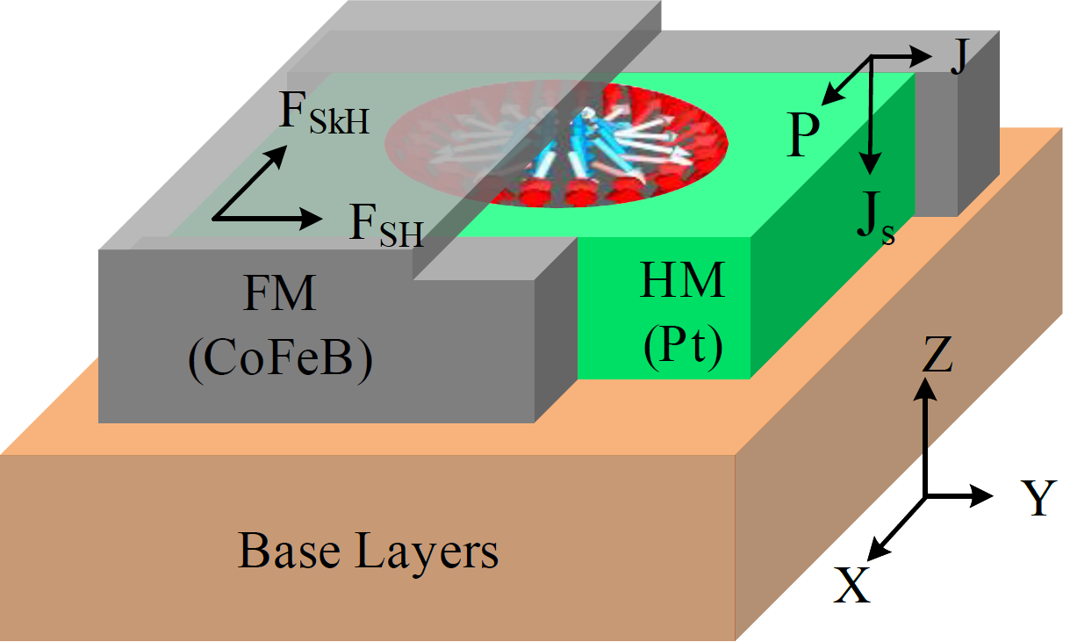
Skyrmion Motion in Nanotrack (Continued)
Skyrmion nanotrack structure consists of three parts: a ferromagnetic (FM) layer, a heavy metal (HM) layer and the base.
The skyrmion lies in the ferromagnetic layer at the interface with the heavy metal.
Skyrmion is driven by a continuous electric current in +y direction, which is also the direction of the skyrmion motion.
Figure 1: Nanotrack structure for skyrmion movement
Notes:
Skyrmion nanotrack structure consists of three parts: The figure shows 3D cross sectional view of a nanotrack consisting of a ferromagnetic or FM layer shown in gray, a heavy-metal or HM layer shown in green. and a base layer shown in brown. The skyrmion exists in the gray FM layer at the interface with the green HM layer. It is moved by a continuous electric current in +y detection. F_SH stands for the driving force generated by the spin-orbit torque and F_SkH represents the force generated by the skyrmion Hall effect. The side wall wrapping structure eliminates any possible transverse motion of the skyrmion caused by the skyrmion Hall effect, allowing only linear motion along the y-axis.

Slide 7
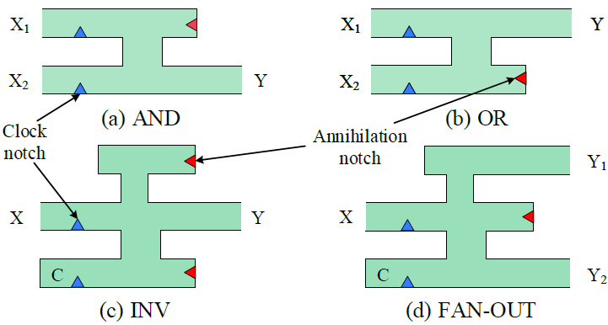
Skyrmion Logic Gates
A traditional skyrmion gate combines phenomena such as spin Hall effect, skyrmion Hall effect, skyrmion-skyrmion repulsion and skyrmion curb repulsion.
The green part is the nanotrack of skyrmion, small blue triangle is clock notch and red triangle is annihilation notch.
Figure 2: Structure of skyrmion gates. (a) AND gate (b) OR gate (c) Inverter, and (d) Fanout.
Note: The skyrmion behaves as a single pseudoparticle, so a logic circuit additionally needs a special fanout element to generate multiple skyrmions for fanout branches.
Notes:
We have adopted Skyrmion Logic Gates originally developed at the University of Texas at Dallas by Dr. Friedman by modifying them as non-reversible logic gates. + A traditional skyrmion gate combines phenomena such as spin Hall effect, skyrmion Hall effect, skyrmion-skyrmion repulsion and skyrmion curb repulsion. The green part is the nanotrack of skyrmion, The blue triangle on the inputs side is the clock notch to synchronize the computing system. A red triangle is added at the end of a nanotrack so that any additional skyrmions are destroyed to preserve the proper logic operation which is primarily dependent on skyrmion-skyrmion interactions. Please note that the skyrmion behaves as a pseudo particle, so the skyrmion circuit additionally needs a special fanout element to generate multiple skyrmions for fanout branches.

Slide 8
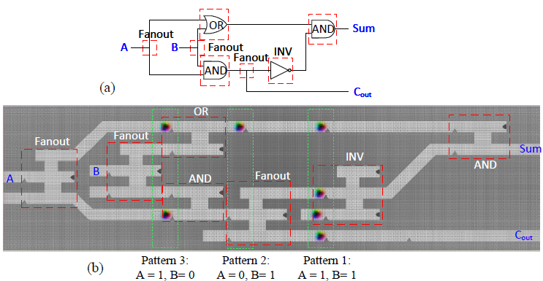
Skyrmion Logic Circuit
Figure 3: Skyrmion circuit design of a half adder.
Note: The design of our skyrmion circuit is a pipeline system.
Notes:
This slide shows how to convert Gate-level schematic to Skyrmion circuit. This circuit is a half adder skyrmion circuit using AND, OR and fanout gates.
Please note that : The skyrmion circuit is a pipeline system. The correct result will be generated after five cycles, and an output will be generated in each subsequent cycle.
Three groups of input patterns 11, 01, 10 are applied in three cycles in order.

Slide 9
Defect Characterization
Due to the process and environmental variations, defects will appear in a skyrmion-based circuit.
The design and manufacture of skyrmion circuit are different from traditional CMOS circuits, the defects in skyrmion circuit are also different.
We describe the defects under two separate categories, technology-independent and technology-dependent defects.
Notes:
Due to the process and environmental variations during manufacturing process, defects will appear in the circuit.
The design and manufacture of a skyrmion circuit are completely different from traditional CMOS circuits. Defects in the skyrmion circuit are also different from traditional CMOS circuits.
We describe these defects under two separate categories, technology-independent and technology-dependent defects.

Slide 10
Defect Characterization (Continued)
Technology-Independent Faults.
Models of defects that are irrelevant to the skyrmion gate technology
Will not be affected by the gate design changes.
Include material void, crack in a nanotrack, and bridging between the two nanotracks
Figure 4: Simulation of technology independent faults - (a)-(d): Defects causing stuck-at-0 fault, and (e)-(f): Defects resulting in a bridging fault.
Notes:
Technology independent faults are the models of defects that are irrelevant to the skyrmion gate technology and hence will not be affected by the gate design changes. We consider these defects to be present in the interconnect between two logic gates. The standard technology-independent defects include material void, crack in a nanotrack, and bridging between the two nanotracks. Figures 4 (a)-(f) show snapshots of the skyrmion movement at three different simulation times. The simulation result is from the micromagnetic simulation tool MuMax3.
A break in the nanotrack is shown in Figure 4 (a) such that the skyrmion cannot move along the nanotrack. A hollow structure/void appears on nanotrack and is shown in Figure 4(b). When the speed is low, the skyrmion will stop before the void defect. When the skyrmion is moving at a high speed, the skyrmion will collide on the void and vanish. As shown in Figures 4 (c) and (d), there are etching blemishes on one or both surfaces of the nanotrack, respectively. Figures 3(e) and (f) show two types of bridging defects. When the bridging between the nanotracks is wide enough, the skyrmion will cross over to the upper nanotrack. However, a narrow bridging defect will not affect the skyrmion movement and will not produce any incorrect response.

Slide 11
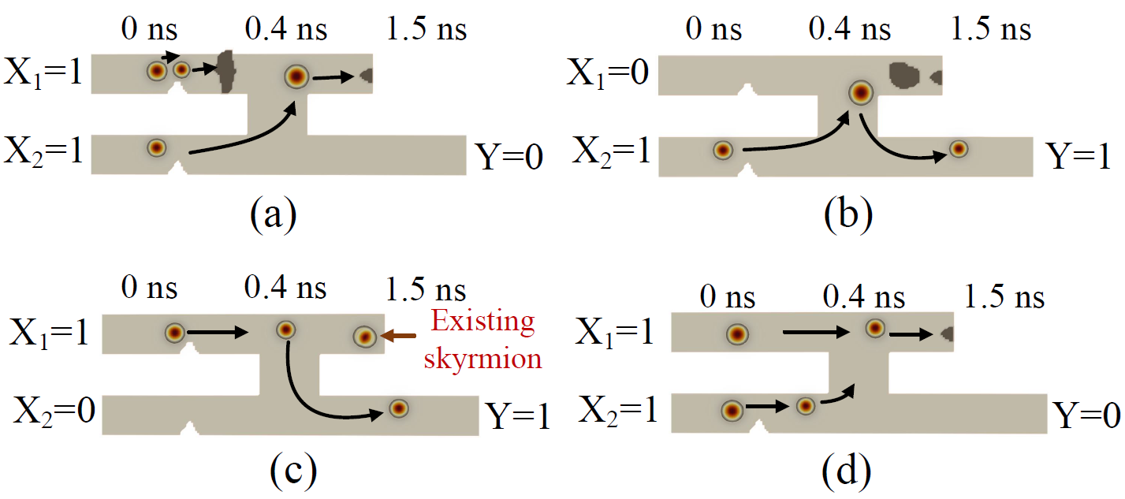
Defect Characterization – AND gate example.
Technology-Dependent Faults in AND gate:
T₁ through T₄ represent a break in X₁, X₂, Y or the dummy channel, respectively;
T₆ through T₉ a void located in track X₁, X₂, Y or the dummy channel, respectively;
T₁₁ is absence of annihilation notch;
T₁₄, T₁₅ is an absent clock notch at X₁ or X₂, respectively;
T₁₆ denotes as a bridge between the two input tracks of a gate;
T₁₇ denotes as a break in two input nanotracks.
Figure 5: Technology-dependent faults in AND gate.
Notes:
The defects inside a gate are mapped as technology-dependent faults due to their occurrence on technology dependent gate structure.
These defects may cause malfunction of a gate for some input patterns. In this paper, we present a comprehensive taxonomy of technology-dependent faults.
Lets take AND gate as an example.
Figure 5 (a) shows a break located before the junction denote as defect T1. 5(b) shows a void appearing before an annihilation notch denotes as defect T9. 5(c) shows that the annihilation notch is missing denotes as defect T11, so the skyrmion in the previous computations will not vanish due to this defect. Figures 5(d) shows a missing clock notch in X1 will cause logic malfunction because of the synchronization mismatch.
Defects T5. T10 , etc are not modeled for AND but used for other gates.
Due to the time limitation, I will not explain these defects one by one here. We summarize 18 types of Technology-Dependent Faults in our paper, If you want to know all about them, please see the detailed information in the paper.
Better to examine all defects of just an AND gate. Then list which ones map onto stuck-at and which do not.

Slide 12
Fault Modeling procedure
Exhaustive simulation of faulty gates.
Comparison with faults logic gates:
Identify skyrmion gate defects as equivalent logic stuck at faults.
Identify skyrmion gate defects as non-equivalent logic stuck at faults.
Identify skyrmion gate defects as no-fault.
Notes:
(Read the slides.)

Slide 13
Fault Modeling
Table I: Exhaustive simulation of skyrmion gates
The asterisk (*) marks the defects that will produce faulty response with a pair of input patterns rather than a single one. Also, (-) denotes the absence of any faulty response from the gate.
Notes:
We applied a exhaustive test for all defects in all the gates.
From the simulation of Technology-Dependent Faults, we observe erroneous outputs under different input conditions. This table summarizes the results for all defects under exhaustive input conditions. Column 1 gives the gate type, and Columns 2 and 3 denote the input pattern and the correct output response, respectively. The remaining columns titled T1 through T18 show the responses of the defective gates. The asterisk (*) marks the defects that will produce faulty response with a pair of input patterns rather than a single one. Also, (-) denotes the absence of any faulty response from the gate.
After analyzing this table, we divide the defects of skyrmion into 3 categories: equivalent logic stuck at faults, non-equivalent logic stuck at faults, and no-fault. T1 can be equivalent to Y/X1 stuck at 0. Defect T11 is no similar to any stuck at faults so it is classified as non-equivalent logic stuck at faults（which is the future work of us）. Defect T4 will not cause any Incorrect results is consider as no-fault.
Need to list defects T1 to T18 of just an AND gate. Then identify them as undetectable (-), detectable as stuck-at, detectable but not as stuck-at.

Slide 14
Fault Modeling- Cont.
Table II: Stuck-at fault detection in AND/OR logic gate
Table III: Stuck-at fault detection in inverter/fanout logic gate
Notes:
After analyzing the results of the previous table, it is found that some patterns can detect certain defects of skyrmion circuits just like they detect stuck-at faults in CMOS circuits. These skyrmion circuit defects can be mapped onto traditional stuck-at faults of a logic circuit. An input pattern 01 applied to an AND gate will produce a faulty output 1 when T9 (a voids at dummy channel ) or T17 (A break between the nanotrack) is present. In a similar way, the test pattern 01 can be used to detect input X1 or output Y stuck-at-1 faults.
Need to say what are the skyrmion defects T9 and T17.
Table II here shows how we converted the skyrmion defects to equivalent stuck-at faults. First, we find the test patterns for the skyrmion-based circuit that will produce faulty results. Then, for those patterns, we list out the stuck-at faults detected in the logic gate of the same function. In this way the skyrmion-based defects have been converted into a conventional stuck-at fault of CMOS (logic) gates. In the same way, Table III was also obtained for inv and fanout.

Slide 15
Results and Discussion
To evaluate the effectiveness of the proposed test generation process, we use Synopsys tools.
We used Synopsys 32nm SAED32 EDK Generic Library and ISCAS’85 benchmark circuits.
We wrote a Tcl script to control the EDA tool to generate test patterns for both conventional CMOS circuit and skyrmion-based logic circuit.
Notes:
After we mapped the skyrmion defects onto equivalent stuck-at faults, we can use commercial EDA tools to generate traditional CMOS circuits from skyrmion circuits and then generate test patterns. To evaluate the effectiveness of the proposed test generation process, we use Synopsys tools, e.g., Design Compiler for synthesis, and TestMAX ATPG for test pattern generation. We used Synopsys 32nm SAED32 EDK Generic Library on ISCAS’85 benchmark circuits. We wrote a Tcl script to control the EDA tool to generate test patterns for both the conventional CMOS circuit and skyrmion-based logic circuit.

Slide 16
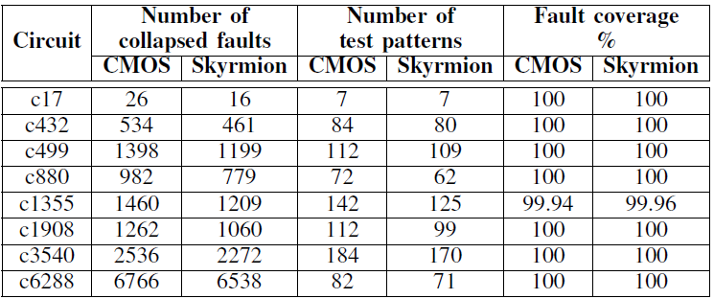
Results and Discussion-Cont.
Table IV: Testing stuck-at faults in CMOS and Skyrmion circuits.
Notes:
Table IV shows the results, such as collapsed stuck-at fault count, test pattern count and fault coverage, for skyrmion logic circuits and compare them with traditional CMOS circuits. The first column of this table indicates the benchmark circuit name. The second and third columns show the pattern counts for both conventional CMOS and skyrmion logic circuits. The fourth and fifth columns show the fault coverages for the same circuit pair. It can be concluded that our pattern generation method for skyrmion logic circuits has reduced the number of test patterns, and increased fault coverage compared to the traditional CMOS circuits due to smaller number of stuck-at-1 faults in the netlist. But this is not the complete story. Please note that the result here shows only those faults that could be mapped onto stuck-at faults. There are other faults (technology dependent) that are part of our ongoing research.
Need to say that the result here shows only those faults that could be mapped onto stuck-at faults. There are other faults (technology dependent) that are part of our ongoing research.

Slide 17
Conclusion
We considered defect scenarios for skyrmion based digital circuits and describe these defects under two separate categories, technology-independent and technology dependent defects.
We believe we are the first to characterize such defects using magnetic simulation.
We also find for those defects the representative fault models.
We devised a test pattern generation procedure for skyrmion-based circuits.
We used traditional ATPG approaches in the existing CAD tools to generate test patterns.
Notes:
Read slides.

Slide 18
Future Work
Designing more complex gates such as NAND, NOR, XOR, 3-input AND, OR and AND-OR-Invert (AOI) gates.
Study how to use skyrmion-based circuit to design sequential circuit.
Develop a new detection methods to test the remaining defects in the skyrmion–based circuit.
Analyze the defects that may exist in other parts of the on skyrmion-based circuit (such as MTJ).
Notes:
In the end, I want to briefly describe my future research direction. +(Read slide)

Slide 19
Thank you!
Any Questions?
Contact:
Ziqi Zhou
Department of Electrical and Computer Engineering, Auburn University
Email: ziqi.zhou@auburn.edu
This presentation and recording belong to the authors. No distribution is allowed without the authors’ permission.
Notes:
I will stop here. thank you very much for attending my talk. Please feel free to contact me if you have any questions or concerns. Thank you very much and have a good day.

