Slide 1
Delay Fault Testing – Present and Future
Jubayer Mahmod, Spencer Millican, Ujjwal Guin, and Vishwani Agrawal

Slide 2
Structure
Delay vs. stuck-at fault testing
Delay fault models – nuances and strategies
  Path delay fault (PDF) model
  Transition delay fault (TDF) model
  Small delay defects (SDDs)
Scan chains for delay fault testing
Current literature directions
  GPGPU-enabled simulation
  Security

Slide 3
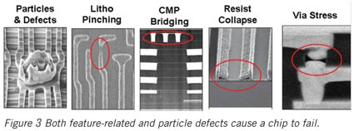
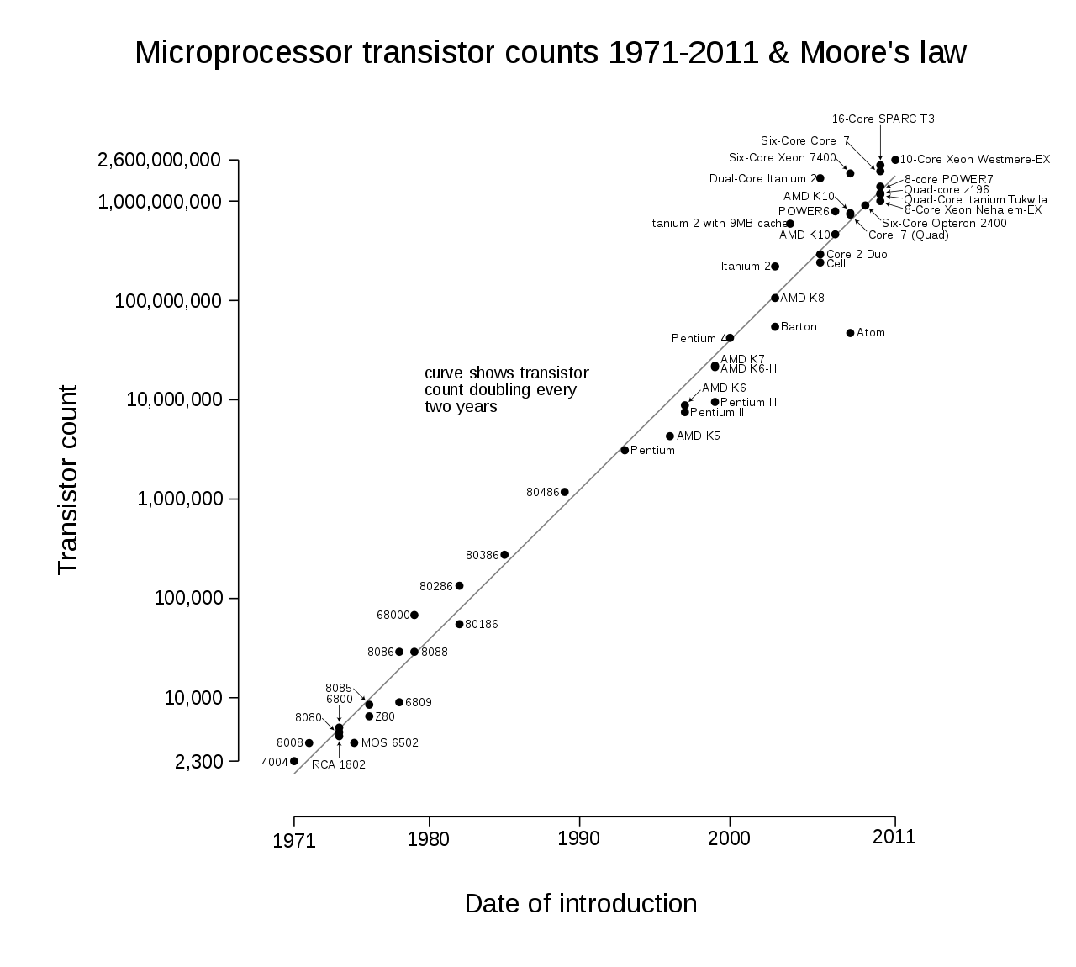
Motivation for delay fault testing
© Chip Design Magazine
© CC BY-SA 3.0

Slide 4
Delay vs. stuck-at fault test

Slide 5
Delay fault models
Time

Slide 6
Path delay fault (PDF) model
Path P1
1 3
0
1
P2
2 4 6
1
0
2
3
P3
0
2
5
Clock period
Fast transitions
Slow transitions
Initial value
Final value
time

Slide 7
PDF - Robustness
Non-robust Test
Robust Test (singularly testable faults)
U1
S0
R1
S0
R1
U0
U1
R1
R1
F0
R1
F0
R1
U0
U1
U0
U0

Slide 8
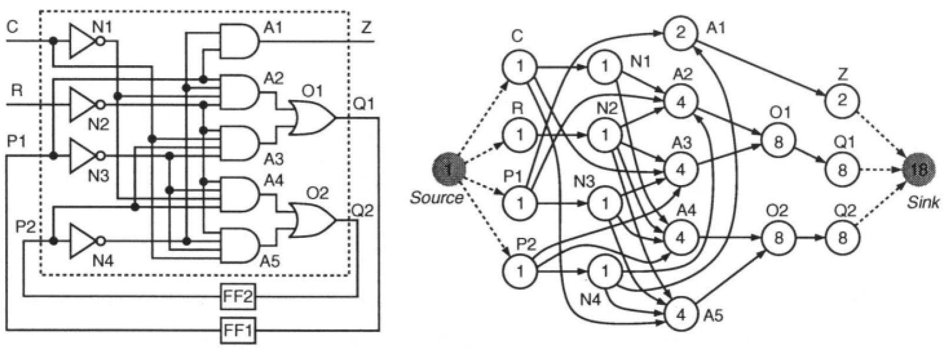
PDF – computational complexity

Slide 9
Transition delay fault (TDF) model
{X,0}
{0,0}
{0,1}
{1,U}
{0,X}
s.t.r.
X
{0,D}
{1,U}
{0,1}

Slide 10
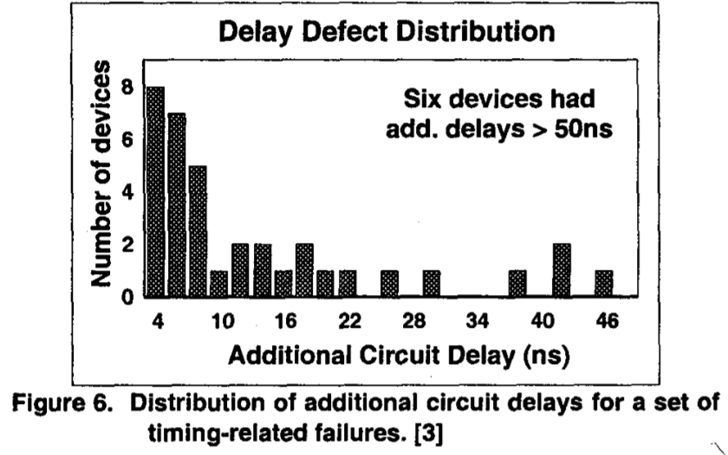
Small delay defects (SDDs) – The TDF detection problem
A second trend is illustrated in Figure 6, which shows the additional propagation delay for a set of timing-related failures. Although the data it limited, it suggests there are more small delay defects than large delay defects. Figures 5 and 6 suggest that there may be many small delay defects and that faster designs may be more sensitive to these additional (small) delays. This assumes, however, that the additional propagation delays of timing-related defects do not scale as designs get faster.
P. Nigh & Anne Gattiker, “Test Method Evaluation Experiments & Data”, ITC, 2000.

Slide 11
TDF – SDD Detection problem
{X,0}
Not detected!
{0,0}
{0,1}
X
s.t.f.
Detected!
{1,U}
{0,X}
s.t.r.
X
{0,D}
{1,U}
{0,1}

Slide 12
Segment delay fault (SDF) model
Fan-in Cone
Fan-out Cone
$$Length=L=\left\{1,L_{MAX}\right\}=\{TDF,PDF\}$$
Transition launch
Transition propagate

Slide 13
Unspecified transition faults – detecting SDDs with modified TDFs
{X,0}
Optimistic
{0,0}
{1,X}
{1,X}
{0,1}
D Q
{1,X}
{0,X}
Pessimistic
s.t.r.
X
{1,X}
{1,1}
{0,X}
{1,X}
D Q
{0,1}

Slide 14
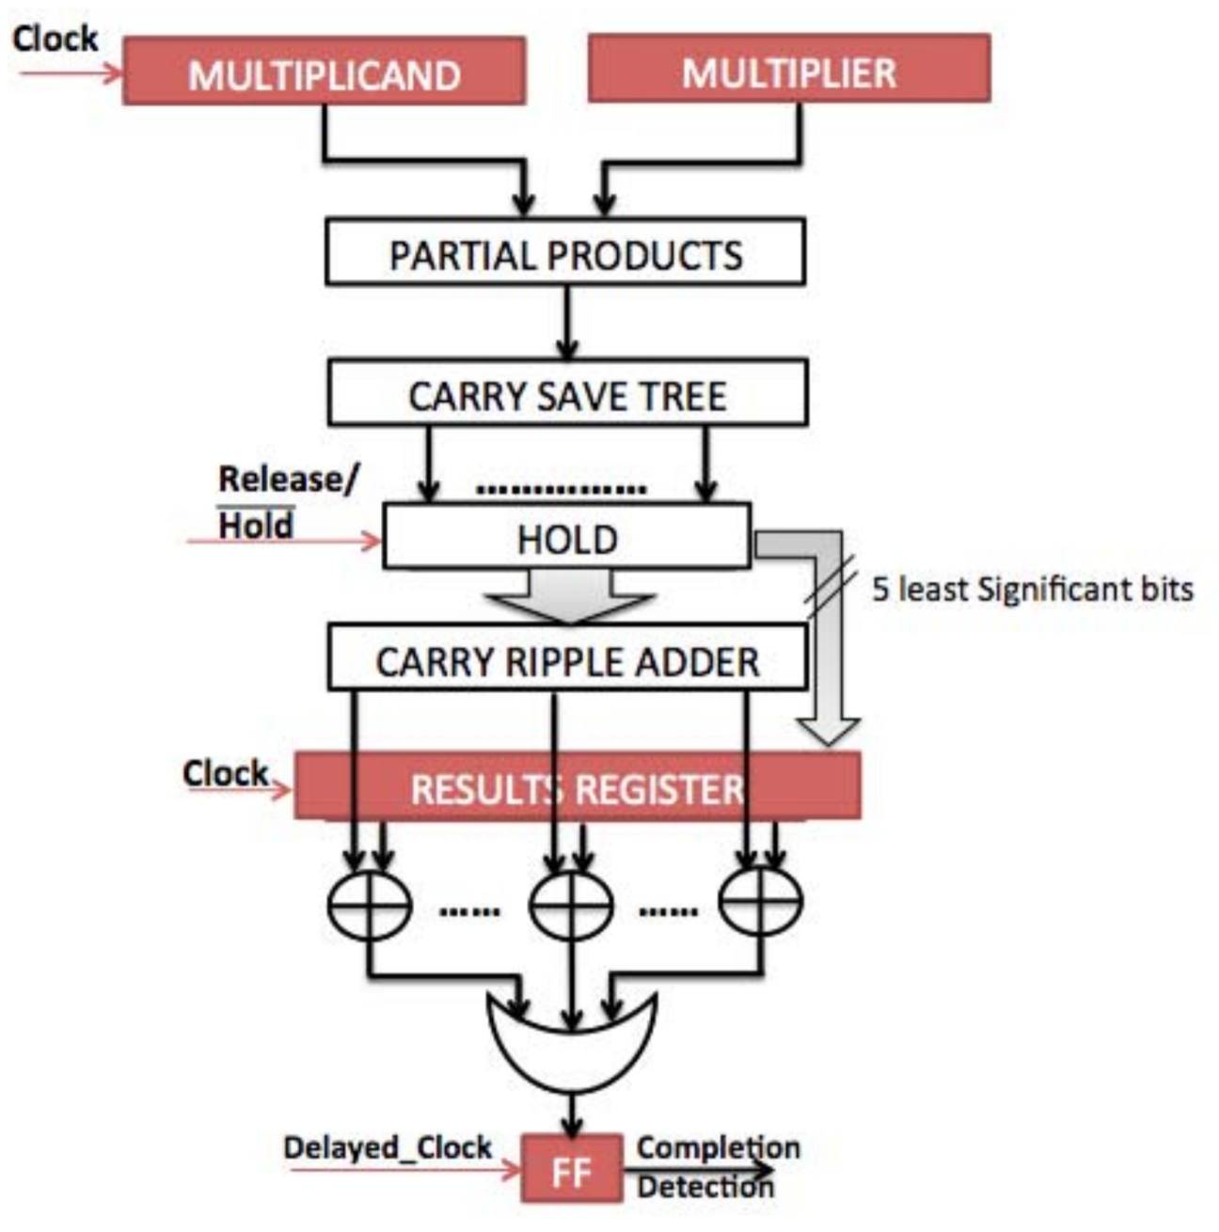
Faster-than-speed testing
[123] R. T. Uppu, R. K. Uppu, A. D. Singh, and A. Chatterjee, “A high throughput multiplier design exploiting input based statistical distribution in completion delays,” in Proc. 26th International Conference on VLSI Design, Jan. 2013, pp. 109–114.

Slide 15
X-canceling MISRs
Scan Chain
Scan Chain
Decompressor/LFSR
MISR
…
…
Scan Chain
Selection

Slide 16
The two-vector scanning problem

Slide 17
Scan-hold / enhanced scan
CK
period
PI
Combinational
circuit
PO
CK
SCAN-
OUT
CK TC
HL
SFF
HOLD
Scanout
result
HL
SFF
V1 settles
SCANIN
HOLD
Normal
mode
Scan mode
Normal
mode
CK TC
TC
CK: system clock
TC: test control
HOLD: hold signal
SFF: scan flip-flop
HL: hold latch
Scanin
V1
states
Scanin
V2 states
Result
latched
Capture
V1 PI
applied
V2 PI
applied
Launch

Slide 18
Using existing scan architectures
Launch-off-shift (LOS)
“skew load”
Launch-off-capture (LOC)
“broadside”

Slide 19
Multiple scan enables
PI
Combinational
circuit
PO
CK TC1
SFF
SCANIN1
SCANOUT1
SFF
SCANIN2
SCANOUT2
CK TC2
CK: system clock
TC1, TC2: test control
SFF: scan flip-flop

Slide 20
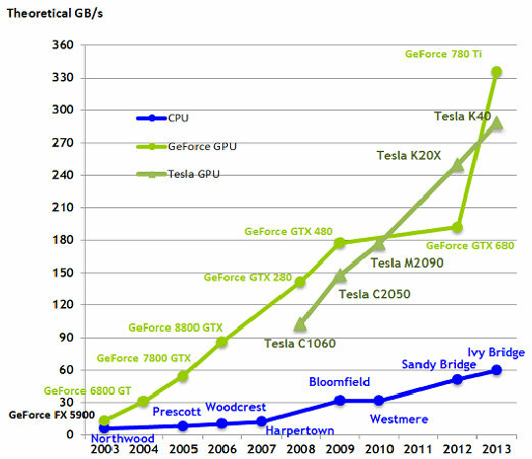
GPU-based fault simulation
Thambawita, Vajira, Roshan Ragel, and Dhammika Elkaduwe. “To Use or Not to Use: Graphics Processing Units for Pattern Matching Algorithms,” December 25, 2014.

Slide 21
Delay fault testing for security

Slide 22
ATPG to find trojan-induced delays

Slide 23
IC Recycling detection using machine learning of measured delays

Slide 24
What else is next?
Signal integrity & process variation
Asynchronous & self-timed circuits
Emerging nano-devices

Slide 25
Thank you

