Slide 1
Energy Efficient Power Distribution on Many-Core SoC
Mustafa M. Shihab* and Dr. Vishwani D. Agrawal
Department of Electrical and Computer Engineering Auburn University, Auburn, AL 36849, USA
January 09, 2019
*Currently a PhD candidate at the University of Texas at Dallas

Slide 2
Outline
Motivation
On-Chip Power Distribution Network
I²R Power Loss
Problem Statement
Proposed Scheme
Results
Challenges, Development and Future Work
References

Slide 3
Motivation
In 1965, Intel co-founder Gordon Moore observed and formulized that - transistor density is doubling every 18 months
Intel Xeon Phi processor
5,000,000,000 Transistors
Sources:
http://www.computerhistory.org/semiconductor/timeline.html
http://en.wikipedia.org/wiki/Transistor_count

Slide 4
On-Chip Power Distribution Network
Power Supply System – From Board to Chip:
Source:
N. Weste et al., CMOS VLSI design: A Circuits and Systems Perspective 2006

Slide 5
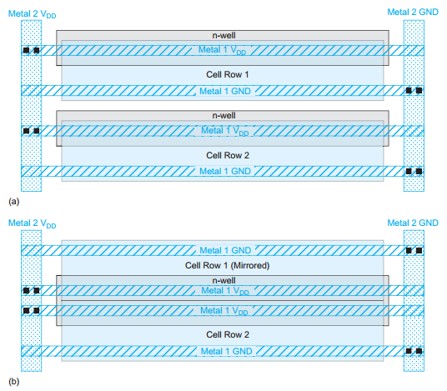
On-Chip Power Distribution Network
Power Distribution for Standard Cell Layout:
Source:
N. Weste et al., CMOS VLSI design: A Circuits and Systems Perspective 2006

Slide 6
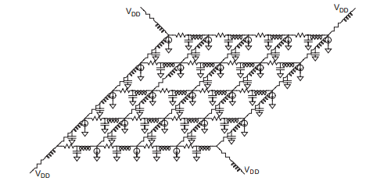
On-Chip Power Distribution Network
Power Distribution ‘Grid’:
Source:
N. Weste et al., CMOS VLSI design: A Circuits and Systems Perspective 2006

Slide 7
On-Chip Power Distribution Network
Issues with Present Day On-Chip Power Grid:
IR Drop
L(di/dt) Noise
Electromigration
Signal Delay Uncertainty
On-chip Clock Jitter
Noise Margin Degradation

Slide 8
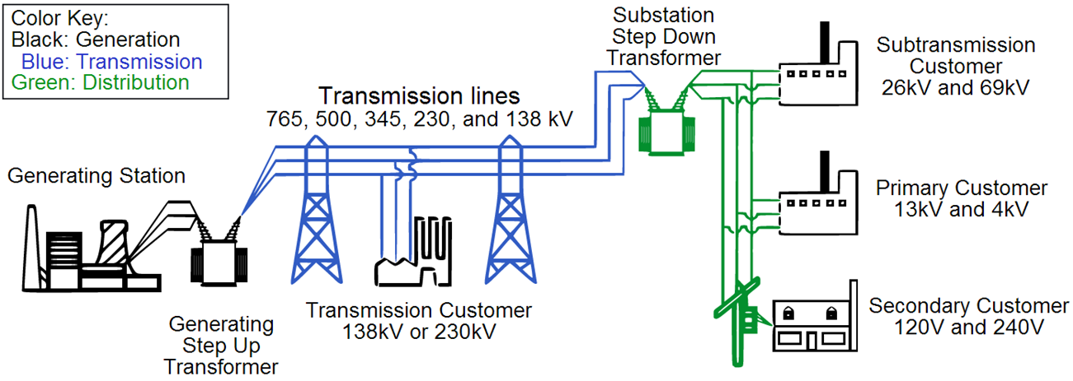
I²R Power Loss
Long Distance Power Grid
For a 100 mile long line carrying 1000 MW of energy:
@ 138 kV power loss = 26.25% @ 765 kV power loss = 1.1% to 0.5%
@ 345 kV power loss = 4.2%
Source: “American Electric Power Transmission Facts “, http://bit.ly/11nUMvf

Slide 9
I²R Power Loss
I²R Loss in On-Chip Power Distribution Network:
Increasing Current Density
Increasing Wire Resistivity
Increasing I²R Loss
Technology
Scaling

Slide 10
Problem Statement
We propose a scheme for delivering power to different parts of a large integrated circuit, such as cores on a System on Chip (SoC), at a higher than the regular (V_{DD}) voltage
The increase in voltage lowers the current on the grid, and reduces the I²R loss in the on-chip power distribution network

Slide 11
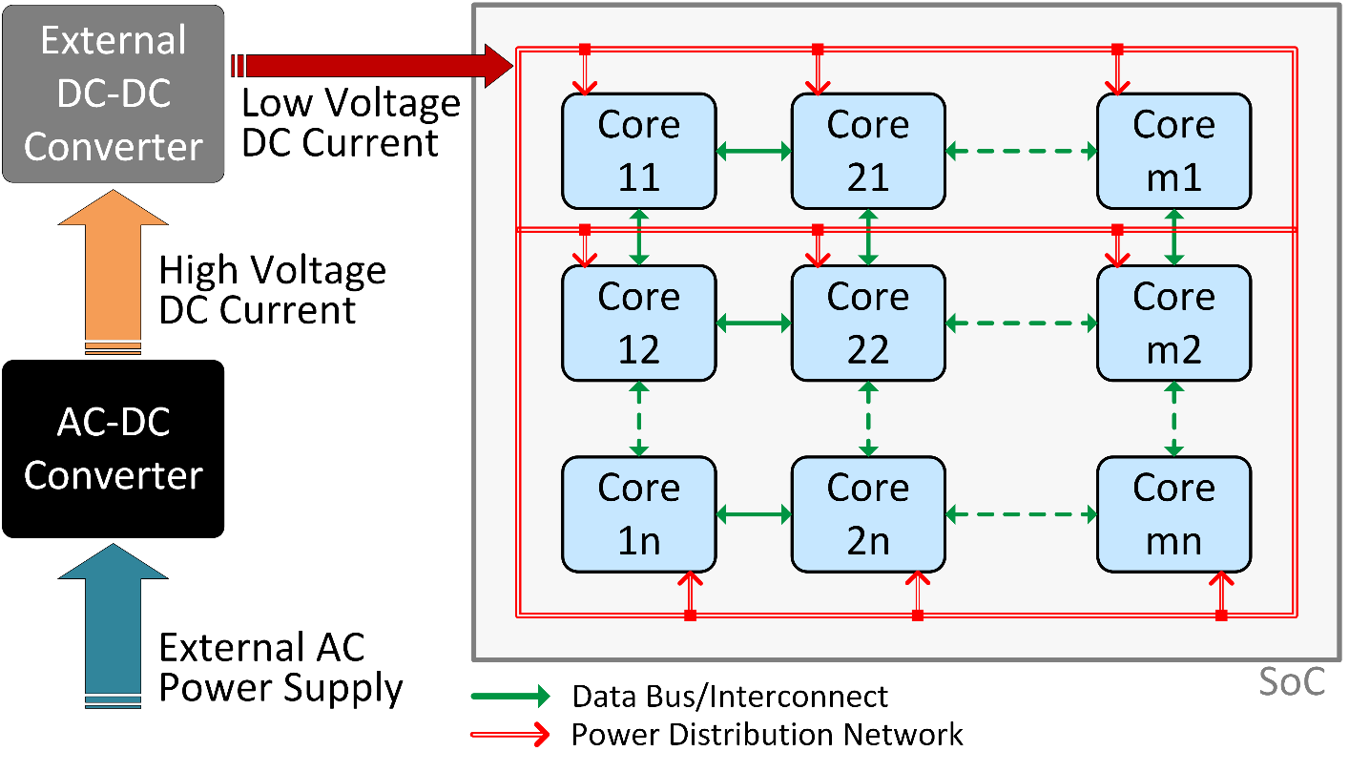
Proposed Scheme
Present Day On-Chip Power Distribution Network:

Slide 12
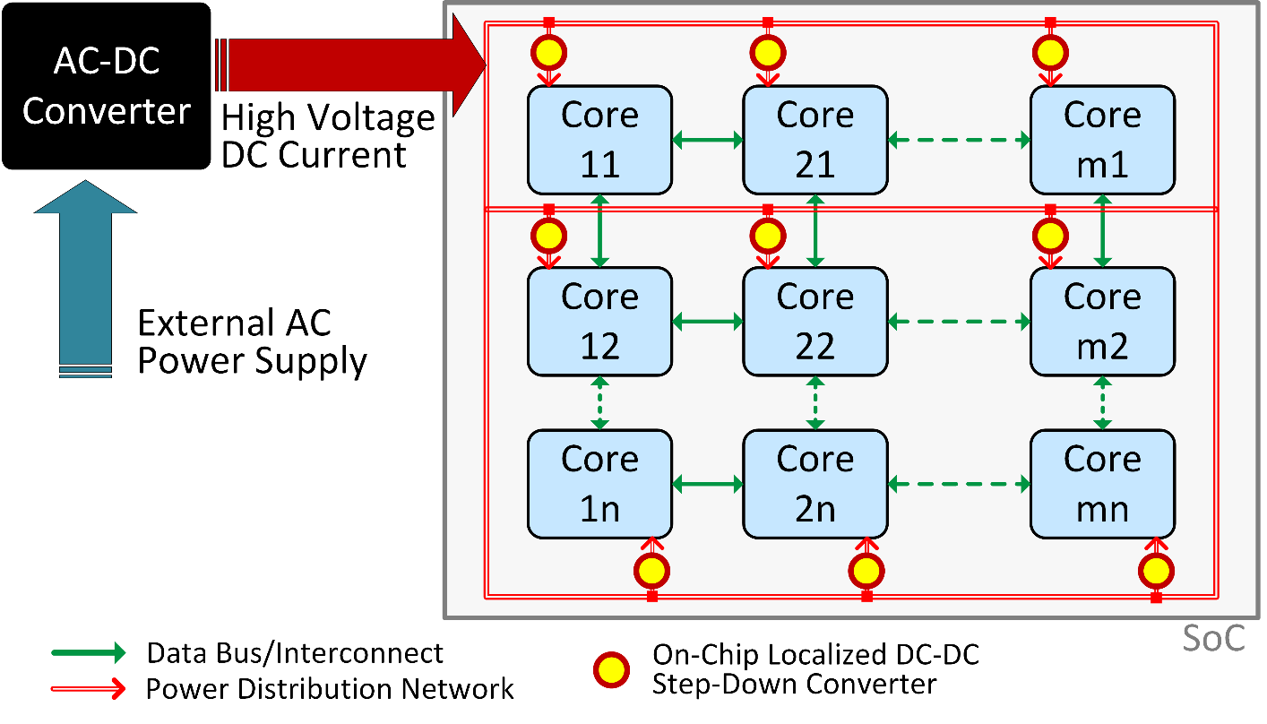
Proposed Scheme
Proposed High-Voltage On-Chip Power Distribution Network:

Slide 13
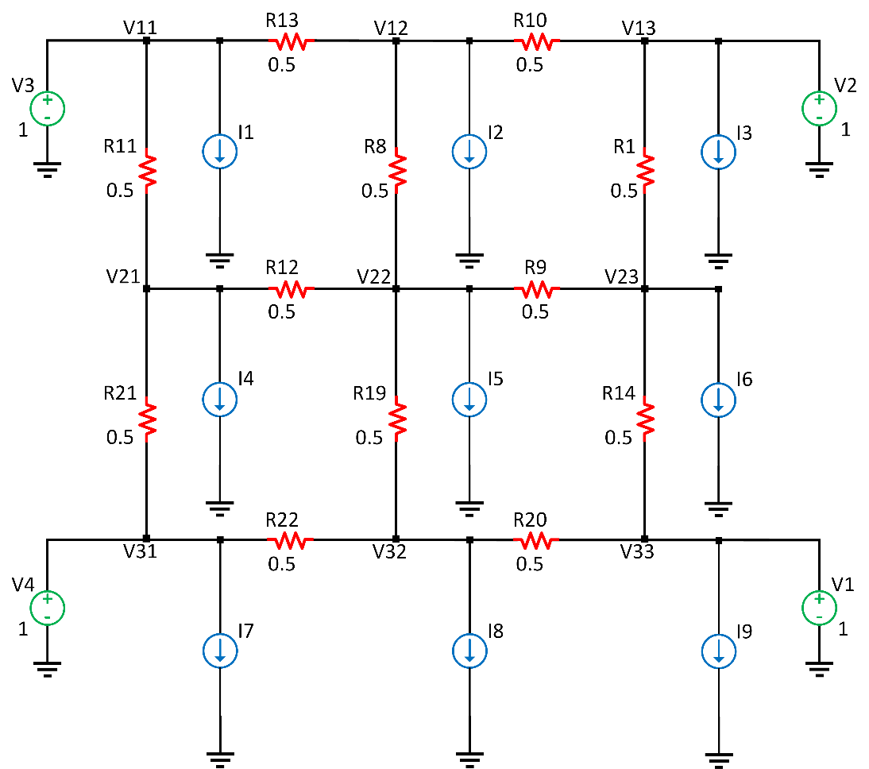
Proposed Scheme
Present Day Low-Voltage (V_{DD} = 1V) Power Grid (9 loads)

Slide 14
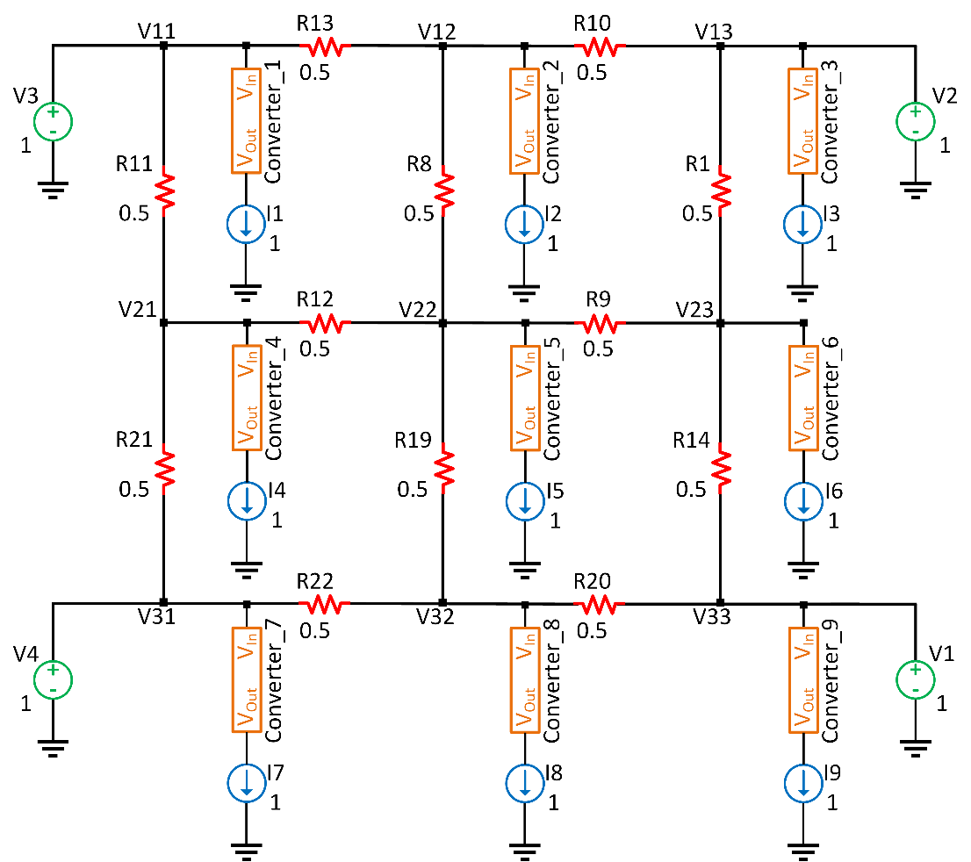
Proposed Scheme
Proposed High-Voltage (3V) Power Grid (9 loads)

Slide 15
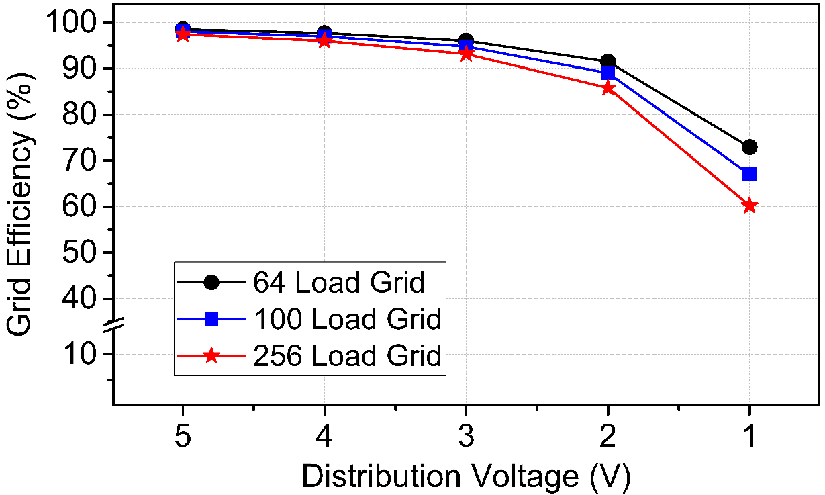
Results
Distribution Voltage vs. PDN Efficiency:
Load: 1W
Grid Resistances: 0.5 Ω (ITRS 2012)

Slide 16
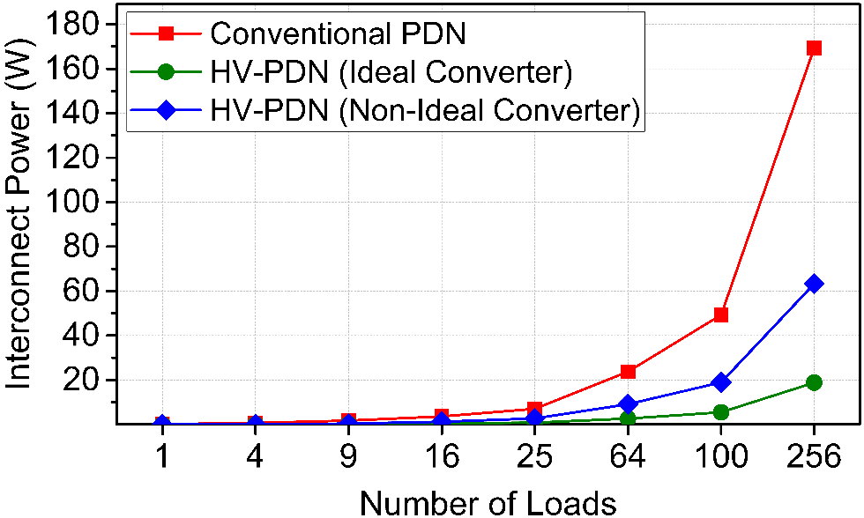
Results
Conventional vs. High-Voltage PDN: Power Consumption
Number of Loads | Load Power (W) | Grid Power (W)
 |  | Present Day PDN | High-Voltage PDN (Ideal Converter) | High-Voltage PDN (Non-Ideal Converter)
1 | 1 | 0.13 | 0.01 | 0.02
4 | 4 | 0.67 | 0.07 | 0.11
9 | 9 | 1.69 | 0.19 | 0.39
16 | 16 | 3.57 | 0.40 | 1.21
25 | 25 | 7.02 | 0.78 | 2.68
64 | 64 | 23.76 | 2.64 | 9.12
100 | 100 | 49.32 | 5.48 | 18.97
256 | 256 | 169.40 | 18.82 | 63.3
Load: 1W
Grid Resistances: 0.5 Ω (ITRS 2012)
DC-DC Converter: LTC 3411-A
(Ideal: 100% Efficiency, Non-Ideal: 80% Efficiency)

Slide 17
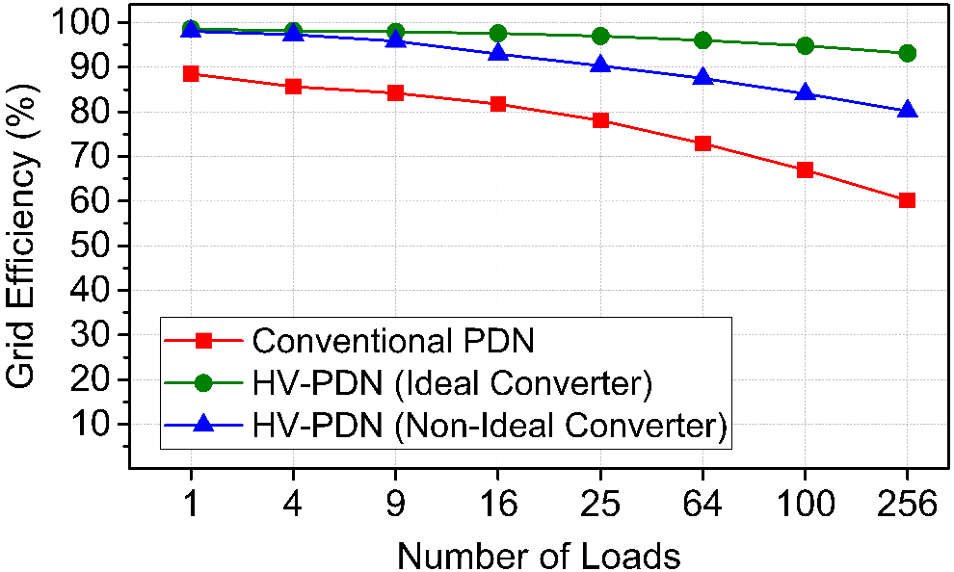
Results
Conventional vs. High-Voltage PDN: Power Delivery Efficiency
Number of Loads | Efficiency
 | Regular PDN | High-Voltage PDN (Ideal Converter) | High-Voltage PDN (Non-Ideal Converter)
1 | 88.50 | 98.58 | 98.04
4 | 85.65 | 98.17 | 97.32
9 | 84.19 | 97.96 | 95.85
16 | 81.76 | 97.58 | 92.97
25 | 78.08 | 96.97 | 90.32
64 | 72.93 | 96.04 | 87.53
100 | 66.97 | 94.80 | 84.05
256 | 60.18 | 93.15 | 80.18
Load: 1W
Grid Resistances: 0.5 Ω (ITRS 2012)
DC-DC Converter: LTC 3411-A
(Ideal: 100% Efficiency, Non-Ideal: 80% Efficiency)

Slide 18
Challenges and Developments
Challenges with DC-DC Converter Design:
Efficiency
Power
Area
Output Drive Capacity
Fabrication
Developments:
Input Voltage: 3.3 V
Output Voltage: 1.3 V – 1.6 V
Output Drive Current: 26 mA
Efficiency: 75% - 87%
Input Voltage: 3.6 V & 5.4 V
Output Voltage: 0.9 V
Output Drive Current: 250 mA
Efficiency: 87.8% & 79.6%
Sources:
B. Maity et al., Journal of Low Power Electronics 2012
V. Kursun et al., Multi-voltage CMOS Circuit Design. Wiley, 2006

Slide 19
Challenges, Developments and Future Work
Future Work:
DC-DC Converters:
Have the capability of driving output loads of reasonable size
Have power efficiency of 90% or higher
Meet the tight area requirements of modern high-density ICs
Be fabricated on-chip as a part of the SoC
Also have ‘regulator’ capability to convert a range of input voltage to the designated output voltage
Higher Efficiency + Higher Output Drive
Smaller
Cores
DC-DC Converters
High-Voltage PDN
SoCs

Slide 20
Thank You

