Slide 1
Defect Diagnosis of Digital Circuits Using Surrogate Faults
Chidambaram Alagappan
Vishwani D. Agrawal
Department of Electrical and Computer Engineering
Auburn University, AL 36849 USA

Slide 2
Presentation Outline
Purpose
Introduction to Fault Diagnosis
Diagnosis Algorithm
Proposed Algorithm
Analysis of the Algorithm
Experimental Results
Conclusion

Slide 3
Purpose
Fault Diagnosis proves helpful in ramping up the yield.
Most fault diagnosis procedures are fault model dependent.
In this work, we propose a diagnosis procedure using single stuck-at fault analysis, without assuming that the actual defect is a stuck-at fault.
Notes:
Every presentation on fault diagnosis starts by quoting Moore’s law, which says that every 18 months, the transistor count on an IC doubles approximately.

Slide 4
Fault Diagnosis Strategies
Cause-effect analysis
Builds simulation response database (fault dictionary) for modeled faults.
Too much information increases resources used.
Not suitable for large designs.
Effect-cause analysis
Analyzes failing outputs to determine cause.
Backward trace for error propagation paths for possible faults.
Memory efficient and suitable for large designs.

Slide 5
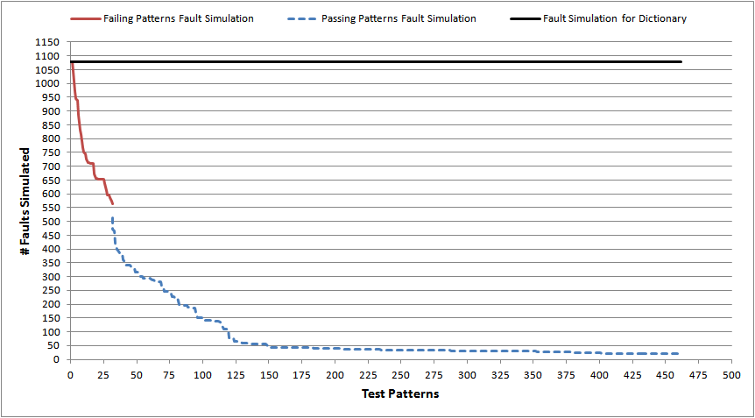
C432: Comparing with Fault Dictionary

Slide 6
Prime Suspect and Surrogate Faults
A prime suspect fault must produce all observed failures. It provides a perfect match with observed failures.
A surrogate fault has some, but not all, characteristics of the actual defect in the circuit.
A surrogate fault is not believed to be the actual defect.
A surrogate fault can only partially match symptoms of the actual defect.
Surrogates are representatives of the actual defect and may help identify the location or behavior of the defect.
L. C. Wang, T. W. Williams, and M. R. Mercer, “On Efficiently and Reliably Achieving Low
Defective Part Levels," in Proc. International Test Conf., Oct. 1995, pp. 616-625.

Slide 7
The Diagnosis Algorithm
The Diagnosis algorithm consists of four phases.
Assumption: No circular fault masking is present in the circuit.

Slide 8
Four Phase Diagnosis Algorithm
Group test patterns into failing and passing sets.
Phase 1: Simulate all faults with failing pattern set; all_suspects contains detectable faults.
Phase 2: Simulate all_suspects with passing patterns; remove detectable faults from all_suspects.
Phase 3: prime_suspects = faults from all_suspects that are detected by all failing patterns. surrogates = all_suspects – prime_suspects.
Phase 4: Augment prime_suspects and surrogates with equivalent and opposite polarity faults.

Slide 9
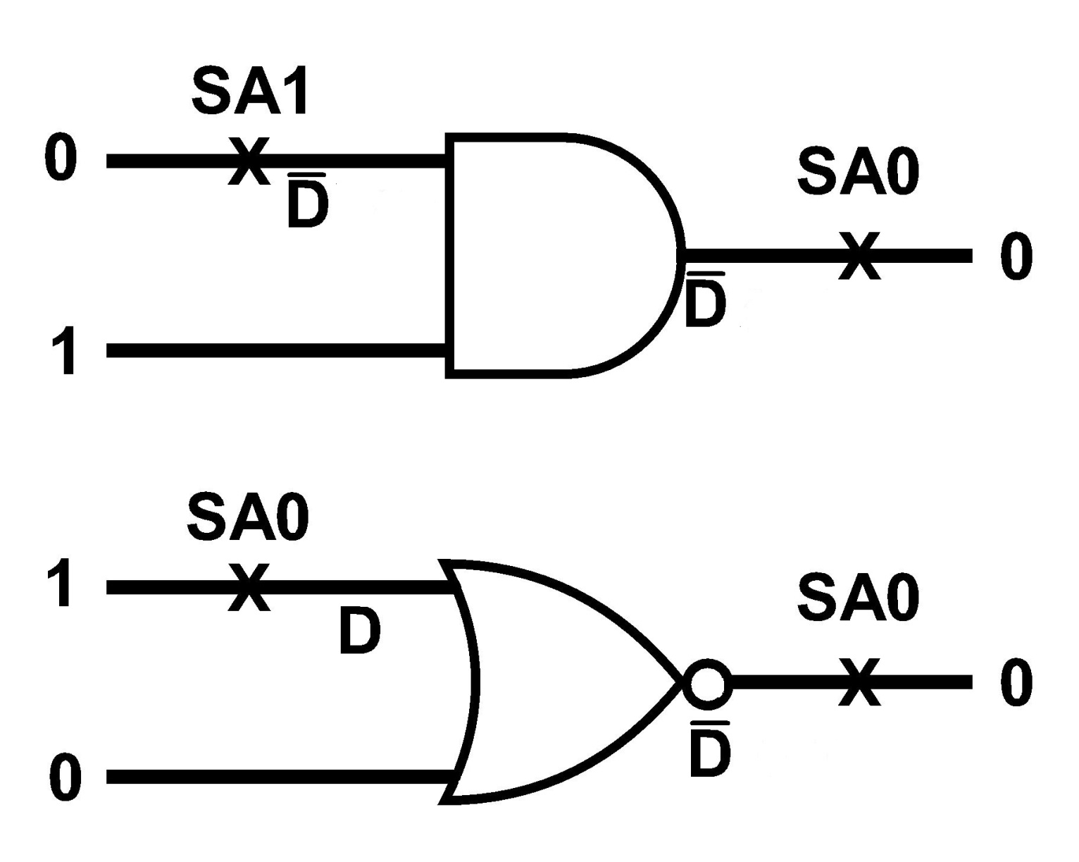
Why Add Opposite Polarity Faults?

Slide 10
Prime Suspect Theorem
If there is only a single stuck-at-fault present in the circuit under diagnosis (CUD), the diagnosis algorithm will always identify that fault, irrespective of the detection or diagnostic coverage of the test pattern set.

Slide 11
Failed Diagnosis!
Faults detected by failing pattern
Suspects
No suspect found
Faults detected by passing pattern

Slide 12
Fault Ranking
Fault ranking is needed when both fault lists, prime_suspects and surrogates, are empty.
Rank of a fault F = (#failing patterns detecting F) – (#Passing patterns detecting F)
Highest ranked faults are placed in prime_suspects and second highest ranked faults are placed in surrogates.
All lower ranked faults are discarded. The numerical ranks can be zero or even negative.

Slide 13
Experimental Results
Results for every circuit were obtained by calculating the average values from two separate runs of experiments, each containing 50 random failure cases (except for C17, which has only 22 faults).
Circuit modeling and algorithm – Python
Mentor Graphics Fastscan – ATPG and Fault simulator
Test pattern manipulation – VBA Macros

Slide 14
Diagnostic Coverage
Diagnostic coverage based on single stuck-at faults, excluding redundant faults is defined as
Fault Ratio for every set is defined as
Fault Ratio (FR) = (#Expected faults) / (#Reported faults)
Y. Zhang and V. D. Agrawal, “An Algorithm for Diagnostic Fault Simulation,” in Proc. 11th Latin-American Test Workshop (LATW), Mar. 2010, pp. 1–5.

Slide 15
Single Fault Diagnosis with 1-Detect Tests
Circuit | #Outputs | #Patterns | DC (%) | Diagnosis (%) | CPU* (s) | Fault Ratio
 |  |  |  |  |  | prime_s | surrogates
C17 | 2 | 10 | 95.454 | 100 | 0.067 | 1.100 | 1.780
C432 | 7 | 462 | 94.038 | 100 | 0.189 | 1.025 | 6.675
C499 | 32 | 2080 | 98.000 | 100 | 0.588 | 1.029 | 16.722
C880 | 26 | 1664 | 94.161 | 100 | 0.503 | 1.069 | 2.248
C1908 | 25 | 3625 | 85.187 | 100 | 1.294 | 1.379 | 28.290
C2670 | 140 | 13300 | 85.437 | 100 | 6.455 | 1.320 | 8.207
C3540 | 22 | 3520 | 89.091 | 100 | 1.333 | 1.229 | 5.200
C5315 | 123 | 13899 | 91.192 | 100 | 6.847 | 1.054 | 4.204
C6288 | 32 | 1056 | 85.616 | 100 | 0.764 | 1.138 | 8.255
C7552 | 108 | 17064 | 86.507 | 100 | 10.123 | 1.281 | 10.765
* PC with Intel Core-2 Duo 3.06GHz Processor and 4GB Memory

Slide 16
Single Fault Diagnosis with 2-Detect Tests
Circuit | #Outputs | #Patterns | DC (%) | Diagnosis (%) | CPU* (s) | Fault Ratio
 |  |  |  |  |  | prime_s | surrogates
C499 | 32 | 3872 | 98.400 | 100 | 1.025 | 1.029 | 7.970
C1908 | 25 | 6425 | 86.203 | 100 | 2.242 | 1.379 | 14.798
C7552 | 108 | 27756 | 86.750 | 100 | 16.076 | 1.281 | 8.023
* PC with Intel Core-2 Duo 3.06GHz Processor and 4GB Memory

Slide 17
Multiple Fault Diagnosis with 1-Detect Tests
Circuit | #Patterns | DC (%) | Both Faults Diagnosed (%) | One Fault Diagnosed (%) | None Diagnosed (%) | CPU* (s) | Fault Ratio
 |  |  |  |  |  |  | prime_s | surrog.
C17 | 10 | 95.45 | 80.950 | 19.040 | 0.000 | 0.067 | 0.500 | 2.091
C432 | 462 | 94.04 | 90.566 | 7.547 | 1.886 | 0.135 | 0.563 | 3.516
C499 | 2080 | 98.00 | 49.056 | 20.754 | 30.188 | 0.613 | 0.371 | 17.589
C880 | 1664 | 94.16 | 86.792 | 9.433 | 3.773 | 0.502 | 0.900 | 3.205
C1908 | 3625 | 85.19 | 90.566 | 0.000 | 9.433 | 0.928 | 0.488 | 12.764
C2670 | 13300 | 85.44 | 88.679 | 3.773 | 7.547 | 4.720 | 0.564 | 7.046
C3540 | 3520 | 89.09 | 86.792 | 3.773 | 9.433 | 1.547 | 0.488 | 5.177
C5315 | 13899 | 91.19 | 98.113 | 1.886 | 0.000 | 7.065 | 0.422 | 3.886
C6288 | 1056 | 85.62 | 83.018 | 0.000 | 16.981 | 0.888 | 0.589 | 5.536
C7552 | 17064 | 86.51 | 96.226 | 1.886 | 1.886 | 7.539 | 0.358 | 7.104
* PC with Intel Core-2 Duo 3.06GHz Processor and 4GB Memory

Slide 18
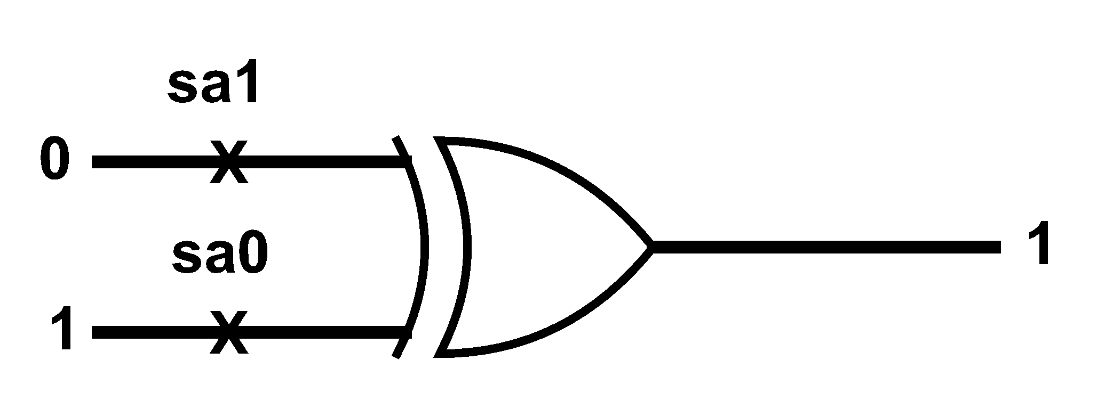
C499 (32-Bit Single Error Correcting Circuit)
C499 has an XOR tree with 104 two input XOR gates.
XOR gates are not elementary logic gates. Set of faults depends on its construction.
Presence of circular fault masking. Probability of circular fault masking will reduce with increase in number of faults.

Slide 19
Multiple Fault Diagnosis with 2-Detect Tests
Circuit | # Patterns | DC (%) | Both Faults Diagnosed (%) | One Fault Diagnosed (%) | None Diagnosed (%) | CPU* (s) | Fault Ratio
 |  |  |  |  |  |  | prime_s | surrog.
C499 | 3872 | 98.0 | 49.056 | 20.754 | 30.188 | 0.7 | 0.37 | 11.6
C1908 | 6425 | 86.2 | 90.566 | 0.000 | 9.433 | 2.3 | 0.49 | 7.23
C7552 | 27756 | 86.8 | 96.226 | 1.886 | 1.886 | 17 | 0.36 | 5.91
* PC with Intel Core-2 Duo 3.06GHz Processor and 4GB Memory

Slide 20
Single Fault Diagnosis with Diagnostic Tests
Circuit | #Outputs | #Patterns | DC (%) | Diagnosis (%) | CPU* (s) | Fault Ratio
 |  |  |  |  |  | prime_s | surrogates
C17 | 2 | 12 | 100 | 100 | 0.07 | 1.000 | 1.780
Multiple Fault Diagnosis with Diagnostic Tests
Circuit | # Patterns | DC (%) | Both Faults Diagnosed (%) | One Fault Diagnosed (%) | None Diagnosed (%) | CPU* (s) | Fault Ratio
 |  |  |  |  |  |  | prime_s | surrog.
C17 | 12 | 100 | 80.952 | 19.047 | 0.000 | 0.07 | 0.49 | 2.10
* PC with Intel Core-2 Duo 3.06GHz Processor and 4GB Memory

Slide 21
Conclusion
Considering fault simulation tools will always be limited to a few fault models, the relationship between non-classical faults and their surrogate classical faults was explored.
The proposed algorithm proves to be memory efficient and utilizes reduced diagnostic effort.
Physical relation of the actual non-classical faults not diagnosed should be examined with respect to the functional relation of the reported faults.
For future work, other non-classical faults (bridging, stuck-open, coupling, delay, etc.) and their surrogates can be examined.

Slide 22
References
M. Abramovici and M. A. Breuer, “Multiple Fault Diagnosis in Combinational Circuits Based on an Effect-Cause Analysis,” IEEE Transactions on Computers, vol. C-29, no. 6, pp. 451–460, June 1980.
M. L. Bushnell and V. D. Agrawal, Essentials of Electronic Testing for Digital, Memory and Mixed-Signal VLSI Circuits. Boston: Springer, 2000.
J. L. A. Hughes, “Multiple Fault Detection Using Single Fault Test Sets,” IEEE Trans.Computer-Aided Design of Integrated Circuits and Systems, vol. 7, no. 1, pp. 100–108, Jan.1988.
Y. Karkouri, E. M. Aboulhamid, E. Cerny, and A. Verreault, “Use of Fault Dropping for Multiple Fault Analysis,” IEEE Transactions on Computers, vol. 43, no. 1, pp. 98–103, Jan.1994.
N. Sridhar and M. S. Hsiao, “On Efficient Error Diagnosis of Digital Circuits,” Proc.International Test Conference, 2001, pp. 678–687.
C. E. Stroud, “A Designer’s Guide to Built-in Self-Test”. Boston: Springer, 2002.
H. Takahashi, K. O. Boateng, K. K. Saluja, and Y. Takamatsu, “On Diagnosing Multiple Stuck-At Faults Using Multiple and Single Fault Simulation in Combinational Circuits,” IEEE Trans. Computer-Aided Design of Integrated Circuits and Systems, vol. 21, no. 3, pp. 362–368, Mar. 2002.

Slide 23
References (contd..)
R. Ubar, S. Kostin, and J. Raik, “Multiple Stuck-at Fault Detection Theorem,” Proc. IEEE 15th International Symp. Design and Diagnostics of Electronic Circuits and Systems, Apr. 2012, pp. 236–241.
L. C. Wang, T. W. Williams, and M. R. Mercer, “On Efficiently and Reliably Achieving Low Defective Part Levels,” Proc. International Test Conf., Oct. 1995, pp. 616–625.
Y. Zhang and V. D. Agrawal, “A Diagnostic Test Generation System,” Proc. International Test Conf., Nov. 2010. Paper 12.3.
V. D. Agrawal, D. H. Baik, Y. C. Kim, and K. K. Saluja, “Exclusive Test and Its Applications to Fault Diagnosis,” Proc. 16th International Conf. VLSI Design, Jan. 2003, pp. 143–148.
L. Zhao and V. D. Agrawal, “Net Diagnosis Using Stuck-At and Transition Fault Models,” Proc. 30th IEEE VLSI Test Symp., Apr. 2012, pp. 221–226.
Y. Zhang and V. D. Agrawal, “An Algorithm for Diagnostic Fault Simulation,” Proc. 11th Latin-American Test Workshop (LATW), Mar. 2010, pp. 1–5.
C. Alagappan, “Dictionary-Less Defect Diagnosis as Real or Surrogate Single Stuck-At Faults,” Master’s thesis, Auburn University, Auburn, Alabama, May 2013.

Slide 24
Thank You . . .

