Slide 1
Externally Tested Scan Circuit with Built-In Activity Monitor and Adaptive Test Clock
Priyadharshini Shanmugasundaram
priyas@nvidia.com
Vishwani D. Agrawal
vagrawal@eng.auburn.edu
Hyderabad, India, January 11, 2012

Slide 2
Testing of VLSI Circuits and Power
High circuit activity during test leads to functional slowdown and high test power dissipation:
Peak power - Large IR drop in power distribution lines
Voltage droop and ground bounce (power supply noise)
Reduced voltage slows the gates down (delay fault)
Average power - Excessive heating
Timing failures
Permanent damage to circuit
Good chip may be labeled as bad → yield loss
Existing solution: Use worst-case test clock rate to keep average and peak power within specification.
Results in long test time.

Slide 3
Problem Statement
Reduce test time without exceeding the power specification:
Proposed solution: Adaptive test clock
Use worst-case clock rate when circuit activity is not known
Monitor circuit activity and speed up the clock when activity reduces

Slide 4
Previous Publications
P. Shanmugasundaram and V. D. Agrawal, “Dynamic Scan Clock Control in BIST Circuits,” RASDAT, January 2011.
P. Shanmugasundaram and V. D. Agrawal, “Dynamic Scan Clock Control in BIST Circuits,” Proc. 43rd IEEE Southeastern Symposium on System Theory, March 14-16, 2011, pp. 239-244.
P. Shanmugasundaram and V. D. Agrawal, “Dynamic Scan Clock Control for Test Time Reduction Maintaining Peak Power Limit,” Proc. 29th IEEE VLSI Test Symposium, May 2-4, 2011, pp. 248-253.
P. Shanmugasundaram, Test Time Optimization in Scan Circuits, Master’s Thesis, Department of ECE, Auburn University, Auburn, Alabama, December 2010.

Slide 5
Built-In Self-Test (BIST)
SR: Scan register (flip-flops
with dual inputs)
RBG: Random bit generator
1
0
1
0
1
0
Combinational Logic
Primary
inputs
Primary
outputs
Test multiplexers
SR, RBG
and RA have
common clock
and reset
RA: Response analyzer

Slide 6
RBG Generates 010101
SR: Scan register (flip-flops
with dual inputs)
RBG: Random bit generator
1
0
1
0
1
0
Primary
inputs
Primary
outputs
Test multiplexers
SR, RBG
and RA have
common clock
and reset
RA: Response analyzer

Slide 7
RBG Generates 111000
SR: Scan register (flip-flops
with dual inputs)
RBG: Random bit generator
0
0
0
1
1
1
Primary
inputs
Primary
outputs
Test multiplexers
SR, RBG
and RA have
common clock
and reset
RA: Response analyzer

Slide 8
Main Idea
Observation: Different sequences of test vector bits consume different amounts of power.
Conventional test clock frequency is chosen based on maximum test power consumption.
All test vector bits are applied with the same clock frequency.
Test vector bit sequences consuming lower power can be applied at higher scan clock frequencies without exceeding power budget of the chip.

Slide 9
Scan Clock Frequency
Upper bounds:
Maximum shift frequency allowed by shift register structure, F1
Shift frequency determined by the highest scan activity and peak power budget, F2
F1 >> F2
Fixed scan clock: use F2
Adaptive clock: monitor activity and vary clock frequency between F1 and F2

Slide 10
Speeding Up Scan Clock
Power
budget
Cycle power
Clock periods
Power
budget
Cycle power
Clock periods

Slide 11
Monitoring Test Activity
Non-transition
monitor
RBG: Random bit generator
1
0
1
0
1
0
Combinational Logic
Primary
inputs
Primary
outputs
Test multiplexers
SR, RBG
and RA have
common clock
and reset
RA: Response analyzer

Slide 12
Monitoring Scan-in, $αpeak =1$

Slide 13
Clock Rate vs. SR Activity
N = number of flip-flops in scan shift register (SR)
M = number of adjustable clock rates = 4, in this illustration
F1 = fmax
fmax/2
fmax/3
F2 = fmax/4
N
N/2
N/4
0
Clock rate
SSR transitions per clock
0 N/4 2N/4 3N/4 N
Number of non-transitions counted

Slide 14
Monitor Scan-out, $αpeak<1$

Slide 15
Experimental Result - $α_{peak}=0.65$
ATPG pattern sets, generated by Tetramax, for four large benchmark circuits analyzed for trends in peak activity factor
Mean ($μ$) $≈ 0.57$
Standard deviation ($σ$) $≈ 0.025$
$μ + 3σ = 0.65$
Peak activity factor was lower than 0.65 in vector sets of all large benchmark circuits

Slide 16
Externally Tested Circuit
Advantest T2000GS Automatic Test Equipment (ATE)
Start scan-in assuming $α_{peak}=0.65$for captured state
Results for ITC02 benchmark t512505
N = 76,714 flip-flops (full-scan)
Scan clock frequency steps, v = 512
Reference case scan clock frequency determined for activity $α_{peak}=0.65$, assumed 100kHz

Slide 17
Adaptive Clock Testing
ATE supplies 51.2 MHz test clock
Test for stuck-at faults
DUT with monitoring and clock control implemented in FPGA
Synchronizer implemented in FPGA as a vector buffer, working with 51.2MHz clock
Adaptive clock:
Begin scan-in with 100kHz scan clock. Set counter.
Step up frequency when count of non-transitions entering scan chain is $\frac{α_{peak}N}{v}$. Set counter.
Step down frequency when count of non-transitions leaving scan chain is $\frac{α_{peak}N}{v}$. Set counter.

Slide 18
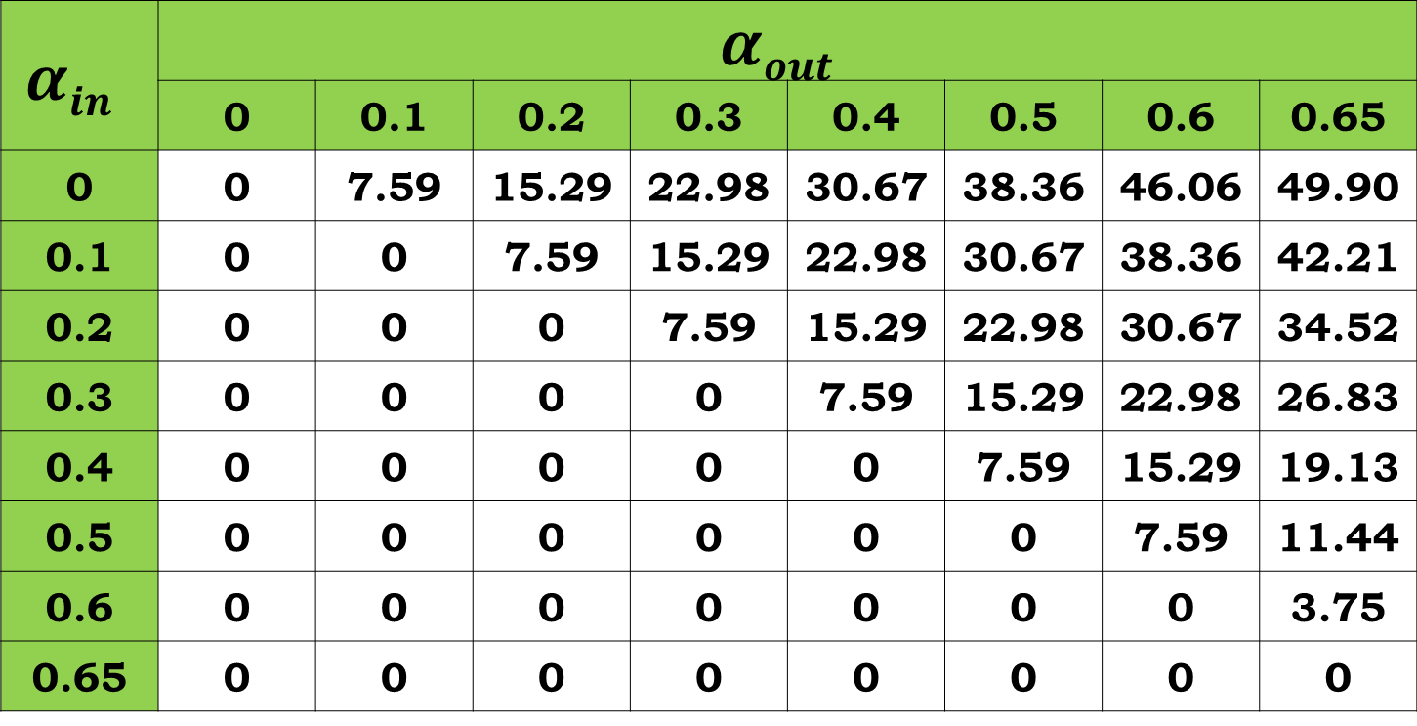
Test Time Reduction (%) in t512505
$$αin$$ | $$αout$$
 | 0 | 0.1 | 0.2 | 0.3 | 0.4 | 0.5 | 0.6 | 0.65
0 | 0 | 7.59 | 15.29 | 22.98 | 30.67 | 38.36 | 46.06 | 49.90
0.1 | 0 | 0 | 7.59 | 15.29 | 22.98 | 30.67 | 38.36 | 42.21
0.2 | 0 | 0 | 0 | 7.59 | 15.29 | 22.98 | 30.67 | 34.52
0.3 | 0 | 0 | 0 | 0 | 7.59 | 15.29 | 22.98 | 26.83
0.4 | 0 | 0 | 0 | 0 | 0 | 7.59 | 15.29 | 19.13
0.5 | 0 | 0 | 0 | 0 | 0 | 0 | 7.59 | 11.44
0.6 | 0 | 0 | 0 | 0 | 0 | 0 | 0 | 3.75
0.65 | 0 | 0 | 0 | 0 | 0 | 0 | 0 | 0

Slide 19
Conclusion
Dynamic control of scan clock frequency proposed:
Reduces testing time without exceeding power budget.
On-chip activity monitor for self testing circuits keeps track of activity in scan chain and adjusts scan clock rate.
On-chip or off-chip activity monitor can be used for externally tested circuits.
Hand-shake protocol used for communication between ATE and DUT.
Vectors with low average scan-in activity and high peak activity achieve large reduction in test time.
Method can be implemented in circuits using compression hardware
Activity monitored at every internal scan chain.
Up to 50% reduction in test time achieved in circuits when start frequency not pre-determined
Results more significant when start frequency is pre-determined.

