Slide 1
Dynamic Scan Clock Control In BIST Circuits
Priyadharshini Shanmugasundaram
priyas@nvidia.com
Vishwani D. Agrawal
vagrawal@eng.auburn.edu

Slide 2
Testing of VLSI Circuits and Power
High circuit activity during test leads to functional slowdown and high test power dissipation:
Peak power - Large IR drop in power distribution lines
Voltage droop and ground bounce (power supply noise)
Reduced voltage slows the gates down (delay fault)
Average power - Excessive heating
Timing failures
Permanent damage to circuit
Good chip may be labeled as bad → yield loss
Existing solution: Use worst-case test clock rate to keep average and peak power within specification.
Results in long test time.

Slide 3
Problem Statement
Reduce test time without exceeding the power specification:
Proposed solution: Adaptive test clock
Use worst-case clock rate when circuit activity is not known
Monitor circuit activity and speed up the clock when activity reduces

Slide 4
Built-In Self-Test (BIST)
SSR: Scan shift
register (flip-flops
with dual inputs)
RBG: Random bit generator
1
0
1
0
1
0
Combinational Logic
Primary
inputs
Primary
outputs
Test multiplexers
SSR, RBG
and RA have
common clock
and reset
RA: Response analyzer

Slide 5
RBG Generates 010101
SSR: Scan shift
register (flip-flops
with dual inputs)
RBG: Random bit generator
1
0
1
0
1
0
Primary
inputs
Primary
outputs
Test multiplexers
SSR, RBG
and RA have
common clock
and reset
RA: Response analyzer

Slide 6
RBG Generates 111000
SSR: Scan shift
register (flip-flops
with dual inputs)
RBG: Random bit generator
0
0
0
1
1
1
Primary
inputs
Primary
outputs
Test multiplexers
SSR, RBG
and RA have
common clock
and reset
RA: Response analyzer

Slide 7
Main Idea
Observation: Different sequences of test vector bits consume different amounts of power.
Conventional test clock frequency is chosen based on maximum test power consumption.
All test vector bits are applied at the same frequency.
Test vector bit sequences consuming lower power can be applied at higher clock frequencies without exceeding power budget of the chip.

Slide 8
Speeding Up Scan Clock
Power
budget
Cycle power
Clock periods
Power
budget
Cycle power
Clock periods

Slide 9
Monitoring Test Activity
Non-transition
monitor
RBG: Random bit generator
1
0
1
0
1
0
Combinational Logic
Primary
inputs
Primary
outputs
Test multiplexers
SSR, RBG
and RA have
common clock
and reset
RA: Response analyzer

Slide 10
A Dynamic Scan Architecture

Slide 11
Clock Rate vs. SSR Activity
N = number of flip-flops in scan shift register (SSR)
M = number of adjustable clock rates = 4, in this illustration
fmax
fmax/2
fmax/3
fmax/4
N
N/2
N/4
0
Clock rate
SSR transitions per clock
0 N/4 2N/4 3N/4 N
Number of non-transitions counted

Slide 12
Dynamic Control of Scan Clock
Monitor number of transitions in scan chain
Speed-up scan clock when activity in scan chain is low or slow-down scan clock when activity in scan chain is high
Scan-in time
Without dynamic control
$4T∗8 = 32T$
With dynamic control
$4T∗4+3T∗2+2T∗2=26T$
Reduction
$\frac{(32T−26T)}{32T}∗100=18.75\%$
Number of flip-flops in scan shift register (SSR), N = 8
Number of adjustable clock rates , M = 4
Maximum clock rate, fmax = f

Slide 13
ISCAS89 Benchmark Circuits
Circuit | Number of Scan flip-flops | Number of clock rate steps | Test time reduction (%) |  | Area overhead (%)
 |  |  | Experiment | Theory
s27 | 8 | 2 | 7.49 | 0.0 | 14.72
s386 | 20 | 4 | 15.25 | 12.64 | 15.29
s838 | 67 | 4 | 13.51 | 12.64 | 11.73
s5378 | 263 | 4 | 13.03 | 12.64 | 6.65
s13207 | 852 | 8 | 19.00 | 18.78 | 3.98
s35932 | 2083 | 8 | 18.74 | 18.78 | 2.55
s38584 | 1768 | 8 | 18.91 | 18.78 | 2.13

Slide 14
S386: Activity for One Scan-In
Input activity = 25%
Time reduction = 22.5%

Slide 15
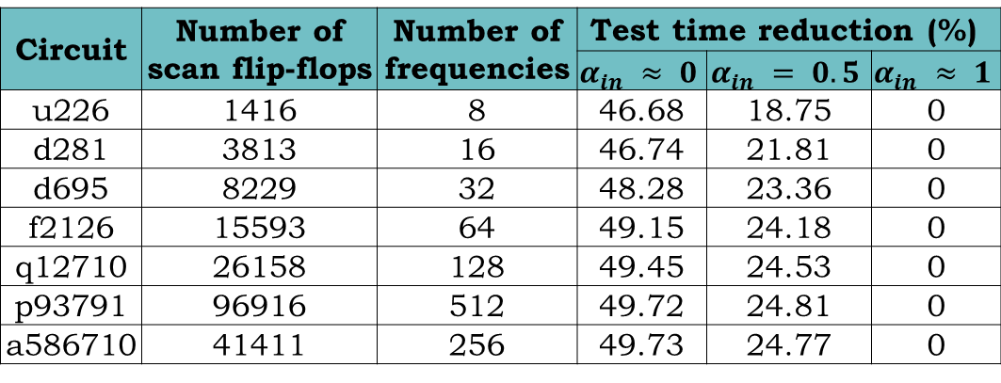
ITC02 Benchmark Circuits
Circuit | Number of scan flip-flops | Number of clock rate steps | Test time reduction (%)
u226 | 1416 | 8 | 46.68 | 18.75 | 0
d281 | 3813 | 16 | 46.74 | 21.81 | 0
d695 | 8229 | 32 | 48.28 | 23.36 | 0
f2126 | 15593 | 64 | 49.15 | 24.18 | 0
q12710 | 26158 | 128 | 49.45 | 24.53 | 0
p93791 | 96916 | 512 | 49.72 | 24.81 | 0
a586710 | 41411 | 256 | 49.73 | 24.77 | 0

Slide 16
Improvement: Monitor Input & Output

Slide 17
Conclusion
Dynamic control of scan clock rate reduces test time without exceeding power specification.
Vectors with low average scan-in activity and high peak activity give more reduction in test time.
Up to 50% reduction in test time is possible.
References:
P. Shanmugasundaram, Test Time Optimization in Scan Circuits, Master’s Thesis, Department of ECE, Auburn University, Auburn, Alabama, December 2010.
P. Shanmugasundaram and V. D. Agrawal, “Dynamic Scan Clock Control for Test Time Reduction Maintaining Peak Power Limit,” Proc. 29th IEEE VLSI Test Symposium, May 2-4, 2011.

