Slide 1
Using MVL (Multi-Valued Logic) Signal in Test Application
Baohu Li, Bei Zhang, Vishwani Agrawal
Auburn University

Slide 2
Overview
Motivation
MVL (Multi-Valued Logic) basics
MVL signal in test application
Ensuring error-free test application
Performance improvement and overhead
Conclusion

Slide 3
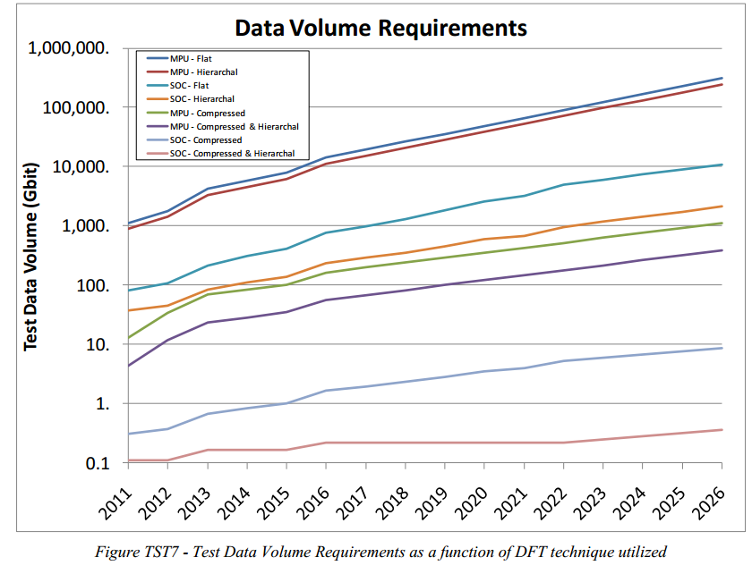
Motivation
Test challenge: Increasing test data volume and test time.
[ITRS 2012]

Slide 4
Motivation
Our objective: Reducing testing time
Some existing solutions:
1. Reduce the test data (test compression).
2. Exploit test parallelism (multi-domain, concurrent test, etc.)
Our solution: Using MVL (Multi-Valued Logic) signal in test application.

Slide 5
MVL (Multi-Valued Logic) basics
MVL uses more levels within full voltage swing rather than two. (contains more information per MVL symbol)
Vdd
2/3Vdd
1/3Vdd
0
Binary signal
(2 lvls, 1bit information)
MVL signal
(4 lvls, 2bits of information)

Slide 6
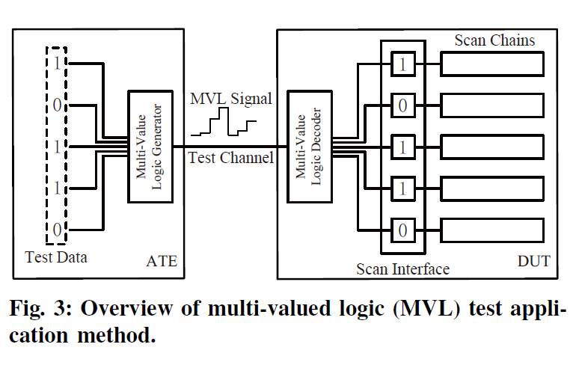
MVL signal in test application
System diagram:

Slide 7
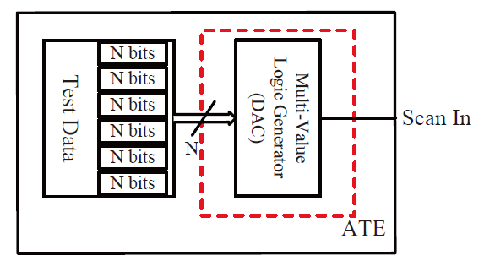
MVL signal in test application
ATE Modification
Test data are sliced into N-bit group to feed into MVL generator (DAC) ; The output of MVL generator become MVL version of test data.

Slide 8
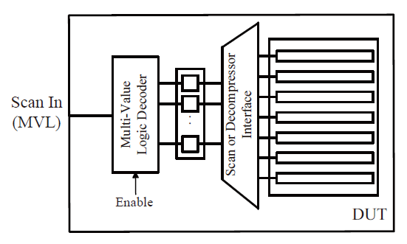
MVL signal in test application
DUT Modification
MVL test data are captured by the MVL decoder (ADC) in DUT;
Decoded test data are distributed into scan chains or decompressor interface.

Slide 9
MVL signal in test application
Improvement in data rate
Data rate per binary channel equals channel clock frequency:
r_{B} = f_{clk}
Data rate per MVL channel equals channel clock frequency times data converter resolution:
r_{M} = f_{clk} x R
Data rate ratio per test channel is:
X = r_{M} / r_{B} = R
So, the MVL test application is faster than traditional way by a factor R.

Slide 10
Ensuring Correct Application
Problem of MVL Test Application:
1. Imperfect performance of DA/AD converters: Due to design limitation, environment/process variance, etc., the transfer function of DA/AD converters is not ideal (nonlinearity exists).
2. Noise problem: In binary system, the noise margin is half the voltage swing. But for MVL system, the noise margin is shrunk by 2^{r} (r is data converter resolution), which makes MVL system more vulnerable to noise.

Slide 11
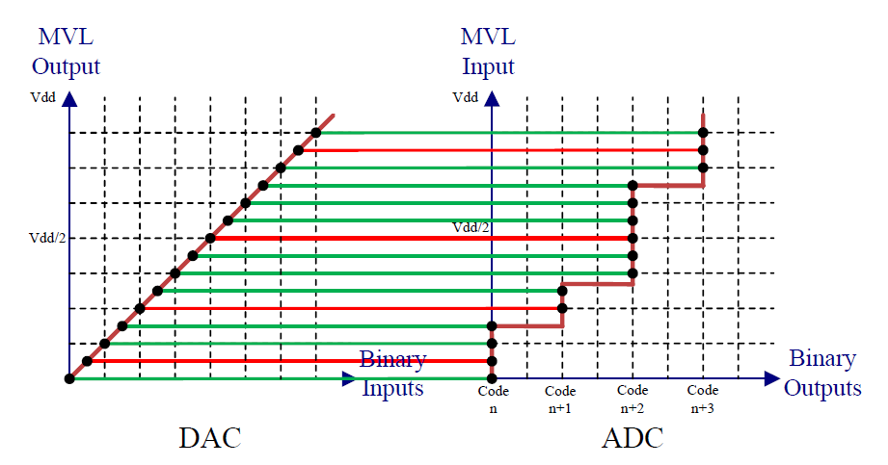
Ensure of Correct Application
Solution to resolve nonlinear effect:
Use DAC with finer resolution and better performance in ATE to calibrate the coarse ADC in DUTs. (DAC has less restriction than the ADC on chip)

Slide 12
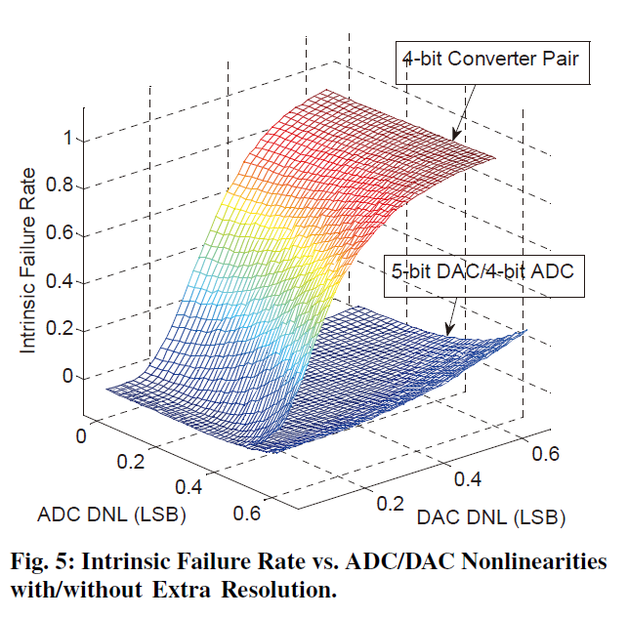
Ensure of Correct Application
Simulation result:
Intrinsic failure is defined as a mismatch between DAC input and ADC output.

Slide 13
Ensure of Correct Application
Solution to resolve noise problem:
Propose an error detect mechanism for MVL decoder so that we can do retest to prevent falsely applied test data.
Retest contributes to longer test time but guarantee good test application; The probability of error’s popping out should be in a proper range or retests become meaningless. (For P_{e} = 0.9, 10 times of retest only result in good application probability as 68.62%, and for P_{e} = 0.1, 3 times of retest can reach 99.99%.)

Slide 14
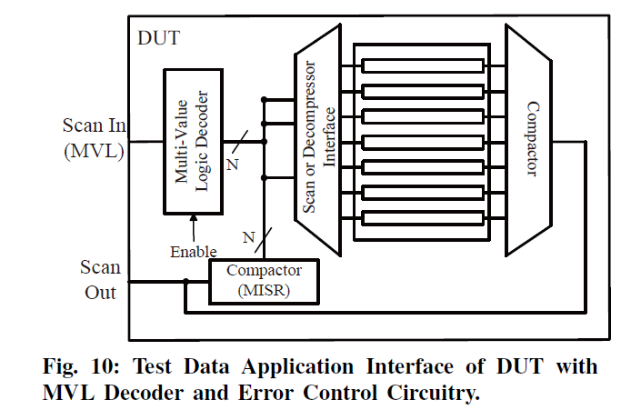
Ensure of Correct Application
Error detection structure:

Slide 15
Ensure of Correct Application
Error detection process:
We add a compactor (MISR) following the MVL decoder to compact decoded test data as test application going on.
At the end of test application, we can get the applied test signature (ATS) in the compactor. By examining the ATS with desired one, whether errors happen during test application can be detected.

Slide 16
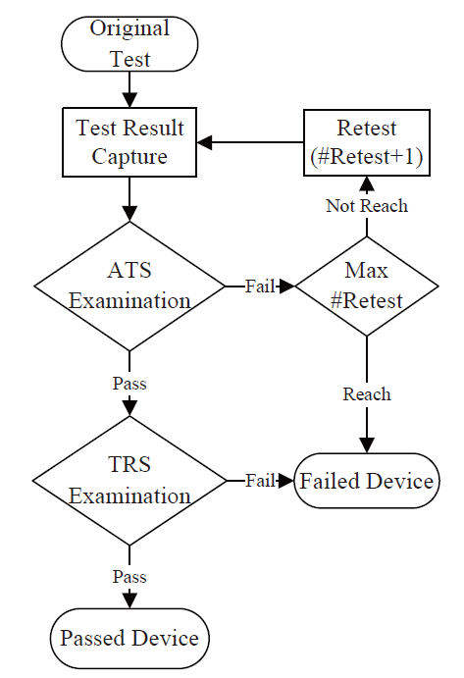
Ensure of Correct Application
Test Flow:
Two signatures, applied test signature (ATS) and test response signature (TRS), should be examined;
Examine ATS to make sure the applied test data are correct;
Examine TRS to make sure the DUT pass the test;
Retest is conducted when ATS has a mismatch but a maximum number for retests is specified.

Slide 17
Estimated Performance Improvement and Overhead
Ideally the data rate per channel is increased by a factor R.
Taking retest into consideration:
X_{T}
where R is the data converter resolution, CAR is the probability of whole test being correctly applied for one time and N is the maximum number of retests.

Slide 18
Estimated Performance Improvement
Final correct test application rate
With retest, the probability for whole test is applied correctly:
CAR_{ec} =
This means DUTs cannot pass the ATS exam and be marked as failed parts.
Simulated situations:
We ran simulations based on different conditions: data converter resolution, test channel SNR, test data volume and max number of retest time. Result is shown in following slide.

Slide 19
Estimated Performance Improvement
We give a statistical estimate for performance improvement in a typical example:
9-bit DAC as MVL generator
6-bit ADC as on-chip MVL decoder
40dB channel SNR (Gaussian noise)
Retest 2 times max
1Gb test data volume
Probability to incorrectly receive and decode one clock MVL signal – WER (Word Error Rate) is 10⁻¹⁰
The overall probability to correctly send whole test set – CAR (Correct Application Rate) is 98.35%
With retest, the probability for each DUT to get correct test data – CAR_{ec} (CAR with error control) is almost 100%
X_{T} (the actual data rate ratio – MVL over binary) is 5.9009.

Slide 20
Overhead
DACs placed in between test data buffers and test channels;
ADC in each DUT (Much more constraints in area, speed and power, etc.)
SAR (successive approximation register) ADC seems to be an on-chip solution, which is the state of the art ADC type for high speed/low power application.

Slide 21
Conclusion
We adopt MVL signal in test application which increases the data rate of test channel. (e.g., 5.9 times in one of the given conditions)
We develop an error detection and control scheme to guarantee the test application correctness.

