Slide 1
Test Programming for power constrained devices
By
Praveen Venkataramani
Vishwani D. Agrawal

Slide 2
Agenda
Problem statement
Prior work
A test time theorem
Test time reduction methods
Summary
Future work
Notes:
We are going to go through

Slide 3
Problem Statement
Power consumption during test must not exceed the specified budget often implying increased test time.
Long test time increases cost; test time can be very long for scan based testing.
Need to reduce test time without exceeding power budget.
Notes:
Large test time is expensive
Low power devices use large number of test patterns that are modified to dissipate less power during test to achieve high fault coverage.
Clock frequency is limited by the power dissipated due to large number signal transitions that normally do not occur in functional operation.

Slide 4
Prior Work
Pattern compression.
Multiple scan chains.
Activity monitor and adaptive BIST clock.
Activity monitoring and adaptive clock in ATE.
Multisite testing.
Notes:
Various methods have been researched over years and few references are given here that talks about the corresponding methods
Pattern overlapping – find a test vector that would share bit values from the test vector start with the scan-chains bit values at the end.
Reusable scan chains – Similar to pattern overlapping method, in the referenced paper they also use a two phase method where in first phase the circuit is tested as a scanless circuit for easy-to-detect faults and in the second phase they use the scan path to detect the hard-to-detect faults.
Simultaneous testing is becoming prevalent in multicore chips and soc where two or more cores are tested together

Slide 5
Test Time
The test time (TT) is bounded by the power dissipated during test and the structural delay of the circuit.
Quantitatively this can be written as
$$TT=max⁡({N ×T}_{STRUCTURE},\frac{ETOTAL}{PAVG} )$$
Where E_{TOTAL} is the total energy, an invariant of the test, P_{AVG} is the average power, and N is the total number of clock cycles.
Notes:
I use this relation for rest of my work which is explained in the following slides.

Slide 6
Power Metrics
Total Energy: Energy consumed by total switching activity during the entire test application.
Energy per cycle: Energy consumed by switching activity during a clock cycle.
Power per cycle : It is the energy dissipated during a clock cycle divided by the clock period.
Average Power: It is the average of power over the entire test.
Maximum Power: It is the maximum power dissipated in any clock cycle during the entire test.
Notes:
Test power calculation :
Gate level power estimators
RTL level power estimators
Weighted transition metric = $\sum{(Scan Chain length −Transition Position)}$

Slide 7
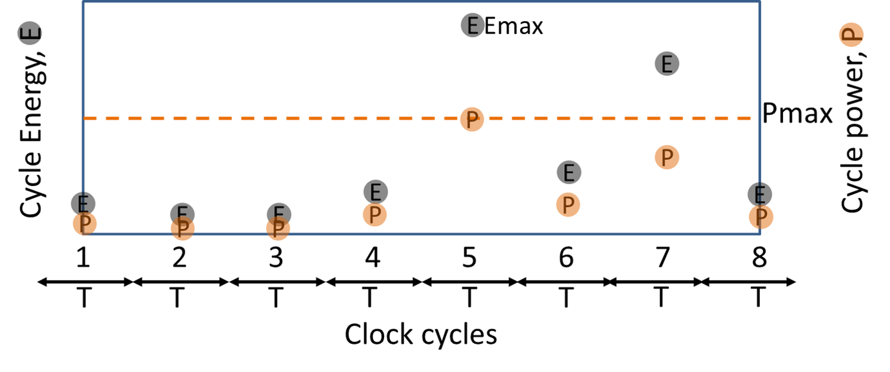
Observations
Dynamic energy is not consumed evenly throughout the entire test.
Reducing the voltage reduces power.
Power dissipated is dependent on the clock period.

Slide 8
Test Time Reduction
To reduce test time we can
Scale the supply voltage, increase the frequency to maintain the power dissipation.
Dissipate the energy at varying rate to maintain the same power dissipation.
Implement scaled supply voltage and varying rate.
Clock period is constrained
Structure: The period of the clock must not be shorter than the delay of the critical path.
Power: The period of the clock must not let the power dissipation exceed the design specification.

Slide 9
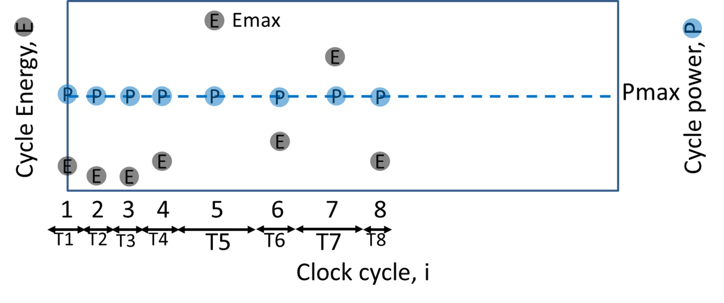
Varying Clock Period
In a synchronous clock test each period depends on the maximum power dissipated.
Each period may not dissipate same amount of power.
Notes:
Periods can be varied such that the cycles that dissipate lower power can be shrunk to match the rated power, while the cycle that have large power dissipation runs at a wider period.

Slide 10
Varying Clock Period
Each period in an asynchronous clock test can be either structure constrained or power constrained
$$Ti=\max{\{T_{STRUCTURE}, \frac{Ei}{PMAXfunc}\}}$$
where T_{i} is the period of each test cycle
E_{i} is the energy dissipated by each cycle
For any voltage an asynchronous clock test can run faster than the synchronous clock test at that voltage

Slide 11
Asynchronous Clock TEST – s298
Notes:
Synchronous and asynchronous simulation of 450-cycle scan test of ISCAS’89 benchmark circuit s298. Synchronous test clock frequency is 240MHz and test time is 1.87us. Asynchronous test time is 1.31us.

Slide 12
Experimental Results
CUT | No. of Cycles | Max. Power (mW) | Sync. Clock Test Time (µs) | Async. Clock Test Time (µs) | Red. (%)
s298 | 540 | 1.23 | 2.63 | 1.39 | 47
s382 | 703 | 2.90 | 1.81 | 1.32 | 27
s713 | 809 | 2.70 | 2.48 | 1.82 | 27
s1423 | 6975 | 4.50 | 51.5 | 42.06 | 18
s1423 | 7724 | 4.50 | 74.8 | 46.50 | 37
s13207 | 41119 | 21.30 | 314.3 | 266.26 | 15
s15850 | 101707 | 67.80 | 534.7 | 385.07 | 28
s384584 | 224112 | 110.60 | 1393.7 | 1213.00 | 13

Slide 13
Asynchronous CLOCK test on ATE
Experimental Setup
The test was implemented on the Advantest T2000GS ATE at Auburn University.
Maximum clock speed of 250 MHz
CUT is an FPGA configured for ISCAS‘89 benchmark circuit.
FPGA is configured on the run using the ATE.
All clock periods for asynchronous clock test are determined prior to external test based on the amount of energy dissipated during each cycle.
Limitations in tester framework sets few margins to the clock periods and the granularity in their variations
Only 4 unique clock periods can be provided for each test flow

Slide 14
Selecting Four CLOCKS FOR s298
The clock periods were grouped into 4 sets.
Each set contains patterns of one clock period.
For synchronous test the maximum period is used as the fixed clock period.
The figure shows the cycle periods determined for each test cycle.
Test cycle will use the clock (dotted line) just above the period

Slide 15
ATE Test Program
Test plan is programmed using the native Open Test Programming Language (OTPL).
Four unique periods and the corresponding information about the signal behavior at each pin is provided in a timing file.
For each period, the input waveform of the clock is set to have a 50% duty cycle.
The output is probed at the end of each period.
Within each period there is a time gap to apply primary inputs (PI) and the clock edge to avoid race condition.
Period for each cycle is specified along with patterns.
Scan patterns are supplied sequentially bit by bit.

Slide 16
ATE Functional Test Using Synchronous Clock Test
Figure shows the waveforms for 33 cycles of the 540 cycles in total test.
The synchronous clock used is 500ns
The time frame to accommodate 33 cycles using synchronous clock is 16.5µs
Total test time for 540 cycles = 540 x . 5 µs = 270 µs
Notes:
We performed two test on the ATE – first is the synchronous test using the fixed clock frequency

Slide 17
ATE Functional Test Using Asynchronous Clock Test
Figure shows the waveforms for 58 cycles of the 540 cycles in total test.
The time frame to accommodate 58 cycles using asynchronous period is 16.5µs
The periods selected for asynchronous clock test are 500ns, 410ns, 300ns, 200ns
Total test time for 540 cycles = $\sum_{i=1}^{540}{Ti }$ = 157.7µs ≈ 38% reduction in test time
Notes:
Hence we see that the test time is significantly reduced using asynchronous clock method.

Slide 18
Scaling Supply Voltage
P. Venkataramani, S. Sindia and V. D. Agrawal, “Finding Best Voltage and Frequency to Shorten Power-Constrained Test Time,” Proc. 31st VTS, April 2013, pp. 19-24.

Slide 19
Scaling Supply voltage
Sync. Clock
Sync. Clock
Async. Clock
Notes:
A minimum optimum voltage can be found for asynchronous test at which the test runs fastest.
As supply voltage is reduced energies of the cycles reduced and hence their periods can be shrunk
At some low voltage some periods of low energy cycles become structure constrained and can no longer be shrunk
There would be a mixture of both power and structure constrained cycles.
The minimum point at which there are majority of low energy cycles that have periods less than the power constrained cycles gives the optimum voltage for asynchronous test.

Slide 20
Scaling Supply Voltage – s298
Notes:
Figures shows minimum test time at each voltage using synchronous and asynchronous test for s298 benchmark circuit.
Using an optimum voltage in synchronous test at voltage 1.07V completes at 0.971µs which is approximately 63% reduction.
An asynchronous test at nominal voltage of 1.8V completes at 1.5µs which is approximately 43.6% reduction.
However if we combine both frequency and voltage scaling using asynchronous test at an optimum voltage 1.25V the test completes at 0.77µs which is a 71% reduction!

Slide 21
Summary
Synchronous test time is reduced by
Scaling supply voltage down
Scaling cycle frequency upward
Asynchronous test produces lower test time at any voltage as long as there are some test cycles that are power constrained.
According to the test time theorem, asynchronous test time is always less than or equal to the synchronous test time.

Slide 22
Future Work
Consider the effect of supply voltage scaling on leakage power.
Study test time reduction for high leakage technologies.
Examine delay testing.

Slide 23
Thank you

