Slide 1
A Test Time Theorem and Its Applications
Praveen Venkataramani
pzv0006@auburn.edu
Suraj Sindia
szs0063@auburn.edu
Vishwani D. Agrawal
vagrawal@eng.auburn.edu
14th IEEE Latin-American Test Workshop
Cordoba, Argentina
April 5, 2013

Slide 2
Test Time Theorem
Theorem: The test time (TT) for a synchronous test is the ratio of total energy dissipated in the entire test to the average power consumption during test.
Quantitatively this can be written as
$$TT= \frac{ETOTAL}{PAVG}$$
Where E_{TOTAL} is the total energy, an invariant of the test, P_{AVG} is the average power.

Slide 3
History of This Work
V. D. Agrawal, “Pre-Computed Asynchronous Scan,” Invited Talk, LATW, April 2012.
P. Venkataramani and V. D. Agrawal, “Test Time Reduction in ATE Using Asynchronous Clocking,” Poster, DFM&Y Workshop, June 2012.
V. D. Agrawal, “Reduced Voltage Test Can be Faster,” Elevator Talk, ITC, Nov 2012.
P. Venkataramani and V. D. Agrawal, “Reducing ATE Time for Power Constrained Scan Test by Asynchronous Clocking,” Poster, ITC, Nov 2012.
P. Venkataramani and V. D. Agrawal, “Reducing Test Time of Power Constrained Test by Optimal Selection of Supply Voltage,” Proc. 26th International Conf. VLSI Design, Jan 2013.
P. Venkataramani, S. Sindia and V. D. Agrawal, “Finding Best Voltage and Frequency to Shorten Power-Constrained Test Time,” Proc. VTS, Apr 2013.
P. Venkataramani and V. D. Agrawal, “Test Programming for Power Constrained Devices,” Proc. NATW, May 2013.
P. Venkataramani and V. D. Agrawal, “ATE Test Time Reduction Using Asynchronous Clocking,” submitted to ITC, Sep 2013.
Notes:
The work has been published or submitted in several conferences and workshops.

Slide 4
Applications of the Theorem
Voltage and frequency scaling for minimum test time.
Synchronous Test: Use a fixed clock frequency for the entire test.
Asynchronous Test: Vary test clock vector by vector to dissipate the test energy at the fastest rate.
Notes:
Test time can be minimized either by voltage scaling or frequency scaling or employing both. Synchronous test is defined as a test which uses fixed clock for the entire test while an asynchronous test uses varying clock periods for each cycle of the test. Each cycle period, however, is limited by certain constrains that limit arbitrary increase in frequency.

Slide 5
Test Clock Constraints
Minimum test time is achieved when energy is dissipated at the maximum rate.
Clock period is limited by
Structure constraint: The period of the clock must not be shorter than the delay of the critical path.
Power Constraint: The period of the clock must not let the power dissipation exceed the design specification.
Notes:
From the theorem we can say that in order to minimize test time, the energy should be dissipated at the maximum rate. However the clock period cannot be too short that it either let the power dissipate more than the specification or create timing violations. These constraints are defined as power and structure constraints respectively.

Slide 6
Synchronous Test
Test produces more than functional activity; consumes more power that the circuit is designed for.
Test clock is slower due to power constrain.
Effects of reducing voltage:
Test power reduces.
Critical path slows down.
Notes:
In a test, the power dissipated is generally more than the power dissipated during functional operation. Hence the test is run at a slower clock period which is determined by the maximum allowable power. However reduction is supply voltage can significantly reduce the power dissipated, but this can increase the critical path delay of the circuit. Hence, an optimum solution is required to balance the trade offs.

Slide 7
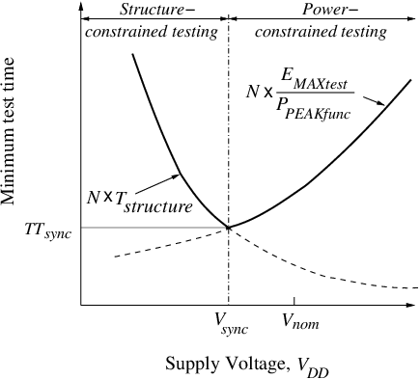
Synchronous Test At Various Supply Voltages
Notes:
In the figure the Y axis shows the minimum test time for the supply voltage on the X axis. The curve N x Tstructure shows test time at each voltage if the circuit is run at its functional speed. The curve $N×\frac{EMAXtest}{PMAXfunc}$ shows test time using the test clock period .
As voltage reduces test power decreases, hence test frequency can be increased. On the right side, the test time is limited only by the test power, hence it is power constrained. However as voltage reduces beyon a certain value the test time is limited by the structural delay, hence structure constrained. Optimum voltage Vsynch is the point at which the cycle period start to become structurally constrained

Slide 8
Sync. Test: Optimum Voltage and Frequency
Circuit (180nm CMOS) | PMAX per cycle (mW) | 1.8V test freq. (MHz) | Test voltage (volts) | Test clock freq. (MHz) | Test time reduction (%)
s298 | 1.2 | 187 | 1.07 | 500 | 63.0
s13207 | 21.3 | 110 | 1.45 | 165 | 40.3
s38584 | 110.6 | 129 | 1.50 | 187 | 31.0
Notes:
We repeat the experiment for several benchmark circuits, a few of which are shown in the table. The value for PMAX here is arbitrarily chosen but in an actual case this is a design specification. It is observed that if the test power is significantly larger than the design specification large reduction in test time can be achieved as in case of s298.

Slide 9
Can test time be reduced further?
The answer is Yes!
Test time depends on the cycle period and the number of cycles.
Each period depends on the maximum power dissipated.
Each period may not dissipate same amount of power.
Periods can be varied based on the power dissipated.
This is achieved by asynchronous test.
Notes:
Now the question lies if we can reduce the test time further, and the answer is yes. Since test time depend on the cycle period and that the cycle period is dependent on the maximum power specified, each cycle period can be modified if that cycle is dissipating lower power. Such a test is possible in an asynchronous test.

Slide 10
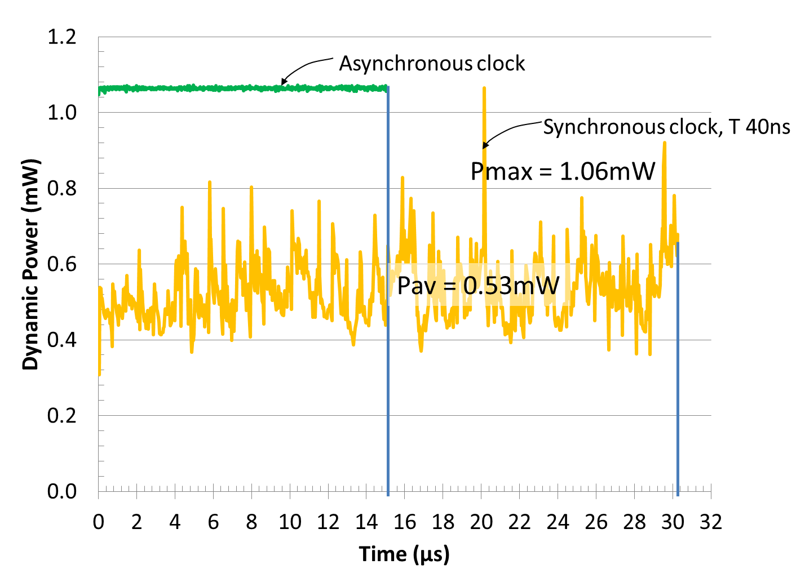
Spice Simulation: s713 Scan Test
Notes:
Figure shows the power dissipated by s713 for each cycle on the X axis. The synchronous clock has a fixed period of 40ns for every cycle and tested for 60 APTG vectors. As seen from the graph, each cycle dissipates different power. The Asynchronous clock has varying periods and the period is shrunk if the power dissipated in that cycle is lower than the maximum else left unchanged. As seen using asynchronous clock we can achieve smaller test time over synchronous clock.

Slide 11
Comparing Test Times
The minimum test time for a synchronous test is the ratio of total energy consumed during the entire test to the average power for all test cycles:
$$TTsync=\frac{ETOTAL}{PAVG}$$
The minimum possible test time is the ratio of total energy consumed during the entire test to the peak power of any test cycle. This test time is achievable by asynchronous clock testing:
Notes:
Since every cycle is shrunk to dissipate the same amount of power, the average power is indeed the maximum power specified for that design. Hence the test time for asynchronous test can be represent by replacing the denominator of synchronous test time with PMAX.

Slide 12
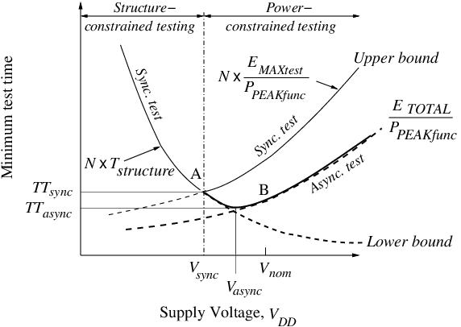
Async. Test: Optimum Voltage and Frequency
Notes:
The figure illustrates the asynchronous test at different supply voltage. Moving to the right from the optimum voltage for a synchronous test (point A) , test cycles become less structure constrained. Hence some cycles dissipate less power and their periods can be shrunk. The lowest point (B) then provides the optimum voltage for asynchronous test.

Slide 13
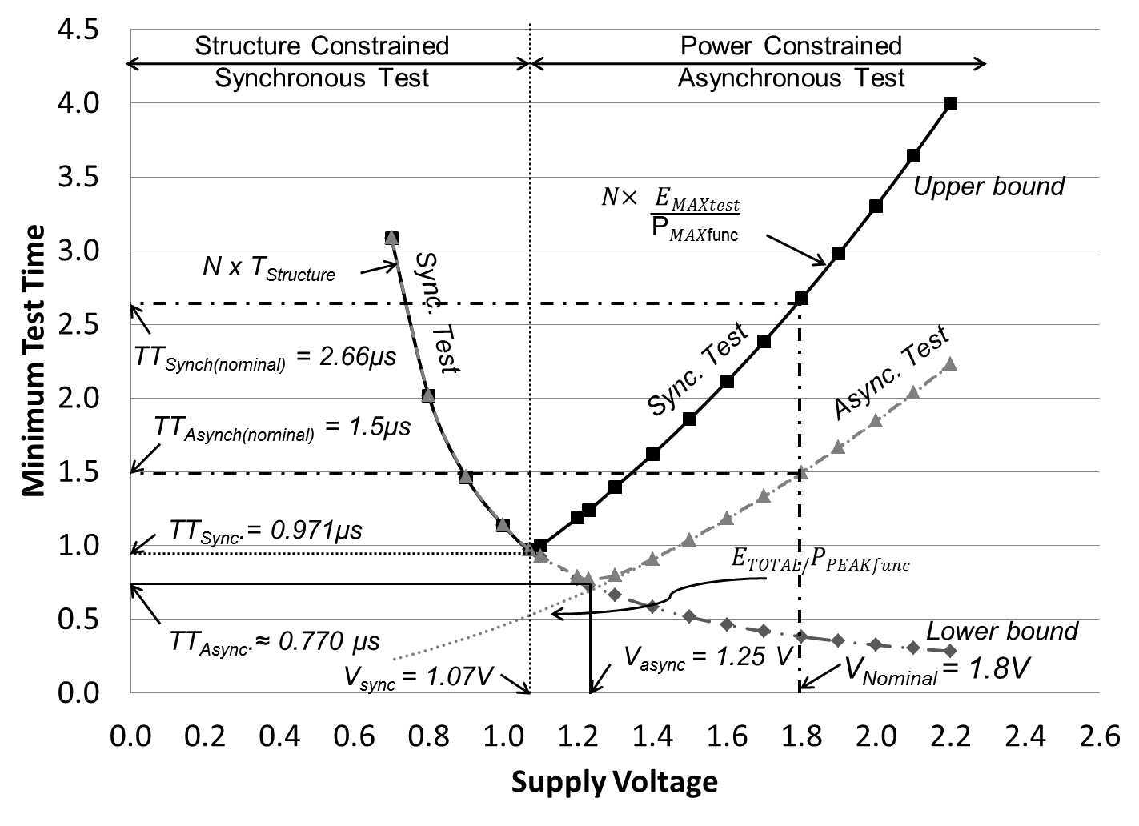
Optimum Voltage s298 Test
Notes:
Figures shows minimum test time at each voltage using synchronous and asynchronous test for s298 benchmark circuit. An asynchronous test at nominal voltage of 1.8V completes at 1.5µs which is approximately 43.6% reduction. Using an optimum voltage in synchronous test at voltage 1.07V completes at 0.971µs which is approximately 63% reduction. However if we combine both frequency and voltage scaling using asynchronous test at an optimum voltage 1.25V the test completes at 0.77µs which is a 71% reduction!

Slide 14
Asynchronous Test Feasibility on ATE
Experimental Setup
The test was implemented on the Advantest T2000GS ATE at Auburn University.
Maximum clock speed of 250 MHz
CUT is an FPGA configured for ISCAS‘89 benchmark circuit.
FPGA is configured on the run using the ATE.
All clock periods for asynchronous test are determined prior to external test based on the amount of energy dissipated during each cycle.
Limitations in tester framework sets few margins to the clock periods and the granularity in their variations
Latency due to analog measurement modules puts additional delay overheads
Only 4 unique clock periods can be provided for each test flow

Slide 15
Asynchronous Periods
Owing to the latency of the analog measurements the minimum clock period is 100ns.
The asynchronous period achieved through simulation were multiplied by 100ns to provide clarity in the variations.
The clock periods were grouped into 4 sets.
Each set contains patterns of one clock period.
For synchronous test the maximum period is used as the fixed clock period.

Slide 16
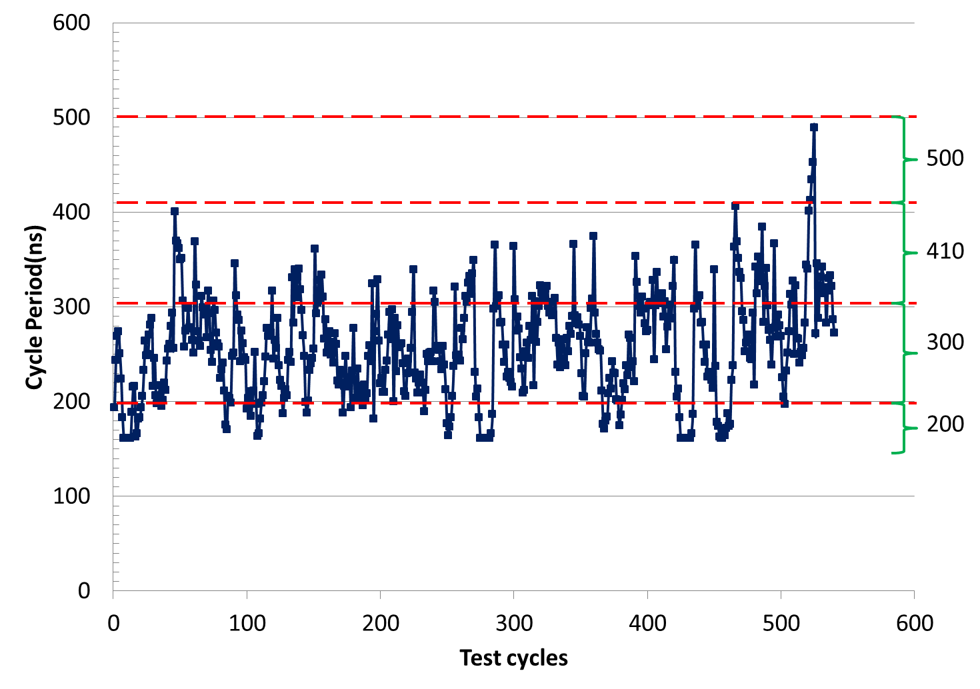
Asynchronous Periods
The figure shows the cycle periods determined for each test cycle.
Test cycle will use the clock (dotted line) just above the period.
Notes:
The figure shows the cycle periods determined for each test cycle. The Y axis shows the test clock periods for each cycle on the X axis. 4 clock periods were chosen heuristically to minimize the test time, though a better choice than the one shown is possible using any optimization tools to find the 4 best periods. A synchronous clock will run at a maximum period of 500ns while an asynchronous test will run at any of the four periods. Each cycle will use the clock period shown in dotted line above that cycle.

Slide 17
Test Program
Test plan is programmed using the native Open Test Programming Language (OTPL).
Four unique periods and the corresponding information about the signal behavior at each pin is provided in a timing file.
For each period, the input waveform of the clock is set to have a 50% duty cycle.
The output is probed at the end of each period.
Within each period there is a time gap to apply primary inputs (PI) and the clock edge to avoid race condition.
Period for each cycle is specified along with patterns.
Scan patterns are supplied sequentially bit by bit.

Slide 18
ATE Functional Test Using Synchronous Clock
Figure shows the waveforms for 33 cycles of the 540 cycles in total test.
The synchronous clock used is 500ns
The time frame to accommodate 33 cycles using synchronous clock is 16.5µs
Total test time for 540 cycles = 540 x .5 µs = 270 µs
Notes:
The figure shows the screen shot of the logic analyzer of the ATE showing 33 cycles out of the 540 cycles ran on the test equipment. The period for each cycle is given on the top which shows a fixed period of 500ns. The time frame shown in this figure consumes 16.5µs and the total test consumes 270 µs.

Slide 19
ATE Functional Test Using Asynchronous Clock
Figure shows the waveforms for 58 cycles of the 540 cycles in total test.
The time frame to accommodate 58 cycles using asynchronous period is 16.5µs
The periods selected for asynchronous test are 500ns, 410ns, 300ns, 200ns
Total test time for 540 cycles = $\sum_{i=1}^{540}{Ti }$ = 157.7µs ≈ 38% reduction in test time
Notes:
Now if we run the same test using asynchronous clock period then we can run more test cycles in a short period of time as shown in the figure. The figure shows a screen shot of the logic analyzer for a period of 16.5 µs. As seen, we now have 58 cycles in the same time frame. The asynchronous test is run using 4 clock periods namely 500ns, 410ns, 300ns and 200ns. The total test time for 540 cycles is now only 157.7 µs which is about 38% reduction in test time.

Slide 20
Conclusion
The test time theorem provides limits of attainable minimum test time, as
$$TT= \frac{ETOTAL}{PAVG}$$
Numerator can be reduced by lowering voltage.
Denominator is increased by asynchronous clock.
Notes:
On concluding over discussion, the test time provides limits that can reduce the test time significantly. The numerator can be lowered by reducing the supply voltage while the denominator can be increased by modifying the period of each cycle.

