Slide 1

Unsupervised Learning in Test Generation for Digital Integrated Circuits
26th IEEE European Test Symposium’ 21
Belgium (Virtual Event)
Soham Roy (Speaker), Spencer K. Millican, Vishwani D. Agrawal
Department of Electrical and Computer Engineering
Auburn University, Auburn, Alabama, USA
Notes:
Hello everyone and welcome to my talk titled, “Unsupervised Learning in Test Generation for Digital Integrated Circuits”. My name is Soham Roy, and I am a PhD candidate at the Electrical and Computer Engineering department at Auburn University in Auburn, Alabama, USA under the supervision of Prof. Spencer Millican and Prof. Vishwani Agrawal.

Slide 2
Outline
Motivation
Machine intelligence: an Introduction
Modus Operandi
Experimental results
Contributions
Future Works
Notes:
I begin by giving the motivation for this study. Then, I will introduce machine intelligence and how it is applied to our study. I will also analyze our experimental results. Finally, I will conclude this talk by briefly pointing out the major contributions of this study and future avenues that may be taken to achieve more interesting results.

Slide 3
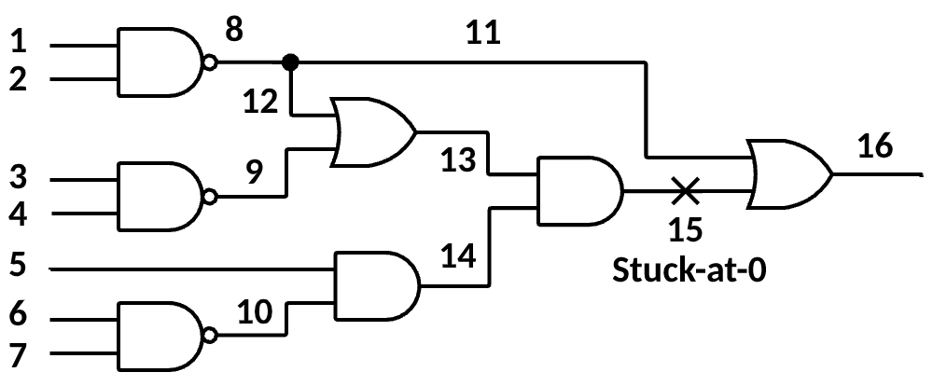
Motivation | ATPG - An example
ATPG
Search for an input vector to detect a given fault.
Complexity increases exponentially with circuit size.
11
0X10X
0
1
D
1
D
Test found!
1
1
Notes:
In 1967, D-algorithm established ATPG as a standard method of generating high-quality tests in the logic circuit industry. However, as circuits became larger, it was noticed that ATPG can have frustratingly long runtimes. Subsequent studies lowered ATPG runtime in numerous ways, but since the introduction of PODEM in 1981, the theoretical upper limit of ATPG runtime has remained constant. Let us see an example: for a circuit with n primary inputs (these I may include scan latches in case of DFT circuits), ATPG may need to simulate up to 2^ (n) vectors to find a test. Although ATPG algorithms typically find tests without simulating close to this many vectors, this upper bound still exists and is occasionally seen in modern circuits.

Slide 4
Motivation | ATPG - Backtraces and backtracks
Goal = 1
Failure!
Backtrack…
Goal = 1
0
0
1
Success!
1
1 0
1
1
1
Failed (undone) backtrace points
Unsuccessful backtrace resulting in backtrack
Two successful backtraces resulting in goal met
Notes:
To avoid this upper limit, most ATPG algorithms employ backtracing subroutines. These subroutines trace backwards (hence the name) through the circuit starting from an objective — such as activating or propagating a fault — and attempt to find input assignments to accomplish the objective. Multiple backtraces from an objective, leading to multiple input assignments, may be required to meet the objective, but if these input assignments accomplish the final goal — that is, find a test for the fault — then only a subset of input vectors must be simulated, which is nothing compared to the theoretical maximum of two to the power $n$.
However, this ideal situation presumes no backtracks occur during ATPG. Sometimes, the backtracing subroutine may make an input assignment that makes the current or future objectives impossible. When this occurs, ATPG must undo, or backtrack, to some previous assignment, which means ATPG wastes time simulating unnecessary input vectors.
Beyond PODEM, numerous ATPG algorithms attempt to reduce runtime by creating fewer objectives, but to our knowledge, no studies compare ways of backtracing *from* an objective. When backtracing, we must decide which direction to take, because choosing a wrong direction could result in a backtrack.

Slide 5
Modus Operandi - Machine intelligence
Input problems
Solver
Desired outputs
Trainer
Supervised learning
Unsupervised learning
Trainer
Evaluator
Reinforced learning
Principal Component Analysis (PCA)
“S. Roy, S. K. Millican, and V. D. Agrawal, “Unsupervised Learning in test Generation for Digital Integrated Circuits,” in Proceedings of the European Test Symposium, Belgium (Virtual Event), Feb. 2021.”
Notes:
To develop a new backtracing strategy, I look towards the technology of machine intelligence. Machine intelligence describes a broad category of algorithms that automatically program themselves through experience. This experience can come from unclassified data which the program finds patterns in, which is unsupervised learning; or the experience can come from a database of training problems with desired outcomes, which is supervised learning; or the experience can come from iterative re-evaluation and adjustment, which is reinforced learning.
In this study, I applied PCA in form of heuristic to guide ATPG without using any neural network. This is known as unsupervised learning in terms of machine intelligence.

Slide 6
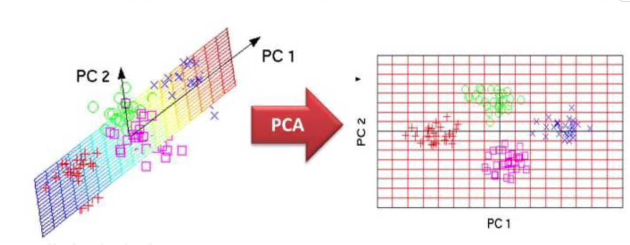
Modus Operandi - Principal Component Analysis (PCA)
Notes:
Principal component analysis is a method that rotates the dataset in a way such that the rotated features are statistically uncorrelated. This rotation is often followed by selecting only a subset of the new features, according to how important they are for explaining the data. PCA is a way of reducing the number of independent variables in a dataset and is particularly applicable when the ratio of data points to independent variables is low. PCA transforms a linear combination of variables such that the resulting variable expresses the maximum variance within the combination of variables.
PCA is a statistical procedure that uses an orthogonal transformation to convert a set of observations of possibly correlated variables into a set of values of linearly uncorrelated variables called principal components.
This transformation is defined in such a way that the first principal component has the largest possible variance (that is, accounts for as much of the variability in the data as possible)

Slide 7
Modus Operandi - PCA applied
Features: Distance,
COP,
SCOAP
Database containing circuit line’s information based on features
PCA
ATPG
PCA-guided backtracing
CPU time, backtracks, & backtraces
COP-guided backtracing
Distance-guided backtracing
SCOAP-guided backtracing
Notes:
The motivation behind this study is the exponential complexity of automatic test pattern generation (ATPG) that uses heuristics in making choices during test generation, but in practice no single heuristic fits all situations.
In such cases, unsupervised learning can combine practically any number of known heuristics, such as input-output distance (logic depths), gate type, fanout information, and testability measures like COP and SCOAP through principal component analysis, and the most prominent principal components can guide ATPG choices.
I apply this novel scheme to benchmark circuits by first performing principal component analysis to combine three heuristics, distance, COP, and SCOAP, and store the principal components (PC) in a database. Then, the most prominent PCs out of this database guide backtrace direction in the PODEM ATPG program. Here, we are comparing four versions of PODEM, each using a different heuristic, i.e., Distance, COP, SCOAP or principal component.

Slide 8
Modus Operandi – Principal Component Analysis (PCA)
Gate Type | Objective value at output of a gate based on Distance [1] |  | Objective value at output of a gate based on COP [2] |  | Objective value at output of a gate based on SCOAP SC0 [3] |  | Objective value at output of a gate based on SCOAP SC1 [3] |  | Objective value at output of a gate based on PCA
Value | 0 | 1 | 0 | 1 | 0 | 1 | 0 | 1 | 0 | 1
AND | Min | Max | Min | Min | Min | Min | Max | Max | ? | ?
NAND | Max | Min | Min | Min | Min | Min | Max | Max | ? | ?
OR | Max | Min | Max | Max | Max | Max | Min | Min | ? | ?
NOR | Min | Max | Max | Max | Max | Max | Min | Min | ? | ?
Gate Type | Objective value at output of a gate based on Distance [1] |  | Objective value at output of a gate based on COP [2] |  | Objective value at output of a gate based on SCOAP SC0 [3] |  | Objective value at output of a gate based on SCOAP SC1 [3] |  | Objective value at output of a gate based on PCA
Value | 0 | 1 | 0 | 1 | 0 | 1 | 0 | 1 | 0 | 1
AND | Min | Max | Min | Max | Min | Max | Min | Max | Min | Max
NAND | Max | Min | Max | Min | Max | Min | Max | Min | Max | Min
OR | Max | Min | Max | Min | Max | Min | Max | Min | Max | Min
NOR | Min | Max | Min | Max | Min | Max | Min | Max | Min | Max
P. Goel, “An Implicit Enumeration Algorithm to Generate Tests for Combinational Logic Circuits,” IEEE Transactions on Computers, vol. C-30, pp. 215–222, 1981.
F. Brglez, “On Testability Analysis of Combinational Circuits,” Proc. International Symp. Circuits and Systems, pp. 221–225, 1984.
L. Goldstein, “Controllability/Observability Analysis of Digital Circuits,” IEEE Transactions on Circuits and Systems, vol. 26, pp. 685– 693, 1979.
Notes:
In combining heuristics in PC, it is necessary that they work cooperatively, and not contradict each other. The upper table shows how individual heuristic works. For example, consider a backtrace through an AND gate with two or more inputs being guided by distance D to primary inputs (PI). To justify the output value 0, the backtrace must take the input at minimum distance from PI [8]. In Table I, this is indicated by minimum D for AND gate for output value 0. To justify a 1 at the output, the backtrace follows the input with maximum D, shown as “max”. We observe that the four heuristics do not agree for any gate. Hence, if combined by PCA, the major component (P) cannot be given guidance criteria, as shown by “question marks” in the table.
The lower table takes a two-step approach to overcome the above difficulty. First, some heuristic data, shown in bold, are complemented. For example, when AND gate output is 1, the COP controllability CC1 is replaced with 1 - CC1, and SC0 with 1 - SC0. Also, when the AND gate output is 0, SC1 is replaced by 1 - SC1. This reverses the corresponding backtrace criteria now shown in bold italics. Similar changes are made for NAND, OR and NOR gates, giving complete synchronization of the choice criteria for all heuristics. However, it necessitates separate PCAs for gate outputs 0 and 1, respectively, requiring two major PCs, P0
and P1, with corresponding backtrace criteria (see the lower table).

Slide 9
Modus Operandi – Preprocessing and ATPG
Notes:
To run ATPG, circuit netlist is preprocessed to compute four values for each signal node, namely, D [8], CC1 [20], and SCOAP combinational measures SC0 and SC1 [21]. Complemented values are computed according to the lower table of the last slide and P0 and P1 are from PC analyses for all gate outputs assumed as 0 and 1, respectively. As we can see, blue bar (also known as major principal component) contains high variance in terms of other and therefore represents the maximum likelihood of feature characteristics. PCA results for ISCAS’85 [22] and ITC’99 [23] benchmarks are shown in these two figures. The blue bars show the major PCs, P0 and P1.

Slide 10
Experimental Results - ATPG for all faults (backtracks and CPU Time)
Notes:
Experiments used testable and redundant faults to prove the efficacy of guidance provided by PCA to PODEM ATPG. To display results, in these graphs circuits are arranged left to right in order of increasing logic depth. The graphs show combined backtracks and CPU times for all stuck-at faults. Corresponding to the four versions of PODEM, there are four bars for total backtracks in the bar chart and four points for CPU times, for each circuit. Curves in the right graph are the MATLAB fit for the four PODEM versions. Notably, the black bars and black curve indicates consistent improvement by the PCA guidance.

Slide 11
Conclusions
PCA-based ATPG seamlessly combines:
Multiple features
Avoid usage of ANN
Reduce dimension of feature set
Outperforms conventional heuristics in terms of backtracks and CPU time
Notes:
In this current work, I used unsupervised learning to guide a test generator that outperforms the conventional heuristic based PODEM ATPG in terms of backtracks and ATPG CPU time by removing the dependency on ANNs and training. One of the circuits: c880 (though small from any standard) shows the possibility of no backtracks using a linear combination method of multiple features. It brings us closer to the elusive goal of zero backtrack. For most circuits, backtracks either match the best of the three heuristics or are lower than all.

Slide 12
Future Work
Many directions for future research
  Can careful training data generation avoid detrimental results?
  Can MI use unsupervised/reinforcement learning, or statistical learning pipelined supervised learning approach to solve ATPG?
  Can more complex MI structures improve results further?
  Can MI find a “sweet-spot” at which reduction of backtracks would be optimum for minimizing CPU time.
  Can MI compress multiple ANN features making a simpler ANN and reduce the training time?
  Can MI solve complex ATPG problems: delay fault testing, sequential test?
  Can MI detect untestable/redundant faults earlier that makes ATPG for the entire circuit faster?
  Can MI improve backtrace performance of reconvergent fanout-free circuits?
  Can MI show its worth using random circuits that can generate limitless training data ?
  Can MI-guided ATPG show its efficacy on a wider variety and larger set of designs to demonstrate broader capabilities?
  Can K-means clustering (another technique of unsupervised learning of MI) or any other techniques show its efficacy and compare against PCA to give some interesting observations.
  MI has never been used for D-Frontier drive selection in PODEM ATPG to witness more ATPG performance improvement.
  Examination of ANN structures beyond single hidden layer.
Notes:
We have a list of future work out of which black highlighted ones are accomplished in previous research studies published in earlier conferences such as International Test Conference and VLSI Design Conference. Those are not highlighted ones can be taken up as the motivation for the future studies. I look forward to exploring those in future studies.

Slide 13
Thank You
Notes:
I would like to end by thanking each and every one for their time and attention. Hope in the future, I can give you encouraging results based on this study. The floor is now open for Q & A.

Slide 14
Q&A
Notes:
SR

