Slide 1
Simulation-Based Equivalence Checking
Speaker: Nansen Huang
VLSI Design and Test Seminar (ELEC7950-001)
March 9, 2016

Slide 2
Simulation-based equivalence checking
Problem statement
Importance of this problem
Various methods of equivalence checking
My method
Experiment
Results
Conclusion

Slide 3
Problem statement
Formal equivalence checking process is a part of electronic design automation (EDA), commonly used during the development of digital integrated circuit.
circuit B is the final netlist in design cycle of circuit A (A: initial RTL model).
A number of transformations and changes
Logic synthesis tool and other programs in
the process
final netlist
Initial RTL model

Slide 4
Problem statement
logically equivalent
In theory
In practice
Logic synthesis tool and other programs in the process
Initial RTL model
final netlist
logically different
Programs bugs, manual changes, errors
Initial RTL model
final netlist
a verification step is needed

Slide 5
Importance of this problem
Historically, one way to check the equivalence was to re-simulate, using the final netlist, and the test cases that were developed for verifying the correctness of the RTL. This process is called gate level logic simulation.
However, the problem with this is that the quality of the check is only as good as the quality of the test cases. Also, gate-level simulation of many test cases are notoriously slow to execute, which is a major problem as the size of digital designs continues to grow exponentially.
An alternative way to solve this is to formally prove that the RTL code and the netlist synthesized from it have exactly the same behavior in all (relevant) cases. This process is called formal equivalence checking and is a problem that is studied under the broader area of formal verification.

Slide 6
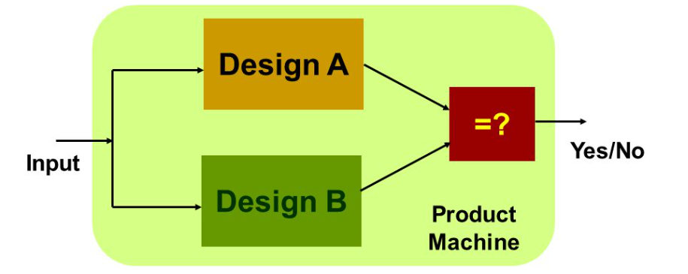
An alternative way
Formal equivalence checking
to formally prove that the RTL code and the netlist synthesized from it have exactly the same behavior in all (relevant) cases.

Slide 7
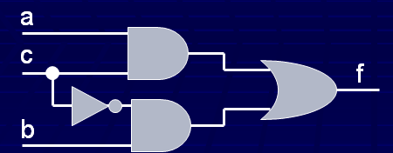
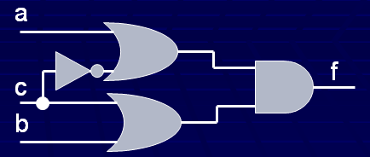
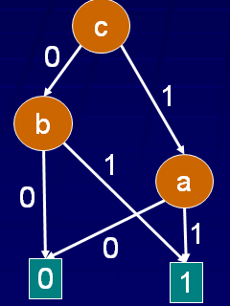
Methods of equivalence checking
ROBDDs (Reduced Ordered Binary Decision Diagram)
Two circuits are functionally identical if they have isomorphic ROBDDs

Slide 8
Methods of equivalence checking
ROBDDs (Reduced Ordered Binary Decision Diagram)
Two identical circuits may not have identical OBDDs even when same variable ordering is used.
ROBDD complexity depends on variable ordering; finding a good variable order is a complex problem.
Even with best variable order, ROBDD can be too complex for large combination functions.

Slide 9
Methods of equivalence checking
Boolean satisfiability
Suppose we have circuits C1 and C2; C2 is an optimized version of C1.
SAT means (F1 and ¬F2) or (¬F1 and F2) = true, where F1 and F2 are outputs of C1 and C2.
If we can find the input variable to satisfy the above formula, then C1 and C2 are not logically equivalent.
However, SAT is proven to be an NP-complete
problem.

Slide 10
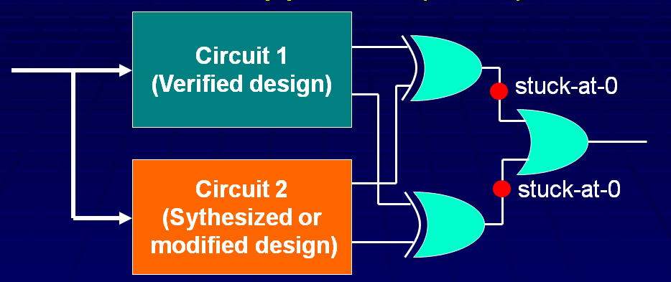
My method - simulation based equivalence checking
ATPG Approach (Miter).
First, redundant stuck-at-0 faults cause equivalence of the output.
Its tests can be used to check non-equivalence, if the faults are detectable.

Slide 11
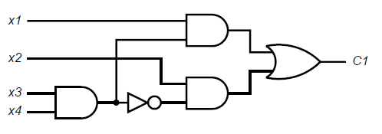
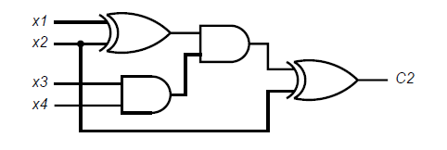
My method - Example
The test effect is based on the number of combined test vectors applied.
Rationale: Most design errors can be modeled as single stuck-at or probably as multiple stuck-at faults.
Example:
C1
C2

Slide 12
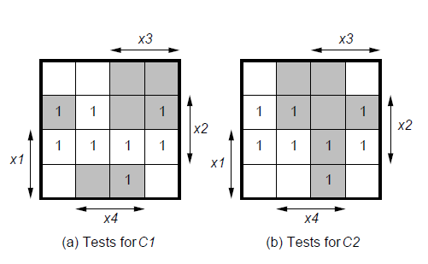
My method - application
Two circuits implement the same Boolean function of four variables:
If we use Miter to test the two circuits supplied with combined test vectors of C1 and C2 shown as shaded minterms in Karnaugh maps, then the output z is always 0 as expected.

Slide 13
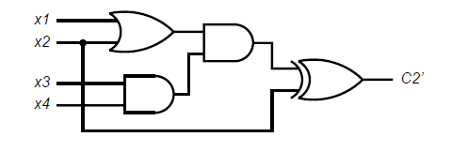
My method - limitation
However, we change C2 by replacing the first exclusive-OR gate by an OR gate. We get circuit C2’.
C2’

Slide 14
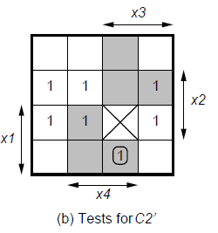
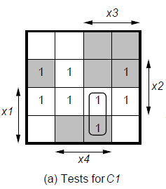
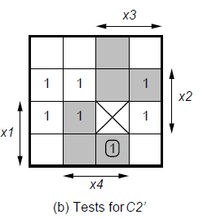
My method - limitations
We still use Miter to check the equivalence of C1 and C2’.
Using combined test vectors of C1 and C2’ in shaded areas, the output z will still remain 0 for all vectors. Actually the two circuits are functionally different.

Slide 15
Experiment
(1) A basic VHDL of a 16-bit adder.
(2) Leonardo
area-optimized adder
delay-optimized adder

Slide 16
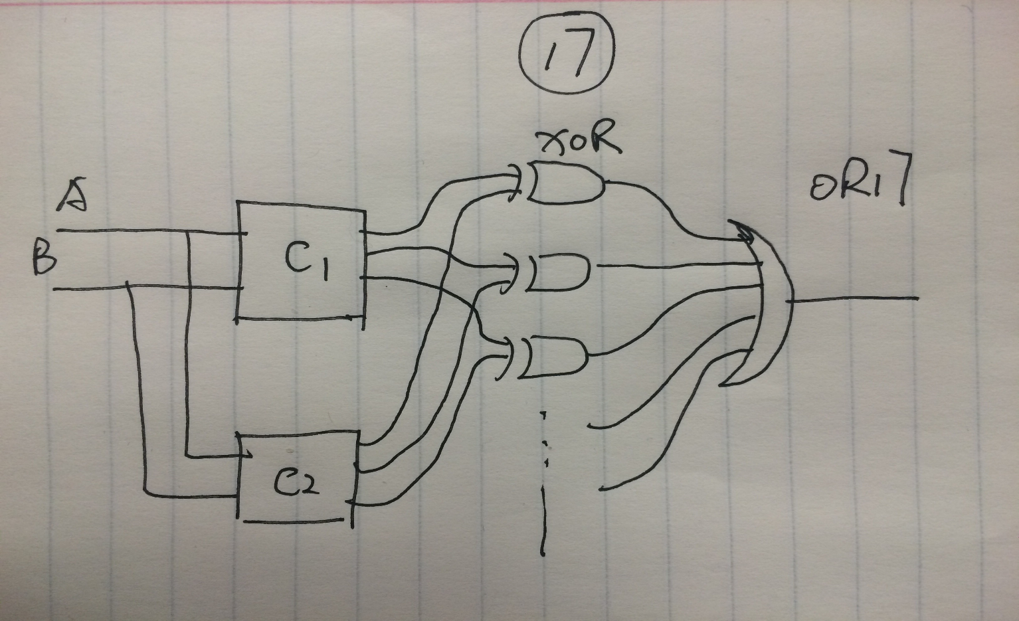
Experiment
Miter used in this experiment

Slide 17
Experiment
Information of two circuits
 | Delay-optimized circuit | Area-optimized circuit
Number of Inputs/outputs | 32/17 | 32/17
Number of gates | 133 | 108
Critical path delay | 4.20ns | 6.04ns

Slide 18
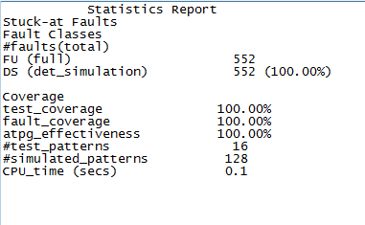
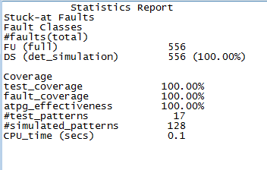
Experiment
(3) ATPG to generate test vectors for 100% faults coverage.
Area-optimized circuit
Delay-optimized circuit

Slide 19
Experiment
(4) the test patterns generated
Area-optimized circuit

Slide 20
Experiment
the test patterns generated
Delay-optimized circuit

Slide 21
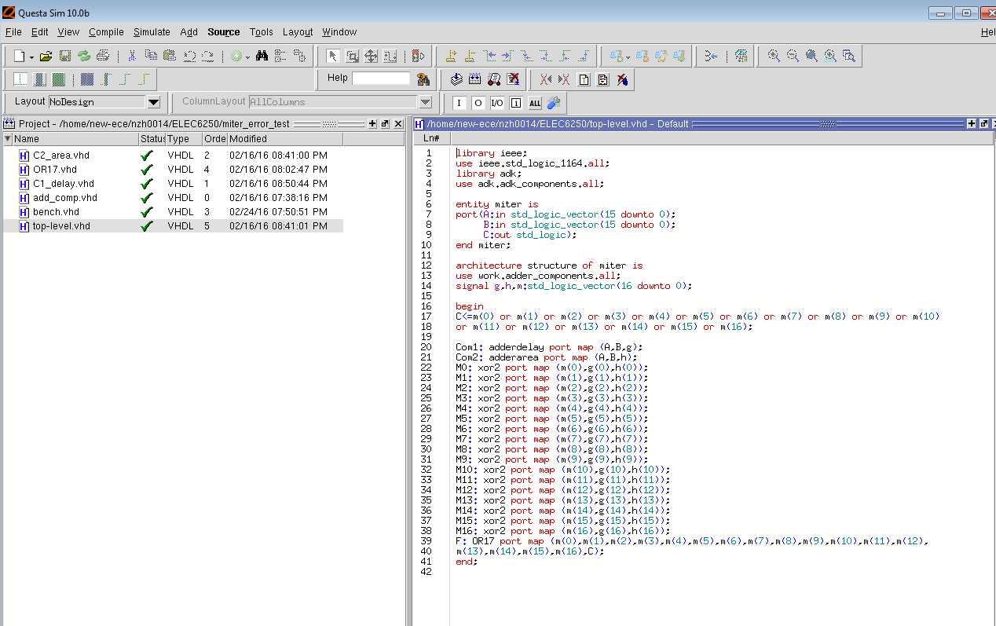
Experiment
(4) use the combinational test vectors to simulate the Miter circuit to check the logical equivalence of the two optimized circuits.

Slide 22
Experiment – simulation result

Slide 23
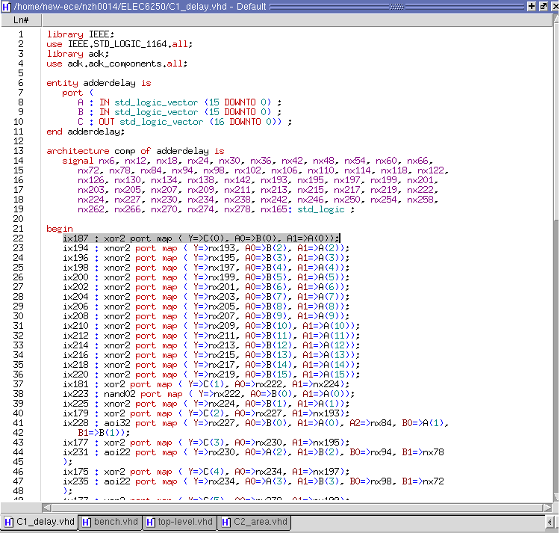
Experiment – non-equivalent circuits
(5) replace a single gate near primary inputs of delay-optimized circuit.

Slide 24
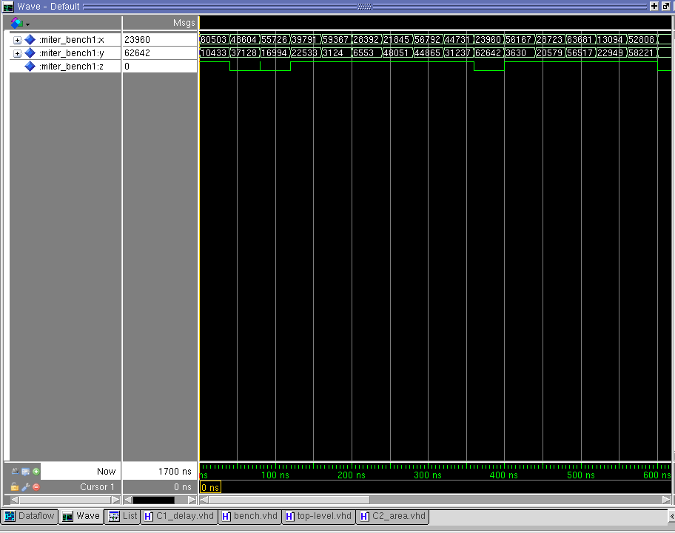
Experiment – simulated miter output

Slide 25
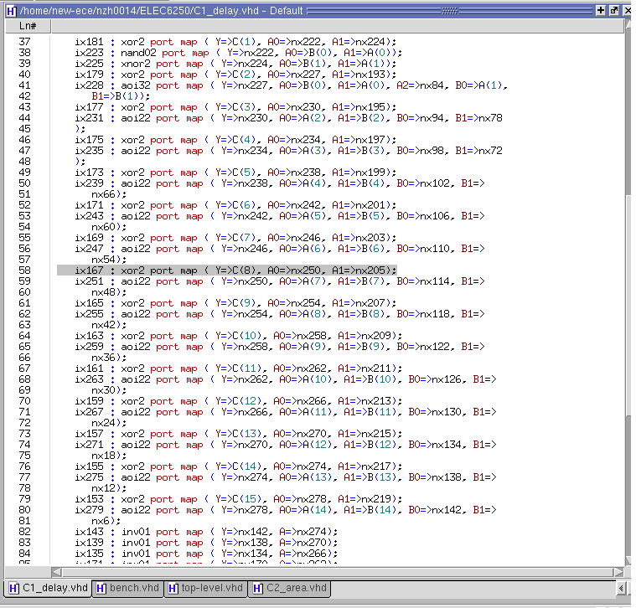
Experiment
(6) replace a single gate in the middle of the delay-optimized circuit.

Slide 26
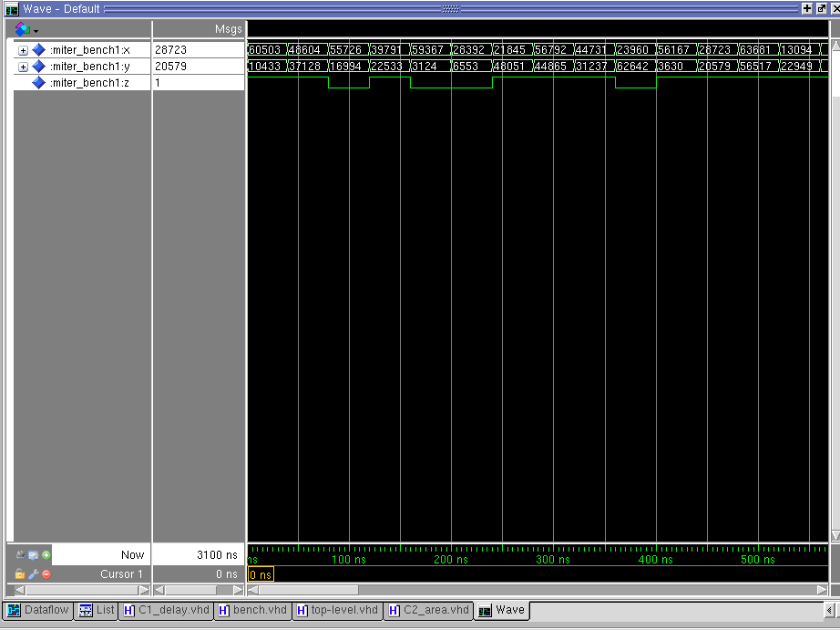
Experiment – simulated miter output

Slide 27
Conclusion
The simulation-based equivalence checking with ATPG vectors, often employed in the industry, mostly works.
But there are limitations as the example shows.
The method can be improved by using fault simulation of faults at primary inputs of the miter.
When simulation shows non-equivalence, fault simulation can be used to help identify design errors.

Slide 28
References
Equivalence Checking Problem: S.-Y. Hwang and K.-T. Cheng, Formal Equivalence Checking and Design Debugging, Springer, 1998.
Formal Verification: E. M. Clarke, Jr., O. Grumberg, and D. A. Peled, Model Checking, MIT Press, 1999.
ROBDD: R. E. Bryant, “Graph-Based Algorithms for Boolean Function Manipulation,” IEEE Trans. Computers, vol. C-35, no. 8, pp. 677-691, August 1986.
SAT: S. Eggersglüß and R. Drechsler, High Quality Test Pattern Generation and Boolean Satisfiability, Springer, 2012.
Miter Heuristic: V. D. Agrawal, “Choice of Tests for Logic Verification and Equivalence Checking and the Use of Fault Simulation,” Proc. 13th International Conf. VLSI Design, January 2000, pp. 306-311.

