Slide 1
EVALUATION OF A CIRCUIT PATH DELAY TUNING TECHNIQUE FOR NANOMETER CMOS
Masters Project Defense
Ahmed Faraz
Advisor: Dr. Adit D. Singh
Committee members: Dr. Vishwani D. Agrawal and Dr. Victor P. Nelson
Department of Electrical and Computer Engineering

Slide 2
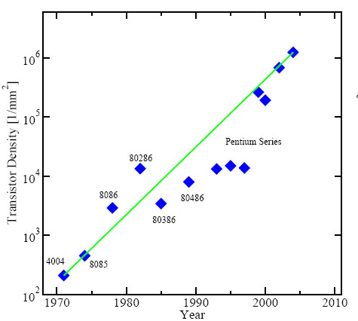
MOORE’S LAW
International Technology Roadmap for Semiconductors (ITRS) is expected to continue for another decade at least
Performance gains measured in terms of processor speeds has started to saturate or even fall back a little
Transistor integration density per die[1]

Slide 3
PROCESSOR CLOCK RATES
Clock Rate
1980
1990
2000
2010
Power dissipation/cooling problems
Process variability

Slide 4
PROCESS VARIATION
Natural variation occurring in the parameters of transistors during the fabrication of integrated circuits
Critical sources are Random Dopant Fluctuations, Line-edge and Line-width roughness and variations in gate oxide thickness[2,3]
All of the sources mentioned above primarily degrade Threshold Voltage(V_{th})

Slide 5
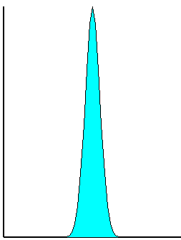
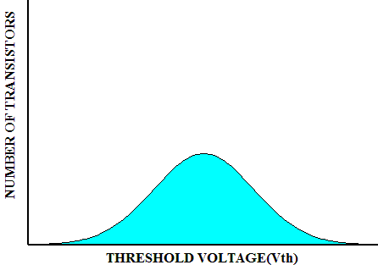
PROCESS VARIATION(contd..)
NUMB
E
R
O
F
T
R
ANS
I
S
T
OR
S
NUMB
E
R
O
F
T
R
ANS
I
S
T
OR
S
THRESHOLD VOLTAGE(Vth)
THRESHOLD VOLTAGE(Vth)
Larger technology
Smaller technology
5 out of 10 million elements lie beyond in a normal distribution
For , worst case delay = 10 X average gate delay

Slide 6
CLOCK RATES IN PIPELINED PROCESSORS
Pre manufacture paths are optimized and balanced
Clock period = Worst case delay
Post manufacture paths are NOT balanced

Slide 7
MOTIVATION
Statistical chance of every chip to have a few hundred exceptionally slow outlier devices
Such outliers (10 X gate delays) make the overall path delay much much greater than the average delays
Post manufacture tuning is proposed to bring down the worst case path delay close to the average case delays[4]

Slide 8
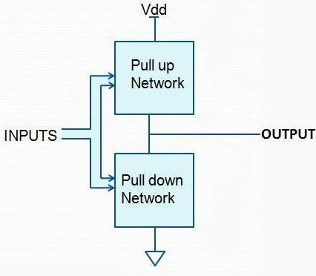
CMOS GATE
Every CMOS gate has a pull-up network with PMOS transistors, and a pull-down network with NMOS transistor
The presence of a parallel path can speed up the charge time or the discharge time respectively

Slide 9
POST MANUFACTURING TUNING
A parallel PMOS transistor with tuning capability is introduced in to the pull-up network
A parallel NMOS transistor with tuning capability is introduced in to the pull-down network
The gate terminals of the tuning transistors are connected to a switch which can be turned ‘ON’ or ‘OFF’

Slide 10
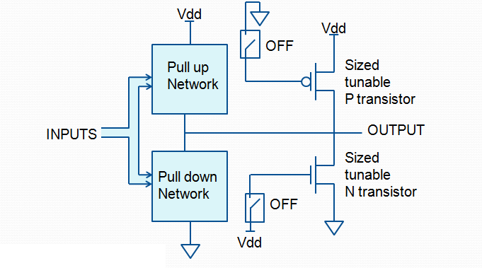
TUNABLE CMOS GATE
ASSUMPTIONS
Outlier gates can be diagnosed
Programming capability exists to control the tuning transistors

Slide 11
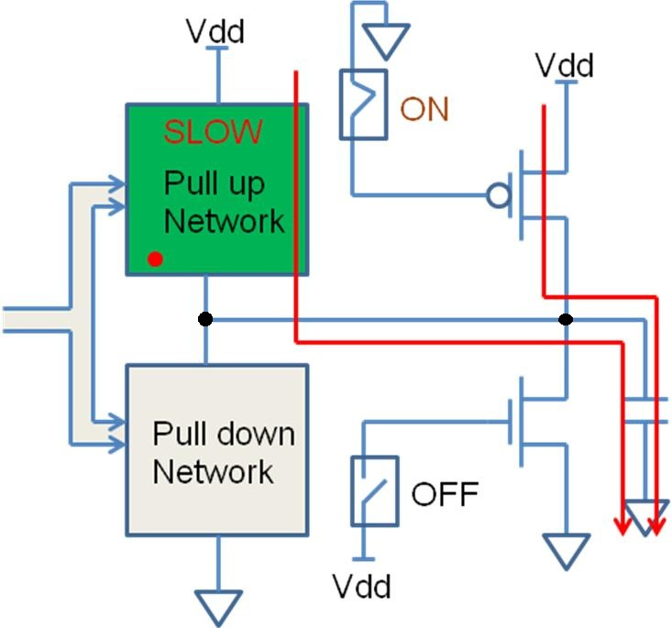
SLOW TRANSISTOR IN PULL- UP NETWORK
Switching on the tuning PMOS transistor
Parallel path in pull- up network will speed up the charge time

Slide 12
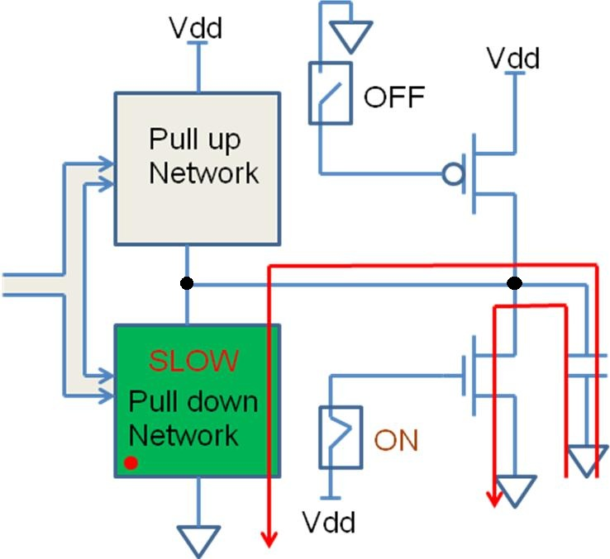
SLOW TRANSISTOR IN PULL- DOWN NETWORK
Switching on the tuning NMOS transistor
Parallel path in pull- down network will speed up the discharge time

Slide 13
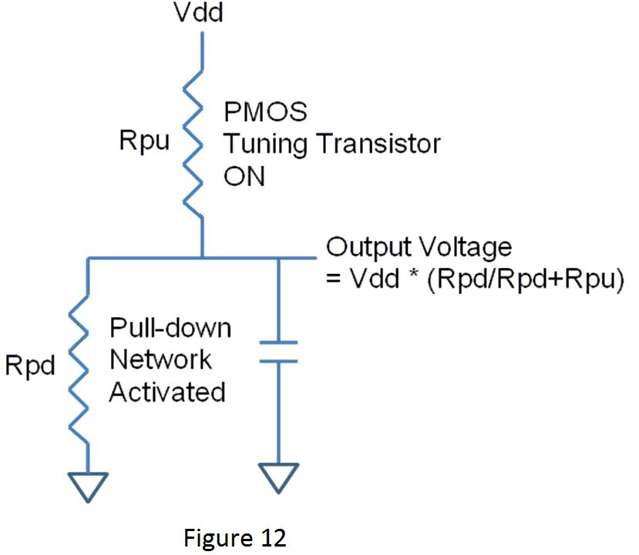
SIZING TUNING TRANSISTORS

Slide 14
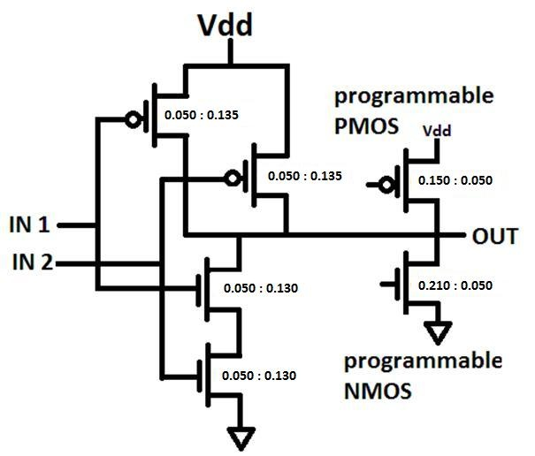
SIZING (CONTD..)

Slide 15
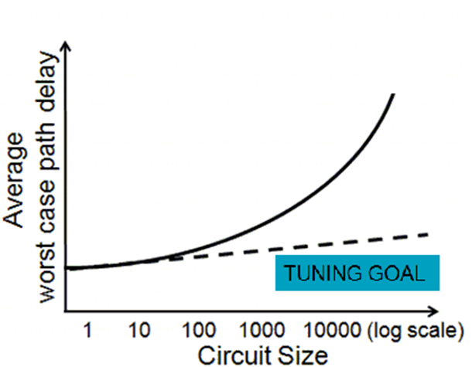
EVALUATION OF TUNING TECHNIQUE
Need SPICE simulation studies to evaluate the effectiveness of tuning technique

Slide 16
GENERATING SPICE NETLIST (USING 45 nm NANGATE OPEN CELL LIBRARY)

Slide 17
Modelsim
(functional verification)
Structural model
(Verilog)
RTL Compiler
Perl code
SPICE netlist
Cadence SOC encounter
45 nm tech.
45 nm tech.
Gate level netlist
45 nm tech.
Node capacitance
Transistor level description

Slide 18
EXAMPLE SMALL CIRCUIT
NAND tree with 64 inputs and 1 output
Each NAND gate has tuning capabilty
Every circuit has 381 PMOS and 381 NMOS transistor (including tuning transistor)
Each transistor is assigned a different V_{th}
V_{th} drawn from Gaussian distribution

Slide 19
64 INPUTS
OUTPUT

Slide 20
SIMULATION OF EXAMPLE CIRCUIT
Worst path delay simulated for three cases
Circuit without tuning circuitry added
Circuit with tuning circuitry added
Tuned Circuit

Slide 21
SIMULATING COPIES OF SMALL CIRCUIT
Circuit simulated 10,000 times
New random set of V_{th} values for transistors in every simulation
Worst path delays are stored for every copy of the circuit

Slide 22
CONSTRUCTING LARGER CIRCUITS
Need larger circuits to see impact of parameter variations
Pick N copies of standard small circuit to make a large circuit
Largest delays among N subcircuit is the worst path delays of large circuit
N ranges from 1 to 5000
Pick of N sub-circuits is done 1000 times each to get an average case for every size N

Slide 24
Worst case path delay
N=10
10,000 copies of basic small circuit
Larger circuit with 10 randomly chosen copies
Pick of 10 sub-circuits is done 1000 times to get an average case for size 10

Slide 25
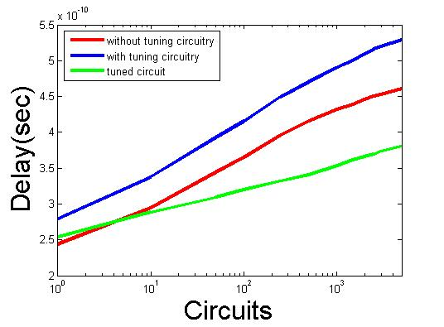
SIMULATION RESULTS
45 nm technology
V_{dd}=1V V_{th}=0.464V Sigma=0.116V
Speed up

Slide 26
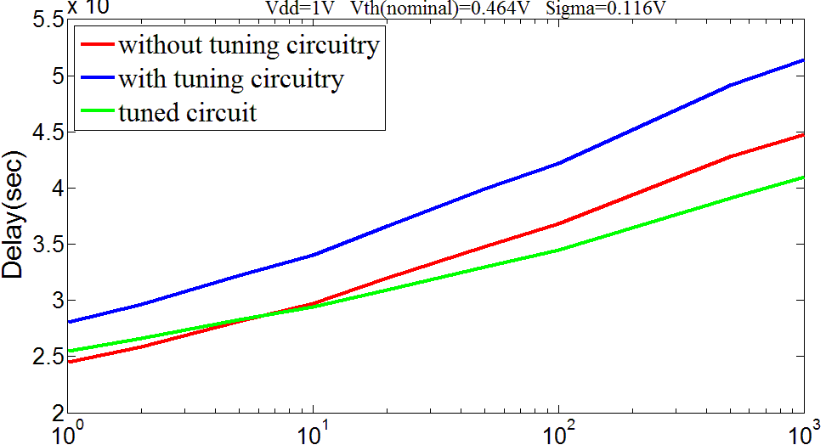
SIMULATION RESULTS

Slide 27
CONCLUSION
This tuning technique speeds up worst case path delays close to the average case delay by adding redundant tuning transistors to the circuit
Only few hundred out of millions of gates are tuned
Simulation results indicate that significant performance gain can be achieved

Slide 28
FUTURE WORK
Adding tunable gates to libraries so that its extraction can be automated
Study of definite diagnosis strategy that would enable the detection of outlier gates in a chip
Simulations with standard circuits to make the case more authentic and applicable

Slide 29
REFERENCES
[1] G. E. Moore et al., “Cramming more components onto integrated circuits," Proceedings of the IEEE, vol. 86, no. 1, pp. 82-85, 1998.
[2] K. S. Saha, “Modeling Process Variability in Scaled CMOS Technology," IEEE Design and Test of Computers, Vol. 27, Issue 2, pp. 8-16, March/April 2010.
[3] C. Kenyon, A. Kornfeld, and et al., “Managing Process Variation in Intel's 45nm CMOS Technology.” Intel Technology Journal , Vol. 12, Issue 2, pp. 92-110, June 2008.
[4] A. D. Singh, K. Mishra, and et al., “Path Delay Tuning for Performance Gain in the face of Random Manufacturing Variations," in proc. International Conference on VLSI Design, Bangalore, India, January 2011

Slide 30
THANK YOU

