Slide 1
Polynomial-Time Algorithms for Designing Dual-Voltage Energy Efficient Circuits
Master’s Thesis Defense
Mridula Allani
Advisor : Dr. Vishwani D. Agrawal
Committee Members: Dr. Victor P. Nelson, Dr. Adit D. Singh
Department of Electrical and Computer Engineering
Auburn University
October 19, 2011

Slide 2
Outline
Motivation
Problem statement
Background
Contributions
Algorithm to find V_{DDL}
Algorithm to assign V_{DDL}
Results
Future work
References

Slide 3
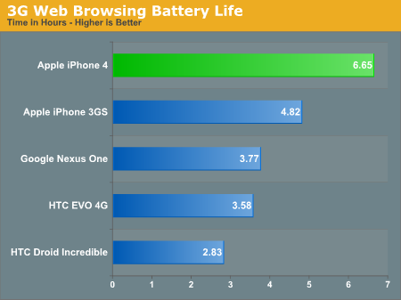




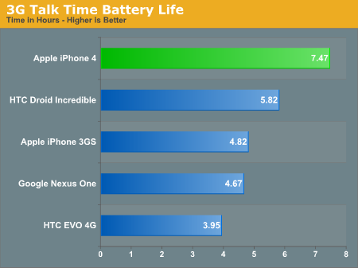
Motivation
Ref. http://www.anandtech.com/show/3794/the-iphone-4-review/13

Slide 4
Motivation
Current dual voltage designs use 0.7V_{DD} as the lower supply voltage.
Algorithms to assign low voltage have exponential or polynomial complexity.
Require faster algorithms that increase energy savings.

Slide 5
Problem Statement
Develop a linear time algorithm to find the optimal lower voltage.
Develop new algorithms for voltage assignment in dual-V_{DD} design.

Slide 6
Background
Gate slack:
The amount of time by which a signal is early or late.
Critical path:
The longest path in the circuit.
All gates on this path have ‘zero’ slack.
Timing constraints:
No other path can be longer than the critical path.
No gate should have a negative slack.

Slide 7
Background
Timing violations:
A path is longer than the critical path.
The gates on this path have negative slack.
Topological constraints:
NoV_{DDL} gate is at the input of any V_{DD} gate.
Estimate of energy savings (neglecting leakage):
where N is the number of gates in low voltage and n is
the total number of gates.

Slide 8
Background
Basic idea: decrease energy consumption without any delay penalty.
Done by assigning lower supply voltage to gates on non-critical paths.
Different algorithms propose different ways of finding these non-critical gates.

Slide 9
Background
Authors Kuroda and Hamada say that power reduction ratio
is minimum when 0.6V_{DD} ≤ V_{DDL} ≤ 0.7V_{DD} .
The works described by Chen, et. al., Kulkarni, et. al., Srivatsava, et. al., claims that the optimal value of V_{DDL} for minimizing total power is 50% of V_{DD}.
Rule of thumb proposed by Hamada, et. al. says

Slide 10
Background
CVS Structure
[Usami and Horowitz]
ECVS Structure [Usami, et. al.]
V_{DDL}
V_{DD}
Level Converter
Ref. K. Usami and M. Horowitz, “Clustered Voltage Scaling Technique for Low-Power Design," in Proceedings of the International Symposium on Low Power Design, pp. 23-26, 1995.
Ref. K. Usami, et. al.,“Automated Low-Power Technique Exploiting Multiple Supply Voltages Applied to a Media Processor," IEEE Journal of Solid-State Circuits, vol. 33, no. 3, pp. 463-472, Mar. 1998.

Slide 11
Background
Kulkarni, et al.
Greedy heuristic based on gate slacks.
Uses 0.7V_{DD} and 0.5V_{DD} as V_{DDL}.
Includes power and delay overhead of level converters.
Sundararajan and Parhi
Linear programming based model.
Minimizes the power consumption.
Includes level converter delay overheads.

Slide 12
Background
TPI (i)
TPO (i)
PI
PO
T_{c}
TPI (i): longest time for an event to arrive at gate i from PI.
TPO (i): longest time for an event from gate i to reach PO.
Delay of the longest path through gate i : D_{p,i} = TPI(i) + TPO(i)
Slack time for gate i: S_{i} = Tc – D_{p,i} , where T_{c} = Max { D_{p,i} } for all i
[Kim and Agrawal]

Slide 13
Background
S_{u}, the upper slack time is the lower bound of slacks of the gates which can be unconditionally assigned low voltage without affecting the critical timing of the circuit.
S_{u} = T_{c}
where β = D’_{p,I} / D_{p,i} and D’_{p,i}, D_{p,i} is the longest path delay through the gate i when it is supplied with V_{DDL} and V_{DD}, respectively.
[Kim and Agrawal]
Notes:
Maximum over all gates

Slide 14
Background
Recent work [Kim and Agrawal]:
Assign V_{DDL} to gates with S_{i} ≥S_{u}.
Assign V_{DDL} to gates with S_{l} ≤ S_{i} ≤ S_{u} one by one without violating timing or topological constraints.
Repeat last two steps across all voltages to find the best V_{DDL} and the corresponding dual-voltage design with the least energy.
Ref. K. Kim and V. D. Agrawal, “Dual Voltage Design for Minimum Energy Using Gate Slack,” in Proceedings of the IEEE International Conference on Industrial Technology, pp. 419-424 , March, 2011.

Slide 15
Example
Without level converter
IN
V₁
V₁
V₁
V₁
V₁
OUT
V₂
V₂
V₂
V₂
V₂

Slide 16
Example: Energy per cycle and delay
Without level converter
9.69fJ ∞ | 44.84fJ 280.6ps | 15.75fJ 123.7ps | 7.315fJ 95.61ps | 7.863fJ 84.15ps
6.465fJ ∞ | 10.13fJ 204.5ps | 4.573fJ 123.2ps | 5.203fJ 99.28ps | 6.65fJ 91.19ps
6.6fJ 1183ps | 2.651fJ 203.3ps | 3.233fJ 132.3ps | 4.289fJ 115ps | 5.678fJ 107.7ps
1.291fJ 801.5ps | 1.761fJ 235.4ps | 2.543fJ 179.4ps | 3.567fJ 164.3ps | 4.977fJ 156.1ps
0.755fJ 1062ps | 1.285fJ 614 ps | 2.052fJ 565.3ps | 3.082fJ 560.5ps | 4.423fJ 557.7ps
1.2
1.0
90 nm PTM model
Clock period: 1500 ps
V₂(V)
0.8
0.6
0.4
0.4
0.6
0.8
1.0
1.2
V₁(V)

Slide 17
Example
With level converter
IN
V₁
V₁
V₁
V₁
V₁
LC(V₁,V₂)
OUT
V₂
V₂
V₂
V₂
V₂

Slide 18
Example
V₂(V)
With level converter
Without level converter
1.2
10.44fJ ∞ | 7.18fJ 249.1ps | 7.18fJ 184.0ps | 7.98fJ 161.7ps | 9.316fJ 153.4ps
7.13fJ 1198ps | 4.39fJ 268.5ps | 4.96fJ 203.3ps | 5.94fJ 182.8ps | 8.05fJ 174.8ps
2.74fJ 952.5ps | 2.83fJ 309.4ps | 3.56fJ 251.4ps | 4.93fJ 231.8ps | 16.14fJ 225.8ps
1.408fJ 948.8ps | 1.91fJ 470.7ps | 2.82fJ 418.9ps | 10.34fJ 405.7ps | 45.31fJ 387.8ps
0.81fJ 2188ps | 1.4fJ 1757ps | 7.08fJ 1733ps | 6.46fJ ∞ | 9.75fJ ∞
9.69fJ ∞ | 44.84fJ 280.6ps | 15.75fJ 123.7ps | 7.315fJ 95.61ps | 7.863fJ 84.15ps
6.465fJ ∞ | 10.13fJ 204.5ps | 4.573fJ 123.2ps | 5.203fJ 99.28ps | 6.65fJ 91.19ps
6.6fJ 1183ps | 2.651fJ 203.3ps | 3.233fJ 132.3ps | 4.289fJ 115ps | 5.678fJ 107.7ps
1.291fJ 801.5ps | 1.761fJ 235.4ps | 2.543fJ 179.4ps | 3.567fJ 164.3ps | 4.977fJ 156.1ps
0.755fJ 1062ps | 1.285fJ 614 ps | 2.052fJ 565.3ps | 3.082fJ 560.5ps | 4.423fJ 557.7ps
1.0
0.8
0.6
0.4
0.4
0.6
0.8
1.0
1.2
0.4
0.6
0.8
1.0
1.2
V₁(V)

Slide 19
Outline
Motivation
Problem statement
Background
Contributions
Algorithm to find V_{DDL}
Algorithm to assign V_{DDL}
Results
Future work
References

Slide 20
Grouping of gates
S_{u} = 336.9 ps
45º line
P
∑(dl_{i}–dh_{i})≤min{S_{i}}
G
≥0
Notes:
Full paths
CVS gates begin from PI

Slide 21
Groups when V_{DDL} = 1.2V
S_{u} = 0 ps
45º line
V_{DD} = 1.2V
V_{DDL} = 1.2V
G
P
T_{c} = 510 ps
Notes:
Full paths
CVS gates begin from PI

Slide 22
Groups when V_{DDL} = 1.19V
S_{u} = 14.6 ps
45º line
V_{DD} = 1.2V
V_{DDL} = 1.19V
T_{c} = 510 ps
P
G
Notes:
Full paths
CVS gates begin from PI

Slide 23
Groups when V_{DDL} = 0.49V
S_{u} = 336.9 ps
45º line
P
T_{c} = 510 ps
G
Notes:
Full paths
CVS gates begin from PI

Slide 24
Groups when V_{DDL} = 0.39V
S_{u} = 469ps
45º line
V_{DD} = 1.2V
V_{DDL} = 0.39V
G
P
T_{c} = 510 ps
Notes:
Full paths
CVS gates begin from PI

Slide 25
Groups when V_{DDL} = 0.1V
S_{u} = 510 ps = T_{c}
V_{DD} = 1.2V
V_{DDL} = 0.1V
G
T_{c} = 510 ps
45º line
P
Notes:
Full paths
CVS gates begin from PI

Slide 26
Theorems
1. Gates above the 45º line in the ‘Delay increment versus
slack’ plot cannot be assigned lower supply voltage without violating the timing constraint.
2.
where β_{i} = dl_{i}/dh_{i} and dl_{i} is the low voltage delay and dh_{i} is the high voltage delay of gate i. The maximum value of β_{i}; β_{max}, will give us the lower bound on the gate slacks.

Slide 27
Theorems
3. Groups within P which satisfy
can be assigned lower supply voltage without violating
the timing constraint. (where, y_{i} = dl_{i} – dh_{i} , dl_{i} = low
voltage delay of gate i, dh_{i} = high voltage delay of
gate i and S_{i} = slack of the gate i at V_{DD}.)
4. Group with slacks greater than S_{u}, G, can always be
assigned the lower supply voltage without causing any
topological violations.
Notes:
Theorem 4

Slide 28
Algorithm to find V_{DDL}
Assume all gates are assigned V_{DD} initially.
Calculate the gate slacks.
Group the gates according to their slacks and delays.

Slide 29
Algorithm to find V_{DDL}
V_{DDL} = V_{DDL1}, when using no level converter.
V_{DDL} = (V_{DDL1}V_{DDL2})^{1/2}, when using level converter.

Slide 30
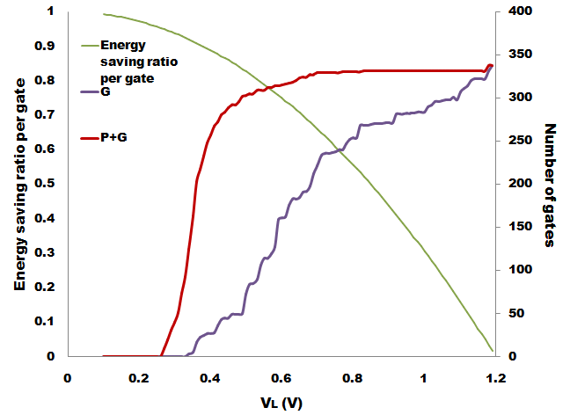
Algorithm to find V_{DDL}
C880
Total 360 gates
=V_{DD}
Notes:
Energy saving ratio per gate

Slide 31
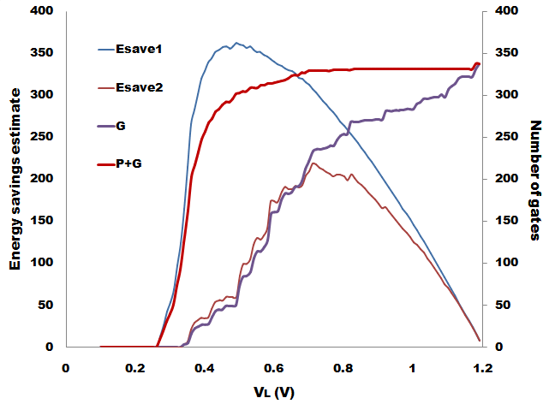
Algorithm to find V_{DDL}
V_{DDL1}= 0.49V
V_{DDL2}= 0.71V
C880
Total 360 gates
=V_{DD}
Notes:
Vl1 and vl2 in graph.

Slide 32
Results: V_{DDL} selection algorithm
ISCAS’85 | Total gates | Without level converters
 |  | V_{DDL} = V_{DDL1} |  |  | V_{DDL} = V_{DDL2} |  |  | V_{DDL}= (V_{DDL1}+V_{DDL2} )/2 |  |  | V_{DDL} = (V_{DDL1}V_{LDD2})^{1/2}
 |  | V_{DDL} (V) | Gates in V_{DDL} | E_{sav}(%) | V_{DDL} (V) | Gates in V_{DDL} | E_{sav}(%) | V_{DDL} (V) | Gates in V_{DDL} | E_{sav} (%) | V_{DDL} (V) | Gates in V_{DDL} | E_{sav} (%)
C432 | 154 | 0.80 | 8 | 2.9 | 0.89 | 8 | 2.3 | 0.84 | 8 | 2.7 | 0.84 | 8 | 2.7
C499 | 493 | 0.76 | 113 | 13.7 | 1.11 | 141 | 4.1 | 0.93 | 123 | 10.0 | 0.91 | 129 | 11.1
C880 | 360 | 0.49 | 213 | 49.3 | 0.71 | 229 | 41.3 | 0.6 | 229 | 47.7 | 0.58 | 229 | 48.8
C1355 | 469 | 0.77 | 76 | 9.5 | 1.11 | 108 | 3.4 | 0.94 | 76 | 6.3 | 0.92 | 76 | 6.7
C1908 | 584 | 0.60 | 221 | 28.4 | 1.00 | 221 | 11.6 | 0.80 | 221 | 21.9 | 0.77 | 221 | 22.3
C2670 | 901 | 0.48 | 570 | 53.1 | 0.82 | 570 | 33.7 | 0.65 | 570 | 44.7 | 0.62 | 570 | 46.4
C3540 | 1270 | 0.52 | 149 | 9.5 | 0.73 | 149 | 7.4 | 0.62 | 149 | 8.6 | 0.61 | 149 | 8.7
C5315 | 2077 | 0.49 | 1220 | 49.0 | 0.75 | 1226 | 36.0 | 0.62 | 1220 | 43.1 | 0.60 | 1220 | 44.1
C6288 | 2407 | 0.55 | 75 | 2.5 | 1.00 | 77 | 0.98 | 0.77 | 77 | 1.9 | 0.73 | 77 | 2.0
C7288 | 2823 | 0.54 | 1582 | 44.7 | 0.71 | 2123 | 8.9 | 0.62 | 1672 | 43.4 | 0.61 | 1672 | 43.4

Slide 33
Results: V_{DDL} selection algorithm
ISCAS’85 | Total gates | With level converters
 |  | V_{DDL} = V_{DDL1} |  |  | V_{DDL} = V_{DDL2} |  |  | V_{DDL}= (V_{DDL1}+V_{DDL2} )/2 |  |  | V_{DDL} = (V_{DDL1}V_{LDD2})^{1/2}
 |  | V_{DDL} (V) | Gates in V_{DDL} | E_{sav}(%) | V_{DDL} (V) | Gates in V_{DDL} | E_{sav}(%) | V_{DDL} (V) | Gates in V_{DDL} | E_{sav} (%) | V_{DDL} (V) | Gates in V_{DDL} | E_{sav} (%)
C432 | 154 | 0.80 | 73 | 17.1 | 0.89 | 85 | 24.8 | 0.84 | 81 | 26.8 | 0.84 | 81 | 26.8
C499 | 493 | 0.76 | 173 | 21.1 | 1.11 | 359 | 10.5 | 0.93 | 249 | 20.2 | 0.91 | 247 | 21.3
C880 | 360 | 0.49 | 223 | 51.6 | 0.71 | 309 | 55.8 | 0.6 | 290 | 60.4 | 0.58 | 286 | 60.9
C1355 | 469 | 0.77 | 122 | 15.3 | 1.11 | 260 | 8.0 | 0.94 | 197 | 16.3 | 0.92 | 193 | 17.0
C1908 | 584 | 0.60 | 263 | 33.8 | 1.00 | 267 | 24.4 | 0.80 | 395 | 37.6 | 0.77 | 385 | 38.8
C2670 | 901 | 0.48 | 376 | 35.1 | 0.82 | 784 | 46.4 | 0.65 | 677 | 53.1 | 0.62 | 633 | 51.5
C3540 | 1270 | 0.52 | 647 | 41.4 | 0.73 | 1073 | 53.2 | 0.62 | 906 | 52.3 | 0.61 | 881 | 51.5
C5315 | 2077 | 0.49 | 1140 | 45.0 | 0.75 | 1777 | 52.1 | 0.62 | 1633 | 57.6 | 0.60 | 1602 | 57.8
C6288 | 2407 | 0.55 | 659 | 21.6 | 1.00 | 1877 | 23.8 | 0.77 | 1302 | 31.8 | 0.73 | 1189 | 47.3
C7288 | 2823 | 0.54 | 1560 | 44.1 | 0.71 | 2235 | 51.5 | 0.62 | 1998 | 51.9 | 0.61 | 1197 | 51.8

Slide 34
Results: Comparison with reported data
ISCAS’85 | Total gates | Without level converters
 |  | V_{DDL}=V_{DDL1} |  |  | V_{DDL}= V_{DDL} = 0.7V_{DD} = 0.84V |  | V_{DDL}= V_{DDL} = 0.5V_{DD} = 0.6V
 |  | V_{DDL} (V) | Gates in V_{DDL} | E_{sav} (%) | Gates in V_{DDL} | E_{sav} ( %) | Gates in V_{DDL} | E_{sav} (%)
C432 | 154 | 0.80 | 8 | 2.9 | 8 | 2.7 | 8 | 3.9
C499 | 493 | 0.76 | 113 | 13.7 | 121 | 12.5 | 56 | 8.5
C880 | 360 | 0.49 | 213 | 49.3 | 229 | 32.4 | 229 | 47.7
C1355 | 469 | 0.77 | 76 | 9.5 | 76 | 8.3 | 64 | 10.2
C1908 | 584 | 0.60 | 221 | 28.4 | 221 | 19.3 | 221 | 28.4
C2670 | 901 | 0.48 | 570 | 53.1 | 570 | 32.3 | 570 | 47.5
C3540 | 1270 | 0.52 | 149 | 9.5 | 149 | 6.0 | 149 | 8.8
C5315 | 2077 | 0.49 | 1220 | 49.0 | 1240 | 30.5 | 1220 | 44.1
C6288 | 2407 | 0.55 | 75 | 2.5 | 77 | 1.6 | 75 | 2.3
C7288 | 2823 | 0.54 | 1582 | 44.7 | 2359 | 42.6 | 1672 | 43.9

Slide 35
Results: Comparison with reported data
ISCAS’85 | Total gates | With level converters
 |  | V_{DDL}=V_{DDL1} |  |  | V_{DDL}=V_{DDL} = 0.7V_{DD} = 0.84V |  | V_{DDL}=V_{DDL} = 0.5V_{DD} = 0.6V
 |  | V_{DDL} (V) | Gates in V_{DDL} | E_{sav} (%) | Gates in V_{DDL} | E_{sav} ( %) | Gates in V_{DDL} | E_{sav} (%)
C432 | 154 | 0.84 | 81 | 26.8 | 81 | 26.8 | 43 | 20.9
C499 | 493 | 0.91 | 247 | 21.3 | 211 | 21.2 | 99 | 15.1
C880 | 360 | 0.58 | 286 | 60.9 | 323 | 45.8 | 290 | 60.4
C1355 | 469 | 0.92 | 193 | 17.0 | 154 | 16.8 | 44 | 7.0
C1908 | 584 | 0.77 | 385 | 38.8 | 415 | 36.2 | 263 | 33.8
C2670 | 901 | 0.62 | 633 | 51.5 | 813 | 46.0 | 606 | 50.5
C3540 | 1270 | 0.61 | 881 | 51.5 | 1093 | 43.9 | 864 | 51.0
C5315 | 2077 | 0.60 | 1602 | 57.8 | 1812 | 44.5 | 1602 | 56.9
C6288 | 2407 | 0.73 | 1189 | 47.3 | 1470 | 31.2 | 780 | 24.3
C7288 | 2823 | 0.61 | 1197 | 51.8 | 2347 | 42.4 | 1943 | 51.6

Slide 36
Outline
Motivation
Problem statement
Background
Contributions
Algorithm to find V_{DDL}
Algorithm to assign V_{DDL}
Results
Future work
References

Slide 37
Algorithm to assign V_{DDL}
Assume all gates are at V_{DD} initially.
Calculate slacks of all gates.
Assign V_{DDL} to gates whose slacks,
S_{i} ≥S_{u}
Recalculate slacks.

Slide 38
Algorithm to assign V_{DDL}
Assign V_{DDL} to a group of gates in P satisfying the condition
Recalculate slacks.
Check whether there are any V_{DDL} gates at the inputs of any V_{DD} gates and if there are any negative slacks.

Slide 39
Algorithm to assign V_{DDL}
If there any violations occur, put the corresponding gate back to V_{DD} .
Recalculate slacks.
Repeat previous five steps until we do not have any V_{DD} gates in groups P and G.

Slide 40
c880 slack distribution
S_{u} =336.9 ps
45º line
P
V_{DD} = 1.2V
V_{DDL} = 0.49V
G

Slide 41
Slack data after V_{DDL} assignment
S_{u} = 336.9ps
45º line
P
G
V_{DD} = 1.2V
V_{DDL} = 0.49V

Slide 42
Dual voltage design without level converter
ISCAS’85 | Total gates | V_{DDL}=V_{DDL1} Determination and assignment |  |  |  | SPICE Results ** |  |  | [Kim and Agrawal]
 |  | V_{DDL} (V) | Gates in V_{DDL} | E_{sav} (%) | CPU* (s) | E_{single VDD} (fJ) | E_{dual VDD}( fJ) | E_{sav} (%) | E_{sav} (%) | CPU (s)
C432 | 154 | 0.80 | 8 | 2.9 | 1.78 | 161.3 | 155.4 | 3.7 | 3.9 | 15.8
C499 | 493 | 0.76 | 113 | 13.7 | 9.41 | 463 | 427 | 7.8 | 5.9 | 194.4
C880 | 360 | 0.49 | 213 | 49.3 | 5.39 | 277.6 | 115.8 | 58.3 | 50.8 | 62.1
C1355 | 469 | 0.77 | 76 | 9.5 | 8.75 | 455.2 | 433.1 | 4.9 | 4.3 | 132
C1908 | 584 | 0.60 | 221 | 28.4 | 11.43 | 496.5 | 378.3 | 23.8 | 19.0 | 247.8
C2670 | 901 | 0.48 | 570 | 53.1 | 23.49 | 660.3 | 251.5 | 61.9 | 47.8 | 480.7
C3540 | 1270 | 0.52 | 149 | 9.5 | 45.44 | 1843 | 1620 | 12.2 | 9.6 | 1244
C5315 | 2077 | 0.49 | 1220 | 49.0 | 109.47 | 2320 | 1272 | 45.2 | N/R | N/R
C6288 | 2407 | 0.55 | 75 | 2.5 | 154.94 | 1932 | 1869 | 3.3 | 2.6 | 6128
C7288 | 2823 | 0.54 | 1582 | 44.7 | 191.04 | 2465 | 1562 | 36.6 | N/R | N/R
Intel Core i5 2.30GHz, 4GB RAM
**90nm PTM model

Slide 43
CPU Time Vs. Number of Gates

Slide 44
c880 slacks with 5% increase in T_{c}
S_{u} = 293ps
45º line
V_{DD} = 1.2V
V_{DDL} = 0.67V
P
G

Slide 45
c880 final slacks with 5% increase in T_{c}
S_{u} = 293ps
45º line
V_{DD} = 1.2V
V_{DDL} = 0.67V
P
G

Slide 46
Dual voltage design without level converter with 5% increase in T_{c}
ISCAS’85 | Total gates | V_{DDL}=V_{DDL1} Determination and assignment |  |  |  | SPICE Results **
 |  | V_{DDL} (V) | Gates in V_{DDL} | E_{sav} (%) | CPU* (s) | E_{single VDD} (fJ) | E_{dual VDD} (fJ) | E_{sav} (%)
C432 | 154 | 1.08 | 154 | 19.0 | 1.70 | 161.3 | 123.9 | 23.2
C499 | 493 | 1.03 | 493 | 26.3 | 9.18 | 463 | 321.9 | 30.5
C880 | 360 | 0.67 | 334 | 65.8 | 4.32 | 277.6 | 83.86 | 69.8
C1355 | 469 | 1.06 | 469 | 22.0 | 8.52 | 455.2 | 339.9 | 12.2
C1908 | 584 | 1.00 | 584 | 30.6 | 8.56 | 496.5 | 445 | 10.4
C2670 | 901 | 0.81 | 899 | 54.3 | 15.81 | 660.3 | 257.3 | 61.0
C3540 | 1270 | 0.90 | 1270 | 43.8 | 28.22 | 1843 | 949.5 | 48.5
C5315 | 2077 | 0.72 | 2077 | 64.0 | 61.77 | 2320 | 716.8 | 69.1
C6288 | 2407 | 1.07 | 2407 | 20.5 | 108.39 | 1932 | 1464 | 24.2
C7288 | 2823 | 0.68 | 2816 | 67.7 | 175.07 | 2465 | 677.2 | 72.3
Intel Core i5 2.30GHz, 4GB RAM
**90nm PTM model

Slide 47
Future work
Accommodate level converter energy overheads.
Consider leakage energy reduction.
Dual threshold designs.
Simultaneous dual supply voltage and dual threshold voltage designs.
Include the effects of process variations.

Slide 48
References
T. Kuroda and M. Hamada, “Low-Power CMOS Digital Design with Dual Embedded Adaptive Power Supplies," IEEE Journal of Solid-State Circuits, vol. 35, no. 4, pp. 652-655, Apr. 2000.
M. Hamada, Y. Ootaguro, and T. Kuroda, “Utilizing Surplus Timing for Power Reduction,” in Proceedings of the IEEE Custom Integrated Circuits Conference, pp. 89-92, 2001.
C. Chen, A. Srivastava, and M. Sarrafzadeh, “On Gate Level Power Optimization Using Dual-Supply Voltages," IEEE Transactions on Very Large Scale Integration (VLSI) Systems, vol. 9, no. 5, pp. 616-629, Oct. 2001.
S. H. Kulkarni, A. N. Srivastava, and D. Sylvester, “A New Algorithm for Improved VDD Assignment in Low Power Dual VDD Systems," in Proceedings of the International Symposium on Low Power Design, pp. 200-205 , 2004.
A. Srivastava, D. Sylvester, and D. Blaauw, “Concurrent Sizing, Vdd and Vth Assignment for Low-Power Design," Proceedings of the Design, Automation and Test in Europe Conference, pp. 107-118, 2004.
K. Kim, Ultra Low Power CMOS Design. PhD thesis, Auburn University, ECE Dept., Auburn, AL, May 2011.

Slide 49
References
K. Kim and V. D. Agrawal, “Dual Voltage Design for Minimum Energy Using Gate Slack,” in Proceedings of the IEEE International Conference on Industrial Technology, pp. 419-424 , Mar. 2011.
K. Usami and M. Horowitz, “Clustered Voltage Scaling Technique for Low-Power Design," in Proceedings of the International Symposium on Low Power Design, pp. 23-26, 1995.
K. Usami, M. Igarashi, F. Minami, T. Ishikawa, M. Kanzawa, M. Ichida, and K. Nogami, “Automated Low-Power Technique Exploiting Multiple Supply Voltages Applied to a Media Processor," IEEE Journal of Solid-State Circuits, vol. 33, no. 3, pp. 463-472, Mar. 1998.
V. Sundararajan and K. K. Parhi, “Synthesis of Low Power CMOS VLSI Circuits Using Dual Supply Voltages," in Proceedings of the 36th Annual Design Automation Conference, pp. 72-75, 1999.
M. Allani and V. D. Agrawal, “Level-Converter Free Dual-Voltage Design of Energy Efficient Circuits Using Gate Slack,” Submitted to Design Automation and Test in Europe Conference, March 12-16, 2012.

Slide 50

Thank you.

