Slide 1
Triple-Parity RAID and Beyond
Hai Lu

Slide 2
RAID
RAID, an acronym for redundant array of independent disks or also known as redundant array of inexpensive disks, is a technology that allows high levels of storage reliability from low-cost and less reliable PC-class disk-drive components, via the technique of arranging the devices into arrays for redundancy.
RAID is now used as an umbrella term for computer data storage schemes that can divide and replicate data among multiple hard disk drives. The different schemes/architectures are named by the word RAID followed by a number, as in RAID 0, RAID 1, etc. RAID's various designs involve two key design goals: increase data reliability and/or increase input/output performance.

Slide 3
RAID-0
Data is striped across devices for maximal write performance. It is an outlier among the other RAID levels as it provides no actual data protection.

Slide 4
RAID-1
Disks are organized into mirrored pairs and data is duplicated on both halves of the mirror. This is typically the highest-performing RAID level, but at the expense of lower usable capacity.

Slide 5
RAID-5
A group of N+1 disks is maintained such that the loss of any one disk would not result in data loss. This is achieved by writing a parity block, P, for each logical row of N disk blocks. The location of this parity is distributed, rotating between disks so that all disks contribute equally to the delivered system performance. Typically P is computed simply as the bitwise XOR of the other blocks in the row.

Slide 6
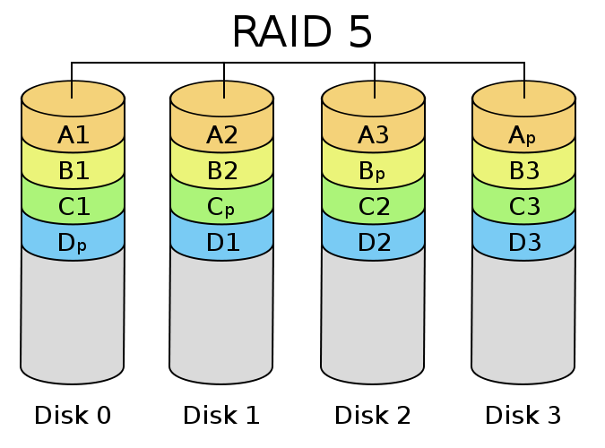
P=D1 xor D2 xor D3 … xor Dn

Slide 7
RAID-6
This is like RAID-5, but employs two parity blocks, P and Q, for each logical row of N+2 disk blocks. There are several RAID-6 implementations such as IBM’s EVENODD, NetApp’s Row-Diagonal Parity, or more generic Reed-Solomon encodings.

Slide 9
There are other less prevalent RAID levels:
RAID-2
Data is protected by memory-style ECC (error correcting codes). The number of parity disks required is proportional to the log of the number of data disks; this makes RAID-2 relatively inflexible and less efficient than RAID-5 or RAID-6 while also delivering lower performance and reliability.

Slide 10
RAID-3
As with RAID-5, protection is provided against the failure of any disk in a group of N+1, but blocks are carved up and spread across the disks—bitwise parity as opposed to the block parity of RAID-5. Further, parity resides on a single disk rather than being distributed between all disks. RAID-3 systems are significantly less efficient than with RAID-5 for small read requests; to read a block all disks must be accessed; thus the capacity for read operations is more readily exhausted.

Slide 11
RAID-4
This is merely RAID-5, but with a dedicated parity disk rather than having parity distributed among all disks. Since fewer disks participate in reads (the dedicated parity disk is not read except in the case of a failure), RAID-4 is strictly less efficient than RAID-5.

Slide 12
The primary ramification of an uncorrectable bit error is felt when a disk fails and the contents of the failed disk must be reconstructed by reading data from the nonfailed disks. For example, the reconstruction of a failed disk in a 100GB disk array requires the successful reading of approximately 200 million sectors of information. A bit error rate of one in bits implies that one 512-byte sector in 24 billion sectors cannot be correctly read. Thus, if we assume the probability of reading sectors is independent of each other, the probability of reading all 200 million sectors successfully is approximately
This means that on average, 0.8% of disk failures would result in data loss due to an uncorrectable bit error.

Slide 13
Disk capacity has increased by slightly more than two orders of magnitude, doubling about every two years and nearly following Kryder’s law. Today, a RAID group with 10TB (nearly 20 billion sectors) is commonplace, and typical bit error rate stands at one in bits:
While bit error rates have nearly kept pace with the growth in disk capacity, throughput has not been given its due consideration when determining RAID reliability.

Slide 14
NetApp published a small comparison of RAID-5 and -6 with equal capacities (7+1 for RAID-5 and 14+2 for RAID-6) and hard drives of varying quality and capacity.

Slide 15
Capacity vs. Throughput
Capacity has increased steadily and significantly, and the bit error rate has improved at nearly the same pace. Hard-drive throughput, however, has lagged behind significantly.

Slide 17
By dividing capacity by throughput, we can compute the amount of time required to fully scan or populate a drive. It is this duration that dictates how long a RAID group is operating without full parity protection.
Figure below shows the duration such an operation would take for the various drive types over the years.

Slide 18
Triple –Parity RAID
With RAID-6 increasingly unable to meet reliability requirements, there is an impending but not yet urgent need for triple-parity RAID. The addition of another level of parity mitigates increasing RAID rebuild times and occurrences of latent data errors.

Slide 19
REFERENCE
"Triple-Parity RAID and Beyond," A. Leventhal, Comm. ACM, vol. 53, no. 1, pp. 58-63, January 2010.
Wikipedia Raid
http://en.wikipedia.org/wiki/Raid

