Slide 1
Design Of A 16 bit RISC Microprocessor Using Multi-Cycle Data path
By
Praveen Venkataramani

Slide 2
Instruction set architecture
Maximum allowable instruction N =16
Number of op-code bits = log₂N = log₂16 = 4 bits
Number of bits in the instruction word = 16 bits
Bits allocated in for R-Type Instruction Format (explained below) = 16/4 = 4 bits each
Total number of registers = 2^No of bits allocated for the operands = 2^4 = 16 registers
Register number goes from 0 -> 15
Number of permissible instructions per word = 1
Relative address size = 16 words = log₂16 = 4 bits long
Absolute address size= 8K words = log₂ (8k) = 13 bits long
Op-code = 3 bits long
Conflict with op-code
Absolute address reduced to 12 bits

Slide 3
Instructions
R-Type Instruction
Addition, subtraction, AND, OR, & hold (no-operation)
I- Type Instruction
Load word, Store word
Add immediate
Branch on equal, Branch on not equal
Branch on less than, Branch on less than and equal
Branch on greater than, Branch on greater than and equal
J-Type instruction
Jump and Return, Jump

Slide 4
Choice of data path
Pros:
Shared components
Simple data path Architecture
Easy to debug in code
Availability of materials for design
Cons
Requires intermediate registers to store values between clock cycles
Larger control logic
Requires finite state machine for control logic

Slide 5
Choice of shared components
Component Name | Shared/ Dedicated | Operation
Memory | Shared | Store both data and instructions
Register File | Dedicated | Store the register data for computation
ALU | Shared | Arithmetic operations Increment PC Computes Branch Address
Instruction Register | Dedicated | Intermediate register to store instruction word from the Memory
Memory Data Register | Dedicated | Intermediate register to store the data to be written into the register during “load” operation
A and B Registers | Dedicated | Intermediate register to store data for computation
ALUOUT | Dedicated | Intermediate register to store output of the ALU
PC | Dedicated | Stores the address of the next instruction

Slide 6
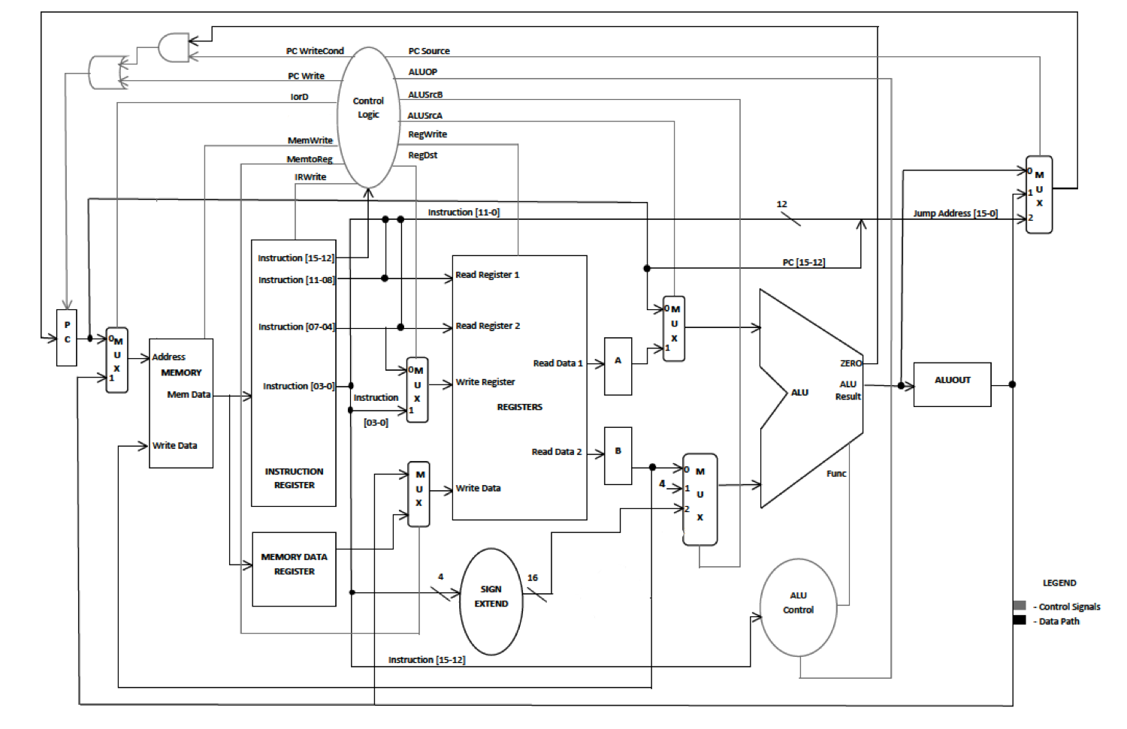
Multi-cycle data path

Slide 7
Program
 | ASSEMBLY LANGUAGE | MACHINE LANGUAGE
 |  | OPCODE | RS | RT/RD | RD/ADDRESS/CONSTANT
START | addi $2,$0,2 | 1101 | 0000 | 0010 | 0010
 | addi $12,$0,-4 | 1101 | 0000 | 1100 | 1100
 | addi $14,$0,-2 | 1101 | 0000 | 1110 | 1110
 | add $4,$2,$2 | 0000 | 0010 | 0010 | 0100
L1 | sub $4,$4, $2 | 0001 | 0100 | 0010 | 0100
 | sub $10,$12,$2 | 0001 | 1100 | 0010 | 1010
 | sub $5,$2,$4 | 0001 | 0010 | 0100 | 0101
 | sub $7,$14,$4 | 0001 | 1110 | 0100 | 0111
 | beq $4,$2,L1 | 0111 | 0010 | 0100 | 1011
 | jmp START | 1111 | 000000000001

Slide 8
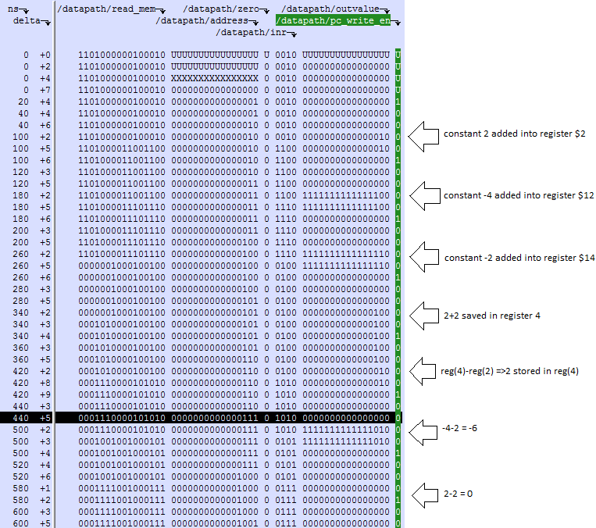
Data Path with Forced control Logic

Slide 9
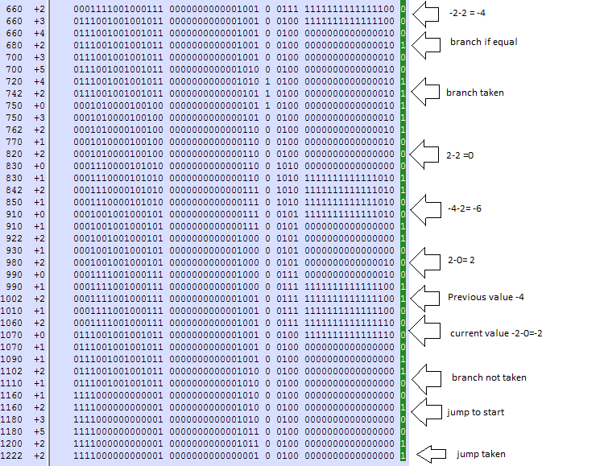
Data path with forced control logic

Slide 10
Control States
Instruction Fetch
Instruction Decode
LW/SW
Address Computation
R- Type
Read Memory
Write Memory
Write Register
Execution
Write Register
Branch Type
Jump Type

Slide 11
Branch Control Signal
Instruction Fetch
Instruction Decode
Branch Decision
Instruction fetch –
PC Write =1
ALUSRC B= 01
ALUSRC A = 0
PC Source =00
Instruction Decode-
PC Write = 0
ALUSRC B = 10
Branch Decision
ALUSRC A = 1
ALUSRC B = 00

Slide 12
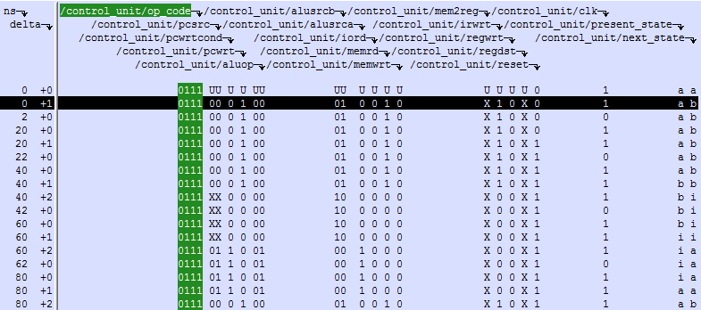
Branch Instruction

Slide 13
Jump Control Signals
Instruction Fetch
Unconditional Jump
Instruction Decode
Instruction fetch –
PC Write -1
ALUSRC B – 01
ALUSRC A – 0
PC Source =00
Instruction Decode-
PC Write – 0
ALUSRC B – 10
Jump Execution
PC Source =10

Slide 14
Jump type INSTRuction

Slide 15
R –type Instruction
Instruction Fetch
Instruction Decode
Execution
Write Register
Instruction fetch –
PC Write -1
ALUSRC B – 01
ALUSRC A – 0
Instruction Decode-
PC Write – 0
ALUSRC B – 10
Execution
ALUSRC A = 1
ALUSRC B = 0
Write Register –
Read Write – 1
Register Destination – 1
Memory to Register - 0

Slide 16
R-Type Instruction

Slide 17
Store Word control signals
Instruction Fetch
Instruction Decode
Address calculation
Write into memory
Instruction fetch –
PC Write =1
ALUSRC B= 01
ALUSRC A = 0
Instruction Decode-
PC Write = 0
ALUSRC B = 10
Address calculation
ALUSRC A = 1
ALUSRC B = 10
Write Memory –
I or D = 1
Memory write = 1

Slide 18
Store Word Instruction

Slide 19
Load word control signals
Instruction Fetch
Instruction Decode
Address Calculation
Write register
Read Memory
Instruction fetch –
PC Write =1 PC Source =00
ALUSRC B= 01
ALUSRC A = 0
Instruction Decode-
PC Write = 0
ALUSRC B = 10
Address calculation
ALUSRC A = 1
ALUSRC B = 10
Read Memory –
I or D = 1
Memory write = 0
Write Register
RW =1
Register destination = 0
Memory to Register = 1

Slide 20
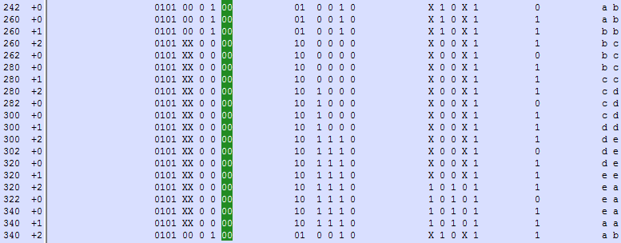
Load Word Instruction

Slide 21
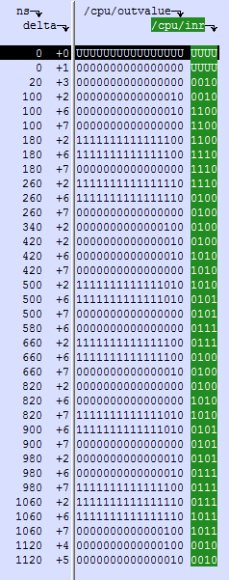
CPU Simulation

Slide 22
Conclusion
The project provided an hands experience in actual design of a CPU
What we learnt
RTL Programming in VHDL
Use of FPGA boards
Trouble shooting and testing
Different types of data paths
Advice to people
Check each component in the data path with and without control unit while simulating
Do the same on the board
Do not be stingy in using the pins or switches use as many to test each component
Note you can save the pin configuration for future use by exporting it
Simplicity in code
Sometimes laziness helps – so save your simulation commands in a .do file / text file
Isolate and test
Only write enable in the memory- writes when asserted; reads always.
While using pulse switch for clock, keep in mind that after some time the keys might get sloppy and may double clock the circuit

