Slide 1
Supercomputer Computer Architecture and Design Fall 2009
Zhao Lixing

Slide 2
Introduction
A supercomputer is a computer that is at the frontline of current processing capacity, particularly speed of calculation.
Supercomputers were introduced in the 1960s and were designed primarily by Seymour Cray at Control Data Corporation (CDC).
Supercomputers using custom CPUs traditionally gained their speed over conventional computers through the use of innovative designs that allow them to perform many tasks in parallel, as well as complex detail engineering.

Slide 3
Development
CDC's early machines were simply very fast scalar processors(a scalar processor processes one data item at a time), some ten times the speed of the fastest machines offered by other companies.
In the 1970s most supercomputers were dedicated to running a vector processor(a single instruction operates simultaneously on multiple data items), and many of the newer players developed their own such processors at a lower price to enter the market.
In the late 1980s and 1990s, attention turned from vector processors to massive parallel processing(a computer system with many independent arithmetic units or entire microprocessors that run in parallel) systems with thousands of "ordinary" CPUs, some being off the shelf units and others being custom designs.

Slide 4
Today, parallel designs are based on "off the shelf" server-class microprocessors, such as the PowerPC, Opteron, or Xeon, and most modern supercomputers are now highly-tuned computer clusters using commodity processors combined with custom interconnects.

Slide 5
Modern Supercomputer Architecture
The top ten supercomputers on the Top500 list have the same top-level architecture.
Each of them is a cluster of MIMD(Multiple Instruction Multiple Data ) multiprocessors, each processor of which is SIMD (Single Instruction Multiple Data ) .
The supercomputers vary radically with respect to the number of multiprocessors per cluster, the number of processors per multiprocessor, and the number of simultaneous instructions per SIMD processor.

Slide 6
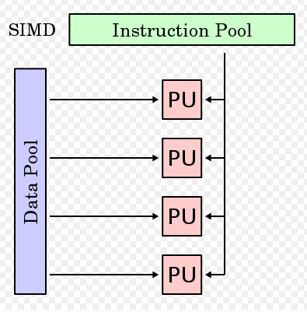

Slide 7
Programming
The base language of supercomputer code is Fortran or C, using special libraries to share data between nodes.
Environments such as PVM(Parallel Virtual Machine) and MPI(Message Passing Interface) for loosely connected clusters and OpenMP(Open Multi-Processing) for tightly coordinated shared memory machines are used.
Significant effort is required to prevent any of the CPU's from wasting time waiting on data from other nodes.

Slide 8
Operating Systems
Supercomputer operating systems today are most often variants of Linux.
Supercomputers are often priced at millions of dollars, are sold to a very small market and the R&D budget for the OS was often limited.
The advent of Unix and Linux allows reuse of conventional desktop software and user interfaces.

Slide 9
Challenges
Supercomputer generates large amounts of heat and must be cooled. Cooling most supercomputers is a major HVAC (Heating, Ventilating, and Air Conditioning) problem.
In modern supercomputers built of many conventional CPUs running in parallel, latencies of 1-5 microseconds to send a message between CPUs are typical.
Supercomputers consume and produce massive amounts of data in a very short period of time. Much work on external storage bandwidth is needed to ensure that this information can be transferred quickly and stored/retrieved correctly.

Slide 10
Common Uses
Supercomputers are used for highly calculation-intensive tasks.
quantum mechanical physics
weather forecasting
climate research
molecular modeling(structures and properties of chemical compounds)
physical simulations

Slide 13
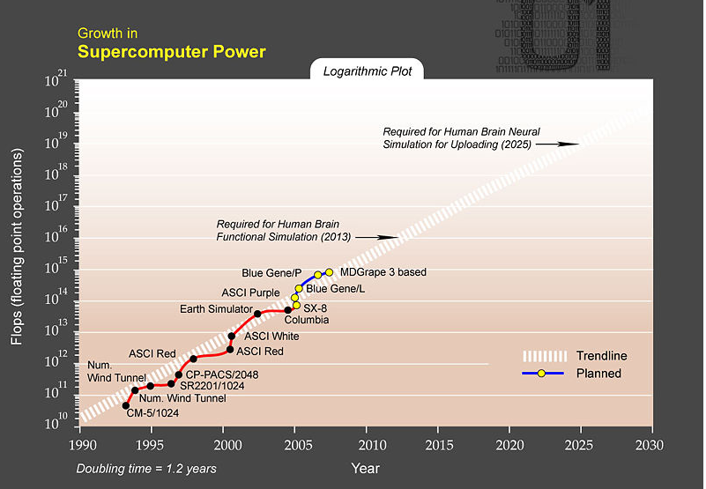

Slide 15
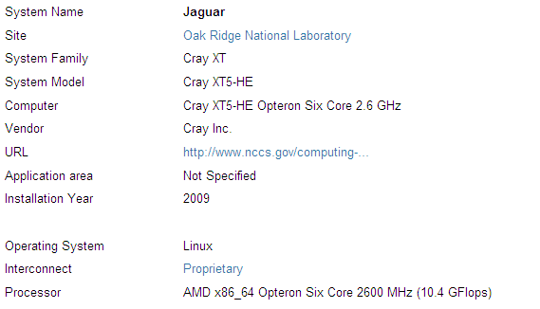

Slide 16
Future Development
IBM is developing the Cyclops64 architecture, intended to create a "supercomputer on a chip".
Meanwhile, IBM is constructing a 20 PFLOPs supercomputer at Lawrence Livermore National Laboratory, named Sequoia, which is scheduled to go online in 2011.
Erik P. DeBenedictis of Sandia National Laboratories theorizes that a zettaflops (10²¹) computer is required to accomplish full weather modeling, which could cover a two week time span accurately. Such systems might be built around 2030.

Slide 17
References
Vaughan-Nichols, S.J. , “New trends revive supercomputing industry”, Computer, Volume 37, Issue 2, Feb 2004 Page(s):10 - 13
http://en.wikipedia.org/wiki/Supercomputer
http://www.top500.org/lists/2009/11
http://www.lonympics.co.uk/new/supercomputer.htm

