Slide 1
PowerPC
Computer Architecture and Design Fall 2009
Indraneil Gokhale

Slide 2
Introduction
POWER is a RISC instruction set architecture designed by IBM. The name is a ackronym for Performance Optimization With Enhanced RISC
Created by the 1991 Apple-IBM-Motorola alliance, known as AIM.
PowerPC is largely based on IBM's POWER architecture, and retains a high level of compatibility with it; the architectures have remained close enough that the same programs and operating systems will run on both if some care is taken in preparation.
32-bit and 64-bit PowerPC processors have been a favorite of embedded computer designers. To keep costs low on high-volume competitive products, the CPU core is usually bundled into a system-on-chip (SOC) integrated circuit.

Slide 3
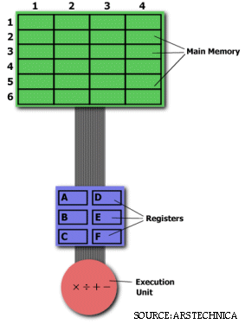
RISC VS CISC
CISC
MUL 2:3,5:2
RISC
LOAD A, 2:3 LOAD B, 5:2 PROD A, B STORE 2:3, A
RISC – relatively few number of Pipelined Instructions to achieve a high throughput on each clock pulse.

Slide 4
AIM Contributions
IBM - Record Breaking RISC Architecture
APPLE - Pink Operating System to Run on the POWERPC
MOTOROLA – Chip Designers and Submicron Chip Fabrication Plant.

Slide 5
What They Gained !!!
IBM - merchant semiconductor market they were looking for.
APPLE - got to use one of the most powerful RISC CPUs on the market, and massive press buzz due to IBM's name.
MOTOROLA - got an up-to-date RISC chip, and help with design methodology from IBM.
(Motorola already had its own RISC design in the form of the 88000 which was doing poorly in the market)

Slide 6
PowerPC and Power Architecture
The PowerPC architecture is a modified version of the POWER architecture.
The PowerPC architecture added:
Single-precision floating point instructions.
General register-to-register multiply and divide instructions.
Removed some POWER features such as the specialized multiply and divide instructions using the MQ register.
It also added a 64-bit version of the architecture.
PowerPC 600 family, PowerPC 700 family, PowerPC 900 family, PowerPC 400.

Slide 7
Current Status
PowerPC e200 - 32 bit power architecture microprocessor - speed ranging up to 600 MHz - ideal for embedded applications.
PowerPC e300 – similar to e200 with an increase in speed upto 667 MHz.
PowerPC e600 – speed upto 2 Ghz – ideal for high performance routing and telecommunications applications.
POWER5 – IBM – dual core μP
POWER6 – IBM – Dual core μP - A notable difference from POWER5 is that the POWER6 executes instructions in-order instead of out-of-order
PowerPC G3 - Apple Macintosh computers such as the PowerBook G3, the multicolored iMacs, iBooks and several desktops, including both the Beige and Blue and White Power Macintosh G3s.
PowerPC G4 - is a designation used by Apple Computer to describe a fourth generation of 32-bit PowerPC microprocessors.
PowerPC G5 - 64-bit Power Architecture processors
Cell is a microprocessor architecture jointly developed by Sony Computer Entertainment, Toshiba, and IBM – PS3 game console
Xenon - based on IBM’s PowerPC ISA – XBOX 360 game console.
Broadway – based on IBM’s PowerPC ISA – Nintendo Wii gaming console
Blue Gene/L - dual core PowerPC 440, 700 MHz, 2004
Blue Gene/P - quad core PowerPC 450, 850 MHz, 2007

Slide 8
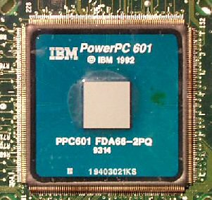
MPC601 Architecture
Fixed length 32-bit wide Instructions
3 parallel execution units
Branch Processing Unit
Interger Unit
Floating Point Unit
Instructions are dispatched to the different execution units via an Instruction Unit, which can queue up to 8 instructions and has a dedicated adder for prefetching.

Slide 9
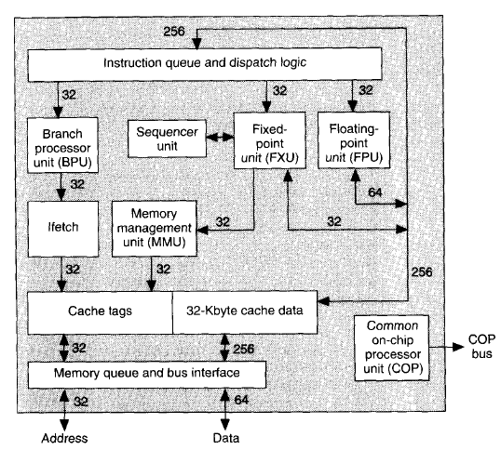
PowerPC 601 Architecture

Slide 10
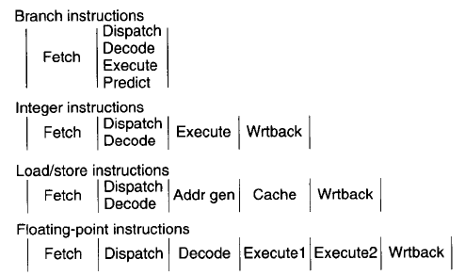
Pipeline Structure

Slide 11
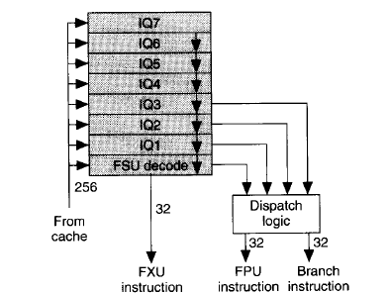
Instruction Queue and Dispatch Logic
It is Fed by eight-word bus from the cache.
During each cycle, the dispatch logic considers the bottom four entries of the instruction queue and dispatches up to three instructions.

Slide 12
Future Technologies:
POWER7 - currently under development at about a dozen IBM sites including IBM's Rochester, Austin and Böblingen laboratories as of April 2006.
The POWER7 is the successor to POWER6 and will be released in mid-2010.
PowerPC e700 or NG-64 (Next Generation 64-bit) a line of future high performance 64-bit embedded RISC-processor cores built using Power Architecture technology designed by Freescale.
TITAN – 32 bit Power Architecture -based microprocessors designed by Applied Micro Circuits Corporation (AMCC)

Slide 13
References
A. Marsala and B. Kanawati, “PowerPC Processors”, Proc. 26th IEEE Southeastern Symp. System Theory, 20-22 March, 1994, pp. 550-556.
Michael K. Becker, Michael S. Allen, Charles R. Moore, John S. Muhich, David P. Tuttle, "The Power PC 601 Microprocessor," IEEE Micro, vol. 13, no. 5, pp. 54-68, Sep/Oct, 1993
http://en.wikipedia.org/wiki/PowerPC
http://www.experiencefestival.com/a/powerpc%20-%20history/id/5389870

