Slide 1
Chapter 4 Fourier Transform of Discrete-Time Signals 2nd lecture Mon. June 17, 2013

Slide 2
4.1 Discrete-Time Fourier Transform
Continuous-time F.T. from Chapt. 3:
CTFT
Now, the input is x[n]. Define Discrete-time F.T.:
DTFT

Slide 3
Inverse DTFT (4.1.3, p. 175)
Eq. 4.27:

Slide 4
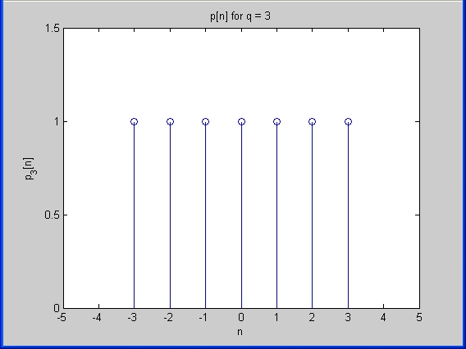
Example 4.3 – Rectangular Pulse

Slide 5
Example 4.3 – Rectangular Pulse, cont’d
Even signal, so DTFT is purely real. Use the def. (Eq. 4.2) and follow Ex. 4.1 to get:

Slide 6
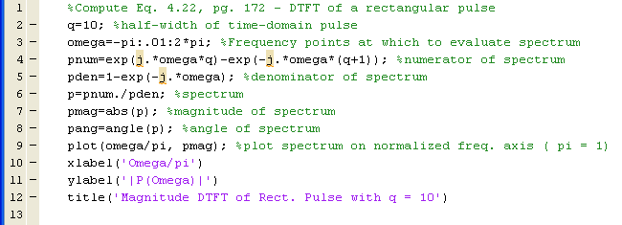
Example 4.3 – Rectangular Pulse, cont’d
MATLAB code* to plot magnitude:
*This script can be found on the class website with the filename dtft_pulse.m

Slide 7
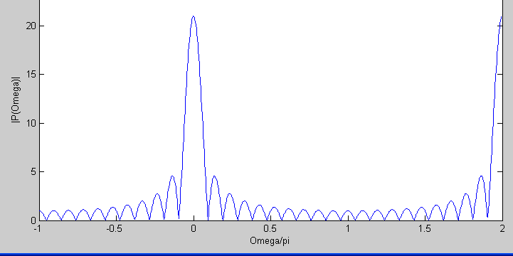
Example 4.3 – Rectangular Pulse, cont’d

Slide 8
Sect. 4.2 – Discrete Fourier Transform (DFT / FFT)
This is arguably the most important result in all of signal processing and modern communication.

Slide 9
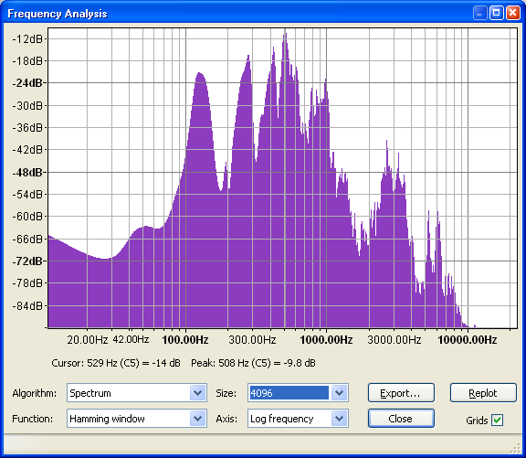
Frequency Domain
Voltage
“Hello”
Frequency

Slide 10
Discrete Fourier Transform
Need to store the transform in computer memory & files.
DFT:
Inverse DFT:

Slide 11
Discrete Fourier Transform
N-point DFT is computed using the FFT algorithm.
DFT:
MATLAB:
n=1:1024;
x=(-.7).^n;
xf=fft(x);
stem(xf)

Slide 12
Discrete Fourier Transform
N-point DFT:
N is always 2^{n} in practice. Common values are 1024, 4096.
First point is k = 0, last point is k = N-1, center point is N/2.
Magnitude is symmetric around N/2:
|X(N-1)|=|X(1)|,
|X(N-2)|=|x(2)|, …

