Slide 1
Chapter 2 System Models – Time Domain

Slide 2
Model of a System
Mathematical equation that describes the relationship between input x(t) or x[n] and the output y(t) or y[n].
Drawing or diagram that illustrates the input – output relationship
Words that define the inputs, outputs, and their relationship.

Slide 3
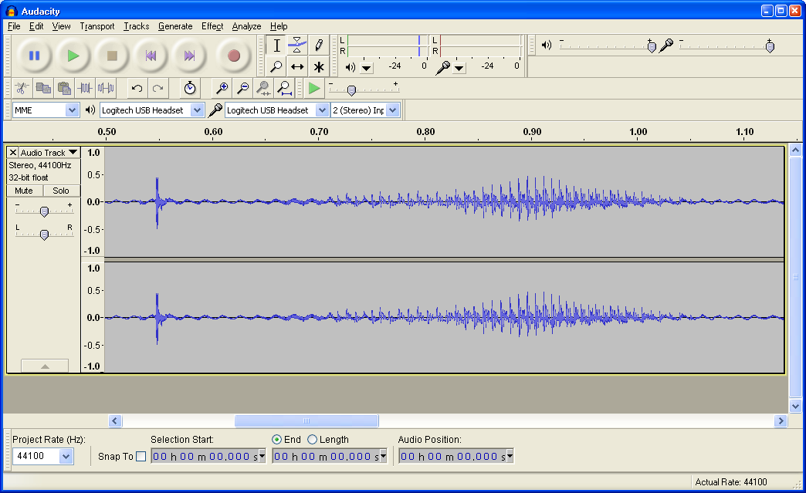
“Hello”
Time Domain
Voltage
Time

Slide 4
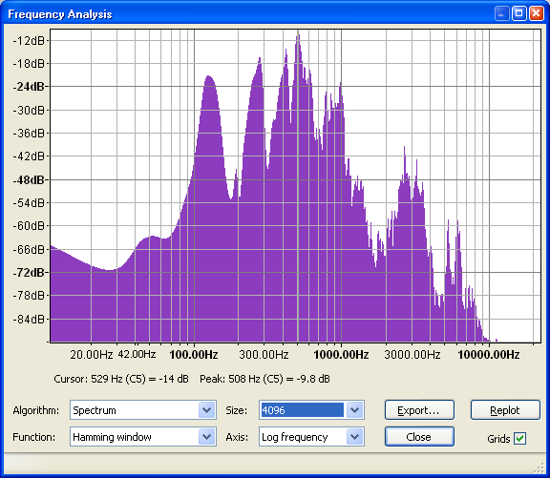
Frequency Domain
Voltage
“Hello”
Frequency

Slide 5
Chapter 2
2.1 – 2.3: Discrete time
2.4 – 2.6: Continuous time

Slide 6
Discrete Time: 3 Models
Input / Output
Convolution
Difference Equation
Convolution is Most Important Model

Slide 7
Why Convolution is Important
Leads most directly to frequency domain.
Most signal analysis is performed in the frequency domain.
Most system analysis is performed in the frequency domain.

Slide 8
INPUT/OUTPUT REPRESENTATION OF DISCRETE-TIME SYSTEMS
N-point moving average filter:

Slide 9
INPUT/OUTPUT REPRESENTATION OF DISCRETE-TIME SYSTEMS
Generalization:
The weights, w_{i} , define the system.

Slide 10
INPUT/OUTPUT REPRESENTATION OF DISCRETE-TIME SYSTEMS
Further Generalization:
Any causal linear time-invariant discrete-time system with the input x[n] equal to zero for all n < 0 can be expressed in this form!

Slide 11
UNIT-PULSE RESPONSE
Denote by h[n]
Set x[n] = δ[n]

Slide 12
UNIT-PULSE RESPONSE
The unit-pulse response lets you “see” everything inside the system. It’s like kicking the tires and slamming the doors on a used car to see what rattles.

Slide 13
CONVOLUTION REPRESENTATION
Rewriting the I/O equation using h[n] yields
CONVOLUTION

Slide 14
CONVOLUTION EXAMPLE
>> x=[1 0 0 0]; % input unit pulse
>> h=[1 2 3 2 1]; % unit pulse response
>> y=conv(x,h); % output
>> y
y =
1 2 3 2 1 0 0 0
>>
More about computing convolution later…

Slide 15
DIFFERENCE EQUATION MODEL (Sect. 2.3)
Nth-Order Input/Output Difference Equation:
Present output, y[n], depends on previous inputs and outputs, and present input, x[n]. Solve recursively, or find a closed-form solution.

Slide 16
DIFFERENTIAL EQUATION MODELS (Sect. 2.4 / 2.5)
R-C circuit example (1st order)
Mass-spring-damper example (2nd order)
…solve using standard techniques from diff. eq.

