Slide 1
Ultra Low Power CMOS Design
Doctoral Defense
Kyungseok Kim
ECE Dept. Auburn University
Dissertation Committee:
Chair: Prof. Vishwani D. Agrawal
Prof. Victor P. Nelson, Prof. Fa Foster Dai
Outside reader: Prof. Allen Landers
April 6, 2011

Slide 2
Outline
Motivation
Problem Statement
Ultra-Low Power Design
Contributions of This Work
Conclusion

Slide 3
Motivation
Energy budget for ultra-low power applications is more stringent for long battery life or energy harvesting.
Minimum energy operation has a huge penalty in system performance, but a niche market exists.
Near-threshold design gives moderate speed, but energy consumption is 2X higher than that attained by subthreshold operation.
Transistor sizing [1] and multi-Vth [2] techniques for power saving in are ineffective in subthreshold region.
Low power design with dual supply voltages for above-threshold voltage operation has been explored, but dual voltage design has not been explored in subthreshold region .

Slide 4
Problem Statement
Investigate dual-Vdd design for bulk CMOS subthreshold circuits.
Develop new mixed integer linear programs (MILP) that minimize the total energy per cycle for a circuit for any given speed requirement.
Develop a new algorithm for dual-Vdd design using a linear-time gate slack analysis.
4

Slide 5
Outline
Motivation
Problem Statement
Ultra-Low Power Design
Contributions of This Work
Conclusion

Slide 6
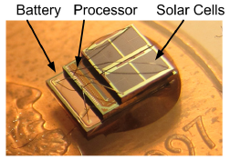
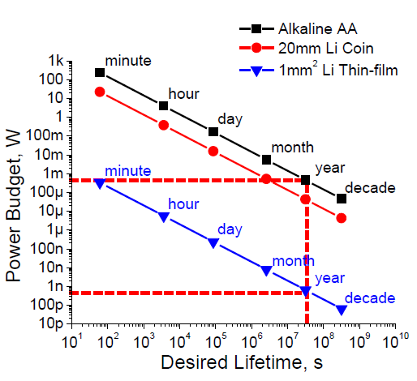
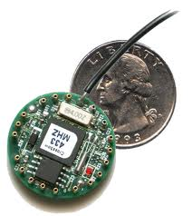
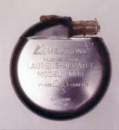
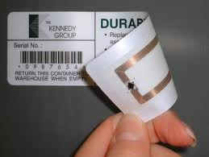
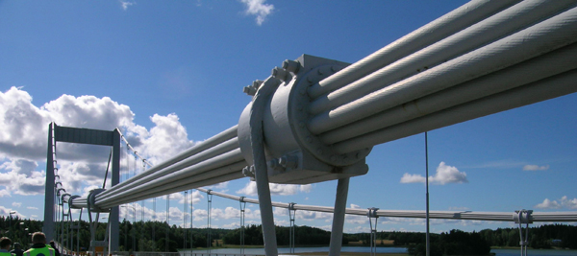
Energy Constrained Systems
Examples :
Micro-sensor networks,
Pacemakers, RFID tags,
Structure monitoring,
and Portable devices
Vdd=0.4V, Freq.=73kHz
28.9 pJ per instruction
G. Chen et al., ISSCC2010 [3]

Slide 7
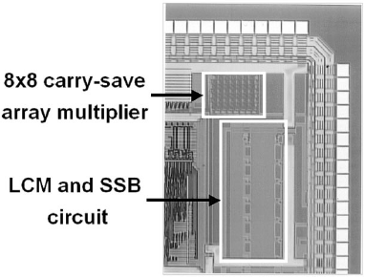
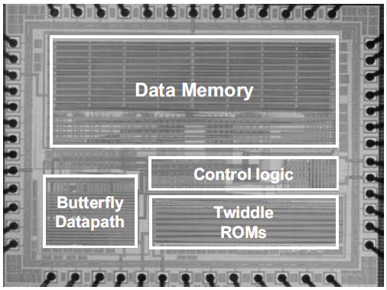
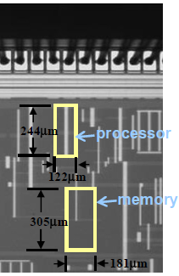
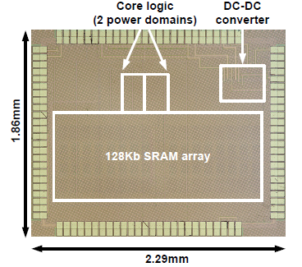
Subthreshold Circuit Design
DLMS Adaptive Filter
FFT Processor
Vdd < Vth
Emin
C. Kim et al., TVLSI2003 [4]
Vdd = 0.45V, Freq. = 22kHz
Emin = 2.80nJ (0.35um CMOS)
A. Wang et al., ISSCC2004 [5]
Vdd = 0.35V, Freq. = 9.6kHz
Emin = 155nJ (0.18um CMOS)
Low
to Medium
Speed
Sensor Processor
Microcontroller
with SRAM and DC to DC
J. Kwong et al., ISSCC2008 [7]
Vdd = 0.5V, Freq. = 434kHz
Emin = 27.3pJ (65nm CMOS)
B. Zhai et al., SVLSI2006 [6]
Vdd = 0.36V, Freq. = 833kHz
Emin = 2.6pJ (0.13um CMOS)
7
Notes:
7

Slide 8
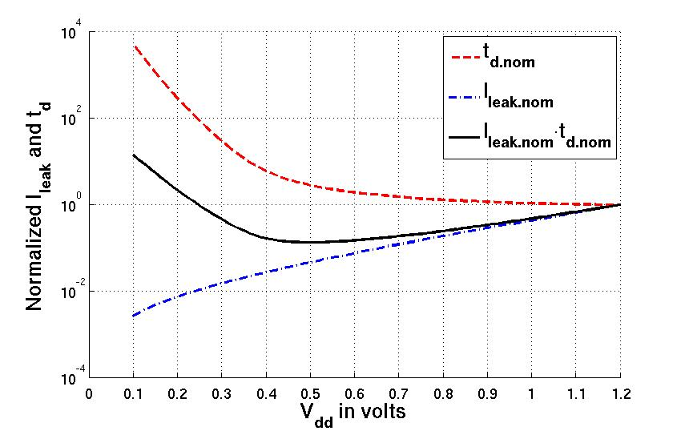
Subthreshold Inverter Properties
Subthreshold Current (Isub) and Delay (td)
$I_{sub}$ =$I_{o}∙e^{\frac{V_{gs}−V_{th}+ηV_{ds}}{mV_{T}}}∙(1−e^{\frac{−V_{ds}}{V_{T}}}$)
$t_{d}$ = $\frac{KC_{L}V_{dd}}{I_{sub}}\text{=}\frac{KC_{L}V_{dd}}{I_{o}∙e^{\frac{{\left(η+1\right)V_{dd}−V}_{th}}{mV_{T}}}}$
Inverter (PTM 90nm CMOS)
Eleak increase
8

Slide 9
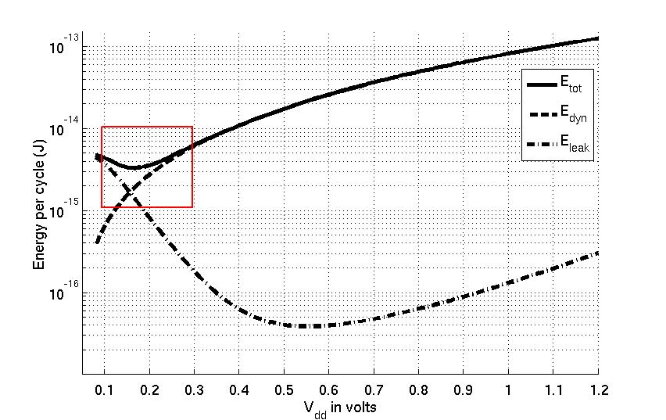
Subthreshold 8-Bit Ripple Carry Adder
SPICE Result: Minimum Energy per cycle (Emin )
Emin normally occurs in subthreshold region ( Vdd < Vth ).
Actual energy can be higher to meet performance requirement.
8-bit Ripple Carry Adder (PTM 90nm CMOS) with α=0.21
Vdd,opt = 0.17 V
Etot,min = 3.29 fJ (1.89 MHz)
$$E_{dyn}=\text{α}C_{L}V_{dd}^{2}$$
$$E_{leak}=I_{leak}V_{dd}T_{c}^{}$$
9

Slide 10
Outline
Motivation
Problem Statement
Ultra-Low Power Design
Contributions of This Work
MILP I for Minimum Energy Design Using Dual-Vdd without LC
Conclusion

Slide 11
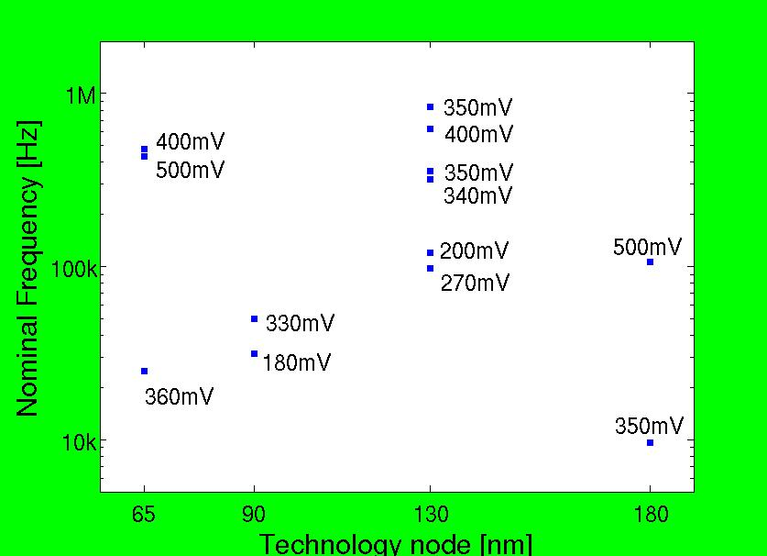
Previous Work
Published subthreshold or near-threshold VLSI design and operating voltage for minimum energy per cycle [8]
All work assumes scaling of a single Vdd

Slide 12
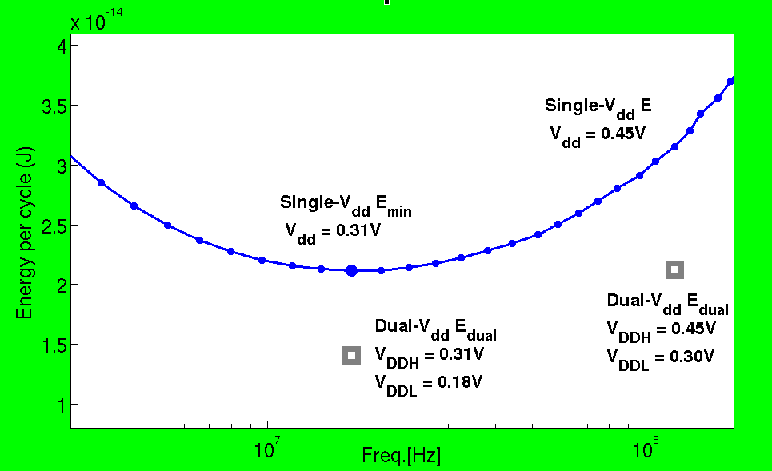
32-bit Ripple Carry Adder (α=0.21)
0.67X
7.17X
SPICE Simulation of PTM 90nm CMOS

Slide 13
Low Power Design Using Dual-V_{dd}
CVS Structure [9]
MILP I
FF
FF/
LCFF
LC(Level Converter)
ECVS Structure [10]
MILP II
FF
FF/
LCFF
VDDH
VDDL

Slide 14
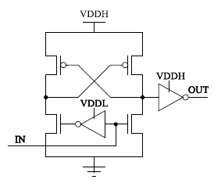
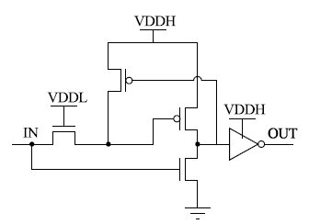
Level Converter Delay Overhead
DCVS Level Converter
PG Level Converter
Optimized Delay by Sizing with HSPICE for PTM 90nm CMOS
ALCs | V_{DDH} = 300mV V_{DDL} = 230mV | Norm to INV(FO4) V_{dd} = 300mV
DCVS | 79.1ns | 60.4
PG | 37.6ns | 28.7
LC Delay Overhead at Nominal Voltage Operation is 3~4X INV(FO4) Delay

Slide 15
MILP I (without LC)
Objective Function
$$Minimize \sum_{i∈all gates }{\left(E_{tot,V_{DDL},i}∙X_{i}+E_{tot,V_{DDH},i}∙{(1−X}_{i})\right)}$$
$$E_{tot}=α_{i}{∙C}_{L,i}∙V_{dd,i}^{2}+P_{leak,V_{dd},i}∙T_{c}$$
Performance requirement TC (VDDH) is given.
Integer variable Xi : 0 for a VDDH cell or 1 for a VDDL cell.

Slide 16
MILP I (without LC)
Subject to Timing Constraints:
$T_{i}≤T_{c} ∀i ∈ \text{all} \text{PO} \text{gates}$
Ti is the latest arrival time at the output of gate i from PI events
$$T_{2}≥T_{1}+t_{d,VDDL}∙X_{2}+t_{d,VDDH}∙(1−X_{2})$$
1
2
3
4

Slide 17
MILP I (without LC)
Subject to Topological Constraints:
$X_{i}−X_{j}≥0 ∀j ∈ \text{all} \text{fanin} \text{gates} \text{of} \text{gate} \text{i}$
Xj
=0
=1
j
HH: Xi – Xj = 0
Xi
=1
=0
LL: Xi – Xj = 0
VDDH
VDDL
i
HL: Xi – Xj = 1
VDDL
VDDH
k
LH: Xi – Xj = -1

Slide 18
Outline
Motivation
Problem Statement
Ultra-Low Power Design
Contributions of This Work
MILP I for Minimum Energy Design Using Dual-Vdd without LC
MILP II for Minimum Energy Design with Dual-Vdd and Multiple Logic-Level Gates
Conclusion

Slide 19
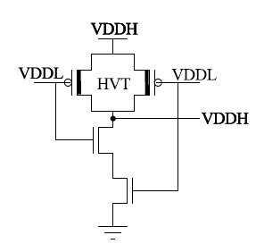
Multiple Logic-Level Gates (Delay)
Multiple Logic-Level Gates V_{VDDH} = 300mV V_{VDDL} = 230mV | Norm to INV(FO4) V_{dd} = 300mV
INV | 1.3
NAND2 | 2.3
NAND3 | 3.1
NOR2 | 3.9
DCVS | 60.4
PG | 28.7
Multiple Logic-Level NAND2 [11]
SPICE Simulation for PTM 90nm CMOS
At Nominal Vdd = 1.2V,
Vth,PMOS = -0.21V, Vth,NMOS = 0.29V
Vth,PMOS-HVT = -0.29V

Slide 20
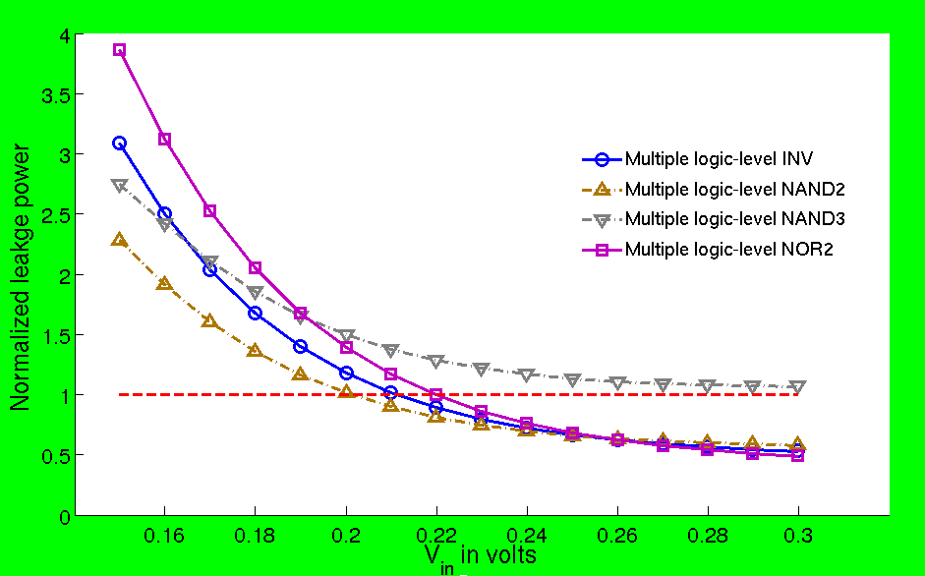
Multiple Logic-Level Gates (Pleak)
SPICE Simulation for PTM 90nm CMOS
Vdd = 300mV
Normalized to a Standard INV with Vdd = 300mV

Slide 21
MILP II (Multiple Logic-Level Gates)
Objective Function
Total Energy per cycle
$$Minimize\sum_{i}{\left[ \sum_{v∈V}{\left(α_{i}{∙C}_{i,v}∙V_{dd,v}^{2}+P_{leak,i,v}∙T_{c}\right)}∙X_{i,v}+\sum_{v∈V_{L}}{P_{leako,i,v}∙T_{c}∙}P_{i,v} \right]}, ∀i ∈all gates$$
$$V_{min}≤V≤V_{VDDH}, V_{low} ≤V_{L}≤V_{DDH}$$
Leakage Energy Penalty
from Multiple Logic-Level Gates
Integer variable Xi,v and Pi,v

Slide 22
MILP II (Multiple Logic-Level Gates)
Timing Constraints:
Delay Penalty from Multiple Logic-Level Gates
$$T_{i} ≥T_{j}+\sum_{v∈V}{{td}_{i,v}}∙X_{i,v}+\sum_{v∈V_{L}}{{tdo}_{i,v}}∙P_{i,v}$$
$∀i ∈all gates, ∀j∈fanin gates of gate i$
$T_{i}≤T_{c}$ $∀i∈all PO gates$

Slide 23
MILP II (Multiple Logic-Level Gates)
Penalty Constraints:
$$F_{i,v}+X_{i,VDDH}≥2∙P_{i,v} ∀i ∈all gates$$
$F_{i,v}+X_{i,VDDH}≤2∙P_{i,v}+1$ $∀v∈ V_{L}$
Boolean AND
$$\sum_{j}{X_{j,v}}≤N_{i}∙F_{i,v} ∀j ∈fanin gates of gate i$$
$$\sum_{j}{X_{j,v}}≥N_{i}∙F_{i,v}−\left(N_{i}−1\right) ∀i ∈all gates , ∀v∈V_{L}$$
Boolean OR
$$\sum_{v∈V}{V_{dd,v}}∙X_{i,v}≤\sum_{v∈V}{V_{dd,v}}∙X_{j,v}+\sum_{v∈V_{L}}{V_{nom}}∙P_{i,v}$$
$∀j ∈fanin gates of gate i$

Slide 24
MILP II (Multiple Logic-Level Gates)
Dual Supply Voltages Selection:
$$\sum_{v∈V}{V_{v}}=2 V_{DDH}=1$$
$$\sum_{v∈V}{X_{i,v}}=1 ∀i ∈all gates , ∀v∈V_{L}$$
$$\sum_{i}{X_{i,v}}≤G_{tot}∙V_{v}$$
Bin-Packing

Slide 25
ISCAS’85 Benchmarks
 |  |  | Single-V_{dd} Design |  |  | Dual-V_{dd} Design
 |  |  |  |  |  | MILP I |  |  | MILP II
Bench mark | Total gate | Activity α | V_{DDH} (V) | E_{sing.} (fJ) | Freq. (MHz) | V_{DDL} (V) | V_{DDL} gates (%) | E_{dual} (fJ) | V_{DDL} (V) | V_{DDL} gates (%) | Multiple logic-level gates(#) | E_{dual} (fJ)
C432 | 154 | 0.19 | 0.25 | 7.9 | 14.4 | 0.23 | 5.2 | 7.8 | 0.23 | 5.2 | 0 | 7.8
C499 | 493 | 0.21 | 0.22 | 20.2 | 11.9 | 0.18 | 9.7 | 19.8 | 0.18 | 9.7 | 0 | 19.8
C880 | 360 | 0.18 | 0.24 | 14.4 | 13.6 | 0.18 | 46.4 | 11.2 | 0.19 | 56.7 | 23 | 10.9
C1355 | 469 | 0.21 | 0.21 | 19.5 | 9.8 | 0.18 | 10.2 | 19.0 | 0.18 | 10.2 | 0 | 19.0
C1908 | 584 | 0.20 | 0.24 | 26.5 | 11.8 | 0.21 | 24.3 | 25.0 | 0.21 | 27.6 | 71 | 23.2
C2670 | 901 | 0.16 | 0.25 | 32.8 | 17.4 | 0.21 | 46.4 | 28.0 | 0.19 | 40.2 | 41 | 26.9
C3540 | 1270 | 0.33 | 0.23 | 88.0 | 7.2 | 0.14 | 7.0 | 84.6 | 0.16 | 40.8 | 69 | 70.8
C5315 | 2077 | 0.26 | 0.24 | 116.8 | 9.8 | 0.19 | 47.1 | 98.0 | 0.19 | 60.5 | 62 | 92.2
C6288 | 2407 | 0.28 | 0.29 | 165.4 | 9.4 | 0.18 | 2.7 | 162.0 | 0.19 | 4.7 | 20 | 159.1
C7552 | 2823 | 0.20 | 0.25 | 131.7 | 13.6 | 0.21 | 42.3 | 117.1 | 0.21 | 51.6 | 201 | 112.1
SPICE Simulation of PTM 90nm CMOS

Slide 26
Total Energy Saving (%)

Slide 27
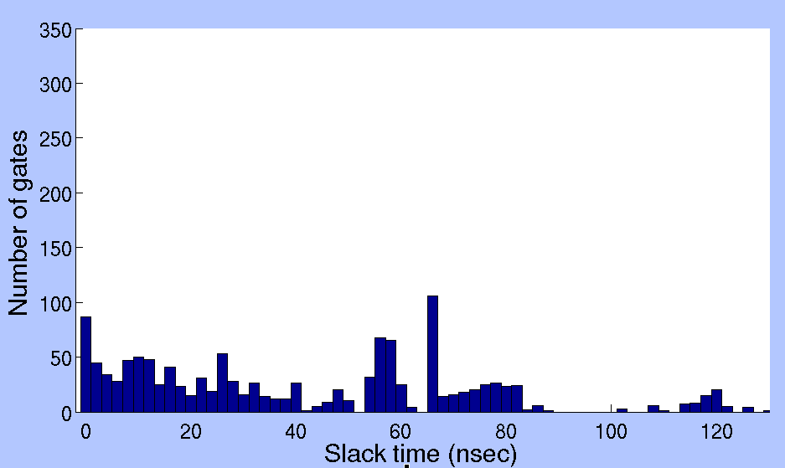
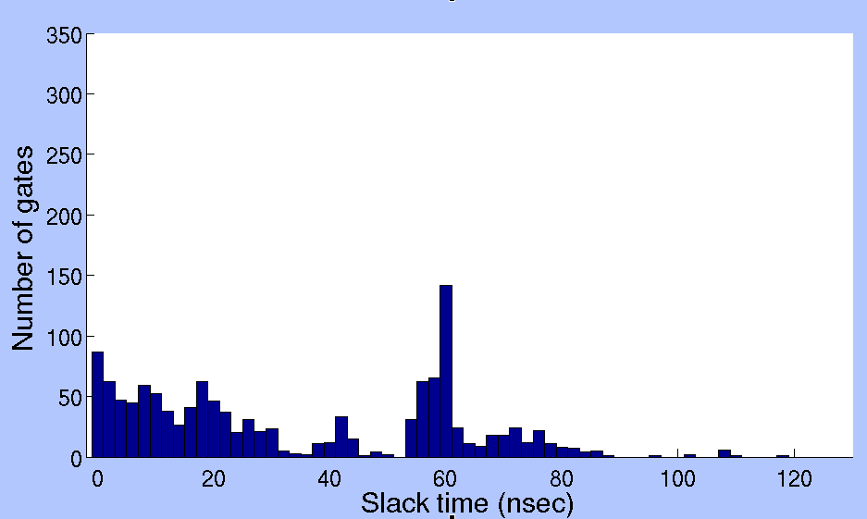
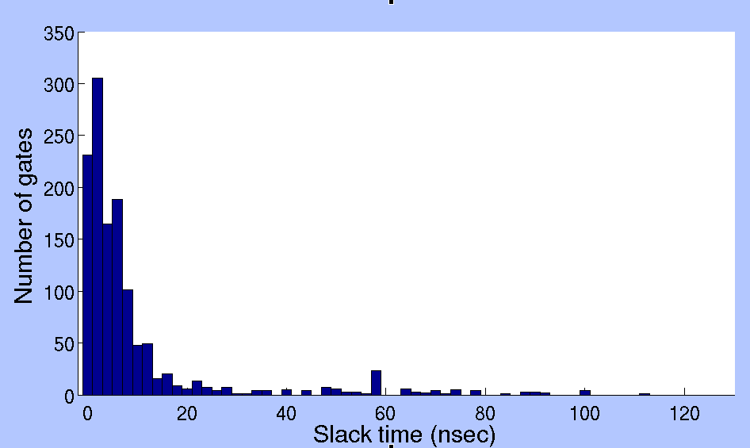
Gate Slack Distribution (C3540)
Single Vdd
MILP I
MILP II

Slide 28
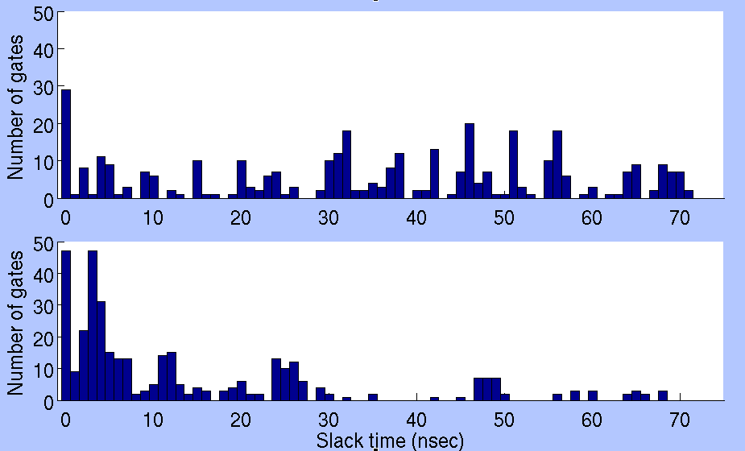
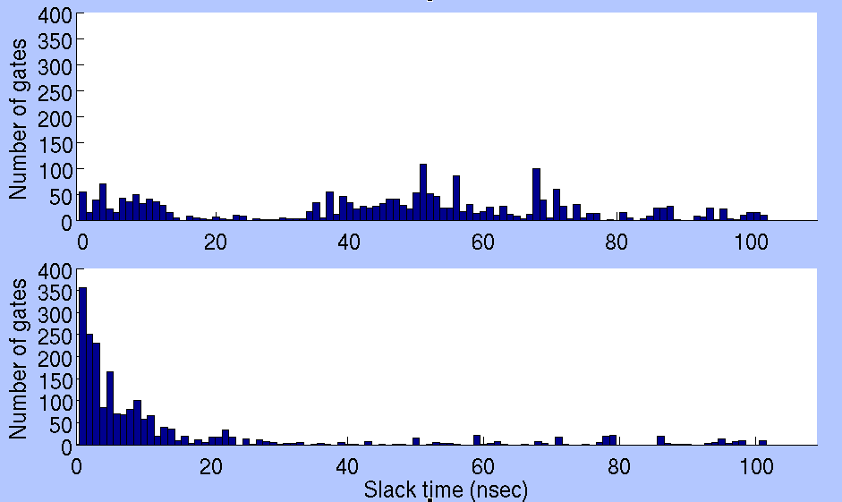
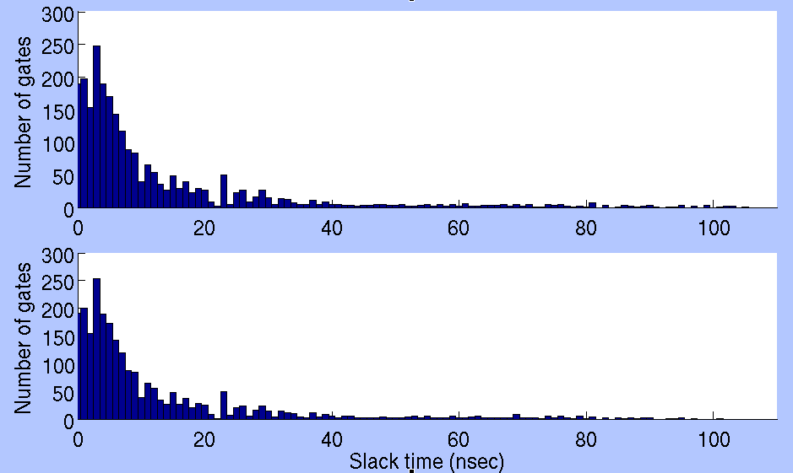
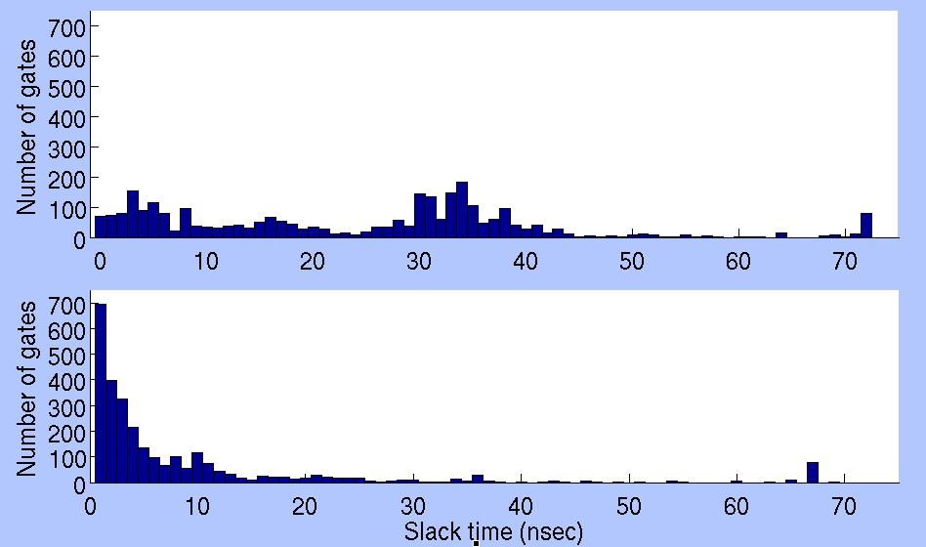
Gate Slack Distribution (MILP II)
c880
c5315
Dual-Vdd Esave= 24.5%
Dual-Vdd Esave= 21.1%
c6288
c7552
Dual-Vdd Esave= 3.8%
Dual-Vdd Esave= 14.9%

Slide 29
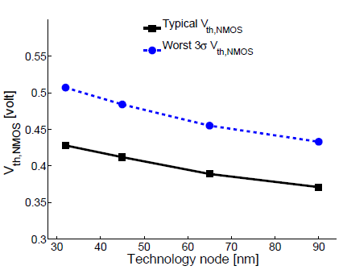
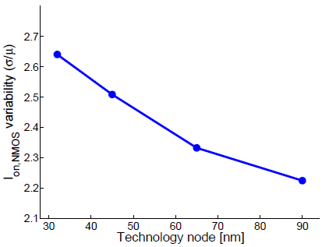
Process Variation (PTM CMOS Tech.)
Global Variation: $σ_{V_{th}}= \text{5\% }\text{relative} \text{to} \text{vth}\text{0}$
Local Variation (RDF): $σ_{V_{th}}=3.19×{10}^{−8}∙\frac{T_{ox}∙N_{ch}^{0.4}}{\sqrt{W_{eff}∙L_{eff}}}$
Vth,NMOS Variation
Isub,NMOS Variability
SPICE Simulation of a 1k-point Monte Carlo at Vdd = 300mV

Slide 30
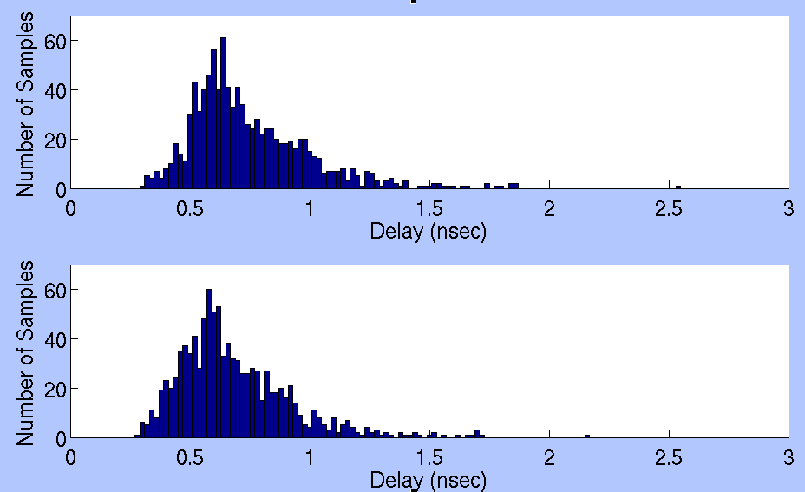
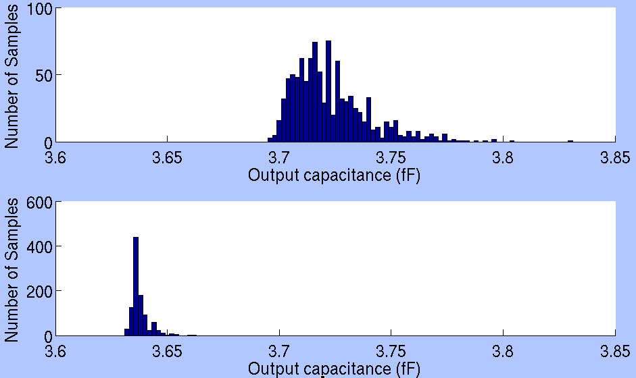
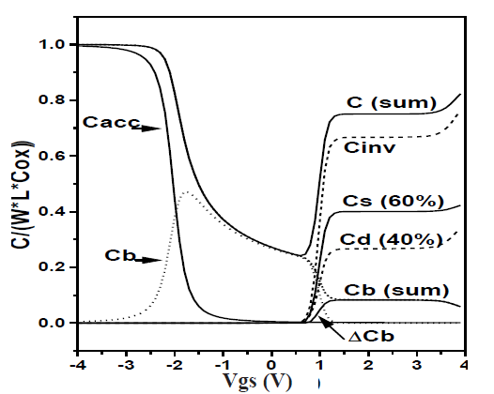
Process Variation Tolerance in Dual-Vdd
INV(FO4) Delay
INV(FO4) Cload
300mV
300mV
180mV
180mV
BSIM4
When driving INV operates at VDDH=300mV,
the operating voltage of fanout INVs is:
VDDH = 300mV → td,worst 3σ = 1.51ns
VDDL = 180mV → td,worst 3σ = 1.39ns (8% Reduction)
SPICE Simulation of a 1k-point Monte Carlo at VDDH = 300mV and VDDL=180mV in PTM 90nm CMOS

Slide 31
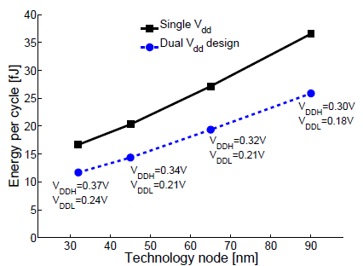
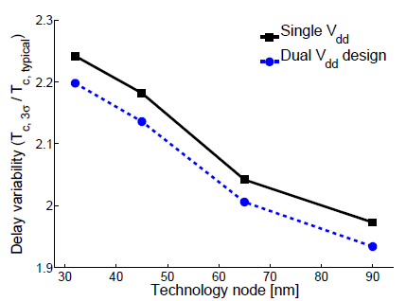
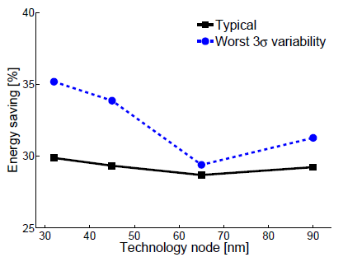
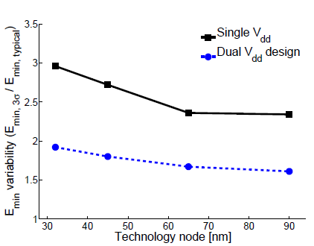
Process Variation (32-bit RCA)
Emin w/o Process Variation
Delay Variability
Energy Saving
Emin Variability
SPICE Simulation of a 1k-point Monte Carlo

Slide 32
Outline
Motivation
Problem Statement
Ultra-Low Power Design
Contributions of This Work
MILP I for Minimum Energy Design Using Dual-Vdd without LC
MILP II for Minimum Energy Design with Dual-Vdd and Multiple Logic-Level Gates
Linear-Time Algorithm for Dual-Vdd Using Gate Slack
Conclusion

Slide 33
Gate Slack
TPI (i)
TPO (i)
gate i
TPI (i): longest time for an event to arrive at gate i from PI
TPO (i): longest time for an event from gate i to reach PO
Delay of the longest path through gate i : Dp,i = TPI(i) + TPO(i)
Slack time for gate i: Si = Tc – Dp,i
where Tc = Maxi { Dp,i } for all i

Slide 34
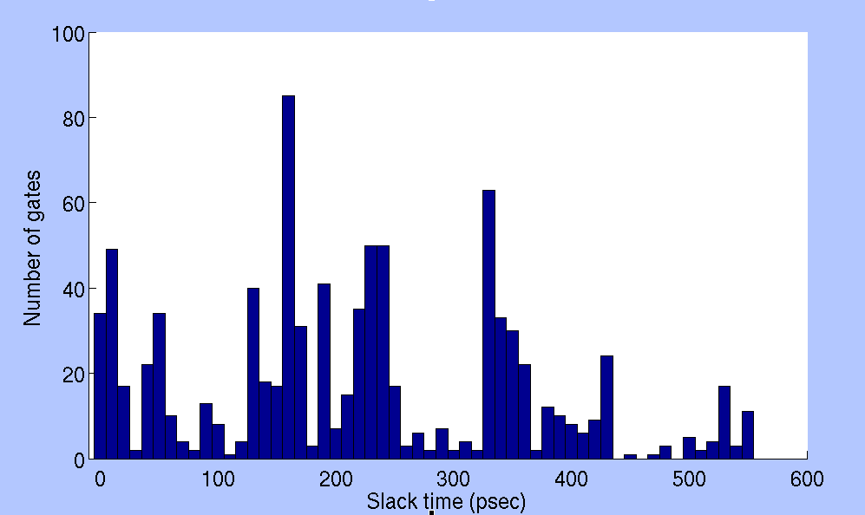
Gate Slack Distribution (C2670)
Total number of gates = 901
Nominal Vdd = 1.2V for PTM 90nm CMOS
Critical path delay Tc = 564.2 ps

Slide 35
Upper Slack (Su) and Lower Slack (Sl)
Su is minimum slack of a gate such that it can tolerate VDDL assignment:
S’i = Tc – βDp,i = Tc – β(Tc – Su) ≥ 0
Su = $\frac{β−1}{β}∙$Tc where β = $\frac{\text{D}\text{’}\text{p}\text{,}\text{i}}{\text{D}\text{p}\text{,}\text{i}}$ ≈ $\frac{\text{T}\text{’}\text{c}}{\text{T}\text{c} }≥1$
Sl is maximum slack for which gate can not have VDDL:
Sl = Mini [ (β – 1)td,i ] for all i where β = $\frac{t_{d,i}^{′}}{t_{d,i}}≈\frac{D_{p,i}^{′}}{D_{p,i}}≥1$

Slide 36
Classification for Positive Slack (C2670)
VDDH Gates
VDDH = 1.2V
Possible
VDDL Gates
VDDL Gates
VDDL= 0.69V
Sl = 7ps
Su = 239ps

Slide 37
Selected ISCAS’85
Circuit | Single |  | MILP I |  |  |  | Slack-time Algorithm
 | V_{DDH} (V) | E_{sing.} (fJ) | V_{DDL} (V) | V_{DDL} gates (%) | E_{dual} reduc. (%) | CPU time (s)** | V_{DDL} (V) | V_{DDL} gates (%) | E_{dual} reduc. (%) | CPU time (s)**
C432 | 1.2 | 160.1 | 0.75 | 5.2 | 3.9 | 0.6 | 0.75 | 5.2 | 3.9 | 15.8
C499 | 1.2 | 460.6 | 0.79 | 19.5 | 5.9 | 403.8 | 0.79 | 19.5 | 5.9 | 194.4
C880 | 1.2 | 277.6 | 0.59 | 56.9 | 51.0 | 455.0 | 0.60 | 57.5 | 50.8 | 62.1
C1355 | 1.2 | 453.0 | 0.69 | 13.6 | 4.3 | 340.2 | 0.69 | 13.6 | 4.3 | 132.0
C1908 | 1.2 | 496.5 | 0.67 | 26.9 | 19.0 | 2146.9 | 0.67 | 26.9 | 19.0 | 247.8
C2670 | 1.2 | 647.6 | 0.69 | 57.9 | 47.8 | 20848.9 | 0.69 | 57.9 | 47.8 | 480.7
C3540 | 1.2 | 1844.0 | 0.70 | 11.6 | 9.6 | 601.0 | 0.70 | 11.6 | 9.6 | 1243.5
C6288 | 1.2 | 3066.0 | 1.18 | 53.1 | 2.9 | 10523.7 | 0.47 | 2.9 | 2.6 | 6128.0
** Intel Core 2 Duo 3.06GHz, 4GB RAM

Slide 38
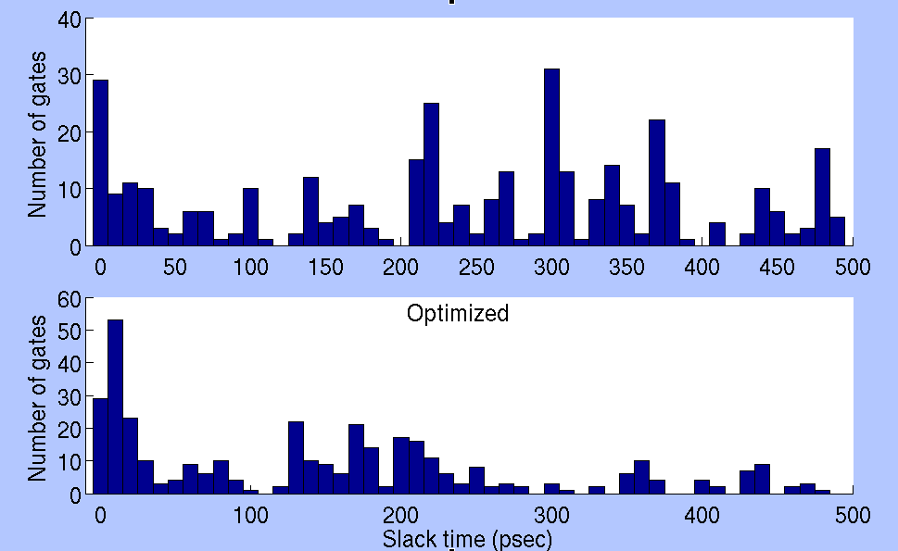
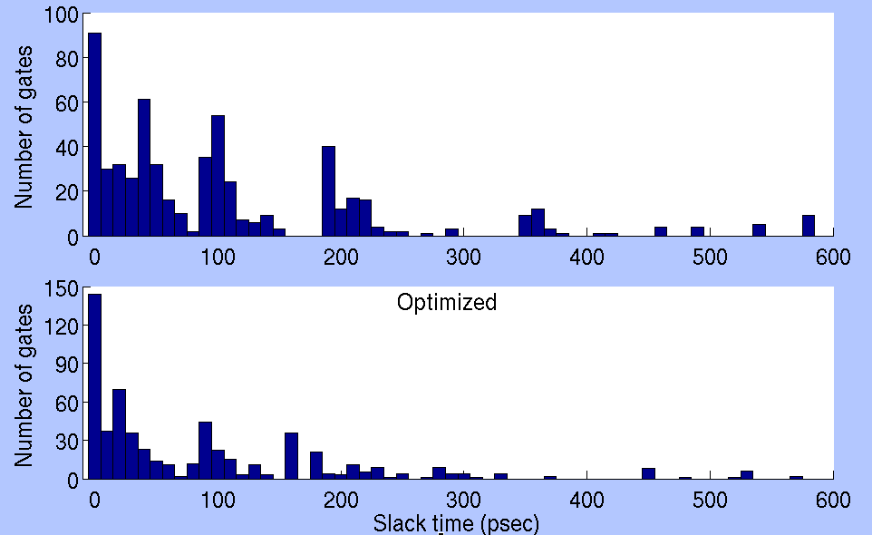
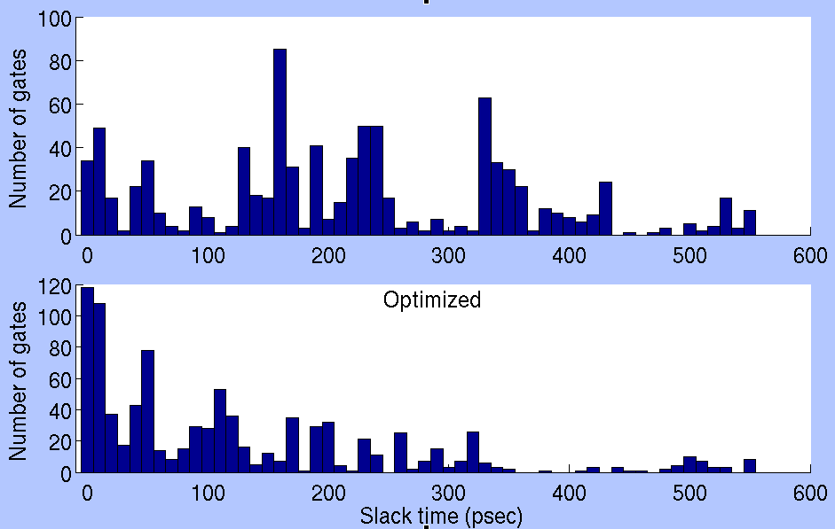
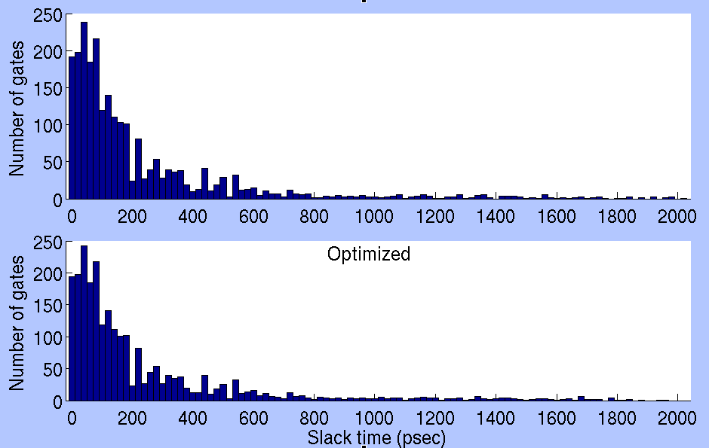
Gate Slack Distribution
C880
C1908
Dual-Vdd Esave= 50.8%
Dual-Vdd Esave= 19%
C2670
C6288
Dual-Vdd Esave= 47.8%
Dual-Vdd Esave= 2.6%

Slide 39
Outline
Motivation
Problem Statement
Ultra-Low Power Design
Contributions of This Work
MILP I for Minimum Energy Design Using Dual-Vdd without LC
MILP II for Minimum Energy Design with Dual-Vdd and Multiple Logic-Level Gates
Linear-Time Algorithm for Dual-Vdd Using Gate Slack
Conclusion

Slide 40
Conclusion
Dual Vdd design is valid for energy reduction below the minimum energy point in a single Vdd as well as for substantial speed-up within tight energy budget of a bulk CMOS subthreshold circuit.
Conventional level converters are not usable due to huge delay penalty in subthreshold regime.
MILP I finds the optimal Vdd and its assignment for minimum energy design without using LC.
MILP II improves the energy saving using multiple logic-level gates to eliminate topological constraints for dual-Vdd design.
Proposed algorithm for dual-Vdd using linear-time gate slack analysis can reduce the time complexity, ~O(n), for n gates in the circuit.
Runtime of MILP is too expensive and heuristic algorithms still have polynomial time complexity O(n²).
Gate slack analysis unconditionally classifies all gates into VDDL, possible VDDL, and VDDH gates.
The methodology of slack classification can be applied to other power optimization disciplines, such as dual-Vth.

Slide 41
List of Publications
K. Kim and V. D. Agrawal, “Minimum Energy CMOS Design with Dual Subthreshold Supply and Multiple Logic-Level Gates”, in IEEE Journal on Emerging and Selected Topics in Circuits and Systems (Submitted)
K. Kim and V. D. Agrawal, “Minimum Energy CMOS Design with Dual Subthreshold Supply and Multiple Logic-Level Gates”, in Proc. 12th International Symposium on Quality Electronic Design, Mar. 2011, pp. 689-694.
K. Kim and V. D. Agrawal, “Dual Voltage Design for Minimum Energy Using Gate Slack”, in Proc. IEEE International Conference on Industrial Technology, Mar. 2011, pp. 405-410.
K. Kim and V. D. Agrawal, “True Minimum Energy Design Using Dual Below -Threshold Supply Voltages”, in Proceedings of 24th International Conference on VLSI Design, Jan. 2011, paper C2-3. (Selected for a special issue of JOLPE).

Slide 42
References
[1] A.Wang, B. H. Calhoun, and A. P. Chandrakasan, Sub-Threshold Design for Ultra Low-Power Systems. Springer, 2006.
[2] D. Bol, D. Flandre, and J.-D. Legat, “Technology Flavor Selection and Adaptive Techniques for Timing-Constrained 45nm Subthreshold Circuits,” in Proceedings of the 14th ACM/IEEE International Symposium on Low Power Electronics and Design, 2009, pp. 21–26.
[3] G. Chen et al, “Millimeter-Scale Nearly Perpetual Sensor System with Stacked Battery and Solar Cells,” in Proc. ISSCC 2010, pp. 288–289.
[4] Kim, C.H.-I, Soeleman, H. and Roy, K., "Ultra-low-power DLMS adaptive filter for hearing aid applications," IEEE Transactions on Very Large Scale Integration (VLSI) Systems , vol.11, no.6, pp. 1058- 1067, Dec. 2003. [5] A. Wang and A. Chandrakasan, “A 180mV FFT Processor Using Subthreshold Circuit Techniques,” in IEEE International Solid-State Circuits Conference Digest of Technical Papers, 2004, pp. 292–529.
[6] B. Zhai, et al, “A 2.60pJ/Inst Subthreshold Sensor Processor for Optimal Energy Efficiency”, Proc. Symposium on VLSI circuits, 2006
[7] J. Kwong, et al, “A 65nm Sub-Vt Microcontroller with Integrated SRAM and Switched-Capacitor DC-DC Converter”, Proc. ISSCC, 2008
[8] M. Seok, D. Sylvester, and D. Blaauw, “Optimal Technology Selection for Minimizing Energy and Variability in Low Voltage Applications,” in Proc. of International Symp. Low Power Electronics and Design, 2008, pp. 9–14.
[9] K. Usami and M. Horowitz, “Clustered Voltage Scaling Technique for Low-Power Design,” in Proc. International Symposium on Low Power Design, 1995, pp. 3–8.
[10] K. Usami, M. Igarashi, F. Minami, T. Ishikawa, M. Kanzawa,M. Ichida, and K. Nogami, “Automated Low-Power Technique Exploiting Multiple Supply Voltages Applied to a Media Processor,” IEEE Journal of Solid-State Circuits, vol. 33, no. 3, pp. 463-472, 1998.
[11] A. U. Diril, Y. S. Dhillon, A. Chatterjee, and A. D. Singh, “Level-Shifter Free Design of Low Power Dual Supply Voltage CMOS Circuits Using Dual Threshold Voltages,” IEEE Trans. on VLSI Systems, vol. 13, no. 9, pp. 1103–1107, Sept. 2005.

Slide 43
Thank you!!
&
Questions?

