Slide 1
Security Design for IEEE P1687
Hejia Liu
Major Professor: Vishwani D. Agrawal

Slide 2
Introduction
Part 1: Introduction of IEEE P1687 (IJTAG)
security risks in P1687
Part 2: Security design and expected unlocking time
Part 3: Discussion of a proposal and improvement in security

Slide 3
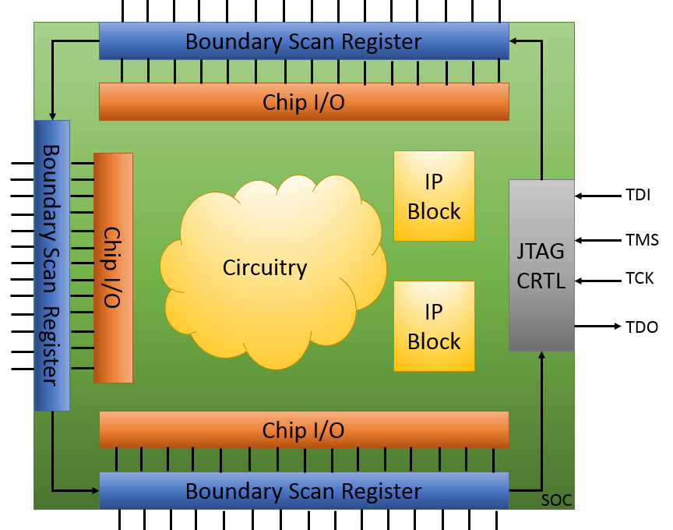
IEEE 1149.1 (JTAG) Interface

Slide 4
What is P1687/ IJTAG?
IEEE P1687 is a valuable tool for accessing on-chip instruments during test, diagnosis, debug and board configurations.
P1687 is a proposed IEEE Standard that has 3 components
A flexible set of serial scan chain techniques for the instrument access architecture (called the network)
A network description language (called instrument connectivity language, ICL)
An instrument vector language (called procedure description language, PDL)
Notes:
IEEE P1687 is a valuable tool for accessing on-chip instruments during test, diagnosis, debug and board configurations.

Slide 5
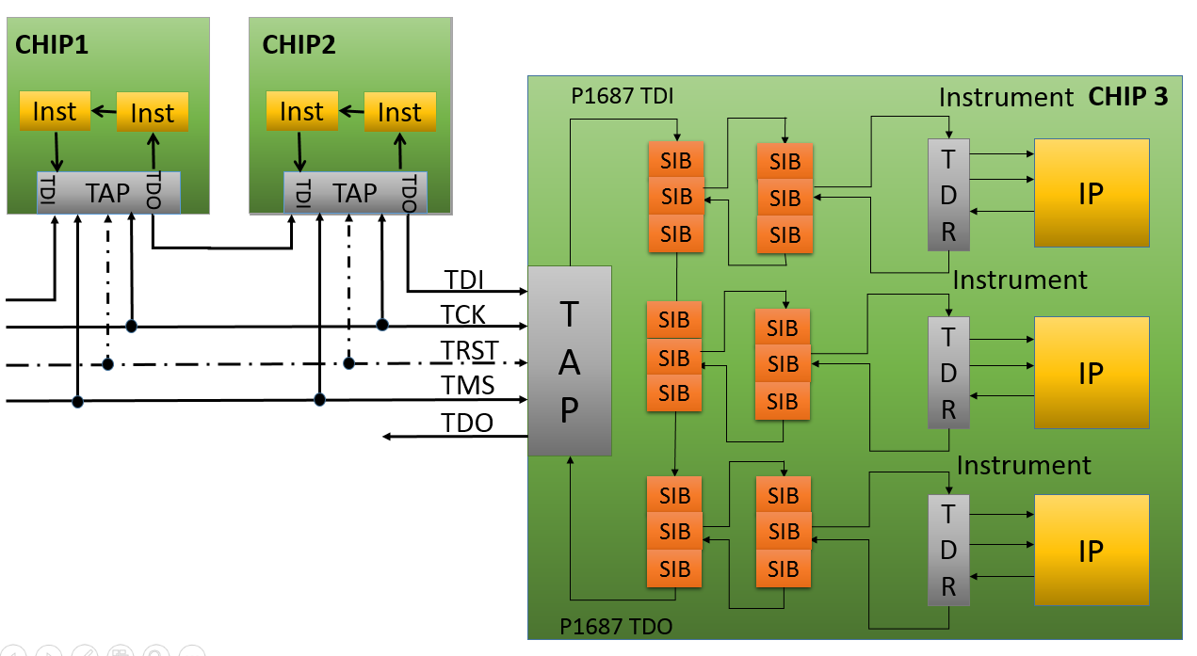
Communication between Chips
An example of communication P1687 network between 3 chips

Slide 6
Instruments, IPs
An IP (Intellectual property core) with a P1687 compliant interface is named instrument.
IPs: Analog, digital or mixed signal circuitry performing particular functions, such as a clock a generator, an interface to an external measurement probe, a radio tuner, an analog signal converter, a digital signal processor, etc.

Slide 7
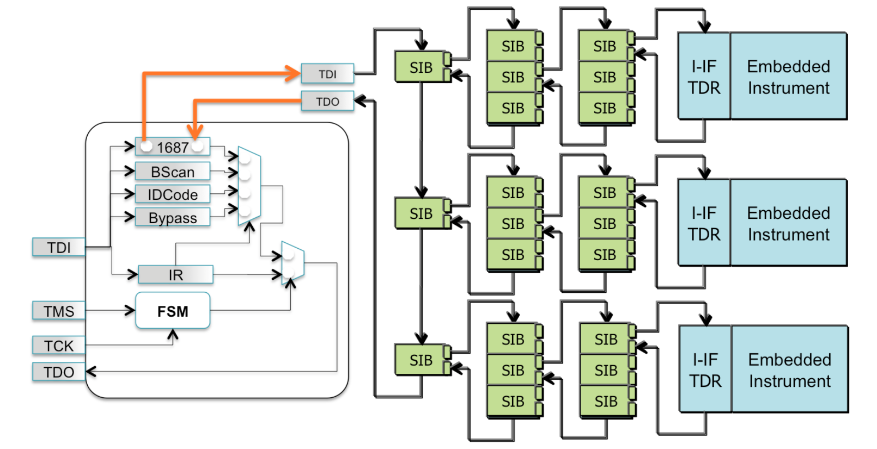
P1687 Network
Rst
Optional
Notes:
TAP controller : All transitions between states are determined by TMS
Decoder: EXTEST, SAMPLE/PRELOAD, IDCODE, BYPASS
SIB can provide 2 accessing path. When a SIB is open, it will include the segments in the next level to the scan path. SIB is closed, exclude the next level path to scan path.

Slide 8
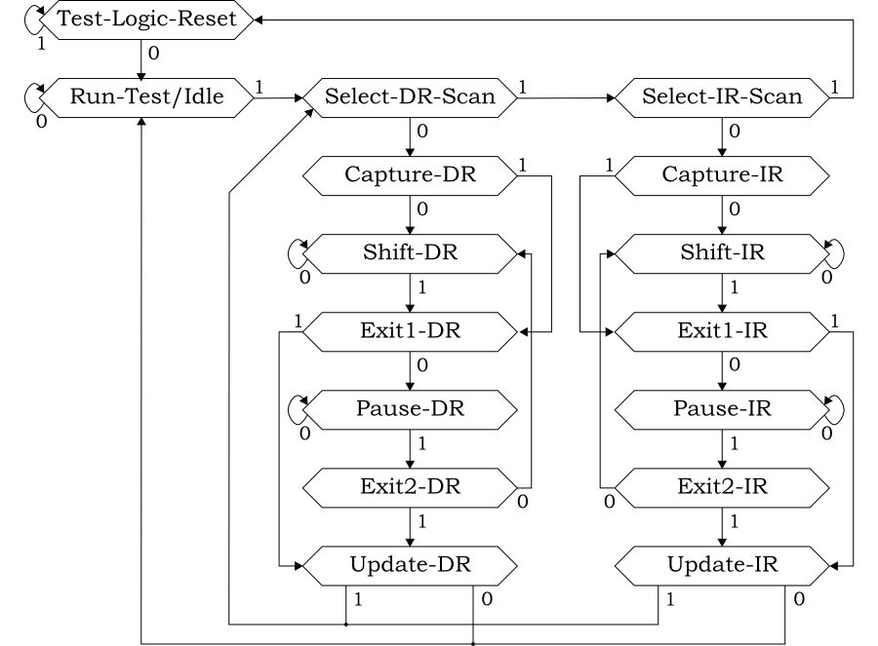
FSM of TAP Controller
Notes:
FSM: only the shaded states affect the ASIC core logic, the other states are intermediate steps
The pause states let the controller jog in place while the tester reloads its memory with a new set of test vectors

Slide 9
Security Risks
Depending on the application, data may be stored on-chip, including chip ID, codes, and encryption keys.
An attacker can access a targeted instrument and obtain the secret data easily.
Notes:
Open every SIBs in the network will let the attacker access targeted instrument.

Slide 10
A Possible Break-in Procedure
Step 1: Load Instruction code in TAP
Step 2: Shift in an attempt vector
Step 3: Clock the TAP controller
Step 4: If attempt successful, access instrument
Step 5: Else, repeat from step 2

Slide 11
Security Levels
Insecurity: Break-in time at the level of days
Weak security: Break-in time at the level of years
Strong security: Break-in time at the level of ten years
Full Security: Break-in time in the level of thousand years
Notes:
The security design doesn’t need to be a silver bullet solution for protecting something absolutely critical. We aim to make the attacker pay more efforts when we increase the security level of structure.

Slide 12
Structure of SIB (Segment Insertion Bit)
Select=1 ShiftEn=1
To_TDI2
To_TDO1
0
1
0
1
TDI
0
1
Update cell
1
Select
From_TDO2
Shift cell
ShiftEn
Select
TCK
UpdateEn
Notes:
There are 2 flip flops in 1 SIB.
The label with No.1 is belonging to the current level
The label with No. 2 is for the next level
TDI is always as an input
In this image, SIB includes the input from next level

Slide 13
Structure of SIB (Segment Insertion Bit)
Select=0 ShiftEn=1
To_TDO1
To_TDI2
0
1
0
1
TDI
0
1
Update cell
0
Shift cell
Select
From_TDO2
ShiftEn
Select
TCK
updateEn
Notes:
There are 2 flip flops in 1 SIB.
The label with No.1 is belonging to the current level
The label with No. 2 is for the next level
TDI is always as an input
In this image, SIB excludes the input from next level
SIB IS CLOSE.

Slide 14
The Structure of SIB (Segment Insertion Bit)
ShiftEn=0 UpdateEn=1
To_TDI2
To_TDO1
0
1
0
1
TDI
0
1
Shift cell
1
Update cell
1
Select
From_TDO2
ShiftEn
Select
TCK
UpdateEn
Notes:
How to Change the value in UPDATE cell
Clock TAP FSM in UPDAREdr UPDATE en=1
Then the value will be delivered from the shiftCELL
1 shift in value in shift cell
2 clock TAP to updatecDR state and deliver the value from shift cell to update cell

Slide 15
Locking-SIB With Trap
Dworak, et al.. ,”Don’t forget to lock your SIB:Hiding instrument using P1687,” ITC 2013
To_TDI2
To_TDO1
0
1
0
1
TDI
0
1
RST
Shift cell
Update cell
From_TDO1
ShiftEn
Select
TCK
UpdateEn
Key[0]
Key[n]
Whether the key and trap feedback value is 1 or 0 is decided by structure
Trap feedback select signal
Select
Notes:
Select signal of mux in frond of UPDATE cell is repaced by the output of and gate
Locking part: The keys are from other cell in the scan chain.
Trap part: The current value of Update cell will also feed back to AND gate
Only KEYS and current value in update cell ARE CORRECT , the updateEN will be delivered to the multiplexer and active the path from Shift cell to update cell.

Slide 16
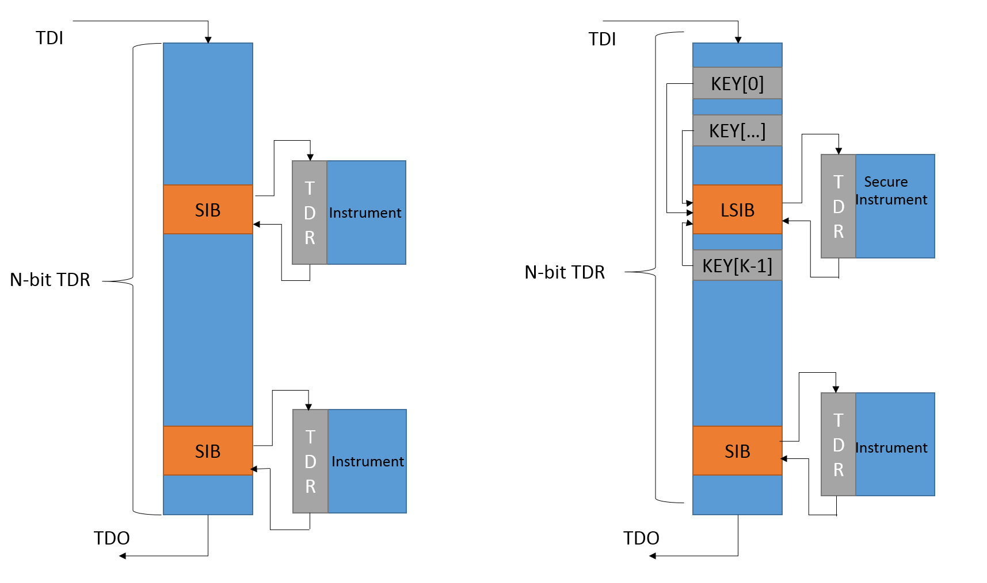
Unsecure and Secure P1687 Networks

Slide 17
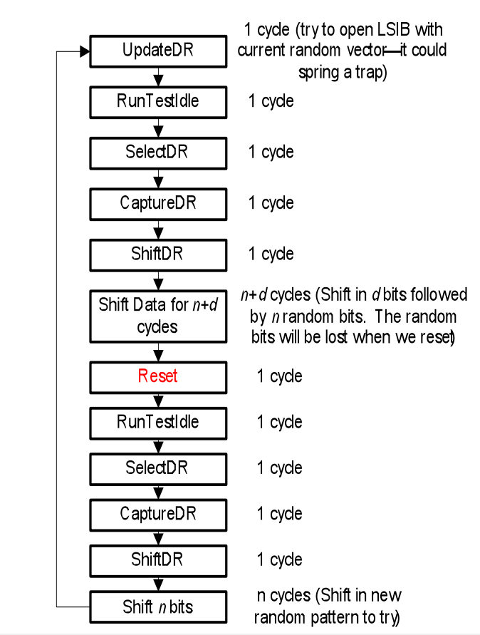
Break-in Procedure
Dworak, et al., “Don’t forget to lock your SIB: Hiding instrument using P1687,” ITC 2013
Cost(LSIB unlock attempt w/Trap)
$$=10+2n+d$$
Prob(opening SIB with key of k bits)
= $\frac{1}{2^{k+1}}$
Expected Cost(LSIB unlock w/Trap)
$=(10+2n+d$) $2^{k+1}$

Slide 18
Complex Structure Security Strategies
Break-in procedures:
Step 1: Break-in the first level
Step 2: Figure out the CARE BITs
a: Shift in attempt vectors
b: Clock TAP in UpdateDR
c: Test positive feedback
Step 3: Break-in the next level
Step 4: Repeat step 2 and step 3 until
the instrument is accessed

Slide 19
Expected Results (f = 100MHz)
Key length K | Chain Length N | Expected time to unlock LSIB with Trap
 |  | Days | Years
8 | 640 | 7.79E-07 | 2.13E-09
16 | 1280 | 3.94E-04 | 1.08E-06
32 | 2560 | 5.13E+01 | 1.41E-01
48 | 5120 | 6.69E+06 | 1.83E+04
64 | 10240 | 8.76E+11 | 2.40E+09
80 | 20480 | 1.15E+17 | 3.15E+14
96 | 40960 | 1.50E+22 | 4.11E+19

Slide 20
Features of Secure Structure
The order of magnitudes for break-in time: $\left(k+1\right)log⁡(\frac{2N}{f})$
An attacker uses the scan chain length as a feedback
What if we hide the length of the scan path?

Slide 21
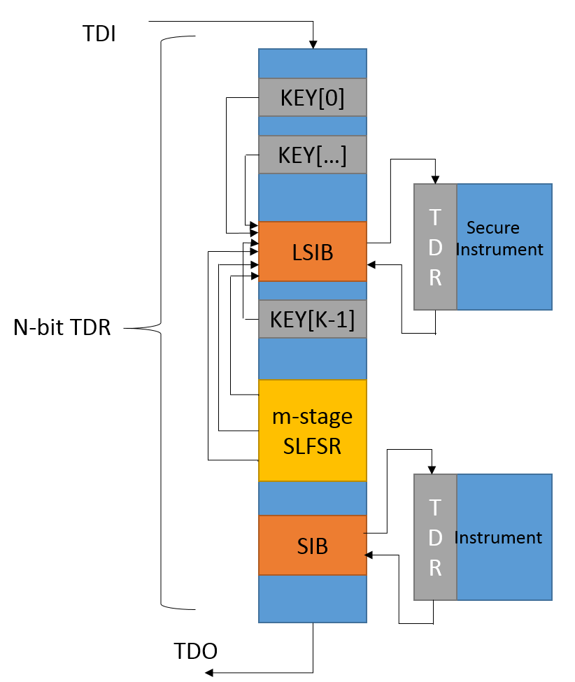
An Original Proposal: Use SLFSR (Secure LFSR) to Hide Scan Path Length

Slide 22
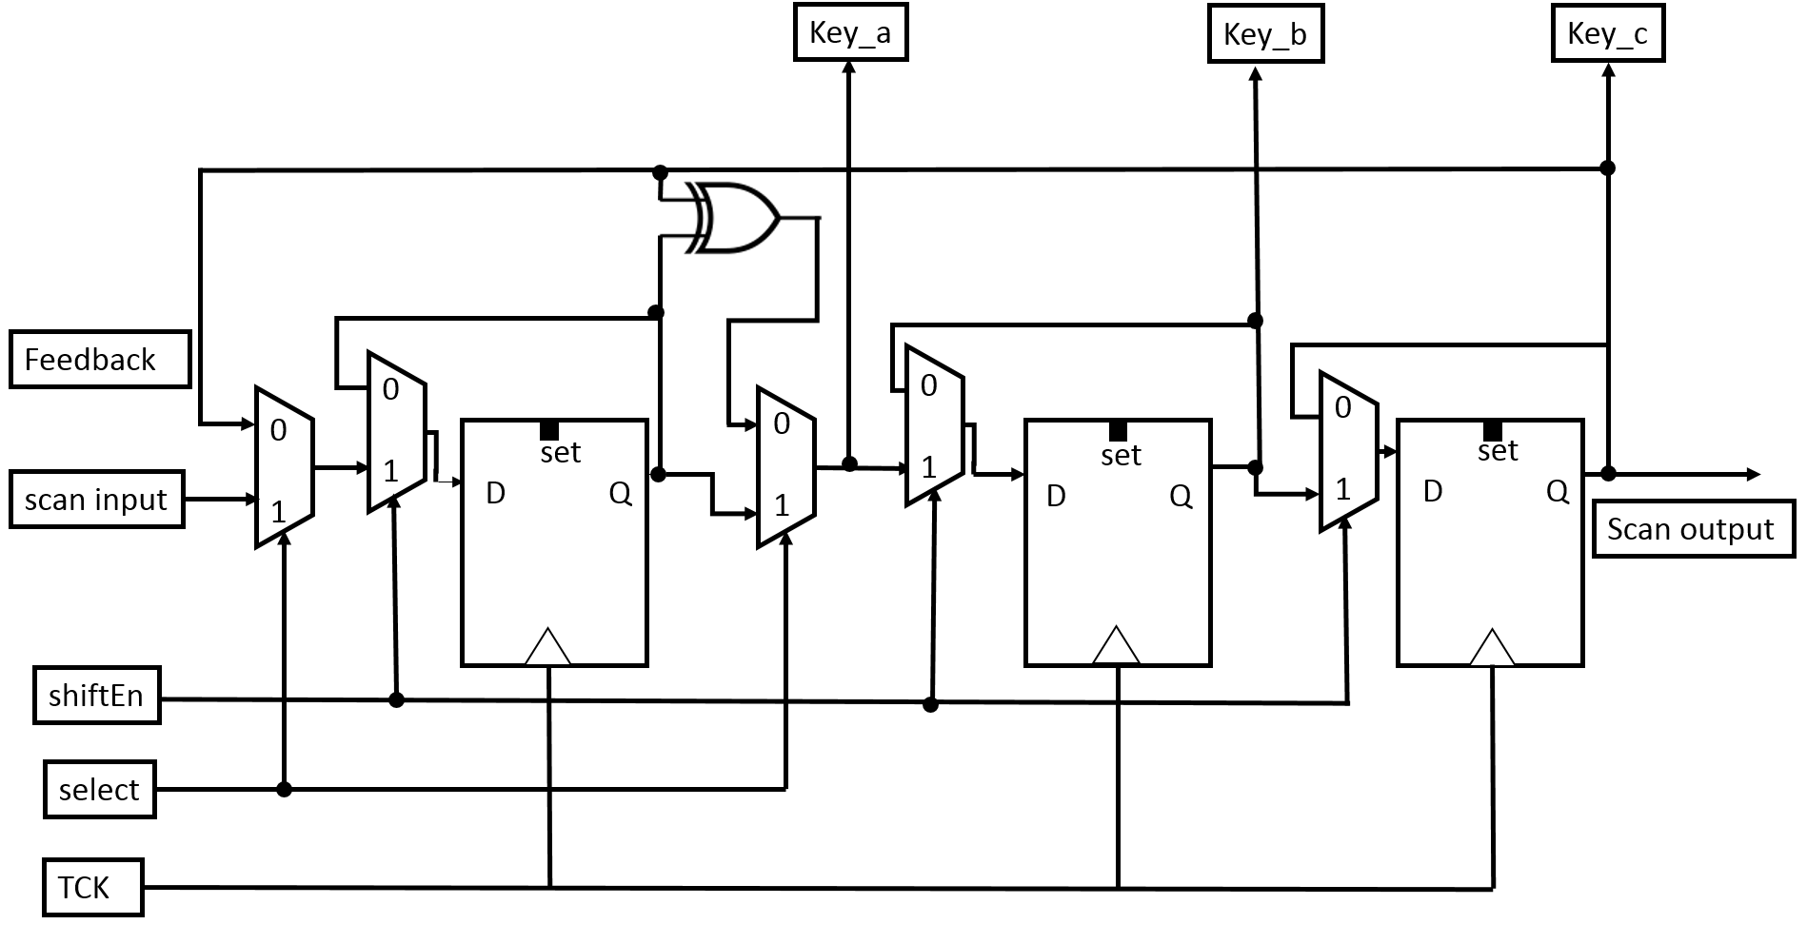
SLFSR Example
3-stage SLFSR, R=$2^{3}−1=7$

Slide 23
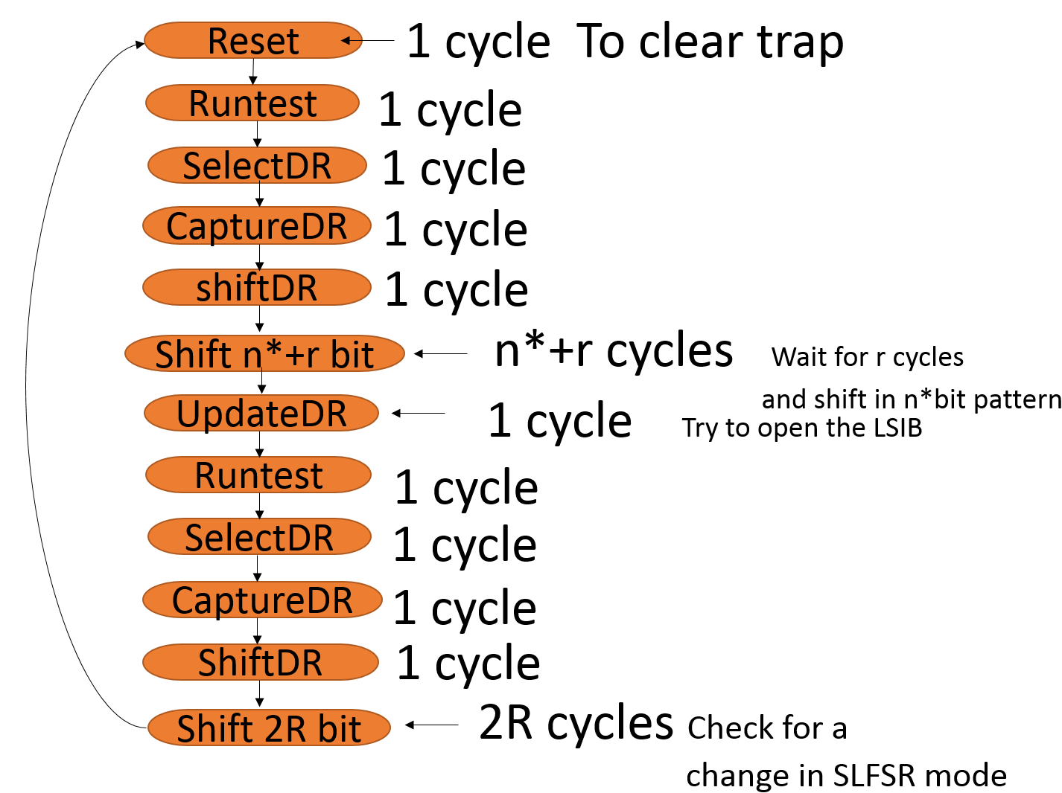
Break-in Procedure
1 attempt=
n*$+E+2R+10$

Slide 24
Attacker’s Strategies
Condition 1: Attempt length is n*< N
$$Total necessary cost when n^{∗}<n$$
$$=\sum_{n∗}{{(n}^{∗}+E+2R+10 )}2^{n∗}R$$
Condition 2: Attempt length is n*= N
$Expected cost=[\left(N +2R+10+E\right)∙R] 2^{k+1}$
Condition 3: Attempt length n*> N
$$Expected cost=[\left(n^{∗}+2R+10+E\right)∙R] 2^{k+1}$$

Slide 25
Expected Results (f = 100MHz)
Condition 3:
Key length K | Chain length N | Expected time to unlock LSIB with SLFSR(days) |  | cycles | %Increase Compared to Trap without SLFSR
 |  | Days | Years
8 | 32 | 2.32E-07 | 6.36E-10 | 2.01e+05 | 395.9596
16 | 64 | 9.34E-05 | 2.56E-07 | 8.07e+07 | 377.9141
32 | 128 | 1.06E+01 | 2.90E-02 | 9.14E+12 | 365.6357
40 | 160 | 3.28e+03 | 8.98 | 2.83E+15 | 362.8169
48 | 192 | 9.85E+05 | 2.70E+03 | 8.51E+17 | 360.8592
56 | 224 | 2.90E+08 | 7.93e+05 | 2.50E+20 | 359.4203
64 | 256 | 8.37E+10 | 2.29e+08 | 7.23E+22 | 358.3181
80 | 320 | 6.74E+15 | 1.85E+13 | 5.82E+27 | 356.7407
96 | 384 | 5.24E+20 | 1.44E+18 | 4.53E+32 | 355.6663

Slide 26
Disadvantage Compared to Structure without SLFSR
In fact, we are increasing the feedback keys alternately.
For the secure chain without LFSR,
$Total expected unlocking time$ without LFSR
= $(10+2N+d)2^{k+1}$
For the secure chain in the worst case condition (condition 3) :
$Total expected unlocking time with LFSR$
= $(10+N+2R)2^{k+1−m}(2^{m}−1)$
Comparing 2 equations, for large n, the efficiency ratio:
$\frac{Expected time w/no SLFSR }{Expected time w/SLFSR}≈2, when N→∞$

Slide 27
Conclusion
It is useful we replace the non-functional segments with SLFSR
Security SLFSR increases attacker’s effort as breaking not only depends on the structure we build up, but also the strategies that attacker chooses.
We should be concerned about the “lucky” attacker

