Slide 1
Fault Modeling and Test Generation for Technology-Specific Defects of Skyrmion Logic Circuits
IEEE VLSI Test Symposium 2022
Ziqi Zhou*, Ujjwal Guin †, Peng Li†, and Vishwani D. Agrawal†
*Cadence Design Systems, Austin, TX, USA
†Dept. of Electrical and Computer Engineering, Auburn University, Auburn, AL, USA
Notes:
Hello ,everyone. I am Ziqi Zhou. I am currently a software engineer at Cadence. Today I am presenting the paper, “Fault Modeling and Test Generation for Technology-Specific Defects of Skyrmion Logic Circuits.” When I did this work, I was a PhD student at Auburn University and my three coauthors belong to the ECE faculty there. Some of you may not have heard of the skyrmion devices. This is because they belong to an emerging technology.

Slide 2
Outline
Overview
Contributions
Skyrmion-based logic circuit
What is Skyrmion?
Skyrmion logic gates
The proposed solution of Skyrmion fault modeling
Defect Mapping by Fault Dominance
Defect Mapping onto Nonclassical Faults
Conclusion
Future work
Notes:
I will start this presentation with a brief overview of an emerging technology. Then, I will describe the contribution of this paper. Starting with what is Skyrmion, I will give some definitions, and illustrate Skyrmion logic gates. Then, I will propose a methodology for defect characterization, fault modeling and test pattern generation. I will also discussion simulation results. Finally, I will conclude my talk and suggest some future direction of this research.

Slide 3
Overview
Shrinking CMOS devices are approaching the quantum-mechanical limits with increased power dissipation and process variation.
Spintronic devices offer a feasible choice for post-Moore devices, which significantly differ from the existing CMOS circuit in physical structure and operation mechanisms.
Magnetic Skyrmion is an emerging digital technology that holds promise for building next-generation spintronic logic, due to its stability, small size, and extremely low operational currents.
Notes:
Read

Slide 4
Previous Work
VTS 2021 paper: Ziqi Zhou, Ujjwal Guin, Peng Li, and Vishwani D. Agrawal, “Defect Characterization and Testing of Skyrmion-Based Logic Circuits,” Proc. VTS, 2021.
That paper presents an algorithm to map physical defects in any technology onto fault models supported in logic-level test tools.
The algorithm uses the principle of fault equivalence for defect to fault mapping.
About 80% of defects could be mapped onto testable faults.
Remaining defects did not have an equivalent fault. The present work addresses their mapping.

Slide 5
Contributions
Proposal of defect to fault mapping by fault dominance. Fault equivalence has been used before (VTS-2021)
Modeling of defects as transition faults whose test generation is supported in logic-level EDA systems. These defects require two-pattern tests.
Use of the well-accepted stuck-at fault in a boolean gate design to model defects of Skyrmion-based design.
A methodology for generating patterns to test a Skyrmion-based circuit by a conventional ATPG tool.
Notes:
Those are the contributions of our paper: (read slide).

Slide 6
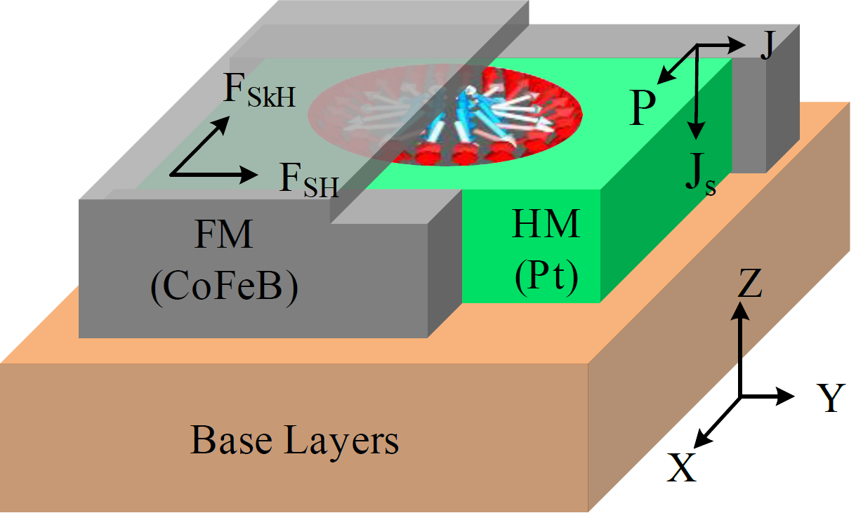
Skyrmion Motion
Skyrmion is a stable magnetic field that acts like a particle, referred to as pseudoparticle.
Skyrmion is created by transverse current injection in a ferromagnetic thin film through magnetic tunnel junction (MTJ).
The state of a logic signal is represented by the presence (logic-1) or absence (logic-0) of a single Skyrmion.
Skyrmion nanotrack structure consists of three parts: a ferromagnetic (FM) layer, a heavy metal (HM) layer and the base.
Skyrmion nanotrack structure consists of three parts: a ferromagnetic (FM) layer, a heavy metal (HM) layer and the base.
Nanotrack structure for skyrmion movement
Notes:
What is Skyrmion.? Skyrmion is a stable magnetic field that acts like a particle, we refer to as pseudoparticle. Skyrmion is created by transverse current injection in a ferromagnetic thin film through the magnetic tunnel junction (MTJ). Once created the skyrmion remains stable until it is intentionally removed by an annhilation procedure. The presence of a skyrmion indicates a logic-high or 1 in skyrmion-based circuit and the absence of skyrmion means logic-low or 0. Patterns on ferromagnetic and metal films form interconnects, called nanotracks, through which drive currents move skyrmions.
Skyrmion nanotrack structure consists of three parts: The figure shows 3D cross sectional view of a nanotrack consisting of a ferromagnetic or FM layer shown in gray, a heavy-metal or HM layer shown in green. and a base layer shown in brown. The skyrmion exists in the gray FM layer at the interface with the green HM layer. It is moved by a continuous electric current in +y detection. F_SH stands for the driving force generated by the spin-orbit torque and F_SkH represents the force generated by the skyrmion Hall effect. The side wall wrapping structure eliminates any possible transverse motion of the skyrmion caused by the skyrmion Hall effect, allowing only linear motion along the y-axis.

Slide 7
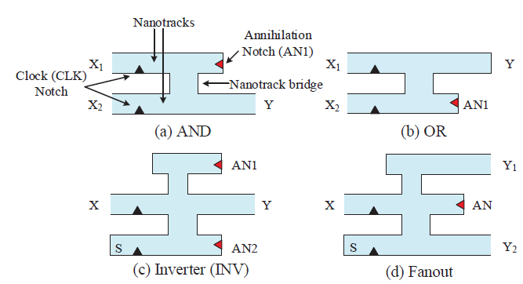
Skyrmion Logic Gates
A traditional Skyrmion gate combines phenomena such as spin Hall effect, skyrmion Hall effect, Skyrmion-skyrmion repulsion and Skyrmion curb repulsion.
The blue part is the nanotrack of Skyrmion, small black triangle is clock notch and red triangle is annihilation notch.
Structures of Skyrmion gates for (a) AND gate (b) OR gate
(c) Inverter (INV), and (d) Fanout.
Note: The Skyrmion behaves as a single pseudoparticle, so a logic circuit additionally needs a special fanout element to generate multiple Skyrmions for fanout branches.
Notes:
We have adopted Skyrmion Logic Gates originally developed at the University of Texas at Dallas by Dr. Friedman by modifying them as non-reversible logic gates. + A traditional skyrmion gate combines phenomena such as spin Hall effect, skyrmion Hall effect, skyrmion-skyrmion repulsion and skyrmion curb repulsion. The green part is the nanotrack of skyrmion, The blue triangle on the inputs side is the clock notch to synchronize the computing system. A red triangle is added at the end of a nanotrack so that any additional skyrmions are destroyed to preserve the proper logic operation which is primarily dependent on skyrmion-skyrmion interactions. Please note that the skyrmion behaves as a pseudo particle, so the skyrmion circuit additionally needs a special fanout element to generate multiple skyrmions for fanout branches.

Slide 8
Defects In Skyrmion Logic Structures
19 defect types are identified and modeled.
Due to structural differences, each defect is relevant only to certain gates.
Micromagnetic simulation of AND gate with defect - void in annihilation track.
Notes:
The design and manufacture of a skyrmion circuit are completely different from traditional CMOS circuits. Defects in the skyrmion circuit are also different from traditional CMOS circuits. In our previous work, we identified 19 defect types in the skyrmion circuit. We describe these defects under two separate categories, technology-independent and technology-dependent defects.
Due to structural differences, each defect is relevant only to certain gates. Fig.3 shows skyrmion AND gate with defect - void in annihilation track
The micromagnetic simulation shows that the skyrmion from X1 goes up through the connecting channel, is repulsed by the void, and moves to the output nanotrack to produce a faulty response of 1.

Slide 9
Technology-Specific Faults.
Fault type:
Stuck-at fault model (classical faults).
Technology-specific faults.
Defect Mapping by Fault Dominance.
Defect Mapping onto Nonclassical Faults.
Mapping of skyrmion gate defects onto equivalent stuck-at faults in logic gates
Total Defects = 61, Equivalence Mapping Coverage (VTS-2021) = 100*51/61 = 83.6%
* 10 Defects not mapped by fault equivalence.
Notes:
We divide faults in skyrmion into two categories: classical faults and Technology-specific faults.
Table II shows how skyrmion defects map onto equivalent stuck-at faults. Notation: Y/0 is Y stuck-at-0, NF is “no-fault”, and a blank cell indicates that defect is not relevant to the gate type as shown in Table I. Asterisk (*)
marks the unresolved mapping of technology-specific defects. T9 of AND, which would have appeared as *, has been corrected as equivalent to X1sa1.
The focus of this paper is on detecting defects represented by asterisks

Slide 10
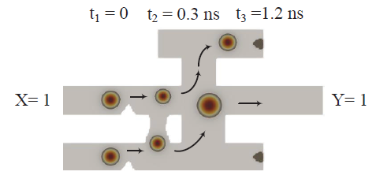
Technology-Specific Faults (Continued)
Defect Mapping by Fault Dominance.
For two faults F1 and F2, if all tests of F2 detect F1, although F1 may have tests that do not detect F2, then F1 is said to dominate F2.
In general, F1 may dominate a set of faults, e.g., F2 and F3. Any test for either F2 or F3 is a test for F1.
Table II: Exhaustive simulation of an inverter under no-fault, defect T16 and stuck-at fault states.
Tests of F1
Tests of F2
Tests of F3
Figure 4: Micromagnetic simulation by MuMax3 for inverter with defect T16 - a bridging defect between tracks.
Notes:
For two faults F1 and F2, if all tests of F2 detect F1, although F1 may have tests that do not detect F2, then F1 is said to dominate F2 [34]. Thus, F2 can be safely targeted to derive a test for F1.(Only keep test for F2)
Micromagnetic simulation by MuMax3 for inverter with defect T16 - a bridging defect between tracks. T16 is detectable by x=1, which is a test for X sa0 or Y sa1.

Slide 11
Technology-Specific Faults (Continued)
Defect Mapping onto Nonclassical Faults.
Fault models other than the stuck-at faults are referred to nonclassical faults.
According to the exhaustive simulation result and map them onto Nonclassical Faults.
Micromagnetic simulation by MuMax3 for AND gate with missing annihilation notch
Micromagnetic simulation of the OR gate with missing annihilation notch.
Notes:
Read,

Slide 12
Results and Discussion
A new coverage metric is required that reflects the detection of all possible defects present in a Skyrmion circuit..
We define defect coverage as the ratio of detected defects to the total number of defects.
We compute the coverage of defects T1 through T19 detected by ATPG test patterns generated by targeting analyzable faults obtained by defect mapping.
Notes:
After we mapped the skyrmion defects onto equivalent stuck-at faults, we can use commercial EDA tools to generate test for skyrmion circuits.

Slide 13
Results and Discussion (Continued)
Defect coverage of benchmark circuits implemented in Skyrmion technology.
Notes:
This table shows defect coverage analysis of ISCAS’85 benchmarks [39]. Let's take circuit c432 as an example, after skyrmion gate defect mapping, we get 3,153 equivalent and 123 dominant stuck-at faults, resulting in a total of 3,276 stuck-at faults. Detecting these 3,153 and 3,276 stuck-at faults provides defect coverages of 80.3% and 83.4%, respectively, for the skyrmion implementation of c432. Finally, the defect coverage rises to 100% after all stuck-at and delay faults are detected.

Slide 14
Conclusion
The new defect detection method for digital circuits implemented in the Skyrmion technology works with exhaustive simulation only at the single gate level. Hence, computation complexity is manageable.
We map defects to analyzable logic fault models by using the principles of fault equivalence and fault dominance. It requires comparison of gate-level truth-tables.
We model defects as stuck-at and transition faults, for which we can generate test patterns from logic-level EDA tools.
Our detection method can cover all known Skyrmion circuit defects until new defects are discovered.
Our physical defect to logic fault modeling algorithm is applicable to any newly discovered defects in any device technology either in use, or being developed, or of the future.
Notes:
Read slides.

Slide 15
Future Work
For defects mapped onto transition faults, which require two-pattern tests, hazard analysis will be useful.
Additional gates, such as NAND, NOR, in Skyrmion technology may be investigated for technology-specific defects.
A study of Skyrmion-based sequential circuit elements, e.g., flip-flop, dynamic latch, etc., for defects and testing should be undertaken.
Notes:
In the end, I want to briefly describe my future research direction. +(Read slide)

Slide 16
Thank you!
Any Questions?
Contact:
Ziqi Zhou
Cadence Design Systems
Email: ziqi@cadence.com
This presentation and recording belong to the authors. No distribution is allowed without the authors’ permission.
Notes:
I will stop here. thank you very much for attending my talk. Please feel free to contact me if you have any questions or concerns. Thank you very much and have a good day.

