Slide 1
ATE Test Time Reduction by Scaling Voltage and Frequency
Praveen Venkataramani
Advisor: Vishwani D. Agrawal

Slide 2
Problem statement
“Test is not free* – Test time is proportional to test cost”
Scan based test clock period is limited by the maximum power consumed during a clock cycle.
Test cycles can be large, and in addition to the large volume of test vectors increases the total test time.
Reduce test time without exceeding power budget
*Arthur George –”Test is it, or is it not, value added?” Keynote, VTS 2014
Notes:
If you have attended the keynote yesterday, you would have heard Arthur George mention that “Test is not free”. One way to look at it is that test time is proportional to test cost. The speed at which the scan based test runs is limited by the maximum power consumed during one test cycle. If the power consumed during test is more than the rated power for the device, then the test runs at a slower speed and in addition to the large number of cycles the total test time is increased.

Slide 3
Test time theorem
“For power constrained testing where the peak power during any clock cycle must not exceed the rated power of the device, the test time has a lower bound”
$$\frac{E_{TOTAL(test)}}{P_{MAX(rated)}} ≤TT = \frac{E_{TOTAL(test)}}{P_{AVG}}$$
where E_{TOTAL(test)} is the total energy consumed during the entire test, P_{MAX(rated)} is the maximum rated power for the device, P_{AVG} is the average power of the entire test and TT is the total test time.
Notes:
The foundation of the proposed methods is based on the theorem that states that in a power constrained where the peak power during any clock cycle must not exceed the rated power of the device, the test time has a lower bound and is quantified as such. The equality on the right hand side is from the well-known power equation, which is the energy dissipated over the period of interest. The inequality on the left hand side is the proposed lower bound that is targeted in this work. Here, ETOTAL is the total energy dissipated during test, Pavg is the average power of the test and PMAX(rated) is the maximum allowable power.

Slide 4
Proposed methods
Lower bound
Optimum supply voltage
Aperiodic clock
Notes:
To achieve the lower bound stated in the theorem, two methods are proposed. In one method the supply voltage for the entire test is reduced to an optimum value which reduces the energy but we now increase the rate at which it is consumed to maintain the same power dissipation.
Using periodic clock, energy due to switching activity is unevenly consumed over the test. So in the second method we use Aperiodic clock where the clock period is varied such that the energy is consumed evenly over the test. The optimum test period for each cycle is calculated based on the energy consumed during the cycle under consideration.

Slide 5
ATE example – Periodic clock
16.5µs
Test clock period = 500µs, Total number of cycles = 33.
Notes:
The feasibility of aperiodic test is demonstrated using s298 benchmark circuit tested on an ATE. The figure shows waveforms for the periodic clock test from the logic analyzer tool on the ATE. The first row shows clock cycle number. The period used for the periodic clock is 500ns shown in the second row. The waveforms following are scan out scan in scan enable and the primary inputs, and finally the scan clock, observe here the clock period is constant. The total time displayed in this frame is 16.5us which composes 33 cycles.

Slide 6
ATE example – Aperiodic clock
16.5µs
Test clock period = 200ns, 300ns, 410ns, 500ns, Total number of cycles = 58.
Notes:
Going to aperiodic clock, the test program and the pattern file is modified to include the chosen periods. The varying periods can be observed in the waveform at the bottom. As observed for the same time period of 16.5us the time frame now compose of 58 cycles. The total test composed of 540 cycles and showed approx. 30% reduction in test time.

Slide 7
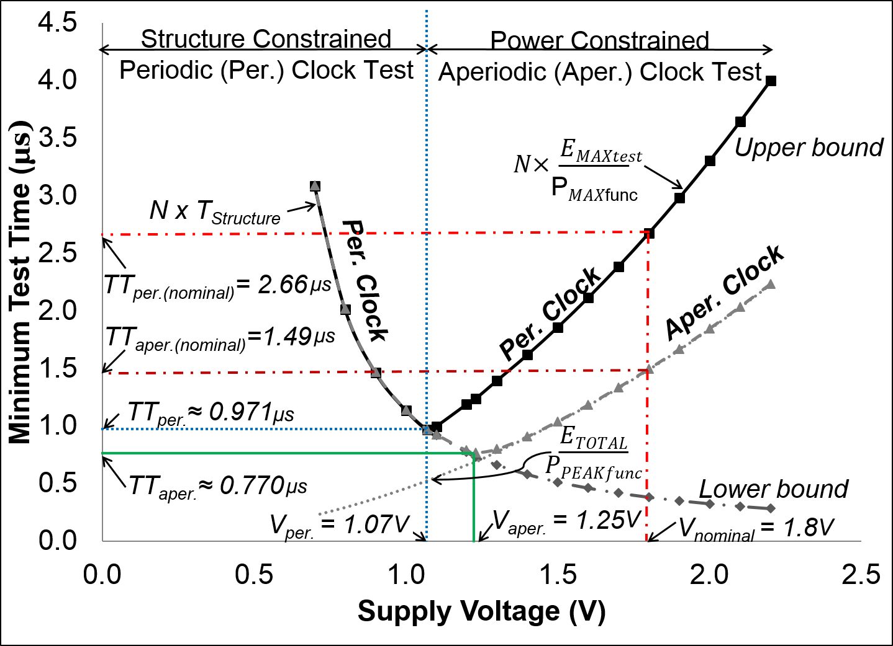
Optimum voltage- s298
Notes:
The graph shows the reduction in test time using the proposed methods for periodic and aperiodic clock tests. The x-axis shows the supply voltage at which the test is performed and the y-axis shows the minimum test time at the corresponding voltage.
A test is power constrained if the minimum test cycle period is limited only by the maximum power dissipated which includes all test on the right hand side region
A test is structure constrained if the minimum test cycle period is constrained only by the structural limit of the path under consideration. Which includes test on the left hand side region.
As the voltage is reduced the test clock period is increased to maintain the same power dissipation. The lowest voltage at which the test runs at the maximum speed is the optimum voltage which is at the boundary when the test starts to become structure constrained. Beyond this minimum voltage the test clock period will be structure constrained and thus has to be increased.
Relative to the conventional testing using a periodic clock at nominal voltage, using aperiodic clock at nominal voltage periodic clock at a reduced optimum voltage reduces test time by 43% and 63%. Further reduction is achievable if the test is run with aperiodic clock at a reduced optimum voltage as shown.

Slide 8
Conclusion
A new lower bound to reduce test time is proposed.
Methods were verified through simulation and experiment on the ATE.
Aperiodic clock test provides lower test time at any voltage as long as there are some test cycles that are power constrained.
According to the test time theorem, aperiodic clock test time will always be less than or equal to the periodic clock test time.
Notes:
In this work we have proposed a novel lower bound that mitigates the trade off between test time and test power.
Methods were proved experimentally on the ATE and by simulation. An aperiodic clock provides a lower test time at any voltage as long as some cycles are power constrained. Based on the theorem aperiodic clock will always be less than or equal to the periodic clock test time.

Slide 9
Future work
Aperiodic clock is not limited to ATE. Use of aperiodic test with on chip clock must be studied.
Implementation of the proposed methods for delay testing.
Dynamic voltage management.
Effect on leakage power must be studied when using the proposed methods.
Implementation using modern technologies
Notes:
Not limited to ATE – for example in the case where on-chip clock is utilized, a frequency divider can be used to provide the required clocks and the ATE can choose the value to be used before applying patterns
In case of delay test, aperiodic test can be limit to scan shift, which involves more cycles.
Using optimum voltage in delay test may require to switch the power supply back to the nominal during launch and capture cycles, this may require additional dummy cycles to compensate the time needed to charge the power lines.
Effect on leakage must be studied, though in technologies such as FinFETs leakage is minimized and the dominant power is due to switching activity, so in that scenario the proposed methods will be more beneficial.

