Slide 1
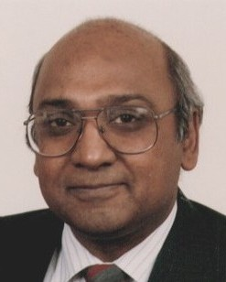
About VLSI Design Conference
Vishwani D. Agrawal
Professor Emeritus
Electrical and Computer Engineering
Auburn University, USA
Guwahati, India, February 22, 2021
Notes:
I am Vishwani Agrawal and I welcome you to VLSID 2021. I am a retired professor at the Auburn University. Although my slides shows Guwahati, I am talking to you from Auburn, Alabama in USA. In the next few minutes, I will give you a few facts about this conference. Most importantly, if you are attending it today, you are in the right place.

Slide 2
Conference Cities
Bangalore (10)
Chennai (3) Started in 1985
Delhi (5)
Goa (1)
Guwahati (1) Virtual in 2021
Hyderabad (5)
Kolkata (4)
Mumbai (3)
Pune (2)
Notes:
This conference started in 1985 in Chennai. It has been held in nine different cities in India. This is the first time in Guwahati and is also the first virtual meeting. For 2022, it is scheduled to be held in Hyderabad.

Slide 3
Accepted Papers at VLSID
Notes:
This chart shows the number of papers selected at VLSID through their peer review procedure. Starting in 1985, the program expended rapidly until about 2007, then stabilizing at about 80 papers.

Slide 4
Nature of the Conference
An international conference
Based in India
Serving the needs:
State of the art tutorials
High standard; all papers available in IEEE Xplore since 1991
Keynote talks by experts
Fellowship program
Student track
PhD forum
Women in Engineering forum
Industry forum
User/Designer track
Hackathon
Sister Conference: Design Automation Conference (DAC), USA
Notes:
This is an international conference, with participation from around the globe. It is always held within India. Offers tutorials by experts. Paper selection through peer reviews maintains the highest standard. All papers are archived in the IEEE Xplore. The conference makes extra effort to bring in selected keynote speakers. Please do not miss any of this year’s keynotes. Every year we may have a selection of the listed activities. I should mention that we enjoy a sister conference relationship with DAC, the Design Automation Conference. At this conference, Session 5B on February 24 will present 4 papers from the recent DAC as highlights of that conference.

Slide 5
VLSID Sponsor: VLSI Society of India (VSI)
Founded in 1990; Sponsor of conferences, symposia and workshops in India.
Mission: By promoting applications and research on all aspects of VLSI, make India a significant player in this field.
http://vlsi-india.org/vsi/
Office Bearers:
President Satya Gupta, CEO, Seedeyas Innovations
Vice-President Niranjan Pol, Seagate
Secretary Chitra Hariharan, Intel
Treasurer Ritesh K. Jain, Seagate, Treasurer
Notes:
VLSI Society of India is our main sponsor. VSI was founded with the mission of promoting VLSI in India. Dr. Satya Gupta is the current President of the Society. He and his team are responsible for maintaining the professional activities like this conference. Of course, the conference is organized by a large team headed by General Chairs, Sudeb Dasgupta and Gaurav Trivedi from IITs at Roorkee and Guwahati. Both institutions have generously supported this effort and we are grateful to them.

Slide 6
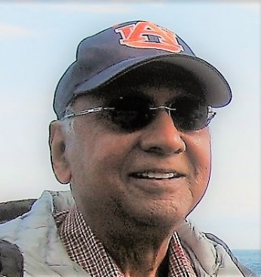
VLSI Design Conference Steering Committee (2020)
Vishwani D. Agrawal, Steering Committee Chair, Auburn University, USA
Jaswinder Ahuja (Past President, VSI), Cadence, India
Srimat T. Chakradhar, NEC, USA
Annajirao Garimella, Intel, USA
Manoj S. Gaur (VDAT), IIT, Jammu, India
Sumit Goswami, Qualcomm, Bangalore, India
Gangadhar Gude, Atai, Hyderabad, India
Satya Gupta (President, VSI), Seedeyas Innovations, Bangalore, India
Chitra Hariharan (Secretary, VSI), Intel, Bangalore, India
Ritesh Jain (Treasurer, VSI), Seagate, Pune, India
Nagi Naganathan (ACM and IEEE), Northrop Grumman, USA
Preeti Ranjan Panda (Embedded Systems), IIT Delhi, India
Niranjan Pol (Vice-President, VSI), Seagate, India
Virendra Singh (RASDAT), IIT Bombay, India
Susmita Sur-Kolay, ISI, India
Preet Yadav, NXP Semiconductors, Noida, India
Notes:
Within the VLSI Society of India, a Steering Committee of 16 volunteers is responsible for maintaining the continuity of the conferences. I chair this committee, which is always looking for proposals, mainly for two conferences listed on the next slide. If you are interested in organizing, you can send me a proposal giving the location, facilities, names of organizers, and a tentative budget.

Slide 7
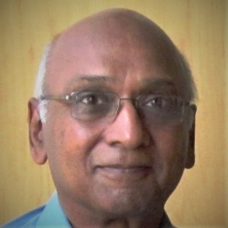
Recent and Upcoming Events
Twenty-fourth International Symposium on VLSI Design and Test (VDAT), Virtual Event, Bhubaneswar, India, July 23-25, 2020.
Thirty-fourth International Conference on VLSI Design and 21st International Conference on Embedded Systems (VLSID), Hyderabad, January 2-6, 2022.
Future conference proposals to: agrawvd@auburn.edu
Notes:
In the recent past, the 24th International Symposium on VLSI Design and Test (VDAT) was held in July 2020 at Bhubaneswar in a virtual format. Next the 34th VLSID will be held at Hyderabad during January 2022. I am looking for proposals for future conferences and here is my email. I hope to hear from you.

Slide 8
Thank You

