Slide 1
An Amalgamated Testability Measure Derived from Machine Intelligence
37th International Conference on VLSI Design
&
23rd International Conference on Embedded Systems
Soham Roy (Speaker)
Design for Test Engineering Group
Intel Corporation, Santa Clara, CA 95054
Vishwani D. Agrawal
Dept. of Electrical and Computer Engineering
Auburn University, Auburn, AL 36849
Jan XX, 2024
Notes:
Hello everyone and welcome to my talk titled, “An Amalgamated Testability Measure Derived from Machine Intelligence”.

Slide 2
Outline
Motivation
Modus Operandi
Experimental results
Conclusions
Future Works
Notes:
I begin by giving the motivation for this study. Then, I will introduce machine intelligence and how it is applied to our study. I will also analyze our experimental results. Finally, I will conclude this talk by briefly pointing out the major contributions of this study and future avenues that may be taken to achieve more interesting results.

Slide 3
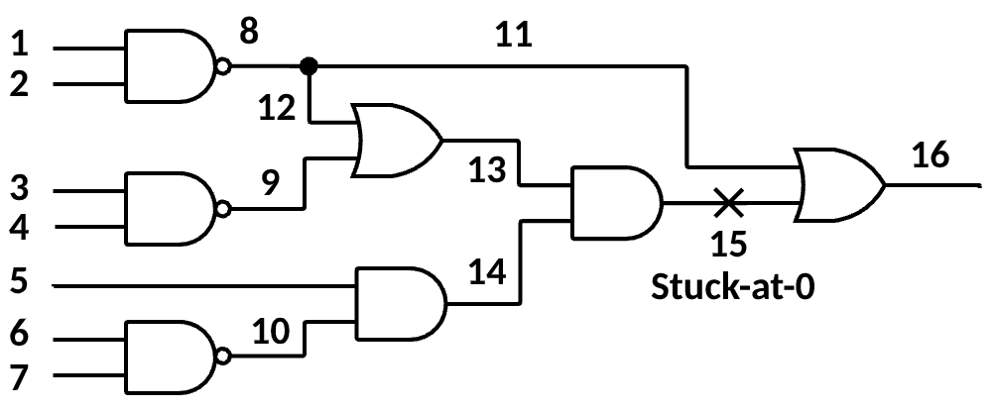
Motivation | ATPG - An example
ATPG
Search for an input vector to detect a given fault.
Complexity increases exponentially with circuit size.
11
0X10X
0
1
D
1
D
Test found!
1
1
Notes:
In 1967, D-algorithm established ATPG as a standard method of generating high-quality tests in the logic circuit industry. However, as circuits became larger, it was noticed that ATPG can have frustratingly long runtimes. Subsequent studies lowered ATPG runtime in numerous ways, but since the introduction of PODEM in 1981, the theoretical upper limit of ATPG runtime has remained constant. Let us see an example: for a circuit with n primary inputs (these I may include scan latches in case of DFT circuits), ATPG may need to simulate up to 2^ (n) vectors to find a test. Although ATPG algorithms typically find tests without simulating close to this many vectors, this upper bound still exists and is occasionally seen in modern circuits.

Slide 4
Motivation | ATPG - Backtraces and backtracks
Goal = 1
Failure! Backtrack…
Goal = 1
0
0
1
Success!
1
1 0
1
1
1
Failed (undone) backtrace points
Unsuccessful backtrace resulting in backtrack
Two successful backtraces resulting in goal met
Notes:
To avoid this upper limit, most ATPG algorithms employ backtracing subroutines. These subroutines trace backwards (hence the name) through the circuit starting from an objective — such as activating or propagating a fault — and attempt to find input assignments to accomplish the objective. Multiple backtraces from an objective, leading to multiple input assignments, may be required to meet the objective, but if these input assignments accomplish the final goal — that is, find a test for the fault — then only a subset of input vectors must be simulated, which is nothing compared to the theoretical maximum of two to the power $n$.
However, this ideal situation presumes no backtracks occur during ATPG. Sometimes, the backtracing subroutine may make an input assignment that makes the current or future objectives impossible. When this occurs, ATPG must undo, or backtrack, to some previous assignment, which means ATPG wastes time simulating unnecessary input vectors.
Beyond PODEM, numerous ATPG algorithms attempt to reduce runtime by creating fewer objectives, but to our knowledge, no studies compare ways of backtracing *from* an objective. When backtracing, we must decide which direction to take, because choosing a wrong direction could result in a backtrack.

Slide 5
Modus Operandi - Random Pattern Test Generation (RPTG)
Set Input Probabilities
Generate Random Vector
Change Probabilities
Continue
Simulate Faults
Check Coverage
Stop (Adequate Coverage or Random Vectors Ineffective)
Notes:
In 1972, random pattern test generation (RPTG) was used for testing the ILLIAC IV parallel computer. The coverage of random patterns always saturated between 60-80% and switching to D-algorithm program at that point proved beneficial. An essential part of the RPTG scheme is a fault simulator that selects useful patterns. In the present work, we first run an RPTG scheme on a set of benchmarks and try to cover easy-to-detect faults, before switching to PODEM ATPG to detect the remaining hard-to-detect faults.

Slide 6
Modus Operandi - Machine intelligence (MI)
Input problems
Solver
Desired outputs
Trainer
Supervised learning
Unsupervised learning
Trainer
Evaluator
Reinforced learning
Principal Component Analysis (PCA)
“S. Roy, S. K. Millican, and V. D. Agrawal, “Unsupervised Learning in test Generation for Digital Integrated Circuits,” in Proceedings of the European Test Symposium, Belgium (Virtual Event), Feb. 2021.”
Notes:
To develop a new backtracing and D-Frontier drive strategy, I look towards the technology of machine intelligence. Machine intelligence describes a broad category of algorithms that automatically program themselves through experience. This experience can come from unclassified data which the program finds patterns in, which is unsupervised learning; or the experience can come from a database of training problems with desired outcomes, which is supervised learning; or the experience can come from iterative re-evaluation and adjustment, which is reinforced learning. In this study, I applied PCA in form of testability measure to guide ATPG without using any neural network. This is known as unsupervised learning in terms of machine intelligence.

Slide 7
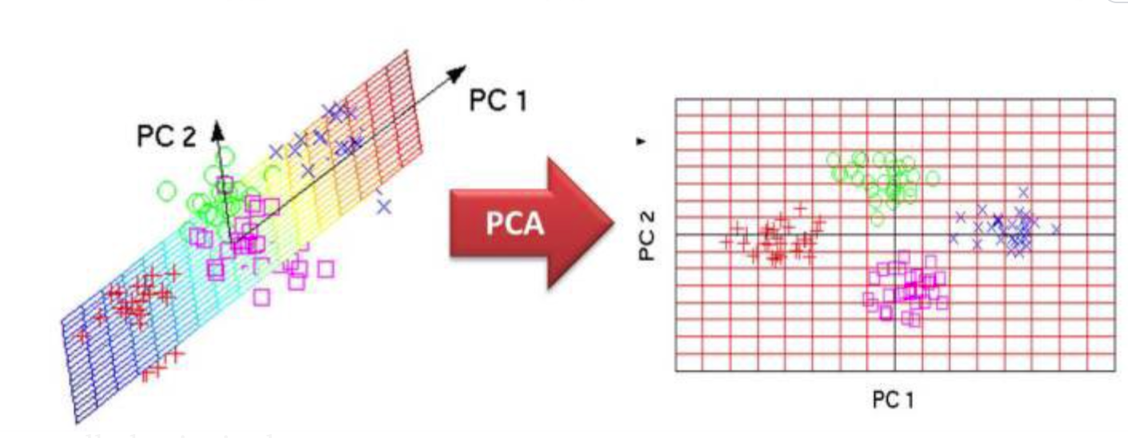
Modus Operandi - Principal Component Analysis (PCA)
Notes:
Principal component analysis is a method that rotates the dataset in a way such that the rotated features are statistically uncorrelated. This rotation is often followed by selecting only a subset of the new features, according to how important they are for explaining the data. PCA is a way of reducing the number of independent variables in a dataset and is particularly applicable when the ratio of data points to independent variables is low. PCA transforms a linear combination of variables such that the resulting variable expresses the maximum variance within the combination of variables.
PCA is a statistical procedure that uses an orthogonal transformation to convert a set of observations of possibly correlated variables into a set of values of linearly uncorrelated variables called principal components. This transformation is defined in such a way that the first principal component has the largest possible variance (that is, accounts for as much of the variability in the data as possible)

Slide 8
Modus Operandi - PCA applied to RTPG filtered faults
Features: Distance,
COP,
SCOAP
Database containing circuit line’s information based on features
PCA
ATPG
PCA-guided backtracing
CPU time, backtracks, & backtraces
COP-guided backtracing
Distance-guided backtracing
SCOAP-guided backtracing
Notes:
The motivation behind this study is the exponential complexity of automatic test pattern generation (ATPG) that uses testability measures in making choices during test generation, but in practice no single testability measure fits all situations. In such cases, unsupervised learning can combine practically any number of known testability measures, such as input-output distance (logic depths), COP and SCOAP through principal component analysis, and the most prominent principal components can guide ATPG choices.
Most importantly, we filtered out the easy-to-detect faults using random test pattern generator and left over hard-to-detect faults are for our novel scheme PCA.
I apply this novel scheme to benchmark circuits by first performing principal component analysis to combine three testability measures, distance, COP, and SCOAP, and store the principal components (PC) in a database. Then, the most prominent PCs out of this database guide backtrace direction in the PODEM ATPG program. Here, we are comparing four versions of PODEM, each using a different testability measures, i.e., Distance, COP, SCOAP or principal component.

Slide 9
Modus Operandi – Principal Component Analysis (PCA) for backtracing
Gate Type | Objective value at output of a gate based on Distance [1] |  | Objective value at output of a gate based on COP [2] |  | Objective value at output of a gate based on SCOAP SC0 [3] |  | Objective value at output of a gate based on SCOAP SC1 [3] |  | Objective value at output of a gate based on PCA
Value | 0 | 1 | 0 | 1 | 0 | 1 | 0 | 1 | 0 | 1
AND | Min | Max | Min | Min | Min | Min | Max | Max | ? | ?
NAND | Max | Min | Min | Min | Min | Min | Max | Max | ? | ?
OR | Max | Min | Max | Max | Max | Max | Min | Min | ? | ?
NOR | Min | Max | Max | Max | Max | Max | Min | Min | ? | ?
Gate Type | Objective value at output of a gate based on Distance [1] |  | Objective value at output of a gate based on COP [2] |  | Objective value at output of a gate based on SCOAP SC0 [3] |  | Objective value at output of a gate based on SCOAP SC1 [3] |  | Objective value at output of a gate based on PCA
Value | 0 | 1 | 0 | 1 | 0 | 1 | 0 | 1 | 0 | 1
AND | Min | Max | Min | Max | Min | Max | Min | Max | Min | Max
NAND | Max | Min | Max | Min | Max | Min | Max | Min | Max | Min
OR | Max | Min | Max | Min | Max | Min | Max | Min | Max | Min
NOR | Min | Max | Min | Max | Min | Max | Min | Max | Min | Max
P. Goel, “An Implicit Enumeration Algorithm to Generate Tests for Combinational Logic Circuits,” IEEE Transactions on Computers, vol. C-30, pp. 215–222, 1981.
F. Brglez, “On Testability Analysis of Combinational Circuits,” Proc. International Symp. Circuits and Systems, pp. 221–225, 1984.
L. Goldstein, “Controllability/Observability Analysis of Digital Circuits,” IEEE Transactions on Circuits and Systems, vol. 26, pp. 685– 693, 1979.
Notes:
In combining heuristics in PC, it is necessary that they work cooperatively, and not contradict each other. The upper table shows how individual testability measure works. For example, consider a backtrace through an AND gate with two or more inputs being guided by distance D to primary inputs (PI). To justify the output value 0, the backtrace must take the input at minimum distance from PI [8]. In Table I, this is indicated by minimum D for AND gate for output value 0. To justify a 1 at the output, the backtrace follows the input with maximum D, shown as “max”. We observe that the four testability measures do not agree for any gate. Hence, if combined by PCA, the major component (P) cannot be given guidance criteria, as shown by “question marks” in the table.
The lower table takes a two-step approach to overcome the above difficulty. First, some testability measure data, shown in bold, are complemented. For example, when AND gate output is 1, the COP controllability CC1 is replaced with 1 - CC1, and SC0 with 1 - SC0. Also, when the AND gate output is 0, SC1 is replaced by 1 - SC1. This reverses the corresponding backtrace criteria now shown in bold italics. Similar changes are made for NAND, OR and NOR gates, giving complete synchronization of the choice criteria for all testability measures. However, it necessitates separate PCAs for gate outputs 0 and 1, respectively, requiring two major PCs, P0, and P1, with corresponding backtrace criteria (see the lower table).

Slide 10
Modus Operandi – Principal Component Analysis (PCA) for D-drive
D-drive selection criterion w.r.t testability measures
Distance | COP | SCOAP | PCA
Min | Max | Min | Min
P. Goel, “An Implicit Enumeration Algorithm to Generate Tests for Combinational Logic Circuits,” IEEE Transactions on Computers, vol. C-30, pp. 215–222, 1981.
F. Brglez, “On Testability Analysis of Combinational Circuits,” Proc. International Symp. Circuits and Systems, pp. 221–225, 1984.
L. Goldstein, “Controllability/Observability Analysis of Digital Circuits,” IEEE Transactions on Circuits and Systems, vol. 26, pp. 685– 693, 1979.
Notes:
Similar approach is taken to calculate the amalgamated testability measure for D-drive that selects a D from the D-frontier to be propagated toward PO. Once again, various testability measure data, distance, COP observability, and SCOAP observability, all normalized to the range [0,1], are examined in this table for conflicts. Thus, testability measure data for COP observability, shown in boldface, are complemented as 1- COP observability, while distance, SCOAP remain unchanged.

Slide 11
Experimental Results – Backtracks in PODEM ATPG of B07
Testability class of fault | Backtracks for various guidance data
 | Distance | COP | SCOAP | PCA
Hard-to-detect #1 | 122 | 720 | 105 | 56
Hard-to-detect #2 | 86 | 92 | 94 | 80
Hard-to-detect #3 | 36 | 170 | 68 | 0
Hard-to-detect #4 | 2 | 978 | 2 | 0
Hard-to-detect #5 | 22 | 19 | 154 | 5
Hard-to-detect #6 | 2 | 2 | 2 | 0
Hard-to-detect #7 | 13 | 2 | 2 | 0
Easy-to-detect #1 | 1 | 26 | 7 | 0
Easy-to-detect #2 | 1 | 22 | 9 | 0
Easy-to-detect #3 | 2 | 250 | 2 | 0
Redundant #1 | 94 | 92 | 94 | 80
Redundant #2 | 98 | 92 | 96 | 86
Notes:
We used sample of faults (easy-to-detect, hard-to-detect, and redundant) for circuits to prove the power and efficiency of PCA-guidance via a fault-by-fault approach. Table in this slide shows a reduced number of backtracks (almost zero in several cases) for 12 faults (7 hard-to-detect, 3 easy-to-detect, and 2 redundant faults) of the benchmark circuit b07. Although, the number of backtracks for redundant faults were reduced, they did not drop to zero, confirming that it must take at least one backtrack to complete the search for a test for a redundant fault.
This experiment provokes some interesting thoughts. With amalgamated testability measure, a circuit can either have detectable faults (fast enough in terms of detection) or redundant faults (fast enough to declare a fault as redundant) since PCA guided ATPG can reduce backtracks to zero for both HTD and ETD faults. This will remove the demarcation of easy or hard faults and boils down the fault classification list to only two categories of faults, i.e., detected faults and redundant faults. However, this experiment points to a prominent disadvantage, i.e., one cannot classify faults in a circuit without applying ATPG. That could change since amalgamated testability measure-guided ATPG runtime is substantially low

Slide 12
Experimental Results - ATPG for RTPG filtered faults (fault coverage)
Notes:
Circuits are arranged left to right in order of increasing number of nodes. Experiments are also carried out on faults left over from random pattern detection to examine the effectiveness of amalgamating testability measure (PCA) in PODEM ATPG application. Per-fault ATPG time limit for each single measure guidance as well as for PCA guidance was kept constant. Results in the above figure show zero relative change in fault coverages in most cases (no bars), some higher coverages by PCA (positive bars), and a few dropped coverages (negative bars).
Comparison of fault coverage when a single testability measure (TM) guides backtracing as opposed to amalgamated testability measure (PCA) to detect testable and redundant checkpoint faults left over from random pattern detection. PCA provides steady and often considerable benefits; positive or no bars show improved or same fault coverage by PCA as by a single measure. PCA is frequently the best guidance for ATPG, but even when it is not, it is never the worst.

Slide 13
Experimental Results - ATPG for RTPG filtered faults (backtracks)
Notes:
Circuits are arranged left to right in order of increasing number of nodes. This figure shows combined backtracks for all stuck-at faults left over from RTPG. Comparison of total backtracks when single testability measure (TM) is applied to PODEM backtrace as opposed to amalgamated testability measure (PCA) to detect the left over testable and redundant checkpoint faults after random pattern detection. Again, PCA provides steady and often considerable benefits, positive bars show reduced backtracks by PCA over a single measure.

Slide 14
Experimental Results - ATPG for RTPG filtered faults (CPU Time)
Notes:
Circuits are arranged left to right in order of increasing number of nodes. Comparison of CPU time when single testability measure (TM) is applied to PODEM backtrace as opposed to amalgamated testability measure (PCA) to detect the left over testable and redundant checkpoint faults after random pattern detection. Clearly, PCA provides steady and often considerable benefit; positive bars show reduced CPU time by PCA over a single measure.

Slide 15
Conclusions
Practical ATPG systems combine a simple program (e.g., random vector ATPG) for easy faults and a complex program (e.g., MI-based or quantum-computing ATPG) for hard-to-detect faults.
PCA was used to combine multiple features, and a linear transformation formulated the ATPG backtracing using a new major PC (the first PC) that replaces the tradition single testability measure guidance found in practical ATPG (tested on hard-to-detect faults).
Notes:
Practical ATPG systems combine a simple program (e.g., random vector ATPG) for easy faults and a complex program (e.g., MI-based or quantum-computing ATPG) for hard-to-detect faults. PCA was used to combine multiple features, and a linear transformation formulated the ATPG backtracing using a new major PC (the first PC) that replaces the tradition single testability measure guidance found in practical ATPG (tested on hard-to-detect faults).

Slide 16
Future Work
All ATPG algorithms use various heuristics to achieve a lower test generation runtime but achieving the lowest ATPG run-time is still an open problem.
Backtraces can be reduced to generate more efficient tests requiring fewer PI assignments.
A total backtrack elimination has a cost in CPU time.
A quick detection of redundant faults in a circuit
Comparing k-means clustering against PCA.
Using large industry-standard circuits to observe the performance trends of MI-guided ATPG system.
Notes:
All ATPG algorithms use various testability meaasures to achieve a lower test generation runtime, but achieving the lowest ATPG run-time is still an open problem. This study uses MI to combine various ATPG inputs as testability measure, narrow down the search space, and achieve speed-up in ATPG runtime. However, with the dramatic rise in research on quantum computing, it is only natural to use those ideas to break the VLSI testing area out of its plateau. Reconvergent fanout-free circuits do not have any backtracks, but backtraces can be reduced to generate more efficient tests requiring fewer PI assignments. A total backtrack elimination has a cost in CPU time, finding a ``sweet-spot" may be feasible to obtain optimized non-zero backtracks for minimal CPU time.
A quick detection of redundant faults in a circuit may expedite ATPG by MI-guided ATPG. Comparing $k$-means clustering against PCA as the second unsupervised learning technique could reveal some interesting results. This study used academic benchmark circuits instead of large industry-standard circuits; the authors believe the observed performance trends are likely to be valid for larger circuits and prove to be valuable in the future.

Slide 17
Thank You

Slide 18
Q & A

