Slide 1
Analog and RF Circuit Testing
Suraj Sindia
Vishwani D. Agrawal
Auburn University
ECE Dept., Auburn, AL 36849, USA
www.eng.auburn.edu/~vagrawal
Education Day, VDAT, July 2, 2012

Slide 2
Outline
Introduction to analog/RF circuit test
Techniques for analog/RF circuit test
Specification based test with examples
Alternate test with examples
Conclusion
Notes:
We will first motivate our talk with a discussion of the need for testing analog and RF circuits. Then we proceed to discuss the prevalent techniques for testing analog and RF circuits. We begin with the most widely used technique today in the industry, namely, Specification based test, then proceed to describe the less-used fault-model based and alternate test techniques. In each case, we use the same circuit examples that would help us in comparing the relative merits of each technique over the other. We finally conclude with a summary of the state of the art and directions of future research for more enthusiastic participants who would like to pursue this line of research.

Slide 3
Outline
Introduction to analog/RF circuit test
Techniques for analog/RF circuit test
Specification based test with examples
Alternate test with examples
Conclusion
Notes:
Let’s begin with an introduction to analog and RF circuit testing.

Slide 4
Introduction
What are analog circuits?
Circuits that process input signals in continuous time and give out an output signal also in continuous time are referred to as analog circuits.
Examples: Operational amplifier, voltage regulator, charge pump, level shifter, filters, etc.
What are RF circuits?
These are also analog circuits with the condition that their input signals are at a frequency, typically higher than 100s of kHz. They are form different blocks of signal chain in RF signal transmission or reception.
Examples: Low noise amplifier, mixer, couplers, intermediate frequency filter, etc.
Notes:
Circuits that process input signals in continuous time and give out an output signal also in continuous time are referred to as analog circuits. Analog circuits are virtually everywhere. As a simple example, your car stereo system you would find a multitude of analog circuits used for:
1) voltage amplification (i.e. increasing the signal strength);
2) voltage regulation (i.e. providing a steady DC bias);
3) level shifting (to generate high values of DC voltage from a relatively smaller value);
4) filtering out undesirable tones from the signal that is to be played out;
In fact all circuits, including so called “digital circuits” can be viewed as analog circuits. It is just that when we are dealing with digital circuits, we interpret the signals that we see at different nets as digital signals. That is, we label voltages close to the supply voltage as logic HIGH, and voltage close to zero as logic LOW. If you were to probe a node using an oscilloscope, you’d still see continuous time signals out of the probe.
<click ENTER here>
What are RF circuits?
These are also analog circuits with the condition that their input signals are at a frequency, typically higher than 100s of kHz. Typical examples include low noise amplifier, mixer, couplers, intermediate frequency filter, which form different blocks of signal chain in RF signal transmission or reception.
Having answered the question “What are analog and RF circuits?”, leads us to the next question, which is, “How do we design these circuits?”, but I must caution, this is not a subject for today’s talk. We shall therefore jump the gun and address the next question – Given that we have a manufactured analog circuit, “How does one test it?” But before that, we will digress and see “Why is testing analog circuits important and an increasingly hard problem?”

Slide 5
Analog Circuits
Operational amplifier (analog)
Programmable gain amplifier (mixed-signal)
Filters, active and passive (analog)
Comparator (mixed-signal)
Voltage regulator (analog or mixed-signal)
Analog mixer (analog)
Analog switches (analog)
Analog to digital converter (mixed-signal)
Digital to analog converter (mixed-signal)
Phase locked loop (PLL) (mixed-signal)

Slide 6
An RF Communications System
Superheterodyne Transceiver
ADC
0°
LNA
VGA
Phase
Splitter
LO
90°
ADC
Duplexer
LO
Digital Signal Processor (DSP)
DAC
0°
PA
VGA
Phase
Splitter
LO
90°
DAC
RF
IF
BASEBAND

Slide 7
Components of an RF System
Radio frequency
Duplexer
LNA: Low noise amplifier
PA: Power amplifier
RF mixer
Local oscillator
Filter
Intermediate frequency
VGA: Variable gain amplifier
Modulator
Demodulator
Filter
Mixed-signal
ADC: Analog to digital converter
DAC: Digital to analog converter
Digital
Digital signal processor (DSP)

Slide 8
Why Do We Test Analog/RF Circuits?
Follows from the philosophy of testing:
Manufacturing defects and process variation cause a circuit to deviate from its intended behavior.
Testing circuits, ensures that they meet their desired behavior within the limits specified by the system.

Slide 9
Is Testing Analog/RF Circuits a Hard Problem?
The answer is a resounding YES. But why?
No standard procedure.
Different circuits need different test equipment.
No standard fault model.
Precise modeling of fault behavior is not possible.
Different components need different fault models.
In contrast, “stuck-at” fault model has served us well in digital circuit testing.
In spite of the small proportion (<5%) of area they occupy on a System-on-Chip (SoC), analog circuits contribute to as much test cost as digital circuits.
Notes:
SoC – System on Chip

Slide 10
Methods of Analog/RF Testing
Specification-based testing
Model-based testing
Catastrophic fault model
Range model
Alternate test

Slide 11
Outline
Introduction to analog/RF circuit test
Techniques for analog/RF circuit test
Specification based test with examples
Alternate test with examples
Conclusion

Slide 12
Analog Circuit Testing: Specification Based Test
Specification based test
Widely followed methodology in the industry.
Compares the circuit output to its datasheet specifications.
Uses a combination of DSP and measurement tools for validating circuit under test.

Slide 13
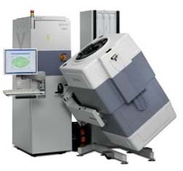
Specification Based Test
Circuit Under Test
v_{in}
v_{out}
ATE
Datasheet
Spec. 1
●●●
Spec. N
Test programs on Automatic Test Equipment (ATE) arrive at pass/fail decision
based on whether circuit under test (CUT) meets all data-sheet specifications.

Slide 14
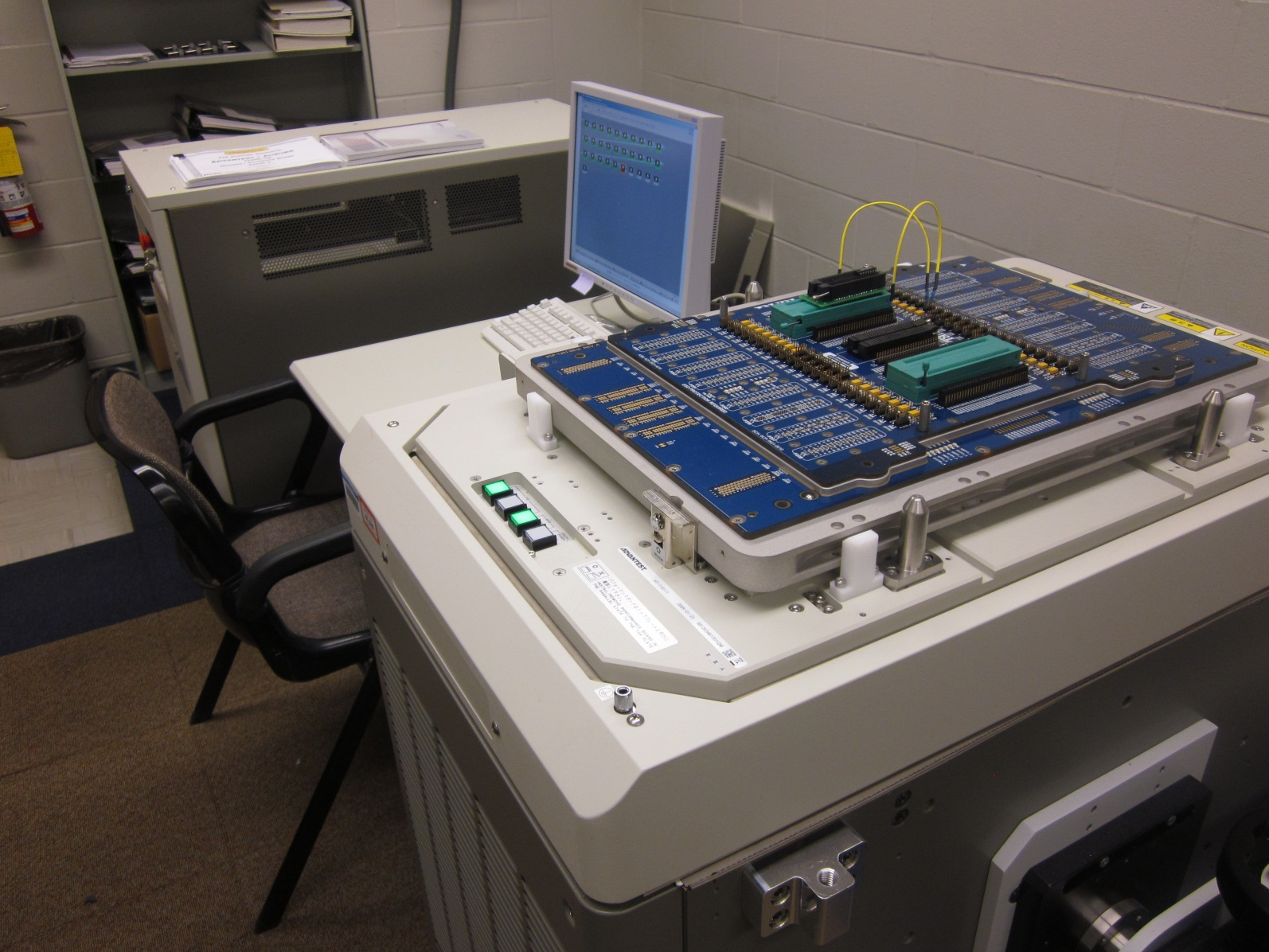
VLSI Test Lab at Auburn University

Slide 15
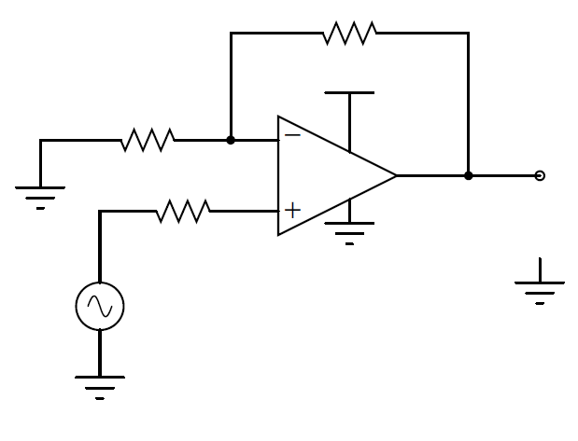
Specification Based Test: An Example
Non-inverting amplifier that employs an operational amplifier – μA741.
R_{f}= 4k
V_{DD}= 5V
R₁= 1k
μA741
V_{o}
R_{in}= 1k
V_{in}

Slide 16
Specification Based Test: Amplifier Example
Specification | Nominal value | Minimum value | Maximum value
DC gain | 5 | 4.9 | 5.1
3dB Bandwidth | 100kHz | 90kHz | 110kHz
Signal to noise ratio | 45dB | 43dB | 47dB
Input offset current | 500nA | 300nA | 520nA
Input offset voltage | 0.5mV | 0.3mV | 0.52mV
Output offset voltage | 2.5mV | 1.5mV | 2.6mV

Slide 17
Specification Based Test: Procedure
Each specification is measured for circuit under test (CUT).
Measured value is verified to be within minimum/maximum limits.
CUT is labeled GOOD, if and only if all measured specifications are within limits, else it is rejected.

Slide 18
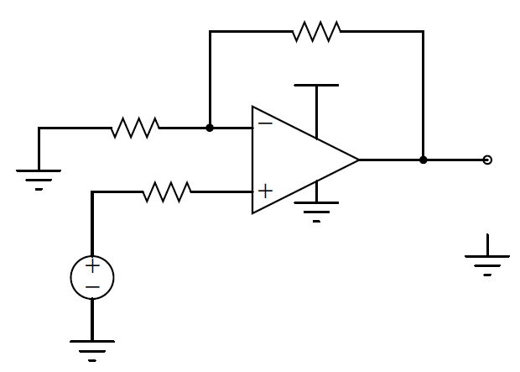
Measuring DC Gain: Test Setup
R_{f}= 4k
V_{DD}= 5V
R₁= 1k
μA741
V_{o}
R_{in}= 1k
V_{in}
0V-1V
Compute Vo/Vi, by varying V_{in} in the range 0-1V
at intervals of 0.1V

Slide 19
DC Gain: Results
Measured DC gain at various sample points for two CUT.
V_{o}/V_{in}= 1+R_{f}/R₁= 5
(Ideal)
Passing Device
DC Gain = V_{o}/V_{in}
Failing Device
V_{in} (in V)

Slide 20
Measuring Bandwidth: Test Setup
R_{f}= 4k
V_{DD}= 5V
R₁= 1k
μA741
V_{o}
R_{in}= 1k
V_{in} = 1V
Variable
frequency
source

Slide 21
Bandwidth Measurement Procedure
Procedure:
Set input voltage amplitude to 1V.
Sweep input frequency from 10Hz to 10MHz.
Find gain at each frequency.
Frequency at which gain falls 3dB below its value at 10Hz is the bandwidth.

Slide 22
Bandwidth Measurement: Results
Measured spectrum of two CUT on NI ELVIS*
-3dB gain threshold
Gain (dB)
BW of PASSING part = 93kHz
BW of FAILED part = 87.5kHz
(Acceptable BW: 90-110kHz)
Frequency (Hz)
*NI ELVIS: National Instruments Electronic Virtual Instrumentation Suite

Slide 23
Outline
Introduction to analog/RF circuit test
Techniques for analog/RF circuit test
Specification based test with examples
Alternate test with examples
Conclusion

Slide 24
Analog Circuit Testing: Alternate Test
Alternate test
Has limited acceptance in the industry. Has been used for RF/analog circuits in academic literature.
CUT is classified as PASS/FAIL based on an economically measurable parameter instead of direct measurement of specification.
A regression model relating the easier-to-measure parameter with all the circuit specifications is developed a priori. This regression model is then used to classify the CUT as PASS/FAIL.

Slide 25
Alternate Test: An Example
Problem:
To measure the DC gain and Input offset current
using only one measurement – supply current.
R_{f}= 4k
V_{DD}= 5V
R₁= 1k
μA741
V_{o}
R_{in}= 1k
V_{in}

Slide 26
Alternate Test: An Example
Specifications and limits on alternate measurement: I_{DD}, zero-input supply current.
 |  | MINIMUM | MAXIMUM
Actual specification | DC gain (Nominal = 5) | 4.9 | 5.1
Alternate measurement | I_{DD} | 3.8mA | 4.1mA
DC gain
 |  | MINIMUM | MAXIMUM
Actual specification | Input offset Current (Nominal=500nA) | 300nA | 520nA
Alternate measurement | I_{DD} | 3.85mA | 4.2mA
Input
offset
current

Slide 27
Alternate Test: DC Gain
Measured scatter plot of DC gain vs. I_{DD} of 300 devices
Accepted
I_{DD} range
DC Gain
Acceptable
DC gain
Yield loss = 3.33%
Defect level = 26.29%
I_{DD} (mA)

Slide 28
Alternate Test for DC Gain: Summary
Out of 300 devices tested for DC gain:
No. of truly good parts = 195
No. of good parts passing the alternate test = 185
No. of bad parts passing the alternate test = 66
No. of good parts rejected by the test = 10
True yield = 195/300 = 65%
Yield loss = (195-185)/300 = 3.33%
Defect level = 66/(185+66) = 26.29%

Slide 29
Alternate Test: Input Offset Current
Measured scatter plot of I_{offset} vs. I_{DD} of 300 devices
Accepted I_{DD}
I_{offset}(nA)
Yield loss = 9.67%
Defect level = 0%
Accepted I_{offset} current
I_{DD} (mA)

Slide 30
Alternate Test for I_{offset}: Summary
Out of 300 devices tested for I_{offset}:
No. of true good parts = 299
No. of good parts passing the alternate test = 270
No. of bad parts passing the alternate test = 0
No. of good parts rejected by the test = 29
True yield = 299/300 = 99.67%
Yield loss = (299-270)/300 = 9.67%
Defect level = 0/(270+0) = 0%

Slide 31
Conclusion
Specification based test is a prevalent technique used for circuit testing.
Set of measured performance parameters are compared with the datasheet limits through direct measurements, using custom-built instrumentation.
Alternate test is a novel method for testing analog/RF circuits.
Uses an indirect easier-to-measure quantity to classify the chip as pass or fail.
Pass/fail limits for measured quantity are determined by experiment or Monte Carlo simulation to minimize yield loss (YL) and defect level (DL).

Slide 32
A Problem to Solve
An alternate test for an operational amplifier consists of the measurement of the zero input supply current, IDD(0). To set the pass/fail thresholds for IDD(0), Monte Carlo simulations are performed for 1,000 sample circuits in which component values are randomly varied. The computed gain and IDD(0) for these samples are shown in the following graph, where each sample appears as a point (assume that the total number of points is 1,000). Compute the defect level and yield loss as percentages.

Slide 33
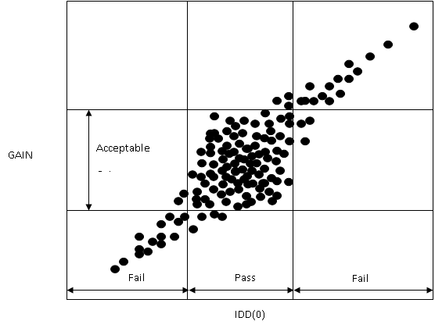

Slide 34
Answer
3 bad chips pass test
15 bad chips fail test
3 good chips fail test
GAIN
Acceptable
Gain
2 good chips fail test
14 bad chips fail test
4 bad chips pass test
Fail
Pass
Fail
IDD(0)

Slide 35
True Yield:
Y = [(1,000 – 14 – 2 – 15 – 3)/1,000]·× 100 = 96.7%
Yield loss:
YL = (Good chips failing test/All fabricated chips) × 100
= [(2+3)/(1,000 – 14 – 2 -15 – 3)] × 100 = 0.51%
Defect level:
DL = (Bad chips passing test/All chips passing test) × 100
= [(3+4)/(1,000 – 14 – 2 – 15 – 3)]·× 100 = 0.72%

Slide 36
References – Analog Test
A. Afshar, Principles of Semiconductor Network Testing, Boston: Butterworth-Heinemann, 1995.
M. Burns and G. Roberts, Introduction to Mixed-Signal IC Test and Measurement, New York: Oxford University Press, 2000.
M. L. Bushnell and V. D. Agrawal, Essentials of Electronic Testing for Digital, Memory and Mixed-Signal VLSI Circuits, Boston: Springer, 2000.
R. W. Liu, editor, Testing and Diagnosis of Analog Circuits and Systems, New York: Van Nostrand Reinhold, 1991.
M. Mahoney, DSP-Based Testing of Analog and Mixed-Signal Circuits, Los Alamitos, California: IEEE Computer Society Press, 1987.
A. Osseiran, Analog and Mixed-Signal Boundary Scan, Boston: Springer, 1999.
T. Ozawa, editor, Analog Methods for Computer-Aided Circuit Analysis and Diagnosis, New York: Marcel Dekker, 1988.
B. Vinnakota, editor, Analog and Mixed-Signal Test, Upper Saddle River, New Jersey: Prentice-Hall PTR, 1998.

Slide 37
References – RF Test
S. Bhattacharya and A. Chatterjee, "RF Testing," Chapter 16, pages 745-789, in System on Chip Test Architectures, edited by L.-T. Wang, C. E. Stroud and N. A. Touba, Amsterdam: Morgan-Kaufman, 2008.
M. L. Bushnell and V. D. Agrawal, Essentials of Electronic Testing for Digital, Memory & Mixed-Signal VLSI Circuits, Boston: Springer, 2000.
J. Kelly and M. Engelhardt, Advanced Production Testing of RF, SoC, and SiP Devices, Boston: Artech House, 2007.
B. Razavi, RF Microelectronics, Upper Saddle River, New Jersey: Prentice Hall PTR, 1998.
J. Rogers, C. Plett and F. Dai, Integrated Circuit Design for High-Speed Frequency Synthesis, Boston: Artech House, 2006.
K. B. Schaub and J. Kelly, Production Testing of RF and System-on-a-chip Devices for Wireless Communications, Boston: Artech House, 2004.

Slide 38
References – Alternate Test
P. N. Variyam, S. Cherubal and A. Chatterjee, “Prediction of Analog Performance Parameters Using Fast Transient Testing,” IEEE Trans. Computer-Aided Design, vol. 21, no. 3, pp. 349-361, March 2002.
H.-G. Stratigopoulos and Y. Makris, “Error Moderation in Low-Cost Machine-Learning-Based Analog/RF Testing,” IEEE Trans. Computer-Aided Design, vol. 27, no. 2, pp. 339-351, February 2008.

