Slide 1
True Minimum Energy Design Using Dual Below-Threshold Supply Voltages
Kyungseok Kim and Vishwani D. Agrawal
ECE Dept. Auburn University
Auburn, AL 36849, USA
24th International Conference on VLSI Design
Chennai, January 4, 2011

Slide 2
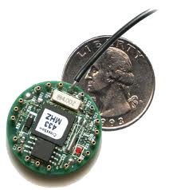
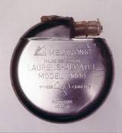
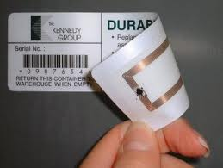
Energy Constrained Systems
System Properties [1]
Low activity rates
Relaxed performance requirements
Long battery lifetime (more than 1 year)
Energy harvesting from the environment
Solar, Vibration, Thermoelectric
Examples :
Micro-sensor networks, Pacemakers, RFID tags, and Portable devices

Slide 3
Minimum Energy Operation
Minimum Operating Voltage (Vmin)
Swanson and Meindl (1972) [2]
Vmin = 8kT/q ≈ 200 mV at 300K
Ideal limit of the lowest possible supply voltage (2001) [3]
Vmin = 2kT/q ≈ 57 mV at 300K
Minimum Energy per Cycle (Emin )
Emin normally occurs in subthreshold region ( Vdd < Vth) if speed is not constrained.
Practical Emin may be higher for system performance
Vdd cannot be scaled down to achieve Emin
3

Slide 4
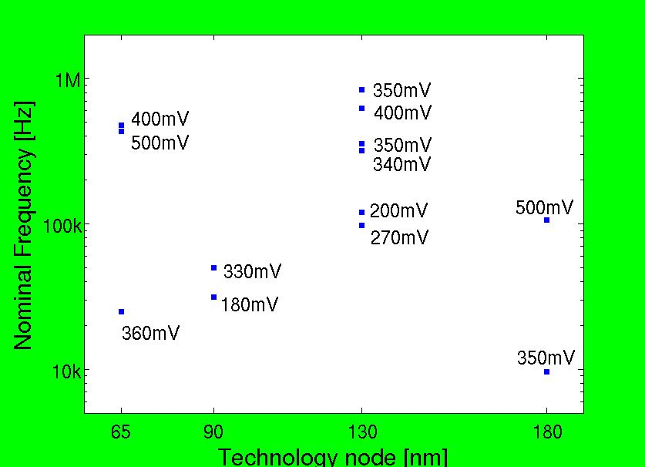
Previous Work
Published subthreshold or near-threshold VLSI design and operating voltage for minimum energy per cycle [4]
All work assumes scaling of a single Vdd

Slide 5
Motivation
Energy budget for energy constrained systems may need to be more stringent for long battery life or energy harvesting.
Minimum energy operation has a huge penalty in system performance.
Near-threshold design gives moderate speed, but increases energy consumption about 2X from Emin.
Utilizing time slack for low power design is common at above-threshold, but has not been explored in subthreshold operation.
Sizing affects functional failure and fixed mult-Vth by foundries may not be adequate to utilize time slack in subthreshold region. But, two supply voltages are manageable and acceptable in today’s VLSI design

Slide 6
Dual-V_{dd} Design
Apply V_{DDH} to gates on critical paths to maintain performance, while V_{DDL} to gates on non-critical paths to reduce power.
Two heuristic algorithms
Clustered Voltage Scaling (CVS) [5]
Extended Clustered Voltage Scaling (ECVS) [6]
- Use level converters in a combinational circuit block to achieve
more power saving than CVS.
Level converter has unacceptable delay overhead in subhreshold region.
PTM 90nm CMOS Gate delay | Nominal V_{DDH}=1.2V, V_{DDL}=0.8V | Subthreshold V_{DDH}=0.3V, V_{DDL}=0.25V
INV (fanout = 4) Level converter (LC) | 23.64 psec 112.33 psec | 1.52 nsec 121.86 nsec
LC / INV (FO=4) | 4.8 | 80.2
Eliminate use of LCs by topological constraints in MILP !!

Slide 7
MILP for VDDL Assignment
Objective Function
Performance requirement TC (VDDH) is given.
Integer variable Xi : 0 for a VDDH cell or 1 for a VDDL cell.
The optimal VDDL is searched with MILP constraints by multiple-run between Vmin and VDDH.

Slide 8
Timing Constraints
Ti is the latest arrival time at the output of gate i from PI events [7]
T2 ≥ T1 + td,VDDL×X2 + td,VDDH×(1-X2)
1
2
3
4

Slide 9
Topological Constraints
Xj
=0
=1
j
HH: Xi – Xj = 0
Xi
=1
=0
LL: Xi – Xj = 0
VDDH
VDDL
i
HL: Xi – Xj = 1
VDDL
VDDH
k
LH: Xi – Xj = -1

Slide 10
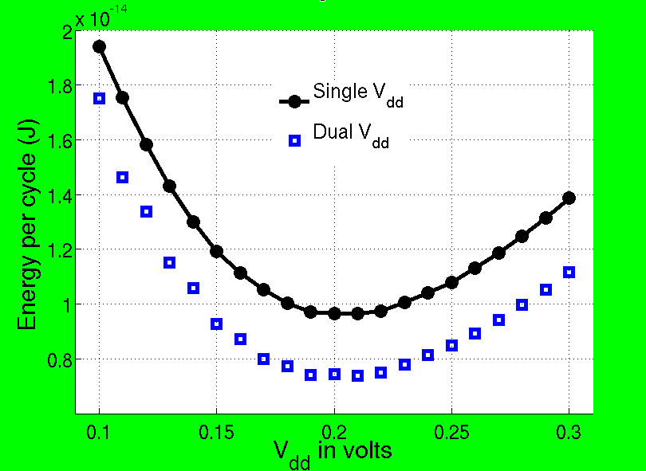
16-bit Ripple Carry Adder (RCA)
Energy Saving
23.6%
Speed-up
4X
PTM 90nm CMOS (α=0.21, total gates=179)
Operation | V_{DD} (V) | Energy/cycle (fJ) | Clock rate
Nominal | 1.2 | 263.4 | 1.16 GHz
Minimum Energy Single V_{DD} | 0.21 | 9.65 | 2.15 MHz
Dual V_{DD} ( energy opt.) | 0.21, 0.14 | 7.37 | 2.15 MHz
Dual V_{DD} ( perf. opt.) | 0.27, 0.19 | 9.42 | 8.41 MHz

Slide 11
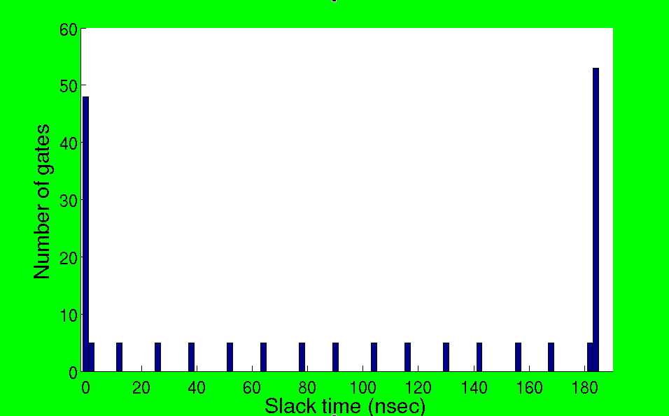
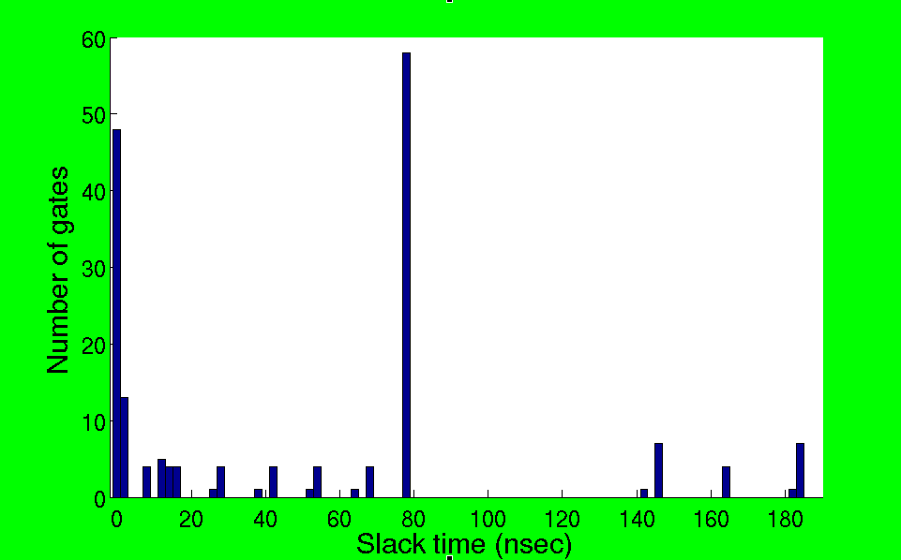
Gate Slack Distribution
large slack gates
Non-optimized 16-bit RCA
Single Vdd = 0.21V at Emin
Optimized 16-bit RCA
VDDH= 0.21V, VDDL= 0.14V
Topological
constraints

Slide 12
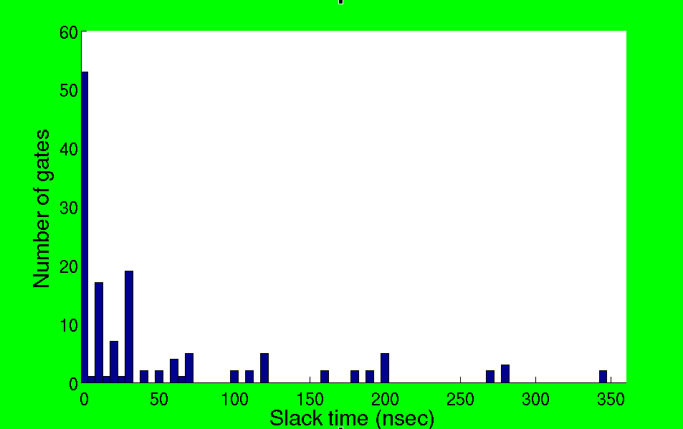
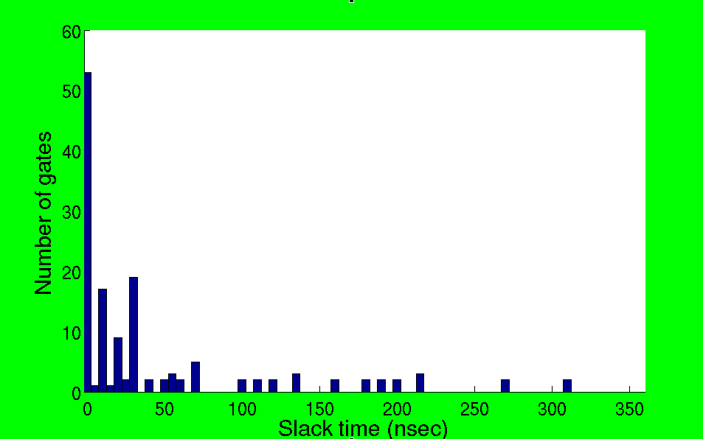
4x4 Multiplier
PTM 90nm CMOS (α=0.32, total gates=140)
Operation | V_{DD} (V) | Energy/cycle (fJ) | Clock rate
Minimum Energy Single V_{DD} | 0.17 | 9.48 | 1 MHz
Dual V_{DD} ( energy opt.) | 0.17, 0.12 | 8.99 | 1 MHz
Dual V_{DD} ( perf. opt.) | 0.19, 0.13 | 9.19 | 1.67 MHz
Non-optimized
Optimized
Energy Saving 5.2%
Path balanced circuits reduce energy saving or speed-up from dual Vdd design.

Slide 13
Selected ISCAS’85 Benchmark
MILP solution at minimum energy single Vdd = VDDH
Benchmark circuit | Total gates | Activity α | V_{DDH} (V) | V_{DDL} (V) | V_{DDL} gates (%) | E_{single} (fJ) | E_{dual} (fJ) | Reduc. (%) | Freq. (MHz)
C880 | 360 | 0.18 | 0.24 | 0.18 | 46.4 | 14.4 | 11.2 | 22.2 | 13.6
c2670 | 901 | 0.16 | 0.25 | 0.21 | 46.4 | 32.8 | 28.0 | 14.8 | 17.4
C5315 | 2077 | 0.26 | 0.24 | 0.19 | 47.1 | 116.8 | 98.0 | 16.1 | 9.8
C6288 | 2407 | 0.28 | 0.29 | 0.18 | 2.7 | 165.4 | 162.0 | 2.1 | 9.4
C7552 | 2823 | 0.20 | 0.25 | 0.21 | 42.3 | 131.7 | 117.1 | 11.1 | 13.6
** PTM 90nm CMOS

Slide 14
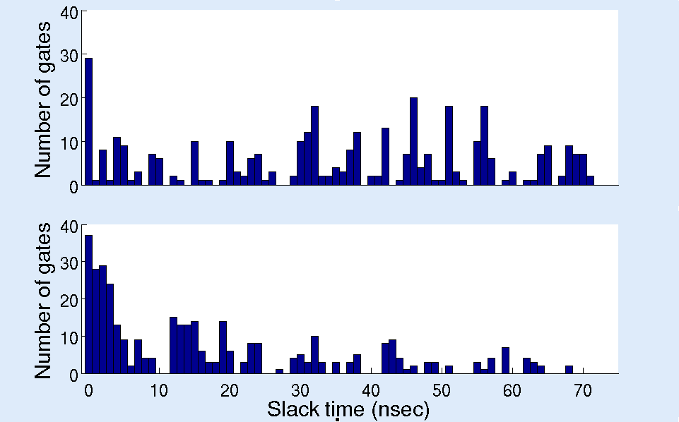
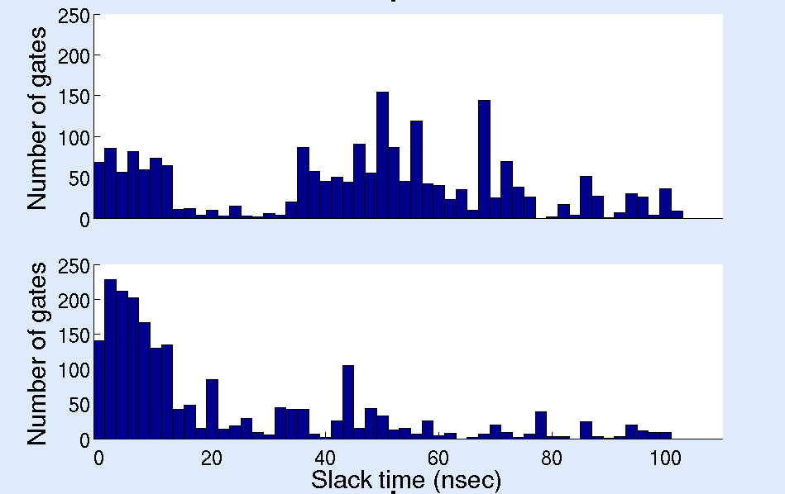
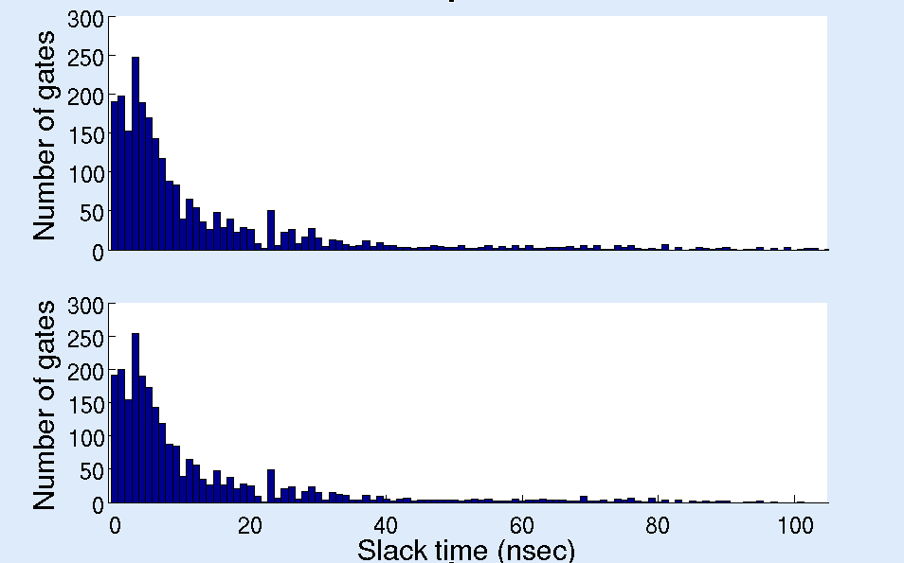
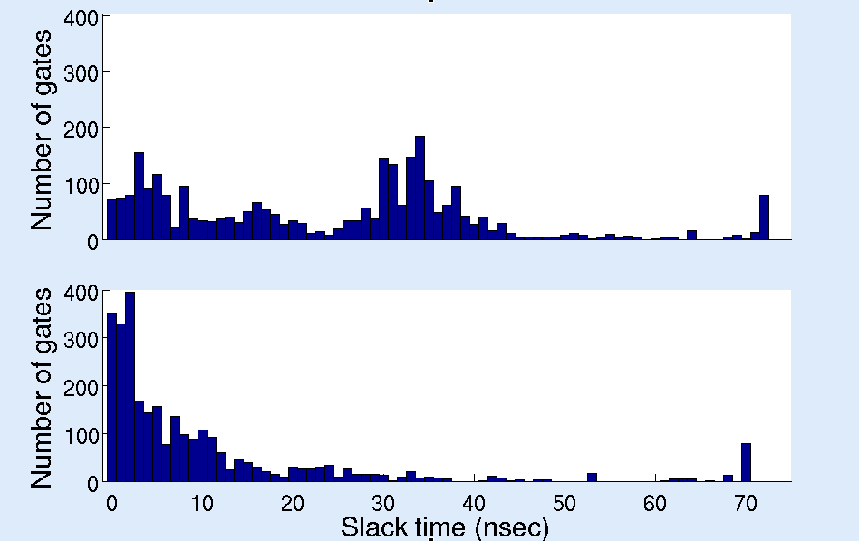
Gate Slack Distribution
c880
c5315
c6288
c7552

Slide 15
MILP for High Performance
MILP is applicable for all performance criteria between minimum energy mode and nominal high performance mode
Benchmark circuit | Total gate | Activity α | V_{DDH} (V) | V_{DDL} (V) | V_{DDL} gates (%) | E_{single} (fJ) | E_{dual} (fJ) | Reduc. (%)
C880 | 360 | 0.18 | 1.2 | 0.59 | 56.9 | 277.6 | 136.1 | 51.0
c1908 | 584 | 0.20 | 1.2 | 0.67 | 26.9 | 496.5 | 402.4 | 19.0
C2670 | 901 | 0.16 | 1.2 | 0.69 | 57.9 | 647.6 | 337.9 | 47.8
C3540 | 1270 | 0.33 | 1.2 | 0.70 | 11.6 | 1844.0 | 1667.0 | 9.6
C6288 | 2407 | 0.28 | 1.2 | 1.18 | 53.1 | 3066.0 | 2976.0 | 2.9
** PTM 90nm CMOS
Delay exponentially depends on Vdd in subthreshold region, but is polynomial dependence following the alpha-power law model [8] in above-threshold operation.
This delay characteristic causes less energy saving for subthreshold circuits

Slide 16
Conclusion and Future Work
Dual Vdd design is valid for energy reduction below the minimum energy achievable by a single Vdd as well as for substantial speed-up within the minimum energy budget of a bulk CMOS subthreshold circuit.
Use of a conventional level converter is impractical due to huge delay in subthreshold dual-Vdd design and is eliminated by topological constraints in MILP.
Presented MILP for mininum energy CMOS design is applicable from minimum energy operation to high performance operation.
Delay of a subthreshold circuit is susceptible to process variation and investigation is needed in the minimum energy design.
Removing topological constraints in MILP by a proper level-shifting device is needed to achieve more energy saving.
Investigate technology scaling effect for dual-Vdd design in subtheshold region.

Slide 17
References
[1] A. Wang, B. H. Calhoun, and A. P. Chandrakasan, Sub-Threshold Design for Ultra Low-Power Systems. Springer, 2006.
[2] R. M. Swanson and J. D. Meindl, “Ion-Implanted Complementary MOS Transistors in Low-Voltage Circuits,” IEEE JSSC, vol. 7, no. 2, April 1972.
[3] A. Bryant, J. Brown, P. Cottrell, M. Ketchen, J. Ellis-Monaghan, E. Nowak, I. Div, and E. Junction, “Low-power CMOS at Vdd= 4kT/q,” in Device Research Conference, 2001, pp. 22–23.
[4] M. Seok, D. Sylvester, and D. Blaauw, “Optimal Technology Selection for Minimizing Energy and Variability in Low Voltage Applications,” in Proc. of International Symp. Low Power Electronics and Design, 2008, pp. 9–14.
[5] K. Usami and M. Horowitz, “Clustered Voltage Scaling Technique for Low-Power Design,” in Proceedings of International Symposium on Low Power Design, 1995, pp. 3–8.
[6] K. Usami, M. Igarashi, F. Minami, T. Ishikawa, M. Kanzawa,M. Ichida, and K. Nogami, “Automated Low-Power Technique Exploiting Multiple Supply Voltages Applied to a Media Processor,” IEEE Journal of Solid-State Circuits, vol. 33, no. 3, pp. 463–472, 1998.
[7] T. Raja, V. D. Agrawal, and M. L. Bushnell, “Minimum Dynamic Power CMOS Circuit Design by a Reduced Constraint Set Linear Program,” in Proceedings of 16th International Conference on VLSI Design, Jan.2003, pp. 527–532.
[8] T. Sakurai and A. Newton, “Alpha-Power Law MOSFET Model and Its Applications to CMOS Inverter Delay and Other Formulas,” IEEE Journal of Solid-State Circuits, vol. 25, no. 2, pp. 584–594, Apr. 1990.

Slide 18
Thank you!!
&
Questions?

