Slide 1
MobSched: An Optimizable Scheduler for Mobile Cloud Computing
S. Sindia S. Gao B. Black
Lim V. D. Agrawal P. Agrawal
Auburn University, Auburn, AL
45th IEEE Southeastern Symposium on System Theory 2013, Waco, TX
March 11, 2013

Slide 2
Outline
Traditional vs. cloud computing
Mobile vs. classical cloud computing
The scheduling problem
MobSched: Proposed formulation
Results
Conclusion

Slide 3
Traditional Computing
User
Interface
User
Dedicated
computer

Slide 4
Cloud Computing
User
Interface
User
Interface
Scheduler
User
Cloud of shared
computers
User
Interface

Slide 5
Scheduling in Cloud Computing
Govt.
Enterprise
R&D
Individual
Cloud
Customer
job
job
job
job
Service-provision Scheduling
Cloud
Provider
service
service
service
service
Server farms
Notes:
A typical scenario that would call for scheduling in classical cloud computing. Two parts: Cloud customer and cloud provider. Scheduler plays the role of provisioning service to the jobs as seamlessly as possible. Homogeneous service provider, but heterogeneous job seekers.

Slide 6
Scheduling in Mobile Cloud Computing
Cloud
Customer
job
job
job
job
Service-provision Scheduling
Cloud
Provider
service
service
service
service
Notes:
More homogeneous nature of job seekers. But service providers can be heterogeneous: cloud of servers or compute available on individual users willing to share their compute resource.

Slide 7
Scheduling Hierarchy in Mobile Cloud Computing
Social networks, Office suites,
Video processing, etc.
SERVICE
Data Management
Interface and Portals
Hosting and Mediating
MIDDLEWARE
Billing and Metering
Monitoring and Logging
Security Management
Meta tasks
MobSched
Task Execution Scheduling
INFRASTRUCTURE

Slide 8
Scheduling Hierarchy in Mobile Cloud Computing
Social networks, Office suites,
Video processing, etc.
SERVICE
Data Management
Interface and Portals
Hosting and Mediating
MIDDLEWARE
Billing and Metering
Monitoring and Logging
Security Management
Meta tasks
MobSched
Task Execution Scheduling
INFRASTRUCTURE

Slide 9
Desirable Features of Scheduler
Tunable/Optimizable for specific needs
E.g.: system power, throughput, load balanced, fault tolerant, etc.
Dynamic
Adaptive to time-varying load conditions
Low overhead/latency
Responsive with short lead times

Slide 10
Scheduling Problem
Decision Problem
Optimization Problem
For a specified feasible solution, problem needs a YES or NO answer as to where the object is achieved
Computationally easy problem
Requires finding the best solution among all the feasible solutions
Computationally hard problem

Slide 11
Common Schedulers
Fair scheduler
Assigns equal resource to all tasks
Helps keep the load balanced
FIFO scheduler
First in – first out heuristic
Simple scheme, low overhead
Capacity scheduler
Cluster capacity to multiple queues each of which contains fraction of capacity

Slide 12
MobSched: Problem Formulation
Objective:
Constraints:
Linear Programming Problem
power consumed by each node
throughput offered by each node
link quality between i^{th} node and the rest

Slide 13
Experimental Setup
Optical character recognition & translation problem
Input is image of text in a foreign language
Program returns translated output in English
Four computers serve as load generators
Cluster of four computers serve as cloud

Slide 14
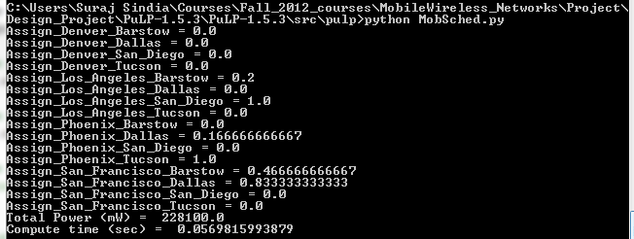
Example Run on MobSched
Linear Programming problem solved using
Python’s PuLP package

Slide 15
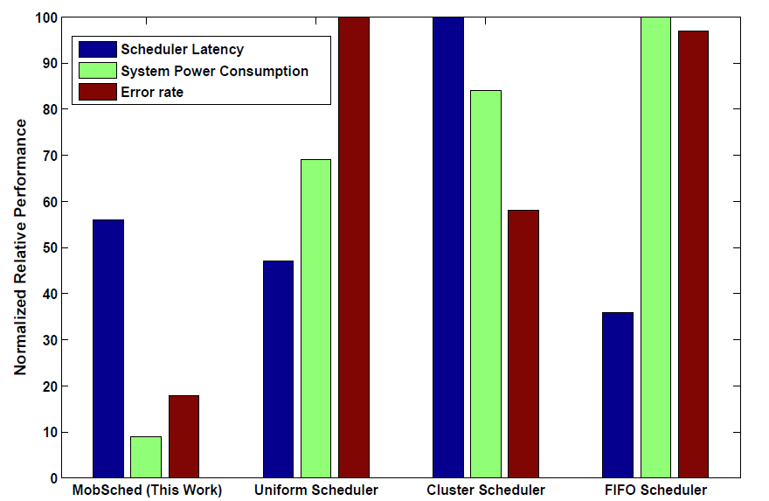
Comparison of Scheduler Metrics

Slide 16
Conclusion
Computing on mobile devices needs sophisticated schedulers
Tunable, responsive, low overhead
Conventional schedulers cannot adequately address the needs of mobile cloud computers
MobSched provides a hybrid scheme that can optimize for one or more parameters dynamically at a low overhead.
Thanks to the LP formulation

Slide 17
Q
A

