Slide 1
Optimal Power-Constrained SoC Test Schedules with Customizable Clock Rates
Vijay Sheshadri, Vishwani D. Agrawal, Prathima Agrawal
Dept. of Electrical and Computer Engineering
Auburn University, AL 36849, USA

Slide 2
Outline
Introduction
Problem Statement
Background
Test Compatibility Graph
Integer Linear-Programming Model
Results
Conclusion

Slide 3
Introduction
Technology scaling has led to more cores and increased complexity in SoC devices.
This has resulted in high test data volumes and longer test times.
Reducing test time is one of the major objectives in SoC testing

Slide 4
Test Schedule Optimization Problem
Given an SoC with N core tests and a peak power budget, find a test schedule to:
Test all cores.
Maximize concurrency to reduce test time.
Conform to power budget by restricting concurrency.
Notes:
3D bin packing - Test power, time and resource are the 3 axes. SoC and core tests are modeled as 3D boxes. Idea is to fit all the core boxes in the Soc box optimally
SA – test pin allocation to each core is optimized using SA algo
ILP – test scheduling is formulated into a math model for optimization

Slide 5
Background
Y. Zorian, “A distributed control scheme for complex VLSI devices,” VTS’93, pp. 4–9.
Introduced ASIC Z
ASIC Z often used as benchmark for SoC test scheduling
RAM 2
(61,241)
RAM 3
(38,213)
Random logic 1 (134, 295)
Random logic 2 (160, 352)
Blocks of ASIC Z, and their test time (in a.u.) and test power (in mW)
ROM 1
(102,279)
ROM 2
(102,279)
RAM 4
(23,96)
RAM 1
(69,282)
Reg. file
(10,95)
P_{max}= 900
Block
(time, power)

Slide 6
Background
R. M. Chou et al, “Scheduling tests for vlsi systems under power constraints,” IEEE Trans. VLSI Systems, vol. 5, no. 2, pp. 175–185, 1997.
Power and resource constrained test scheduling.
Total test time for ASIC Z = 331 units.
E. Larsson and Z. Peng, “An integrated framework for the design and optimization of soc test solutions,” JETTA, vol. 18, pp. 385–400, 2002.
Bin packing algorithm with Best-fit Decreasing heuristic.
Total test time for ASIC Z = 300 units.

Slide 7
Background
Comparison of existing optimal test schedules for ASIC Z.
Test Session | Chou et al. |  | Larsson and Peng
 | Test Time | Blocks | Test Time | Blocks
1 | 69 | RAM1,RAM3,RAM4,RF | 160 | RL2,RL1,RAM2
2 | 160 | RL1,RL2 | 102 | RAM1, ROM1, ROM2
3 | 102 | ROM1,ROM2,RAM2 | 38 | RAM3, RAM4,RF
 | 331 |  | 300

Slide 8
Background
K. Chakrabarty, “Test scheduling for core-based systems using mixed-integer linear programming,” IEEE TCAD, vol. 19, no. 10, pp. 1163–1174, 2000.
Resource constrained test scheduling using Integer Linear Programming.

Slide 9
Test Compatibility Graph (TCG)
Node represent core tests and edges represent compatibility.
All nodes (tests) connected by the same edges can run simultaneously.
Each sub-graph rep. a test session.
1
(2,100)
2
(1,10)
6
(1,100)
3
(2,10)
5
(1,10)
4
(1,5)
P_{max} = 4
Core tests i
(p_{i} ,t_{i})
TCG from R.M.Chou et al, IEEE VLSI, 1997
Node notation

Slide 10
Test Compatibility Graph (TCG)
i^{th} core test characterized by test time, t_{i} and power, p_{i,} at nominal frequency, f_{nom}
For j^{th} session(sub-graph):
Test time, T_{j} = max{t_{i} },
Test power, P_{j} = ∑ (p_{i})
Example: for session 1-5,
t₁ = 100, t₅ = 10 => T₁₋₅ = 10
p₁ = 2, p₅ = 1 => P₁₋₅ = 3
1
(2,100)
2
(1,10)
6
(1,100)
3
(2,10)
5
(1,10)
4
(1,5)
P_{max} = 4
Core tests i
(p_{i} ,t_{i})
TCG from R.M.Chou et al, IEEE VLSI, 1997
Node notation

Slide 11
ILP Formulation
Given:
Power budget for SoC, P_{max}
N core tests for an SoC.
t_{i} = test time and p_{i} = test power of i^{th} test characterized at a nominal frequency, f_{nom}
K sessions in the test schedule for N core tests.
Test time of j^{th} session is, T_{j} = max{t_{i} },
Test power of j^{th} session is, P_{j} = ∑ (p_{i}),

Slide 12
ILP: Nominal Test Clock
All tests sessions assumed to run at nominal test clock frequency, f_{nom}.
Let x_{j} be binary decision variable for the j^{th} session.
Objective:
Minimize , where
Subject to:
Power constraint:
Test completeness constraint:

Slide 13
ILP: Nominal Test Clock
All tests sessions assumed to run at nominal test clock frequency, f_{nom}.
Total test time for ASIC Z = 300 units.

Slide 14
Variable Test Clock Frequency
Selectable clock frequency for each test session.
Increasing test clock frequency, by a factor f, lowers test time but raises power consumption.
core test time, and power,
f < 1 => increases test time but allows more tests to run in parallel by lowering power.

Slide 15
Frequency Factor
We define frequency factor of i^{th} test as:
,
f_{i_max} : max. frequency of core test limited due to power or structural constraint.
Frequency factor of j^{th} session defined as:
F_{j} = min{ f_{i} } ,
Proper choice F_{j} for sessions can lower overall test time.
0 ≤ f_{i} ≤ f_{i_max}

Slide 16
ILP: Variable Test clock
Objective:
Minimize , where
Subject to:
Power constraint:
Test completeness constraint:

Slide 17
f_{i_max} for ASIC Z
Based on test time and power, f_{i_max} values assigned to ASIC Z blocks.
With these values, we optimize the test schedule for ASIC Z.
Block | f_{i_max}
RAM 1 | 1.75
RAM 2 | 2
RAM 3 | 3
RAM 4 | 5
ROM 1 | 1.5
ROM 2 | 1.5
RL 1 | 1.2
RL 2 | 1
RF | 8

Slide 18
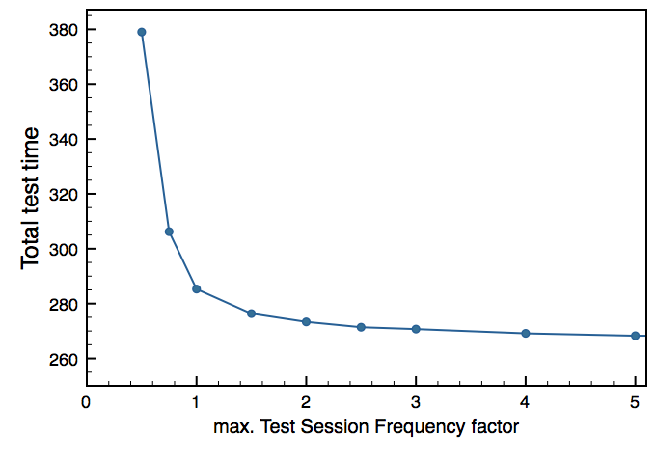
Results
Nominal clock
Nominal test frequency
Variable test frequency
Slower clock
Faster clock

Slide 19
Results
Nominal test session frequency.
Session | Blocks | Test time
1 | RAM1, ROM1, ROM2 | 160
2 | RAM3, RAM4, RF | 102
3 | RAM2, RL1, RL2 | 38
Total Test time = |  | 300

Slide 20
Results
Variable test session frequency.
Session | Blocks | Freq. factor | Test time
1 | RAM1, ROM2 | 1.5 | 68
2 | RAM2, RAM3 | 1.98 | 30.77
3 | RAM4, RF | 4.71 | 4.88
4 | ROM1, RL1, RL2 | 0.97 | 164.624
Total Test time = |  |  | 268.274

Slide 21
Results
Slower clock: 0 ≤ F_{j} ≤ 1
Session | Blocks | Freq. factor | Test time
1 | ROM1,2 & RL 1,2 | 0.75 | 214.224
2 | RAM 1,2,3,4 & RF | 0.97 | 71.07
Total Test time = |  |  | 285.294

Slide 22
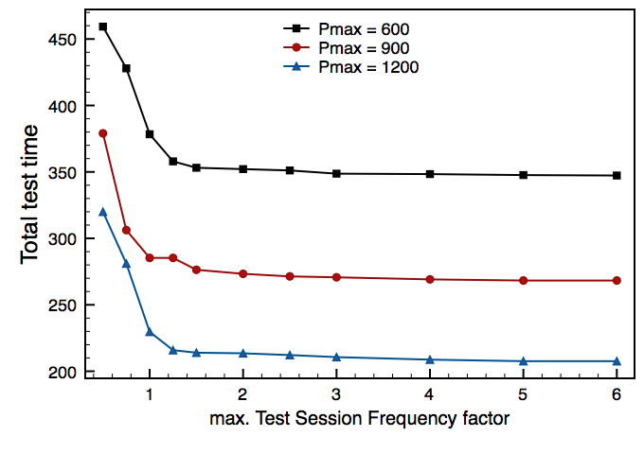
Results
Effect of P_{max} on the test schedule optimization:

Slide 23
Conclusion
New method for power-constrained test schedule optimization.
Custom clock rate for each test session.
Proposed method demonstrated on ASIC Z.
Increasing and decreasing clock rate show improvement over existing solution.
Future work: investigating influence of V_{DD} and clock rate on the optimization process.
Preliminary results show a total test time = 175 units for ASIC Z

Slide 24
Recent Work
X. Kavousianos, K. Chakrabarty, A. Jain, R. Parekhji, “Time-Division Multiplexing for Testing SoCs with DVS and Multiple Voltage Islands”, ETS 2012, pp 1-6.
V. Sheshadri, V. D. Agrawal, P. Agrawal, “Optimum Test Schedule for SoC with Specified Clock Frequencies and Supply Voltages”, VLSID 2013 (accepted).

Slide 25
Thank you

