Slide 1
Dual-Threshold Design of Sub-Threshold Circuits
Jia Yao and Vishwani D. Agrawal
Department of Electrical and Computer Engineering
Auburn University
Auburn, AL 36830, USA

Slide 2
Outline
Motivation and background
Single-Vth design
Dual-Vth design
Our framework and slack-based algorithm
Implementation results
Summary

Slide 3
Motivation and Background
Demand for energy constrained designs, like portable electronics, medical electronics and sensors
Minimum energy operation typically occurs in sub-threshold region [1]
Increasing problems of leakage current as technology scales down
Dual-Vth technique is effective for reducing leakage power. How about energy per cycle?

Slide 4
Motivation and Background
Sub-threshold current [2]
(1)
where
(2)
When Vds > 3Vt , Eq (1) can be further simplified to
(3)
Note: μ is effective mobility, Cox is oxide capacitance, W is transistor width, L is transistor length, Vgs is gate-source voltage, Vds is drain-source voltage, Vt is thermal voltage, Vth is threshold voltage and n is sub-threshold slope.

Slide 5
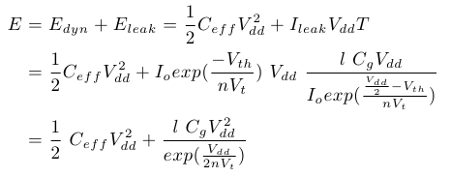
Single-Vth Design
Energy Per Cycle is independent of Vth
(4)
Ceff is average switched capacitance per clock cycle in the circuit, Cg is gate capacitance of a characteristic inverter, l is the length of critical path in terms os characteristic inverters and T is clock period

Slide 6
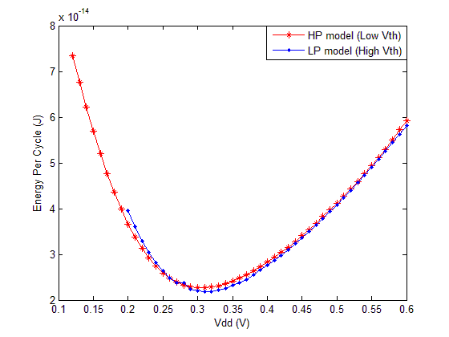
Single-Vth Design
HSPICE simulations for EPC for 32-bit RCA
single-Vth designs
PTM 32nm technology with Wn=5L and Wp=12L
Each design runs at its maximum operating frequency
Energy per cycle of the two designs remain practically same over sub-threshold supply voltage region

Slide 7
Dual-Vth Design
Low Vth gate is fast but more leaky
High Vth gate is slow but less leaky
Dual Vth design reduces EPC by
inserting high Vth gates to reduce leakage power while keeping maximum operating frequency
Maximum operating frequency is obtained from single-Vth design with low Vth
For given circuit netlist, our framework is able to generate optimum dual Vth design, optimal Vdd, optimal high Vth level and estimate the EPC

Slide 8
Slack-Based Algorithm
Step 1: Initialization
Assign low Vth to all gates
Step 2: First round of gate selection
Run STA to calculate slack for each gate (Si) and circuit Delay (T) for every Vdd and Vth conditions
If S(i) > Su, gate i can directly switch to high Vth
If S(i) < Sl, gate i can never switch to high Vth
If S (i) > Delta (i), gate i needs further verification
Note: Delta (i) = Dh(i) – Dl(i) Su = (k-1)/k * Tc and k = Tc’/Tc Sl = Min { Delta (i) }
Tc = maximum path delay of the circuit with low Vth
Tc’ = maximum path delay of the circuit with high Vth

Slide 9
Slack-Based Algorithm
Step3: Verification
For any gates j selected in Step2, switch it to high Vth and re-calculate gate slacks and circuit delay.
If newly calculated T $≤$ original T, gate j can switch to high Vth without circuit performance degradation
Step 4: Results
Generate dual Vth design, estimate EPC and
find out optimal Vdd and high Vth level with lowest EPC
Ceff,i and Pleak,i are obtained from HSPICE simulations of basic logic gates under varying Vdd, Vth and fan-out conditions

Slide 10
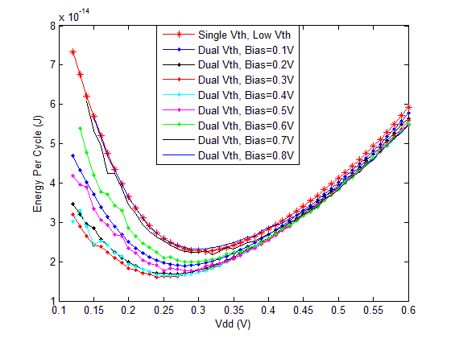
Implementation Results
HSPICE simulations for EPC for 32-bit RCA single and dual-Vth designs
Single-Vth design
Min EPC = 2.268E-014 J
Optimal Vdd = 0.31V
Dual-Vth design
Min EPC = 1.610E-014J
Optimal Vdd = 0.24V
Optimal Bias = 0.3V
Min EPC reduction : 29%

Slide 11
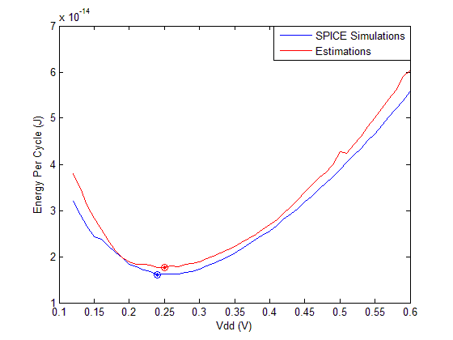
Implementation Results
HSPICE simulations Vs. estimation for EPC
for 32-bit RCA dual-Vth design at bias = 0.3V
HSPICE Simulation
Min EPC = 1.61E-014J
Optimal Vdd = 0.24V
Estimation
Min EPC = 1.77E-014J
Optimal Vdd = 0.25V
The average error between estimation and simulation is 6.99%

Slide 12
Summary
EPC of a single-Vth design is independent of threshold voltage
Dual-Vth design reduces EPC while maintaining maximum operating frequency
For 32-bit ripple carry adder, minimum EPC is reduced by 29% by dual-Vth approach
Our framework generates dual-Vth designs, estimates EPC, finds optimum Vdd and high Vth level; average EPC estimation error is under 7%

Slide 13
References
[1] A. Wang and A. P. Chandrakasan, “A 180mV FFT Processor using Subthreshold Circuits Techniques,” Proc. IEEE ISSCC, 2004, pp.292-529
[2] A. Wang, B. H. Calhoun and A. P. Chandrakasan, Sub-threshold Design for Ultra Low-Power Systems. Springer, 2006
[3] “Latest PTM Models.” Arizona State University, http://ptm.asu.edu/
(accessed on December 11, 2011)
[4] “HSPICE Reference Manual: Commands and Control Options, Version
D-2010.03-SP1,” June 2010. http://www.synopsys.com/Tools/Verification/
AMSVerification/CircuitSimulation/HSPICE/Pages/default.aspx
(accessed on October 14, 2011)
[5] K. Kim and V. D. Agrawal, “Ultra Low Energy CMOS Logic Using Below-Threshold Dual-Voltage Supply,” Journal of Low Power Electronics, vol. 7, no.4, pp. 460-470, December 2011
[6] M. Allani and V. D. Agrawal, “An Efficient Algorithm for Dual-Voltage Design Without Need for Level Conversion,” in Proceedings of IEEE Southeastern Symp. On System Theory, March 2012, pp.51-56
[7] M. Allani and V. D. Agrawal, “Energy-Efficient Dual-Voltage Design Using Topological Constraints,” Journal of Low Power Electronics, vol. 9, no.3, pp. 275-287, October 2013

