Slide 1
Retiming Scan Circuit To Eliminate Timing Penalty
Ozgur Sinanoglu
NYU - AD
Vishwani D. Agrawal
Auburn University
Notes:
The slide guide is available in the following file:
slidesV10.1.ppt: PowerPoint, version 2003 format.

Slide 2
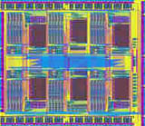
Scan Insertion
Combinational
Combinational
Circuit
Sequential test generation
Sequential
Circuit
Flip-flops converted to
fully accessible scan cells
Bring the circuit to any state
Observe the state any time
Scan cells controlled and observed through shift operations
MUX
MUX
MUX
MUX
MUX
Flip-flops
Notes:
To deal with the sequentiality problem, one widely utilized DfT approach scan insertion. With the late addition of Intel, any chip design company is utilizing scan insertion today. The idea is adding some multiplexer logic to convert registers into fully accessible scan elements during test so that with shift operations desired stimulus can be loaded into the registers while their content can be unloaded for observation. However,still the number of possible patterns is exponential in the number of registers, which approaches one M today.

Slide 3
Scan Based Test
Automatic
Test
Equipment
Automatic
Test
Equipment
Test application:
Circuit
Under
Test
Loading stimulus
Capturing response
Unloading response
F_out
Scan MUX
F_in
Can select:
Functional input
Scan input
MUX
D
Q
S_out
S_in
Scan cell
Scan_en
clk
Notes:
Testers typically have multiple channels; however, the more the channels, the costlier. But multitude of channels enables multiple scan chains. Instead of having one long scan chain, we break it into multiple shorter scan chains, so the load/unload operations take fewer cycles.

Slide 4
Scan Multiplexer
Scan multiplexers enable full access to registers during test
Sequential test generation → combinational test generation
Test generation complexity, test quality, debugging benefits
Combo path
F_out
Scan MUX
F_in
MUX
D
Q
MUX
D
Q
S_out
S_in
Scan cell
Scan_en
clk
Scan delay = (Fanout + MUX) delay on functional paths
⇒ performance degradation (slower chip!)
Remedy: Partial Scan?
Test generation complexity!
Notes:
As designs are getting more complex and new defect types are emerging due to reduced feature sizes, test will become only more challenging and the answer is modular testing due to all the benefits it offers.

Slide 5
Earlier Work: Scan Cell Transformation
Move the scan MUX off the critical path
Additionally, 1 FF and 1 MUX inserted per transformation
Transformation applied on only critical path sinks
MUX delay moved elsewhere
Before transformation
After transformation
F_out
F_out
longer
shorter
F_in
D
Q
F_in
MUX
original
S_out
MUX
D
Q
S_out
S_in
original
MUX
D
Q
S_in
shadow
Scan_en
Sinanoglu, “Eliminating Performance Penalty of Scan,” VLSI Design 2012
Scan_en
Sel_shadow
Notes:
As designs are getting more complex and new defect types are emerging due to reduced feature sizes, test will become only more challenging and the answer is modular testing due to all the benefits it offers.

Slide 6
Earlier Work: Scan Cell Transformation
Scan penalty:
MUX-delay + fanout-delay
Performance saving by this approach (best case):
MUX-delay - fanout-delay (not entire scan penalty)
Before transformation
After transformation
F_out
F_out
longer
shorter
F_in
D
Q
F_in
MUX
original
S_out
MUX
D
Q
S_out
S_in
original
MUX
D
Q
S_in
shadow
Scan_en
Sinanoglu, “Eliminating Performance Penalty of Scan,” VLSI Design 2012
Scan_en
Sel_shadow
Notes:
As designs are getting more complex and new defect types are emerging due to reduced feature sizes, test will become only more challenging and the answer is modular testing due to all the benefits it offers.

Slide 7
Scan Operations with Transformed Cells
Combinational Logic
D
Q
D
Q
S_out
original
original
D
Q
Scan_en
D
Q
shadow
S_in
original
Scan_en
Sel_shadow
Scan_en
3-bit scan chain fragment; middle cell transformed
CAPTURE: Scan-en = 0 Sel_shadow = 1

Slide 8
Scan Operations with Transformed Cells
Combinational Logic
D
Q
D
Q
S_out
original
original
D
Q
Scan_en
D
Q
shadow
S_in
original
Scan_en
Sel_shadow
Scan_en
3-bit scan chain fragment; middle cell transformed
FIRST SHIFT: Scan-en = 1 Sel_shadow = 0

Slide 9
Scan Operations with Transformed Cells
Combinational Logic
D
Q
D
Q
S_out
original
original
D
Q
Scan_en
D
Q
shadow
S_in
original
Scan_en
Sel_shadow
Scan_en
3-bit scan chain fragment; middle cell transformed
OTHER SHIFTS: Scan-en = 1 Sel_shadow = 1

Slide 10
Scan Operations with Transformed Cells
Combinational Logic
D
Q
D
Q
S_out
original
original
D
Q
Scan_en
D
Q
shadow
S_in
original
Scan_en
Sel_shadow
Scan_en
3-bit scan chain fragment; middle cell transformed
Same scan capabilities ⇒ Same test time, coverage, etc.

Slide 11
Proposed: Retiming Scan Circuit
Retiming in general:
Moving FFs across combinational logic
Functionality of a synchronous circuit unchanged
D
Q
Combinational
Logic
Combinational
Logic
Retiming
D
Q
D
Q
Proposed solution:
Apply retiming across scan multiplexer at the critical path sinks
Apply retiming across scan fanout at the critical path origins
Save entire scan penalty
C. E. Leiserson, F. Rose, and J. B. Saxe, “Optimizing Synchronous Circuits by Retiming,” Caltech Conf. on VLSI, 1983

Slide 12
Proposed: Retiming Scan Circuit
F_out
Critical path
D
Q
F_in
S_out
D
Q
S_in
Critical path
Scan_en
D
Q
D
Q
F_in
S_in
D
Q
Select between current func/scan input based on current scan-en
Scan_en
D
Q
Scan_en_del
Select between registered func/scan input based on registered scan-en

Slide 13
Proposed: Retiming Scan Circuit
F_out
Critical path
D
Q
F_in
S_out
D
Q
S_in
Critical path
Scan_en
D
Q
D
Q
F_in
S_in
D
Q
Scan_en_del
Select between current func/scan input based on current scan-en
D
Q
Select between registered func/scan input based on registered scan-en
Scan_en
shared
Scan_en_del

Slide 14
Proposed: Retiming Scan Circuit
F_out
Critical path
D
Q
F_in
S_out
D
Q
S_in
Critical path
Scan_en
D
Q
D
Q
F_in
S_in
D
Q
Scan_en_del
Identical functionality
Both normal & scan modes
D
Q
MUX delay transferred forward
Best case saving: MUX delay
Scan_en
shared
Scan_en_del

Slide 15
Proposed: Retiming Scan Circuit
Critical path
F_out
D
Q
D
Q
S_out
F_in
original
S_in
D
Q
shadow
Scan_en_del
Scan enable
D
Q
clock
4
4
2
3
Scan_en
Scan_en_del
1
Impact on test application (stuck-at):
Loaded stimulus reflects from shadow FF
Response captured in original FF
First shift from original FF
Subsequent shifts from shadow FF

Slide 16
Proposed: Retiming Scan Circuit
Critical path
F_out
D
Q
D
Q
S_out
F_in
original
S_in
D
Q
shadow
Scan_en_del
Scan enable
4
D
Q
clock
5
5
2
3
Scan_en
Scan_en_del
1
Impact on test application (LOC-based):
Loaded stimulus reflects from shadow FF
Launch from original FF
Capture in original FF
First shift from original FF
Subsequent shifts from shadow FF

Slide 17
Proposed: Retiming Scan Circuit
Critical path
F_out
D
Q
D
Q
S_out
F_in
original
S_in
D
Q
shadow
Scan_en_del
Scan enable
4
D
Q
clock
5
5
2
3
Scan_en
Scan_en_del
1
Impact on test application (LOS-based):
Loaded stimulus reflects from shadow FF
Shift-based launch from shadow FF
Capture in original FF
First shift from original FF
Subsequent shifts from shadow FF

Slide 18
Proposed: Retiming Scan Circuit
Critical path
F_out
D
Q
D
Q
S_out
F_in
original
S_in
D
Q
shadow
Scan_en_del
D
Q
Scan_en
Scan_en_del
Same scan capabilities ⇒ Same test time, coverage, etc.

Slide 19
Impact on Timing
CP – 1.0∆_{MUX}
s12
s13
CP – 0.8∆_{MUX}
s7
CP – 1.5∆_{MUX}
s6
s9
s8
CP – 0.7∆_{MUX}
CP
s4
s10
CP – 0.3∆_{MUX}
All paths within 2∆_{MUX} delays from critical path shown above
Originally | Critical Path: CP

Slide 20
Impact on Timing
CP – 1.0∆_{MUX}
s12
s13
CP – 0.8∆_{MUX}
CP – 0.5∆_{MUX}
s7
CP – 1.5∆_{MUX}
s6
s9
s8
CP – 0.7∆_{MUX}
CP – 1.7∆_{MUX}
CP
s4
s10
CP – 1.0∆_{MUX}
CP – 0.3∆_{MUX}
All paths within 2∆_{MUX} delays from critical path shown above
Originally | Critical Path: CP

Slide 21
Impact on Timing
CP – 1.0∆_{MUX}
s12
s13
CP – 0.8∆_{MUX}
CP – 0.5∆_{MUX}
s7
s6
s9
s8
CP – 1.7∆_{MUX}
s4
s10
CP – 1.0∆_{MUX}
CP – 0.3∆_{MUX}
All paths within 2∆_{MUX} delays from critical path shown above
Originally | Critical Path: CP
Trans. #1 | Critical Path: CP - 0.3∆_{MUX}

Slide 22
Impact on Timing
CP – 1.0∆_{MUX}
s12
s13
CP – 0.8∆_{MUX}
CP – 0.5∆_{MUX}
s7
s6
s9
s8
CP – 1.7∆_{MUX}
CP – 1.3∆_{MUX}
s10
s4
CP – 1.0∆_{MUX}
CP – 0.3∆_{MUX}
All paths within 2∆_{MUX} delays from critical path shown above
Originally | Critical Path: CP
Trans. #1 | Critical Path: CP - 0.3∆_{MUX}

Slide 23
Impact on Timing
CP – 1.0∆_{MUX}
s12
s13
CP – 0.8∆_{MUX}
CP – 0.5∆_{MUX}
s7
s6
s9
s8
CP – 1.7∆_{MUX}
CP – 1.3∆_{MUX}
s10
s4
CP – 1.0∆_{MUX}
All paths within 2∆_{MUX} delays from critical path shown above
Originally | Critical Path: CP
Trans. #1 | Critical Path: CP - 0.3∆_{MUX}
Trans. #2 | Critical Path: CP - 0.5∆_{MUX}

Slide 24
Impact on Timing
CP – 1.0∆_{MUX}
s12
s13
CP – 0.8∆_{MUX}
CP – 0.5∆_{MUX}
s7
CP – 1.5∆_{MUX}
s6
s9
CP – 0.7∆_{MUX}
s8
CP – 1.7∆_{MUX}
CP – 1.3∆_{MUX}
s10
s4
CP – 1.0∆_{MUX}
All paths within 2∆_{MUX} delays from critical path shown above
Originally | Critical Path: CP
Trans. #1 | Critical Path: CP - 0.3∆_{MUX}
Trans. #2 | Critical Path: CP - 0.5∆_{MUX}

Slide 25
Impact on Timing
CP – 1.0∆_{MUX}
s12
s13
CP – 0.8∆_{MUX}
s7
CP – 1.5∆_{MUX}
Already
transformed
s6
s9
CP – 0.7∆_{MUX}
s8
CP – 1.3∆_{MUX}
s10
s4
CP – 1.0∆_{MUX}
All paths within 2∆_{MUX} delays from critical path shown above
Originally | Critical Path: CP
Trans. #1 | Critical Path: CP - 0.3∆_{MUX}
Trans. #2 | Critical Path: CP - 0.5∆_{MUX}
Trans. #3 | Critical Path: CP - 0.7∆_{MUX}
Shortened critical path by 0.7 ∆_{MUX} via 3 transformations

Slide 26
Impact on Timing
CP – 1.0∆_{MUX}
s12
s13
CP – 0.8∆_{MUX}
s7
CP – 1.5∆_{MUX}
Already
transformed
s6
s9
CP – 0.7∆_{MUX}
s8
CP – 1.3∆_{MUX}
s10
s4
CP – 1.0∆_{MUX}
All paths within 2∆_{MUX} delays from critical path shown above
Limitation:
Critical path originating and terminating at the same FF
Shortened critical path by 0.7 ∆_{MUX} via 3 transformations

Slide 27
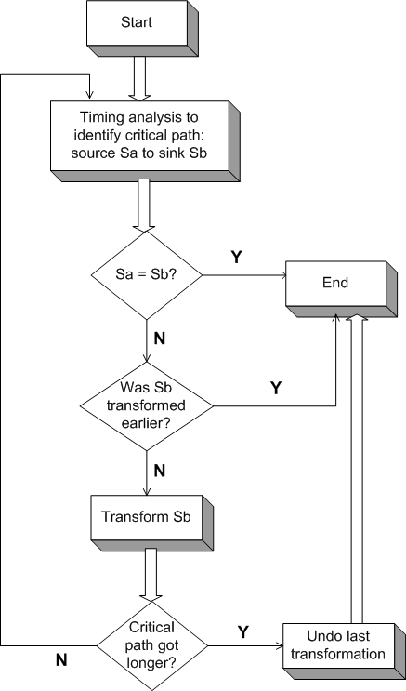
Iterative Application of Transformations

Slide 28
Scan Retiming Further
Critical path
F_out
D
Q
F_in
D
Q
S_out
S_in
D
Q
Scan_en_del
Critical path
D
Q
F_out
D
Q
F_in
S_in
D
Q
S_out
D
Q
Scan_en_del
MUX delay transferred forward
Fanout delay transferred backwards
Best case saving: Entire scan penalty
(= MUX+fanout delay)
D
Q
Scan_en
shared
Scan_en_del

Slide 29
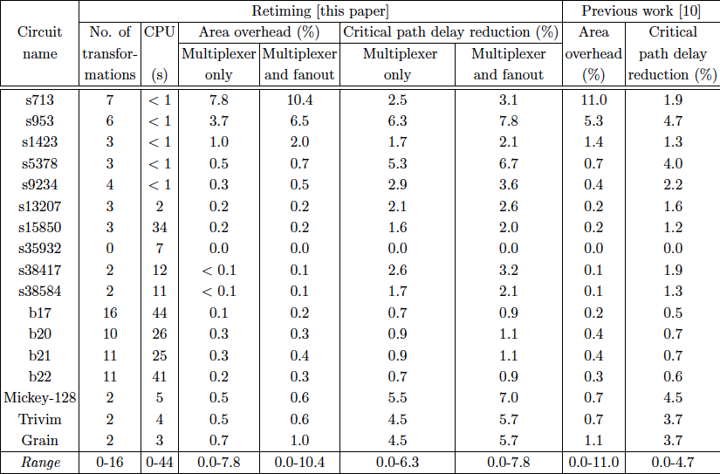
Experimental Results
High performance stream-cipher encryption circuits
➔ Higher reductions in critical path delay

Slide 30
Conclusions
MUX and fanout delay transfer through proposed scan circuit retiming
Can eliminate performance penalty of scan
Clock paths untouched
Retains intact:
Test development process (fault coverage, pattern count, etc)
Test application process (test time, data volume, etc)
Few scan cells transformed ⇒ very small area cost

