Slide 1
Adopting Multi-Valued Logic for Reduced Pin-Count Testing
Baohu Li, Bei Zhang and Vishwani Agrawal
Auburn University, ECE Dept., Auburn, AL 36849, USA
16th IEEE Latin-American Test Symposium
Puerto Vallarta, Mexico, March 25-27, 2015

Slide 2
Outline
Motivation and problem statement
Multi valued logic (MVL) signal test channel
Assurance of error-free MVL test data application
Experimental setup and results
Conclusion and future work

Slide 3
Problem Statement and Motivation
Motivation
Extensively growing test cost.
Multi-site test reduces test cost but requires extra test channels and fixtures for parallel testing.
Reduced pin count test (RPCT) allows multi-site test though a traditional SerDes implementation may lead to longer test time.
Problem statement
Find a way to transfer test data with fewer test pins and without compromising test speed.

Slide 4
Background
Multi-site testing and RPCT
Multi-site testing aims at best utilizing the ATE resources to test many DUTs at the same time.
RPCT uses fewer ATE resources to test a DUT, helping solve bandwidth mismatch and increase parallelism in multi-site testing.
RPCT and SerDes
A commonly implemented RPCT technology is SerDes
Scan test with three pins, J. Moreau et al., ITC’09
Scan architecture using SerDes in GPU chips, A. Sang et al., VTS’11
Test Data are serially sent by ATE with fewer test channels and deserialized in DUTs.

Slide 5
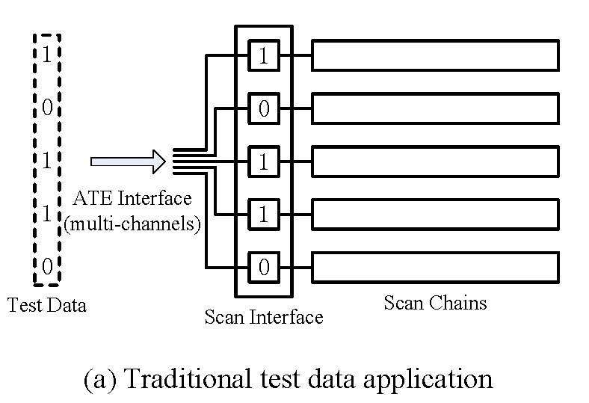
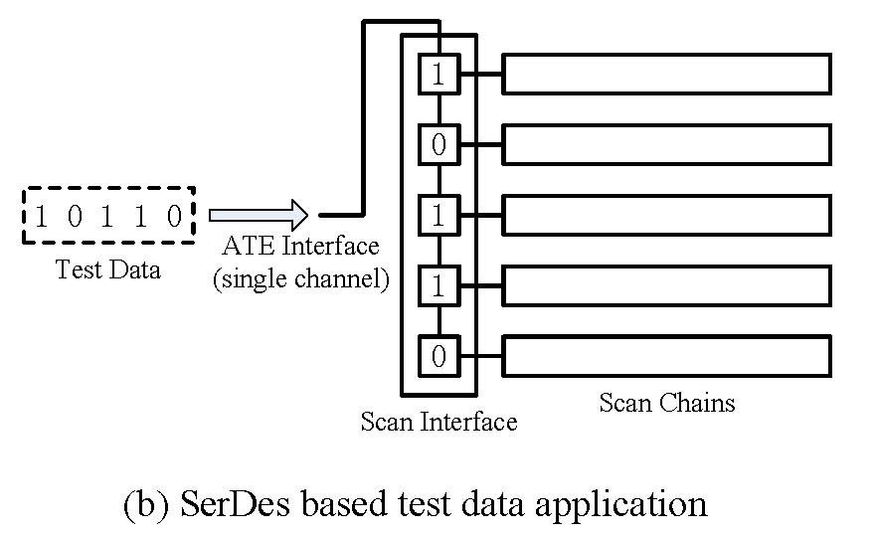
Background
An RPCT implementation with SerDes
To send 5 bits test data, a SerDes using a single wire needs 5 cycles, compared to 1 cycle in the traditional 5-wire case (sacrifice test speed).
multi-site test but a traditional SerDes implementation requires longer test time.

Slide 6
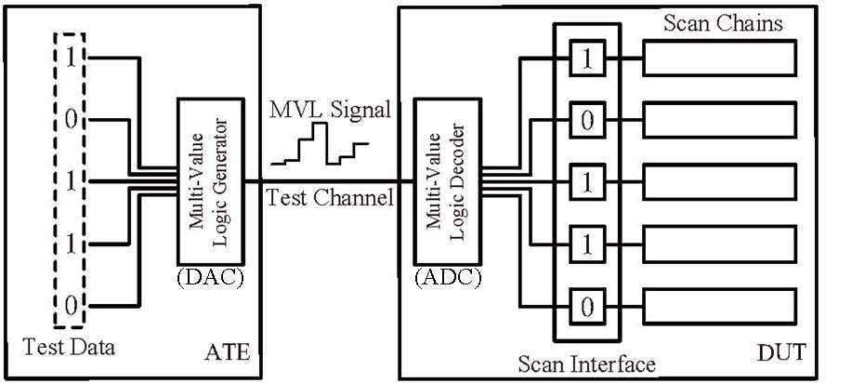
Proposed Alternative: An MVL Channel
2⁵ = 32 levels2

Slide 7
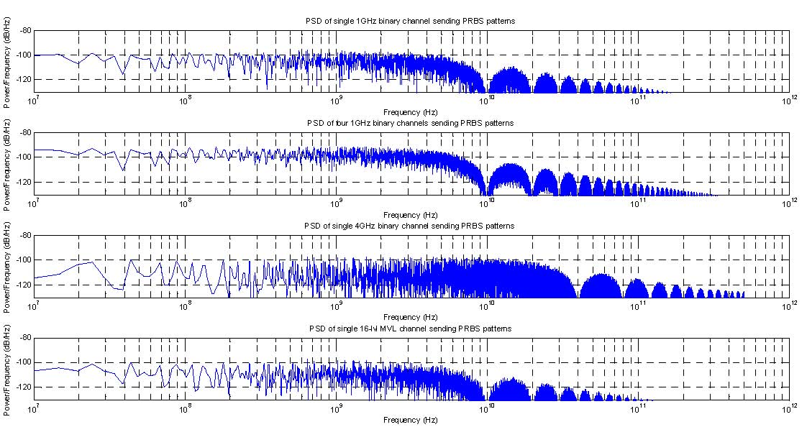
Four-bi
Power Consumption
One binary channel
0
1
1
0
0
1
0
1
0
0
1
1
0
1
1
1
0
1
1
1
0
Four binary channels
0
0
1
0
0
1
0
4 binary pins send some data
1 binary pins send same data
with 4x clock frequency
A 16 lvls MVL pin send same data
4-bit SerDes channel
16-level MVL channel

Slide 8
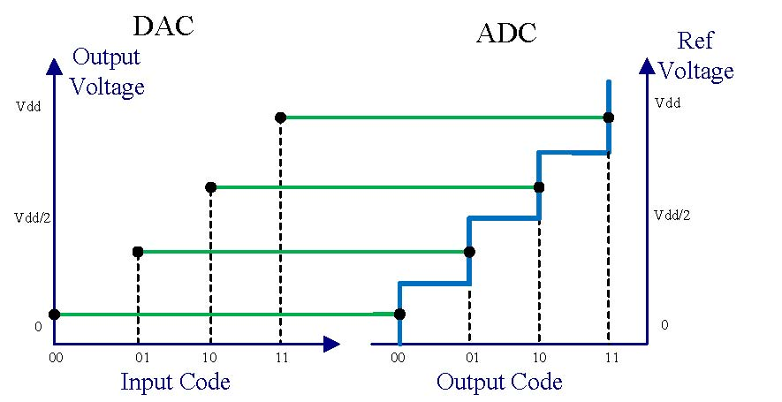
Assurance of Error-Free MVL Test Data Application
Ideal MVL signal encoding and decoding
In the ideal situation, every code is correctly encoded and decoded with maximum noise margin.
Compared to binary signal, the noise margin is shrunk for MVL.

Slide 9
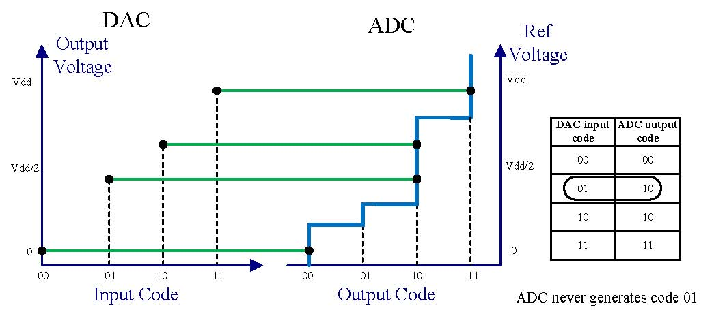
Assuring Error-Free MVL Test Application
Data converter errors
Nonlinearities: DAC cannot convert a digital pattern into an analog voltage level exactly.
The ranges of ADC codes are not ideal.
Mismatch between DAC and ADC.
Noise in channel
Data converters have dynamic noise.
Digital switching noise, power supply and ground noise, EMI.

Slide 10
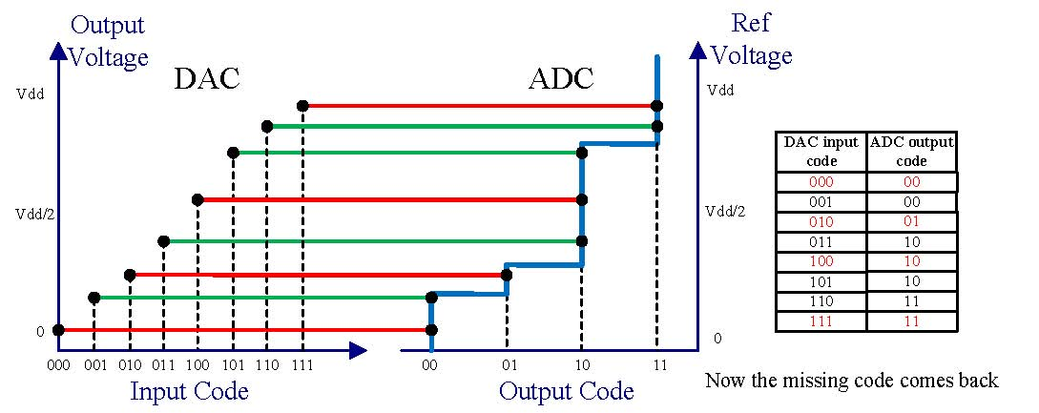
Assuring Error-Free MVL Test Data
DAC in ATE is assumed calibrated.
ADC in DUT is hard to modify after fabrication.
ADC nonlinearity must be calibrated.
Method:
calibrate ADC nonlinearity by adjusting DAC output (use finer resolution DAC)
Sweep all DAC input codes and capture the decoded codes from ADC
Pick the code, which is median among which are decoded as the same code, to be the DAC output for this ADC code

Slide 11
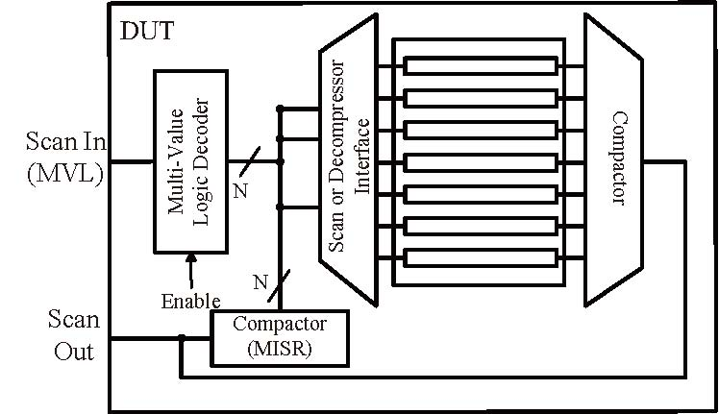
Assuring Error-Free MVL Test Data
An error control technique:
Noise is the major factor causing erroneous test data application after nonlinearity calibration.
Solution: detect any error during test application; if error occurs, conduct retest.
We compact all decoded patterns into a signature to be examined at the end of test.

Slide 12
Assuring Error-Free MVL Test Data
An example
Implementation with error detection. Test repeated on error.
Assume 99.999% DUTs need to receive correct test data with maximum test repetitions as 4.
Assume test set size is 100mb ⇒ SER (symbol error rate) should be lower than 4.21e-9.

Slide 13
Experimental Setup and Results
Experiment setup
Use DAC AD557 and ADC AD7822 to imitate the MVL encoder and decoder
Use NI ELVIS II+ prototype board system as the platform to send and receive test data
DE2 FPGA board is used for imitate the core logic under test
Experiments conducted
Reliability Measurement: measure the SER of such converter pair in terms of noise margin with/without FPGA load
Verify the nonlinearity calibration scheme
Apply scan test with MVL signal

Slide 14
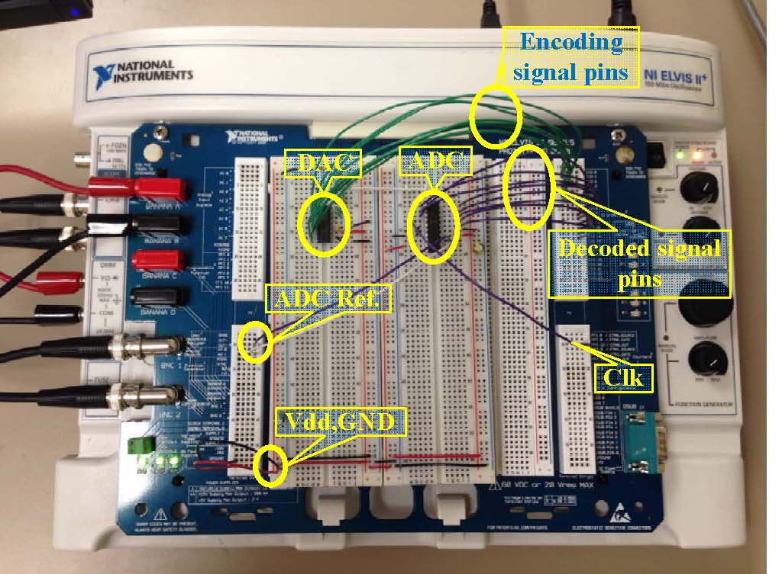
Experimental Setup
Hardware setup
Hardware system without FPGA load

Slide 15
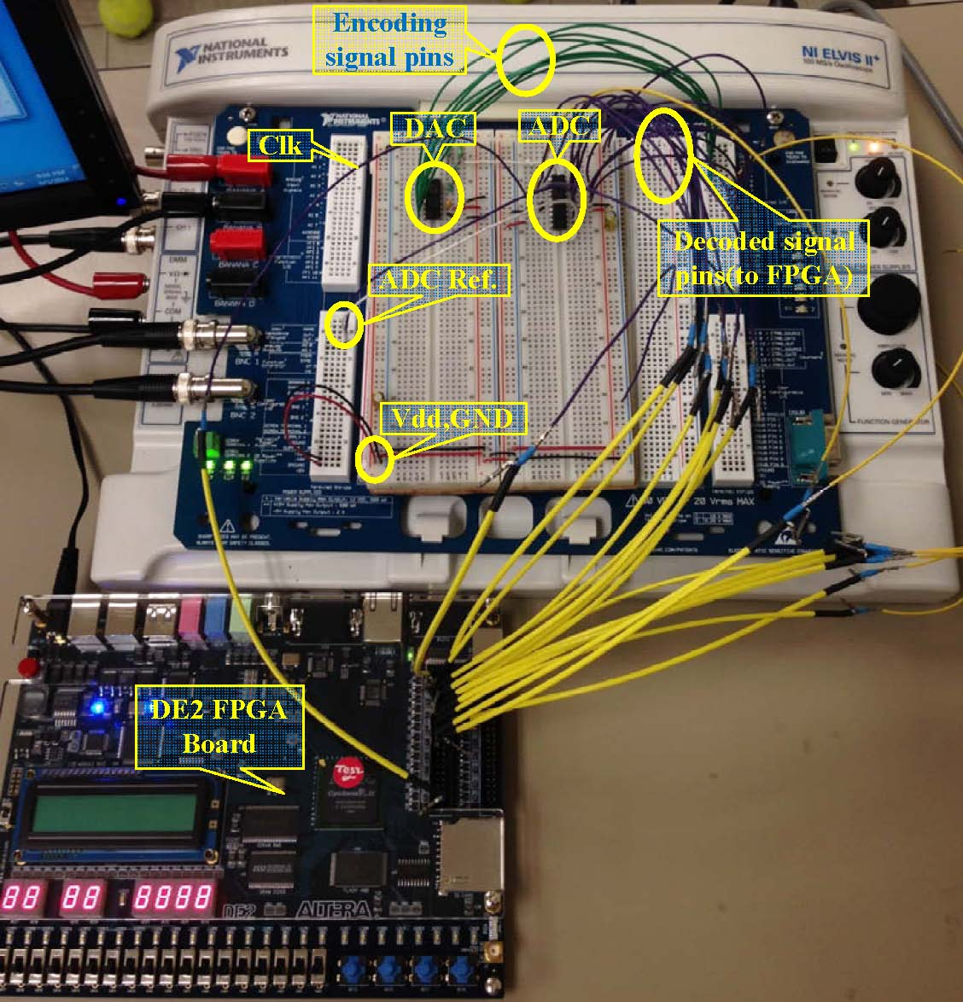
Experimental Setup
Hardware setup
Hardware system with FPGA load

Slide 16
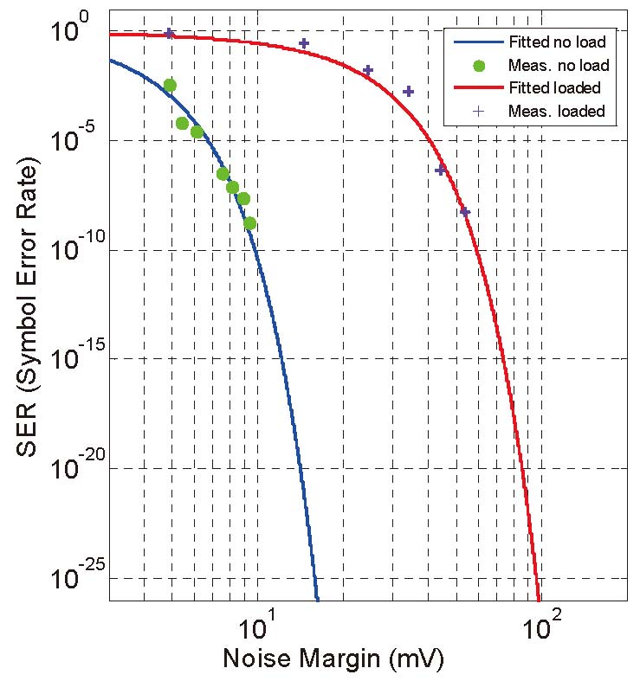
Experimental Result
Reliability (SER) measurement
We used voltage divider on the output of DAC to change the full scale voltage in which case the noise margin was controlled.

Slide 17
Scan Test Result
National Instruments ELVIS system and AD577 DAC serve as an ATE.
AD7822 ADC and DE2 FPGA board implementing benchmark s298 serve as DUT.
Five inputs, G0, G1, G2, scan_in1 and scan_en, are sent in MVL format, clock and reset remain binary.
Test channels are reduced from 7 to 3.
MVL test feasibility is established by obtaining test result identical to that of the normal 7 binary pin test.

Slide 18
Conclusion and Future Work
Conclusion
This is the first work to apply test data in MVL format.
Reliability issues and proposed solutions are discussed in the paper.
A prototype experiment proves the feasibility and verifies proposed error control solutions.
Overhead remains an issue but will be helped as data converter techniques evolve.
Future work
Further experiments on real ATE platform.

