Slide 1
ATE Test Time Reduction Using Asynchronous Clock Period
Praveen Venkataramani
pzv0006@tigermail.auburn.edu
Vishwani D. Agrawal
vagrawal@eng.auburn.edu

Slide 2
Outline
Test time theorem
Asynchronous clock test
Simulation example
Simulation results
Experiments on ATE
ATE results
Reduced supply voltage test

Slide 3
Problem Statement
Power consumption during test must not exceed the specified budget often implying increased test time.
Long test time increases cost; test time can be very long for scan based testing.
Need to reduce test time without exceeding power budget.

Slide 4
Power Metrics
Energy per cycle: Energy dissipated due to switching activity in one clock cycle.
Power per cycle: It is the energy dissipated during one clock cycle divide by the period.
Average power: It is total energy dissipated over the entire test divide by the test time.
Maximum power: It is the maximum power consumed by any one cycle during the entire test.
Maximum energy: It is the energy dissipated by the cycle having the maximum signal transitions.
Total energy: It is the energy dissipated during the entire test.

Slide 5
Test Time Theorem
For power constrained testing where the peak power during any clock must not exceed the rated power of the device, the test time has a lower bound,
$$\frac{E_{TOTAL(test)}}{P_{MAX(rated)}} ≤TT = \frac{E_{TOTAL(test)}}{P_{AVG}}$$
where E_{TOTAL(test)} is the total energy consumed during the entire test, P_{MAX(rated)} is the maximum rated power for the device, P_{AVG} is the average power of the entire test and TT is the total test time.

Slide 6
Clock Constraints
Power constrain: A test is power constrained, if the minimum test clock period is limited by the maximum rated power for the circuit under test.
Structure constrain: A test is structure constrained if the minimum test clock period is limited by the structural (critical path) delay of the circuit under test.

Slide 7
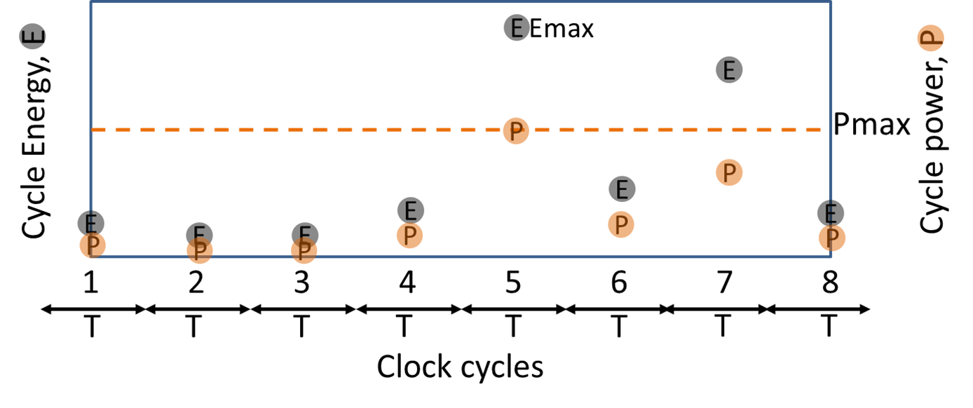
Synchronous Clock Period
Dynamic energy is not consumed evenly throughout the entire test.
Reducing the voltage reduces power.
Power dissipated is dependent on the clock period.

Slide 8
Ways to Reduce Test Time
To reduce test time we can:
Scale the supply voltage down, increase the frequency to maintain the power dissipation.
Dissipate the energy at varying rate to maintain the same power dissipation.
Implement scaled supply voltage and varying rate.
Clock period has two constrains:
Structure: The period of the clock must not be shorter than the delay of the critical path.
Power: The period of the clock must not let the power dissipation exceed the design specification.

Slide 9
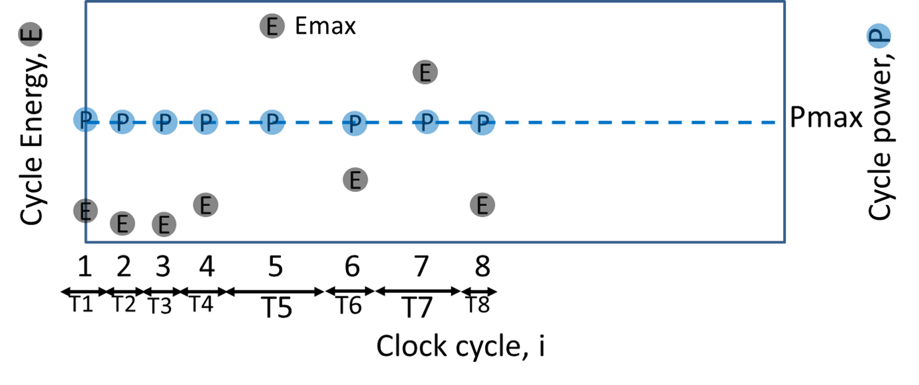
Varying Clock Period
In a synchronous clock test each period depends on the maximum power dissipated.
Each period may not dissipate same amount of power.
Each period can be adjusted to dissipate same amount of power.

Slide 10
Asynchronous Clock Test
Each period can be either structure constrained or power constrained, i.e.,
$$Ti=\max{\{T_{STRUCTURE}, \frac{Ei}{PMAXfunc}\}}$$
where T_{i} is the period of each test cycle
E_{i} is the energy dissipated by each cycle
This is termed as asynchronous clock test where each cycle may not use exactly the same period as its neighboring cycle.
For any given voltage an asynchronous clock test can run faster than the synchronous clock test at that voltage

Slide 11
Example – s298 Benchmark

Slide 12
Experimental Results
CUT | No. of test clock cycles | Max. per cycle power (mW) | Sync. clock test time (µs) | Async. clock test time (µs) | Test time reduction (%)
s298 | 540 | 1.23 | 2.63 | 1.39 | 47
s382 | 703 | 2.90 | 1.81 | 1.32 | 27
s713 | 809 | 2.70 | 2.48 | 1.82 | 27
s1423 | 6975 | 4.50 | 51.5 | 42.06 | 18
s1423 | 7724 | 4.50 | 74.8 | 46.50 | 37
s13207 | 41119 | 21.30 | 314.3 | 266.26 | 15
s15850 | 101707 | 67.80 | 534.7 | 385.07 | 28
s384584 | 224112 | 110.60 | 1393.7 | 1213.00 | 13

Slide 13
ATE Experiment
Experimental Setup
The test was implemented on the Advantest T2000GS ATE at Auburn University.
Maximum clock speed of 250 MHz
CUT is an FPGA configured for ISCAS‘89 benchmark circuit.
FPGA is configured on the run using the ATE.
All clock periods for asynchronous clock test are determined prior to external test based on the amount of energy dissipated during each cycle.
Limitations in tester framework sets few margins to the clock periods and the granularity in their variations
Only 4 unique clock periods can be provided for each test flow

Slide 14
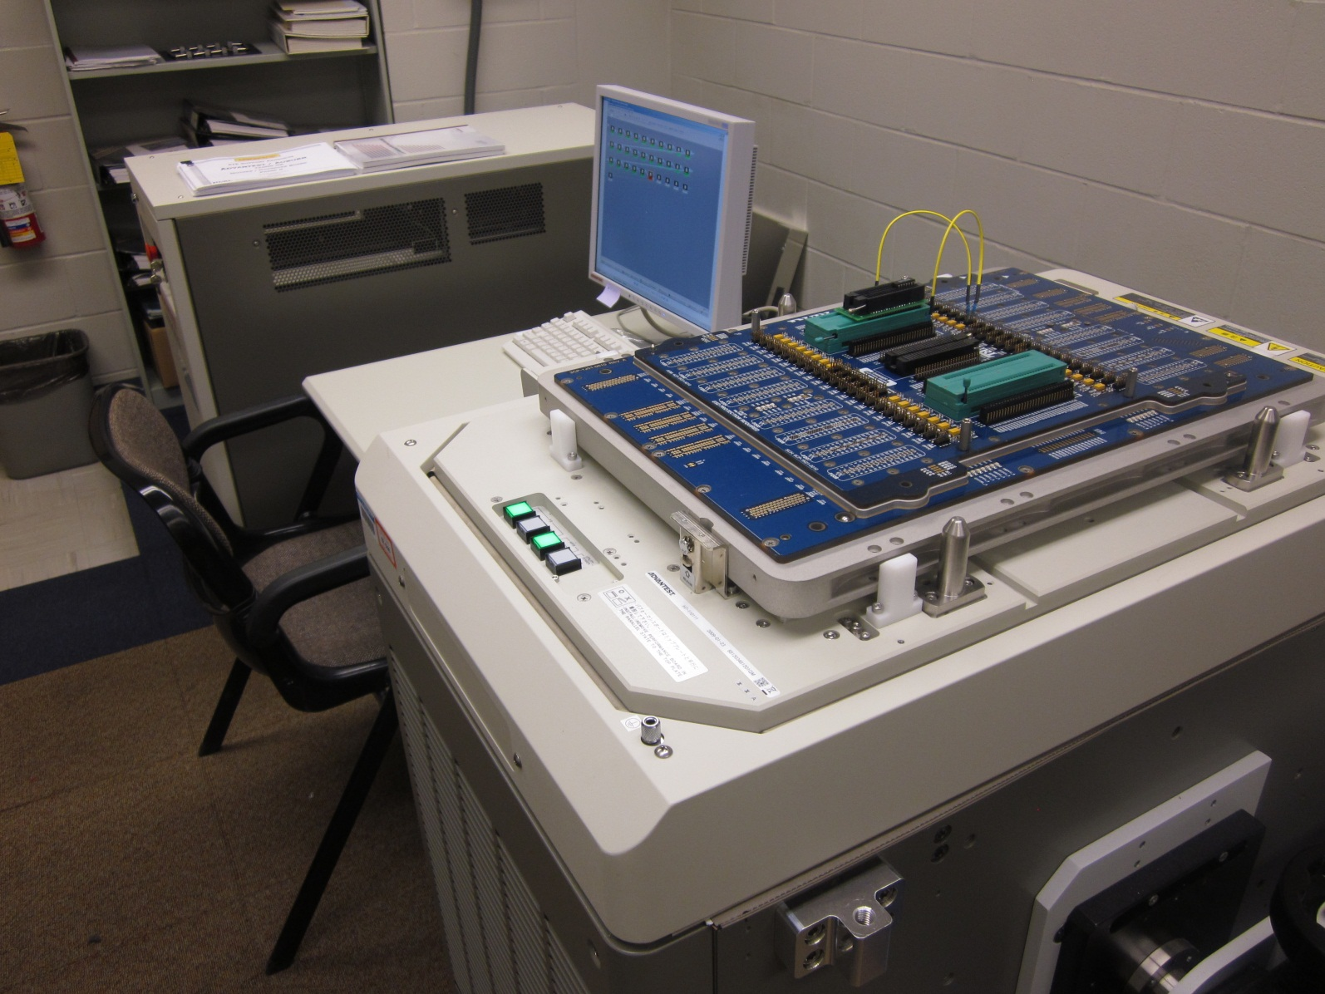
T2000GS ATE at Auburn University

Slide 15
Selecting Four Clocks for s298
The clock periods were grouped into 4 sets.
Each set contains patterns of one clock period.
For synchronous test the maximum period is used as the fixed clock period.
The figure shows the cycle periods determined for each test cycle.
Test cycle will use the clock (dotted line) just above the period

Slide 16
Test Programming
Test plan is programmed using the native Open Test Programming Language (OTPL).
Four unique periods and the corresponding information about the signal behavior at each pin is provided in a timing file.
For each period, the input waveform of the clock is set to have a 50% duty cycle.
The output is probed at the end of each period.
Within each period there is a time gap to apply primary inputs (PI) and the clock edge to avoid race condition.
Period for each cycle is specified along with patterns.
Scan patterns are supplied sequentially bit by bit.

Slide 17
ATE Functional Test Using Synchronous Clock
Figure shows the waveforms for 33 cycles of the 540 cycles in total test.
The synchronous clock used is 500ns
The time frame to accommodate 33 cycles using synchronous clock is 16.5µs
Total test time for 540 cycles = 540 x .5 µs = 270 µs

Slide 18
ATE Functional Test Using Asynchronous Clock
Figure shows the waveforms for 58 cycles of the 540 cycles in total test.
The time frame to accommodate 58 cycles using asynchronous period is 16.5µs
The periods selected for asynchronous clock test are 500ns, 410ns, 300ns, 200ns
Total test time for 540 cycles = $\sum_{i=1}^{540}{Ti }$ = 157.7µs ≈ 38% reduction in test time

Slide 19
Scaling Supply Voltage
P. Venkataramani, S. Sindia and V. D. Agrawal, “Finding Best Voltage and Frequency to Shorten Power-Constrained Test Time,” Proc. 31st VTS, April 2013, pp. 19-24.

Slide 20
Scaling Supply Voltage

Slide 21
Simulation Example-s298

Slide 22
Conclusion
Synchronous test time is reduced by,
Scaling supply voltage down
Scaling cycle frequency upward
Asynchronous clock test produces lower test time at any voltage as long as there are some test cycles that are power constrained.
According to the test time theorem, asynchronous test time is always less than or equal to the synchronous test time.

