Slide 1

Securing IEEE 1687-2014 Standard Instrumentation Access by LFSR Key
Hejia Liu* and Vishwani D. Agrawal
Auburn University, ECE Dept., Auburn, AL 36849, USA
Email: hzl0037@tigermail.auburn.edu
agrawvd@auburn.edu
* Present address: Broadcom, San Diego, CA 92127, USA
Notes:
Welcome to this presentation of SECURING IEEE 1687 Standard by LFSR Key.
I am Vishwani Agrawal, a professor at Auburn University. This work was done jointly with Hejia Liu, my recent master’s degree student from China, who now works at Broadcom in California. Unfortunately, neither of us is able to attend the ATS, so we did the next best thing of sending you this presentation. We apologize for not answering your questions in person and would like you to send them to us at the email addresses given here. I will again show you these at the end of the talk.

Slide 2
Topics
The big picture: IEEE 1149.1 boundary scan standard
An example of 1687 architecture
  Its purpose
  security problem
  Previous security solution: LSIB and LSIB trap
The new LFSR solution.
Notes:
Here you see an outline of the talk.
The big picture is the IEEE 1149.1 Standard that applies to testing of VLSI chips embedded on a printed circuit board. There is also an IEEE 1687 Standard that allows access to certain hidden proprietary information. Sort of like your bank account number that you don’t disclose to everyone you interact with. However, a malicious user can get such proprietary information by using a part of the IEEE standard known as SIB or segment insertion bit. Recent security methods have proposed locking SIB or LSIB trap. These methods provide some security. The security solution in this paper uses a linear feedback shift register to provide much greater resistance to break-in. Let us find out how.

Slide 3
IEEE 1149.1 Boundary Scan Standard
Notes:
Here you see a chip with IEEE 1149.1 Standard.
The IEEE 1149.1 Standard, also known as the JTAG standard was originally intended for printed circuit board test. It basically consists of two test access items added to every chip on the board, namely, a boundary scan register tied to the input and output pins, shown in blue, and a test access port, or TAP shown on the right. This is a gateway to internal scan and provides many other test, debug and programming features. As IEEE 1149.1 became better established, the capabilities of TAP were explored. It could provide a higher level of access into the chip without the need for intrusive methods.

Slide 4
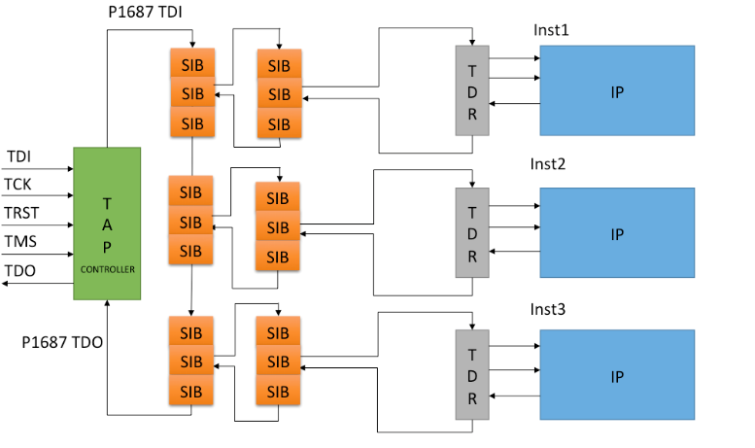
1687 Structure
Notes:
This is another IEEE Standard known as 1687 that allows access to intellectual property or IP blocks shown in blue on the right. These blocks contain the proprietary data, accessible through the TAP of the 1149.1, shown in green on the left.
Typically, the 1687 specifies a digital control interface, such as a command register, associated commands and synchronization signals, and a data path. Specifically, a standard scan cell, called segment insertion bit (SIB), is inserted in the scan chain of 1687. When certain bit is updated in SIB, it allows access to instruments or to other scan paths. By including or excluding scan network segments, SIB effectively changes the length of the scan-path. Nevertheless, this capability of accessing the IP data, intended for authorized user, presents a security risk.

Slide 5
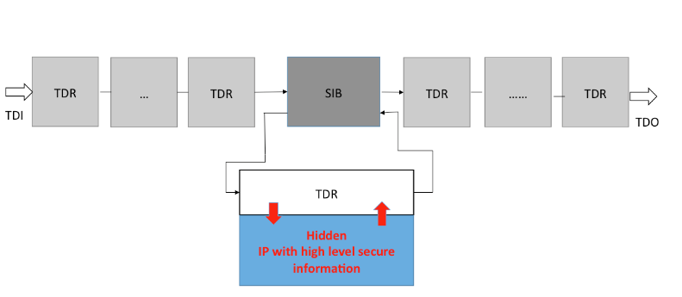
Security Risks
Depending on the application, data may be stored on-chip, including chip ID, codes, and encryption keys.
An attacker can access a targeted instrument and obtain the secret data by understanding (or exploring) TAP controller and shifting in a certain pattern.
Notes:
In a plain 1687 network, anyone who can shift certain data into the SIB and set the 1149.1 TAP controller state to UpdateDR can open any SIB in the chain and access the instrument behind it. An intruder, assuming that the IEEE 1687 is implemented in the chip, can access the instrument by shifting in instruction code from TDI to make the TAP controller work on 1687. By shifting in patterns into the 1687 scan chain, and loading 1s in certain segments, the intruder can access new paths and IP information, that is normally hidden, at a time cost of only a few clock cycles.

Slide 6
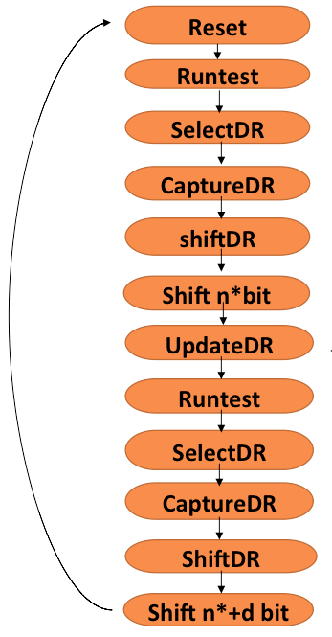
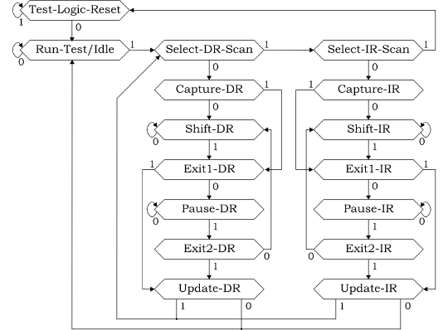
Break-in Procedure
TAP FSM Break-in flow
Notes:
The 1149.1 TAP contains a controller, which is a finite state machine. The state diagram of that FSM is shown here. The state transitions on the right show a typical break-in attempt, which may be repeated many times. The length of the accessed scan chain is seen as a feedback from successive break-in attempts. An intruder generates a break-in flow that repeats by shifting patterns in the shift state and updating patterns to open SIB. Besides, intruder observes the length of the test data register, TDR, to determine the next move. We can estimate the break-in time by calculating average number of clock cycles needed.

Slide 7
A Previous Solution: LSIB Trap Bit
To_TDO1
To_TDI2
0
1
0
1
TDI
0
1
RST
Select
Update cell
From_TDO1
Shift cell
ShiftEn
Select
TCK
updateEn
Key[0]
Key[n]
Whether the key and trap feedback value is 1 or 0 is decided by the structure
Trap feedback select signal
Notes:
To make the attack difficult, several types of locking-SIBs have been proposed. In a locking-SIB, called LSIB, an n-bit key is required for the SIB cell to correctly work. Unless the key is correct, the SIB will remain locked holding the select signal to 0 and keeping the SIB in the closed state. Additionally, a trap-bit SIB uses the select signal as a feedback key. The example in this slide combines these two designs of locking and trapped SIB that have been proposed in recent papers.

Slide 8
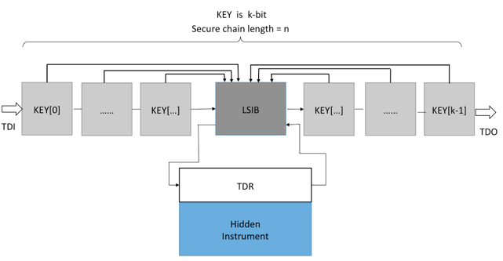
LSIB Security Solution in P1687
Notes:
Consider an IP block shown as hidden instrument behind an LSIB. To negotiate a path through this LSIB, an intruder needs to open the LSIB by attempting again and again. While LSIB provides several impressive strategies, the length of the scan chain is always seen as a feedback to successive break-in attempts. Upon a failed attempt to unlock an LSIB the intruder may increase the assumed chain length. Sometimes, unlocking a new LSIB or opening a new path will lock another LSIB, a strategy known as honeytrap LSIB. Inserting LSIBs that are initially open on the circuit and locked when the correct keys are set provide negative feedback to the intruder, who must overcome the resulting confusion. As long as the structure and strategies are complex enough, continue to increase the effort of intruder dramatically. Even the average breaking time can be on the order of hundreds of years. But for this structure, the key information for intruder is the length of scan chain. All attempts are based on finding the scan chain length. What if we make the determination of scan chain length more difficult.

Slide 9
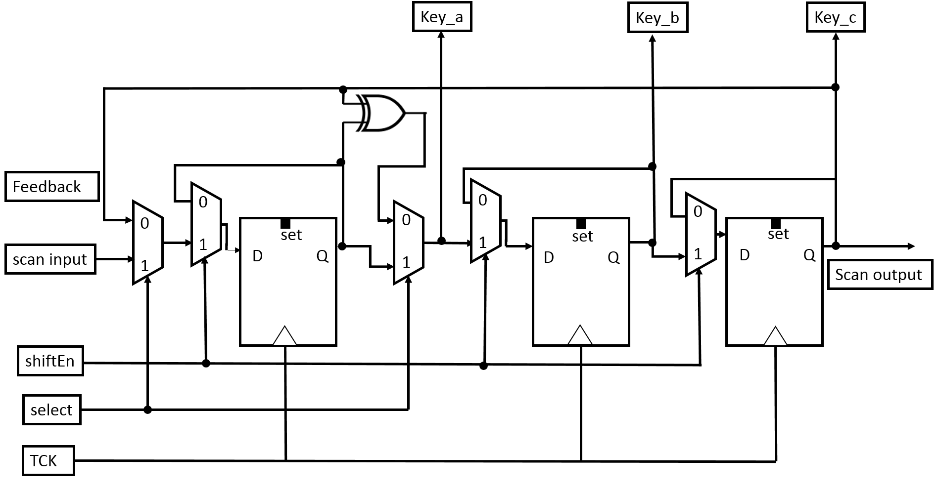
SLFSR Example
3 stage SLFSR R = 7
Notes:
The main idea of this work is a SECURITY Linear Feedback Sift Register, or SLFSR. This slide shows a three-bit SLFSR.
This SLFSR is inserted in the p1687 LSIB secure structure to hide the scan chain length and to provide additional locking capability.
We propose a dual mode m-stage SLFSR placed just before TDO. Parallel outputs from SLFSR are used as a feedback key to an LSIB as shown in the next slide. To open the LSIB, we must shift in the correct key, which is produced as a sequence from the SLFSR. The select signal from the update cell of LSIB will decide the status of SLFSR. When LSIB is closed, the select will set the LFSR in the feedback- shift mode. When LSIB is open, the select will disconnect all feedback signals from D inputs in the LFSR and set it in the normal shift register mode. The signal ShiftEnable plays an important role. When it is 0, the state of the SLFSR remains frozen. When ShiftEnable is 1, the SLFSR simply shifts data from TDI. This design can be realized by adding multiplexers to a traditional LFSR. When the LSIB is locked, the TDO will be a repeating sequence. Only when LSIB is unlocked, the SLFSR will not be an obstacle in the scan path and we can get correct information from shifting out the pattern in the scan path.

Slide 10
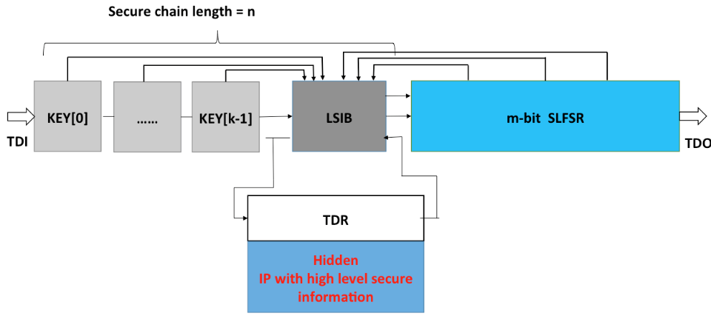
1687 Security with SLFSR
Notes:
The SLFSR in the P1687 scan structure scrambles the bits being transmitted. Hence, their observation at TDO prevents the determination of scan chain length. As I said before, the intruder must first determine the chain length to break in. The SLFSR, therefore, significantly increases the effort of break-in.

Slide 11
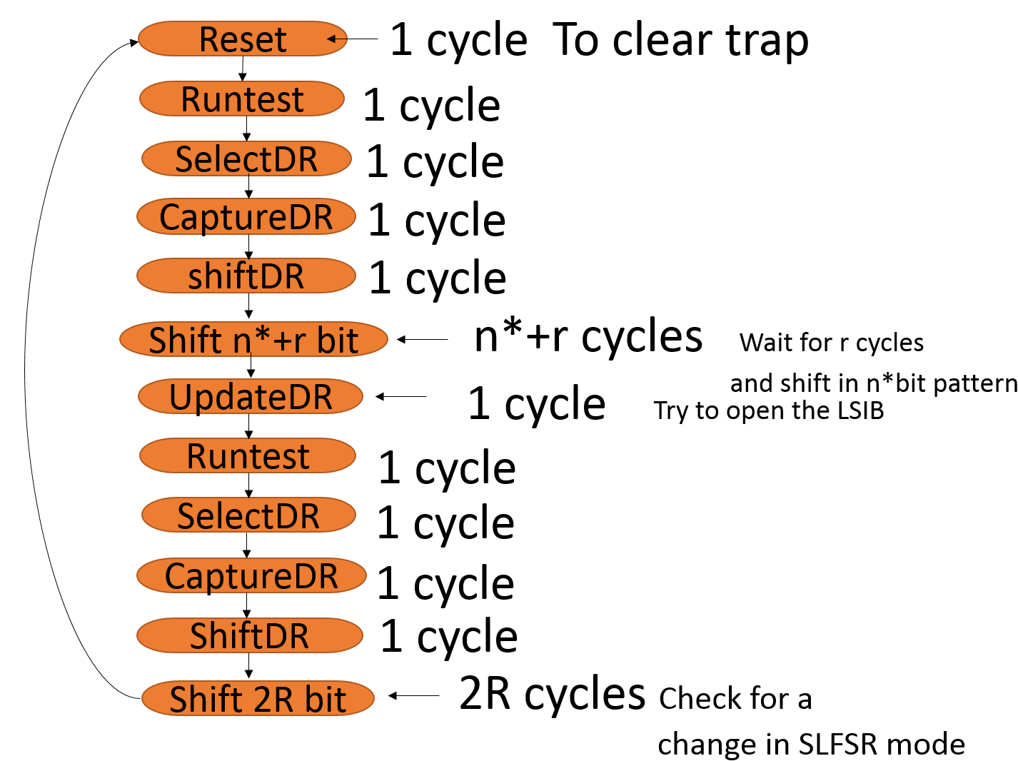
Break-in Procedure with SLFSR
Notes:
The break-in procedure remains similar, though with a few differences. First, the intruder guesses the length of the n-stage scan chain as n* and verifies it before making another guess. The SLFSR interferes with this process. Second, if the intruder assumes the presence of the SLFSR, the cycle length R is unknown. Trials may be made with assumed cycle length r as 1, 2, 3, etc.
Irrespective of the strategy taken by the intruder, the paper shows that the SFSR enhances security by increasing the number of break-in attempts an intruder may have to make.

Slide 12
Attacker’s Strategies
Condition 1: Attempt length is n*< n
Expected cost = (n∗ + E(r) + 2R +10) 2^{n∗}
Condition 2: Attempt length is n*= n
Expected cost = (n + 2R + 10 + E(r)) R 2^{k+1}
Condition 3: Attempt length n*> n
Expected cost = (n∗ + 2R + 10 + E(r)) R 2^{k+1}
Where E(r) is the mean value of r
r = guess about LFSR cycle length R
Notes:
If the structural parameters, that is, length n of scan chain and the SLFSR cycle length R, are known to a malicious user, then of course the system will become insecure. However, the question remains, if those parameters can only be guessed, then many trials will be required. As in any system of locks, the level of security is determined as the time or effort of break-in. The idea of any locking scheme is increase the break-in time beyond some specified threshold.
In this work, we examine the average cost as the time that an intruder might take to break-in. This is done under three possible conditions. Our intruder guesses the scan chain length as n*, while the actual length is n. The average break-in cost is analyzed for three conditions, where n* is less than, equal to, or greater than n. Obviously, Condition 2, where n* = n, i.e., scan chain length is known to the intruder, is the least secure case.

Slide 13
Expected Results (f = 10MHz)
Key length k | Chain length n | Expected time to unlock LSIB with SLFSR |  | Cycles | %Increase Compared to Trap without SLFSR
 |  | Days | Years
8 | 32 | 2.32E-07 | 6.36E-10 | 2.01e+05 | 395.9596
16 | 64 | 9.34E-05 | 2.56E-07 | 8.07e+07 | 377.9141
32 | 128 | 1.06E+01 | 2.90E-02 | 9.14E+12 | 365.6357
40 | 160 | 3.28e+03 | 8.98 | 2.83E+15 | 362.8169
48 | 192 | 9.85E+05 | 2.70E+03 | 8.51E+17 | 360.8592
56 | 224 | 2.90E+08 | 7.93e+05 | 2.50E+20 | 359.4203
64 | 256 | 8.37E+10 | 2.29e+08 | 7.23E+22 | 358.3181
80 | 320 | 6.74E+15 | 1.85E+13 | 5.82E+27 | 356.7407
96 | 384 | 5.24E+20 | 1.44E+18 | 4.53E+32 | 355.6663
Notes:
Condition 2 is the best condition favoring the intruder. This table gives the break-in time for n-bit scan chain with k-bit LSIB and trap and 3-stage SLFSR. The chain length n includes both the hidden secure chain and SLFSR. The 3-bit SLFSR has a repeat cycle length of 7. Clock is 10MHz. From the result, to unlock the hidden secure chain with SLFSR, intruder needs 3 to 4 times as many cycles in comparison to scan chain without SLFSR to unlock LSIB. Note this is the worst situation since the chain length has been guessed correctly. Consider a practical case that is highlighted here. The key is 40 bits, n is 160 bits, and the expected break-in time is 8.98 years. Larger chains are much more secure and SLFSR always enhances security 3 to 4 times.

Slide 14
Conclusion
It is useful we replace the non-functional segments with SLFSR.
Security SLFSR increases attacker’s break-in effort.
But break-in success can depend on strategies that attacker chooses.
We should be concerned about the “lucky” attacker. To be considered in the future.
Notes:
The hidden secure chain with SLFSR provides two defense mechanisms. One is the length of the scan chain is camouflaged by SLFSR. The other is a sort of two-dimensional locking. If k bits in the scan chain are one dimension in locking, the feedback from SLFSR provides the other dimension. Only when both dimensions are correctly set, the LSIB will be unlocked. No matter how conservative or how aggressive a strategy is chosen, the intruder must spend excessive time. As a result a higher security will be provided.
In the end, we point to the case of the LUCKEY ATTACKER. Though highly improbable, this is a situation to examine in the future.
Also, the side channel attack may be considered during further research.

Slide 15
Please Email Questions to:
hzl0037@tigermail.auburn.edu
agrawvd@auburn.edu
Notes:
That brings us to the end of this presentation. I thank you for listening. Please refer to the details of this work in the paper in ATS proceedings. We look forward to your questions and feedback.

