Slide 1
Tailoring Tests for Functional Binning of Integrated Circuits
21st IEEE Asian Test Symposium, Niigata, Japan
Suraj Sindia (szs0063@auburn.edu)
Vishwani D. Agrawal (agrawvd@auburn.edu)
Dept. of ECE, Auburn University, Auburn, AL

Slide 2
Outline
Motivation
Problem Statement
Functional Binning
Integer Linear Programming Formulation
Experimental Results
Conclusion

Slide 3
Outline
Motivation
Problem Statement
Functional Binning
Integer Linear Programming Formulation
Experimental Results
Conclusion

Slide 4
A Quick Puzzle
Can you make sense of this statement?
Bracak Omaba is the Persdient of the Uinted Satets of Amircea
Solution:
Barack Obama is the President of the United States of America

Slide 5
One More Puzzle
Can you spot the differences?

Slide 6
This One is Easier
Can you spot the differences?

Slide 7
The Differences Are …
Both images have 256 intensity levels
σ/µ=1% uniform random
noise added at every pixel
Original image

Slide 8
More Differences …
σ/µ=10% uniform random
noise added at every pixel
Original image

Slide 9
Error Resilient Applications: Examples
Leverage the inherent error tolerance of human eye/brain combination.
  Color image processing
    Roy et. al., ICCAD ’07
  Motion estimation
    Ortega et. al., DFT’05
  Image/Video compression
    Shanbhag et. al., TVLSI’01, Ortega et. al., DFT’05, Kurdahi et. al., ISQED’06
  Image smoothening/sharpening
    Sindia et. al., ISCAS’12
Notes:
Breuer et. al., IEEE D&T ’04 – show about 80% faults are benign at a threshold of 1%

Slide 10
Testing for Error Resilient Applications: Background
Only faults that degrade functional performance of a system beyond a threshold are tested.
  Such faults are called malignant faults.
Faults that do not degrade system performance beyond a threshold need not be tested.
  Such faults are called benign faults.
Notes:
Notion of performance can be different for different applications. For example, in a adder or multiplier, the absolute deviation from the actual value can be considered as a performance metric, while in a comparator rate of errors can be a performance metric. Threshold is decided based on the acceptable limits of performance for a given application.

Slide 11
Why Optimize Test for Error Resilient Applications?
Yield improvement ☺
Gupta et. al. ITC’02, ITC’07
Breuer et. al. IEEE D&T’04
Yield
All faults covered
Only malignant faults
Yield improvement
Fault Coverage

Slide 12
Outline
Motivation
Problem Statement
Functional Binning
Integer Linear Programming Formulation
Experimental Results
Conclusion

Slide 13
Problem Statement
For a circuit, given a partitioning of faults as malignant and benign, and a test vector set covering all faults, choose a subset of test vectors that maximizes coverage of malignant faults and minimizes coverage of benign faults.

Slide 14
Outline
Motivation
Problem Statement
Functional Binning
Integer Linear Programming Formulation
Experimental Results
Conclusion

Slide 15
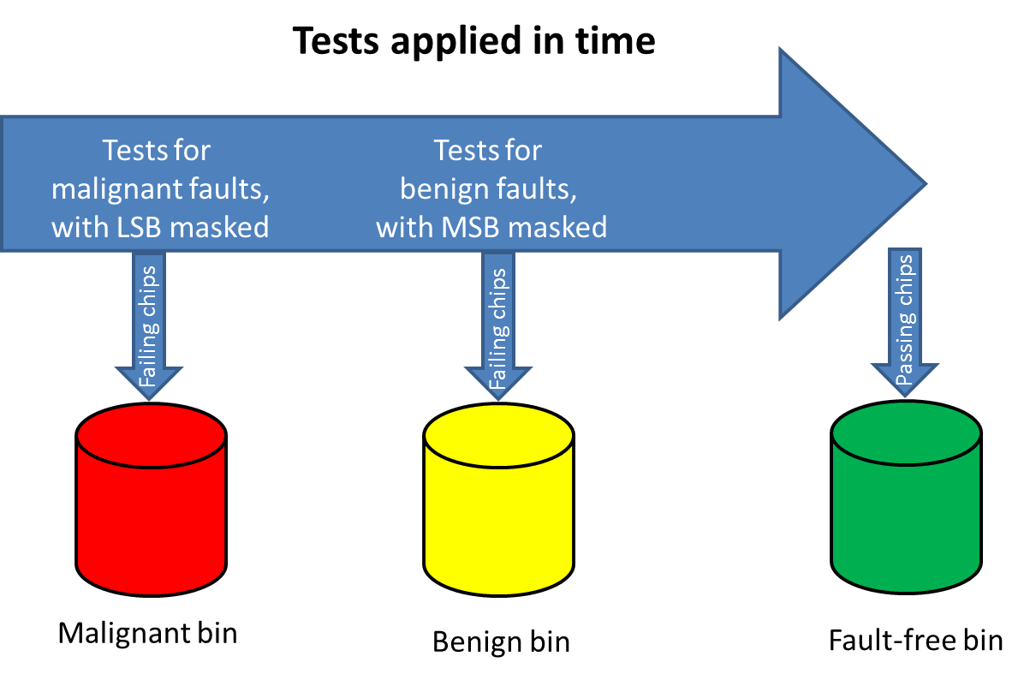
Functional Binning
Notes:
Selectively masking outputs to filter out chips in three stages: First, the output LSB bits are masked and chips that fail in the non-LSB (or MSB) are discarded into the malignant bin. Next, output MSB are masked and chips that fail in the LSB are classified into the benign bin and the remaining ones, which are the fully functional chips proceed to the fault-free bin.

Slide 16
Outline
Motivation
Problem Statement
Functional Binning
Integer Linear Programming Formulation
Experimental Results
Conclusion

Slide 17

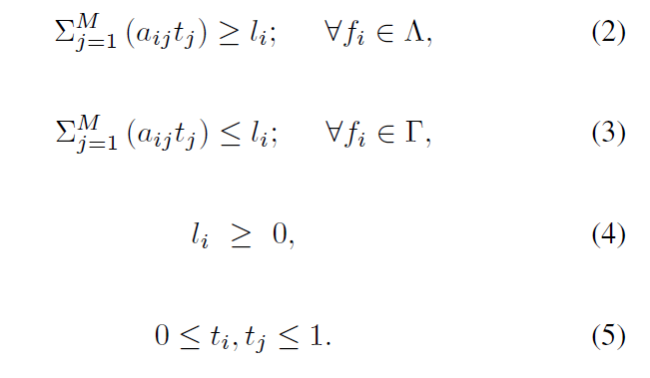
Integer Linear Programming (ILP) Formulation (1/2)
Cost function:
  Maximize:
  Subject to:

Slide 18







ILP Formulation (2/2)
Notation
  denotes fault for all .
  denotes set of all malignant faults.
  denotes set of all benign faults.
  (=1), if test vector is to be included, else (=0), for all .
  (=1), if test vector can detect , else (=0).
  is an indicator function (= ), if is in , else = – (1- ).

Slide 19
Outline
Motivation
Problem Statement
Functional Binning
Integer Linear Programming Formulation
Experimental Results
Conclusion

Slide 20
Design of Experiments
Example circuits: Three 16 bit adder circuits
Performance metric: Absolute deviation from the fault-free value
Fault model: Single stuck-at fault
Adder architecture | Total number of faults N | Fraction of all faults causing deviations greater than or equal to τ
 |  | τ = 25 | τ = 50
Ripple carry adder | 432 | 75.8% | 65.4%
Look ahead carry adder | 630 | 63.2% | 52.6%
Carry save adder | 520 | 70.5% | 62.4%

Slide 21
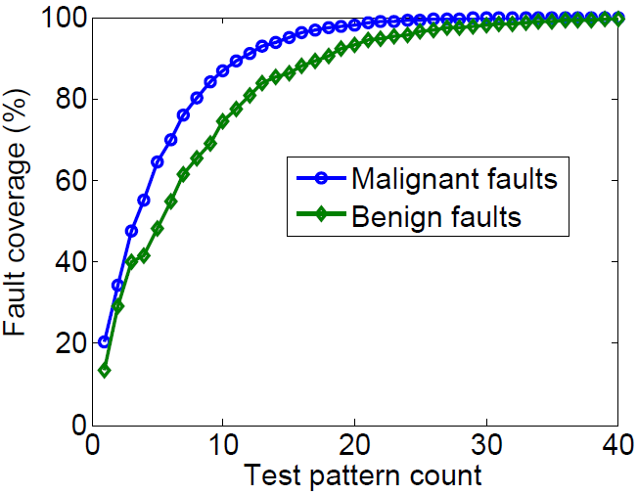
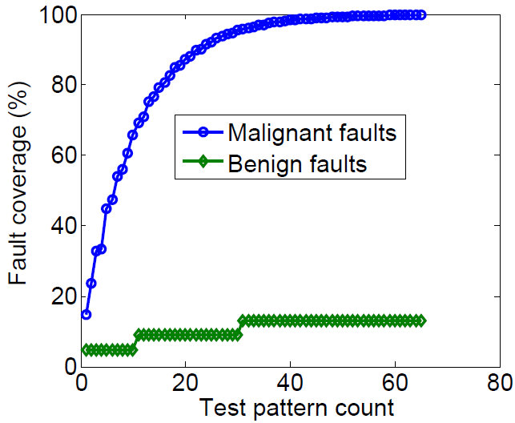
Results: Fault Coverage Optimization
Example 1: Ripple carry adder (τ = 25)
Before optimization
After optimization

Slide 22
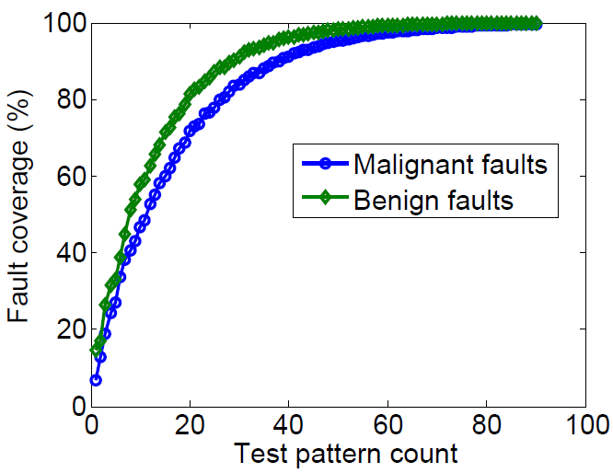
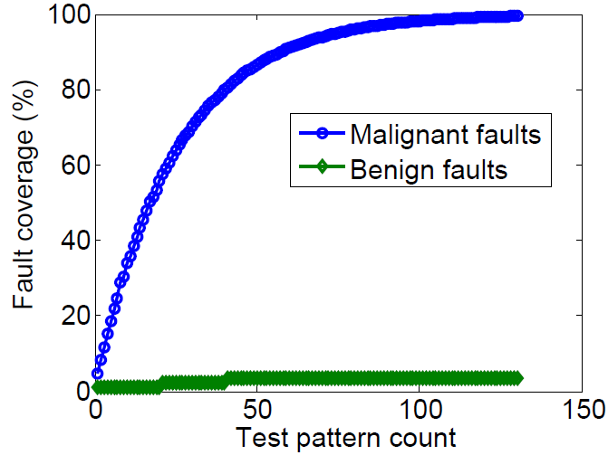
Results: Fault Coverage Optimization
Example 2: Look ahead carry adder (τ = 25)
Before optimization
After optimization

Slide 23
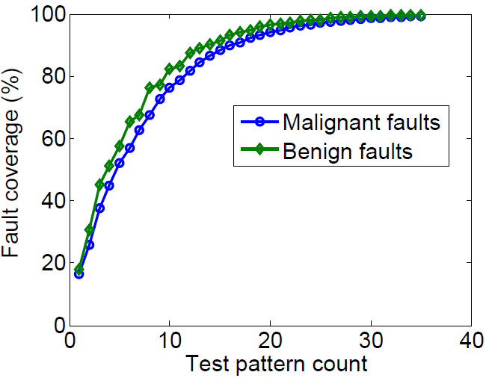
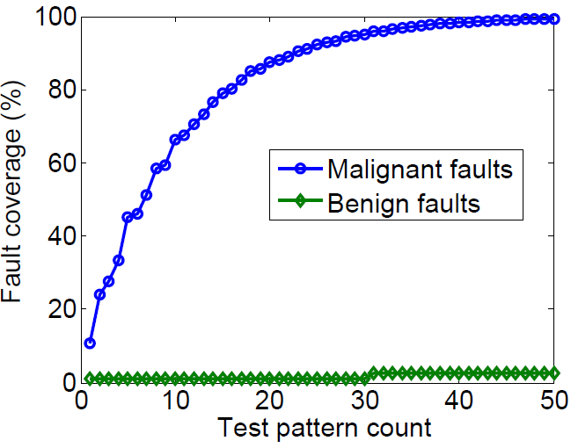
Results: Fault Coverage Optimization
Example 3: Carry save adder (τ = 25)
Before optimization
After optimization

Slide 24
Implications on Yield: A Simple Model
Y: Original yield
N: Total number of faults
p: Probability of each fault assuming uniform probability of occurrence
  p = 1-(Y)^{1/N}
N’: No. of faults tested after optimization
Y’: Yield on testing only the optimized set of faults
  Y’ = (Y)^{N’/N}

Slide 25
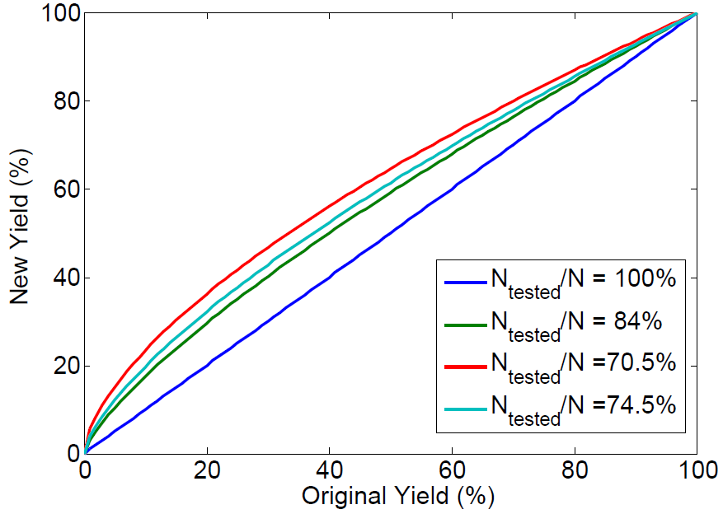
Yield Implications
Reference line
Carry save adder
Carry look ahead adder
Ripple carry adder

Slide 26
Outline
Motivation
Problem Statement
Functional Binning
Integer Linear Programming Formulation
Experimental Results
Conclusion

Slide 27
Conclusion
Tailoring tests, and masking outputs appropriately at production test can aid in functional binning of chips.
An ILP formulation for maximizing fault coverage of malignant faults while minimizing coverage of benign faults.
Demonstrated optimization on three adder examples.
  Performance metric used was absolute deviation from ideal value.
  Average fault coverage of about 10% for benign faults across three examples.
  Incurred a test vector increase of about 30%.
Discussed implication on yield for all three cases.
  In the best case, yield can increase between 10-25%. (Assuming uniform probability of fault occurrence.)
  Increased yield justifies small increase in test pattern count.

