Slide 1
High Performance Compute Cluster
Jia Yao
Director: Vishwani D. Agrawal

Slide 2
Outline
Computer Cluster
Auburn University vSMP HPCC
How to Access HPCC
How to Run Programs on HPCC
Performance

Slide 3
Computer Cluster
A computer cluster is a group of linked computers
Works together closely thus in many respects they can be viewd as a single computer
Components are connected to each other through fast local area networks

Slide 4
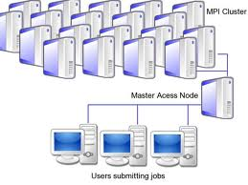
Computer Cluster
Computate
Nodes
Head
Node
User
Terminals

Slide 5
Auburn University vSMP HPCC
Virtual Symmetric Multiprocessing High Performance Compute Cluster
Dell M1000E Blade Chassis Server Platform
4 M1000E Blade Chassis Fat Nodes
16 M610 half-height Intel dual socket Blade
2CPU, Quad-core Nehalem 2.80 GHz processors
24GB RAM, two 160GB SATA drives and
Single Operating System image (CentOS).

Slide 6
Auburn University vSMP HPCC
Each M610 blade server is connected internally to the chassis via a Mellanox Quad Data Rate (QDR) InfiniBand switch 40Gb/s for creation of the ScaleMP vSMP
Each M1000E Fat Node is interconnected via 10 GbE Ethernet using M6220 blade switch stacking modules for parallel clustering using OpenMPI/MPICH2
Each M1000E Fat Node also has independent 10GbE Ethernet connectivity to the Brocade Turboiron 24X Core LAN Switch
Each node with 128 cores @ 2.80 GHz Nehalem
Total of 512 cores @ 2.80 GHz, 1.536TB shared memory RAM, and 20.48TB RAW internal storage

Slide 7
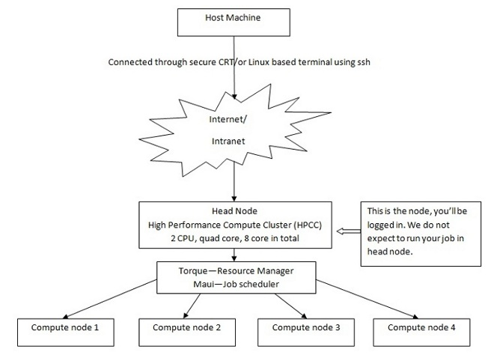
Auburn University vSMP HPCC

Slide 8
How to Access HPCC by SecureCRT
http://www.eng.auburn.edu/ens/hpcc/
access_information.html

Slide 9
How to Run Programs on HPCC
After successfully connected to HPCC
Step 1
Save .rhosts file in your H Drive
Save .mpd.conf file in your H Drive
Edit .mpd.conf file according to your user id
secretword = your_au_user_id
Chmod 700 .rhosts
Chmod 700 .mpd.conf
.rhost and .mpd.conf file can be downloaded from
http://www.eng.auburn.edu/ens/hpcc/access_information.html

Slide 10
How to Run Programs on HPCC
Step 2
Register your username on all 4 compute nodes by
ssh compute-1
exit
ssh compute-2 exit
ssh compute-3 exit
ssh compute-4 exit

Slide 11
How to Run Programs on HPCC
Step 3
Save pi.c file in your H Drive
Save newmpich_compile.sh file in your H Drive
Save mpich2_script.sh in your H Drive
Chmod 700 newmpich_compile.sh
Chmod 700 mpich2_script.sh
Three files can be downloaded from
http://www.eng.auburn.edu/ens/hpcc/software_programming.html
Run newmpich_compile.sh to compile pi.c

Slide 12
How to Run Programs on HPCC
Edit this line for varying number of nodes
#PBS -l nodes=4:ppn=10,walltime=00:10:00
#PBS -l nodes=2:ppn=2,walltime=01:00:00
Add this line
#PBS –d /home/au_user_id/folder name
folder_name is the folder where you saved pi.c, newmpich_compile.sh and mpich2_script.sh
Put in your user id into this line
to receive emails when job done #PBS -M au_user_id@auburn.edu
At the end of this file, add this line
data >> out
Step 4
Edit mpich2_script.sh file as shown on the right
Submit your job onto HPCC by
qsub ./mpich2_script.sh

Slide 13
How to Run Programs on HPCC
Step 5
After job submission, you will get a job number
Check if your job is successfully submitted by
pbsnodes –a
and find out if your job number is listed
Wait for job gets done and record the execution time of your job in out file

Slide 14
Performance
Run | Processor | Time in Minute
1 | 1 | 6.37
2 | 2 | 3.36
3 | 3 | 2.14
4 | 4 | 3.25
5 | 5 | 3.51
6 | 10 | 5.3

Slide 15
Performance
Run time curve

Slide 16
Performance
speedup curve

Slide 17
References
http://en.wikipedia.org/wiki/Computer_cluster
http://www.eng.auburn.edu/ens/hpcc/index.html
“High Performance Compute Cluster”, Abdullah Al Owahid, http://www.eng.auburn.edu/~vagrawal/COURSE/E6200_Fall10/course.html

