Slide 1
Introduction to VHDL
Mridula Allani
Fall 2010
(Refer to the comments if required)

Slide 2
HDLs in Digital System Design
Model and document digital systems
Hierarchical models
System, RTL (Register Transfer Level), gates
Different levels of abstraction
Behavior, structure
Verify circuit/system design via simulation
Synthesize circuits from HDL models

Slide 3
Hardware Description Languages
VHDL = VHSIC Hardware Description Language (VHSIC = Very High Speed Integrated Circuits)
Developed by DOD from 1983 – based on ADA
IEEE Standard 1076-1987/1993/200x
Based on the ADA language
Verilog – created in 1984 by Philip Moorby of Gateway Design Automation (merged with Cadence)
IEEE Standard 1364-1995/2001/2005
Based on the C language
IEEE P1800 “System Verilog” in voting stage & will be merged with 1364

Slide 4
Anatomy of a VHDL model
“Entity” describes the external view of a design/component
“Architecture” describes the internal behavior/structure of the component
Example:
1-bit full adder
A
B
Cin
Full Adder
Sum
Cout

Slide 5
Entity Inputs/Outputs
External view comprises input/output signals (“ports”)
A “port” is defined by its signal name, direction and type:
port_name: direction data_type;
direction:
in - driven into the entity from an external source
out - driven from within the entity
inout - bidirectional – drivers within the entity and external
data_type: any scalar or aggregate signal type

Slide 6
IEEE Standard 1164 Data Types
Type std_logic data values:
‘U’, ‘X’ – uninitialized/unknown ‘0’, ‘1’ – strongly-driven 0/1 ‘L’, ‘H’ – weakly-driven 0/1 (resistive) ‘Z’, ‘W’ - strong/weak “floating” ‘-’ - don’t care
Type std_logic_vector is array of std_logic
Include package: library IEEE; use IEEE.std_logic_1164.all;

Slide 7
Entity format
ENTITY entity_name IS
GENERIC (optional) (generic_name: type :=default_value;
…
generic_name: mode signal_type);
PORT (signal_name: mode signal_type;
…
signal_name: mode signal_type);
END ENTITY entity_name;

Slide 8
Full-Adder Adds Three Bits
c_in
FA
h_s
(a, b)
h_s
(h_s(a, b), c_in)
XOR
a
XOR
sum
HA
c_o
(a, b)
HA
c_o
(h_s(a, b), c_in)
AND
b
AND
OR
c_out

Slide 9
Entity example (1-Bit Full Adder)
A
B
Cin
Full Adder
Sum
Cout
ENTITY Full_adder IS
PORT ( -- I/O ports
a: IN STD_LOGIC; -- a input
b: IN STD_LOGIC; -- b input
cin: IN STD_LOGIC; -- carry input
sum: OUT STD_LOGIC; -- sum output
cout: OUT STD_LOGIC); -- carry output
END Full_adder ;

Slide 10
Architecture format
ARCHITECTURE architecture_name OF entity_name IS
-- data type definitions (ie, states, arrays, etc.)
-- internal signal declarations
-- component declarations
-- function and procedure declarations
BEGIN
-- behavior of the model is described here using:
-- component instantiations
-- concurrent statements
-- processes
END ARCHITECTURE architecture_name;

Slide 11
Dataflow architecture example
ARCHITECTURE dataflow OF Full_adder IS
BEGIN
sum <= a xor b xor cin;
cout <= (a and b) or (a and cin) or
(b and cin);
END dataflow;

Slide 12
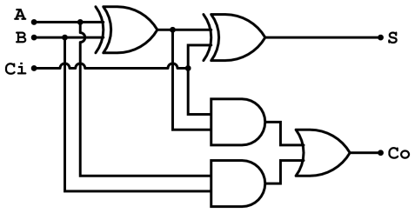
Structural architecture example
ARCHITECTURE structure OF Full_adder IS
COMPONENT xor IS -- declare component to be used
PORT (x,y: IN STD_LOGIC;
z: OUT STD_LOGIC);
END COMPONENT xor;
COMPONENT or IS -- declare component to be used
PORT (x,y: IN STD_LOGIC;
z: OUT STD_LOGIC);
END COMPONENT or;
COMPONENT and IS -- declare component to be used
PORT (x,y,z: IN STD_LOGIC;
p: OUT STD_LOGIC);
END COMPONENT xor;
SIGNAL x1,x2,x3,x4: STD_LOGIC; -- signal internal to this component
BEGIN
G1: xor PORT MAP (a, b, x1); -- instantiate 1st xor gate
G2: xor PORT MAP (x1, Cin, Sum); -- instantiate 2nd xor gate
G3: or PORT MAP (a, b, x2); -- instantiate 1st or gate
G4: or PORT MAP (a, Cin, x3); -- instantiate 2nd or gate
G5: or PORT MAP (b, Cin, x4); -- instantiate 3rd or gate
G6: and PORT MAP (x2, x3, x4, Cout); -- instantiate and gate
END structure;
Full-adder

Slide 13
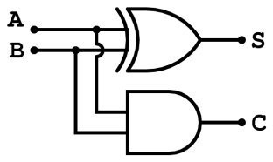
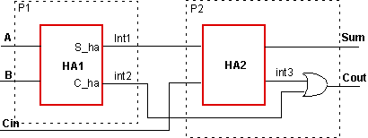
Alternative structural architecture example
ARCHITECTURE structural OF Full_adder IS COMPONENT half_adder PORT(a,b : IN STD_LOGIC; sum, carry : OUT STD_LOGIC); END COMPONENT; COMPONENT or_2 PORT(a,b : IN STD_LOGIC; c : OUT STD_LOGIC); END COMPONENT; SIGNAL int1, int2, int3 : STD_LOGIC; BEGIN H1: half_adder port map(a=>A, b=>B, sum=>int1, carry=>int3); H2: half_adder port map(a=>s1, b=>C_in, sum=>sum, carry=>s2); O1: or_2 port map(a=> int2, b=>int3, c=>C_out);
END structural;
ENTITY half_adder IS PORT (a,b : IN STD_LOGIC ; sum,carry : OUT STD_LOGIC); END half_adder; ARCHITECTURE dataflow OF half_adder IS BEGIN sum<= a xor b; carry <= a and b; END dataflow;
ENTITY or_2 IS PORT (a,b : IN STD_LOGIC ; c : OUT STD_LOGIC); END or_2; ARCHITECTURE dataflow OF or_2 IS BEGIN c<= a or b; END dataflow;
Each Half-adder
Full-adder
Full-adder

Slide 14
Extending full-adder circuit to multiple-bit adition
library ieee;
use ieee.std_logic_1164.all;
ENTITY adder_4bit IS
PORT (a, b: IN STD_LOGIC_VECTOR(3 DOWNTO 0);
Cin : IN STD_LOGIC;
sum: OUT STD_LOGIC_VECTOR (3 DOWNTO 0);
Cout: OUT STD_LOGIC);
END adder_4bit;
ARCHITECTURE structural OF adder_4bit IS
SIGNAL c: STD_LOGIC_VECTOR (4 DOWNTO 0);
COMPONENT Full_adder
PORT(a, b, c: IN STD_LOGIC;
sum, carry: OUT STD_LOGIC);
END COMPONENT;
BEGIN
FA0: Full_adder
PORT MAP (a(0), b(0), Cin, sum(0), c(1));
FA1: Full_adder
PORT MAP (a(1), b(1), C(1), sum(1), c(2));
FA2: Full_adder
PORT MAP (a(2), b(2), C(2), sum(2), c(3));
FA3: Full_adder
PORT MAP (a(3), b(3), C(3), sum(3), c(4));
Cout <= c(4);
END structural;

Slide 15
Behavioral architecture example
ARCHITECTURE behavioral OF Full_adder IS
BEGIN
Sum: PROCESS(a, b, cin)
BEGIN
sum <= a xor b xor cin;
END PROCESS Sum;
Carry: PROCESS(a, b, cin)
BEGIN
cout <= (a and b) or (a and cin) or (b and cin);
END PROCESS Carry;
END behavioral;
ARCHITECTURE behavioral OF Full_adder IS
BEGIN
PROCESS(a, b, cin)
BEGIN
sum <= a xor b xor cin;
cout <= (a and b) or (a and cin) or (b and cin);
END PROCESS;
END behavioral;

Slide 16
VHDL “Process” Construct
Allows conventional programming language methods to describe circuit behavior
Supported language constructs (“sequential statements”) – only allowed within a process:
variable assignment
if-then-else (elsif)
case statement
while (condition) loop
for (range) loop

Slide 17
Process Format
[label:] process (sensitivity list)
declarations
begin
sequential statements
end process;
Process statements executed once at start of simulation
Process halts at “end” until an event occurs on a signal in the “sensitivity list”

Slide 18
Using a “process” to model sequential behavior
ENTITY dff IS
PORT (d,clk: IN STD_LOGIC;
q: OUT STD_LOGIC);
END dff;
ARCHITECTURE behavioral OF dff IS
BEGIN
PROCESS(clk) -- “process sensitivity list”
BEGIN
IF (clk’event and clk=‘1’) THEN
q <= d AFTER 1 ns;
END IF;
END PROCESS;
END behavioral;
Process statements executed sequentially (sequential statements)
clk’event is an attribute of signal clk which is TRUE if an event has occurred on clk at the current simulation time
D Q
CLK

Slide 19
Alternative to sensitivity list
ENTITY dff IS
PORT (d,clk: IN STD_LOGIC;
q: OUT STD_LOGIC);
END dff;
ARCHITECTURE behavioral OF dff IS
BEGIN
PROCESS -- no “sensitivity list”
BEGIN
WAIT ON clk; -- suspend process until event on clk
IF (clk=‘1’) THEN
q <= d AFTER 1 ns;
END IF;
END PROCESS;
END behavioral;
Other “wait” formats:
WAIT UNTIL (clk’event and clk=‘1’) WAIT FOR 20 ns;
Process executes endlessly if no sensitivity list or wait statement!
D Q
CLK

Slide 20
Sequential statements in process
if-then-elsif-else statement if condition then (... sequence of statements...) elsif condition then (... sequence of statements...) else (... sequence of statements...) end if;
case statement case expression is when choices => sequence of statements when choices => sequence of statements ... when others => sequence of statements end case;

Slide 21
Sequential statements in process
while loop [label:] while condition loop ... sequence of statements ... end loop [label];
for loop [label:] for loop_variable in range loop ... sequence of statements... end loop [label];

Slide 22
Behavioral architecture example using conditional statements
ARCHITECTURE functional OF Full_adder IS BEGIN PROCESS(A,B,Cin) BEGIN If (Cin = '0' and A = '0' and B = '0' ) then sum<= '0'; Cout <= '0'; elsif(Cin = '0' and A = '0' and B = '1') then sum <= '1' ; Cout <= '0'; elsif(Cin = '0' and A = '1' and B = '0' ) then sum <= '1' ; Cout <= '0'; elsif(Cin = '0' and A = '1' and B = '1' ) then sum<= '0'; Cout <= '1';
elsif(Cin = '1' and A = '0' and B = '0' ) then sum <= '1' ; Cout <= '0'; elsif(Cin = '1' and A = '0' and B = '1' ) then sum<= '0'; Cout <= '1'; elsif(Cin = '1' and A = '1' and B = '0' ) then sum<= '0'; Cout <= '1'; elsif(Cin = '1' and A = '1' and B = '1' ) then sum <= '1' ; Cout <= '1'; else sum <= 'X' ; Cout <= 'X'; end if;
END PROCESS;
END functional;

Slide 23
Sequential architecture example
ENTITY counter_4bit IS
PORT(Ld, Clr, Clk: IN STD_LOGIC;
D: IN STD_LOGIC_VECTOR (3 DOWNTO 0);
Cout: OUT STD_LOGIC;
Qout: OUT STD_LOGIC_VECTOR (3 DOWNTO 0));
END counter_4bit;
ARCHITECTURE behavioral OF counter_4bit IS
SIGNAL Q: STD_LOGIC_VECTOR(3 DOWNTO 0);
BEGIN
Qout <= Q;
Cout <= Q(3) and Q(2) and Q(1) and Q(0);
PROCESS(Clk)
BEGIN
IF Clk'event and Clk = '1' THEN
IF Clr = '0' THEN
Q <= "0000";
ELSIF Ld = '0' THEN
Q <= D;
ELSE
Q <= Q + 1;
END IF;
END IF;
END PROCESS;
END behavioral;

Slide 24
References
VHDL mini-reference on Prof. Nelson’s website
http://www.eng.auburn.edu/department/ee/mgc/vhdl.html
VHDL resources on Prof. Stroud’s website
http://www.eng.auburn.edu/~strouce/elec4200.html
VHDL resources on Prof. Agrawal’s website
http://www.eng.auburn.edu/~agrawvd/COURSE/E6200_Fall10/course.html
http://esd.cs.ucr.edu/labs/tutorial/
http://www.seas.upenn.edu/~ese201/vhdl/vhdl_primer.html#_Toc526061344
http://www.vhdl.org/
http://www.doulos.com/knowhow/vhdl_designers_guide/
http://www.altera.com/support/examples/vhdl/vhdl.html
http://www.vhdl-online.de/tutorial/
http://www.people.vcu.edu/~rhklenke/tutorials/vhdl/modules/m12_23/sld006.htm
http://www.doc.ic.ac.uk/~ih/teaching/lectures/comparch/logic/adder/

Slide 25
Using Modelsim
Modelsim PE (Student Edition) can be downloaded from
http://model.com/content/modelsim-pe-student-edition-hdl-simulation?quicktabs_4=1#quicktabs-4
Modelsim is installed on the Windows7 platform in Lab 310, Broun Hall.

Slide 26
Using Modelsim

Slide 27
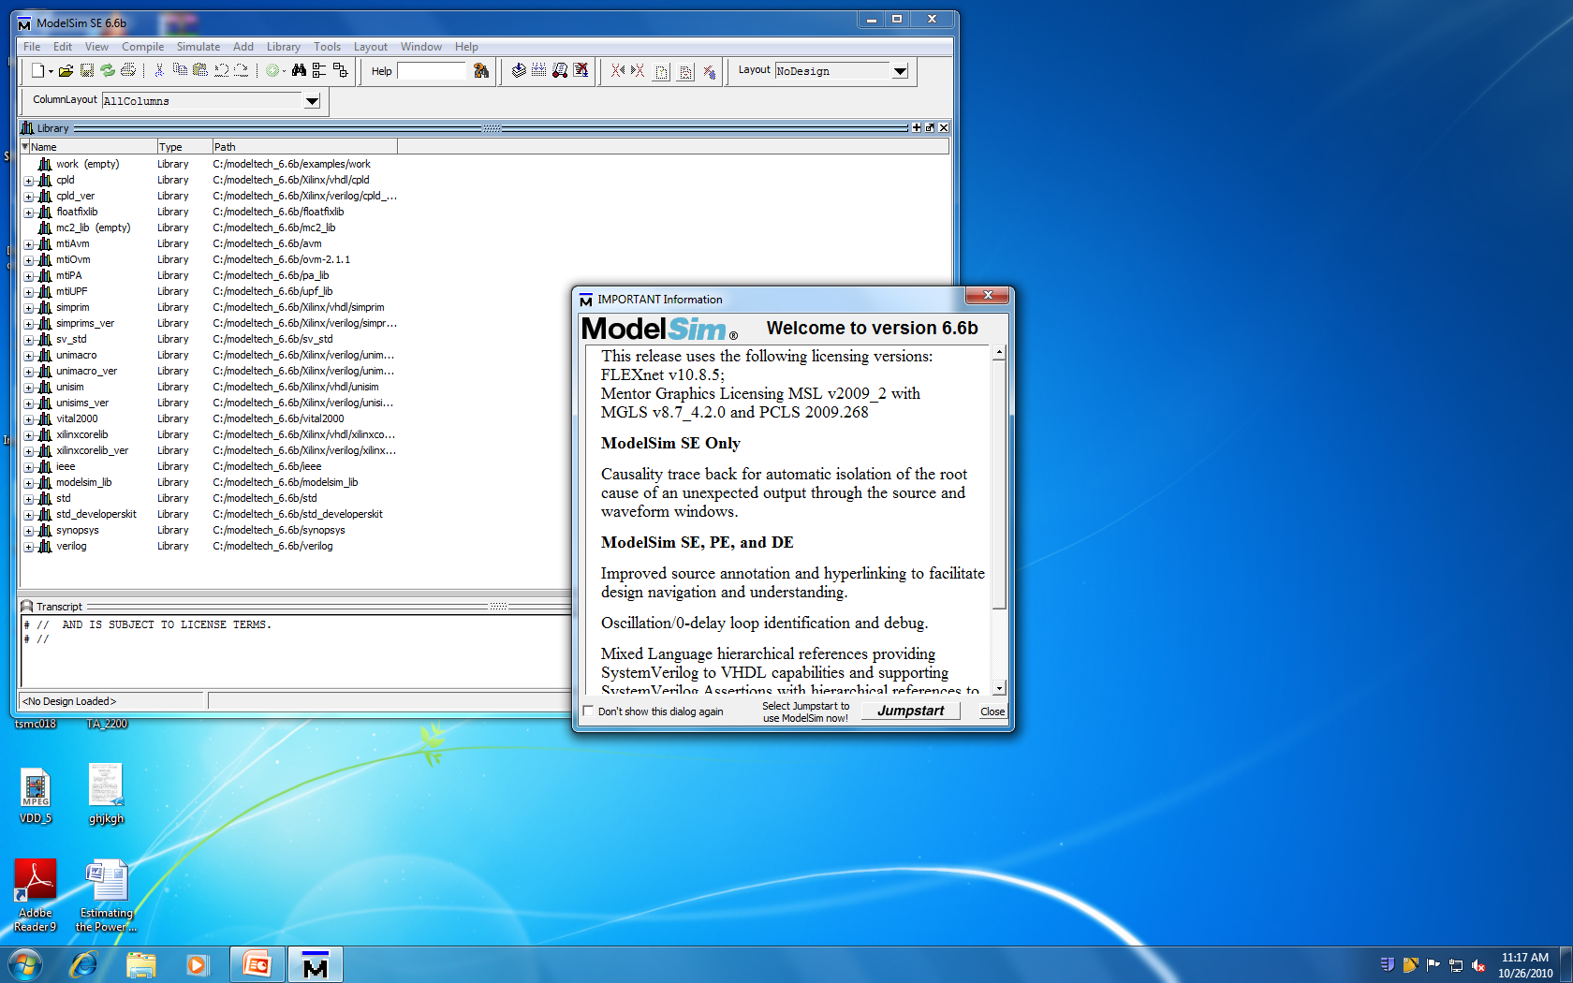
Using Modelsim

Slide 28
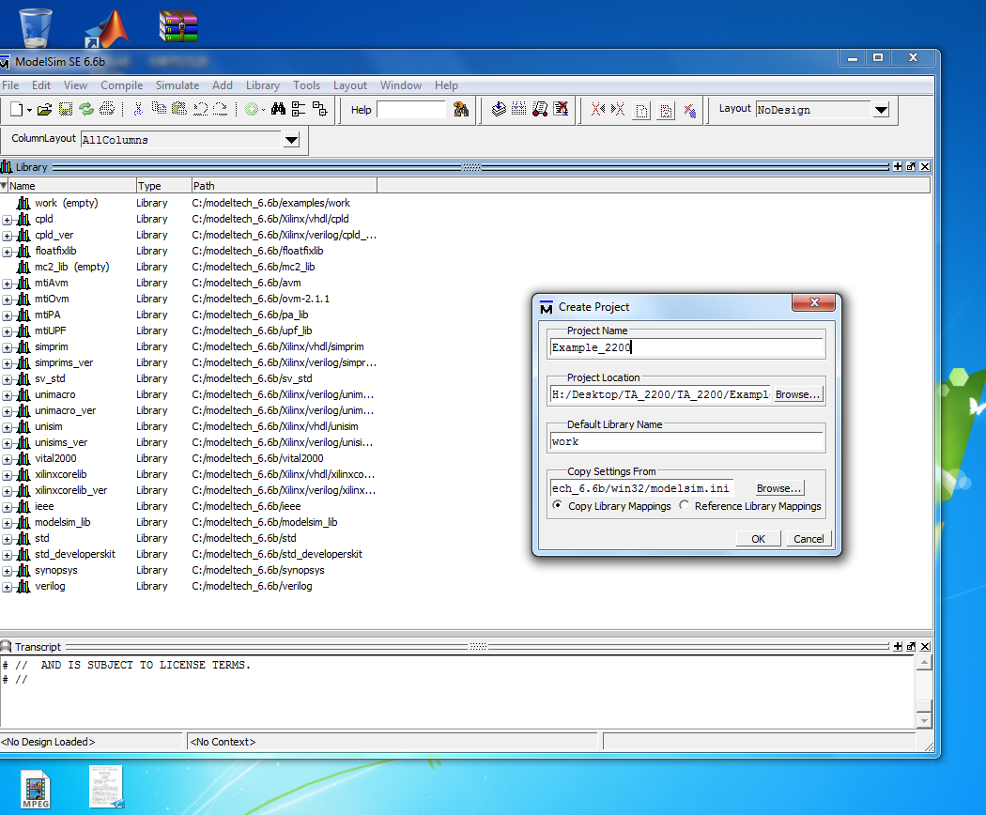
Using Modelsim

Slide 29
Using Modelsim

Slide 30
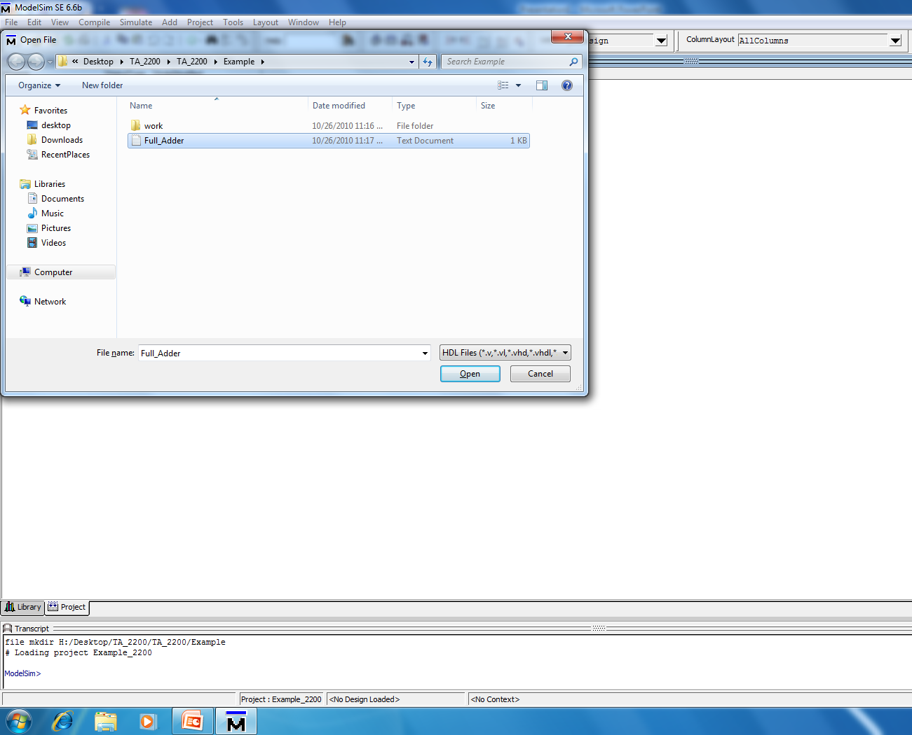
Using Modelsim

Slide 31
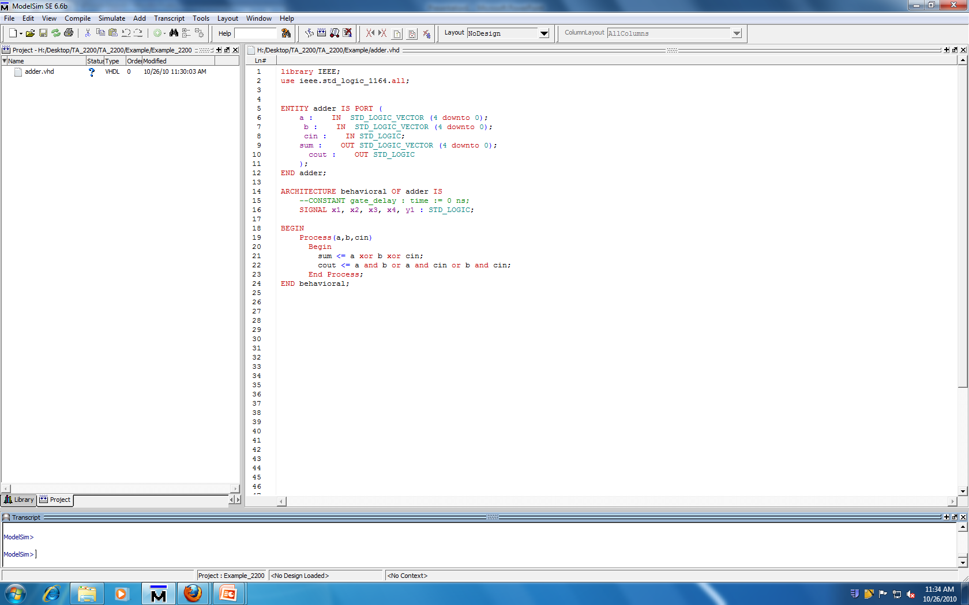
Using Modelsim

Slide 32
Using Modelsim

Slide 33
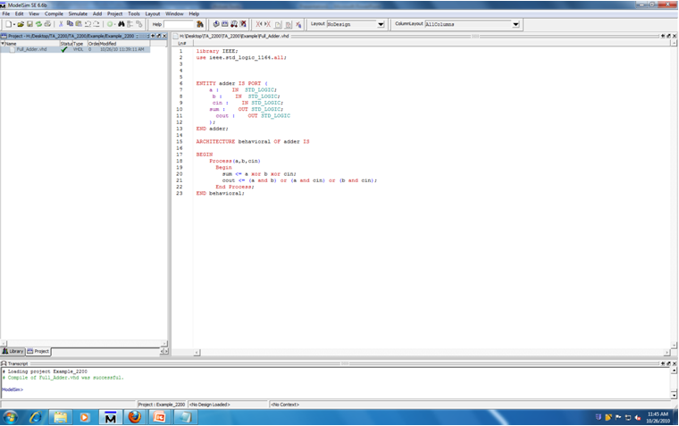
Using Modelsim

Slide 34
Using Modelsim

Slide 35
Using Modelsim

Slide 36
Using Modelsim

Slide 37
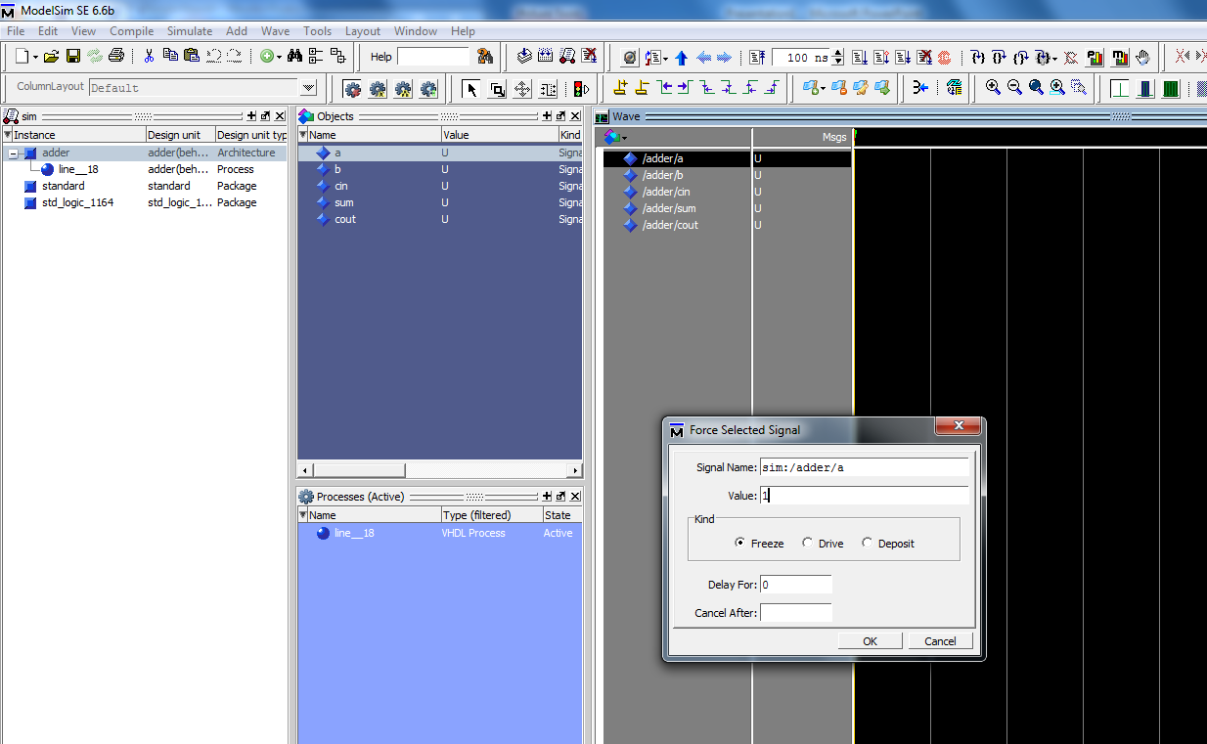
Using Modelsim

Slide 38
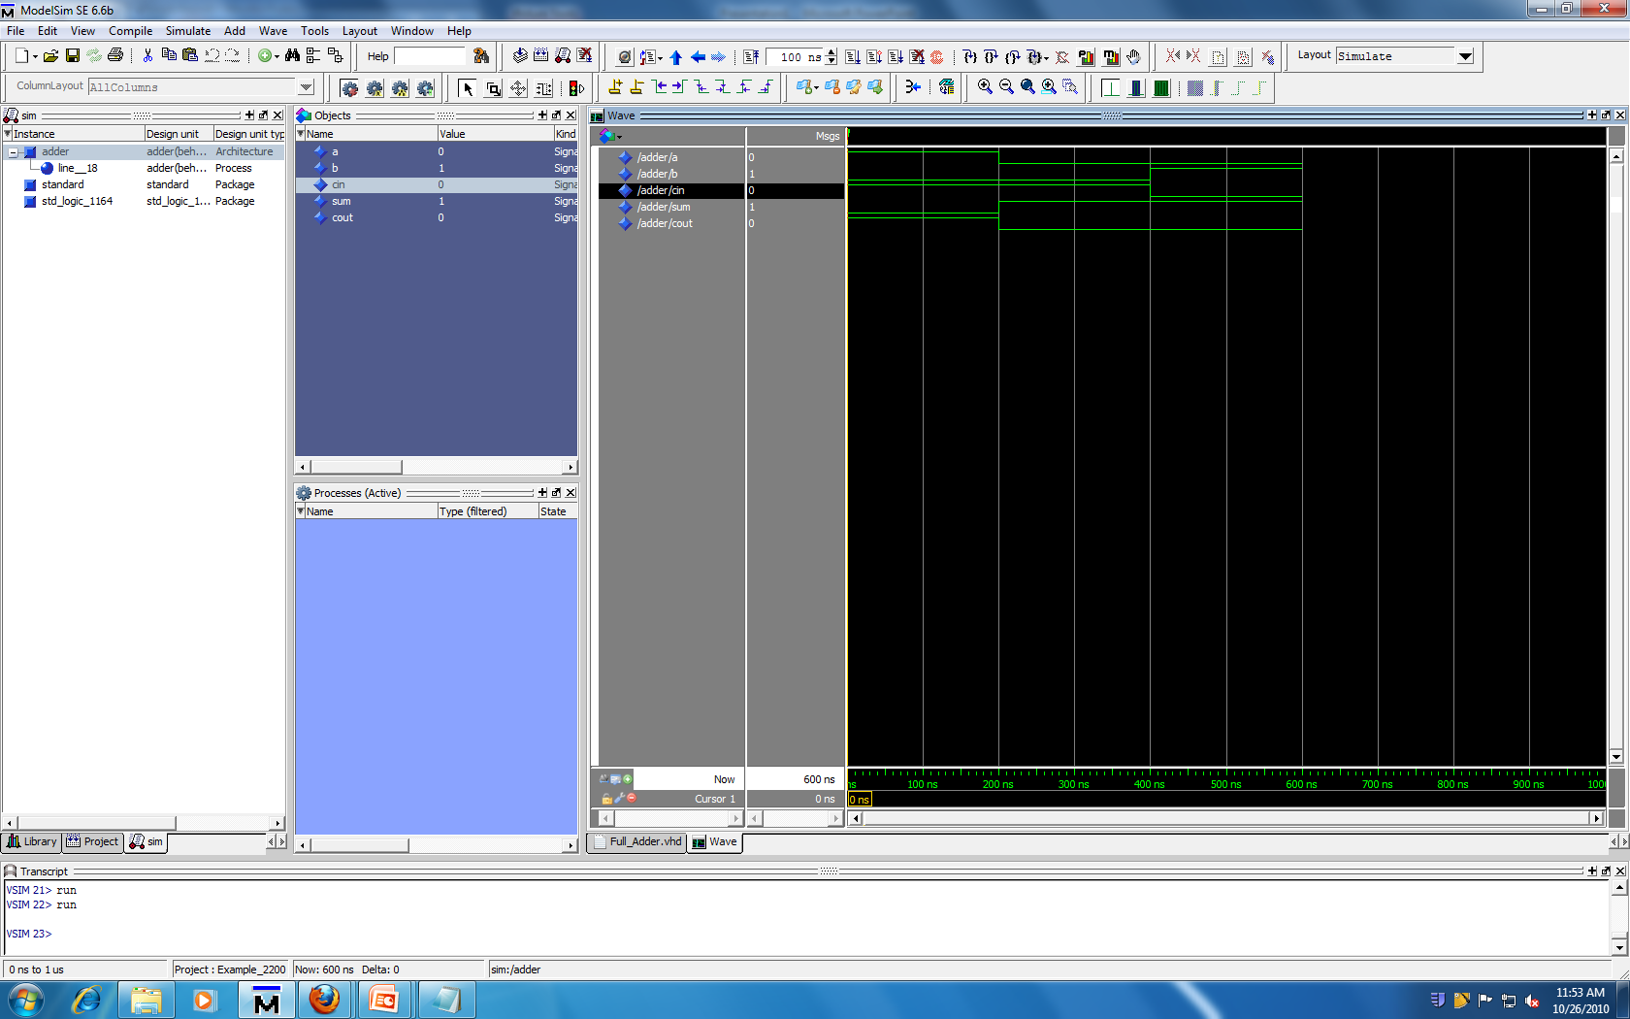
Using Modelsim

Slide 39
Using Modelsim

