Slide 1
Performance Evaluation of Traditional Caching Policies on
A Large System with Petabytes of Data
Ribel Fares¹, Brian Romoser¹, Ziliang Zong¹, Mais Nijim² and Xiao Qin³
Texas State University, TX, USA¹
Texas A&M University-Kingsville²
Auburn University, AL, USA³
Presented at the 7th IEEE International Conference on Networking, Architecture, and Storage (NAS2012)

Slide 2
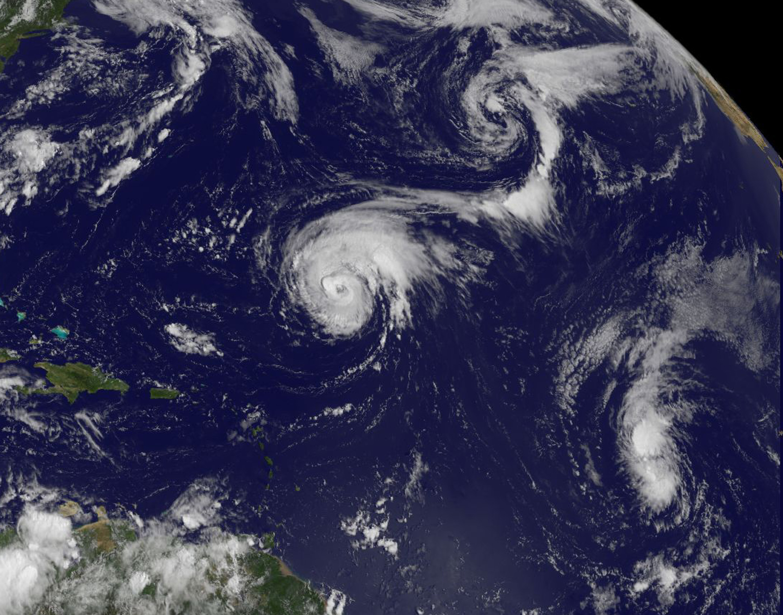



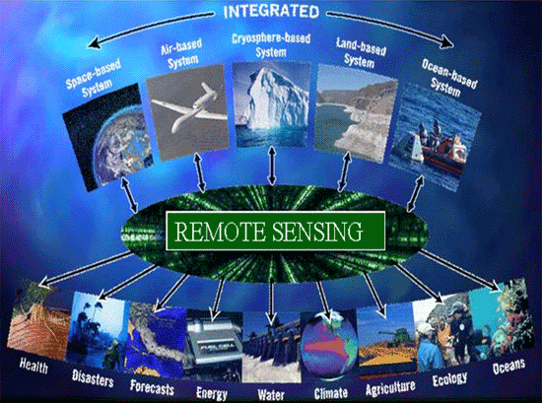
Motivation
Large-scale data processing
High-performance storage systems
Notes:
Remote sensing data set
Financial engineering

Slide 3

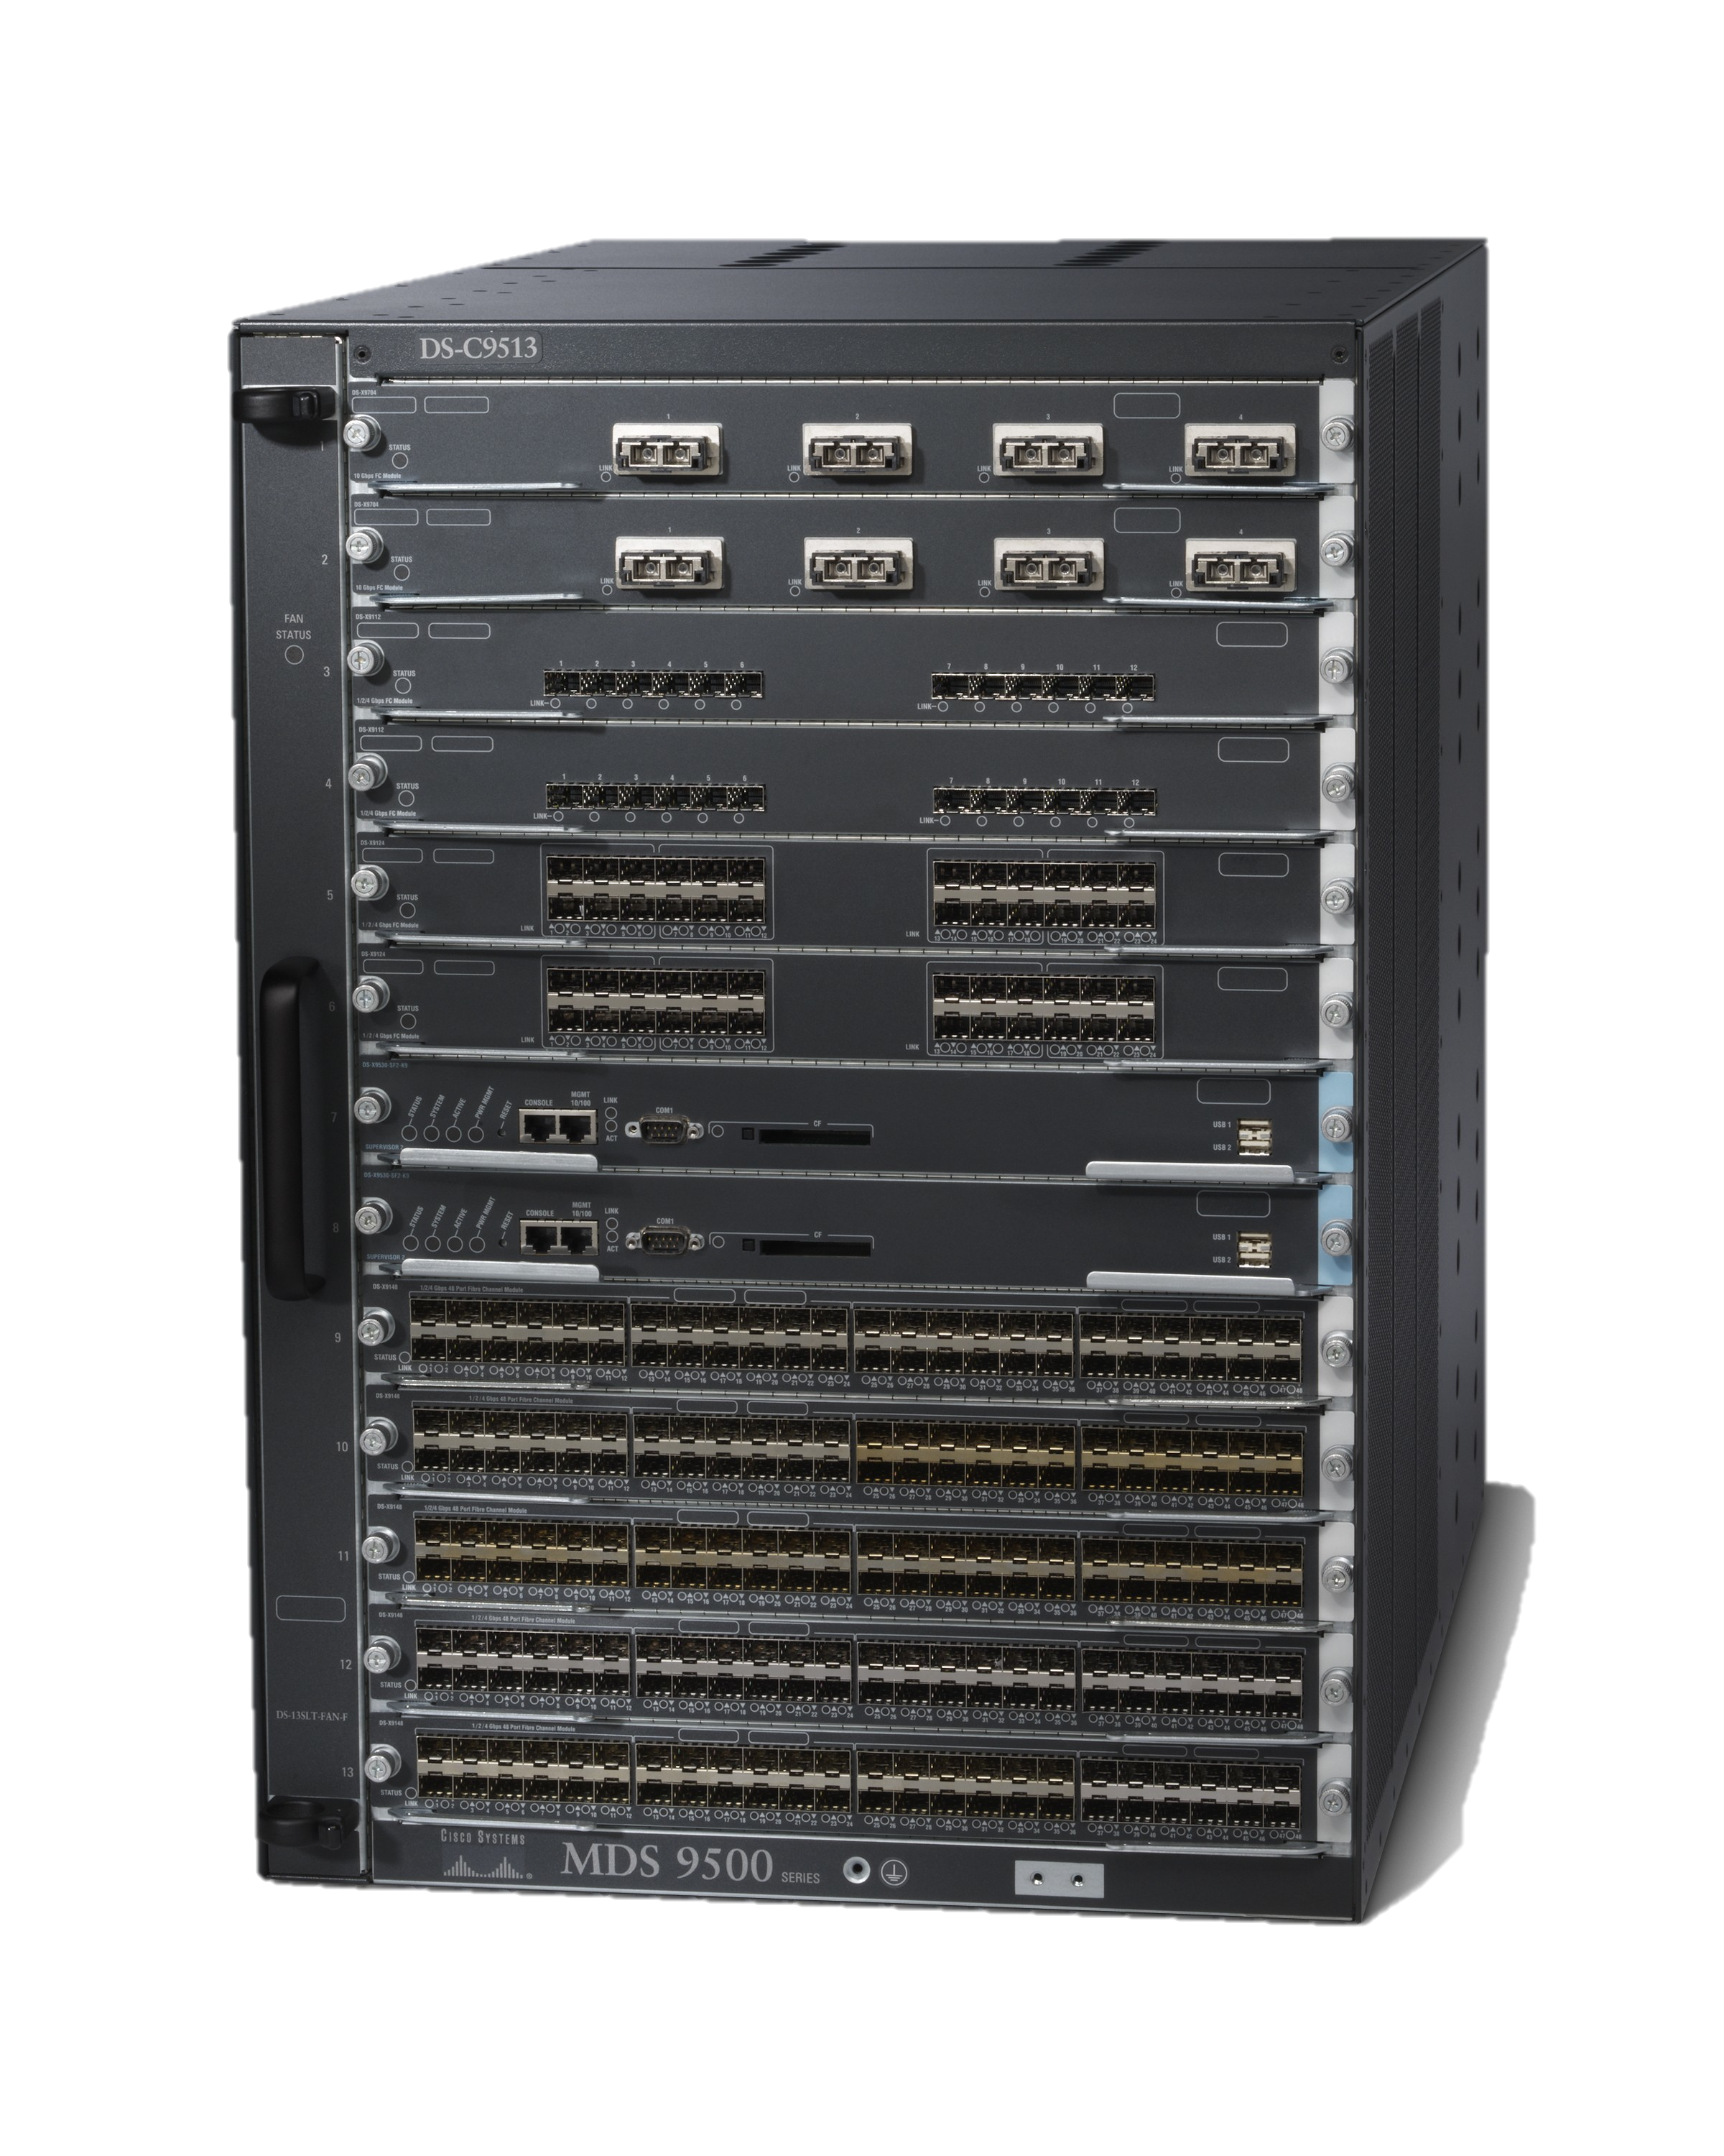

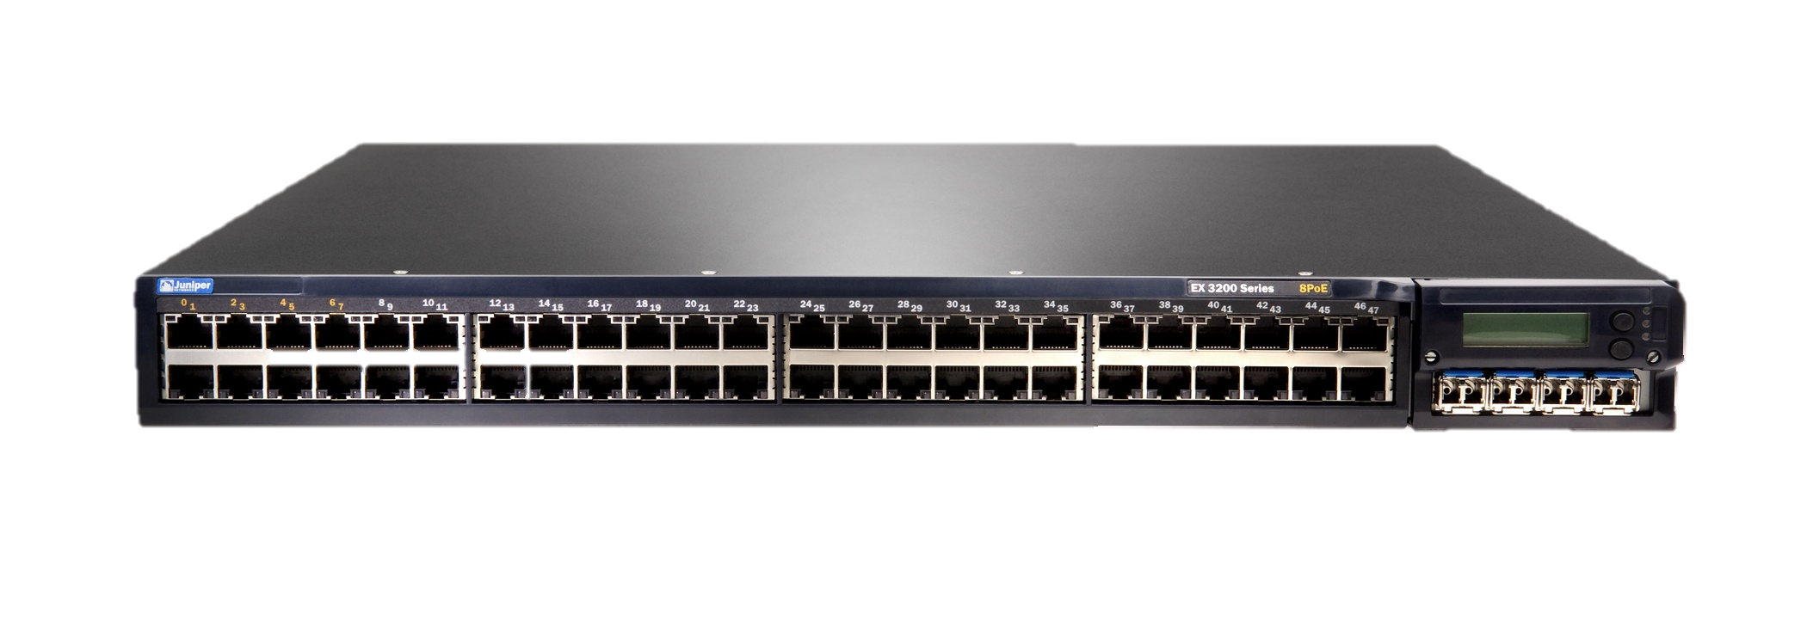

High-Performance Clusters
The Architecture of a Cluster
Storage subsystems
(or Storage Area Network)
Head Node
Internet
Client
Network switch
Computing
Nodes

Slide 4
Techniques for High-Performance Storage Systems
Caching
Prefetching
Active Storage
Parallel Processing

Slide 5
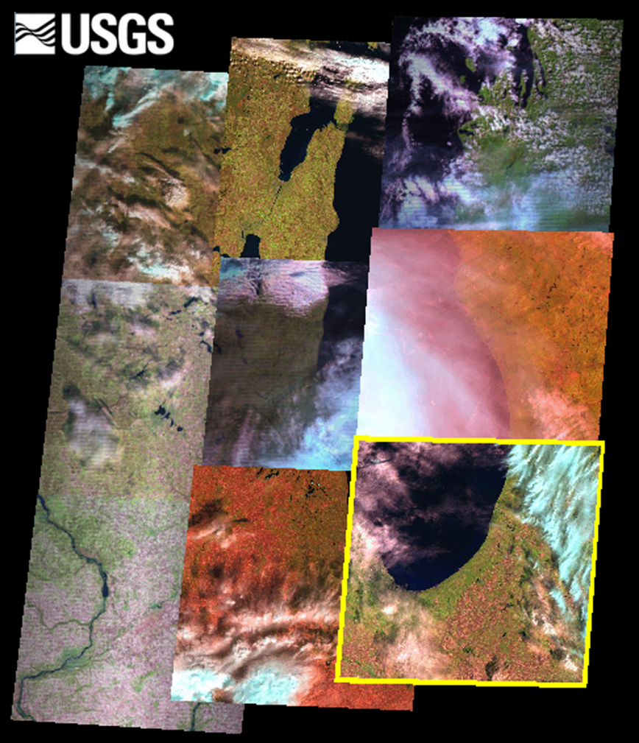
Do traditional caching policies still work effectively?
Earth Resources Observation and Science (EROS) Center
Over 4 petabytes of
satellite imagery available.
More than 3 million image
requests since 2008.
Notes:
The EROS Data Center is home to the U.S. National Satellite Land Remote Sensing Data Archive. The EROS Data Center is managed by the United States Geological Survey.
Provides one of the largest satellite image distribution services in the world.
Released image repository to public domain in October 2008.

Slide 6
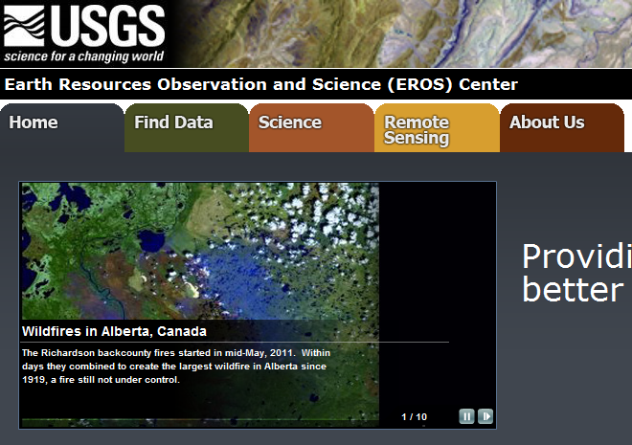
EROS Data Center - System Workflow
data
data
data
data

Slide 7
USGS / EROS Storage System
Type | Model | Capacity | Hardware | Bus Interface
1 | Sun/Oracle F5100 | 100 TB | SSD | SAS/FC
2 | IBM DS3400 | 1 PB | HDD | SATA
3 | Sun/Oracle T10K | 10 PB | Tape | Infiniband
The FTP server from which users download images is of type 1.

Slide 8
The USGS / EROS Distribution System
Each cache miss costs 20–30 minutes of processing time.
Notes:
When a user requests an image over the web, the download starts immediately if the requested image is available on the FTP server. Otherwise, the user is sent an e-mail with a link to the requested image once the processing is complete.

Slide 9
USGS / EROS Log File
L
Landsat
7
Satellite designation
E
ETM+ sensor
004
WRS path
063
WRS row
2006
Acquisition year
247
Acquisition day of year
ASN
Capture station
00
Version
Notes:
Detailed description of the log file. From left to right, the attributes in the log file is as follows: scene ID (further broken down into sub-attributes), user ID, request date.

Slide 10
Observation 1
Top 9 aggressive users account for 18% of all requests.
A second log file was created by removing requests made by the top 9 aggressive users.
Notes:
A clear power distribution is visible; few people request many images, many people request few images.

Slide 11
Observation 2
Duplicate images within 7 days were removed from the log file.
Notes:
An exceptionally large amount of duplicate (same user requests same image again) requests were made. We were told by USGS that this was a result of the currentuser interface.

Slide 12
Caching Algorithms
FIFO: First entry in cache gets removed first.
LRU: Least recently requested image removed first.
LFU: Least popular image removed first.
Notes:
Normally, LRU and LFU improve FIFO significantly. Is this going to be the case on a global system with petabytes of data?

Slide 13
Case Studies
Simulation Number | Cache Policy | Cache Size (TB) | Top 9 Aggressive Users
1 | FIFO | 30 | Included
2 | FIFO | 30 | Not Included
3 | FIFO | 60 | Included
4 | FIFO | 60 | Not Included
5 | LRU | 30 | Included
6 | LRU | 30 | Not Included
7 | LRU | 60 | Included
8 | LRU | 60 | Not Included
9 | LFU | 30 | Included
10 | LFU | 30 | Not Included
11 | LFU | 60 | Included
12 | LFU | 60 | Not Included
Notes:
Cache size in simulations are smaller than the actual FTP server size.

Slide 14
Simulation Assumptions/Restrictions
When cache server reaches 90% capacity, images will be removed according to adopted cache policy until server load is reduced down to 45%.
Images are assumed to be processed instantaneously.
A requested image can not be removed from the server before 7 days.
Notes:
Instantaneous image processing is assumed to simplify simulation. With this simplification, we can not measure the wait time for users. However, we can still calculate the cache hit-rates.

Slide 15
Results – Hit Rates of
Differing Cache Replacement Policies
Notes:
No images removed from FTP server until first clean up date. Therefore, all three cache policies behave exactly the same before the first clean up. During clean up. different set images is removed from the server, depending on the cache adopted policy.

Slide 16
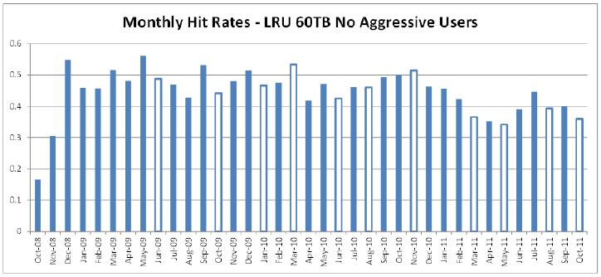
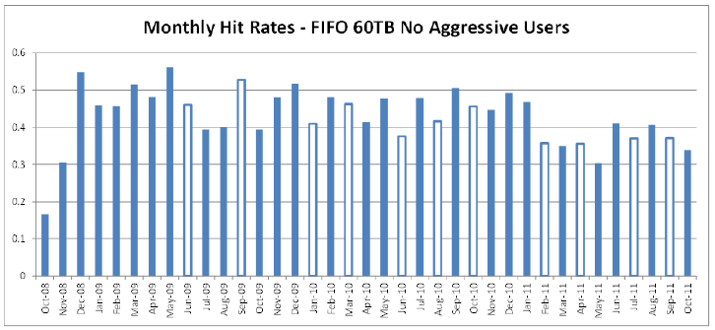
Monthly hit ratios
Aggressive users excluded
Notes:
Number of clean-ups
The monthly hit rate of each of the three cache
replacement policies is shown individually. Hollow bars represent
months in which a “clean-up” occurred. Hilighting months
in which “clean-ups” occur, we find that all replacement
policies examined will execute a “clean up”, on average, once
every 1.8 months. Several brief periods were observed wherein
FIFO and the pair of LRU and LFU will exhibit differences in their respective lengths of time between ”clean-ups” being
initiated, however differences in ”rest times” were marginally
small (two months at maximum). In addition, we confirm that
LRU and LFU behave extremely similarly, with “clean-up”
taking place in the same month for the two policies across all
resultant data sets.

Slide 17
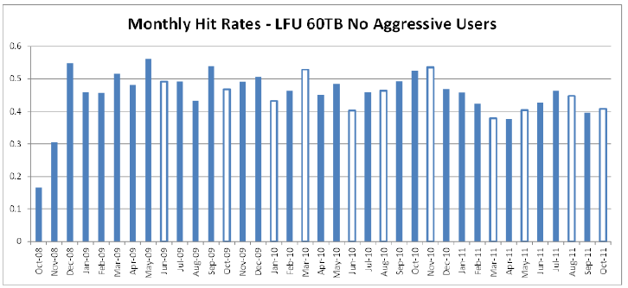
Monthly hit ratios
Aggressive users excluded
Notes:
Number of clean-ups
The monthly hit rate of each of the three cache
replacement policies is shown individually. Hollow bars represent
months in which a “clean-up” occurred. Hilighting months
in which “clean-ups” occur, we find that all replacement
policies examined will execute a “clean up”, on average, once
every 1.8 months. Several brief periods were observed wherein
FIFO and the pair of LRU and LFU will exhibit differences in their respective lengths of time between ”clean-ups” being
initiated, however differences in ”rest times” were marginally
small (two months at maximum). In addition, we confirm that
LRU and LFU behave extremely similarly, with “clean-up”
taking place in the same month for the two policies across all
resultant data sets.

Slide 18
Results – Impact of Inclusion of
Aggressive Users
Notes:
When requests from top-9 aggressive users are included, LRU seems to be the best performer.

Slide 19
Results – Impact of Exclusion of
Aggressive Users
Notes:
When requests from top-9 aggressive users are removed, LFU outperforms LRU. It may be the case that LFU is better when requests are evenly distributed throughout users. Whereas LRU is better when there is a Power Distribution.

Slide 20
Conclusion & Future Work
LRU and LFU initiate cache clean-up at similar points.
Aggressive users destabilize monthly hit rates
LFU was least affected by the inclusion of aggressive users.

Slide 21
Conclusion & Future Work cont’d.
LRU and LFU methods improve FIFO as expected.
However, improvements are on the weaker side.
Global user behaviors should be further investigated to design more complex caching and/or prefetching strategies.

Slide 22
Summary
Data-Intensive Processing
  EROS (Earth Resources Observation and Science) Data Center
  visEROS
Improving I/O Performance
  Prefetching
  Active Storage
  Parallel Processing

Slide 23
The VisEROS Project –
Motivation
2M downloads from the EROS data center.
No existing visualization tools available to utilize these data
Need a tool to:
  Monitor user download behaviors
  Show the current global download “hot spots”
  Demonstrate the actual usage of EROS data
  Optimize the storage system performance
  Improve the satellite image distribution service
Notes:
In September 2008, EROS announced its new policy to place all of their satellite imagery in the public domain for free download. Since then, the number of downloads has significantly increased (already reached 2M). This number is expected to grow steadily.
No existing visualization tools available to utilize these data for the purpose of system optimization, user download pattern analysis, data mining, etc.
A well designed visualization tool will be helpful to:
monitor the historical and current global user download behaviors
show the current global download “hot spots”
demonstrate the importance and actual usage of EROS data
optimize the storage system performance
improve the satellite image distribution service provided by EROS

Slide 24
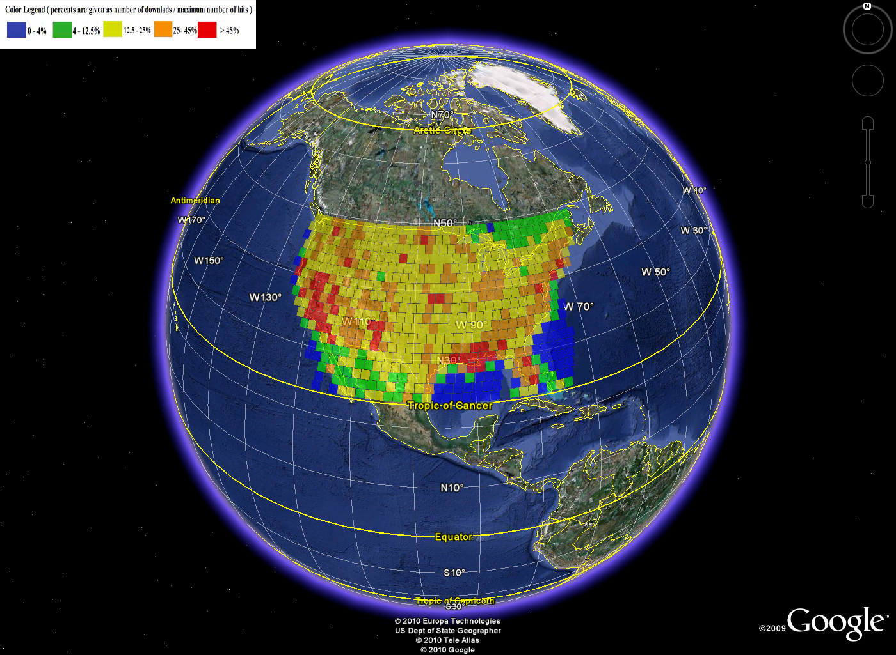
The VisEROS Prototype
Generated by VisEROS

Slide 25
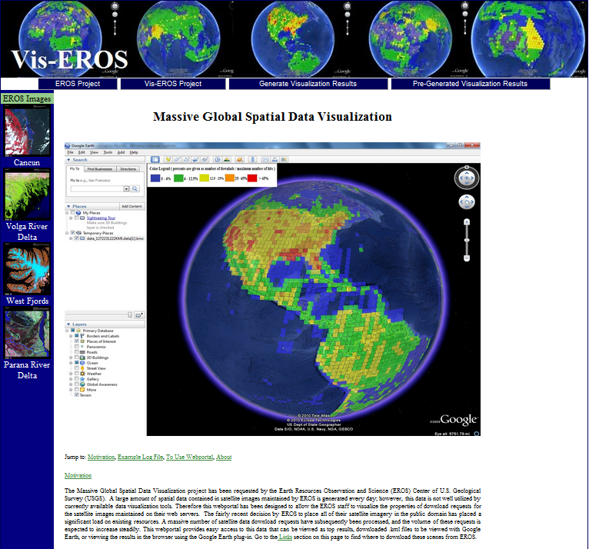
This project is supported by
the U.S. National Science Foundation
No. 0917137

Slide 26

Download the presentation slides http://www.slideshare.net/xqin74
Google: slideshare Xiao Qin

Slide 27

Many Thanks!

