Slide 1
Energy Source Lifetime Optimization for a Digital System through Power Management
Master’s Thesis Defense
Manish Kulkarni
Advisor: Dr. Vishwani Agrawal
Committee: Dr. Adit Singh and Dr. Victor Nelson
Department of Electrical and Computer Engineering
Auburn University

Slide 2
Outline
Motivation
Chip power density
Leakage component in total power
Battery energy density trend
Energy source optimization methods
Voltage and Clock Management
Functional Management
Voltage and Clock Management (DVFS)
Background
A typical system powered with battery
Battery Simulation Model
DC to DC converter
Problem statement
Proposed Method
Functional Management
Instruction Slowdown for Processor Architecture
Increase in Total Energy
Battery Lifetime Improvement
Conclusion
References

Slide 3
Motivation
VLSI Chip Power Density
Sun’s
10000
Surface
Rocket
1000
Nozzle
Nuclear
100
Power Density (W/cm²)
Reactor
8086
Hot Plate
10
4004
P6
8008
8085
386
Pentium®
8080
286
486
1
1970
1980
1990
2000
2010
Year
Source: Patrick P. Gelsinger , Keynote, ISSCC, Feb. 2001[1]

Slide 4
Leakage Component in Total Power
Motivation (Continued)
9.3%
27.5%
54.9%
66.1%
Results obtained by Simulation of a 32-bit, 32 Word Register File using HSPICE [6] with PTM bulk CMOS models [5]

Slide 5
Motivation (Continued)
Battery Energy Density Trend
Growth in battery energy density does not follow the power consumption requirements of semiconductor devices.
Energy Density Doubled in 10 Years
Source: Panasonic Presentation at Florida Education Seminar, March 14, 2006

Slide 6
Motivation (Continued)
Battery Energy Density Trend
Batteries have a limit to which their energy densities can be increased.
Source: http://en.wikipedia.org/wiki/List_of_energy_densities

Slide 7
Energy Source Optimization Methods
Timing Management
Functional Management
Voltage Management
Dynamic Voltage Management
Multi-Voltage design
Dynamic Voltage and Frequency
Scaling (DVFS)
Dynamic Frequency Management
Retiming
Fetch Throttling
Dynamic Task Scheduling
Instruction Slowdown
Low Power solutions to common operations e.g. Low Power FSMs, Bus Encoding etc

Slide 8
Energy Source Optimization Methods
Timing Management
Functional Management
Voltage Management
Dynamic Voltage and Frequency Scaling (DVFS)
Parallel
Architectures
Instruction Slowdown Method
in Processors

Slide 9
Introduction: Powering a System
R_{B}
I_{L}
V_{B}
+
_
V_{L}
R_{L}
AHr
(capacity)
Power supplied to load, P_{L} = I_{L}² R_{L} = (V_{B}²/R_{B})(R_{L}/R_{B}) / (1+ R_{L}/R_{B})²
Ideal lifetime = AHr/I_{L} = AHr.R_{B} (1 + R_{L}/R_{B}) / V_{B}
Efficiency = P_{L} / Battery Power = (1+ R_{B}/R_{L}) ^{–1}

Slide 10
Lifetime, Power and Efficiency
10
8
6
4
2
0
1.0
0.8
0.6
0.4
0.2
0.0
Efficiency
Lifetime (x AHr.R_{B} /V_{B})
Efficiency or Power
P_{L} = V_{B}²/(4R_{B})
Lifetime
0 1 2 3 4 5 6 7 8
R_{L}/R_{B}

Slide 11
Power Subsystem of an Electronic System
VDD
4.2 V to 3.5 V Lithium- ion
Battery
DC – DC
Voltage Converter
Electronic
System
Decoupling Capacitor
GND

Slide 12
Some Characteristics
Lithium-ion battery
Open circuit voltage: 4.2V, unit cell 400mAHr, for efficiency ≥ 85%, current ≤ 1.2A
Discharged battery voltage ≤ 3.0V
DC-to-DC converter
Supplies VDD to circuit, VDD ≤ 1V for nanometer technologies.
VDD control for energy management.
Decoupling capacitor(s) provide smoothing of time varying current of the circuit.

Slide 13
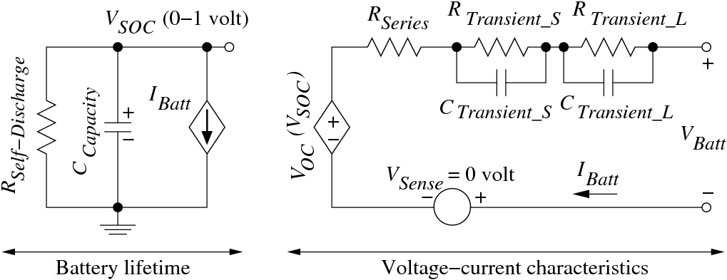
Battery Simulation Model
Lithium-ion battery, unit cell capacity: N = 1 (400mAHr)
Battery sizes, N = 2 (800mAHr), N = 3 (1.2AHr), etc.
Ref: M. Chen and G. A. Rincón-Mora, “Accurate Electrical Battery Model Capable of Predicting Runtime and I-V Performance,” IEEE Transactions on Energy Conversion, vol. 21, no. 2, pp. 504–511, June 2006.

Slide 14
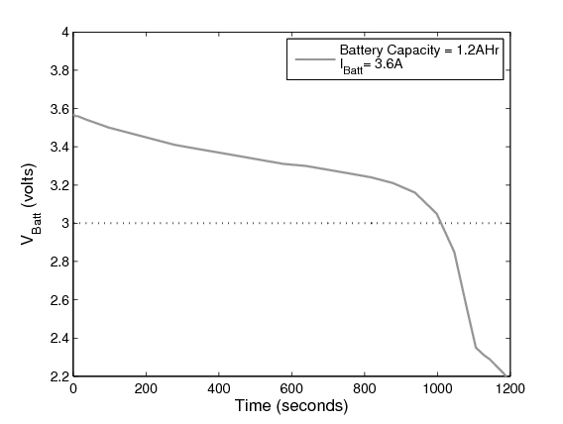
Lifetime from Battery Simulation
1008 Sec

Slide 15
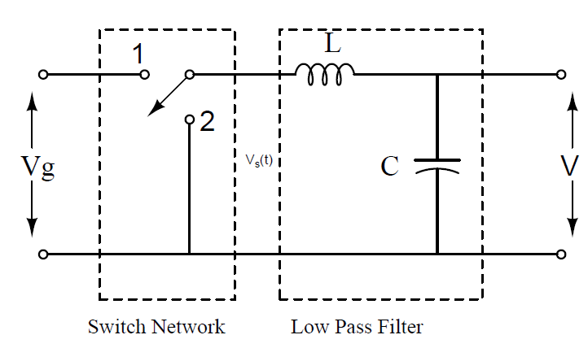
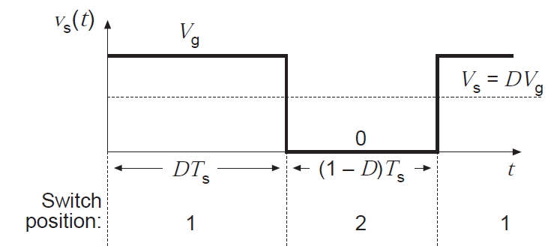
DC-to-DC Buck (Step-Down) Converter
Components:
Switch (FETs, VDMOS), diode, inductor, capacitor.
Switch control: pulse width modulated (PWM) signal.
V_{s} = D · V_{g},
D is duty cycle of PWM control signal.
s
Source: Robert W. Erickson, “DC to DC Power Converters, Wiley Encyclopedia of Electrical and Electronics Engineering

Slide 16
An Electronic System Example
A 32-bit Ripple Carry Adder (RCA)
352 NAND gates (2 or 3 inputs)
1,472 transistors
In order to realize a practical circuit and to generate sufficient current for the battery model, we used 200,000 copies of RCA
That makes it 352 x 200,000 ≈ 70 million gate circuit.
Critical path: 32bit ripple-carry adder
45nm bulk CMOS technology, PTM models[6].

Slide 17
HSPICE Simulation of 32-Bit RCA, VDD = 0.9V
100 random vectors including critical path vectors
Average total current, I_{circuit} = 74.32μA, Leakage current = 1.108μA
Critical path vectors
2ns

Slide 18
HSPICE Simulation of 32-Bit RCA, VDD = 0.3V
100 random vectors including critical path vectors
Average total current, I_{circuit} = 0.2563μA, Leakage current = 0.092μA
Critical path vectors
200ns

Slide 19
Finding Battery Current, I_{Batt}
Assume 32-bit ripple carry adder (RCA) with about 350 gates represents circuit activity for the entire system.
Total current for 70 million gate circuit,
I_{circuit} = (average current for RCA) x 200,000
DC-to-DC converter translates VDD to 4.2V battery voltage; assuming 100% conversion efficiency,
I_{Batt} = I_{circuit} x VDD/4.2
Example: HSPICE simulation of RCA: 100 random vectors
VDD = 0.9V, vector period = 2ns,
Average current = 74.32μA, I_{batt} = 3.18A

Slide 20
Finding Battery Efficiency
Consider:
1.2AHr battery
I_{Batt} = 3.6A
Ideal efficiency = 1.2AHr/3.6A
= 1/3 hour (1200s)
Actual lifetime from simulation = 1008s
Efficiency = (Actual lifetime)/(Ideal lifetime)
= 1008/1200
= 0.84 or 84%

Slide 21
Problem Statement
Case I : System is Performance Bound
Battery should be capable of supplying power (current) for required system performance.
Battery should meet the lifetime (time between replacement or recharge) requirement.
How to extend the lifetime of selected battery.

Slide 22
Proposed Method
Step 1: Determine the operating voltage based on required performance.
Step 2: Determine minimum battery size for efficiency ≥ 85%
Step 3: Increase battery size over the minimum size to meet lifetime requirement.
Step 4: Determine a lower performance mode with maximum lifetime.

Slide 23
Determining Operating Voltage
1
Consider a performance requirement of 200MHz clock, critical path delay ≤ 5ns.
Circuit simulation gives,
VDD = 0.6V and I_{Batt} = 477mA.

Slide 24
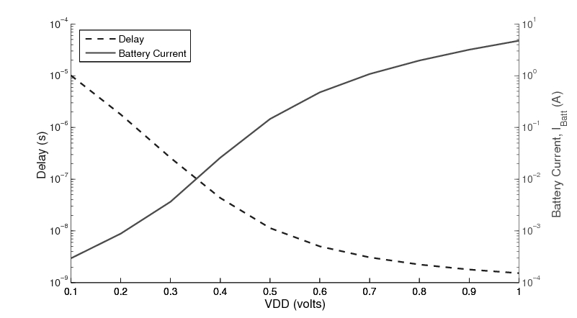
Based on required system performance, Determine the operating voltage
1
477 mA
200 MHz

Slide 25
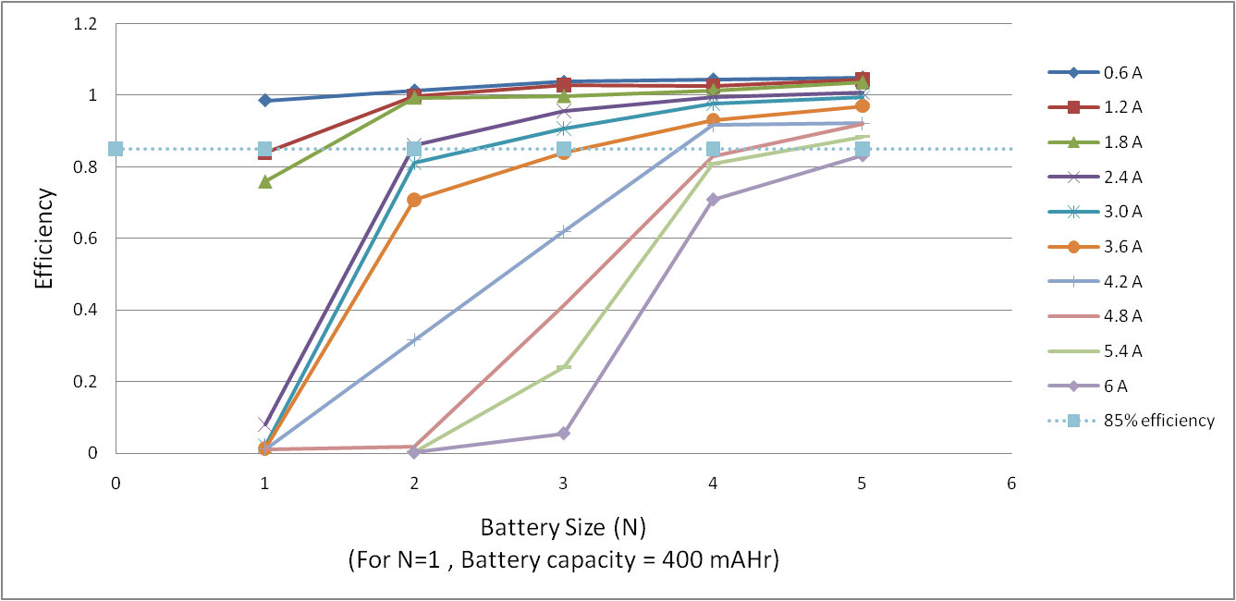
Determine Minimum Battery Size
2
For required current (477 mA) &
Battery Efficiency ≥ 85 %
We Choose,
400 mAHr Battery

Slide 26
Simulating Selected Battery
2
A meaningful measure of the work done by the battery is its lifetime in terms of clock cycles.
For each VDD in the range of valid operation, i.e., VDD = 0.1V to 1.0V, we calculate lifetime using circuit delay and battery efficiency obtained from HSPICE simulation.
Minimum energy operation maximizes the lifetime in clock cycles.

Slide 27
Simulation of 400mAHr Battery
2
Over entire operating voltage range of 0.1 V to 1 V
For both Ideal and Simulated battery
Higher Circuit Speed,
Lower Battery Efficiency
Higher Battery Lifetime,
Lower Circuit Speed
0.098 0.560 3.860 23.00 88.00 199.0 325.0 446.0 557.0 657.0 (MHz)

Slide 28
Battery Lifetime Requirement
3
Case II : System needs higher battery lifetime
Suppose battery lifetime for the system is to be at least 3 hour.
For smallest battery, size N = 1 (400mAHr)
I_{Batt} = 477mA,
Efficiency ≈ 98%,
Lifetime = 0.98 x 0.4/0.477 = 0.82 hour
For 3 hour lifetime, battery size
N = 3/0.82 = 3.65 ≈ 4.
We should use a 4 cell (1600mAHr) battery.

Slide 29
Meeting Lifetime Requirement
3
2540 Giga Cycles
205 min ( > 3 Hrs)
619 Giga Cycles,
50 minutes
0.098 0.560 3.860 23.00 88.00 199.0 325.0 446.0 557.0 657.0 (MHz)

Slide 30
Minimum Energy Operation
4
6630 Giga Cycles
1660 Giga Cycles
0.098 0.560 3.860 23.00 88.00 199.0 325.0 446.0 557.0 657.0 (MHz)

Slide 31
Summary
4
Battery size |  | VDD = 0.6V, 200MHz |  |  | VDD = 0.3V, 3.86MHz
 |  | Effici. % | Lifetime |  | Effici. % | Lifetime
N | mAHr |  | x10³ seconds | X10 ⁹ cycles |  | x10³ seconds | X10 ⁹ cycles
1 | 400 | 98 | 3 | 619 | 100+ | 414.5 | 1660
4 | 1600 | 100+ | 12.3 | 2540 | 100+ | 1364 | 6630
> two-times
Battery size should match the current need and satisfy
the lifetime requirement of the system:
(a) Undersize battery has poor efficiency.
(b) Oversize battery is bulky and expensive.
2 Minimum energy mode can significantly increase battery lifetime.

Slide 32
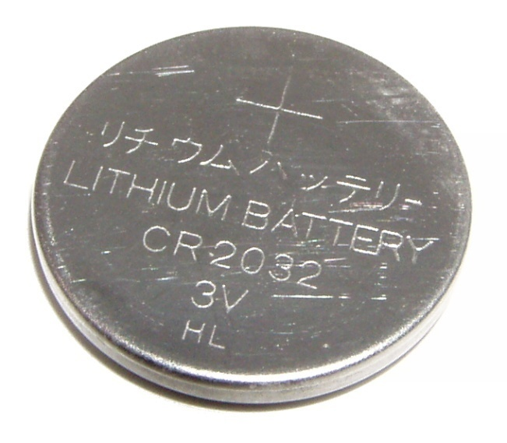
Case III : Battery size or weight is constrained
Some real life applications call for a fixed size (or weight) of a battery e.g.
Bio-implantable devices, hearing aid
Performance requirements are secondary and the primary goal is to maximize the lifetime (or number of cycles before next recharge).
Example:
A CR2032(CR) Lithium-ion battery
Nominal Voltage: 3V
Capacity: 225mAHr
Nominal Current: 0.3 mA
Maximum Current: 3 mA

Slide 33
540 Giga Cycles
0.098 0.560 3.860 23.00 88.00 199.0 325.0 446.0 557.0 657.0 (MHz)

Slide 34
Functional Management
Common Low Power Design Techniques
Dynamic Voltage and Frequency Scaling (DVFS)
Scale Voltage and Frequency depending on throughput requirement.
Use of multi-voltage domains and multiple clocks.
Frequency scaling at constant voltage (Clock Slowdown)
Voltage scaling has a limit.
22nm bulk CMOS, Vnom = 0.8 V, Vth = 0.32 V [5]
High power at lower voltages causes higher IR drops in power rails in chips.
Proposed method
Instruction Slowdown [8]
Voltage and Frequency are kept constant.
Specialized instructions called SLOwdown for low Power (SLOP) are inserted in the pipeline.
Additional control is provided in the data path to execute Clock Gating (CG) or Power Gating (PG) of idle units in the pipeline.

Slide 35
Normal Mode Operation
CC1
CC2
CC3
CC4
CC5
CC6
CC7
LW $8, 0($7)
ADD $9, $8, $2
SW $9, 0($7)

Slide 36
Operation with One SLOP
CC1
CC2
CC3
CC4
CC5
CC6
CC7
CC8
CC9
LW $8, 0($7)
SLOP
ADD $9, $8, $2
SLOP
SW $9, 0($7)

Slide 37
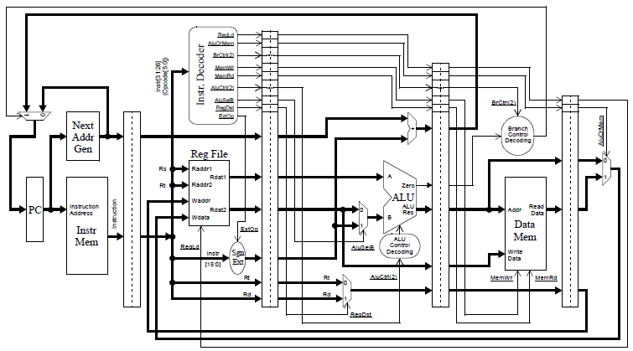
IF
ID
EX
DM
WB
PG
PG
PG
PG
Drowsy
CG
Drowsy
PG
CG
PG
PG
PG
PG

Slide 38
Example of Power Gating
VDD
Data 1
32 - bit
ALU
(Low V_{t})
32
Data 2
Data Out
32
32
Add / Sub
GND_V
 | Normal X 10 ⁻⁶ (W) | Sleep X 10 ⁻⁶ (W) | Power Saving (%)
Avg. Dynamic Power | 660.0 | 0.322 | 99.95 %
Avg. Leakage Power | 34.01 | 0.241 | 99.29 %
Peak Power | 5040.5 | 1.361 | 99.79 %
Minimum Power | 29.254 | 127.4 | 99.56 %
Sleep Transistor Network
(High V_{t})
Sleep
Results obtained by Simulation of a 32-bit, ALU using HSPICE [6] with PTM bulk CMOS models [5]

Slide 39
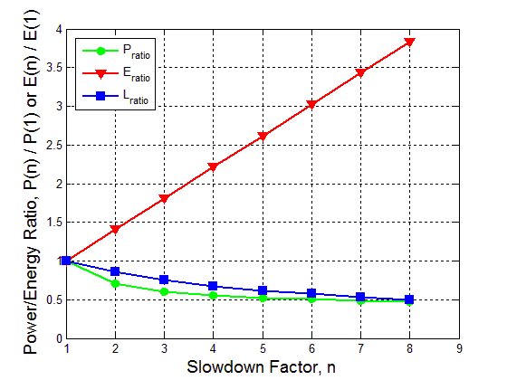
Power and Energy Ratios
For 32 nm bulk CMOS models
Ideal Battery of 800 mAHr Capacity

Slide 40
Battery Lifetime Improvement
For 32 nm bulk CMOS models
Battery of 800 mAHr Capacity

Slide 41
References
Patrick P. Gelsinger , Keynote, ISSCC, Feb. 2001.
M. Pedram and Q. Wu, “Design Considerations for Battery-Powered Electronics,” Proc. 36th Design Automation Conference, June 1999, pp. 861–866.
L. Benini, G. Castelli, A. Macii, E. Macii, M. Poncino, and R. Scarsi, “A Discrete-Time Battery Model for High-Level Power Estimation,” Proc. Conference on Design, Automation and Test in Europe, Mar. 2000, pp. 35–41.
M. Chen and G. A. Rincón-Mora, “Accurate Electrical Battery Model Capable of Predicting Runtime and I-V Performance,” IEEE Transactions on Energy Conversion, vol. 21, no. 2, pp. 504–511, June 2006.
Simulation model: 45nm bulk CMOS, predictive technology model (PTM), http://ptm.asu.edu/
Simulator: Synopsys HSPICE, www.synopsys.com/Tools/Verification/AMSVerification/CircuitSimulation/HSPICE/Documents/hspice ds.pdf
Kulkarni, M., Agrawal, V., “Matching Power Source to Electronic System: A tutorial on battery simulation”, VLSI Design and Test Symposium, July 2010
Khushaboo Sheth, “A Hardware-Software Processor Architecture using Pipeline Stalls for Leakage Power Management”, Master’s Thesis, Dec 2008

Slide 42
Conclusion
We study the impact of change in voltage and frequency of a digital system on battery system with the help of a simulation model.
A method of selecting the right size of battery for required performance OR the right system operating point for a fixed size/weight of battery is developed.
An architectural power optimization method is implemented and analyzed for its benefits towards power source efficiency.
SLOP insertion method offers a unique opportunity in hardware and software management for energy efficiency. SLOPs may additionally eliminate pipeline hazards.

Slide 43
THANK YOU !!!
Questions

