Slide 1
Test Programming an ATE for Diagnosis
MEE project defense
Heng Zhao
Advisor:
Dr. Vishwani D. Agrawal
Committee Members:
Dr. Victor P. Nelson Dr. Adit D. Singh

Slide 2
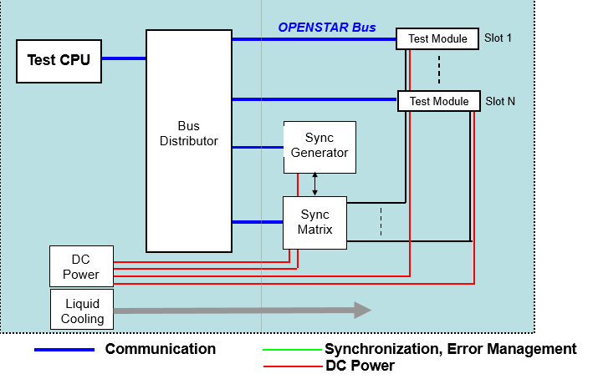
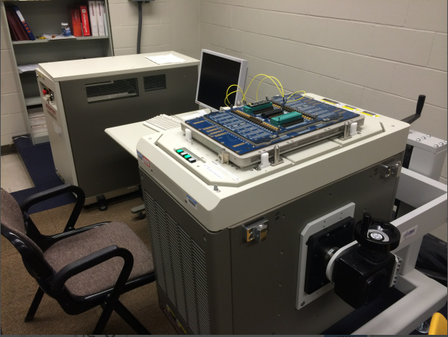
ATE: Automatic Test Equipment
Advantest T2000GS
Notes:
This is the ATE machine, Advantest T2000GS. Which located in the VLSI test lab.
The OPENSTAR architecture is a standardized infrastructure definition used for combining instrumentation from multiple suppliers into a common platform. Comminication, Test / Tester Control and a Module Standard.
Basic look at the OpenStar Architecture Standard
We have a Test CPU (SiteC) interfaced with a Bus Distributor (Bus Switch Matrix) that uses standardized protocol to communicate to the Test Modules over the OPENSTAR Bus.
Sync Gen and Sync Matrix coordinate and synchronize all operations between the Test Modules.

Slide 3
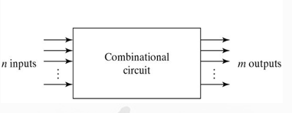
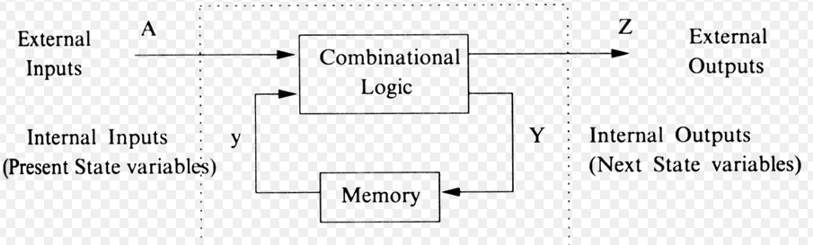
combinational logic circuit
sequential circuit
A Sequential circuit is basically a combinational circuit with additional capability of storage (to remember past inputs) and contains feedback
Notes:
There are two types of device under test.
Combinational logic circuits implement Boolean functions. Boolean functions are mappings of input bit strings to output bit strings. These circuits are functions of input only.What does that mean? It means that if you feed in an input to a circuit, say, 000, then look at its output, and discover it is, say, 10, then the output will always be 10 for that circuit, if 000 is the input. 000 is mapped to 10.
A sequential circuit uses flip flops. Unlike combinational logic, sequential circuits have state, which means basically, sequential circuits have memory.

Slide 4
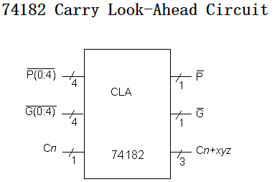
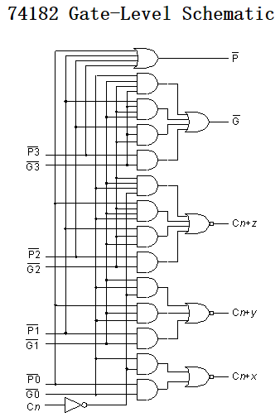
The carry look-ahead (CLA) realization of the carry function is used by each of the 74X-series circuits modeled here. Given carry-in (C_n), generate (G) and propagate (P) signals, the circuit produces three carry out signals, plus two P and G signals used to cascade into another CLA block.
Notes:
The benchmark circuit, 74182 is a carry look-ahead circuit , This is a 9 inputs; 4 output; 19 gates circuit.
I use this circuit for the project to test.
介绍幻灯片
To make a diagnostic test, the first thing we should do is make a test module, then we can set this fault into every port and net.
For this project, I will use the stuck-at-fault.

Slide 5
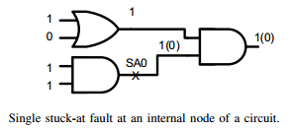
Stuck-at fault is a particular fault model used by fault simulators and automatic test pattern generation (ATPG) tools to mimic a manufacturing defect within an integrated circuit
Individual signals and pins are assumed to be stuck at Logical '1', '0' and 'X'
Notes:
This fault model applies to gate level circuits, or a block of a sequential circuit which can be separated from the storage elements. Ideally a gate-level circuit would be completely tested by applying all possible inputs and checking that they gave the right outputs, but this is completely impractical: an adder to add two 32-bit numbers would require 2⁶⁴ = 1.8*10¹⁹ tests, taking 58 years at 0.1 ns/test. In this way, the model in the project we used, the stuck at fault model, may assumes that only one input on one gate will be faulty at a time, assuming that if more are faulty, a test that can detect any single fault, should easily find multiple faults. 念PPt 的文字

Slide 6
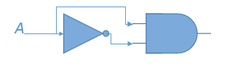
Traditional way to create stuck-at-0
(~A*A) = 0
The logical way to create stuck-at-1 is, change the ‘and’ gate to ‘or’ gate, then we can have the logic (~A+A) = 1.
Notes:
This is the traditional way to simulate a stuck-at-fault. As we can see, we will add a ‘nor’ gate and a ‘and ‘ gate to the port which we assume to be a stuck-at-1 fault.
In a normal test, this may be an effective and easy way for testing. However, in this project, I may use another way to simulate. Because the algorithm which I used may need to test different ports. If we need to reload the circuit in the FPGA board every time when we need to try another port, it will waste a lot of time.

Slide 7
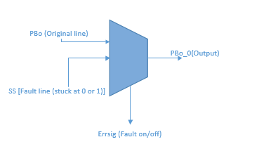
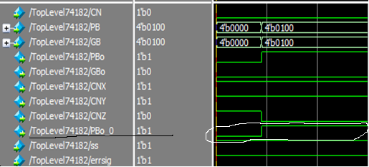
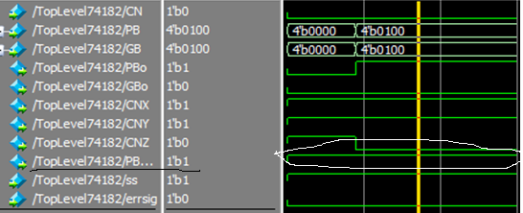
Use multiplexer to simulate stuck-at-fault
At the checkpoint a multiplexer is inserted with one input connecting to the original gate connection and the second input connecting to the stuck-at-1 or 0 fault being simulated. The mux-select signal is used to choose between the faulty node data and the correct data.
stuck-at-1 simulation
Notes:
In my project, I will set the line in stuck-at-fault just by multiplexer, I will changing the signal which I give to the multiplexer and make the output stuck at 1 or 0. This will save a lot of time in downloading the circuit and test the diagnostic tree.
Here is the multiplexer which I use. 介绍multiplexer,（念PPt文字）
From the from in Model-Sim simulation , we can see that:
the signal Pbo_0, which used to be the same as the original signal ‘Pbo’, were keep in high when the signal ‘errsig’ turns to zero. Just like the stuck-at-fault.

Slide 8
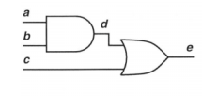
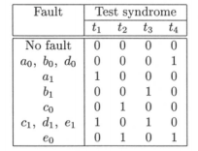
Fault dictionary
T1 = (010)
T2 = (011)
T3 = (100)
T4 = (110)
1 under T1 indicates that T1 detect the fault
0 under T1 indicates that T1 do not detect the fault
Notes:
Application of a test simply tells us whether or not the system under test is faulty. We must further analyze the test result to determine the nature of the fault, so that it can be fixed. A fault dictionary contains the set of test symptoms associated with each modeled fault. The following example of gate-level diagnosis illustrates the concept. Let’s consider a test set that detects all single stuck-at faults in the circuit . I will take this circuit as an example. It is just a small circuit, with a,b,c input and e output.
The dictionary of this circuit will contains four vectors, T1 = (010) T2 = (011) T3 = (100) T4 = (110), 1 under T1 indicates that T1 detect the fault, 0 under T1 indicates that T1 do not detect the fault. For diagnosis, we simulate faults without fault dropping. The simulation result is shown in the fault dictionary

Slide 9
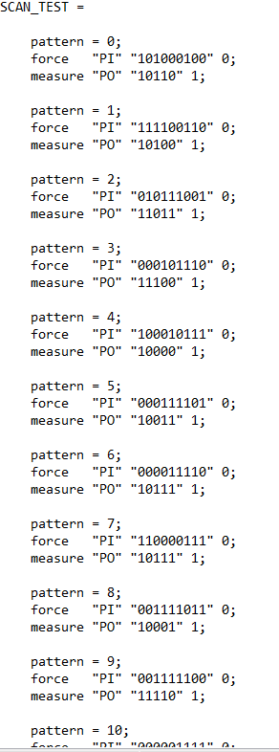
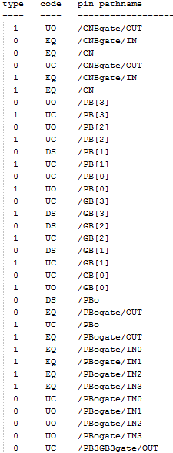
reload each pattern in Fast-Scan to find out the faulty parts which the pattern detects
Notes:
Now Let’s turn to the big circuit which we use in project. For the benchmark circuit 74182, the vector which we need may be hard for us to generate just by looking at it and write out by hand. In this way , the test patterns which we use, were generated by fast-Scan.
The figure on the left is the eleven patterns .
In order to make the fault dictionary, I should know which vector can detect which fault. So I reload each vector into the fast-Scan to find out the faulty parts which each pattern detects. I just got a file like the figure on the right.
From the figure we can see, the code, DS – fault detected in simulation RE – redundant fault UO – unobserved fault UC – uncontrolled fault UT – untestable fault

Slide 10
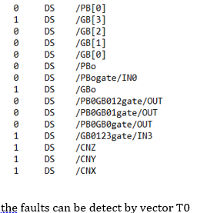
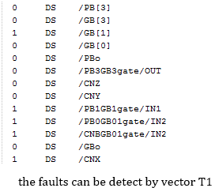
FastScan to generate 74182 circuit fault dictionary
DS means the fault can be detected
.
.
.
eleven vectors have eleven files. (T1, T2…T10)
Notes:
As we know, only the DS means the fault can be detected, I will pick up the pin path with the DS.
It may be hard for us to pick up by hand, as there are so many faulty part, so I will use python to pick them up. Eleven vectors have eleven files, as the test classes. Just like the figure on the right
Then we can get the file about each vector detection.
And now, we can use them to create the fault dictionary.

Slide 11
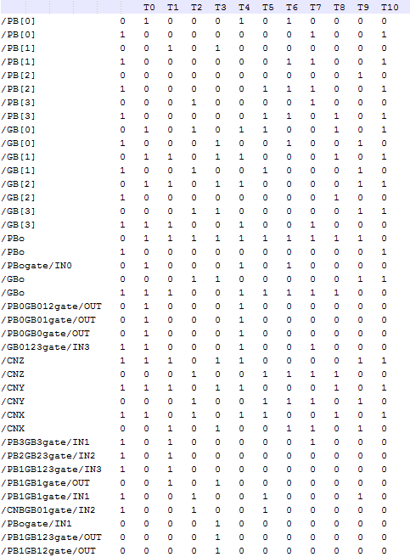
Final version of fault dictionary
Notes:
This is the Final version of fault dictionary. It is such a huge dictionary that this just a small part of it.

Slide 12
Algorithms
Diagnostic test: The diagnostic test is applied after a system has failed. The aim of this test
is to identify the faulty part that should be replaced.
Diagnostic tree
It is a top down, deductive failure analysis of the state of system, with boolean logic to apply a series of vectors. The tests are applied one at a time, after the application of the partial test diagnosis is obtained, the diagnostic tree will help the program to choose the next vector to be applied based on the outcome of the previous test.
Notes:
Now I will introduce the algorithm which I use in my project, the diagnostic tree.
Let’s have a basic knowledge about what diagnostic is.
As we know , the diagnostic test is applied after a system has failed. The aim of this test is to identify the faulty part that should be replaced.
In this way, the diagnostic tree, is a top down, deductive failure analysis in a state of system, with a boolean logic to combine a series of vectors. The tests are applied one at a time, after the application of the partial test diagnosis is obtained, the diagnostic tree will help the circuit to choose another vector which is chosen based on the outcome of the previous test.

Slide 13
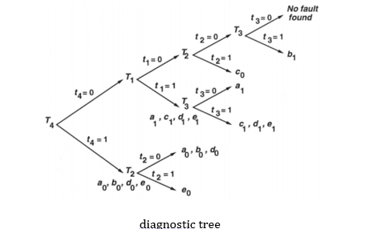
Algorithms
With the fault dictionary, we can make a diagnostic tree
Diagnostic tree
Notes:
This just a small diagnostic tree which created by the fault dictionary.
We will give the circuit T4 first to test, if it pass, which means the T4 can’t detect any fault, it will be test by T1, if it failed , it will goto T2. After the circuit has been tested by T1, we will also give it another vector to test it.
From the diagnostic tree, we can see that if we want to find out the port e stuck-at-0, we only need to use two pattern to test it, the T2 and T4. In this way, the diagnostic tree just save a half of time in testing. Because we know, in the traditional way, we can tell the fault only after the four vectors have all been tested.

Slide 14
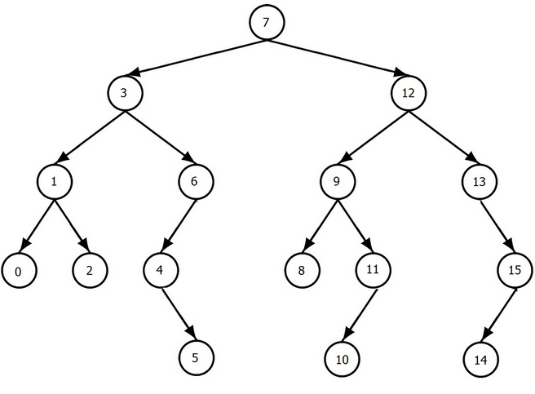
Optimize the diagnostic tree
As we know, the diagnostic tree can be arranged in several ways. One approach is to reduce the depth. The depth can be reduced by dividing the fault set into equal halves by each test.
A binary tree is a tree data structure in which each node has at most two children, which are referred to as the left child and the right child.
A self-balancing (or height-balanced) binary search tree is any node-based binary search tree that automatically keeps its height (maximal number of levels below the root) small in the face of arbitrary item insertions and deletions
Notes:
As we know, the diagnostic tree can be arranged in several ways. In testing, different arrangement of diagnostic tree may cost different time. There are many way to optimize the diagnostic tree, one approach is to reduce the depth. The depth can be reduced by dividing the fault set into equal halves by each test. Just like the self-balancing binary tree, which keeps its height small in the face of arbitrary item insertions and deletions.
Now I will introduce another algorithm to use in my project, a binary tree. 读PPT里面的内容， 左半部分， I will use the self-balancing binary search tree to optimize the diagnostic tree

Slide 15
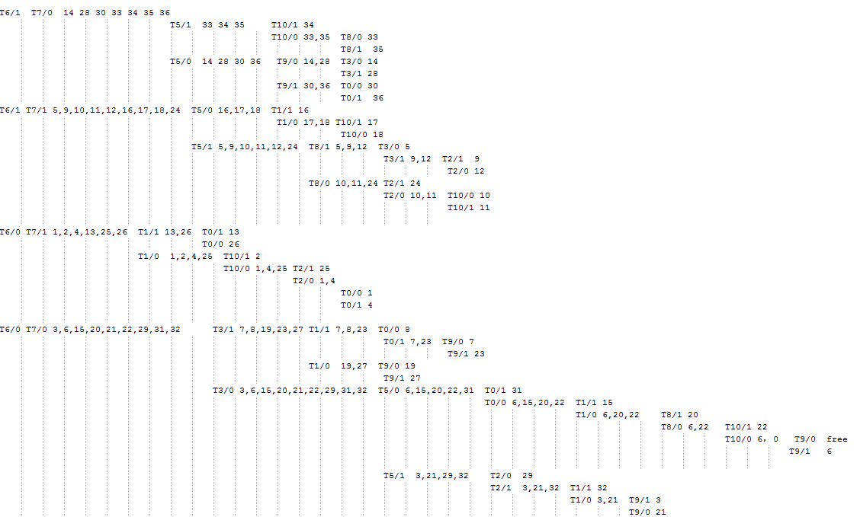
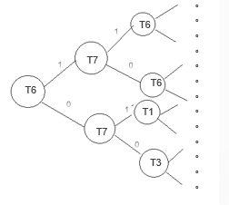
The final version of diagnostic tree for 74182
Notes:
This is the final version of diagnostic tree for 74182.
As it is such a huge tree, I can only type in the note and can’t draw it like a tree. it may be not as beautiful as the simple one before.
And here I just show the root part of it. The T6 will be its root, the first vector to be tested, as in the dictionary, T6 can detect so many faulty part.
Then I will use the tree to write a testplan which will be used in the ATE machine .

Slide 16
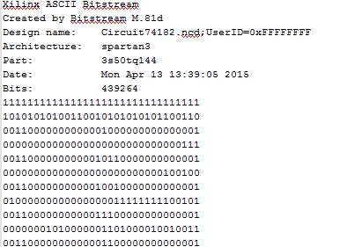
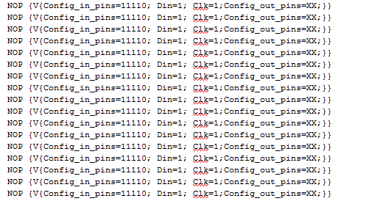
Old way to implement 74182 on FPGA using ATE
The old way:
In the software ISE Project Navigator, we transfer the Verilog file to rbt file
The pattern file:
Using the script language : perl
Notes:
Now, the preparation in the algorithm has been finished.
The next step we should do, is just implement the benchmark circuit 74182 on FPGA using ATE.
The old way which we usually do, is using the ISE software.
In the software ISE Project Navigator, we transfer the Verilog file to rbt file.
Just like the figure on the left.
Then we transfer the rbt file into the pattern file, with the script language Perl.

Slide 17
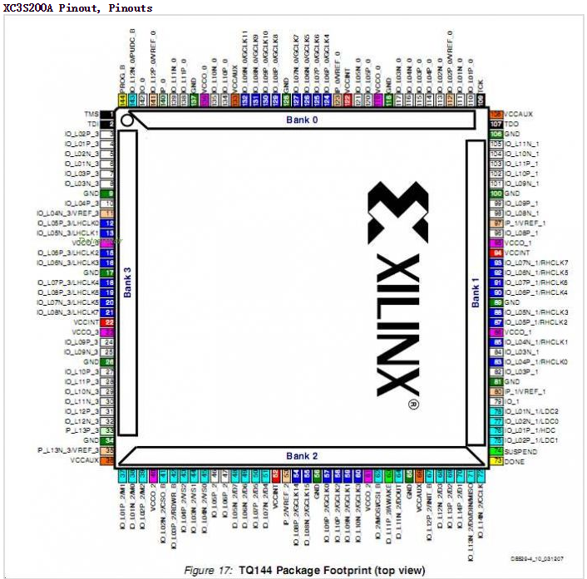
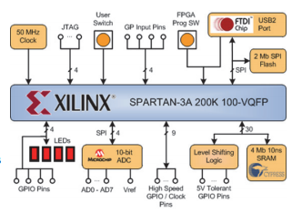
74182 CUT implemented on Spartan-3A FPGA
In this board, I just use the ISE to generate a bit file. Using the download tool mercury and download the bit file to the FPGA board.
Notes:
However, with the new board , Spartan-3A FPGA board, I don’t need to transfer the file. I can just use the ISE and Verilog netlist to generate a file in bit form. Using the download tool mercury to download the bit file on the FPGA board. In this way, it will help to save a lot of time.
Then I check the TQ144 Package Footprint, to set the pins which will be used in the test and give the pins their signal to control the circuit and test.

Slide 18
Test Plan resides here along with the Test Classes needed for device test. Interfaces to specific Framework Classes ultimately with Standard Interfaces that translate to module-specific commands.
Notes:
If we want to simulate the diagnostic tree in the ATE，the most important thing we need is the testplan.
So what is testplan? We can look at the figure. It is used in the site controller。
Here is the module of the machine 讲这页的内容， testplan 连接了什么 然后读右边的内容

Slide 19
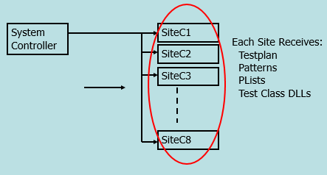
Test Plan
  A test program written by the test engineer.
  The test plan creates the tests by using the framework classes and/or standard or user supplied test classes, configures the hardware using the standard interfaces, and defines the test plan flow.
Notes:
What is a testplan
First thing we should know is the classes, it is just the vectors which we got before. On the ATE machine, we should set the time and the voltage which will be gave, and put them in different files. So the testplan will connect them. Just like the main function in the C language, will control many classes which will be used.
介绍右下角ppt的小图， we can see so many sites there, the testplan 读ppt 第二点

Slide 20
The test plan
A test program written by the test engineer
It is written in OTPL (Open Architecture Test Programming Language)
Uses Framework Classes (Test, Level, DC Parameterics, Timing)
The code is used to control the modules to test the device
Executes on each Site Controller
Uses a standard interface library to communicate with any kind of module installed in the test head
Notes:
Let’s have a conclusion of what the testplan is 读ppt

Slide 21
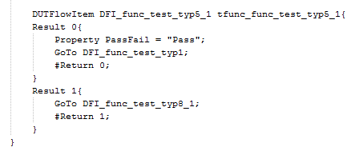
An OTPL test plan is made up of several files that specify the conditions and execution sequence of a set of tests to be applied to a DUT. These conditions can include setting in the levels and timing for the DUT pins, and the vectors to be applied as part of the functional pattern. The eleven vectors are putted into eleven pat files. Each time, the circuit fails in a pattern, it will go to another pattern. However, if it pass, it will go to another one. In the end, the bin tool will tell you which faulty part it will be.
Notes:
Here is just a small part which I use to make the diagnostic tree in the testplan. 介绍右上角 Goto

Slide 22
One requirement of any testplan is that there must be a way of tracking failures, and of sorting the failed DUTs by the handler.
OTPL provides two support classes for Hard and Soft binning.
  Hard binning, the number of DUTs sent to a specific handler bin are counted.
  Soft binning, which compensates for the limited number of hardware bins, counts the number of DUT failures based on “software” failure types (counters).
Notes:
Even though we have finished the testplan and can test the circuit, we still need some way to get the name of the fault, as the diagnostic tree in test-plan can only help you to find out which patterns it failed or not. In this situation, we need the bin tool.

Slide 23
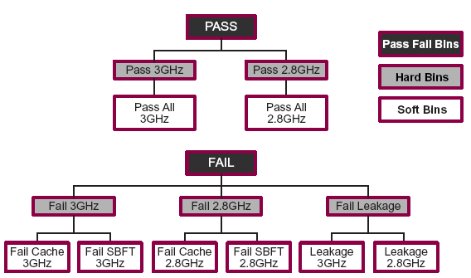
In OTPL, binning is based on a “tree” and “leaf” structure.
- In this example, the two primary bins are “Pass” and “Fail”.
All other subdivisions are based on these two bins.
Whenever a DUT Fails:
The specific bin counter for the failure gets incremented
All of the superseding bin counters increment as well
Notes:
Here is a general example of how binning would work for various tests.
OTPL classifies its binning as a “tree” “leaf” structure.

Slide 24
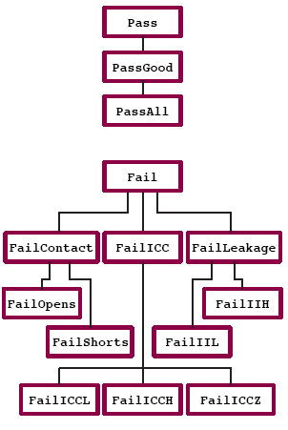
Version 1.0;
BinDefs {
BinGroup PassFailBins {
# Bin name Bin # Description
Bin Pass 0: “Total passing DUTS.”;
Bin Fail 1: “Total failing DUTS.”;
}
BinGroup HardBins {
# Bin name Bin # Description Parent bin
Bin PassGood 1: ”DUTs pass”, Pass;
Bin FailContact 2: ”DUTs failing contact”, Fail;
Bin FailICC 3: ”DUTs failing ICC”, Fail;
Bin FailLeakage 4: ”DUTs failing leakage”, Fail;
}
BinGroup SoftBins
# Bin name Bin # Description Parent bin
LeafBin PassAll 1: ”DUTs pass all tests”, PassGood;
LeafBin FailOpens 2: ”Fail Opens”, FailContact;
LeafBin FailShorts 3: ”Fail Shorts”, FailContact;
LeafBin FailICCL 4: ”Fail ICC, Low”, FailICC;
LeafBin FailICCH 6: ”Fail ICC, High”, FailICC;
LeafBin FailICCZ 7: ”Fail ICC, Hi-Z”, FailICC;
LeafBin FailIIL 8: ”Fail IIL”, FailLeakage;
LeafBin FailIIH 9: ”Fail IIH”, FailLeakage;
}
SortBinGroup = HardBins;
}
Notes:
Here is an example which we write the bining. From the figure, We can see that the LeafBin is which will use in the test. Here is its Bin name, Bin number and its description and parent bin.
Only after this configuration has been set, we can get the name of the faulty part in ATE.
In my project, I will name the faults by the number of the order in the fault dictionary.

Slide 25
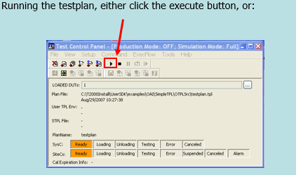
Start testing the circuit
Notes:
After finish writing the bin, we can start the testing in the ATE machine T2000GS.

Slide 26
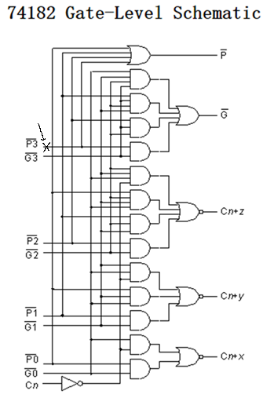
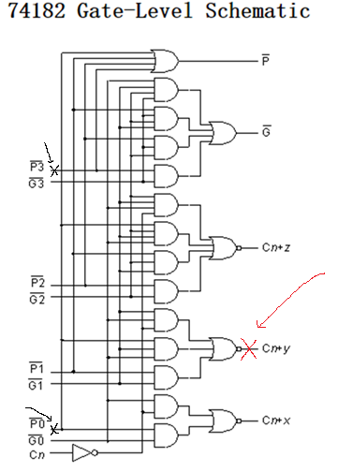
Some faults to be diagnosed
Single stuck-at fault
Multiple stuck-at fault
PB[3] stuck at 1
PB[3] stuck at 1
CNY stuck-at-0
PB[0] stuck at 1
Notes:
Here are two main faults which we will diagnose, the single-stuck-at-fault and multiple stuck-at-fault.
介绍ppt 的内容， 在哪里设置了fault. Even though the main idea of the project is for the single stuck at fault, we still need to try more faults and see if it can work well. As we know , in real life, there can’t only be the single stuck at fault.

Slide 27
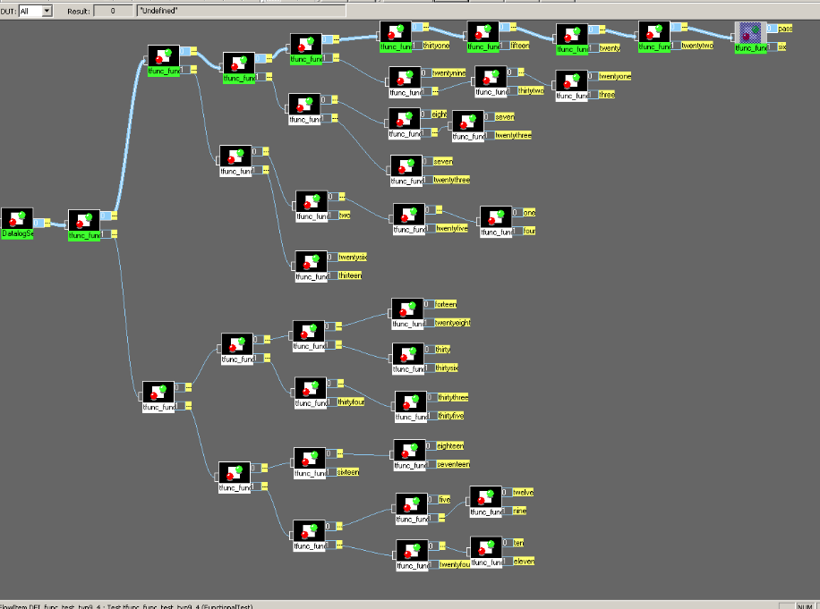
Fault free circuit in Flow edit
Notes:
I put the benchmark circuits with fault free.
This is the result.
The first one is the configuration vector for the test. And we can see that we only need nine vectors to test whether it is a fault free circuit. And we can also see the yellow part, its will show the name of fault when I click a button.

Slide 28
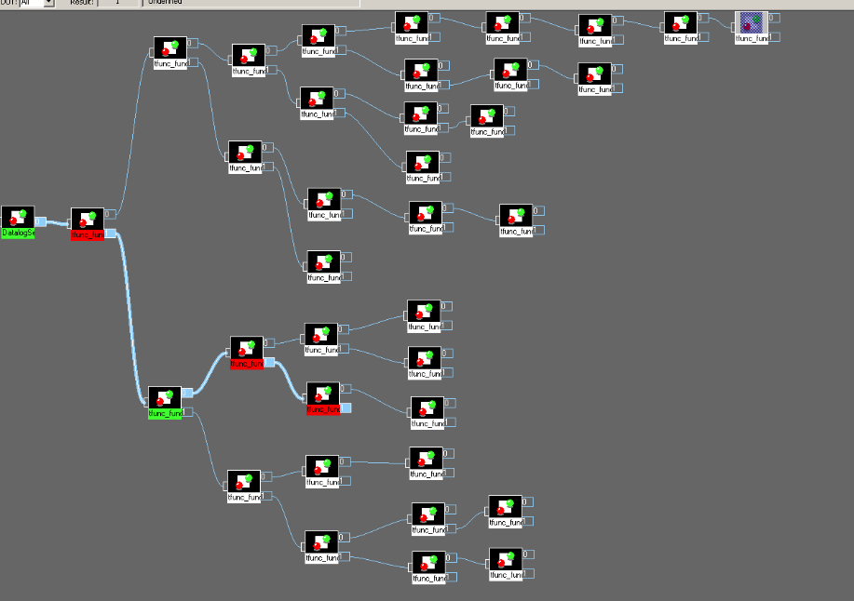
Single stuck-at fault
traditional way to test circuit
diagnostic tree to test circuit
The fault which we set is ‘/PB[3] stuck-at-1’
The result which we got from the two ways are both the same, ‘/PB[3] stuck-at-1’
PB[3] stuck at 1
Notes:
This is the result of single stuck at fault. The above figure is the traditional way , which use eleven vectors. The figure below is the diagnostic tree to test the circuit with single stuck at fault. We can see that it only use four vectors to test it and get the answer which we expected, the same result as the traditional way. This is the picture without the bin.

Slide 29
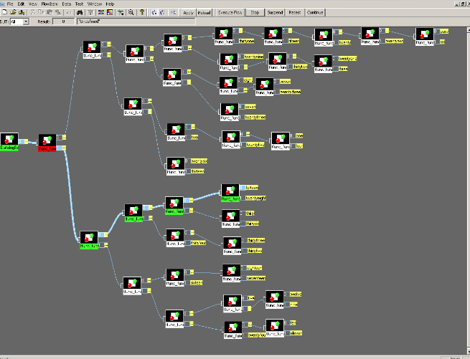
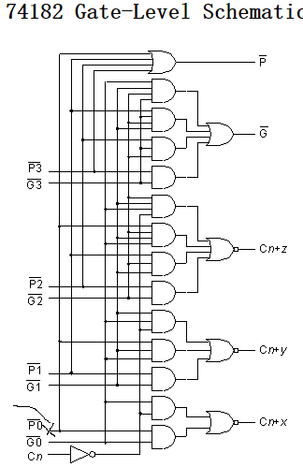
Single stuck-at fault
Fault set: stuck_at_ 0_PB[0]
Result _14 :stuck_at_ 0_PB[0
Stuck-at- 0_PB[0]

Slide 30
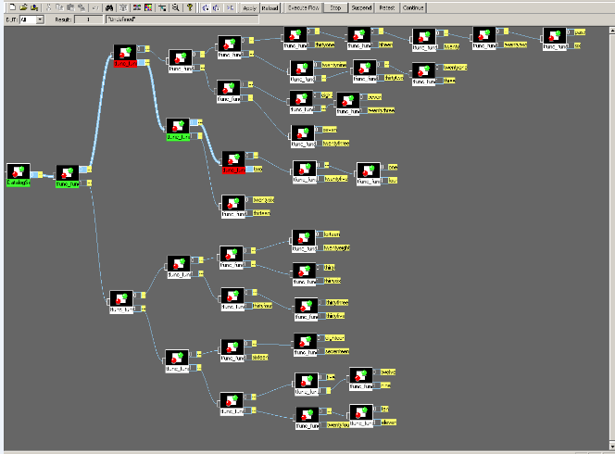
Single stuck-at fault
Fault set: stuck_at_ 1_PB[0]
Result _2 :stuck_at_ 1_PB[0]
Stuck-at- 1_PB[0]

Slide 31
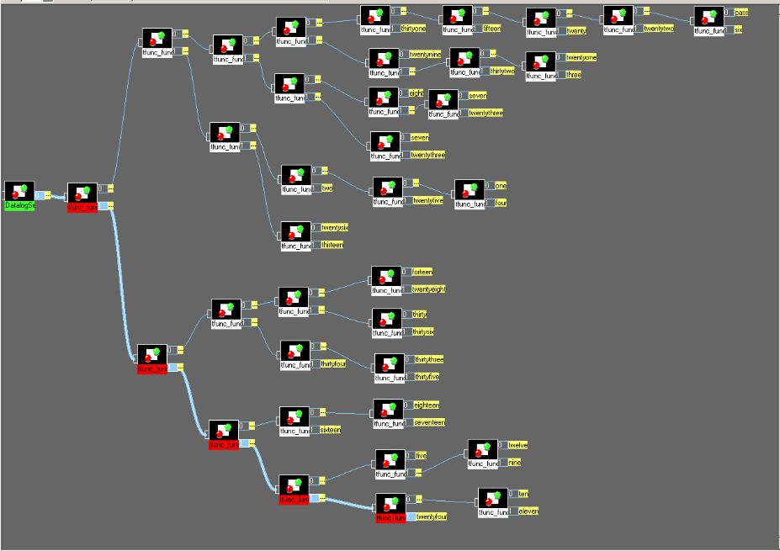
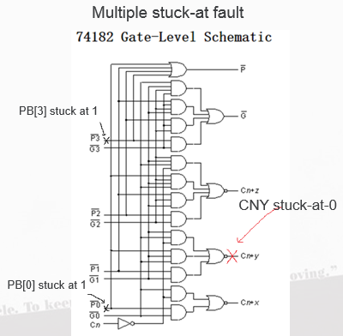
Multiple (2) stuck-at fault
Fault set: PB[0] stuck-at-1 and PB[3] stuck-at-1
The result_24 : /CNY stuck-at-0
Notes:
This is the fault for multiple stuck at fault , PB[0]PB[3]_stuck_1_result_24
Actually I tried some multiple stuck-at-fault, many of them go to the fault No.24, /CNY stuck-at-0.
I think the main reason is that the No.24 fault are the fault which all the vectors failed on the diagnostic tree.

Slide 32
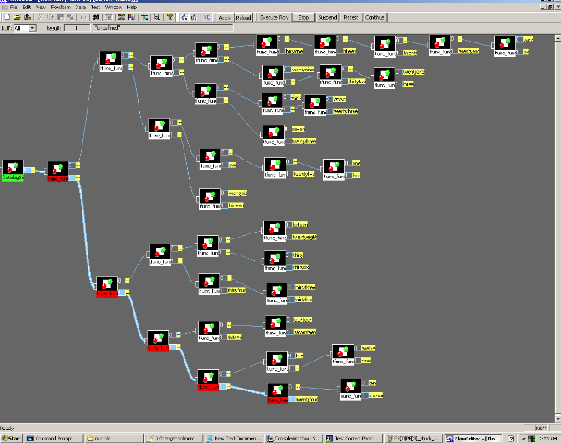
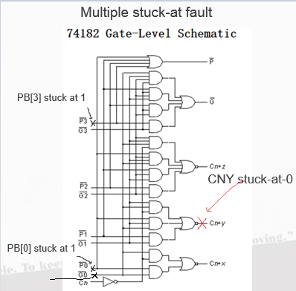
Multiple (3) stuck-at fault
Fault set: GB[0] stuck-at-1 PB[0] stuck-at-1 PB[3] stuck-at-1
The result_24 : /CNY stuck-at-0
GB[0] stuck at 1

Slide 33
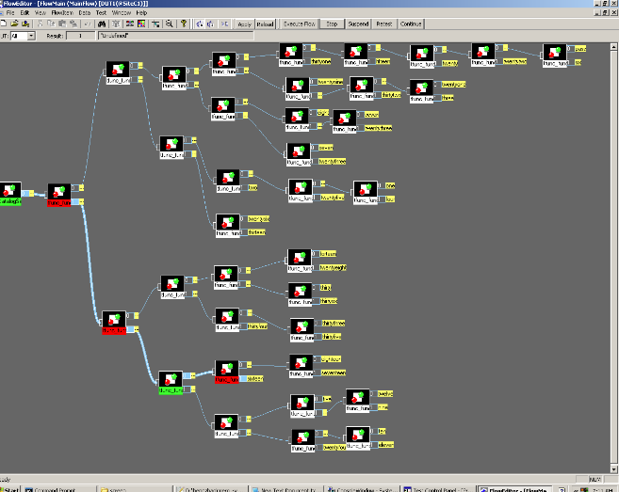
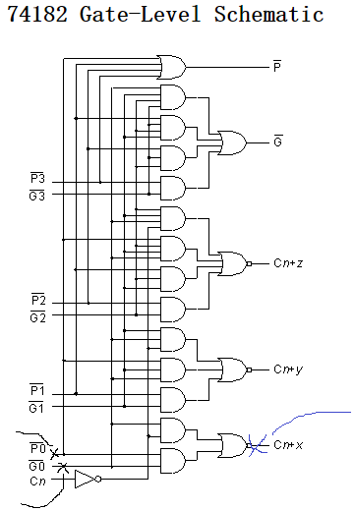
Multiple (2) stuck-at fault
Fault set: GB[0] stuck-at-1 PB[0] stuck-at-1
The result_16 : /CNX stuck-at-0
/CNX stuck-at-0
PB[0] stuck-at-1
GB[0] stuck-at-1

Slide 34
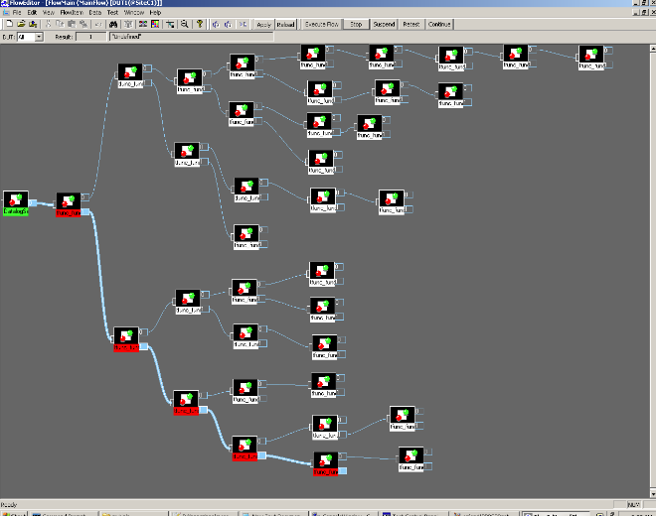
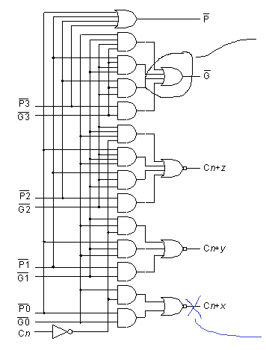
Fault set:
or GBogate(GBo,PB3GB3,PB2GB23,PB1GB123,GB0123);
change to
nor GBogate(GBo,PB3GB3,PB2GB23,PB1GB123,GB0123);
Result :No.24
/CNY stuck-at-0
Gate replacement fault
or gate change to nor gate
/CNY stuck-at-0

Slide 35
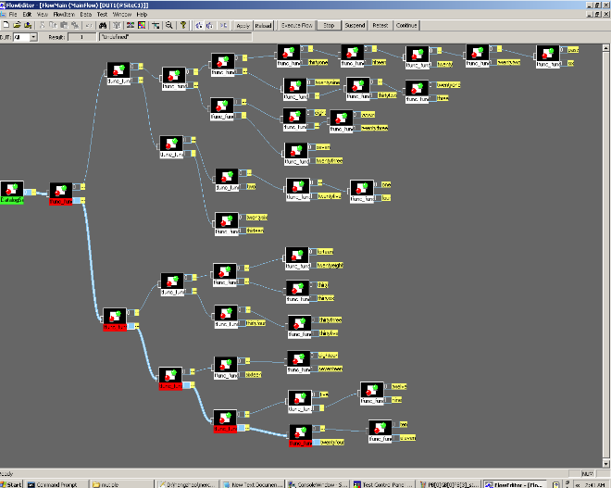
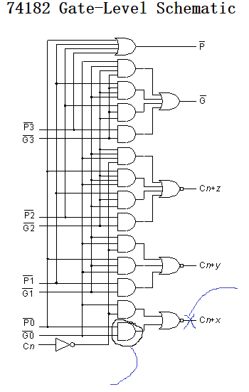
Gate replacement fault
Fault set:
and PB0GB0gate(PB0GB0, PB[0], GB[0]);
change to
or PB0GB0gate(PB0GB0, PB[0], GB[0]);
Result :No.24
/CNY stuck-at-0
/CNY stuck-at-0
and gate change to or gate

Slide 36
Summary of diagnostic program results
Type of fault | Actual fault | Daignosis | Remark
No fault | None | No fault | Correct
Single stuck-at fault | P3 s-a-1 | P3 s-a-1 | Correct
Single stuck-at fault | PB0 s-a-0 | PB0 s-a-0 | Correct
Single stuck-at fault | PB0 s-a-0 | PB0 s-a-0 | Correct
Multiple (2) stuck-at’s | PB0, PB3 both s-a-1 | PO CNY s-a-0 | PO reachable from one fault
Multiple (3) stuck-at’s | PB3, PB0, GB0 all s-a-0 | PO CNY s-a-0 | PO reachable from one fault
Multiple (2) stuck-at’s | PB0, GB0 both s-a-0 | PO CNX s-a-0 | PO reachable from both faults
OR replaced by NOR | Gate GB0 | PO CNX s-a-0 | No correlation
AND replaced by OR | Gate PB0GB0 | PO CNX s-a-0 | PO reachable from gate

Slide 37
Conclusion
The diagnostic tree helps to save a lot of time in VLSI testing.
The diagnostic tree can be built in many ways and the same circuit may have many diagnostic trees.
Making it as the binary tree is the most efficient way to optimize the test.
With the mux-select, we can simulate the stuck-at-fault models in the FPGA board.
Diagnostic program on T2000GS makes the diagnosis visual. We can see how the vectors pass or fail.

Slide 38
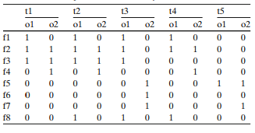
Future work
The f1 ~ f8 are the faults detected by vectors t1 ~ t5. A ‘1’ for t1 and f1 under o1 means that fault f1 can be detected by t1 at the output o1. The ‘0’ for t1 and f1 under o2 means that fault f1 can’t be detected by t1 at the output o2.
full-response fault dictionary

Slide 39
Thank you !!!
Questions?

